Slide 1
On a Scientist's door: "Gone Fission".
Outside a Hotel: "Help! We need inn-experienced people.“
At a Music Store: "Out to lunch. Bach at 12:30. Offenbach sooner.“
On a Music Teacher's door: "Out Chopin."
Notes:
From Lori Wilson. Last week’s on Hamas and Netanyahu, from Sergio Vinocur.

Slide 2
Notes:
Last week, Sergio Vinocur provided the Israeli Hamas joke.

Slide 3
Notes:
This weeks spiritual news.

Slide 4
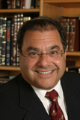
Rabbi Dr. Shlomo
Riskin, Chancellor
& Founder, in 2008
opened the first
Orthodox Jewish
center to dialogue
with the Christian
world – the Center
for Jewish-Christian
Understanding and
Cooperation (CJCUC).
Notes:
http://cjcuc.com/site/staff/#riskin

Slide 5
Rabbi Shlomo Riskin (Israel) and many others: As did Maimonides and Yehudah Halevi, we acknowledge that Christianity is neither an accident nor an error, but the willed divine outcome and gift to the nations.
Notes:
http://cjcuc.com/site/2015/12/03/orthodox-rabbinic-statement-on-christianity/

Slide 6
Rabbi Jacob Emden wrote that “Yeshua brought a double goodness to the world. On the one hand he strengthened the Torah of Moses majestically… and not one of our Sages spoke out more emphatically concerning the immutability of the Torah. On the other hand he removed idols from the nations and obligated them in the seven
Notes:
http://cjcuc.com/site/2015/12/03/orthodox-rabbinic-statement-on-christianity/

Slide 7
commandments of Noah so that they would not behave like animals of the field, and instilled them firmly with moral traits.”
Notes:
http://cjcuc.com/site/2015/12/03/orthodox-rabbinic-statement-on-christianity/

Slide 8
What we are now witnessing is the undoing of 2,000 years of Jewish rejection and animosity towards Yeshua, a miracle by any estimation. For the out-and-out refusal by Jews to accept Yeshua is slowly, but surely, coming to an end, as growing numbers of prestigious Orthodox rabbis welcome Jesus back.
Notes:
http://cjcuc.com/site/2015/12/03/orthodox-rabbinic-statement-on-christianity/
Seems like a great breakthrough.
Then, an e-magazine issue arrived.

Slide 10
Rabbi Riskin’s acceptance of Yeshua as “G-d’s will” is heresy. He suggests G-d contradicts himself, as Yeshua / Christianity violate G-d ’s commands. Crusades murdered thousands of Jews, yet the rabbi says this was God’s will. Since Christianity is “G-d’s will,” Rabbi Riskin endorses adding to G-d’s Torah, to which god said not to add. Rabbi Riskin’s view leads to endorsing a deification of man and a G-d figure, the Torah’s most fundamental sin: idolatry.
Notes:
So, two rabbinic schools radically disagree. Maybe not SUCH a breakthrough.

Slide 11
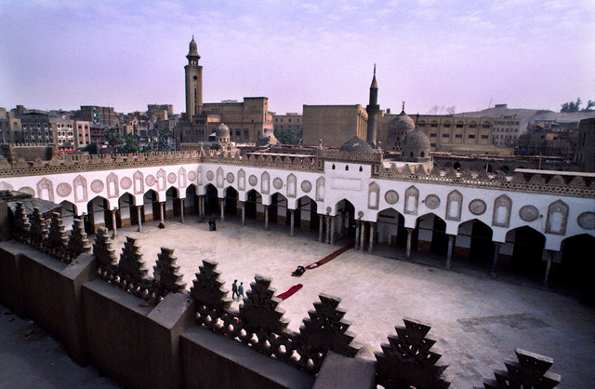
The Islamic University,
Al Azhar in Cairo, Egypt

Slide 12
The Islamic university, Al Azhar in Cairo, Egypt, is considered by Sunni Muslims the most prestigious university in the world. It has 450,000 students and 9,000 schools. Within this university, there rages great controversy over the… violent laws. Sheikh Muhammad Abdullah Nasr is a scholar of Islamic law and graduate of Egypt’s Al Azhar.
Notes:
http://www.maozisrael.org/site/DocServer/0116_Spread.pdf?docID=5443

Slide 13
When asked why Al Azhar, which regularly denounces secular thinkers as un-Islamic, refused to denounce the Islamic State (ISIS), Sheikh Nasr explained, The Islamic State is a byproduct of Al Azhar’s programs. So can Al Azhar denounce itself as un-Islamic? Al Azhar says there must be a caliphate…
Notes:
http://www.maozisrael.org/site/DocServer/0116_Spread.pdf?docID=5443
So, Egypt, one of the very few border states with Israel that has a working peace treaty, is fundamentally committed to world dominance of Islam, by brutal force.
Then

Slide 14
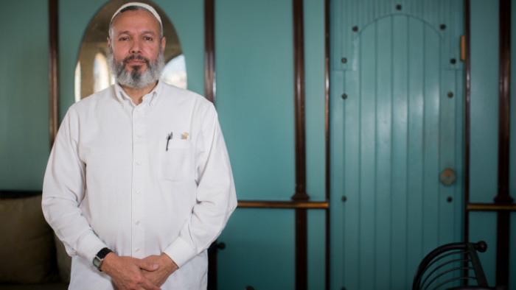
Yale University alumnus
Sheikh Omer Salem

Slide 15
Yale University alumnus Sheikh Omer Salem who visited Israel last week, December 26, 2015 lectured at Haifa University. He is a PhD graduate of Al Azhar University in Cairo has just published his book The Missing Peace: The Role of Religion in the Arab-Israeli Conflict.
Notes:
http://www.israeltoday.co.il/NewsItem/tabid/178/nid/28083/Default.aspx
Same university as cited above that endorses ISIS and the brutal Islamic world conquest.

Slide 16
Following are excerpts from the sheikh's interview:
"Everything I say is based on the Quran. I wasn't poisoned by political Islam. A lot of money is invested to advance the anti-Israel position. One needs to understand that much of what is said is politics, not Quran. Anyone following the Quran will be kind to you and will not tell you [Jews] to leave the Land."
Notes:
Israel Today Magazine http://www.israeltoday.co.il/NewsItem/tabid/178/nid/28083/Default.aspx

Slide 17
"The Jews can pray peacefully on the Mount [but they need to be patient]. You will get the Temple Mount, but that needs to happen in stages. Muslims will agree to remove the mosque, but it must be initiated by the Muslims. If Jews try to do it there will be great bloodshed. When it [the removal of the mosque] will happen it will be a gift from Allah. He is the one who will turn the hearts of the Muslims."
Notes:
http://www.israeltoday.co.il/NewsItem/tabid/178/nid/28083/Default.aspx
Remove the Dome of the Rock and the Al Aksa!!!

Slide 18
So,
One rabbinic school says Yeshua is OK: Rabbi Riskin
One Rabbinic school says Yeshua belief is idolatry
One Imam says the ISIS caliphate is OK
One Imam says the Jews will have the Land
Notes:
Conclusion: don’t get too impressed with the news. Hear the Word.

Slide 19
מַתִּתְיָהוּ Mattityahu
(Matthew) 10:16-17
Notes:
Last week? Go to homes, and offer, convey shalom. That’s really our inventory:
^{Ro 14.17} the Kingdom of God is … righteousness, shalom and joy in the Ruakh HaKodesh. New Year inventory: do you have shalom Bayit?
Forgiveness by the atonement: death and resurrection of the Messiah, consequential coming of the Ruakh/Spirit with shalom and joy!

Slide 20
Mattityahu (Matthew) 10.16
הִנֵּה אָנֹכִי שׁוֹלֵחַ אֶתְכֶם כִּכְבָשִׂים בֵּין זְאֵבִים.
Pay attention! I am sending you out like sheep among wolves
Notes:
He’s sending us into the maelstrom! Somewhat like Yeshayahu/Isaiah’s commissioning:
He said, “Go and tell this people: ‘Yes, you hear, but you don’t understand. You certainly see, but you don’t get the point!’ “Make the heart of this people [sluggish with] fat, stop up their ears, and shut their eyes. Otherwise, seeing with their eyes, and hearing with their ears, then understanding with their hearts, they might repent and be healed!”
Sheep are notoriously defenseless against predators in their own strength.

Slide 21
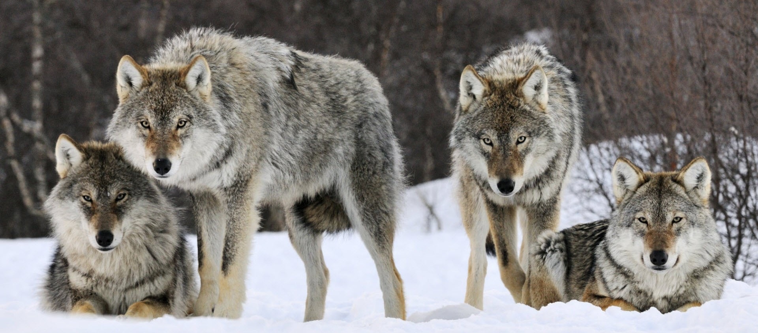
Notes:
https://www.google.com/search?q=sheep+among+wolves&safe=active&espv=2&biw=1278&bih=939&source=lnms&tbm=isch&sa=X&ved=0ahUKEwirw-HyhZvKAhVEbiYKHVaOCXMQ_AUIBygC#tbm=isch&tbs=rimg%3ACVqJK2dBYRwtIjgxlYFVbIVHT16M3b-T2Tl8lZorEMiMT-9Ibuq8qgYY_1dif0R9L8JkHLNtJm_172Rgh0zUT1V6fxzioSCTGVgVVshUdPEQGoSnJReXqgKhIJXozdv5PZOXwRw50TmaSy4WwqEgmVmisQyIxP7xHSpf60ZCTNdyoSCUhu6ryqBhj9Ecz-gUdNTm5jKhIJ2J_1RH0vwmQcRMTSrzF5j9MMqEgks20mb_1vZGCBHaFO4hawS2dSoSCXTNRPVXp_1HOEQhmjzu3OqCb&q=sheep%20among%20wolves&imgrc=NoX71mBOs6YfuM%3A
Oops, did I make a wrong turn?

Slide 22
^{Mtt. 5.11-12} “How blessed you are when people insult you and persecute you and tell all kinds of vicious lies about you because you follow me! Rejoice, be glad, because your reward in heaven is great — they persecuted the prophets before you in the same way.
Notes:
Live in His praise and joy. Not dependent on success!

Slide 23
^{2 Tim 3.12} Indeed, all who want to live a godly life united with the Messiah Yeshua will be persecuted
Notes:
But wolves come from unexpected places. Live in His praise and joy.

Slide 24
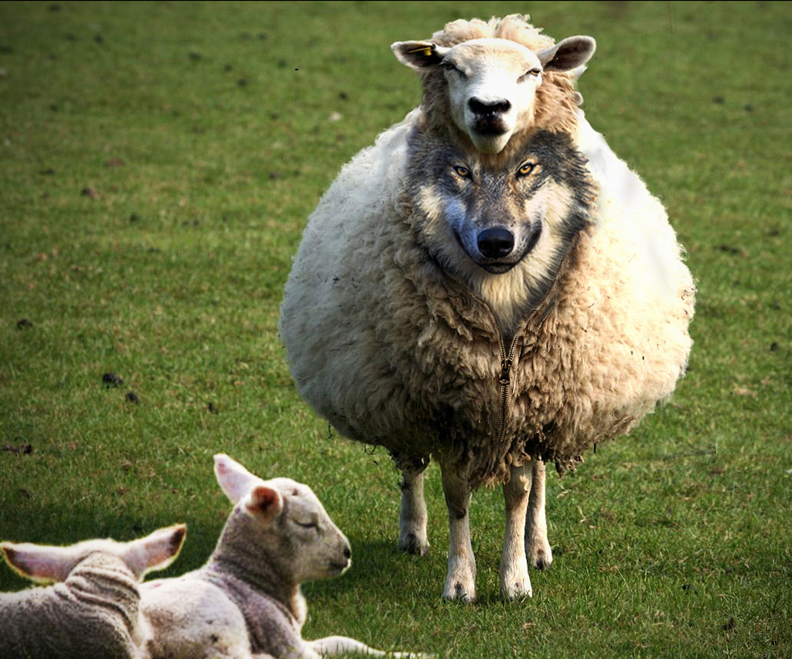
Notes:
Slows down the outreach work big time, when internal contention. ^{Gal 5.14-15} For the whole of the Torah is summed up in this one sentence: “Love your neighbor as yourself”; but if you go on snapping at each other and tearing each other to pieces, watch out, or you will be destroyed by each other!
Joy Starts Here p 157-158 Narcissism: a grandiose view of one's own talents and a craving for admiration, leadership/authority, superiority/arrogance, self-absorption/self-admiration, and exploitativeness/entitlement.
https://en.wikipedia.org/wiki/Narcissism
Do you think you are the only one who does things right?

Slide 25
^{Acts 20.29-31} I know that after I leave, savage wolves will come in among you; and they won’t spare the flock. Even from among your own number, men will arise and teach perversions of the truth, in order to drag away the talmidim after themselves. So stay alert! Remember that for three years, night and day, with tears in my eyes, I never stopped warning you!
Notes:
I am sending you out like sheep among wolves.
Doesn’t say, “as sheep TO wolves.”
“Sheep among wolves” could mean wolves on the team. Insiders. Actually all of us are a bit narcissistic. Consider in house, in heart narcissism. Examine yourself:
Easily admit failure, and
Tender with the weak?

Slide 26
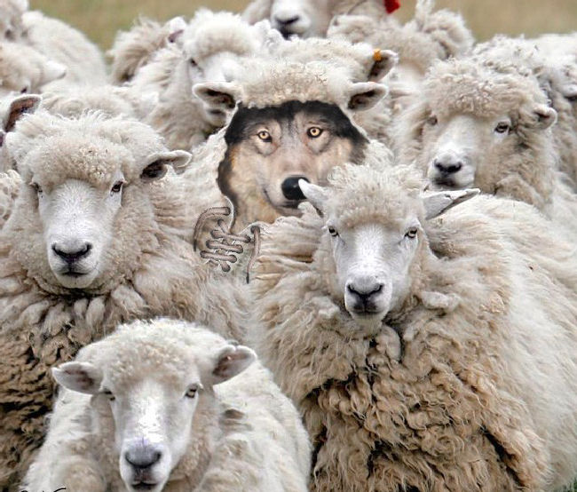
Notes:
Who is the wolf? It’s me.

Slide 27
Mattityahu (Matthew) 10.16
לָכֵן הֱיוּ עֲרוּמִים כִּנְחָשִׁים וּתְמִימִים כְּיוֹנִים.
So be as prudent as snakes and as harmless as doves.
Notes:
Wise, careful. serpent is a very sharp sighted,
innocence and harmlessness of the dove, being free from all wicked cunning and craftiness, without rancour, malice, and wrath; not meditating and seeking revenge, but meek and humble in their deportment, leading inoffensive lives, and proceeding in the course of their calling, though liable to many insults, and much oppression.
It IS possible to be a fruitful sheep, making other sheep, even among wolves.

Slide 28
Sean
Steckbeck
(right)
with one of
his young
disciples
Notes:
http://www.maozisrael.org/site/News2?abbr=maoz_&page=NewsArticle&id=10906&news_iv_ctrl=-1
Mentioned him last week as having introduced the Luke 10 method here. Hoping he’s our tour guide this summer, but maybe not. He plans to be in America in August. Sean Steckbeck stories,
outreach among wolves: Palestinian Muslims committed to the destruction of Jews.

Slide 29
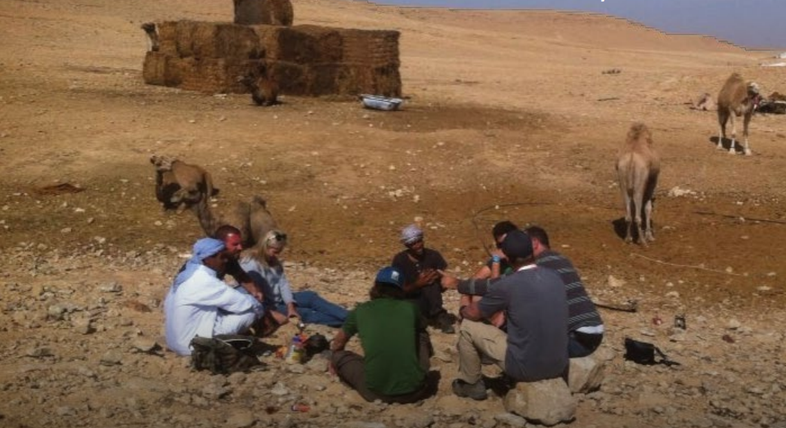
Ministering to Bedouin in the
South of Israel.
Notes:
http://www.maozisrael.org/site/News2?abbr=maoz_&page=NewsArticle&id=10906&news_iv_ctrl=-1 By Sean Steckbeck Something amazing is happening in Judea, Samaria, and Gaza among Muslims and traditional Arab Christians. The Holy Spirit is breathing on the beginnings of a Disciple-Making Movement. There are new geographical based teams forming, and disciples making disciples that is starting to spread across the West Bank and Gaza. Some of these areas are dangerous to say the least. At the heart of such a move is the Great Commission, which commands us to, “teach them to observe everything I have commanded” (Matthew 28:20). One of the commands of Yeshua is to “Love Your Enemy” and specifically to the Arab people group, it is the Jewish people. We have seen the Holy Spirit move in amazing ways to change their hearts in order to fulfill this command.

Slide 30
Ministering to Bedouin in the
South of Israel.
Notes:
A group of three new Palestinian Muslim-background disciples were driving within the West Bank when as usual they were stopped at a security checkpoint by the IDF. In the past, they would complain and be embittered by the lost time waiting at checkpoints and they thoroughly despised any interrogation.
However, this time the Lord was working in all their hearts. They noticed the Jewish soldier also spoke Arabic. They began to share the love of Yesua (Yeshua) with the Jewish soldier and encouraged him to learn more about Him until he reluctantly had to get back to his guard duty. Ironically, the three Muslim-background believers in Yeshua pray to get stopped at checkpoints so they can share the love of Yeshua with Jewish soldiers - with whom they would usually never have access or contact. They are excited to love their enemies and God has given them a special love in their hearts for soldiers!
Ahmed (not his real name) is one of the team leaders and lived most of his life in Gaza until the overthrow of the Palestinian Authority by Hamas. He had never come in contact with Jewish people. However, now, living in Judea and Samaria (the West Bank) God has been doing something in his heart towards Israelis - especially as he teaches other Arabs to love their enemies.

Slide 31
Ministering to Bedouin in the
South of Israel.
Notes:
Recently, Ahmed was given military permission to cross an Israeli checkpoint and went on a ministry trip to Beer Sheva with an Israeli friend and teammate of his. While eating at a restaurant, the waiter asked Ahmed where he was from and he responded that he was from Gaza. The waiter said he had been to Gaza as an IDF soldier in the last war and had lost a friend of his there. Ahmed then got up, hugged him, and with tears apologized for his friend’s death on behalf of his people. The waiter was so touched that he also was in tears.
This led to the young waiter bringing over two other Jewish Israeli waitresses to hear Ahmed’s testimony of what God had done in his heart through Yeshua. They were so open and hungry for the message of the Gospel because of the love they saw in Ahmed’s eyes towards them. The conversation continued until the manager reminded all the waiters/waitresses that they had a job to do! That night, the Holy Spirit moved in Ahmed’s heart as he wept and travailed for the salvation of the Jewish people.

Slide 32
Ministering to Bedouin in the
South of Israel.
Notes:
“A” is a Muslim background believer who has recently come to know Yeshua. He is very passionate about sharing the gospel and making disciples of his fellow Muslims. Recently, his mother had to go to an Israeli hospital. While in the waiting area, “A” was sitting beside an Orthodox Jewish man who was in the same room as his mother. “A” then told the man his testimony and how he was once violent towards the Jewish people, but Yeshua changed his heart.
The Orthodox Jewish man, who probably wouldn’t listen to any other person tell him about Yeshua, was very interested. “A” then shared from the Tanakh/ Old Testament scriptures about Yeshua fulfilling the role of Messiah and how he can change hearts. He gave himself as an example. The Orthodox Jewish man left and said, “You have given me a lot to think about that I never would have considered” and promised to really examine Yeshua.
It all starts with “Love Your Enemies.”

Slide 33
Notes:
Joel Richardson said that most of the stories he’s heard of Muslims coming to faith is through the love of believers. Also dreams and visions. Mostly loving relations.
Stories from http://www.jesusfilm.org/

Slide 34
What is Or HaOlam doing for outreach?
Prayer station
UMKC possible
Santa Fe Towers probable
March of Remembrance

Slide 35
Mattityahu (Matthew) 10.17
הִזָּהֲרוּ מִבְּנֵי אָדָם, כִּי יִמְסְרוּ אֶתְכֶם לְסַנְהֶדְרִיּוֹת וְיַלְקוּ אֶתְכֶם בְּבָתֵּי הַכְּנֶסֶת שֶׁלָּהֶם.
Be on guard, for there will be people who will hand you over to the local Sanhedrins and flog you in their synagogues.
Notes:
sanhedrim, of which there were three sorts; the greater, which consisted of seventy one persons, and was only held in Jerusalem; the lesser one, which was made up of twenty three members, and was kept in every place where there were an hundred and twenty Israelites; and the third, where there was not that number, and was a triumvirate, or a bench of three judges only

Slide 36
^{2 Cor. 11.21-24} But if anyone dares to boast about something — I’m talking like a fool! — I am just as daring. Are they Hebrew-speakers? So am I. Are they of the people of Isra’el? So am I. Are they descendants of Avraham? So am I. Are they servants of the Messiah? (I’m talking like a madman!) I’m a better one! I’ve worked much harder, been imprisoned more often, suffered more beatings, been near death over and over. Five times I received “forty lashes less one” from the Jews.
Notes:
49 – 1 = 39
What does that really mean?
13 on the chest, 26 on the back: 13 on each shoulder
Shaul/Paul 5x!!!

Slide 37
“they bind both his hands to a pillar, here and there; and the minister of the synagogue takes hold of his clothes…they are ripped till his breast is uncovered; for he is not to beat him on his clothes, as it is said, "he shall beat him", but not his clothes: and a stone is placed behind him, on which the minister that scourges stands,
Notes:
Maimon. Hilch. Sanhedrim, c. 16. sect. 8, 9, 10, 11. Misn. Maccot, c. 3. sect. 12, 13, 14.

Slide 38
and a white leather whip in his hand, doubled two and two with four, and two lashes of an ass's hide …the breadth of the whip was an hand's breadth, and the length of it, so as to reach to the navel, and the handle of the whip, by which he took hold, was the length of an hand;
Notes:
Maimon. Hilch. Sanhedrim, c. 16. sect. 8, 9, 10, 11. Misn. Maccot, c. 3. sect. 12, 13, 14.

Slide 39
and he lifts up the whip with both his hands, and strikes with one hand, with all his might; and gives him the third part [13] of his stripes before, upon [his chest], and two thirds [26] behind him; one third upon this shoulder, and the other upon the other shoulder.
Notes:
Maimon. Hilch. Sanhedrim, c. 16. sect. 8, 9, 10, 11. Misn. Maccot, c. 3. sect. 12, 13, 14.

Slide 40
Mattityahu (Matthew) 10.18-20
On my account you will be brought before governors and kings as a testimony to them and to the Goyim.
But when they bring you to trial, do not worry about what to say or how to say it; when the time comes, you will be given what you should say. For it will not be just you speaking, but the Spirit of your heavenly Father speaking through you.

Slide 41
^{Yn 14.25-27} “I have told you these things while I am still with you. But the Counselor, the Ruakh HaKodesh, whom the Father will send in my name, will teach you everything; that is, he will remind you of everything I have said to you.
“What I am leaving with you is shalom — I am giving you my shalom. I don’t give the way the world gives. Don’t let yourselves be upset or frightened.

Slide 42
Conclusion/Application:
Slay the wolf within, the narcissist, the person who has to be right, get praised, find fault with others. Put that old nature tendencies on the Execution stake with Messiah.
Go to wolves out there, with the Love of Messiah.
Receive Him, if you haven’t!

