Slide 2
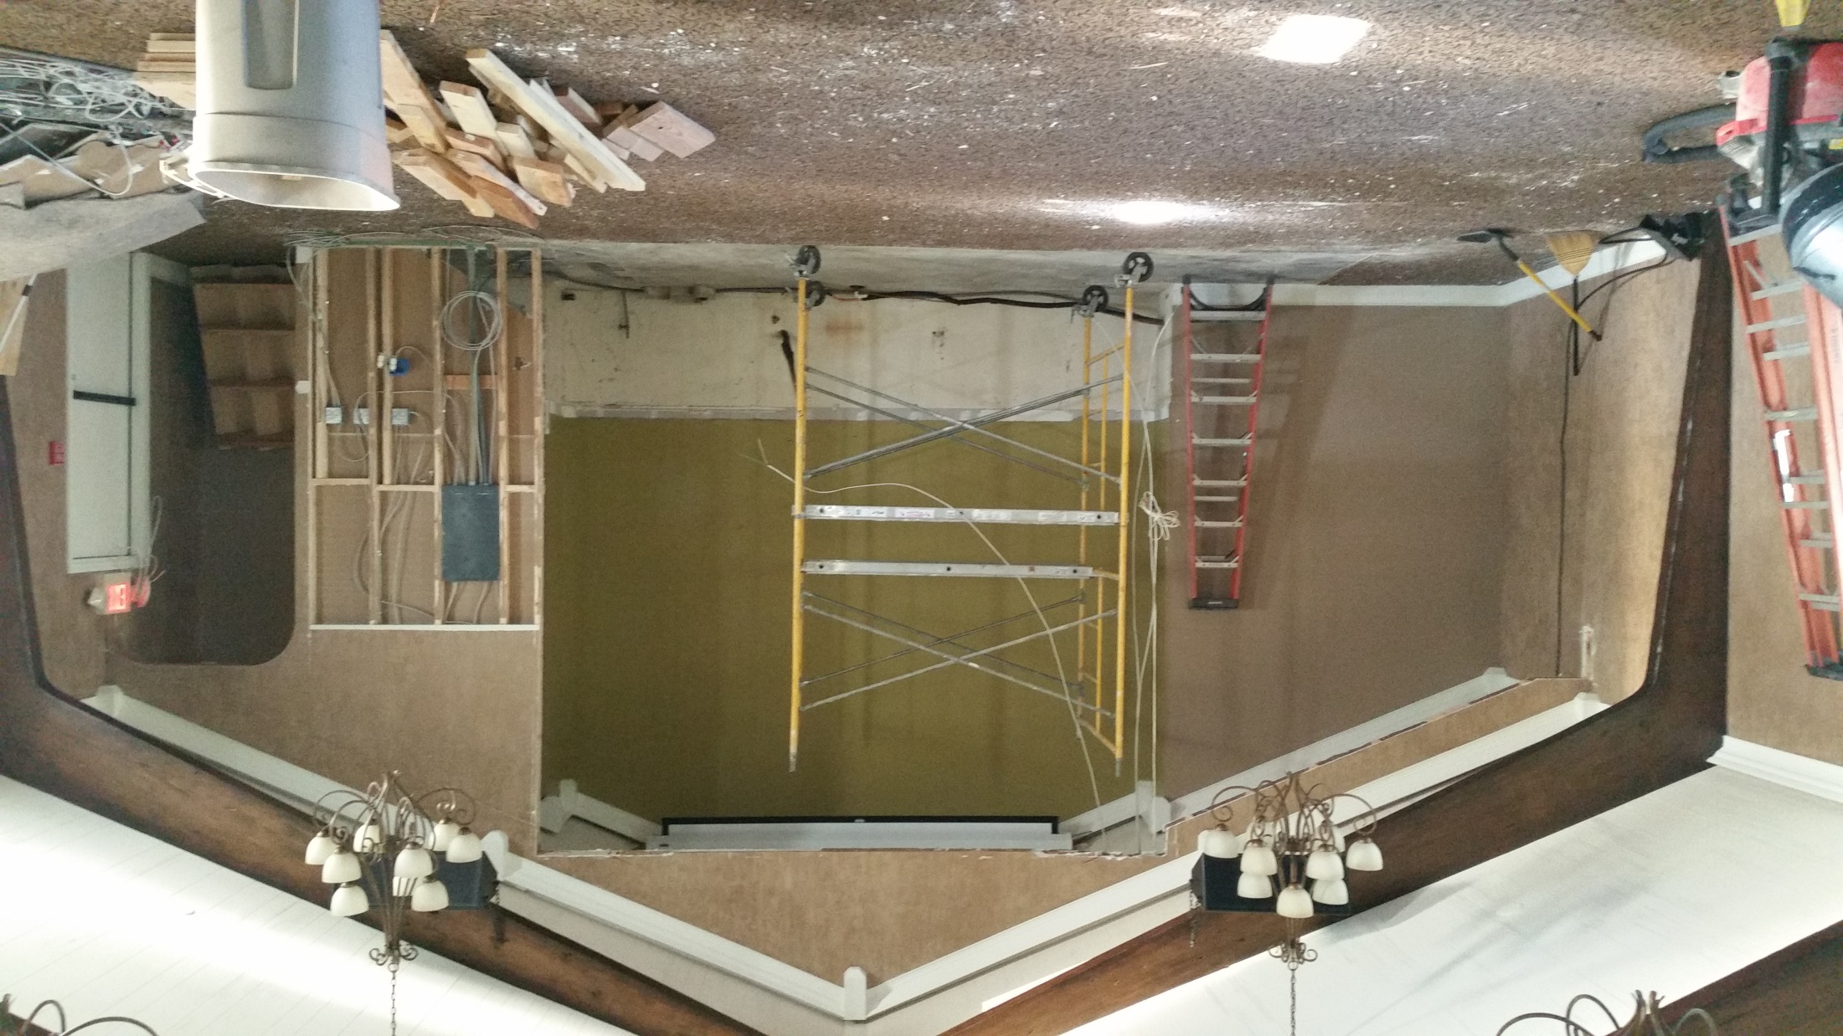
Notes:
Steve Kline, Mark Hughes, Jarrod Kline, Calev Schrader, Chris Meyers.
Ty Lewis, Shay Weber, Ted & Suzanne Alongi, Cathy Adler [Jim countless hours negotiating!], Blaine Jean Robison, Vicki Kline, Roxie Lyle, John Younger, Shannon Hunt, Pam Allen, Louise Ballard, Joelle Rutlege, Edina Coe, Ellen Juarez, Debbie Sullivan, Rachel Snider, Jude Mahoney, Erika Sanchez, DAWN WOLKENFELD

Slide 3
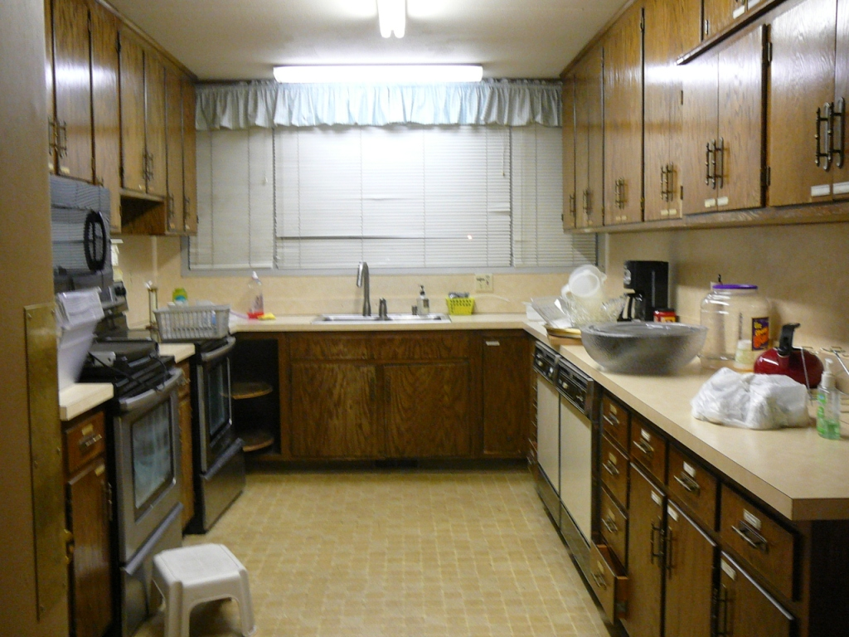

Slide 4
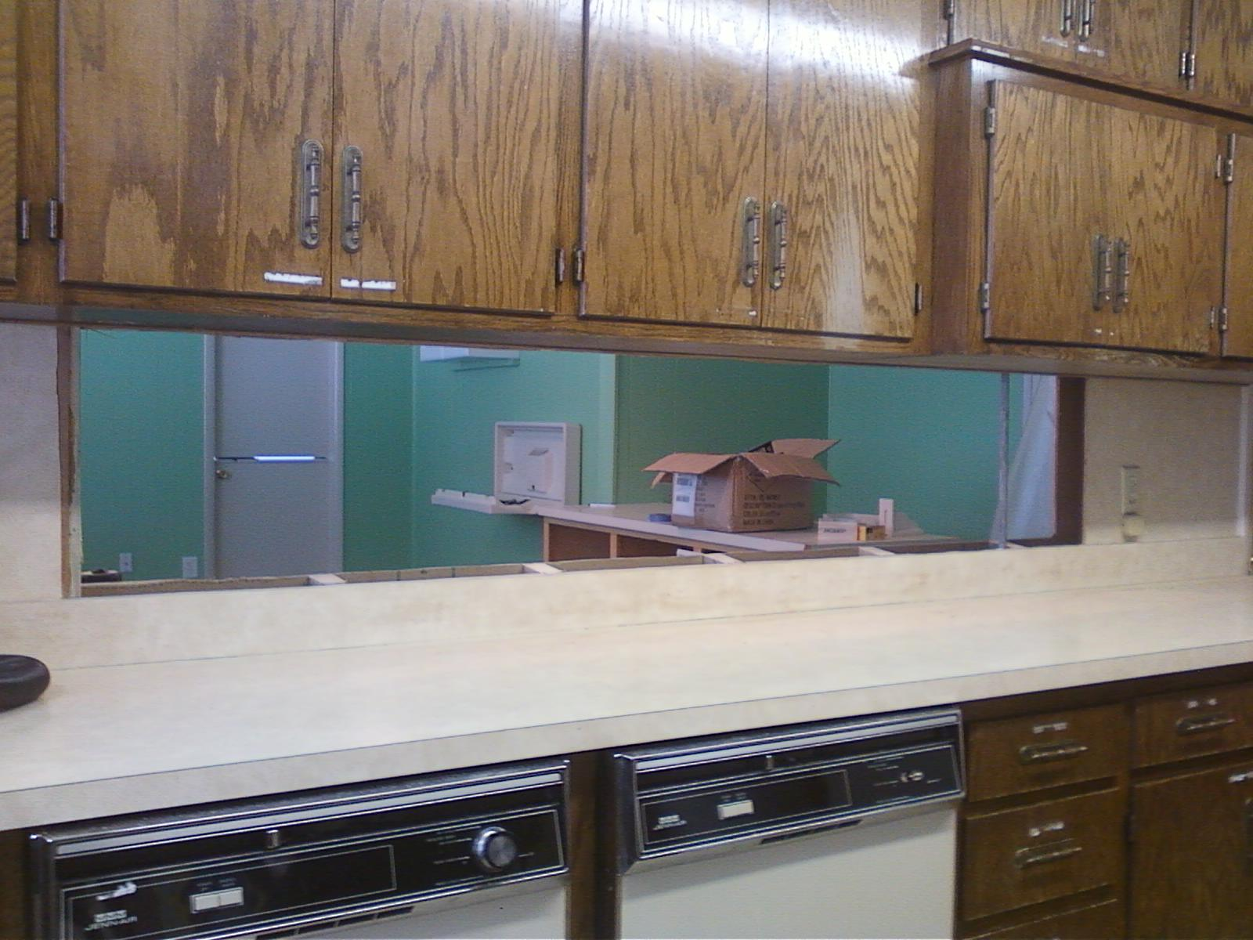

Slide 5
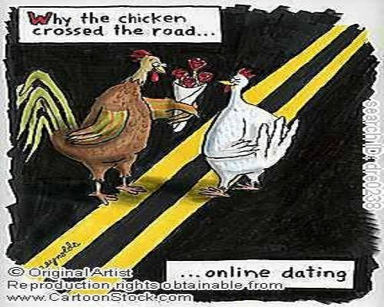
Notes:
Concerning gender dysphoria…one line is that I am a really a man trapped in a woman’s body. We found the truth.

Slide 6
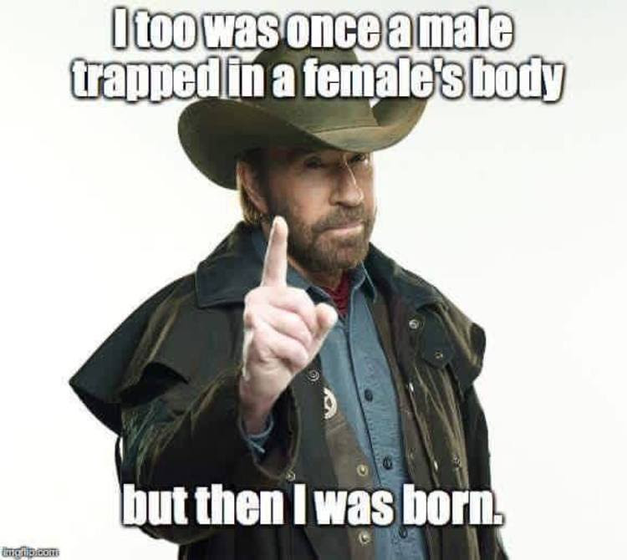
Notes:
For some real heroic news

Slide 7
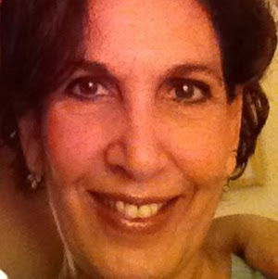
Margalit Bergman, Research
Assistant in Life Sciences
At Bar Ilan U, Tel Aviv

Slide 8
As reported by The Jerusalem Post’s Ben Hartman, on Wednesday night, Margalit Bergman had been eating at the Benedict restaurant in the Sarona Market with a group of friends, when she saw two “wealthy Italian- looking businessmen in fancy suits and skinny ties” sitting in the common dinning area. These innocent- looking men turned out to be Palestinians out to commit mass murder, who opened fire.

Slide 9
On Thursday morning, “traumatized and shaking off the sleeping pills she took the night before,” as Hartman put it, Bergman returned to the scene of the crime and to the very same table where she sat the night before. It was her way of overcoming her fear.

Slide 12
Bergman was not alone in her refusal to cave in to terrorism. MKs Tzipi Livni and Shelly Yacimovich could be seen Thursday sitting at one of the tables drinking and talking. [Knesset parliamentarians]
“What Tel Avivians are doing is important. The terrorists lose when they see that people are enjoying life. We can tell the terrorists that we are not afraid of them,” he said.
Notes:
They tried to kill us, G-d saved us, let’s eat. Sometimes there’s a price to that.
We love death like the Israelis love life.

Slide 13
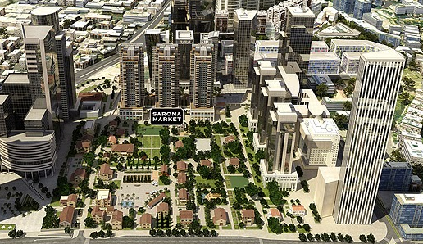
Notes:
This is Israel. Alive AND ancient. Spiritually and physically.

Slide 14
מַתִּתְיָהוּ Mattityahu
(Matthew) 12:15b-19
Notes:
Yeshua had been travelling, then healing on Shabbat, and arguing with the P’rushim/Pharisees about His practices.

Slide 15
Mattityahu (Matthew) 12:114-15a
But the P’rushim went out and began plotting how they might do away with Yeshua. Aware of this, he left that area.
Notes:
Enough arguments. He withdrew. Sometimes you just aren’t going to win the arguments, so you withdraw from the conflict. Not permanently. Ultimately must face, but timing.
He’s the chosen One, with the chosen message, but also the chosen method/spirit, chosen timing.

Slide 16
Mattityahu (Matthew) 12:16
אַךְ רַבִּים הָלְכוּ אַחֲרָיו. הוּא רִפֵּא אֶת כֻּלָּם ;וְהִזְהִיר אוֹתָם שֶׁלֹּא יְגַלּוּ אוֹתוֹ,
Many people followed him; and he healed them all; but warned them not to make him known.
Notes:
He was the Healer. Not the primary denouncer. Giver. Not yet time to face conflict.
Popularity increasing: some construct His ministry:
Year of obscurity
Year of popularity. He was here.
Year of adversity
Mattityahu, under the influence of the Ruakh, saw Yeshayahu/Is 42.1 in this

Slide 17
Mattityahu (Matthew) 12:17
לְמַעַן יִתְקַיֵּם מַה שֶּׁנֶּאֱמַר בְּפִי יְשַׁעְיָהוּ הַנָּבִיא:
This was to fulfill what had been spoken through Yesha`yahu the prophet,
Notes:
At least four servant songs in Yeshayahu/Isaiah.
Most commentaries of His day saw this as a description of Israel. Targum Jonathan translates as Messiah. Also Kimchi in loc. Abarbanel
Overlap, parallel Israel = Messiah
Isaiah 42:1-4 Israel and Messiah
Isaiah 49:1-6 Messiah
Isaiah 50:4-9 Israel and Messiah
Isaiah 52:13, continuing through 53:12 Messiah
Mattityahu by the Ruakh applies this to Yeshua primarily.

Slide 18
Mattityahu (Matthew) 12:18
"הֵן עַבְדִּי אֶתְמָךְ-בּוֹ, בְּחִירִי רָצְתָה נַפְשִׁי. נָתַתִּי רוּחִי עָלָיו, מִשְׁפָּט לַגּוֹיִם יוֹצִיא
"Here is my servant, whom I have chosen, my beloved, with whom I am well pleased; I will put my Spirit on him, and he will announce justice to the Gentiles.
Notes:
תָּמַךְ tamakh to support ; to sustain ; to encourage, to buoy up ; to agree with (an opinion, argument) ; to back up, to reinforce

Slide 19
Mattityahu (Matthew) 12:19
לֹא יִצְעַק וְלֹא יִשָּׂא וְלֹא-יַשְׁמִיעַ בַּחוּץ קוֹלוֹ.
He will not fight or shout, no one will hear his voice in the streets;
צָעַק פ' קלtsa-ak to shout, to cry out ; to complain, to protest ; to rebuke, to reprimand, to censure
נָשָׂא nasa to bear, to carry ; to deliver (a speech, address, prayer) ; to suffer, to tolerate
Notes:
he shall not act the part of a plaintiff; he shall not complain, or bring in any charge, or accusation against any
nothing in an ostentatious way, said nothing in his own commendation, was never heard to praise himself
Yeshayahu/Is 6.1 רָם וְנִשָּׂאram v’nisa High and lifted up.
Yeshua was the Servant of Adoni in prophetic vision who comforted, gave, built, without tumult, self promotion, self aggrandizement. He will not fight or shout. Father’s Day transition. Giver

Slide 20
Essence of fatherhood: giver
^{2 Cor 12.14-15} Look, I am ready this third time to come and visit you; and I will not be a burden to you; for it is not what you own that I want, but you! Children are not supposed to save up for their parents, but parents for their children. And as for me, I will most gladly spend everything I have and be spent myself too for your sakes.

Slide 21
Prophetic role of Messiah: Yeshayahu/Is 9.5-6
For a child is born to us, a son is given to us; dominion will rest on his shoulders, and he will be named
פֶּלֶא יוֹעֵץ, אֵל גִּבּוֹר, אֲבִי-עַד, שַׂר-שָׁלוֹם.
Pele-Yo‘etz, El Gibbor,
Avi-‘Ad, Sar-Shalom [Wonder of a Counselor,
Mighty God,
Father of Eternity, Prince of Peace]

Slide 22
Prophetic role of Messiah: Yeshayahu/Is 9.5-6
in order to extend the dominion and perpetuate the peace of the throne and kingdom of David, to secure it and sustain it through justice and righteousness henceforth and forever. The zeal of Adonai-Tzva’ot will accomplish this.
Notes:
Fatherhood is the essence of the expansion of the Kingdom! We are taught to pray Avinua Shehbashamiyim. אבינו שבשמים Our Father in Heaven...

Slide 23
According to the Life Model, 5 stages of life
Infant, birth till 3, learns to live in joy, trusting good adults to meet his unarticulated needs
Child, 4 thru 12, asks for needs, takes some responsibility
Adult, 13 till birth 1st child, cares for self and others
Notes:
#1 the world is ruled by a G-d Who is good, and will send good. As opposed to “life is bitter, hurtful…”

Slide 24
Parent, birth 1st child till empty nest, protects, serves, enjoys family without expecting to be taken care of.
Disclaimer, not meant to be injurious:
for single men, childless men, fatherless men, estranged children. Spirit of fatherhood for all, since G-d is the preeminent Father.
Notes:
Appreciation of our fathers, as far as they took this model. Appreciation of fatherhood.

Slide 25
Amazing revelation when were told that we’ve conceived a child.
[story dentist and in vitro ]
A father gives life: wonderful and fearsome
Do men want children?
Yes and no, depends on if they mastered the first three levels…
Notes:
p. 131 Living with Men.
Someone asked me about new building

Slide 26
According to the Life Model, 5 stages of life
Infant, birth till 3, learns to live in joy, trusting good adults to meet his needs
Child, 4 thru 12, asks for needs, takes some responsibility
Adult, 13 till birth 1st child, cares for self and others
Notes:
Read Summary top p 132

Slide 27
Jim Wilder, Life Model:
“Three quarter or more of the men in the US will revert to infant level maturity under any stress.
Parent, birth 1st child till empty nest, protects, serves, enjoys family without expecting to be taken care of.
Notes:
Living with Men p 132
That is, we don’t believe in the goodness of the Heavenly Father, expressed in people, and our life is founded on striving for identity, acceptance, affirmation. Need based.

Slide 28
10 Traits of Effective Dads:
They realize that their manhood and fatherhood are directly tied to their relationship with God. This means time in God’s Word, time in prayer and time with God’s people is an essential part of their lives.
It’s only by the applied atoning blood of Messiah that we can rise through the levels.
Notes:
http://www.drjamesdobson.org/blogs/the-fatherhood-challenge/the-fatherhood-challenge/2016/02/22/10-traits-of-highly-effective-dads

Slide 29
If married, they uphold their wives as their number one friend and co-worker in life. They realize that loving their wives is one of the greatest things they could ever give their kids and they protect their marriage like it’s their life.

Slide 30
They practice the discipline of meekness. They exemplify the combination of humility and strength. Men need to be strong for their families not at their families. These great dads get this idea well. In these homes, yelling and abuse of any kind is never tolerated.

Slide 31
They’ve tied their hearts to the hearts of their children. There is a very special God-given bond that they cherish and cultivate on a daily basis. This means they are always looking to create heart-moments with their kids, especially when it comes to sharing God’s love and truth with them.

Slide 32
They honor their child’s gender and unique giftedness. They raise their sons to be men and their daughters to become women. There is a difference and a good father knows how to engage both his sons and daughters. When most dads pull back during the adolescent years, these astute men mentor and engage at an even deeper level.
Notes:
NOT shaming

Slide 33
They are great listeners and make themselves available for those “by the way” teaching moments and conversations with their children (Deut. 6:5-7)

Slide 34
They make their children feel special and believe in them. I thought this quote by the late Jim Valvano is very fitting: “My father gave me the greatest gift anyone could give another person, he believed in me.” Great dads believe in their kids and their kids know how special they are.

Slide 35
Mercy and grace are a part of their households. As sinners, these men know that we will always be dealing with offenses and trip-ups. This makes mercy and grace two of their strongest relationship allies. A saying we often come back to is, “forgiven and forgiving.” In this regards, they take the lead in admitting when they are wrong and asking for forgiveness.

Slide 36
Tools for the trade
(chorus)
If you are a father, you are a builder
And your children will become what you've made
Please do your best and please don't forget
God gave you the tools for the trade
Notes:
https://steveandanniechapman.bandcamp.com/track/tools-for-the-trade

Slide 37
He gave you eyes to see where your child might go wrong
And feet to lead them safely through
Hands to hold their hands
And lips to say "i love you"
(repeat chorus)
Notes:
https://steveandanniechapman.bandcamp.com/track/tools-for-the-trade

Slide 38
He gave you arms to hold them
When they are afraid
And time to wait until they’re calm
Ears to hear between their lines
And tears to cry when they’re gone
Notes:
https://steveandanniechapman.bandcamp.com/track/tools-for-the-trade

Slide 39
(bridge)
And your knees are for playing
And they're also for praying
That G-d will watch over the child
And in those times when you can't say it
But they still need to hear it
You can say “I love you" with your smile
Notes:
https://steveandanniechapman.bandcamp.com/track/tools-for-the-trade

Slide 40
If you are a father, you are a builder
And your children will become what you've made
Please do your best
And please don't forget
G-d gave you the tools for the trade
Steve chapman/1986/dawn treader music/bmi
Notes:
https://steveandanniechapman.bandcamp.com/track/tools-for-the-trade

Slide 41
Moment to commit ourselves to receiving, so we can give.
By the merit of the Atoning Blood of Yeshua, all is forgiven
By faith we receive entrance into the beloved fellowship.

