Slide 1
To easily follow these notes, log on to our Wifi
Wifi: mycci01 p/w: ancientquail060
Go to OrHaOlam.com
Click on downloads, messages, 2017

Slide 2
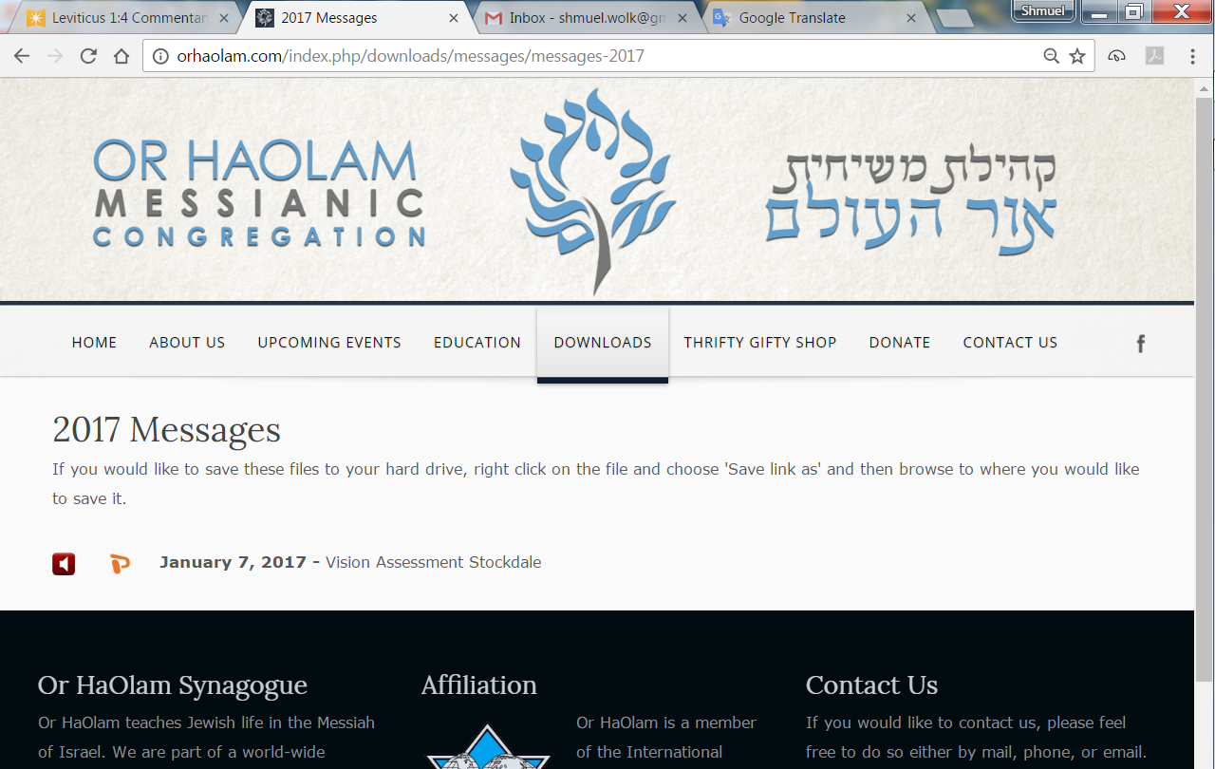

Slide 3
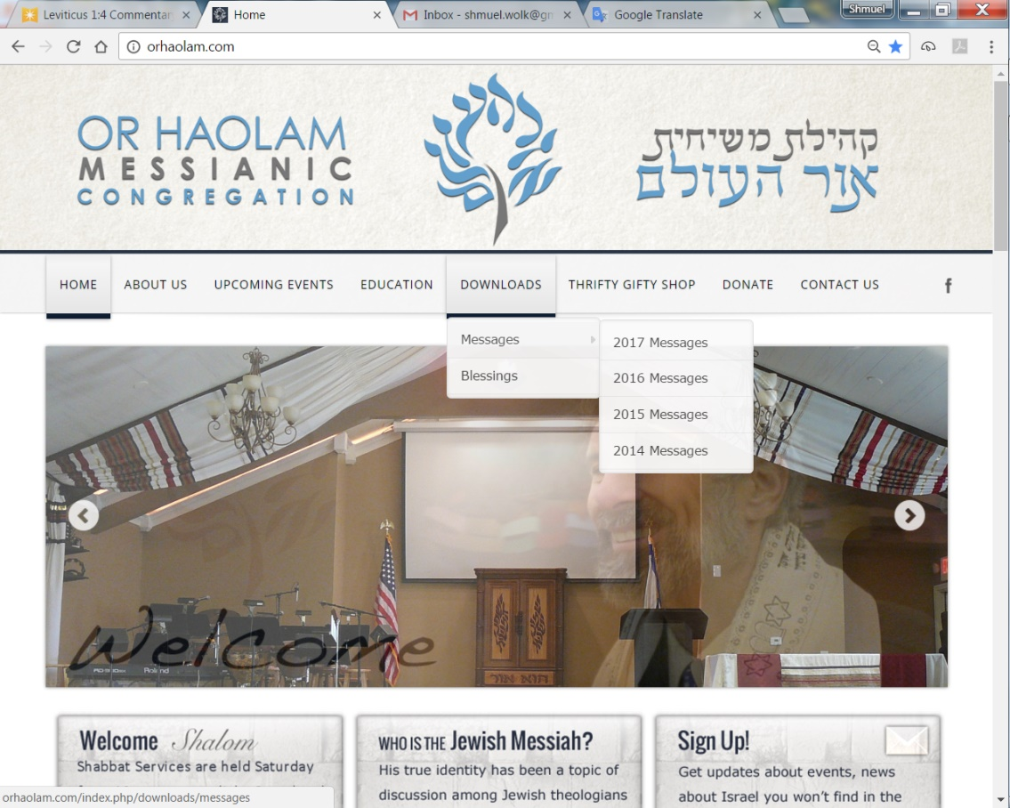
Downloads\messages\
2017 Messages

Slide 4
Notes:
Just go to OrHaOlam.com

Slide 5
Notes:
Just go to OrHaOlam.com
Best epitaph ever:

Slide 7
Did you know that:
Before he got married, Boaz in the Bible was merciless, cruel, heartless, cold-blooded, harsh, callous, unforgiving, uncaring, uncharitable
Can I prove it?

Slide 8
He was Ruthless!
Notes:
From Brian Kaufman

Slide 9
News behind the news!

Slide 10
United Nations Security Council Resolution 1701, 12 August 2006
A long term solution based on (OP8)
Disarmament of all armed groups in Lebanon (implying Hezbollah)
No armed forces other than UNIFIL and Lebanese (implying Hezbollah and Israeli forces) will be south of the Litani Rivers
Notes:
https://en.wikipedia.org/wiki/United_Nations_Security_Council_Resolution_1701

Slide 11
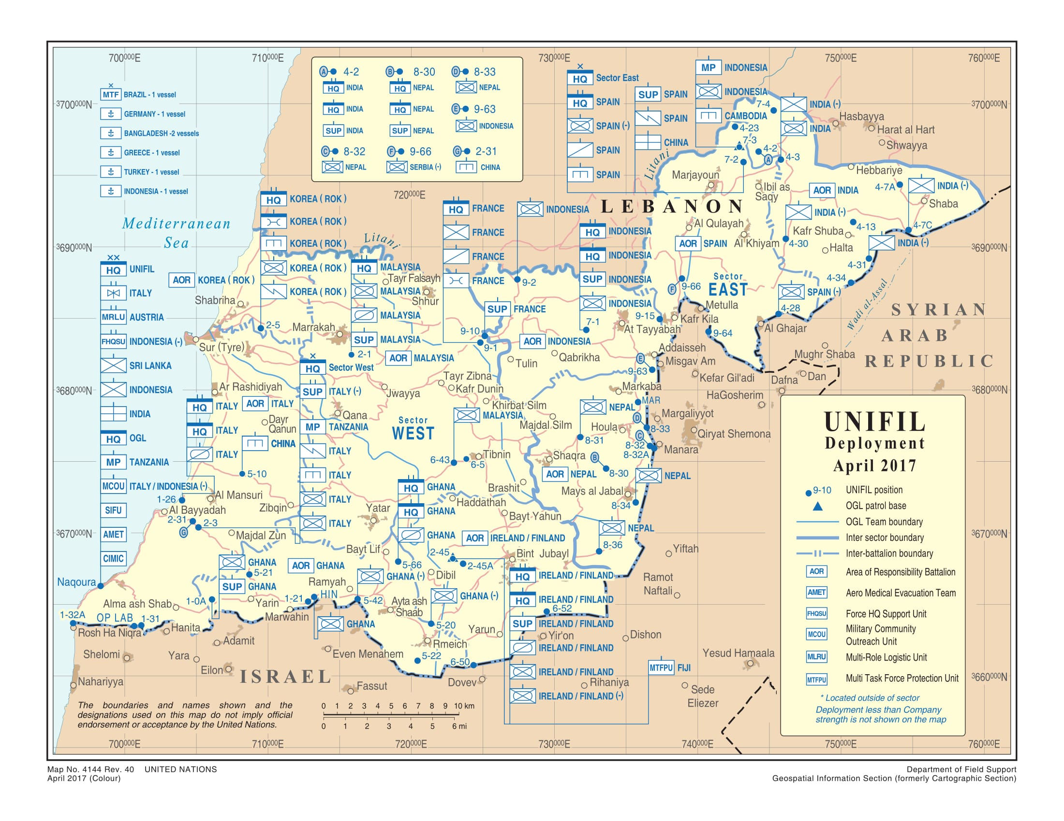

Slide 12
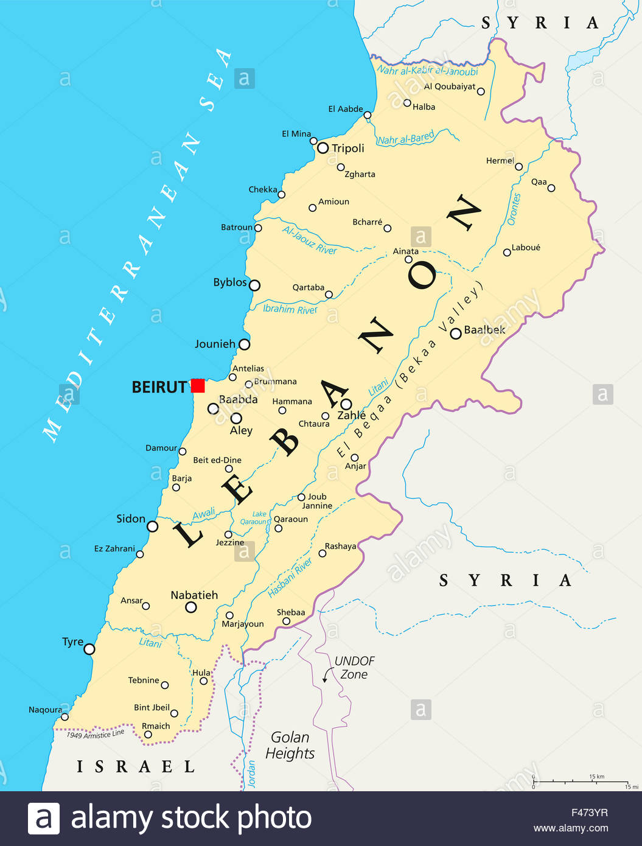
Inset enlarged
On next slide

Slide 13
Notes:
http://www.jpost.com/Arab-Israeli-Conflict/Israel-warns-UN-Hezbollah-has-120000-missiles-aimed-at-Israel-460184

Slide 14
Amb. Ron Prosor is the former Israeli Ambassador to the UN. He currently heads the Abba Eban Institute for International Diplomacy at the IDC Herzilya. He writes:
Yesterday, [Nov. 30, 2017] the United Nations Security Council debated a report recently published by UNIFIL, the United Nations Interim Force in Lebanon.
Notes:
http://unitycoalitionforisrael.org/?p=15704192

Slide 15
It is common knowledge in the intelligence communities…that Hezbollah has amassed over 150,000 missiles directed towards Israeli cities. Instead of detailing the locations of weapon stockpiles and asking the UN Security council to strengthen its mandate so they are able to raid them,
Notes:
http://unitycoalitionforisrael.org/?p=15704192

Slide 16
the report goes into incredible detail of the amount of Lebanese shepherds spotted near the border area. 420 if anyone is interested. Maj. Gen. Michael Beary, has said he sees no evidence of weapons being illegally transferred and stockpiled in the area.
Notes:
http://unitycoalitionforisrael.org/?p=15704192

Slide 17
“If there was a large cache of weapons,” he said last summer, “we would know about it.” As the US Ambassador to the UN, Nikki Haley, has said, Beary “seems to be the only person in south Lebanon who is blind to what Hezbollah is doing.”
Notes:
http://unitycoalitionforisrael.org/?p=15704192
Petition your congressmen to make the UN enforce Res 1701

Slide 18
A bad day when you
find one of these on
your door…

Slide 19
Notes:
Lease violations: non-payment, smoking, pets, breakage of the property
You are OUT

Slide 21
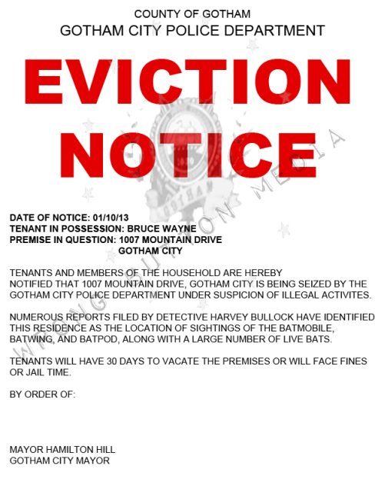

Slide 23
מַתִּתְיָהוּ Mattityahu
(Matthew) 21:33-35
Notes:
But what if the Landlord is G-d? How does He dealt with defaulting tenants?

Slide 24
Mattityahu (Matthew) 21:33
"שִׁמְעוּ מָשָׁל אַחֵר: אִישׁ בַּעַל אֲחֻזָּה נָטַע כֶּרֶם. הוּא גִּדֵּר אוֹתוֹ מִסָּבִיב,
"Now listen to another parable. There was a farmer who planted a vineyard. He put a wall around it,
Notes:
Yeshua telling a story like prophet Yeshayahu/Isaiah ch 5…

Slide 25
^{Yeshayahu/Isaiah 5.1-7} Let me sing of my beloved, a song of my beloved, about His vineyard. My beloved had a vineyard in a very fertile hill. He dug it out and cleared its stones, planted it with a choice vine, built a tower in the midst of it, and even cut out a winepress.

Slide 26
Mattityahu (Matthew) 21:33
חָצַב בּוֹ יֶקֶב וּבָנָה מִגְדָּל,
dug a pit for the winepress and built a tower;

Slide 27
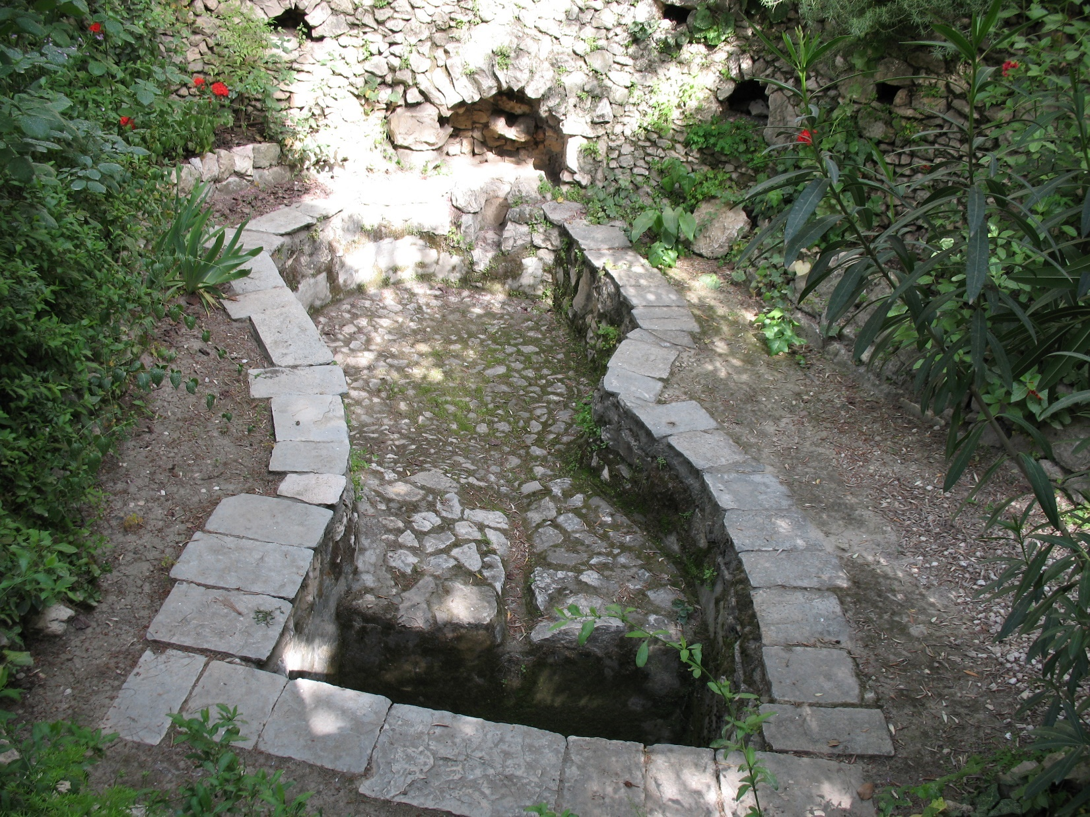
1st century CE winepressing
trough from the Old City of Jerusalem
Notes:
https://en.wikipedia.org/wiki/History_of_the_wine_press#/media/File:Winepress_in_Old_City_Jerusalem.jpg

Slide 28
A Roman architectural relief
from the 1st century CE showing that grape treading was still widely used as a means of pressing wine grapes during Roman times.
Notes:
https://en.wikipedia.org/wiki/History_of_the_wine_press#/media/File:Grapes_02_pushkin.jpg

Slide 29
Mattityahu (Matthew) 21:33
חָצַב בּוֹ יֶקֶב וּבָנָה מִגְדָּל,
dug a pit for the winepress and built a tower;
Notes:
Tower a hut of leaf covered wood or stone, shelter for the workers. Or observation of animals or humans robbing the vineyard.

Slide 30
Mattityahu (Matthew) 21:33
וּלְאַחַר שֶׁהֶחְכִּיר אוֹתוֹ לְכוֹרְמִים ונָסַע.
then he rented it to tenants and left.

Slide 31
^{Vayikra/Lev 19.23-25} When you come into the land and have planted all kinds of trees for food, you are to consider their fruit as forbidden. Three years it will be forbidden to you. It is not to be eaten. Then in the fourth year all its fruit will be holy, for giving praise to Adoni.

Slide 32
^{Vayikra/Lev 19.23-25} In the fifth year you may eat its fruit. So it will yield its increase to you. I am Adoni your God.
Vineyard owner was waiting five years for a harvest!
Notes:
Five years vineyard owner been waiting.

Slide 33
Mattityahu (Matthew) 21:34
בְּהַגִּיעַ עֵת הַבָּצִיר שָׁלַח אֶת עֲבָדָיו אֶל הַכּוֹרְמִים לְקַבֵּל אֶת הַפְּרִי שֶׁלּוֹ.
When harvest-time came, he sent his servants to the tenants to collect his share of the crop.
Three forms of tenancy.

Slide 34
שׂוֹכֵר 1. fixed fee tenant, lessee
^{Song of Solomon 8.11} Shlomo had a vineyard at Ba‘al-Hamon, and he gave the vineyard to caretakers; each of them would pay for its fruit a thousand pieces of silver.
Notes:
https://www.biblestudytools.com/commentaries/gills-exposition-of-the-bible/matthew-21-33.html

Slide 35
חוֹכֵר 2. lessee, tenant khokher
Rented for a fixed amount of the fruit
מקבל 3. receiver m’kabel
Rented for ¼, ¹/₃, ½ of the crop
Notes:
https://www.biblestudytools.com/commentaries/gills-exposition-of-the-bible/matthew-21-33.html
Seems these tenant farmers #3

Slide 36
Mattityahu (Matthew) 21:34
בְּהַגִּיעַ עֵת הַבָּצִיר שָׁלַח אֶת עֲבָדָיו אֶל הַכּוֹרְמִים לְקַבֵּל אֶת הַפְּרִי שֶׁלּוֹ.
When harvest-time came, he sent his servants to the tenants to collect his share of the crop.
[¼, ¹/₃, ½ of the crop]

Slide 37
Mattityahu (Matthew) 21:35
תָּפְסוּ הַכּוֹרְמִים אֶת עֲבָדָיו, אֶת זֶה הִלְקוּ, אֶת זֶה הָרְגוּ וְאֶת זֶה סָקְלוּ.
But the tenants seized his servants — this one they beat up, that one they killed, another they stoned.
Notes:
Remember the Yeshayahu/Is story of the vineyard cited above?

Slide 38
^{Yeshayahu/Isaiah 5.1-7} He expected it to yield good grapes, but it yielded worthless grapes. So now, O inhabitants of Jerusalem and people of Judah, please judge between me and my vineyard. What more was there to do for my vineyard that I have not done?

Slide 39
^{Yeshayahu/Isaiah 5.1-7} Why then, when I expected it to yield good grapes, did it yield worthless grapes? So now, I will make known to you what I will do to my vineyard: I will take away the hedge, and it will be eaten up. I will break down the fence, and it will be trodden down.

Slide 40
^{Yeshayahu/Isaiah 5.1-7} I will lay it waste: it will not be pruned or hoed, but briers and thorns will come up. I will also command the clouds not to rain on it.

Slide 41
^{Yeshayahu/Isaiah 5.1-7} For the vineyard of Adonai-Tzva’ot is the house of Israel, and the people of Judah the planting of His delight. He looked for justice, but behold, bloodshed, for righteousness, but behold, a cry!
Notes:
Some ancient landlords had their own hit squads.
However, this story, the landlord doesn’t give up so quickly.

Slide 42
^{Mattityahu (Matthew) 21:36-41} So he sent some other servants, more than the first group, and they did the same to them. Finally, he sent them his son, saying, `My son they will respect.’

Slide 43
^{Mattityahu (Matthew) 21:36-41} But when the tenants saw the son, they said to each other, ‘This is the heir. Come, let's kill him and take his inheritance!’ So they grabbed him, threw him out of the vineyard and killed him.

Slide 44
No laws in Israel or Rome would have granted the vineyard to tenants who had murdered the heir.
When an owner was murdered, Roman law executed all his slaves.
Notes:
Keener p 514

Slide 45
This violence was disproportional and shocking to ancient ears. Killing of unarmed messengers was viewed as treacherous by all cultures.
Slaughter of a group of ambassadors morally hideus.
Notes:
Keener on Matthew p 512
Romans once enslaved a whole people for killing one of their representatives.
Murder and taking possession was considered astonishingly evil even when done by an Israelite king.

Slide 46
^{1 K 21.17-19} Then the word of the Adoni came to Elijah the Tishbite saying: “Arise, go down to meet King Ahab of Israel, who is in Samaria. Behold, he is in the vineyard of Naboth where he has gone down to take possession of it. You shall speak to him saying,

Slide 47
^{1 K 21.17-19} ‘Thus says Adoni: Have you murdered and then taken possession?’ You shall also speak to him saying, ‘Thus says Adoni: In the same place where dogs licked the blood of Naboth shall dogs lick your blood too.’”
Notes:
Pretty brutal consequence for murdering with the intent to seize land.

Slide 48
^{Mattityahu (Matthew) 21:36-41} Now when the owner of the vineyard comes, what will he do to those tenants?"

Slide 49
^{Mattityahu (Matthew) 21:36-41} They answered him, "He will viciously destroy those vicious men and rent out the vineyard to other tenants who will give him his share of the crop when it's due."
Notes:
Hearers got it. Like Akhav and Naboth. Like Isaiah parable.

Slide 50
What are the parable’s parallels?
Vineyard is Israel
Tenant growers are those who care for Israel’s spirituality:
Cohanim/Priests
Pharises/rabbis
Messengers: Biblical prophets

Slide 51
What are the parable’s parallels?
Tower ~ Temple
Fence ~ Torah
Fruit ~ our character and praise poured out!

Slide 52
Why did the landowner send his son, without military escort & protection?

Slide 53
^{Mattityahu (Matthew) 21:36-41} Finally, he sent them his son, saying, ‘My son they will respect.’
Notes:
What a gamble, risk

Slide 54
^{Yn 1.14} The Word became flesh and made his dwelling among us. We have seen his glory, the glory of the one and only Son, who came from the Father, full of grace and truth.

Slide 55
^{Yokhanan 14.8-11} Philip said to him, "Lord, show us the Father, and it will be enough for us."
Yeshua replied to him, "Have I been with you so long without your knowing me, Philip? Whoever has seen me has seen the Father; so how can you say,

Slide 56
^{Yokhanan 14.8-11} `Show us the Father'? Don't you believe that I am united with the Father, and the Father united with me? What I am telling you, I am not saying on my own initiative; the Father living in me is doing his own works.

Slide 57
^{Yokhanan 14.8-11} Trust me, that I am united with the Father, and the Father united with me. But if you can't, then trust because of the works themselves.

Slide 58
^{Mes. Jews/Heb 1.3} The Son is the radiance of God's glory and the exact representation of his being,
being the effulgence of his glory, and the very image of his substance, ^{ASV}
Solar flares

Slide 61
This Son is the radiance of, literally, “the glory,” best rendered Jewishly as the Sh’khinah, which the Encyclopedia Judaica article on it (Volume 14, pp. 1349–1351) defines as
“the Divine Presence, the numinous immanence of God in the world, … a revelation of the holy in the midst of the profane ….”
Notes:
From David Stern’s New Testament Commentary

Slide 62
“According to Saadiah Gaon [882–942 c.e.], the Shekhinah is identical with kevod ha-Shem (‘the glory of God’), which served as an intermediary between God and man during the prophetic experience.

Slide 63
He suggests that the ‘glory of God’ is the biblical term, and Shekhinah the talmudic term for the created splendor of light which acts as an intermediary between God and man, and which sometimes takes on human form.

Slide 64
Thus when Moses asked to see the glory of God, he was shown the Shekhinah, and when the prophets in their visions saw God in human likeness, what they actually saw was not God Himself but the Shekhinah
Notes:
(see Saadiah’s interpretation of Ezekiel 1:26, 1 Kings 22:19, and Daniel 7:9 in Book of Beliefs and Opinions 2:10).”
The Jewish New Testament Commentary, (Clarksville, MD: Jewish New Testament Publications) 1996.

Slide 65
Yeshua IS the Shekhinah, the Word, the Davar, the Memra, the Logos.

Slide 66
The Father’s great risky plan, that people will see His glory in Yeshua, and repent.

Slide 67
^{2 Cor 4.6} For God, who said, “Let light shine out of darkness,” is the One who has shone in our hearts, to give the light of the knowledge of the glory of God in the face of Messiah Yeshua.
Notes:
Risky…

Slide 68
^{2 Cor 3.15-16} For we are the aroma of Messiah to God, among those who are being saved and those who are perishing — to the one an aroma from death to death, to the other an aroma from life to life.

Slide 69
^{Yeshayahu/Is 53.1-4} ‘Who has believed our report? To whom is the arm of Adoni revealed? For He grew up before Him like a tender shoot, like a root out of dry ground. He had no form or majesty that we should look at Him, nor beauty that we should desire Him.

Slide 70
^{Yeshayahu/Is 53.1-4} He was despised and rejected by men, a man of sorrows, acquainted with grief, One from whom people hide their faces. He was despised, and we did not esteem Him. Surely He has borne our griefs and carried our pains. Yet we esteemed Him stricken, struck by God, and afflicted.

Slide 71
According to the grace of God which is given to me, as a wise master builder, I have laid the foundation, and another builds thereon. But let every man take heed how he builds thereupon. For other foundation can no man lay than that is laid, which is Yeshua the Messiah. ^{I Cor. 3:10-11}

Slide 72
In Greek, τίθημι (tithēmi) is the same word used for laying a foundation as for laying down one's life. It can also mean to sacrifice, to adopt (literally to place, appoint or set as a son) -υἱοθεσία/uihothesia. The sacrifice of Yeshua and laying a foundation are connected.

Slide 73
Greater love has no man than this, that a man lay down his life for his friends.^{John 15:13}
Yeshua laid down His life. This is the foundation of our faith. This is how we lay a foundation. We must do the same. No other foundation can be laid. Laying a foundation always involves laying down our own lives, as He did.

Slide 74
G-d’s risky plan, that Messiah’s loving salvation might be rejected, was overcome by the Resurrection.
We have the same calling…
^{1 Cor 13.4} Love suffers long…
Notes:
WHO CAN YOU LOVE WITH LONGSUFFERING, TO MINISTER TO??

Slide 75
^{Mattityahu (Matthew) 21:43, 45} Therefore, I tell you that the Kingdom of God will be taken away from you and given to the kind of people that will produce its fruit!"…As the head cohanim and the P'rushim listened to his stories, they saw that he was speaking about them.

Slide 76
Not addressed to Israel, but to leaders.
Note “bookend”

Slide 77
^{Mattityahu (Matthew) 21:23} He went into the Temple area; and as he was teaching, the head cohanim and the elders of the people approached him and demanded, "What s'mikhah do you have that authorizes you to do these things?

Slide 78
^{Mtt.21.42} Yeshua said to them, “Haven’t you ever read in the Tanakh, ‘The very rock which the builders rejected has become the cornerstone! This has come from Adoni, and in our eyes it is amazing’?

Slide 79
^{Mtt.21.44}: Whoever falls on this stone will be broken in pieces; but if it falls on him, he will be crushed to powder!”
Notes:
Fall on Him for mercy, breaking of our pride, sins, sensuality
Or
He falls on us, eventually, in judgment

Slide 80
“crushed to powder”
After Weinstein: The Fallout for 34 Men Accused of Sexual Misconduct, From Lewd Texts to Rape
Notes:
https://www.nytimes.com/interactive/2017/11/10/us/men-accused-sexual-misconduct-weinstein.html?_r=0

Slide 81
Etiquette for behavior with the opposite gender
Physical contact: shake hands or touch shoulder
Never be alone nor communicate alone.
Dress modestly. [doesn’t justify]

Slide 82
^{Mtt.21.44}: Whoever falls on this stone will be broken in pieces; but if it falls on him, he will be crushed to powder!”
Notes:
Fall on Him for mercy, breaking of our pride, sins, sensuality
Or
He falls on us, eventually, in judgment

