Slide 1
To easily follow these notes, log on to our Wifi
Wifi: mycci01 p/w: ancientquail060
Go to OrHaOlam.com
Click on downloads, messages, 2017

Slide 2
Notes:
New template for OrHaOlam website
Click on downloads tab

Slide 3
Downloads\2017 Messages
Notes:
New OrHaOlam website

Slide 4
Notes:
Just go to OrHaOlam.com
Travel agent asking me about registration. If you are thinking of going, please do. If not, please pray.

Slide 5
Notes:
Just go to OrHaOlam.com

Slide 6
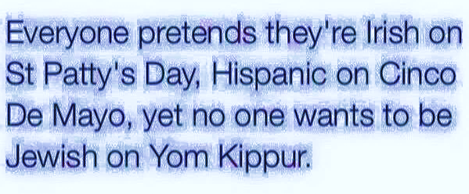
Notes:
News from Israel…

Slide 7
Notes:
7th highest cost of living in the world.
http://www.jerusalemonline.com/israel-news/27.12.17-morning-newscast-from-israel-33312?utm_source=ActiveCampaign&utm_medium=email&utm_content=Israeli+Muslim+convert+convicted+of+attempting+to+join+ISIS%2C+English+Chess+Federation+head+criticizes+Saudi+Arabia+for+discrimination+against+Israelis+and+more+news+at+JerusalemOnline&utm_campaign=MiddayNewsletter+-+Recurring+-+Dec+17

Slide 8
Notes:
USA is the 14th

Slide 9
Impossible questions
Can G-d create a stone that G-d cannot lift?
Did you stop beating your wife yet?
Can you hear me?
Are you sleeping?

Slide 10
^{Mattityahu (Matthew) 22:15-16} Then the P’rushim went away and put together a plan to trap Yeshua with his own words. They sent him some of their talmidim and some members of Herod’s party.
Notes:
Questions, She-a-lot a whole style of literature later, Responsa. 4 categories: halakah/law [here], burut/mockery, derekh eretz/successful life [most imp. commandment], Haggadah/scripture clarification [Ps 110]
Interesting combination. Not older P’rushim might be jaded committed to agenda, but younger open minded, fresh, earnest, zealous, conscientious young men.
With Herod’s Party, who wanted to restore Herod’s full kingdom: [extreme section of the P’rushim hated Herod, Nationalists/Zealots hated Herod.] semi-Roman, semi-Nationalist [Edersheim Life and Times ii 384]

Slide 11
^{Mattityahu (Matthew) 22:15-16} They said, “Rabbi, we know that you tell the truth and really teach what God’s way is. You aren’t concerned with what other people think about you, since you pay no attention to a person’s status.
Notes:
Rhetorical disarming device: capatito benevolentiae

Slide 12
^{Acts 24.1-3} After five days, the cohen hagadol Hananyah came down with some elders and a lawyer named Tertullus, and they presented their case against Sha’ul to the governor. Sha’ul was called, and Tertullus began to make the charges:

Slide 13
^{Acts 24.1-3} “Felix, your Excellency, it is because of you that we enjoy unbroken peace, and it is your foresight that has brought to this nation so many reforms in so many areas. It is with the utmost gratitude that we receive this.

Slide 14
מַתִּתְיָהוּ Mattityahu
(Matthew) 22:17-21

Slide 15
Mattityahu (Matthew) 22:17
עַל כֵּן אֱמֺר נָא לָנוּ, מַה דַּעְתְּךָ: הַאִם מֻתָּר לָתֵת מַס לַקֵּיסָר אוֹ לֹא?"
So tell us your opinion: does Torah permit paying taxes to the Roman Emperor or not?"

Slide 16
Alternatives
If He supports taxes to Rome, then Rome and Caesar are supreme, divine.
If opposes taxes to Rome, then He is rebelling against the Empire. We know that the Empire strikes back.
Notes:
A shock to His followers, and a lie to His own claim to be Messiah-King!
Rebellion. Serious issue to refuse Roman taxes. One historical precedent. Charged used later against Yeshua. During Messianic awakening after the great Shavuot /Pentecost outpouring, leaders considering what do to…

Slide 17
^{Acts 5.37} Y’hudah HaG’lili led another uprising, back at the time of the enrollment for the Roman tax [His birth]; and he got some people to defect to him. But he was killed, and all his followers were scattered.
Notes:
the Messianic pretender, Y'hudah HaG'lili who, according to Josephus, said that people who paid Roman taxes were cowards (Wars of the Jews 2:8:1).
And at Yeshua’s incarceration and trial

Slide 18
^{Lk 23.1-2} With that, the whole Sanhedrin got up and brought Yeshua before Pilate, where they started accusing him. “We found this man subverting our nation, forbidding us to pay taxes to the Emperor and claiming that he himself is the Messiah — a king!”

Slide 19
Mattityahu (Matthew) 22:18
הִבְחִין יֵשׁוּעַ בְּרִשְׁעָתָם וְאָמַר: "לָמָּה אַתֶּם מְנַסִּים אוֹתִי? צְבוּעִים!
Yeshua, however, knowing their malicious intent, said, "You hypocrites! Why are you trying to trap me?
Notes:
They didn’t really want to know His view on taxation.

Slide 20
Mattityahu (Matthew) 22:19
הַרְאוּ לִי אֶת מַטְבֵּעַ הַמַּס." הִגִּישׁוּ לוֹ דִּינָר.
Show me the coin used to pay the tax!" They brought him a denarius;
Notes:
Denarius was a day’s wage

Slide 21
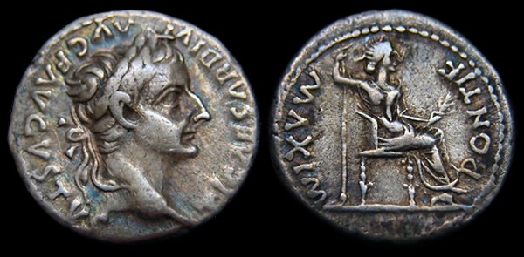
TI. CAESAR DIVI AVG.F.AVUSTUS
Tiberius Caesar, son of the Divine August
Notes:
Other side: feminine image, perhaps Empress Livia personafied as the goddess Roma: PONTIF. MAXIM
Not exact match to above
Jewish people expected to avoid images, Josephus, but they had to use this coin
Poll tax: one per person, including women
Property tax 1%

Slide 22
^{Josephus Wars ii.16.4} The right of coinage implies the authority of levying taxes, and indeed constitutes such evidence of de facto government as to make it a duty absolutely to submit to it.
Notes:
Edersheim Life and Times ii 385

Slide 23
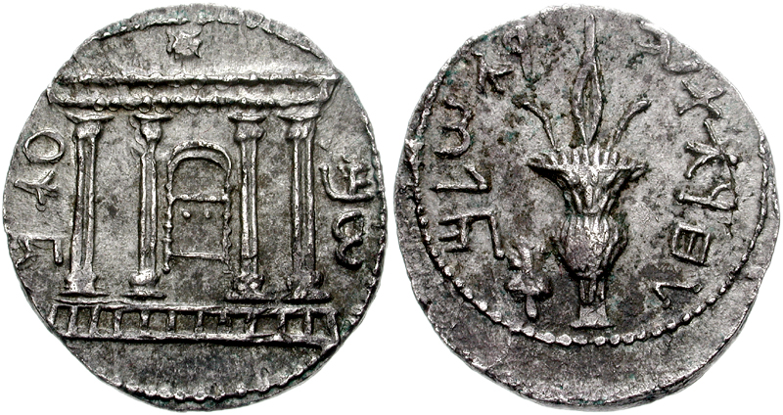
Bar Kochba silver Shekel/tetradrachm
Revolt coins, 132-135 CE
Notes:
Obverse: the Jewish Temple facade with the rising star, surrounded by "Shimon".
Reverse: A lulav, the text reads: "to the freedom of Jerusalem".

Slide 24
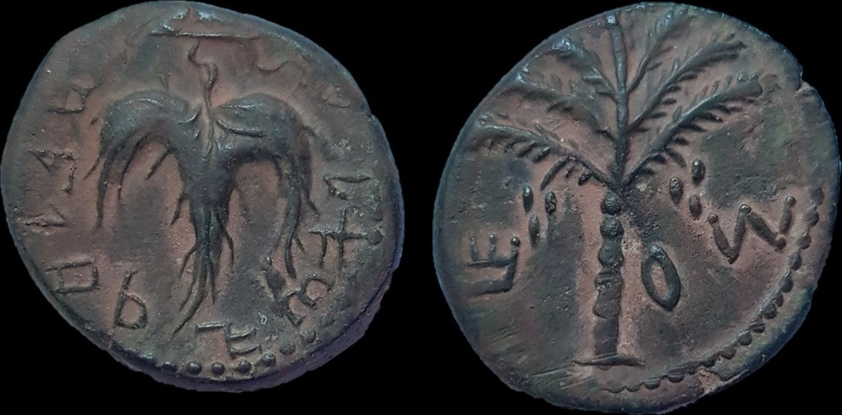
Bar Kochba Revolt coins, 132-135 CE
Bronze Obverse:"Year 2 of the
Freedom of Israel", grape leaf Reverse: "Shim'", palm tree.

Slide 25
Coin of Alexander Jannaeus (103 to 76 BCE). Obv: Seleucid anchor and Greek Legend: BASILEOS ALEXANDROU "King Alexander". Rev: Eight-spoke wheel or starburst ...

Slide 26
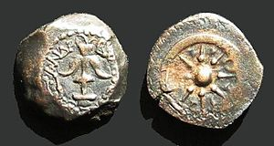
Macabbean coins
Notes:
Coin of Alexander Jannaeus (103 to 76 BCE). Obv: Seleucid anchor and Greek Legend: BASILEOS ALEXANDROU "King Alexander". Rev: Eight-spoke wheel or starburst ...

Slide 28
^{Josephus Wars ii.16.4} The right of coinage implies the authority of levying taxes, and indeed constitutes such evidence of de facto government as to make it a duty absolutely to submit to it.
Notes:
Edersheim Life and Times ii 385

Slide 29
Rav Shmu'el's Talmudic dictum ^{(N'darim 28a),} Dina dimalkuta dina —
דינא דמלכותא דינא
"The [secularl law of the [reigning Gentile) government is the Law [binding as halakhah on Jews]."

Slide 30
Mattityahu (Matthew) 22:20
שָׁאַל אוֹתָם: "שֶׁל מִי הַדְּמוּת הַזֺּאת וְהַכְּתֺבֶת?"
and he asked them, "Whose name and picture are these?"

Slide 31
Mattityahu (Matthew) 22:21
הֵשִׁיבוּ: "שֶׁל הַקֵּיסָר." אָמַר לָהֶם:
"The Emperor's," they replied.
Notes:
Pause. Hold. 1969 I was new believer. Read this the first time. Tried to stop here and imagine an answer.

Slide 32
Mattityahu (Matthew) 22:21
אָמַר לָהֶם: "אִם כֵּן, תְּנוּ לַקֵּיסָר אֶת אֲשֶׁר לַקֵּיסָר וְלֵאלֹהִים אֶת אֲשֶׁר לֵאלֹהִים."
Yeshua said to them, "Nu, give the Emperor what belongs to the Emperor. And give to God what belongs to God!"
Notes:
“Nu” is a Yiddishism meaning, “so, considering all this”

Slide 33
^{Matityahu/Mt.22.22} On hearing this, they were amazed; and they left him and went away.
Notes:
Marvelous beauty and depth…not harshly of Nationalist aspirations, nor yet plead the cause of Rome. Edersheim.
Me too: 1969, saved April 13, witness of the Spirit in Schenectady, NY. Loved the Lord, yet read the whole Old Testament/Tanakh to be sure these Gentile Christians got it right. Therefore, went to the Hasidic store on Delancey St., Manhattan, NY, and bought a Hebrew English Tanakh. About October, 69, in Matthew class or devotions, read these words first time. Tried to guess, NOT to read His response. What could He say.
Evidence of prophetic role, deity…

Slide 34
^{Yeshayahu/Is 9.5} For to us a child is born, a son will be given to us, and the government will be upon His shoulder. His Name will be called
Wonderful Counselor, Pele Yoatz פֶּלֶא יועץ
פֶּלֶא wonder, miracle ;
Notes:
This was WONDERFUL counsel

Slide 35
Mighty God
My Father of Eternity,
Prince of Peace.

Slide 36
^{Yeshayahu/Is 11.3-4} He will not judge by what His eyes see, nor decide by what His ears hear. But with righteousness He will judge the poor, and decide with fairness for the poor of the land. He will strike the land with the rod of His mouth, and with the breath of His lips He will slay the wicked.

Slide 37
Theocracy is not incosistent with submission to the secular power…they are in different domains.

Slide 38
Give the Emperor what belongs to the Emperor. And give to God what belongs to God!“
Nu, What belongs to the Emperor?
What belongs to G-d?

Slide 39
Give the Emperor what belongs to the Emperor.
^{1 Kefa/Peter 2.17} Be respectful to all — keep loving the brotherhood, fearing God and honoring the emperor.
Notes:
Honor Mr. Trump, honor Mr. Obama. Still the president or ex-president.

Slide 40
^{Ro. 13.4-7} He [the government official] is God’s servant, an avenger who inflicts punishment on the evildoer. Therefore it is necessary to be in submission—not only because of punishment but also because of conscience.

Slide 41
^{Ro. 13.4-7} For this reason you also pay taxes, for the authorities are God’s servants, attending diligently to this very thing. Pay to everyone what is due them —tribute to whom tribute is due; tax to whom tax is due; respect to whom respect is due; honor to whom honor is due.
Notes:
In the IDF, Messianic kids, young adults, known for integrity, honesty, do what told. Yes sir!
Pay what’s due, but not a penny more. Get all the deductions and exemptions that you can.
Hopefully better with new tax law. My liberal acquaintances don’t think so…

Slide 42
"Separation of church and state" is paraphrased from Thomas Jefferson and used by others in expressing an understanding of the intent and function of the Establishment Clause and Free Exercise Clause of the First
Notes:
https://en.wikipedia.org/wiki/Separation_of_church_and_state_in_the_United_States

Slide 43
Amendment to the Constitution of the United States which reads: "Congress shall make no law respecting an establishment of religion, or prohibiting the free exercise thereof...
Notes:
https://en.wikipedia.org/wiki/Separation_of_church_and_state_in_the_United_States

Slide 44
In contrast to separationism, the Supreme Court of the United States in Zorach v. Clauson upheld accommodationism, holding that the nation’s “institutions presuppose a Supreme Being"
Notes:
https://en.wikipedia.org/wiki/Separation_of_church_and_state_in_the_United_States

Slide 45
and that government recognition of God does not constitute the establishment of a state church as the Constitution's authors intended to prohibit.
Notes:
https://en.wikipedia.org/wiki/Separation_of_church_and_state_in_the_United_States

Slide 46
As such, the Court has not always interpreted the constitutional principle as absolute, and the proper extent of separation between government and religion in the U.S. remains an on going subject of impassioned debate.
Notes:
https://en.wikipedia.org/wiki/Separation_of_church_and_state_in_the_United_States
Many issues. Right now two cakemakers/bakers

Slide 47
And give to God what belongs to God!”
What belongs to God?

Slide 48
^{Mark 12.29-31} Yeshua answered, “The most important is, ‘Sh’ma Yisra’el, Adoni Eloheinu, Adoni echad [Hear, O Isra’el, the Lord our God, the Lord is one], and you are to love Adoni your God with all your heart,

Slide 49
^{Mark 12.29-31} with all your soul, with all your understanding and with all your strength.’ The second is this: ‘You are to love your neighbor as yourself.’ There is no other mitzvah greater than these.”
Notes:
Easy to get captured in the details. I love the details…

Slide 50
Facility, ministry, sound, video, teaching, music, aesthetics, childcare, food…excellence. VERY IMPORTANT!
However…
Love?
When people walk in, what do they feel the most?
“These people love G-d.”

Slide 51
^{Yeshayahu/Is 57.15} For thus says the High and Exalted One who inhabits eternity, whose Name is Holy: “I dwell in a high and holy place, yet also with a contrite and humble spirit, to revive the spirit of the humble, and revive the heart of the contrite.”
Notes:
Generally understood that the worship service leads up to message. One time I had a family in emergency, and came to service JUST in time to deliver message. MUCH harder.
But there is a sense in which the message is to open your hearts for worship. When I see people lost in worship here, raised hands, dance, and hopefully pattern for all week, I am a happy camper.

Slide 52
^{1 Tim 3.16} Now beyond question, great is the mystery of godliness:
He was revealed in the flesh, Vindicated in the Spirit, Seen by angels, Proclaimed among the nations, Trusted throughout the world, Taken up in glory.
Notes:
Heard Francis Chan yesterday, and he just majored on the fundamentals. Great outreach congregation in San Francisco. Asked about how addresses LGBTQ. Quoted Beckett Cook, who came to faith from that background. When Beckett told friends, I now know G-d, they responded, “Now you can’t have sex with men anymore.”
Beckett: I just told you, I know G-d, and you are talking to me about sex? I know G-d!! Mystery.
Cf: How did you like the service today. 1 to 10.
4 creatures before the throne…
Does it consume us. V’ahavta…

Slide 53
“These people love each other.”
Smile. “Glad as glad to see you.” 6x/sec pre-frontal cortex.
Time. When I hear people are studying, having coffee together…
Notes:
Look at someone, and smile. Now.

Slide 54
Serve with joy:
Serve and smile,
smile and serve
Powerpoint, ushers, food
Respect and honor
Guys: eyes, hands, words
Ladies: necklines, midriff, hem
Notes:
Powerpoint, ushers, food, with that smile…
Mark Hughes came immediately after message and told me he would keep his midriff covered.

Slide 55
^{Galatians 5.13-14} Brothers and sisters, you were called to freedom—only do not let your freedom become an opportunity for the flesh, but through love serve one another. For the whole Torah can be summed up in a single saying: “Love your neighbor as yourself.”
Notes:
Powerpoint, ushers, food,

Slide 56
^{1 Yn 3.1} See what love the Father has lavished on us in letting us be called God’s children! For that is what we are. The reason the world does not know us is that it has not known him.

Slide 57
Pray: Love G-d AND each other in prayer times.
Give: tithe, offerings
Trust
Notes:
We live in very scary times. Most times are, this maybe more. NK, Iran.

Slide 58
UN Votes 128-9 To Criticize USA Decision On Jerusalem: The UN General Assembly on Thurs. 21 Dec. 2017, adopted a resolution criticizing the USA decision to recognize Jerusalem as Israel's capital.

Slide 59
The nonbinding resolution was adopted with 128 nations in favor,
However…9 against, 35 abstained, and 21 countries did not vote.
65 nations were NOT among the opposers.
Notes:
Netanyahu was encouraged!!

Slide 60
Some of us remember the Cold War, and the daily threat of nuclear annihilation. Fallout shelters.
Aggressive and advancing communism. Declining West.

Slide 61
Arriving in Berlin on June 12, 1987, President and Mrs. Reagan were taken to the Reichstag, where they viewed the wall from a balcony. Reagan then made his speech at the Brandenburg Gate at 2:00 pm, in front of two panes of bulletproof glass.
Notes:
https://en.wikipedia.org/wiki/Tear_down_this_wall!

Slide 62
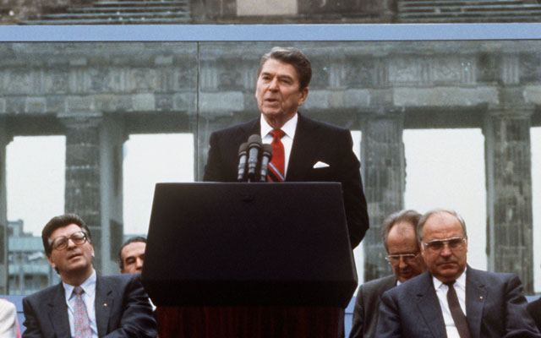

Slide 63
Reagan said, We welcome change and openness; for we believe that freedom and security go together, that the advance of human liberty can only strengthen the cause of world peace. There is one sign the Soviets can make that would be unmistakable, that would advance dramatically the cause of freedom and peace.
Notes:
https://en.wikipedia.org/wiki/Tear_down_this_wall!

Slide 64
General Secretary Gorbachev, if you seek peace, if you seek prosperity for the Soviet Union and Eastern Europe, if you seek liberalization, come here to this gate. Mr. Gorbachev, open this gate. Mr. Gorbachev, tear down this wall!
Notes:
https://en.wikipedia.org/wiki/Tear_down_this_wall!

Slide 65
On December 25, 1991, the Soviet hammer and sickle flag lowered for the last time over the Kremlin, thereafter replaced by the Russian tricolor. Earlier in the day, Mikhail Gorbachev resigned his post as president of the Soviet Union,
Notes:
https://history.state.gov/milestones/1989-1992/collapse-soviet-union

Slide 66
leaving Boris Yeltsin as president of the newly independent Russian state. People all over the world watched in amazement at this relatively peaceful transition from former Communist monolith into multiple separate nations.
Notes:
https://history.state.gov/milestones/1989-1992/collapse-soviet-union

Slide 67
Thousands protest in Iran in anti-government demonstrations
Thousands of Iranians took to the streets throughout the country on Thursday [Dec. 28, 2017] to protest against the deteriorating economic situation. Protesters were filmed shouting anti-government slogans such as “death to the dictator” and “death to Rouhani.”
Notes:
http://www.jerusalemonline.com/news/world-news/around-the-globe/protests-in-iran-death-to-the-dictator-33344?utm_source=ActiveCampaign&utm_medium=email&utm_content=NBA+lists+Palestinian+Territories+as++occupied++on+website%2C+thousands+of+Iranians+protest+against+Rouhani+and+Khamenei+and+more+news+at+JerusalemOnline&utm_campaign=EveningNewsletter+-+Recurring+2017+Dec+17

Slide 68
The demonstrators expressed their dissatisfaction with their government’s attempts to expand its influence in the Middle East and demanded that the regime stop supporting the civil war in Syria and focus on its people instead. “Forget Syria, think of us” read the protesters’ banners. “Don’t be afraid, we are all together.”
Notes:
http://www.jerusalemonline.com/news/world-news/around-the-globe/protests-in-iran-death-to-the-dictator-33344?utm_source=ActiveCampaign&utm_medium=email&utm_content=NBA+lists+Palestinian+Territories+as++occupied++on+website%2C+thousands+of+Iranians+protest+against+Rouhani+and+Khamenei+and+more+news+at+JerusalemOnline&utm_campaign=EveningNewsletter+-+Recurring+2017+Dec+17

Slide 69
Mattityahu (Matthew) 22:21
אָמַר לָהֶם: "אִם כֵּן, תְּנוּ לַקֵּיסָר אֶת אֲשֶׁר לַקֵּיסָר וְלֵאלֹהִים אֶת אֲשֶׁר לֵאלֹהִים."
Yeshua said to them, "Nu, give the Emperor what belongs to the Emperor. And give to God what belongs to God!"
Notes:
“Nu” is a Yiddishism meaning, “so, considering all this”

