Slide 1
To easily follow these notes, log on to our Wifi
Wifi: mycci01 p/w: ancientquail060
Go to OrHaOlam.com
Click on downloads, messages, 2017

Slide 2
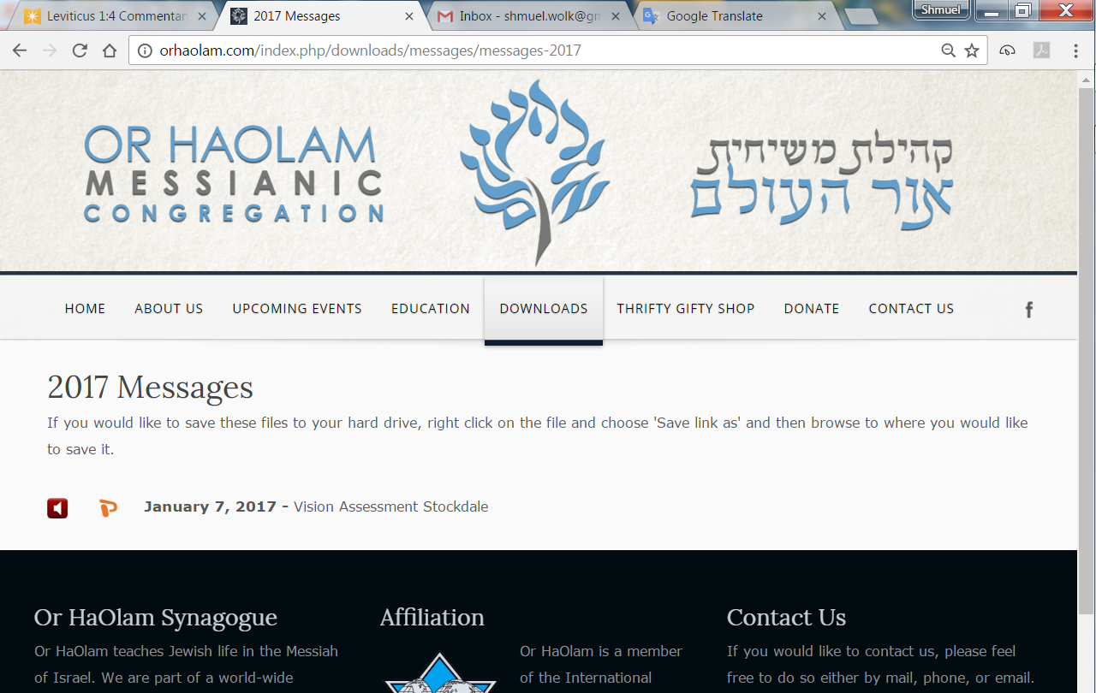

Slide 3
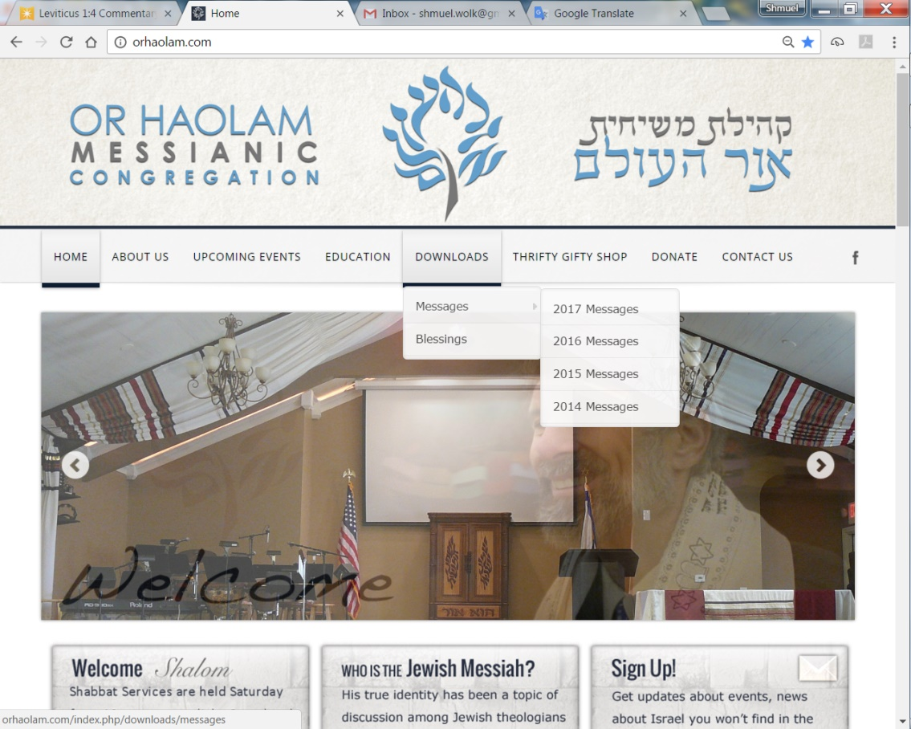
Downloads\messages\
2017 Messages

Slide 4
The other day my wife asked me to pass her lipstick to her.
I accidentally gave her a glue stick.
She still isn't talking to me.
Notes:
Matt Alford, classmate at Bible College

Slide 5
Total Solar Eclipse
Aug 21, 2017

Slide 6
Remember NEVER to look directly at the sun while any part of its bright disk is visible (not TOTALLY eclipsed). If there is ANY bright part of the sun showing, you CANNOT look at it without eye protection. When the eclipse is TOTAL, that is,

Slide 7
when ALL of it is COMPLETELY covered by the moon, you can then look at it directly without eye protection. In fact, during those few brief minutes and seconds of totality, you MUST look at it without protection to see anything at all.

Slide 8
During totality, the eclipsed sun is no brighter than the full moon, and it is an experience you simply will not believe. But please, do NOT look at the sun when ANY PART of it is still bright (not covered by the moon), or it will be the last thing you ever see.

Slide 9
Or HaOlam will get a bulk order of glasses for $2 or $3 each. How many? [Show of hands]

Slide 10
International Holocaust Cartoon Contest was a cartoon competition sponsored by the Iranian newspaper Hamshahri. On February 6, 2006, Farid Mortazavi, graphics editor of Hamshahri, announced a competition for
Notes:
https://en.wikipedia.org/wiki/International_Holocaust_Cartoon_Competition

Slide 11
cartoons on the Holocaust. The twelve best contributions were to be rewarded with a gold coin each, which were later increased to $5,000 to $12,000
Notes:
https://en.wikipedia.org/wiki/International_Holocaust_Cartoon_Competition

Slide 12
After the winners were announced in November 2006, Shojaei said the competition would become an annual event. The Associated Press quoted him as saying "Actually, we will continue until the destruction of Israel".
Notes:
https://en.wikipedia.org/wiki/International_Holocaust_Cartoon_Competition

Slide 13
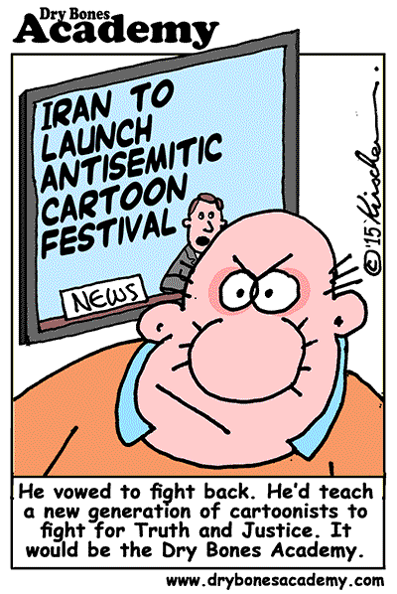

Slide 19
מַתִּתְיָהוּ Mattityahu
(Matthew) 19:3-6
Divorce: unforgivenss and anger
Notes:
Know that this is a risky subject. Many have been through the grief of divorce.

Slide 20
Flow of scripture
Mt. 18.15-20 Communicate: Go. solve offenses, problems. Ultimately adjudicate.
21-35 How long should we go, be involved with each other? When they ‘sin against you’
490x work forgiveness, healing
Notes:
Not just random stories and teachings, flow.
Before we go any further, you must understand that God operates in opposites. His plan is always the opposite of our plan. If someone does you wrong, you plan to tell him off. You go through the conversation in your mind, planning exactly what you’re going to say to him. According to God, all that planning is time and energy wasted, because His plan-the opposite of yours-is to forgive your offender, act as if it never happened and bless him. God’s law of opposites says that if you want to have authority, you must be under authority. If you want to receive, you must give. If you want to be first, you must be last. If you want to live you must die to self. Robert Morris Gateway Church, Dallas.

Slide 21
I can’t do that. Hurts too much. Can’t release it.
Forgive or face:
^{Mt. 18.34} His master turned him over to the jailers for punishment until he paid back everything he owed.
Notes:
If you live with unforgiveness, YOU will be in torment. Even if you’ve done all the steps Mt. 18 to resolve, and all failed and there is adjudication, separation, restraining order, protection, there still has to be forgiveness

Slide 22
Of all cancer patients, 61% have forgiveness issues, and of those, more than half are severe, according to research by Dr. Michael Barry, a pastor and the author of the book, The Forgiveness Project.
Notes:
http://www1.cbn.com/cbnnews/healthscience/2015/June/The-Deadly-Consequences-of-Unforgivenes

Slide 23
"Harboring these negative emotions, this anger and hatred, creates a state of chronic anxiety," he said. "Chronic anxiety very predictably produces excess adrenaline and cortisol, which deplete the production of natural killer cells
Notes:
http://www1.cbn.com/cbnnews/healthscience/2015/June/The-Deadly-Consequences-of-Unforgivenes

Slide 24
which is your body's foot soldier in the fight against cancer," he explained.
Dr. Barry said the first step in learning to forgive is to realize how much we have been forgiven by God.
Notes:
http://www1.cbn.com/cbnnews/healthscience/2015/June/The-Deadly-Consequences-of-Unforgivenes
Pause…picture who you are mad at, wounded by. Choose to forgive. Decide. Emotions not withstanding.
In the context of forgiveness…

Slide 25
Mattityahu (Matthew) 19:3
נִגְּשׁוּ אֵלָיו כַּמָּה פְּרוּשִׁים לְנַסּוֹת אוֹתוֹ וְאָמְרוּ: "הַאִם מֻתָּר לְאִישׁ לְגָרֵשׁ אֶת אִשְׁתּוֹ עַל כָּל דָּבָר?".
Some P'rushim came and tried to trap him by asking, "Is it permitted for a man to divorce his wife on any ground whatever?"

Slide 26
David Stern: The only text in the Five Books of Moses dealing with divorce is Deuteronomy 24:1-4, and its discussion of grounds is perfunctory. Hillel and Shammai, who lived in the generation before Yeshua, took opposing sides in interpreting this passage.
Notes:
They were a ruling pair. Call a Zug, Zugot plural form.

Slide 27
Notes:
https://en.wikipedia.org/wiki/Geonim

Slide 28
Notes:
https://en.wikipedia.org/wiki/Geonim
Before that the prophets, then the Great Assembly with Ezra

Slide 29
"The School of Shammai says a man may not divorce his wile unless he has found unchastity in her, as it is said, '...because he has found in her indecency in a matter.‘
עֶרְוָה nakedness, nudity ; genitalia ; (talmudic, Jewish law) forbidden sex partner
Notes:
So, adultery

Slide 30
But the School of Hillel says he may divorce her even if she burns his food, as it is said, '...because he has found in her indecency in a matter.'"(Mishna: Gittin 9:10)
Shammai closer to the Hebrew
Notes:
Burn your hallah, pancakes, roast beef, she’s out.
Same phrase, opposite interpretation!

Slide 31
Mattityahu (Matthew) 19:4
הֵשִׁיב לָהֶם וְאָמַר: "הַאִם לֹא קְרָאתֶם שֶׁהַבּוֹרֵא 'עָשָׂה אוֹתָם זָכָר וּנְקֵבָה' מִבְּרֵאשִׁית
He replied, "Haven't you read that at the beginning the Creator made them male and female,

Slide 32
Mattityahu (Matthew) 19:5
וְגַם אָמַר, 'עַל-כֵּן יַעֲזָב-אִישׁ אֶת-אָבִיו וְאֶת-אִמּוֹ וְדָבַק בְּאִשְׁתּוֹ וְהָיוּ לְבָשָׂר אֶחָד'?
and that he said, 'For this reason a man should leave his father and mother and be united with his wife, and the two are to become one flesh'?

Slide 33
Mattityahu (Matthew) 19:6
אֵין הֵם עוֹד שְׁנַיִם אֶלָּא בָּשָׂר אֶחָד. לָכֵן מַה שֶּׁחִבֵּר הָאֱלֹהִים אַל יַפְרִיד הָאָדָם."
Thus they are no longer two, but one. So then, no one should split apart what God has joined together."
Notes:
Unity of spirit, soul, body.

Slide 34
Mattityahu (Matthew) 19:7
They said to him, "Then why did Moshe give the commandment that a man should hand his wife a get and divorce her?"

Slide 35
Mattityahu (Matthew) 19:8
He answered, "Moshe allowed you to divorce your wives because your hearts are so hardened. But this is not how it was at the beginning.

Slide 36
Mattityahu (Matthew) 19:9
Now what I say to you is that whoever divorces his wife, except on the ground of sexual immorality, and marries another woman commits adultery!"

Slide 37
Yeshua in v. 9 agrees with the strict-constructionist Beit-Shammai.
, '...because he has found in her indecency in a matter.‘
עֶרְוָה nakedness, nudity ; genitalia ; (talmudic, Jewish law) forbidden sex partner

Slide 38
Beit-Hillel's lenient position became the halakhic norm. Nevertheless, Rabbi El'azar, a member of Beit-Hillel, commented in the Gemara to this mishna

Slide 39
"When a man divorces his first wife, even the altar sheds tears," ^{(Gittin 90b).} There is a Jewish tradition that in Messianic times the stricter rulings of Beit-Shammai will become the standard.
Notes:
Messianic times…

Slide 40
Mattityahu (Matthew) 19:8
He answered, "Moshe allowed you to divorce your wives because your hearts are so hardened. But this is not how it was at the beginning.
Notes:
Now we tie into the 490x forgiveness. Restoration to Gan Eden in our hearts and spirits.
However, there is a caveat…

Slide 41
^{Yermiyahu/Jer.31.33} "For this is the covenant I will make with the house of Isra'el after those days," says ADONI: "I will put my Torah within them and write it on their hearts; I will be their God, and they will be my people.
Notes:
I have ongoing discussions with fervent Jewish people who talk about living righteous enough to bring the Messiah. I tell them that the Messiah MAKES us righteous. But are we really living up to it??
A little aside before I go into an area of dealing with painful relations…

Slide 42
Integrity of Spirit, Soul, Body:
^{1 Cor. 3.16-17} You people are God’s temple and that God’s Spirit lives in you. So if anyone destroys God’s temple, God will destroy him. For God’s temple is holy, and you yourselves are that temple
Notes:
So, if someone is abusing you bodily, protect, intervene, get out. Forgive. Don’t have to stay and be abused.
490x? Intervene, but from safety. Your temple is holy, not to be abused.
So, if someone is abusing you emotionally, protect, intevene, get out. Forgive. You are holy. Don’t have to stay and be abused.
490x? Intervene, but from safety.
So, what are some of the issues that can break up a marriage, lead to divorce? Today’s parasha…

Slide 43
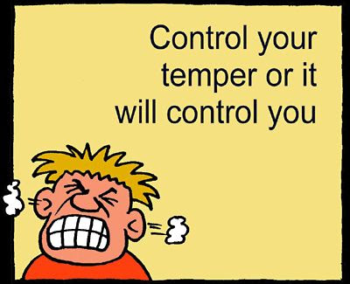

Slide 44
וַיָּרֶם מֹשֶׁה אֶת יָדוֹ וַיַּךְ אֶת הַסֶּלַע בְּמַטֵּהוּ פַּעֲמָיִם, וַיֵּצְאוּ מַיִם רַבִּים וַתֵּשְׁתְּ הָעֵדָה וּבְעִירָם
"Moshe lifted up his hand and hit the rock with his staff twice; much water came forth and the congregation and their cattle drank." ^{(Numbers 20:11)}
Notes:
Note TWICE

Slide 45
Actually, because Moshe hit the rock and did not speak to it, he received a harsh punishment and did not enter the Land of Israel.

Slide 46
It is told that Rabbi Yisrael of Ruzhin once saw his son get angry at someone, and then became angry again.
The father said to the son: We see that Moshe our Teacher

Slide 47
who hit the rock twice received a harsh punishment and did not enter the Land of Israel.
From this we learn that if a person gets angry once, this can happen and it is natural.

Slide 48
But, if he gets angry twice in a row – it is a sign that he is hot-tempered - כַּעֲסָן, and that is a very bad characteristic!

Slide 50
1. In advance, realize: “venting” only makes things worse! Most of us have bought into the idea that letting a little steam out of the kettle now prevents it from exploding later, right?
Notes:
http://shaunti.com/2017/06/4-tricks-control-temper-want-explode/

Slide 51
And taking a few minutes to vent to or about your spouse, child or boss just feels quite satisfying when we have steam pouring out of our ears. The problem is, it turns out, it hurts instead of helping.
Notes:
http://shaunti.com/2017/06/4-tricks-control-temper-want-explode/

Slide 52
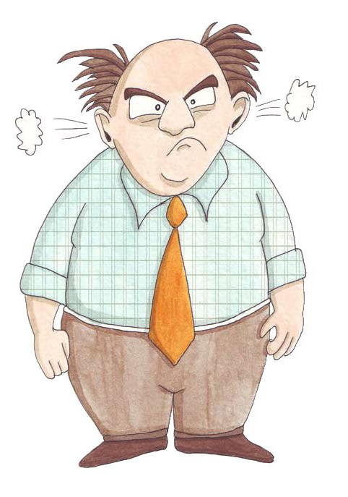

Slide 53
Neuroscientists such as Dr. Brad Bushman at Ohio State have discovered that actually expressing the anger we feel further activates an interconnected anger system in the brain and makes the kettle boil that much more.
Notes:
http://shaunti.com/2017/06/4-tricks-control-temper-want-explode/ Brad J. Bushman
Iowa State University
Catharsis theory predicts that rumination works best, but empirical evidence is lacking. In this study, angered participants hit a punching bag and thought about the person who had angered them (rumination group) or thought about becoming physically fit (distraction group). After hitting the punching bag, they reported how angry they felt. Next, they were given the chance to administer loud blasts of noise to the person who had angered them. There also was a no punching bag control group. People in the rumination group felt angrier than did people in the distraction or control groups. People in the rumination group were also most aggressive, followed respectively by people in the distraction and control groups. Rumination increased rather than decreased anger and aggression. Doing nothing at all was more effective than venting anger. These results directly contradict catharsis theory.

Slide 54
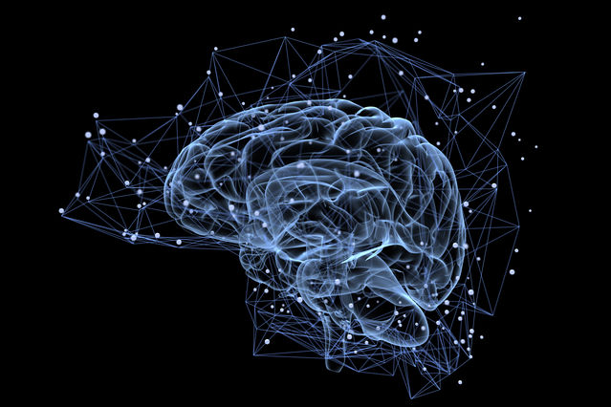
Notes:
https://www.psychologytoday.com/blog/depression-management-techniques/201604/rumination-problem-in-anxiety-and-depression

Slide 55
So while we can certainly express anger any time we want to, the question is whether we should if we want to keep her temper in check and preserve a relationship, a job, or our sanity.
Notes:
http://shaunti.com/2017/06/4-tricks-control-temper-want-explode/

Slide 56
2. Instead of “letting off steam,” remove yourself from the heat. When we decide to be calm, it is the equivalent of smothering the anger and denying it oxygen to burn.
Notes:
http://shaunti.com/2017/06/4-tricks-control-temper-want-explode/

Slide 57
And when we remove or distract ourselves from whatever is making us furious, we find our anger cooling off until, in many cases, we’re simply not angry anymore.
Notes:
http://shaunti.com/2017/06/4-tricks-control-temper-want-explode/
We can’t really forgive since it leaves a debt. Say Thank You. P 16, [19], 20, 24, 32, 33 Black Mercedes story p41

Slide 58
Messiah wants us to receive joy and love from Him as we praise Him.
He wants us to be GIVERS, relationally, emotionally, physically, financially.

Slide 60
^{Mes Jews 13.5} Through him, therefore, let us offer God a sacrifice of praise continually. For this is the natural product of lips that acknowledge his name. But don’t forget doing good and sharing with others, for with such sacrifices God is well pleased.

Slide 61
^{Mes Jews 13.20-21} The God of shalom brought up from the dead the great Shepherd of the sheep, our Lord Yeshua, by the blood of an eternal covenant. May that God equip you with every good thing you need to do his will; and may he do in us whatever pleases him, through Yeshua the Messiah. To him be the glory forever and ever. Amen.

