Slide 1
Middle East news for openers…

Slide 2
The Islamic Republic is gearing up for the first ever International Hourglass Festival, a gala event celebrating the imminent demise of the State of Israel.
Notes:
http://www.israeltoday.co.il/NewsItem/tabid/178/nid/33481/Default.aspx

Slide 3
Iran Front Page reported that the event's marketing information features an hourglass and a disintegrating Star of David above the words "25 Years," a reference to predictions by Iran's top leadership that Israel would cease to exist within the next quarter century.
Notes:
http://www.israeltoday.co.il/NewsItem/tabid/178/nid/33481/Default.aspx

Slide 4
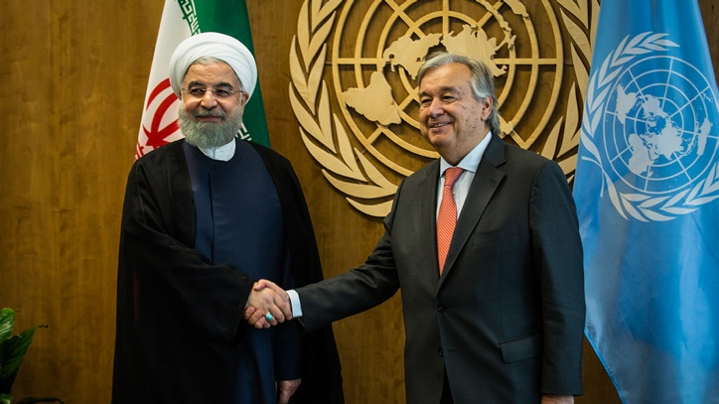
The United Nations continue to insist that the
Iranian regime is becoming more "moderate."
(Amir Levy/Flash90)
Notes:
http://www.israeltoday.co.il/NewsItem/tabid/178/nid/33481/Default.aspx
António Guterres Secretary-General of the United Nations with Hassan Rouhani

Slide 5
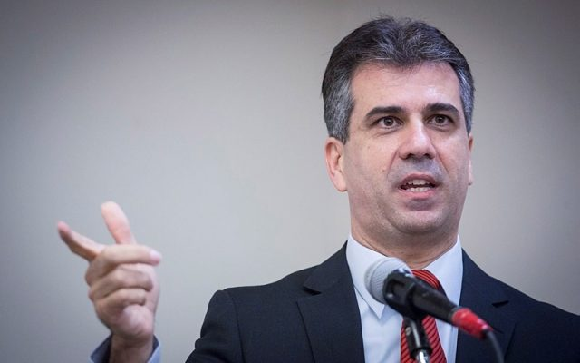
Isr Minister of Economy
and Industry Eli Cohen
(Hadas Parush/Flash90)

Slide 6
“30 countries got phone calls from Israel in 2017, in which Israel said to them: You need to know this and that, in this and that place, pay attention, there’s going to be an attack,” Minister Cohen revealed.
Thirty worldwide terrorist plots foiled by Israel
Notes:
https://worldisraelnews.com/israeli-minister-israels-intelligence-helped-30-countries-thwart-terror-attacks-2017/?utm_source=MadMimi&utm_medium=email&utm_content=Billionaire+Buffett+a+%27Big+Believer%27+in+Israel%3B+Palestinians%3A+Israel+%27One+Big+Settlement%27%3B+Israel+Helped+30+Nations+Foil+Terror+Attacks+in+2017&utm_campaign=20180227_m144263370_Billionaire+Buffett+a+%27Big+Believer%27+in+Israel%3B+Palestinians%3A+Israel+%27One+Big+Settlement%27%3B+Israel+Helped+30+Nations+Foil+Terror+Attacks+in+2017&utm_term=more_btn_light_png

Slide 7
If you saw our livestream YouTube last week, it still wasn’t quite HD video and audio.
Working on it! New internet provider, new equipment. Steve Kline invested hours of study and work!!

Slide 8
To easily follow these notes,
Go to OrHaOlam.com
WITHOUT WIFI
Click on downloads, messages, 2018 messages
“Mtt. 23.13-15. Exemplary”

Slide 9
Notes:
https://youtu.be/Lb5EozgOs2g
Also
https://www.facebook.com/marchoflife/videos/1744828825812790/

Slide 10
Be a part of history and prophecy! 70 years after the founding of the State is the year of Release!
Just go to OrHaOlam.com
Speaking of streaming…
Notes:
Some insights from Ted Alongi

Slide 11
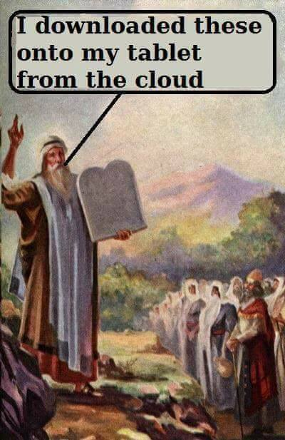
Notes:
Courtesy of David Lloyd, and Lori Wilson

Slide 13
מַתִּתְיָהוּ Mattityahu
(Matthew) 23:13,15
Notes:
Continuing in Yeshua’s last discourse to Israel.

Slide 14
Mattityahu (Matthew) 23:13a
אוֹי לָכֶם סוֹפְרִים וּפְרוּשִׁים צְבוּעִים
But woe to you hypocritical Torah-teachers and P’rushim!
Notes:
Note that Yeshua says “YOU hypocritical…” not “THE hypocritical…” So, He’s not condemning the whole group of Sofrim/Scribes and P’rushim [proto-Rabbis], but rather certain of them.
Woe is not correct…

Slide 15
More of a Semitic sense of lamentation than the Greek sense of a threat. Oy cp Woe
^{Yeshahu/Is 5.20} הוֹי הָאֹמְרִים לָרַע טוֹב, וְלַטּוֹב רָע:
Oy to those who call evil good and good evil,
הוֹי literary) Woe! Alas!)
אוֹי oh, ah, wow, oh my, ouch
Notes:
Common term to the prophets of Israel. An “in family discussion.”

Slide 16
^{Yeshahu/Is 5.21-23} Oy to those who are wise in their own eyes, and clever in their own sight! Oy to those who are heroes at drinking wine, and valiant at mixing drinks, who justify the wicked for a bribe, and deprive the innocent of justice!
Notes:
Yeshua is grieving with our people in their failures and sins.

Slide 17
Mattityahu (Matthew) 23:13a
כִּי סוֹגְרִים אַתֶּם אֶת מַלְכוּת הַשָּׁמַיִם בִּפְנֵי בְּנֵי אָדָם
For you are shutting the Kingdom of Heaven in people’s faces,

Slide 18
Mattityahu (Matthew) 23:13b
הֵן אַתֶּם אֵינְכֶם נִכְנָסִים לְתוֹכָהּ וְגַם לַבָּאִים אֵינְכֶם מַנִּיחִים לְהִכָּנֵס.
neither entering yourselves nor allowing those who wish to enter to do so.

Slide 19
How can it be that the P’rushim, scrupulous, observant, knowledgeable of Torah, could receive this OY from Messiah the King?
Notes:
Similar in Shaul/Paul’s evaluation…

Slide 20
^{Romans 2.23-24} You who take such pride in Torah, do you, by disobeying the Torah, dishonor God? — as it says in the Tanakh, “For it is because of you that God’s name is blasphemed by the Goyim.
Notes:
They took pride in Torah, yet dishonored G-d. !!
Similar in ancient Israel…

Slide 21
^{Yeshahu/Is 52.5} “Now therefore, what do I have here?” it is a declaration of Adoni — “My people are taken away for nothing? Its rulers wail” — it is Adoni’s declaration — “and My Name is continually blasphemed all day long.
Notes:
That is, taken away NOT כי military defeat.
Name is blasphemed by bad behavior…NOT mispronunciation.

Slide 22
^{Yeshahu/Is 22.22} I will set the key of the house of David upon his shoulder—what he opens, no one can shut; what he shuts, and no one can open.
Notes:
That is, Israel in Yeshayahu/Isaih’s day were the gatekeepers of the kingdom. If they failed, no one else could enter. Bad example → bad fruitfulness. World suffers.
So it was in Yeshua’s day, and ours.

Slide 23
^{Yekhezkael/Ezek 36.19-21} I scattered them among the nations and dispersed them throughout the countries; I judged them in keeping with their manner of life and actions. When they came to the nations they were going to, they profaned my holy name;
Notes:
By mispronouncing? No by living licentious, idolatrous, partying lives.

Slide 24
^{Yekhezkael/Ezek 36.19-21} so that people said of them, ‘These are Adoni’s people, who have been exiled from his land.’ But I am concerned about my holy name, which the house of Isra’el is profaning among the nations where they have gone.

Slide 25
^{Romans 2.23-24} You who take such pride in Torah, do you, by disobeying the Torah, dishonor God? — as it says in the Tanakh, “For it is because of you that God’s name is blasphemed by the Goyim.
Notes:
As expressed by Mahatma Gandhi…

Slide 26
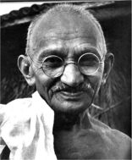
“I like your Christ, I do not like your
Christians.
Your Christians
are so unlike
your Christ.”
Mahatma Gandhi
Notes:
Illustration from the world of aviation

Slide 27
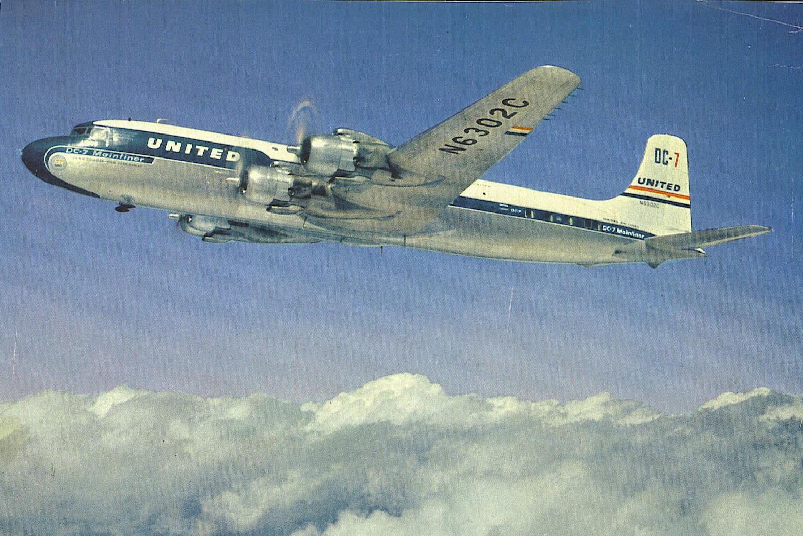
A United Airlines
Douglas DC-7
Notes:
departed Los Angeles International Airport at 9:04 am PST June 30, 1956, with 53 passengers and five crew members aboard bound for Chicago's Midway Airport.
https://en.wikipedia.org/wiki/1956_Grand_Canyon_mid-air_collision

Slide 28
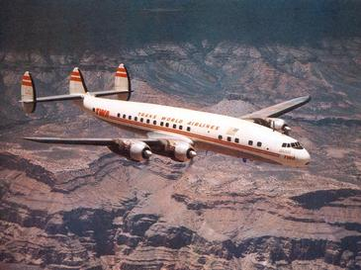
A Trans World Airlines Lockheed
L-1049 Super Constellation
Notes:
Also departed Los Angeles at 9:01 am PST June 30, 1956, with 64 passengers and six crew members and headed to Kansas City Downtown Airport
https://en.wikipedia.org/wiki/1956_Grand_Canyon_mid-air_collision

Slide 29
At about 10:30 AM the flight paths of the two aircraft intersected over the Grand Canyon, and they collided at a closing angle of about 25 degrees. The United DC-7 was banked to the right and pitched down at the time of the collision, suggesting that one or possibly both of the United pilots saw the TWA Constellation seconds before impact.
Notes:
https://en.wikipedia.org/wiki/1956_Grand_Canyon_mid-air_collision

Slide 30
The DC-7's upraised left wing clipped the top of the Constellation’s vertical stabilizer and struck the fuselage causingtail assembly to break away from the rest of the airframe.
Notes:
https://en.wikipedia.org/wiki/1956_Grand_Canyon_mid-air_collision

Slide 31
At the same time, the propeller on the DC-7's left outboard, or number one engine, chopped a series of gashes into the bottom of the Constellation's fuselage.
Artist’s rendering…
Notes:
https://en.wikipedia.org/wiki/1956_Grand_Canyon_mid-air_collision

Slide 32
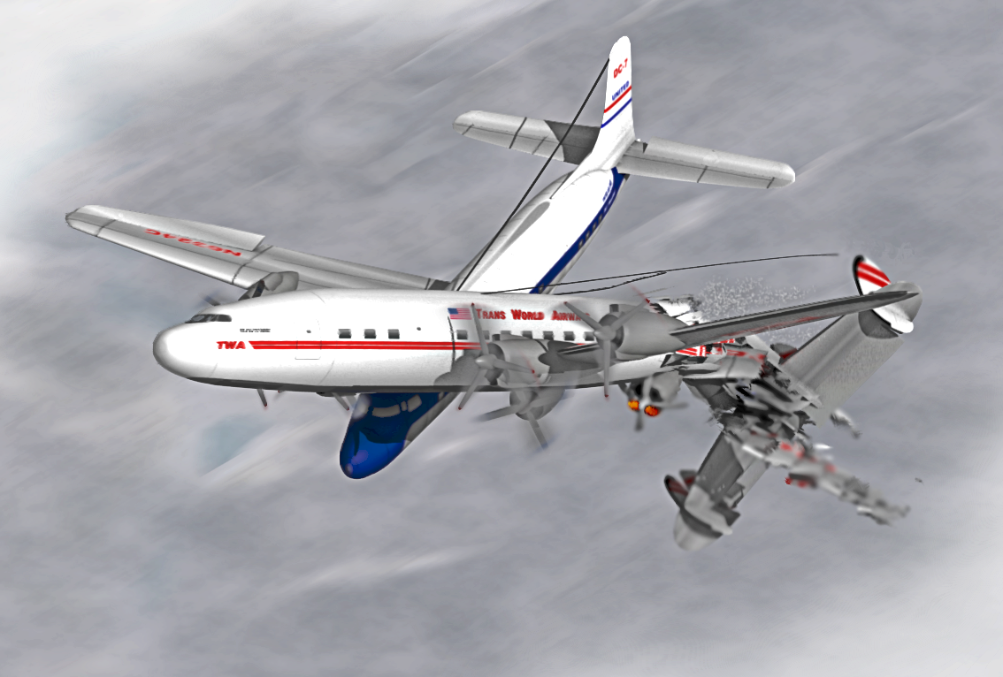
1956 Grand Canyon mid-air collision
Notes:
https://en.wikipedia.org/wiki/1956_Grand_Canyon_mid-air_collision

Slide 33
The Board determines that the probable cause of this mid-air collision was that the pilots did not see each other in time to avoid the collision. It is not possible to determine why the pilots did not see each other, but the evidence suggests that it resulted from any one or a combination of the following factors
Notes:
https://en.wikipedia.org/wiki/1956_Grand_Canyon_mid-air_collision

Slide 34
Intervening clouds reducing time for visual separation, visual limitations due to cockpit visibility, and preoccupation with normal cockpit duties, preoccupation with matters unrelated to cockpit duties
Notes:
https://en.wikipedia.org/wiki/1956_Grand_Canyon_mid-air_collision

Slide 35
such as attempting to provide the passengers with a more scenic view of the Grand Canyon area, physiological limits to human vision reducing the time opportunity to see and avoid the other aircraft
Notes:
https://en.wikipedia.org/wiki/1956_Grand_Canyon_mid-air_collision

Slide 36
Milford "Mel" Hunter, a scientific and technical illustrator with LIFE Magazine wrote:
I was able to plot the two intersecting flight paths, and the fact that both planes were in each other's blind spot.
Notes:
https://en.wikipedia.org/wiki/1956_Grand_Canyon_mid-air_collision

Slide 37
I remember showing that the descending aircraft's propellers chewed a series of gashes along the fuselage top of the ascending aircraft.
Notes:
https://en.wikipedia.org/wiki/1956_Grand_Canyon_mid-air_collision
Doesn’t exactly match the artist’s rendering.

Slide 38
1956 Grand Canyon mid-air collision
Notes:
https://en.wikipedia.org/wiki/1956_Grand_Canyon_mid-air_collision

Slide 39
You can be wrong being right.
The pilots thought they were right, and mostly were right.
P’rushim thought they were doing right, and for the most part were, but missed Messiah.

Slide 40
Notes:
Family Foundations https://www.amazon.com/You-Dont-Have-Wrong-Repent-ebook/dp/B005ERPBG2

Slide 41
Or HaOlam has hosted 4 or 5 Craig Hill Seminars
His 4 year old son’s hamburger story: devalued
Bill and Sue and weekend vacation
Joe and Cathy spiritual growth.

Slide 42
^{Mtt 18.4} Whoever then shall humble himself like this child, this one is the greatest in the kingdom of heaven.

Slide 43
^{Mtt 20.26-28} Whoever among you wants to be a leader must become your servant, and whoever wants to be first must be your slave! For the Son of Man did not come to be served, but to serve — and to give his life as a ransom for many.”

Slide 44
The first one in a conflict to see where they are wrong is the Messiah-like one. The winner.

Slide 45
Dr. Larry Crabb, The Marriage Builder, two basic longings.
Security
Significance
These cannot be gotten, only given.
Notes:
Usually, the wife wants security, reassurance that she’s love. Worthy of pursuit, in John Eldredge terminology. Figure out her needs without her telling you!!
Usually, the guy wants significance, honor.
Craig Hill summary:

Slide 46
Ask Adoni to help you discern where you’ve hurt x.
If you have been hurt, ask Yeshua for grace to forgive. Release.
Ask the Ruakh, “How have I cursed my friend’s identity?”
Notes:
P 18 You Don’t have to be wrong to repent.

Slide 47
Verify with your friend his/her feelings.
LISTEN. Affirm.
Repent. Apologize.
If it’s time and temperature, ask for forgiveness.
Bless your friend.
Notes:
P 18 You Don’t have to be wrong to repent.

Slide 48
You can be wrong being right.
The pilots thought they were right, and mostly were right.
P’rushim thought they were doing right, and for the most part were, but missed Messiah.
Another approach to this…

Slide 49
Notes:
https://www.jointhekindnesschallenge.com/book

Slide 50
Guess what? We are not as kind as we think we are! Yet kindness will change any relationship – and our culture.
Blindspots: Being wrong while mostly right.
Notes:
https://www.jointhekindnesschallenge.com/book

Slide 51
​Learn the ways you are negative without realizing it, how targeted kindness will transform your life (your marriage, parenting, sex life, business, in-law dynamics, etc.), and how to be kind when you really don’t feel like it.
Notes:
Nix the negatives
P. 63-4, 72, 73

Slide 52
30 Day Kindness Challenge
Say NOTHING negative to or about the person.
Say something positive to and about the person.
Do some blessing for the person.
Notes:
Returning to Matithayahu…

Slide 53
[Stern and others] The manuscripts which add v. 14 probably borrowed from Mk 12:40 or Lk 20:47.
Woe to you, Torah scholars and Pharisees, hypocrites! For you devour widows’ houses, while praying at length as a show. Therefore you will receive greater condemnation.

Slide 54
Mattityahu (Matthew) 23:15a
אוֹי לָכֶם סוֹפְרִים וּפְרוּשִׁים צְבוּעִים, כִּי סוֹבְבִים אַתֶּם בַּיָּם וּבַיַּבָּשָׁה כְּדֵי לְגַיֵּר אִישׁ אֶחָד,
“Woe to you hypocritical Torah-teachers and P’rushim! You go about over land and sea to make one proselyte;
Notes:
Stern: Modern Judaism does not consider itself a missionary religion, and already by the time the Talmud was written Jews had become cautious about receiving converts (see Yevamot 47a). But in the second century B.C.E. the Idumeans were forcibly converted to Judaism, and apparently in Yeshua's time there was still active proselytizing by the Jewish community.

Slide 55
Mattityahu (Matthew) 23:15
וְכַאֲשֶׁר יִתְגַּיֵּר אַתֶּם עוֹשִׂים אוֹתוֹ לְבֶן גֵּיהִנּוֹם כִּפְלַיִם מִכֶּם.
and when you succeed, you make him twice as fit for Gei-Himnon as you are!”
Notes:
Are we wanting to lead people to religion, or to Messiah-likeness?

Slide 56
How to apply, to get rid of blind spots? Be truly exemplary?
Purim application:

Slide 57
According to certain teachings, in addition to wanting to determine which date would be best for executing his version of the "Final Solution", Haman wanted to undermine the lot that was cast on the holy day - Yom HaKiPurim.
Notes:
http://www.ulpanor.com/

Slide 58
On Yom HaKiPurim, the Kohen HaGadol כהן הגדול High Priest, cast lots on identical goats to determine which would be brought as an offering within the Temple, and which would be sent off a cliff as a scapegoat.
Notes:
http://www.ulpanor.com/

Slide 59
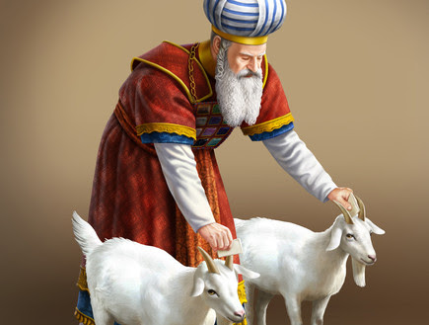
Notes:
http://www.ulpanor.com/

Slide 60
These goats were identical in height, color and even in price. The Hebrew word for goat, AIZ - עז, shares the same root as the Hebrew word for brazenness and boldness OZ עוז .
Although being very humble, Mordekhi and Esther both knew when to be bold.
Notes:
http://www.ulpanor.com/

Slide 61
Pay attention to the striking similarity in the names of Yom HaKiPurim and Purim. Our sages pointed out that the holiday of Purim is even holier than the holy day of Yom HaKiPurim. In Hebrew the preposition כ has the meaning of similarity, likeness. Thus Yom HaKiPurim means "like Purim".
Notes:
http://www.ulpanor.com/

Slide 62
^{Mes Jews/Heb. 9.12-14} [Messiah] entered the Holiest Place once and for all.And he entered not by means of the blood of goats and calves, but by means of his own blood, thus setting people free forever. For if sprinkling ceremonially unclean persons with the blood of goats and bulls
Notes:
http://www.ulpanor.com/

Slide 63
^{Mes Jews/Heb. 9.12-14} …then how much more the blood of the Messiah, who, through the eternal Spirit, offered himself to God as a sacrifice without blemish, will purify our conscience from works that lead to death, so that we can serve the living God!
Notes:
http://www.ulpanor.com/

Slide 64
^{Ester 9.26-28} These days have been called Purim, after the word pur…The Jews resolved and took upon themselves, their descendants and all who might join them that without fail they would observe these two days in accordance with what was written in [this letter]

Slide 65
^{Ester 9.26-28} and at the appointed time, every year; and that these days would be remembered and observed throughout every generation, every family, every province and every city; and that these days of Purim would never cease among the Jews or their memory be lost by their descendants.

Slide 66
Be brave…
Ask those nearest for ways you have hurt them.
Take the issues to G-d in Messiah.
Trust Him for forgiveness, grace to CHANGE.
Notes:
No more notes.

