Slide 1
e-handout
To have these notes
without taking notes
Go to OrHaOlam.com
Click on downloads,
messages, 2019
Notes:
.

Slide 2
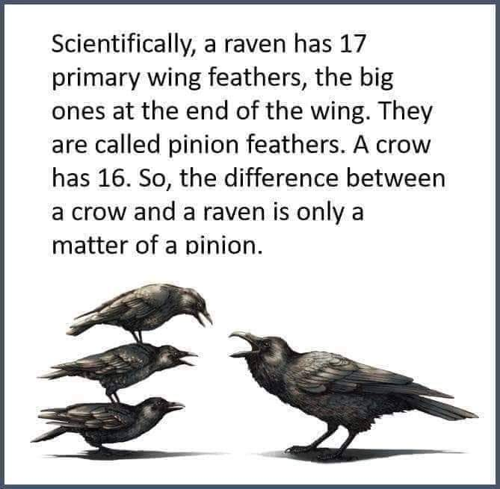

Slide 3
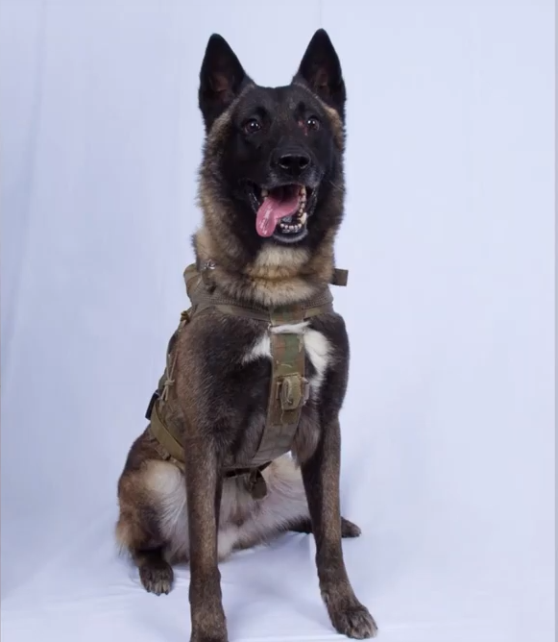
This dog chased Abu Bakr al Baghdadi into the tunnel.
Notes:
https://youtu.be/4QYN00CFIfk
a Belgian Malinois

Slide 4
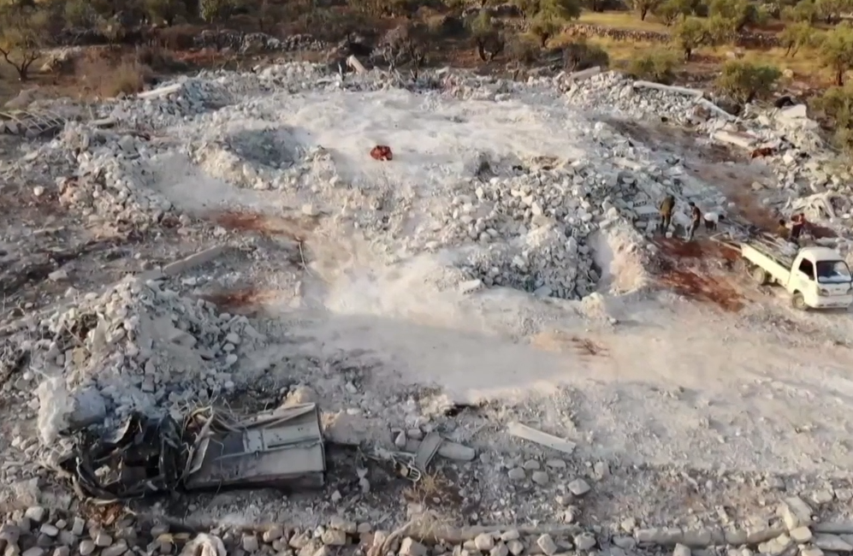
Al Baghdadi fled to a dead
end tunnel with two of his
children, and exploded his vest.

Slide 5
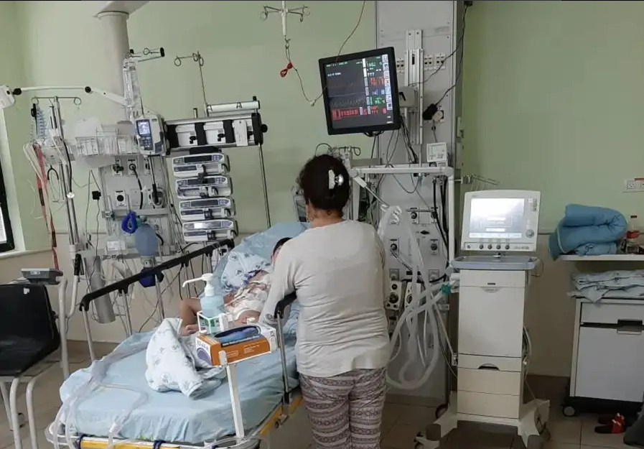
Kurdish children treated in Israel.

Slide 6
Kurdish children with pre-existing heart conditions are being welcomed and treated in Israeli hospitals. Over the past 10 months, 41 Iraqi Kurdish children and 3 from Syria have been treated. In their home cities, proper care and surgery is not available.
Notes:
https://www.chosenpeople.com/site/inside-israel-20191028/?goal=0_ee4b927060-b0b28ccbbc-114691053&mc_cid=b0b28ccbbc&mc_eid=3934978e72

Slide 7
The medical technology has been found to be 60 years behind today’s modern tools. The parents have to speak with the doctors by way of translation from Kurdish → Arabic → Hebrew. Please pray for these children’s safety and healing from war trauma. Please pray they find Messiah while they are in Israel.
Notes:
https://www.chosenpeople.com/site/inside-israel-20191028/?goal=0_ee4b927060-b0b28ccbbc-114691053&mc_cid=b0b28ccbbc&mc_eid=3934978e72

Slide 9
מַתִּתְיָהוּ Mattityahu
(Matthew) 27:57-61

Slide 10
Summary strategies to defeat us:
Opposition: Yeshua was facing.
Smallness of our forces.
Enemies to destroy us. [#1 on steroids]

Slide 11
^{Mattityahu (Matthew) 27:57} But Yeshua, again crying out in a loud voice, yielded up his spirit.
Notes:
Left off last week where Yeshua died with a shout, a loud “megaphone” shout. Touchdown, or goal, shout.
Who dies with a shout? Not typical to die with a shout!
Urged us to shout, lift up your voice in prayer. Anyone try?
Difference: He shouted from His strength as Son of G-d.
We shout IN His strength, or seeking His strength.

Slide 12
Mattityahu (Matthew) 27:57
לְעֵת עֶרֶב בָּא אִישׁ עָשִׁיר תּוֹשַׁב רָמָתַיִם, יוֹסֵף שְׁמוֹ, שֶׁגַּם הוּא נַעֲשָׂה לְתַלְמִיד שֶׁל יֵשׁוּעַ.‏
Towards evening, there came a wealthy man from Ramatayim named Yosef, who was himself a talmid of Yeshua.

Slide 13
Mattityahu (Matthew) 27:58
הוּא בָּא אֶל פִּילָטוֹס וּבִקֵּשׁ אֶת גּוּפַת יֵשׁוּעַ. אָז צִוָּה פִּילָטוֹס לִמְסֹר אוֹתָהּ.
He approached Pilate and asked for Yeshua’s body, and Pilate ordered it to be given to him.
Notes:
Most typical for executed criminals to be buried in a common grave.

Slide 14
Mattityahu (Matthew) 27:59
‏יוֹסֵף לָקַח אֶת הַגּוּפָה, עָטַף אוֹתָה בְּסָדִין נָקִי
Yosef took the body, wrapped it in a clean linen sheet,

Slide 15
Mattityahu (Matthew) 27:60
‏וְהִנִּיחַ אוֹתָהּ בְּקִבְרוֹ הֶחָדָשׁ שֶׁלּוֹ אֲשֶׁר חָצַב בַּסֶּלַע.
and laid it in his own tomb, which he had recently had cut out of the rock.

Slide 16
^{Yeshayahu/Is. 53.9} He was given a grave among the wicked; in his death he was with a rich man.
Notes:
Very unusual for a criminal burial.
Fulfilled prophecy.

Slide 17
A few miles from Manhattan there is a parallel New York. Instead of screeching subway trains and fragrant roasted nut stands, granite-and-glass museums and million-dollar skyscrapers, it’s home to shallow trenches filled with pine coffins and the occasional wooden cross.
Notes:
https://daily.jstor.org/burying-nycs-forgotten-dead-at-hart-island/

Slide 18
This is Hart Island, a 101-acre sliver of land in the waters north of Manhattan, where the tourists never go. New York City has been burying its poor and unclaimed dead here since 1869, with more than a million bodies interred within the soil.
Notes:
https://daily.jstor.org/burying-nycs-forgotten-dead-at-hart-island/

Slide 19
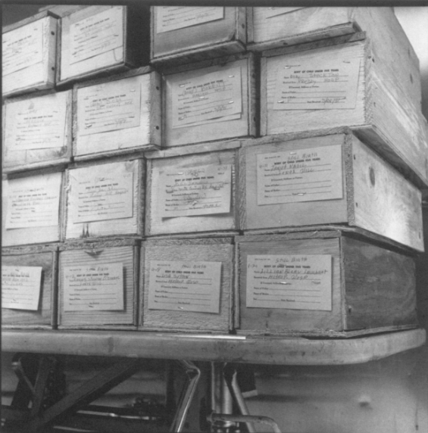

Slide 20
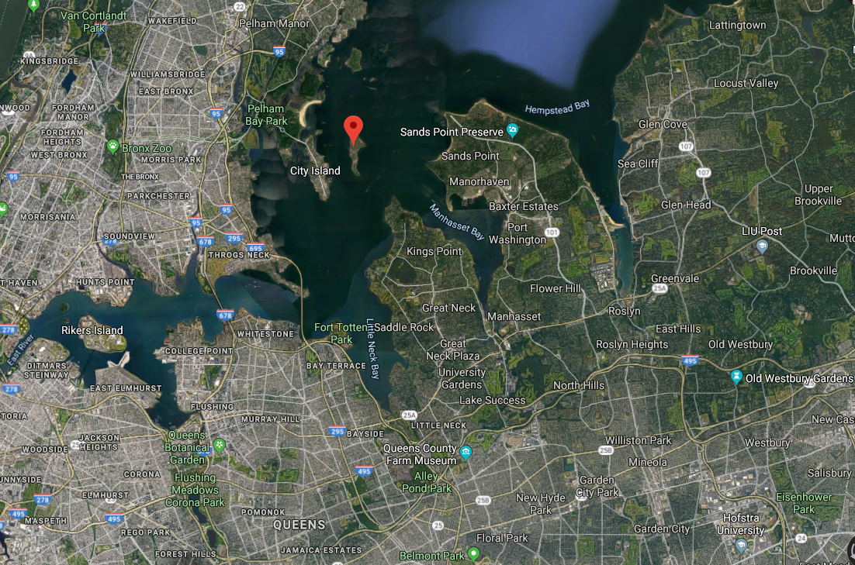
Hart Island, paupers’ cemetery
Notes:
Note Flushing Meadows Park, where the UN vote for the establishment of the State of Israel took place in Nov., 1917
Note: Westbury, where SW went to HS.

Slide 21
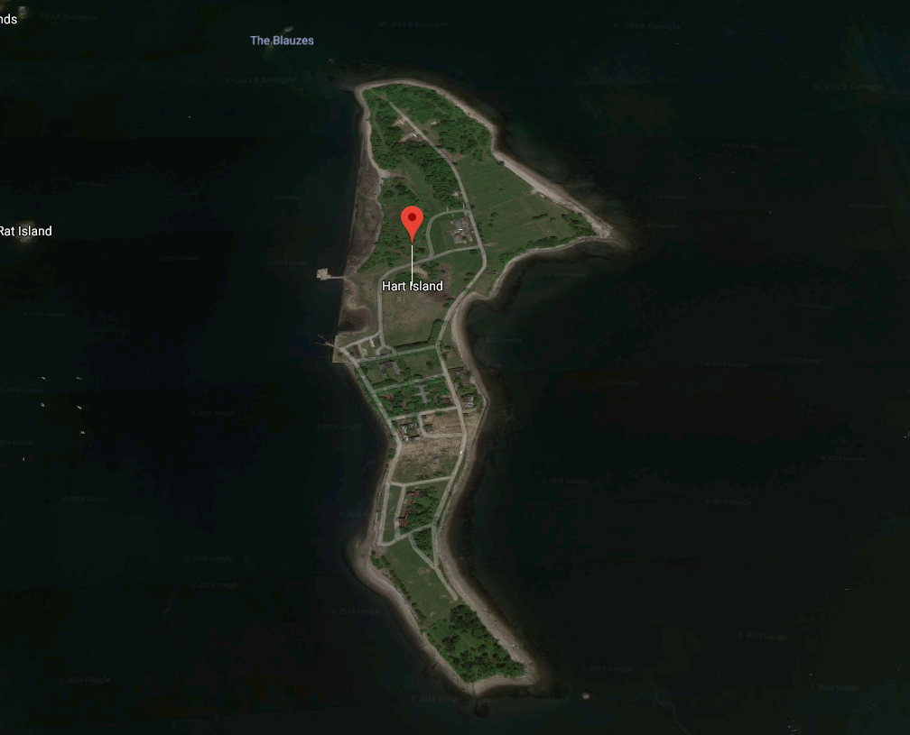
Hart Island, the land of the
unclaimed
dead.

Slide 22
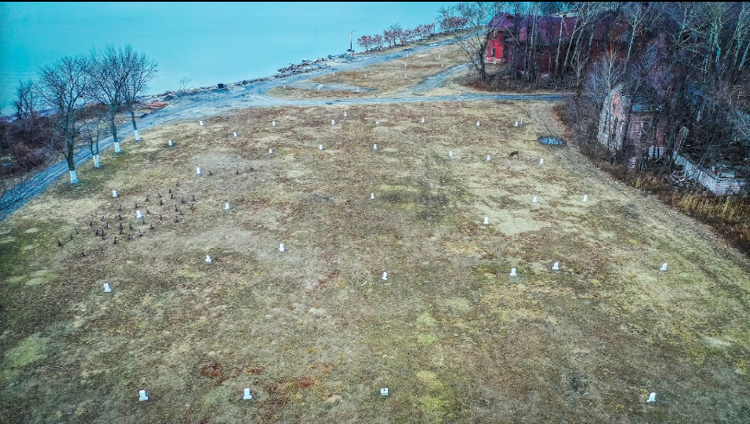
Graves on Hart Island, NYC - Dec 2018
Notes:
https://www.google.com/maps/place/Hart+Island/@40.8536269,-73.7705846,3a,75y,90t/data=!3m8!1e2!3m6!1sAF1QipMTQjW3u-j0HLArk6e8m0Ll7gw-C_IAu_pkS8FB!2e10!3e12!6shttps:%2F%2Flh5.googleusercontent.com%2Fp%2FAF1QipMTQjW3u-j0HLArk6e8m0Ll7gw-C_IAu_pkS8FB%3Dw203-h114-k-no!7i5333!8i3000!4m5!3m4!1s0x89c28c0d7b34078d:0xfea675f600d04b25!8m2!3d40.8536269!4d-73.7705846

Slide 23
Mattityahu (Matthew) 27:60
‏לְאַחַר שֶׁגָּלַל אֶבֶן גְּדוֹלָה עַל פֶּתַח הַקֶּבֶר הָלַךְ לְדַרְכּוֹ.
After rolling a large stone in front of the entrance to the tomb, he went away.
Notes:
G-d keeps His word, however improbable.

Slide 24
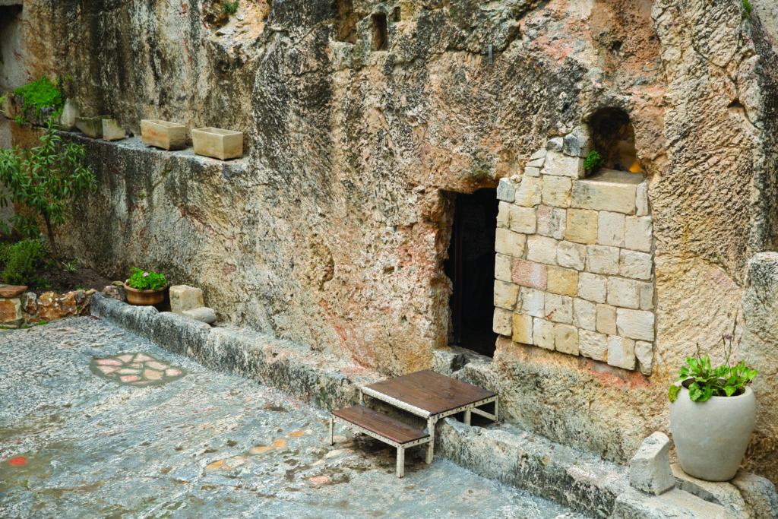
The Garden Tomb, Jerusalem
Notes:
https://www.google.com/search?safe=active&sxsrf=ACYBGNSkSihHv3XiGT5gSGIs4z7x7jJ0XQ:1572663628854&q=garden+tomb&tbm=isch&source=univ&sa=X&ved=2ahUKEwi6v8vHxMrlAhUOZKwKHWbwDBkQ7Al6BAgFEEU&biw=1280&bih=951#imgrc=5N8sLYZAm3fUxM:
Note the trench for the stone.

Slide 25
Mattityahu (Matthew) 27:61
‏וּמִרְיָם הַמַּגְדָּלִית וּמִרְיָם הָאַחֶרֶת הָיוּ שָׁם, יוֹשְׁבוֹת מוּל הַקֶּבֶר.‏
Miryam of Magdala and the other Miryam stayed there, sitting opposite the grave.

Slide 26
^{Mattityahu (Matthew) 27:61-66} Next day, after the preparation, the head Cohanim/ priests and the P’rushim/ Pharisees went together to Pilate and said, “Sir, we remember that that deceiver said while he was still alive, ‘After three days I will be raised.’.
Notes:
Amy Jill Levine: preparation is ambiguous term. Prep for Pesakh, or for Shabbat. Nevertheless, prepared day is past. Shabbat over. Saturday evening.

Slide 27
^{Mattityahu (Matthew) 27:61-66} Therefore, order that the grave be made secure till the third day; otherwise the talmidim/ disciples may come, steal him away and say to the people, ‘He was raised from the dead’; and the last deception will be worse than the first.”

Slide 28
^{Mattityahu (Matthew) 27:61-66} Pilate said to them, “You may have your guard. Go and make the grave as secure as you know how.” So they went and made the grave secure by sealing the stone and putting the guard on watch.
Notes:
This is the download line, the anointed sermon seed to me. A much resistance as you can!
Two things to clarify:
Seal: Roman seal. Soldiers will die for.
“You may have your guard.” Two possibilities.

Slide 29
Notes:
Josh McDowell, Evidence that Demands a Verdict, p 219

Slide 30
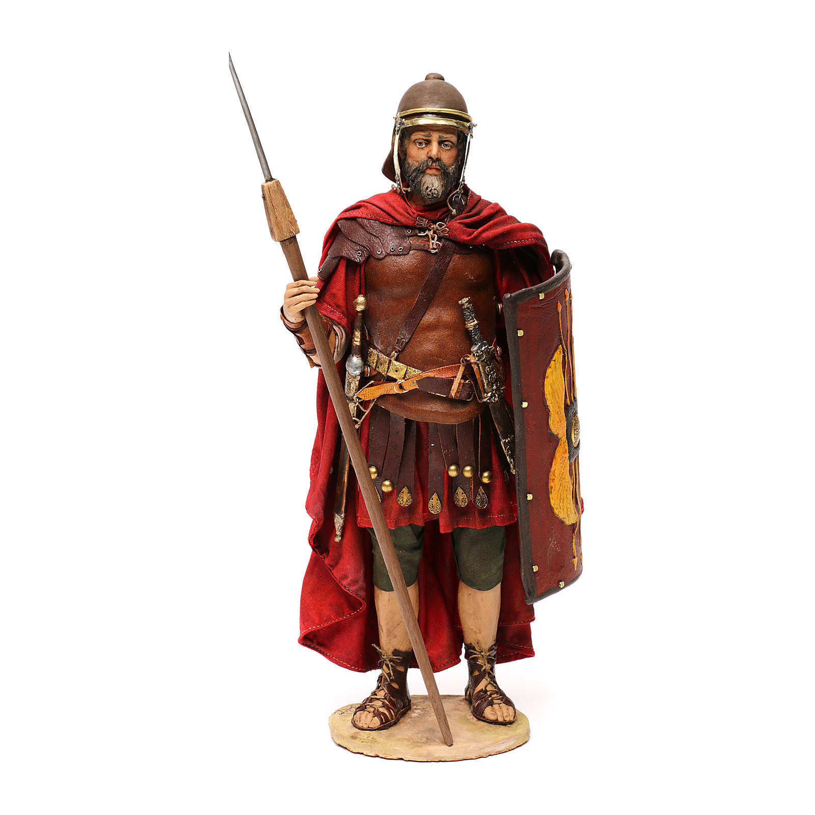
Roman soldier in full weaponry

Slide 31
^{Mattityahu (Matthew) 27:61-66} Go and make the grave as secure as you know how.”

Slide 32
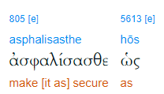
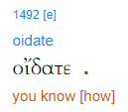

Slide 33
eídō (oida) to see with physical eyes,
perceiving ("mentally seeing"). “I see what You mean;” "I see what you are saying.“
be aware, behold, consider, perceive

Slide 34
Yeshua’s grave was made as secure as these scholars and leaders could devise to cause an apparent resurrection failure.
Do we have any opposition that is intelligently devising our failure?
Notes:
Temple guard
Roman guard
In any case, well strategized.
Some of you may remember Mad magazine: Spy vs Counterspy.

Slide 35
Notes:
https://www.google.com/url?sa=i&source=images&cd=&ved=2ahUKEwir2o2N2MrlAhVDWqwKHRjCCBEQjRx6BAgBEAQ&url=https%3A%2F%2Fwww.amazon.com%2FSpy-vs-Xbox%2Fdp%2FB0002CTTKS&psig=AOvVaw2aGdmTsbA0aGtmaadimZeK&ust=1572755161027275

Slide 36
^{Eph 6.11} Use all the armor and weaponry that God provides, so that you will be able to stand against the deceptive tactics of the Adversary. ^{CJB}
the schemes of the devil. ^{TLV}

Slide 37
^{2 Cor. 2.11} so that we will not be taken advantage of by the Adversary — for we are quite aware of his schemes!

Slide 38
Summary strategies to defeat us:
Opposition: Yeshua was facing.

Slide 39
^{Acts 26.11} Often I went from one synagogue to another, punishing them and trying to make them blaspheme; and in my wild fury against them, I even went so far as to persecute them in cities outside the country.
Notes:
There is a certain innate antagonism to the message of Yeshua by those invested in human righteousness.
Undermines our whole sense of worth, we have to die to ourselves.
Liberation if we see our own sins as bigger than our own righteousness.
Innate opposition, so ultimately it takes revelation to come to Y: sin, righteousness, judgement

Slide 40
^{Messianic Jews 3.1} Therefore, brothers whom God has set apart, who share in the call from heaven, think carefully about Yeshua, whom we acknowledge publicly as God's emissary and as cohen gadol.
take note of, perceive, consider carefully, discern, detect, make account of.

Slide 41
^{Messianic Jews /Hebrews 12.2-3} Focusing on Yeshua, the initiator and perfecter of faith. For the joy set before Him, He endured execution on a stake as a criminal, disregarding its shame.

Slide 42
^{Messianic Jews /Hebrews 12.2-3} and He has taken His seat at the right hand of the throne of God. Consider Him who has endured such hostility by sinners against Himself, so that you may not grow weary in your souls and lose heart.

Slide 43
We don’t preach/teach to instruct you as to what to do.
We are instructing you as to what the Messiah in you will empower you to do, if you walk with Him.

Slide 44
Yeshua the Messiah didn’t come to help bad people be good.
Messiah came to make dead people alive.
We want His LIFE!

Slide 45
Facing opposition
^{Lk 9.51} When the time was coming near for Yeshua to ·depart [ascend], he was determined to go to [resolutely set out for; set his face toward] Jerusalem

Slide 46
^{Lk 9.51} And it came to pass, when the time was come that he should be received up, he steadfastly set his face to go to Jerusalem.
^{Lk 9.51} As the time drew near for his return to heaven, he moved steadily onward toward Jerusalem with an iron will.

Slide 47
^{2 Tim 4. 10-11} Demas, having loved this world, has deserted me and gone to Thessolonica; Crescens has gone to Galatia, and Titus to Dalmatia. Luke is the only one with me. Get Mark and bring him with you, for he is useful to me for service.
Notes:
And Mark had previously been a ministry washout.

Slide 48
^{2 Tim 4. 16-17} At my first defense, no one stood by me; instead, they all deserted me—may it not be counted against them! But the Lord stood by me and strengthened me, so that through me the message might be proclaimed in full measure, and all the nations might hear—and I was rescued from the lion’s mouth!

Slide 49
^{Yeshayahu/Is 50.7} For Adoni Elohim will help. This is why no insult can wound me. This is why I have set my face like flint, knowing I will not be put to shame.

Slide 50
Summary strategies to defeat us:
Opposition: Yeshua was facing.
Response: Abide in Him and set your face to do right.
Smallness of our forces.
Notes:
Yeshua could have said, “They’ve all cleared out except Yokhanan/John.”

Slide 51
^{Zekh 4.8-10} Again the word of Adoni came to me saying: “The hands of Zerubbabel have laid the foundation of this House. His hands will also finish it. Then you will know that Adoni-Tzva’ot has sent me to you. For who despises the day of small things?
Notes:
Introduce a Hebrew term: Halutzim חלוצים

Slide 52
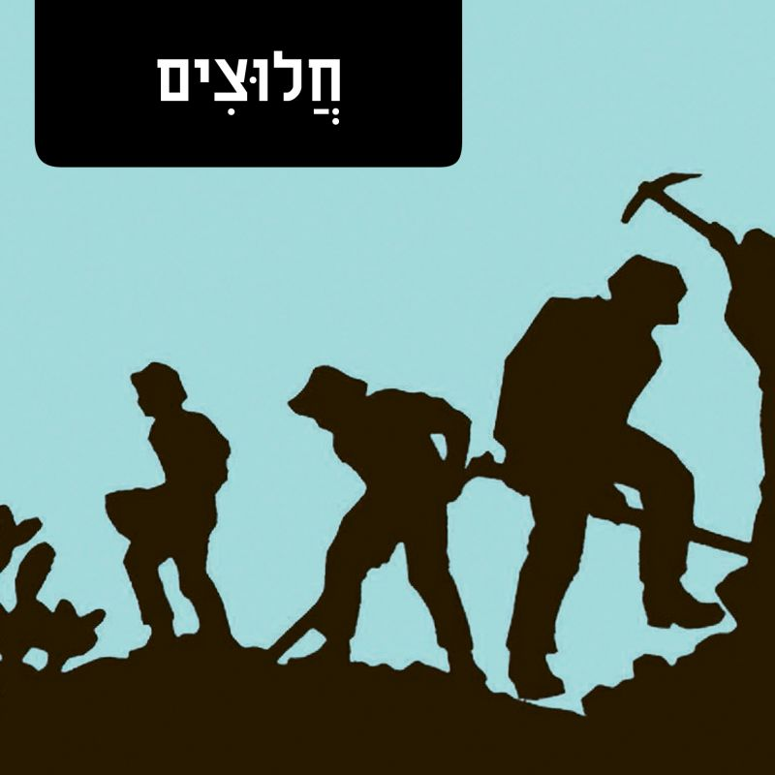
Halutzim: Before high-tech kid millionaires, the embodiment of Zionism’s pioneering spirit was Israel’s laborers.
Notes:
https://www.haaretz.com/.premium-word-of-the-day-halutzim-1.5298517

Slide 53
Brave and progressively depicted as more muscled and tanned, halutzim -- "pioneers" - is a term of reverence used to describe the Jewish migrants-turned-farmers and laborers who settled the frontiers of the expanding New Yishuv.
Notes:
https://www.haaretz.com/.premium-word-of-the-day-halutzim-1.5298517
Ghetto Jews.

Slide 54
The ideology that drove them – and the aura that surrounded them in the popular imagination – came to be known as “halutziut,” or “pioneerism.” חלוציות
The Messianic movement is not in infancy, but it’s still in pioneering mode.
Notes:
https://www.haaretz.com/.premium-word-of-the-day-halutzim-1.5298517

Slide 55
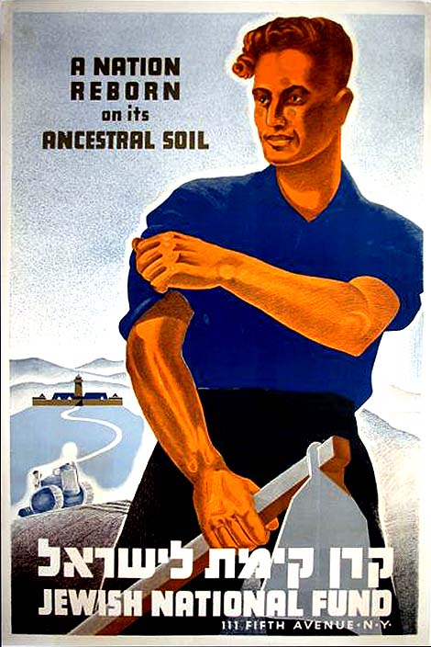
Notes:
Jewish shop keepers, accountants, re-inventing themselves as pioneers, rebuilding the Land. Label on this photo “HaAtid” the future.
https://www.haaretz.com/.premium-word-of-the-day-halutzim-1.5298517
Are you a halutz? Pioneer? If you have this calling, vision?
If so, smallness is not a discouragement, it means “future.”

Slide 56
^{Matt. 9.37-38} Then he said to his talmidim / disciples, “The harvest is rich, but the workers are few. Pray that the Lord of the harvest will send out workers to gather in his harvest.”

Slide 57
Volunteerism: too few. 80%/20%
^{1 Cor 12.4-7} Now there are various kinds of gifts, but the same Ruakh/ Spirit. There are various kinds of service, but the same Lord.

Slide 58
Volunteerism: too few. 80%/20%
^{1 Cor 12.4-7} There are various kinds of working, but the same God who works all things in all people. But to each person is given the manifestation of the Ruakh for the benefit of all.
Notes:
What are you doing here, to make the Kingdom go? It’s not about Or HaOlam, it’s about the Messianic Kingdom, Kingdom of Yeshua the Messiah.
Are you tithing here? Lots of outreach we could do…
Dawn, Blaine, Amy, Steve, Gavriel. “Windows of heaven…”

Slide 59
Summary strategies to defeat us:
Opposition: Yeshua was facing.
Response: Abide in Him and set your face to do right.
Smallness of our forces. Response: We are halutzim, pioneers.
Notes:
Yeshua could have said, “They’ve all cleared out except Yokhanan/John.”

Slide 60
Summary strategies to defeat us:
Opposition: Yeshua was facing.
Smallness of our forces.
Enemies to destroy us. [#1 on steroids]

Slide 61
As a synagogal group, we are invested in the Nation of Israel as a prophetic foundational truth.
^{Mat. 23.39} For I tell you, you will never see Me again until you say, ‘Barukh ha-ba b’shem Adonai. Blessed is He who comes in the name of the Lord!’”^{[j]}

Slide 62
Enemies: Iran, Turkey, Hezbullah, Hamas…
Allies: Kurds, Egyptians?, Saudis?...

Slide 63
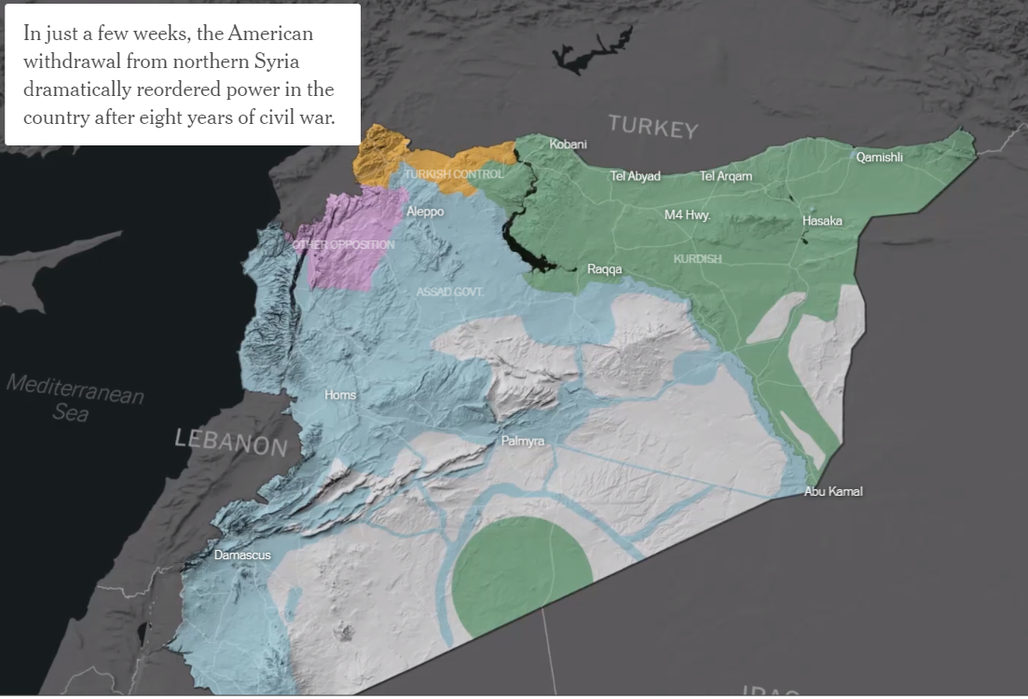
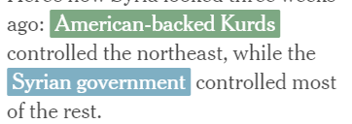
Notes:
https://www.nytimes.com/interactive/2019/10/30/world/middleeast/syria-turkey-maps.html?te=1&nl=morning-briefing&emc=edit_NN_p_20191030&section=topNews?campaign_id=9&instance_id=13470&segment_id=18354&user_id=0c340ef4a0010f69a562b70ff5e66878&regi_id=35997600tion=topNews

Slide 64
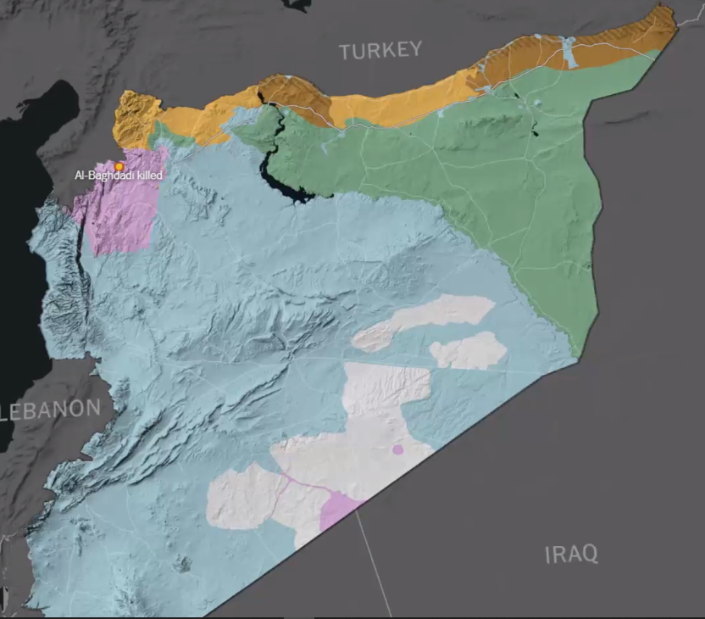
Notes:
https://www.nytimes.com/interactive/2019/10/30/world/middleeast/syria-turkey-maps.html?te=1&nl=morning-briefing&emc=edit_NN_p_20191030&section=topNews?campaign_id=9&instance_id=13470&segment_id=18354&user_id=0c340ef4a0010f69a562b70ff5e66878&regi_id=35997600tion=topNews

Slide 65
Notes:
George Whitten relates a story from the descendent of one in a WW I battle.

Slide 66
WW I era evinced a dramatic and historic change in the tactics of warfare. Battle lines were formed by trenches and widespread use of chemical weapons often determined the outcome, since chemical warfare had not yet been banned by the Geneva convention.
Notes:
https://www.worthydevotions.com/christian-devotional/simply-abide-in-him?utm_source=Worthy+Brief&utm_campaign=6946f6cec2-EMAIL_CAMPAIGN_2019_10_28_09_29&utm_medium=email&utm_term=0_d1151ee7ea-6946f6cec2-104018657

Slide 67
During one such battle, the British faced a German attack with mustard gas. The British regiment, insufficiently equipped with gas masks, was addressed by commander Lt. Colonel Ernest Vaux (our friend’s great-great grandfather). He stood up and said to his battalion,
Notes:
https://www.worthydevotions.com/christian-devotional/simply-abide-in-him?utm_source=Worthy+Brief&utm_campaign=6946f6cec2-EMAIL_CAMPAIGN_2019_10_28_09_29&utm_medium=email&utm_term=0_d1151ee7ea-6946f6cec2-104018657

Slide 68
"Friends, there is no use running… come up here and let us sing a hymn". In that dark and desperate moment, with poison filling the air and all hope evaporating, the soldiers rose out from the trenches and began to sing the powerful lyrics of "Abide with Me" in one accord.
Notes:
https://www.worthydevotions.com/christian-devotional/simply-abide-in-him?utm_source=Worthy+Brief&utm_campaign=6946f6cec2-EMAIL_CAMPAIGN_2019_10_28_09_29&utm_medium=email&utm_term=0_d1151ee7ea-6946f6cec2-104018657

Slide 69
“Abide with me, fast falls the eventide The darkness deepens Lord, with me abide When other helpers fail and comforts flee Help of the helpless, oh, abide with me.
Notes:
https://www.worthydevotions.com/christian-devotional/simply-abide-in-him?utm_source=Worthy+Brief&utm_campaign=6946f6cec2-EMAIL_CAMPAIGN_2019_10_28_09_29&utm_medium=email&utm_term=0_d1151ee7ea-6946f6cec2-104018657
Swift to its close ebbs out life's little day Earth's joys grow dim, its glories pass away Change and decay in all around I see O Thou who changest not, abide with me I fear no foe, with Thee at hand to bless Ills have no weight, and tears no bitterness Where is death's sting? Where, grave, thy victory? I triumph still, if Thou abide with me Hold Thou Thy cross before my closing eyes Shine through the gloom and point me to the skies Heaven's morning breaks, and earth's vain shadows flee In life, in death, O Lord, abide with me Abide with me, abide with me

Slide 70
As they sang, awaiting their undeniable fate, the wind suddenly began to blow the mustard gas in the other direction. Not a single one of those soldiers died that day. When the war was over Captain Wade (then Private Wade)
Notes:
https://www.worthydevotions.com/christian-devotional/simply-abide-in-him?utm_source=Worthy+Brief&utm_campaign=6946f6cec2-EMAIL_CAMPAIGN_2019_10_28_09_29&utm_medium=email&utm_term=0_d1151ee7ea-6946f6cec2-104018657
Swift to its close ebbs out life's little day Earth's joys grow dim, its glories pass away Change and decay in all around I see O Thou who changest not, abide with me I fear no foe, with Thee at hand to bless Ills have no weight, and tears no bitterness Where is death's sting? Where, grave, thy victory? I triumph still, if Thou abide with me Hold Thou Thy cross before my closing eyes Shine through the gloom and point me to the skies Heaven's morning breaks, and earth's vain shadows flee In life, in death, O Lord, abide with me Abide with me, abide with me

Slide 71
recalled the miracle of that day and made a painting of the men who rose up singing "Abide with Me." The painting entitled, "The Miracle of Ypres" features a silhouette of the Lord watching over the soldiers in that darkest hour; rescued by Him to fight again another day.
Notes:
https://www.worthydevotions.com/christian-devotional/simply-abide-in-him?utm_source=Worthy+Brief&utm_campaign=6946f6cec2-EMAIL_CAMPAIGN_2019_10_28_09_29&utm_medium=email&utm_term=0_d1151ee7ea-6946f6cec2-104018657
Swift to its close ebbs out life's little day Earth's joys grow dim, its glories pass away Change and decay in all around I see O Thou who changest not, abide with me I fear no foe, with Thee at hand to bless Ills have no weight, and tears no bitterness Where is death's sting? Where, grave, thy victory? I triumph still, if Thou abide with me Hold Thou Thy cross before my closing eyes Shine through the gloom and point me to the skies Heaven's morning breaks, and earth's vain shadows flee In life, in death, O Lord, abide with me Abide with me, abide with me

Slide 72
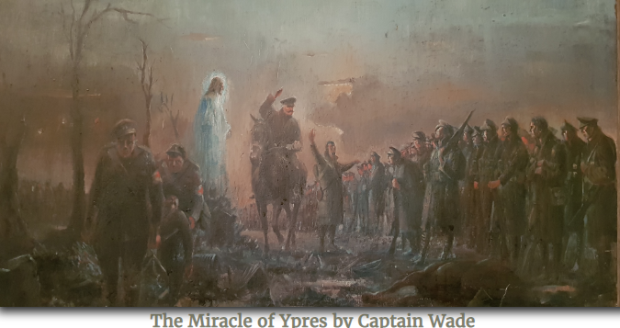

Slide 73
Summary strategies to defeat us:
Opposition: Yeshua was facing. Lock on to His vision for you.
Smallness of our forces. Serve for Him as a pioneer, halutz.
Enemies to destroy us. [#1 on steroids] Trust

Slide 75
The biblical account of the Exodus provides the most dramatic story of redemption in the Old Testament. Yet the validity of this story has been challenged by many scholars, due in part to the lack of evidence for a large population in
Notes:
https://patternsofevidence.com/2019/11/01/discovery-of-canaanite-metropolis-supports-bible/?inf_contact_key=fa8ae55b2f4c76dbf2c8fae6ce2c90e8680f8914173f9191b1c0223e68310bb1

Slide 76
Canaan that can be thought of as greater and mightier than the Israelites, as Moses emphasized in the Book of Deuteronomy. However, spectacular new finds being excavated in northern Israel are providing archaeological evidence to the Bible’s claims.
Notes:
https://patternsofevidence.com/2019/11/01/discovery-of-canaanite-metropolis-supports-bible/?inf_contact_key=fa8ae55b2f4c76dbf2c8fae6ce2c90e8680f8914173f9191b1c0223e68310bb1

Slide 77
A new discovery has been made in Northern Israel and according to excavation director Yitzhak Paz, “The study of this site will change forever what we know about the emergence [and] rise of urbanization in the land of Israel and in the whole region.”
Notes:
https://patternsofevidence.com/2019/11/01/discovery-of-canaanite-metropolis-supports-bible/?inf_contact_key=fa8ae55b2f4c76dbf2c8fae6ce2c90e8680f8914173f9191b1c0223e68310bb1

Slide 78
Being dubbed “The New York of the Early Bronze Age,” an ancient city has been discovered in Northern Israel where none was supposed to be. Co-director Dr. Yitzhak Paz added, “There is no doubt that this site dramatically changes what we know about the character of the period and beginning of urbanization in Israel,” he said in a press release from the IAA.
Notes:
https://patternsofevidence.com/2019/11/01/discovery-of-canaanite-metropolis-supports-bible/?inf_contact_key=fa8ae55b2f4c76dbf2c8fae6ce2c90e8680f8914173f9191b1c0223e68310bb1
Calling it a "cosmopolitan and planned city," the authority said the early Bronze Age settlement covered 65 hectares (160 acres) and was home to about 6,000 people.
"In this city, we have a planned settlement with a whole net of streets and alleys and squares, and drainage installations, storage installation," said Yitzhak Paz, a director of excavation on behalf of the authority.
https://phys.org/news/2019-10-israeli-archaeologists-ancient-city.html

Slide 79
Notes:
3:22

Slide 80
Summary strategies to defeat us:
Opposition: Yeshua was facing. Lock on to His vision for you.
Smallness of our forces. Serve for Him as a pioneer, halutz.
Enemies to destroy us. [#1 on steroids] Trust

