Slide 1
e-handout
To have these notes
without taking notes
Go to OrHaOlam.com
Click on downloads,
messages, 2019
Notes:
Last time about debunking false reports about resurrection, about Jews.
Some more about Israel’s Mossad, legendary spy agency.

Slide 2
A recent Twitter post reported on a Mossad agent that was captured in northern Saudi Arabia.
The official Saudi report determined that the “Mossad agent” was an Israeli vulture armed with photographic and “espionage” equipment.
Notes:
https://news.visionforisrael.com/en/news/december-13-2019/oh-no-not-again-mossad-spy-captured-in-saudi-arabia?mc_cid=54c1c6d917&mc_eid=5c6cdd3ee6

Slide 3
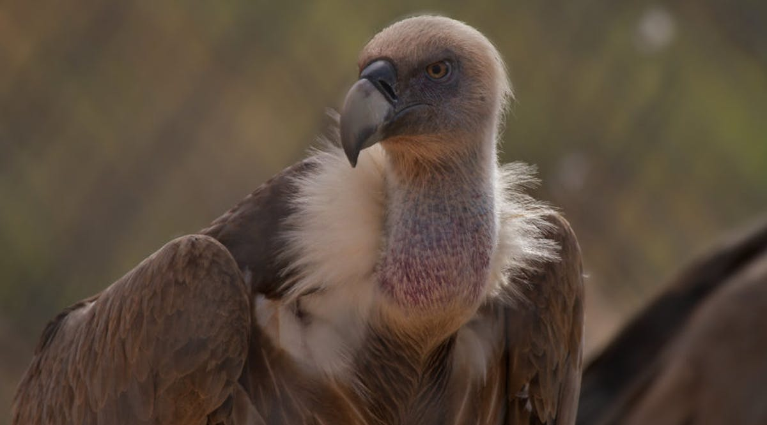
The bird is merely a vulture with a tracking device attached to his body by the Veterinary Department of Tel-Aviv University.
Notes:
https://news.visionforisrael.com/en/news/december-13-2019/oh-no-not-again-mossad-spy-captured-in-saudi-arabia?mc_cid=54c1c6d917&mc_eid=5c6cdd3ee6

Slide 4
In fact, a few years ago another vulture was captured in Lebanon and was immediately accused of being part of an Israeli attempt to spy on Hezbollah. Sharks, pigeons, storks and even squirrels are all animals that have been reported in recent years as being used by the Mossad.
Notes:
https://news.visionforisrael.com/en/news/december-13-2019/oh-no-not-again-mossad-spy-captured-in-saudi-arabia?mc_cid=54c1c6d917&mc_eid=5c6cdd3ee6
Probably still reaction to Eli Cohen infiltration.
https://en.wikipedia.org/wiki/Israel-related_animal_conspiracy_theories

Slide 5
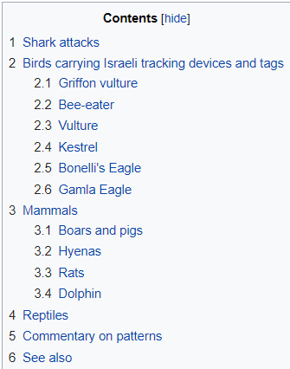
Wikipedia article on Israeli spy animal conspiracy reports.
https://en.wikipedia.org/wiki/Israel-related_animal_conspiracy_theories

Slide 7
מַתִּתְיָהוּ Mattityahu
(Matthew) 28:16-17
Notes:
Last week we discussed alternate explanations that deniers gave then and give now, to undermine the truth of the resurrection of Messiah. Stolen, swoon [Passover Plot], hallucination, wrong tomb, defies science. All of them had great rebuttals…just need to remember them.
Today’s verses a more amazing conundrum.

Slide 8
Mattityahu (Matthew) 28:16
בבֵּינְתַיִם הָלְכוּ אַחַד־עָשָׂר הַתַּלְמִידִים לַגָּלִיל, אֶל הָהָראֲשֶׁר אָמַר לָהֶם יֵשׁוּעַ.‏
So the eleven talmidim went to the hill in the Galil where Yeshua had told them to go.
Notes:
They accepted the report a few verses previous, from the women, ^{Mt 28.10} “Yeshua said to them. “Go tell My brothers to head for the Galilee, and there they will see Me.”

Slide 9
Mattityahu (Matthew) 28:17
כְּשֶׁרָאוּ אוֹתוֹ הִשְׁתַּחֲווּ לוֹ, אֲבָל הָיוּ כַּמָּה שֶׁהַסָּפֵק קִנֵּן בְּלִבָּם.
When they saw him, they prostrated themselves before him; but some hesitated.
REALLY?
Notes:
This is probably the incident ^{1 Cor 15.5-6} “and afterwards he was seen by more than five hundred brothers at one time, the majority of whom are still alive,”

Slide 10
distázō (from "two, double" and stásis, "stance, standing") – properly, going two ways, shifting between positions;

Slide 11
choosing "a double-stance" and hence vacillate (waver); (figuratively) uncertain at a crossroad because refusing to choose one way over the other – "wanting to have our cake and eat it too"; to halt between two opinions (views, beliefs).
Notes:
https://biblehub.com/greek/1365.htm
Yogi Berra, famous catcher for the NY Yankees back in my day: When you come to a fork in the road, take it.

Slide 12
How is it possible to doubt, in the presence of the resurrected Messiah, in the company of 500 invited believers? Ideal circumstances?
How can we be sure we won’t vascillate, and will endure? “Finish well.”
Notes:
This is the challenge, the takeaway, of this message. It is a Hanukkah message.

Slide 13
A radical answer:
Repentance, T’shuva, is the foundation of faith.
Some faith is required for repentance, but minimal.

Slide 14
^{Mark 1.14-15} Yeshua came into the Galil proclaiming the Good News from God: “The time has come, God’s Kingdom is near! Turn to God from your sins and believe the Good News!”
Turn to God = repent
Notes:
You have to believe that the kingdom is near, and that He is the king. Me in 1969.

Slide 15
metanoéō (from metá, "changed after being with" and noiéō, "think") – properly, "think differently after," "after a change of mind"; to repent (literally, "think differently after wards").

Slide 16
Hebrew for repent:
Tshuvah תשובה
Turn around, return

Slide 17
Last Shabbat, some of us say a movie about an amazing revival movement in Iran. Based on this concept:
repentance precedes conversion.
Notes:
We don’t usually say conversion in Messianic circles, because it’s been misunderstood as conversion from Judaism or Jewish identity. Jews don’t convert from Jewishness, but they do convert from sin to holiness.

Slide 18
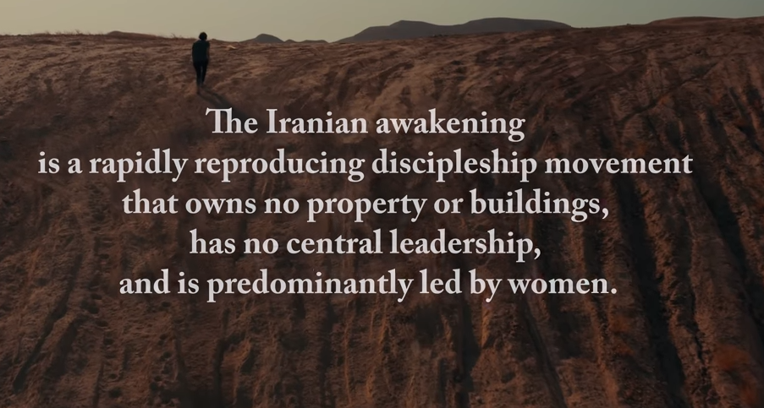
Notes:
They made some points that cut me to the heart. That the Western world of believers is a pastoral/teaching model. I love doing that, and want to do better.
Theirs is a discipleship model. People start obeying before coming to new birth. Converts flee persecution, disciples embrace it. First ~53 seconds

Slide 21
Without repentance, just attendance, curiosity, compliance…
It’s possible to rebel in ideal circumstances, right in the presence of G-d.
Notes:
Fall of Satan, from his original created position in the presence of G-d.

Slide 22
^{Yeshayahu/Is 14.12-14} “How did you come to fall from the heavens, morning star, son of the dawn? [Lucifer] How did you come to be cut to the ground, conqueror of nations? You thought to yourself, ‘I will scale the heavens, I will raise my throne above God’s stars

Slide 23
^{Yeshayahu/Is 14.12-14} I will sit on the Mount of Assembly far away in the north. I will rise past the tops of the clouds, I will make myself like the Most High.’
Notes:
Mysterious origin of evil in the universe.

Slide 24
^{Yekhez/Ezk 28 12, 14-15} You were the seal of perfection, full of wisdom and perfect in beauty…You were an anointed guardian cheruv. I placed you on the holy mountain of God. You walked among stones of fire. You were perfect in your ways from the day that you were created, until unrighteousness was found in you.

Slide 25
G-d loves to help us with our faith if our heart are open.

Slide 26
^{Mark 9.21-24} “Ever since childhood,” he said; “it often tries to kill him by throwing him into the fire or into the water. But if you can do anything, have pity on us and help us!” Yeshua said to him, “What do you mean, ‘if you can’? Everything is possible to someone who has trust!” Instantly the father of the child exclaimed, “I believe! Help my unbelief!”

Slide 27
^{Yn 20.24-29} Now Thomas/T’oma (the name means “twin”), one of the Twelve, was not with them when Yeshua came. When the other talmidim [disciples] told him, “We have seen the Lord,” he replied, “Unless I see the nail marks in his hands,

Slide 28
^{Yn 20.24-29} put my finger into the place where the nails were and put my hand into his side, I refuse to believe it.” A week later his talmidim were once more in the room, and this time T’oma was with them.

Slide 29
^{Yn 20.24-29} Although the doors were locked, Yeshua came, stood among them and said, “Shalom aleikhem!” Then he said to T’oma, “Put your finger here, look at my hands, take your hand and put it into my side.

Slide 30
^{Yn 20.24-29} Don’t be lacking in trust, but have trust!” T’oma answered him, “My Lord and my God!” Yeshua said to him, “Have you trusted because you have seen me? How blessed are those who do not see, but trust anyway!”

Slide 31
^{Luke 24.36-41} While they were speaking of these things, Yeshua Himself stood in the midst of them and said, “Shalom Aleichem!” But they were startled and terrified, thinking they were seeing a ghost.

Slide 32
^{Luke 24.36-41} Then He said to them, “Why are you so shaken? And why do doubts arise in your heart? Look at My hands and My feet—it is I Myself!

Slide 33
^{Luke 24.36-41} Touch Me and see! For a spirit doesn’t have flesh and bones, as you see I have.” And when He had said this, He showed them His hands and His feet. But while they were still in disbelief due to joy and wonder, He said to them, “Do you have anything to eat here?”

Slide 34
Even the MOST radical supernatural experience profits nothing without a decision of faith. Decision releases faith.

Slide 35
^{Acts 27.14-25} But before long, a hurricane-force wind called “the Northeaster” swept down from the island. When the ship was caught and could not face into the wind, we gave way to it and were driven along…But as we were violently battered by the storm…

Slide 36
^{Acts 27.14-25} With neither sun nor stars appearing for many days, and no small storm pressing on us, all hope of our survival was vanishing. As they had long been without food, Paul stood up in their midst and said…

Slide 37
^{Acts 27.14-25} “Yet now I urge you to take heart, for there will be no loss of life among you—but only of the ship. For this very night, there came to me an angel of the God to whom I belong and whom I serve.

Slide 38
^{Acts 27.14-25} He said, ‘Do not fear, Paul. You must stand before Caesar; and indeed, God has granted you all who are sailing with you.’ So take heart, men, for I believe God that it will be exactly as I have been told.
Notes:
Choice to believe G-d

Slide 39
Derek Prince was a pre-eminent lover of Israel and the Messianic awakening. Was in Jerusalem in the siege of 1947 and interceded through the battles! Great explanation of repentance, Christian terminology, till 4.57, at least.

Slide 40
Notes:
Till 4.57

Slide 41
Does this have any application to Hanukkah?
Faith is a bit analogous to the fire of the oil lamps, burned for eight miraculous days.
Underlying faith is the repentance of the Jewish people

Slide 42
from compliance to the corrupt, sensuous, idolatrous Greeks.
The story of Hanukkah as told ~300 years in advance, prophetically, in the book of Daniel.

Slide 43
^{Daniel 11.29-33} “At the appointed time he [Antiochus, the Syrian Greek tyrant] will invade the south again [Israel], only this time the outcome will not be as before. The ships of Kittim [Rome] will come against him, and he will lose heart.

Slide 44
^{Daniel 11.29-33} Then he will turn back and vent his rage against the holy covenant. When he returns, he will favor those who forsake the holy covenant. [compliant Jewish people] “His forces will rise up and profane the fortified Temple; they will stop the daily offering and set up the abomination of desolation.

Slide 45
^{Daniel 11.29-33} With smooth words he will seduce those who act wickedly against the covenant, but the people who know their God will stand strong and prevail. Those who are wise among the people will instruct many, though for many days they will fall by the sword, or be burned, captured or pillaged.

Slide 46
The Maccabees stood up to the Greeks, and resisted, and conquered!
So, have we complied with the pleasure crazed spirit of our age.
Are we givers, lovers, servants? Volunteers? Tithers?
Tony Perkins:

Slide 47
In his book The Road to Character, David Brooks explains that back in the day, there was something called moral realism—a worldview that put an emphasis on human sin and human weakness. Biblical figures like David and Moses were seen as great leaders who were also deeply flawed.
Notes:
https://www.frcblog.com/2019/11/cult-transgenderism-my-brothers-crisis-identity-america-gone-mad/

Slide 48
Fast forward to the 20th century when books like Rabbi Joshua Liebman’s New York Times best seller Peace of Mind (published in 1946) urged people toward a new morality based on the idea that you should never repress any part of yourself as sinful. Instead, you should “love yourself” and not be afraid of your hidden impulses. Humanist psychologists ran with this idea.
Notes:
https://www.frcblog.com/2019/11/cult-transgenderism-my-brothers-crisis-identity-america-gone-mad/

Slide 49
They began arguing that the primary problem for humans was no longer sin, but rather the fact that we weren’t fully accepting of ourselves exactly as God made us. This line of thinking led to the advent of the self-esteem movement in 1969.
Notes:
https://www.frcblog.com/2019/11/cult-transgenderism-my-brothers-crisis-identity-america-gone-mad/

Slide 50
The central belief of the culture of authenticity goes something like this: At the center of every one of us is a Golden Figure known as “the True Self.” The True Self can always be trusted. You know that what you’re doing is right when you feel an inner peace inside your True Self. You know that what you’re doing is wrong when you do not feel inner peace inside your True Self.
Notes:
https://www.frcblog.com/2019/11/cult-transgenderism-my-brothers-crisis-identity-america-gone-mad/

Slide 51
Previous generations believed the development of character and the road to salvation came by struggling against the desires of the True Self. This is why traits like selflessness and self-sacrifice were considered most admirable. But not anymore. Our culture now has a new “salvation”—with the True Self playing the role of redeemer.
The steps to this “new salvation” are as follows:
Notes:
https://www.frcblog.com/2019/11/cult-transgenderism-my-brothers-crisis-identity-america-gone-mad/

Slide 52
Relinquish any previous struggle you had against your True Self. Allow your ego/shadow self to fall away so your True Self can fully emerge without any guilt or shame (both of which are constructs of old, outdated religious systems).
Notes:
https://www.frcblog.com/2019/11/cult-transgenderism-my-brothers-crisis-identity-america-gone-mad/

Slide 53
Our society once believed this sort of self-restraint was the best way to live. Men and women were encouraged to exercise self-restraint in building a life of integrity. But the ideals of selflessness and self-restraint are now seen as hopelessly outdated and must be discarded in favor of the True Self.
Notes:
https://www.frcblog.com/2019/11/cult-transgenderism-my-brothers-crisis-identity-america-gone-mad/

Slide 54
Mattityahu (Matthew) 28:17
כְּשֶׁרָאוּ אוֹתוֹ הִשְׁתַּחֲווּ לוֹ, אֲבָל הָיוּ כַּמָּה שֶׁהַסָּפֵק קִנֵּן בְּלִבָּם.
When they saw him, they prostrated themselves before him; but some hesitated.

Slide 55
^{Mark 1.14-15} Yeshua came into the Galil proclaiming the Good News from God: “The time has come,
God’s Kingdom is near! Turn to God from your sins and believe the Good News!”
Notes:
You have to believe that the kingdom is near, and that He is the king. Me in 1969.

