Slide 1
e-handout
To have these notes
without taking notes
Go to OrHaOlam.com
Click on downloads,
messages, 2019
Notes:
.

Slide 2
For next week:
Yom Kippur greeting:
צוֹם קַל tsom kal
Easy fast

Slide 4
I have a mystery for you!

Slide 5
Notes:
https://www.google.com/url?sa=i&source=images&cd=&ved=2ahUKEwj9jqH7gvfkAhWCITQIHWDJBk0QjRx6BAgBEAQ&url=https%3A%2F%2Fquotefancy.com%2Fquote%2F909487%2FStephen-R-Covey-One-thing-s-for-sure-If-we-keep-doing-what-we-re-doing-we-re-going-to&psig=AOvVaw2VSQIJkgO1AUneBAbnKouj&ust=1569880431155434

Slide 6
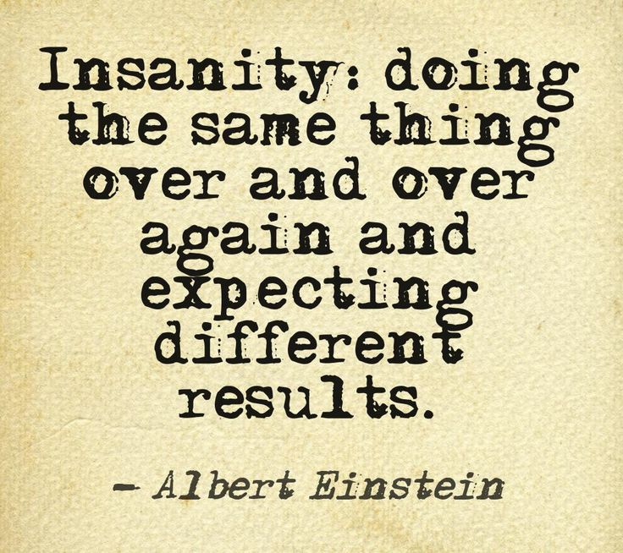
Notes:
https://www.google.com/url?sa=i&source=images&cd=&cad=rja&uact=8&ved=2ahUKEwjT-KCRg_fkAhXkN30KHQsQAQwQjRx6BAgBEAQ&url=%2Furl%3Fsa%3Di%26source%3Dimages%26cd%3D%26ved%3D%26url%3Dhttp%253A%252F%252Fshopglamarous.com%252Fblog%252F2014%252F03%252F24%252Fmotivation-monday-4%252F%26psig%3DAOvVaw2VSQIJkgO1AUneBAbnKouj%26ust%3D1569880431155434&psig=AOvVaw2VSQIJkgO1AUneBAbnKouj&ust=1569880431155434

Slide 7
There is an exception to that.
Notes:
But it’s not from the Twilight Zone.

Slide 8
וַיִּקְרָאVayikra
(Leviticus) 23:22
(from) Emor (Speak) אמור

Slide 9
Vayikra (Leviticus) 23:24
ג כִּי שֵׁם יְהוָה אֶקְרָא ס הָבוּ גֹדֶל לֵאלֹהֵינוּ׃
ג כִּי שֵׁם יְהוָה אֶקְרָא ס הָבוּ גֹדֶל לֵאלֹהֵינוּ׃
דַּבֵּ֛ר אֶל־בְּנֵ֥י יִשְׂרָאֵ֖ל לֵאמֹ֑ר בַּחֹ֨דֶשׁ הַשְּׁבִיעִ֜י בְּאֶחָ֣ד לַחֹ֗דֶשׁ יִהְיֶ֤ה לָכֶם֙
“Tell the people of Isra’el, ‘In the seventh month, the first of the month is to be for you

Slide 10
Vayikra (Leviticus) 23:24
ג כִּי שֵׁם יְהוָה אֶקְרָא ס הָבוּ גֹדֶל לֵאלֹהֵינוּ׃
ג כִּי שֵׁם יְהוָה אֶקְרָא ס הָבוּ גֹדֶל לֵאלֹהֵינוּ׃
שַׁבָּת֔וֹן זִכְר֥וֹן תְּרוּעָ֖ה מִקְרָא־קֹֽדֶשׁ׃
a day of complete rest for remembering, a holy convocation announced with blasts on the shofar.

Slide 11
Vayikra (Leviticus) 23:25
ג כִּי שֵׁם יְהוָה אֶקְרָא ס הָבוּ גֹדֶל לֵאלֹהֵינוּ׃
ג כִּי שֵׁם יְהוָה אֶקְרָא ס הָבוּ גֹדֶל לֵאלֹהֵינוּ׃
ד כָּל־מְלֶ֥אכֶת עֲבֹדָ֖ה לֹ֣א תַעֲשׂ֑וּ וְהִקְרַבְתֶּ֥ם אִשֶּׁ֖ה לַיְיָ
“Do not do any kind of ordinary work, and bring an offering made by fire to Adoni.”

Slide 12
a day of complete rest for remembering
Remembering What?

Slide 13
There is an exception!

Slide 14
^{Luke 18.1-7} Then Yeshua told his talmidim a parable, in order to impress on them that they must always keep praying and not lose heart. “In a certain town, there was a judge who neither feared God nor respected other people. There was also in that town a widow who kept coming to him and saying,
Notes:
She remembered, didn’t forget her need.

Slide 15
^{Luke 18.1-7} ‘Give me a judgment against the man who is trying to ruin me.’ For a long time he refused; but after awhile, he said to himself, ‘I don’t fear God, and I don’t respect other people; but because this widow is such a nudnik, I will see to it that she gets justice — otherwise,

Slide 16
^{Luke 18.1-7} she’ll keep coming and pestering me till she wears me out!’” Then the Lord commented, “Notice what this corrupt judge says. Now won’t God grant justice to his chosen people who cry out to him day and night? Is he delaying long over them?

Slide 17
^{Mtt 7.7-11} “Keep asking, and it will be given to you; keep seeking, and you will find; keep knocking, and the door will be opened to you. For everyone who keeps asking receives; he who keeps seeking finds; and to him who keeps knocking, the door will be opened.

Slide 18
^{Mtt 7.7-11} Is there anyone here who, if his son asks him for a loaf of bread, will give him a stone? or if he asks for a fish, will give him a snake? So if you, even though you are bad, know how to give your children gifts that are good,

Slide 19
^{Mtt 7.7-11} how much more will your Father in heaven keep giving good things to those who keep asking him!

Slide 20
Prayer is the exception.
Keep praying scriptural requests, no matter what.
Notes:
Some of you are on our intercessors list. If you want to be, talk to Dawn, or email us. You have to agree to a statement of confidentiality. Our pray request tab is open to the internet galaxy; we get some bizarre requests.
Illustration from the life of Daniel.

Slide 21
^{Daniel 9.2-4} I, Dani’el, was reading the Scriptures and thinking about the number of years which Adoni had told Yirmeyah the prophet would be the period of Yerushalayim’s desolation, seventy years.

Slide 22
^{Daniel 9.2-4} I turned to Adoni, God, to seek an answer, pleading with him in prayer, with fasting, sackcloth and ashes. I prayed to Adoni my God and made this confession…

Slide 23
^{Daniel 9.17-19} Therefore, our God, listen to the prayer and pleadings of your servant; and cause your face to shine on your desolated sanctuary, for your own sake. My God, turn your ear, and hear; open your eyes and see how desolated we are,

Slide 24
^{Daniel 9.17-19} as well as the city which bears your name. For we plead with you not because of our own righteousness, but because of your compassion. Adoni, hear! Adoni, forgive! Adoni, pay attention, and don’t delay action — for your own sake, my God, because your city and your people bear your name!”
Notes:
Daniel just kept in that prayer mode. Didn’t quit. Shalom Arush, Garden of Emunah is wonderful on insisting this.

Slide 25
הָאֵר פָּנֶיךָ הָאֵר פָּנֶיךָ (CH)
Ha’er panekha Ha’er panekha
כִּי-שִׁמְךָ נִקְרָא עַל-עִירְךָ וְעַל-עַמֶּךָ
Ki shimkha nikra al irkha v’al amekha
Make Your face shine, make Your face shine
For Your city and Your people are called by Your name

Slide 26
אֲדֹנָי שְׁמָעָה, אֲדֹנָי סְלָחָה,
אֲדֹנָי הַקְשִׁיבָה וַעֲשֵׂה
Adoni shma’a Adoni slakha
Adoni hakshiva va’aseh
O Lord, hear O Lord, forgive
O Lord, Listen and Act
Notes:
Gloriously set to music by the King of Kings team. We will likely attend there on our next tour, Aug. 2020.

Slide 27
Notes:
Start at 2:40
Note how they repeat the scripture plea!

Slide 28
The answer came:
^{Daniel 9.20-22} While I was speaking, praying, confessing my own sin and the sin of my people Isra’el, and pleading before Adoni my God for the holy mountain of my God —
Notes:
מ

Slide 29
^{Daniel 9.20-22} yes, while I was speaking in prayer, the man Gavri’el, whom I had seen in the vision at the beginning, swooped down on me in full flight at about the time of the evening sacrifice, and explained things to me.
Notes:
מֻעָף בִּיעָף rapidly, in the twinkling of an eye
Other illustrations:

Slide 30
^{Phil 4.6-7} Don’t worry about anything; on the contrary, make your requests known to God by prayer and petition, with thanksgiving. Then God’s shalom, passing all understanding, will keep your hearts and minds safe in union with the Messiah Yeshua.

Slide 31
^{Shmot/Ex 2.23-24} Sometime during those many years the king of Egypt died, but the people of Isra’el still groaned under the yoke of slavery, and ₁they cried out, and their cry for rescue from slavery came up to God.₂God heard their groaning, and ₃God remembered his covenant with Avraham, Yitz’chak and Ya‘akov.

Slide 32
^{Yehoshua 24.7} But when they cried out to Adoni, He put darkness between you and the Egyptians, then He brought the sea upon them.

Slide 33
^{Shoftim 3.8-9} The anger of Adoni blazed against Isra’el, and he gave them over into the hands of Kushan-Rish‘atayim king of Aram-Naharayim; and the people of Isra’el served Kushan-Rish‘atayim eight years.

Slide 34
^{Shoftim 3.8-9} But when the people of Isra’el cried out to Adoni, Adoni raised up a savior for the people of Isra’el; and he rescued them; this was ‘Otni’el, the son of Kalev’s younger brother K’naz

Slide 35
^{Shoftim 3.13-15} In confederation with the people of ‘Amon and ‘Amalek, ‘Eglon went out and defeated Isra’el, capturing the City of Date-Palms; and the people of Isra’el served ‘Eglon the king of Mo’av eighteen years.

Slide 36
^{Shoftim 3.13-15} But when the people of Isra’el cried out to Adoni, Adoni raised up for them a savior, Ehud the son of Gera, from the tribe of Binyamin, a left-handed man.

Slide 38
Do you remember to pray daily?
Do you read scripture daily?
Do you pray/read daily with your spouse and children?
Do you attend corporate prayer?

Slide 39
I know that sometimes, life happens too fast, and the day gets away. But, almost daily, regularly.
Prayer doesn’t fix issues, but it changes the atmosphere, brings Yeshua into the situation, so that solutions emerge. “I never thought of that…” “I have an idea.”
Notes:
He is Lord of ALL, needs to be kept there, or placed there. Great day to crown Him as King!!

Slide 40
Monday, Oct. 21, is our Simkhat Torah service. We will dance with the Torah scroll. I always make some restriction: only carry and dance with the scroll IF you read…chapter per day, per week. Not that many carry.

Slide 41
I don’t really watch who, but what if all of us could say, at least, a chapter/day!?!
Start tomorrow, and that will count for my Simkhat Torah requirement!

Slide 43
Other issues “to remember”

Slide 44
^{Shmot/Ex 20.8-10} “Remember [זכור]Yom Shabbat, to keep it holy. You are to work six days, and do all your work, but the seventh day is a Shabbat to Adoni your God.
^{Dvarim/Dt.5.12} ‘Observe [שמור] Yom Shabbat to keep it holy, as Adoni your God commanded you
Notes:
It’s not a day for work, or to make other people work by patronizing their businesses. Therefore buying and selling, restaurants, etc.
Concert artists here, only sell Saturday evening. That’s what I feel is right.

Slide 45
^{Acts 19.18-20 CJB} Many of those who had earlier made professions of faith now came and admitted publicly their evil deeds; and a considerable number of those who had engaged in occult practices threw their scrolls in a pile and burned them in public.
Notes:
Apparently, they remembered some things that were displeasing to G-d that they hadn’t dealt with.

Slide 46
^{Acts 19.18-20} When they calculated the value of the scrolls, it came to fifty thousand drachmas. Thus the message about the Lord continued in a powerful way to grow in influence.

Slide 47
Passover ^{Shmot/Ex 12.13-14} The blood will serve you as a sign marking the houses where you are; when I see the blood, I will pass over [pasakh] you — when I strike the land of Egypt, the death blow will not strike you.

Slide 48
^{Shmot/Ex 12.13-14} “‘This will be a day for you to remember and celebrate as a festival to Adonai; from generation to generation you are to celebrate it by a perpetual regulation.
Notes:
Passover is the most remember of all the holidays. When Jews assimilate, this is the last vestige usually. Russian girl and holiday crackers.

Slide 49
^{Shmot/Ex 17.14} Adoni said to Moshe, “Write this in a book to be remembered, and tell it to Y’hoshua: I will completely blot out any memory of ‘Amalek from under heaven.”

Slide 50
^{Dvarim/Dt. 25.1-19} “Remember what ‘Amalek did to you on the road as you were coming out of Egypt, how he met you by the road, attacked those in the rear, those who were exhausted and straggling behind when you were tired and weary…you are to blot out all memory of ‘Amalek from under heaven. Don’t forget!
Notes:
Double exhortation!

Slide 51
^{Dvarim/Dt 7.18} If you think to yourselves, ‘These nations outnumber us; how can we dispossess them?’ nevertheless, you are not to be afraid of them; you are to remember well what Adoni your God did to Pharaoh and all of Egypt.
Notes:
Remember past victories!

Slide 52
^{Dvarim/Dt 9.6-7} For you are a stiffnecked people! Remember, don’t forget, how you made Adoni your God angry in the desert. From the day you left the land of Egypt till you arrived at this place, you have been rebelling against Adoni.
Notes:
Plague of our hearts. We are almost always worse than we think. This statement is a great basis for discouragement. Rather, encouragement. If we can rid ourselves of the plague of our hearts.

Slide 53
^{Dvarim/Dt. 15.12-14} If your kinsman, a Hebrew man or woman, is sold to you, he is to serve you for six years; but in the seventh year, you are to set him free…Remember that you were a slave in the land of Egypt, and Adoni your God redeemed you.
Notes:
Remember the poor, since we were poor not too long ago.
4x in the next few chapters, remember that you were slaves.

Slide 54
^{Matt 28.18-20} “All authority in heaven and on earth has been given to me. Therefore, go and make people from all nations into talmidim, immersing them into the reality of the Father, the Son and the Ruakh HaKodesh,

Slide 55
^{Matt 28.18-20} and teaching them to obey everything that I have commanded you. And remember! I will be with you always, yes, even until the end of the age.”

Slide 56
^{Lk. 17.32} Remember Lot’s wife!
^{Ro 11.18} Don’t boast as if you were better than the branches! However, if you do boast, remember that you are not supporting the root, the root is supporting you.

Slide 57
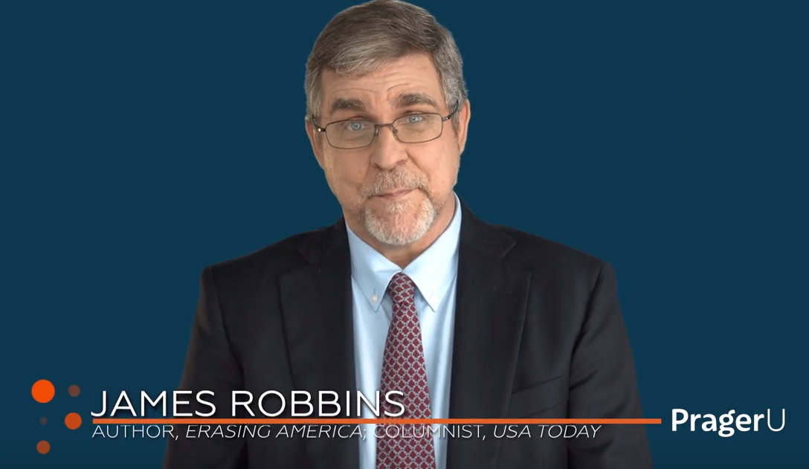
Do you remember America?
Notes:
How does the current culture portray America?

Slide 58
https://www.prageru.com/video/goodbye-america/
Notes:
https://www.prageru.com/video/goodbye-america/

Slide 59
Remember your covenant!
^{Mal. 3.14-16} Adoni is witness between you and the wife of your youth that you have broken faith with her, though she is your companion, your wife by covenant. And hasn’t he made [them] one [flesh] in order to have spiritual offspring?
Notes:
If you are already divorced and remarried, this is not to throw stones at you. But for the future…

Slide 60
^{Mal. 3.14-16} For what the one [flesh] seeks is a seed from God. Therefore, take heed to your spirit, and don’t break faith with the wife of your youth. “For I hate divorce,” says Adoni the God of Isra’el.

Slide 61
From Dr. James Dobson:
Let me illustrate this principle further with a finding from the world of nature. Other than dogs, which I have always loved, the animals that fascinate me most are elephants.
Notes:
https://drjamesdobson.org/about/september-newsletter-2019?sc=FEM&mc=FEM0919NL&utm_source=SilverpopMailing&utm_campaign=20190905%20-%20September%20Newsletter%20(FEM0919NL)%20(1)&spMailingID=22053675&spUserID=MTk2NDM5NTE5MAS2&spJobID=1580257910&spReportId=MTU4MDI1NzkxMAS2

Slide 62
These magnificent creatures are highly emotional and surprisingly intelligent. I suppose that's why it is disturbing to see them suffering the encroachment of civilization.
Notes:
https://drjamesdobson.org/about/september-newsletter-2019?sc=FEM&mc=FEM0919NL&utm_source=SilverpopMailing&utm_campaign=20190905%20-%20September%20Newsletter%20(FEM0919NL)%20(1)&spMailingID=22053675&spUserID=MTk2NDM5NTE5MAS2&spJobID=1580257910&spReportId=MTU4MDI1NzkxMAS2

Slide 63
That is happening in the Pilanesberg National Park in northwestern South Africa. Rangers there have reported that young bull elephants in that region have become increasingly violent in recent years—especially to nearby white rhinos.
Notes:
https://drjamesdobson.org/about/september-newsletter-2019?sc=FEM&mc=FEM0919NL&utm_source=SilverpopMailing&utm_campaign=20190905%20-%20September%20Newsletter%20(FEM0919NL)%20(1)&spMailingID=22053675&spUserID=MTk2NDM5NTE5MAS2&spJobID=1580257910&spReportId=MTU4MDI1NzkxMAS2

Slide 64
Without provocation, an elephant will knock a rhinoceros over and then kneel and gore it to death. This is not typical elephant behavior, and it's been very difficult to explain.
Notes:
https://drjamesdobson.org/about/september-newsletter-2019?sc=FEM&mc=FEM0919NL&utm_source=SilverpopMailing&utm_campaign=20190905%20-%20September%20Newsletter%20(FEM0919NL)%20(1)&spMailingID=22053675&spUserID=MTk2NDM5NTE5MAS2&spJobID=1580257910&spReportId=MTU4MDI1NzkxMAS2

Slide 65
But now game wardens think they've cracked the code. Apparently, the aggressiveness is a by-product of government programs to reduce elephant populations by killing the older elephants. Almost all of the young rogues were orphaned when they were calves, depriving them of adult [bull elephant] contact.
Notes:
https://drjamesdobson.org/about/september-newsletter-2019?sc=FEM&mc=FEM0919NL&utm_source=SilverpopMailing&utm_campaign=20190905%20-%20September%20Newsletter%20(FEM0919NL)%20(1)&spMailingID=22053675&spUserID=MTk2NDM5NTE5MAS2&spJobID=1580257910&spReportId=MTU4MDI1NzkxMAS2

Slide 66
Under normal circumstances, dominant older bulls keep the young elephants in line and serve as role models for them. In the absence of that influence, "juvenile delinquent" elephants grow up and terrorize their neighbors.
Notes:
https://drjamesdobson.org/about/september-newsletter-2019?sc=FEM&mc=FEM0919NL&utm_source=SilverpopMailing&utm_campaign=20190905%20-%20September%20Newsletter%20(FEM0919NL)%20(1)&spMailingID=22053675&spUserID=MTk2NDM5NTE5MAS2&spJobID=1580257910&spReportId=MTU4MDI1NzkxMAS2

Slide 67
I know it's risky to apply animal behavior too liberally to human beings, but the parallel here is too striking to ignore. Let me say it one more time. The absence of early supervision and discipline is often catastrophic—for teenagers and for elephants.
Notes:
https://drjamesdobson.org/about/september-newsletter-2019?sc=FEM&mc=FEM0919NL&utm_source=SilverpopMailing&utm_campaign=20190905%20-%20September%20Newsletter%20(FEM0919NL)%20(1)&spMailingID=22053675&spUserID=MTk2NDM5NTE5MAS2&spJobID=1580257910&spReportId=MTU4MDI1NzkxMAS2

Slide 68
I also want to offer a word of advice to mothers, especially those who are in what feels to them like a loveless marriage. You may be the wife of a good provider, a decent man, and even a solid moral religious man. But, alas, he's not romantic enough, and you're thinking about getting out.
Notes:
https://drjamesdobson.org/about/september-newsletter-2019?sc=FEM&mc=FEM0919NL&utm_source=SilverpopMailing&utm_campaign=20190905%20-%20September%20Newsletter%20(FEM0919NL)%20(1)&spMailingID=22053675&spUserID=MTk2NDM5NTE5MAS2&spJobID=1580257910&spReportId=MTU4MDI1NzkxMAS2

Slide 69
Seventy percent of those who file for divorce are women, many of them for the reason I've just described. Before you call it quits, think of your children. What is it going to do to those kids, both boys and girls, for you to bail?
Notes:
https://drjamesdobson.org/about/september-newsletter-2019?sc=FEM&mc=FEM0919NL&utm_source=SilverpopMailing&utm_campaign=20190905%20-%20September%20Newsletter%20(FEM0919NL)%20(1)&spMailingID=22053675&spUserID=MTk2NDM5NTE5MAS2&spJobID=1580257910&spReportId=MTU4MDI1NzkxMAS2

Slide 70
That may not be what you wanted me to say, but by sharing these thoughts, I might save some women from making a huge mistake. Think and pray hard before tearing your family in two.
Notes:
https://drjamesdobson.org/about/september-newsletter-2019?sc=FEM&mc=FEM0919NL&utm_source=SilverpopMailing&utm_campaign=20190905%20-%20September%20Newsletter%20(FEM0919NL)%20(1)&spMailingID=22053675&spUserID=MTk2NDM5NTE5MAS2&spJobID=1580257910&spReportId=MTU4MDI1NzkxMAS2

Slide 71
Takeaway: prepare for life.
Remember daily
prayer and reading,
and accountability
Simkhat Torah Oct. 21

Slide 72
Do you pray daily?
Do you read scripture daily?
Do you pray/read daily with your spouse and children?
Do you attend corporate prayer?

