Slide 1
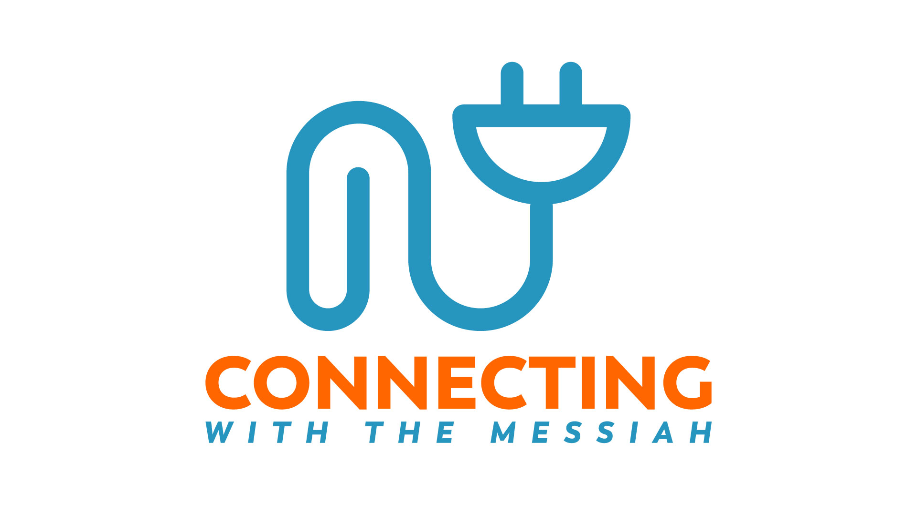
Notes:
Shabbat Shalom and good morning Kedoshim.
And he walks with me and he talks with me…. And the joy we share as we tarry there, none other has ever known.
This is, in my mind, the essence of the practice of our faith – this is connecting with the Messiah. And it’s deeply personal.
Prayer.

Slide 2
CLOSE ENCOUNTERS
Notes:
There was a Jewish young man who grew up in New York City in the 50s and 60s. Like many New York Jews, his parents attended Synagogue only for the holidays. This young man got interested in rock music and became a dummer in a band. He got into drug use, including cocaine and heroin. He had a girl friend who was a Christian and she kept inviting him to church. Finally he went just to show her and his friends that they were wrong. But... Jesus/Yeshua met him there. This young man gave Adonai a test. He said he would go home and shoot up more drugs than ever, and if the drugs had no effect on him, he would accept Jesus as his savior. He shot up a large amount of drugs. He waited. And he waited. Nothing happened. It was a miracle. He gave his life to Adonai. Today he is a world famous evangelist and apologist for Yeshua and Messianic Judaism. You may have guessed already... this man is Dr. Michael Brown.
There was another man who lived at the same time as Yeshua. Quite possibly he was the grandson of a Jewish Roman slave who was granted his freedom. He lived in a city with a great deal of Greek influence. As a result, he grew up in a Jewish household and was trilingual, knowing Hebrew, Aramaic, and Greek. As he got older, he had the privilege of studying under the famous Rabbi Gamaliel, who was the grandson of Hillel. He was a star student, and he was a Pharisee. He may have served in some capacity on the Sanhedrin. When the Nazarene sect of Judaism - that is the Yeshua followers - arose he volunteered to try to eliminate them. He lead and participated in the jailing of believers and even killing them. One day on the way to a persecution in Damascus, Yeshua himself appeared to this man in a bright light. The man was blinded by the light, and he repented. He knew that he had finally MET Adonai. He became a very great apostle, perhaps the greatest apostle. Of course this man is the Apostle Paul, Rav Shual, author of much of the new testament, and Apostle to the Gentiles, meaning to the nations.
I could go on with many stories. The story of Heidi Baker, Jonathan Cahn, William Wilberforce, Pastor Dietrich Bonhoffer, King David, the woman at the well, any of Apostles or millions of ordinary people like me and like you. And many of you have amazing stories! These stories illustrate the life changing power of the Messiah. But sometimes, after we have given ourselves to the Lord, we lose our focus. Life changes. Perhaps we suffer some trauma like a severe illness, or family and relationship troubles, or economic hardship. Maybe we suffer from severe demonic attack, or maybe we get overwhelmed with our jobs and raising a family. Maybe, as now, the culture comes against our treasured beliefs and our hopes get disappointed and we get discouraged. It seems things are going badly.

Slide 3
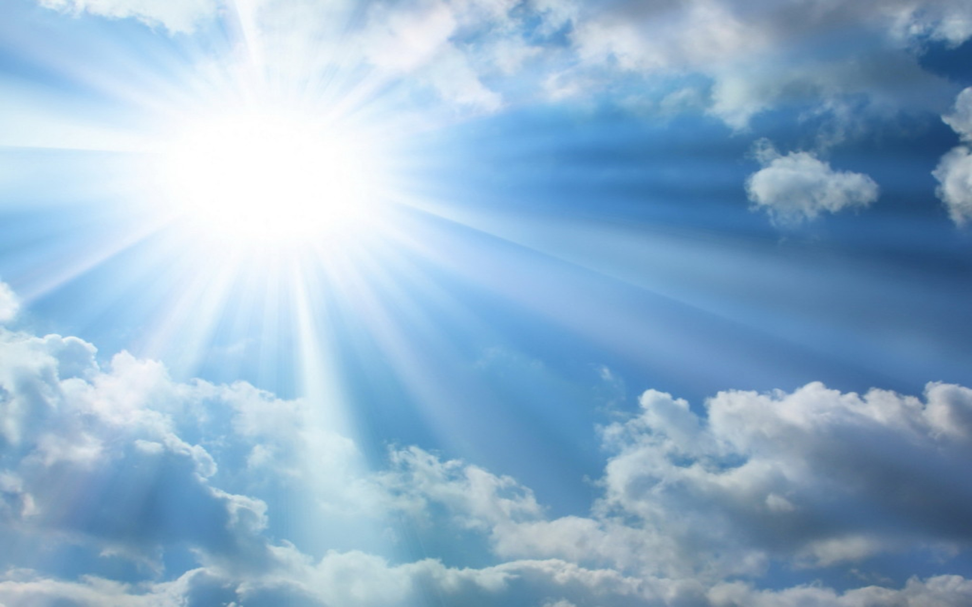
Notes:
But I want to encourage you today, that the same power that saved you is available to you every minute of every day. You can be recharged and filled with joy on a daily basis. Plugging into the Messiah is plugging into the refreshing, glorious, beautiful truth. It is plugging into the way, the truth and the life. It IS life. If you are hearing this message, and you don’t yet know Yeshua, Jesus, the Messiah, this message is just as much for you as for those who already know him. You also can enjoy the joyous transforming power of Yeshua.

Slide 4
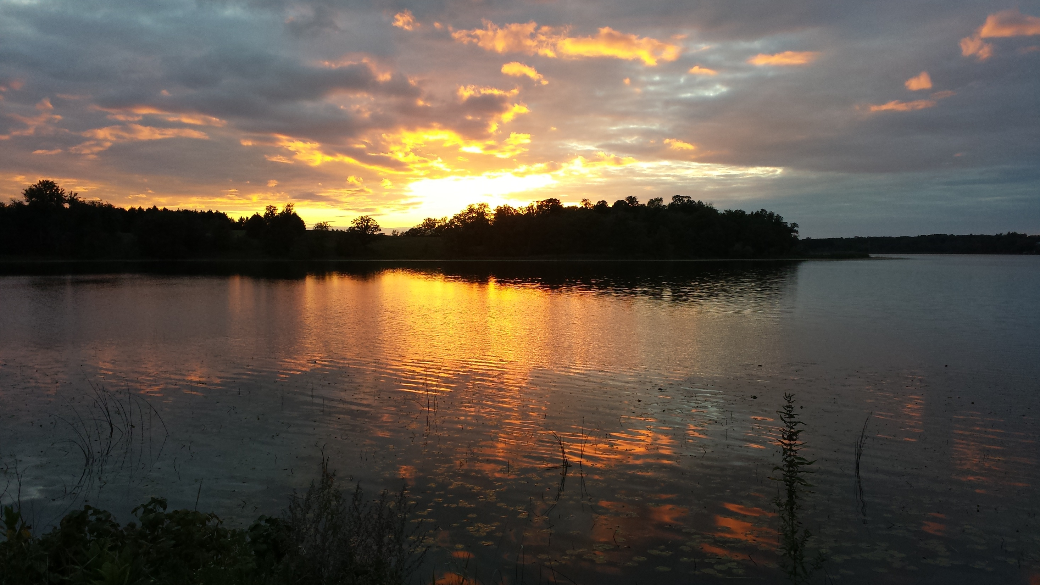
WORSHIP THE LORD
Notes:
The Bible says “Worship the Lord in the beauty of holiness” The Lord is looking for worshippers who will connect with Him and refresh themselves in His presence. He wants to give of His love, joy and peace.
But how do we do this? How do we connect with the Messiah? How can we stay in joy with all the trouble we face? Why did Yeshua say, in John 16:7 “But I tell you the truth, it is to your advantage that I go away! For if I do not go away, the Helper will not come to you; but if I go, I will send Him to you.” We know the Helper is the Holy Spirit, AKA the Ruach HaKodesh, the Spirit of Christ, the Spirit of Messiah, the Spirit of God, or simply the Spirit. We know that as believers, the Spirit lives inside of us. But... sometimes, or even often, the Spirit seems dim or far away. Why is that and what can we do about it?
We need to talk about some barriers to connecting with the Messiah. It is important to recognize this: The Spirit is always available to believers. It is we ourselves who have the barriers to experiencing His presence.

Slide 5
UNHINDERED ACCESS
Notes:
Here is an illustration of unhindered access to the Messiah, which I will follow with a list of barriers that we must overcome to experience his presence. The graphics will illustrate how each of these dims the light of Christ, of the Messiah.
1) Sin in our lives
2) Cares of this world
3) Fear and doubt, anger
4) Emotional wounds from our past
5) Distractions: phones, entertainment
6) Wrong priorities

Slide 6
SIN
Notes:
1) Sin in our lives. We must ask Adonai to make us aware of our sins, and then we must agree with Him and ask Him to help us repent. 1 John1:9 says “If we confess our sins, he is faithful and just and will forgive us our sins and purify us from all unrighteousness.”

Slide 7
SIN +
CARES OF THE WORLD
Notes:
Cares of this world. We all have cares with which we can be absorbed and lose our focus on the Messiah. Cares can completely obstruct our connection with the divine. The Apostle Peter wrote “Therefore humble yourselves under the mighty hand of God, that He may exalt you in due time, casting all your care upon Him, for He cares for you.”

Slide 8
SIN +
CARES OF THE WORLD + FEAR, ANGER, DOUBT
Notes:
Fear and doubt, anger. We cannot connect with God when we are consumed with fear, doubt or anger. We must learn to put these aside while we worship, and learn to deal with these emotions in healthy ways.

Slide 9
SIN +
CARES OF THE WORLD + FEAR, ANGER, DOUBT +
WOUNDS FROM PAST
Notes:
Emotional wounds from our past. Our childhood influences our whole outlook on life and our beliefs. If we have trouble with relationships in general, including God, then we need to seek emotional healing. Pray for God to lead you to healing, and you will probably need the help of a good counselor or healing ministry, such as RTF, Sozo, Theophostics, Ellel, the Life Model and others. Personally I have experienced many counseling modalities and I have received important healing which opened up my understanding of the power and goodness of God.

Slide 10
SIN +
CARES OF THE WORLD + FEAR, ANGER, DOUBT +
WOUNDS FROM PAST+
DISTRACTIONS
Notes:
Distractions: phones, entertainment. What do I need to say? These are HUGE distractions. We MUST have time specifically and only for Adonai and with uncluttered minds. I am NOT saying that entertainment is bad... it has an important place in relaxing and enjoying life. But we cannot allow it to become a God to us. It must take a lower place in our priorities.

Slide 11
SIN +
CARES OF THE WORLD + FEAR, ANGER, DOUBT +
WOUNDS FROM PAST+
DISTRACTIONS+
WRONG PRIORITIES
Notes:
Wrong priorities. Yep, I just mentioned this didn’t I? So I’ll say it again. Yeshua/Jesus said “Seek ye first the kingdom of God, and all these things will be added unto you.. We must make time for meeting with the Lord and studying his word. There is no substitute. Yeshua went out in the morning to pray.
It gets pretty dark if we allow these things to impact our relationship with the Messiah. But we can be restored!

Slide 12
UNHINDERED ACCESS
RESTORED
Notes:
The Lord has answers for ALL of these barriers, and with consistent commitment we can have increasingly unhindered access to him.

Slide 13
WORD of G_D
TORAH
Notes:
Studying God’s word is crucial to connecting with the Messiah. Hebrews 4:12 says that the word of God is living and powerful. In the Messianic culture we talk about the Torah, a Hebrew word which means “instruction” or teaching or law. In Jewish culture it usually refers to the first five books of the Bible - the books of Moses.

Slide 14
All Scripture is God-breathed and is valuable for teaching the truth, convicting of sin, correcting faults and training in right living;
2 Tim 3:16
Notes:
In the general meaning, all scripture is Torah. All Scripture is God-breathed and is valuable for teaching the truth, convicting of sin, correcting faults and training in right living; 2 Tim 3:16.
According to Galatians 3:24 the purpose of the Torah is to lead us to the Messiah. Torah or Bible study can be done in worshipful attitude but when we encounter the Messiah, that is when worship really starts. Studying the Torah/Bible can lead us to true encounter and true worship and it provides the guidance and inspiration that we must have. Psalm 119:105 says “Your word is a lamp to my feet And a light to my path.”

Slide 15
RUACH HAKODESH
THE HOLY SPIRIT
Notes:
Let’s consider a little be more about the Holy Spirit.

Slide 16
He has even made us competent to be workers serving a New Covenant, the essence of which is not a written text but the Spirit.
2 Cor. 3:6
Notes:
In 2 Cor 3:6 Shaul /Paul says “He has even made us competent to be workers serving a New Covenant, the essence of which is not a written text but the Spirit.” The word, or the text, is extremely important, but the essence of the New Covenant, according to Rav Shaul, is the Spirit. This makes sense. Connecting with the Spirit IS connecting with the Messiah. This scripture is another way of saying that the goal of the Torah, the text, is the Messiah. The essence of our faith is a relationship… a relationship with the most wonderful person in the universe- Yeshua, the Messiah.

Slide 17
We have the mind of Messiah (Christ) 2 Cor. 3:16
..work out your salvation with fear and trembling. Phil. 2:12
He has perfected forever those who are being sanctified.
Hebrews 10:14
Notes:
Let’s back up a bit. Shaul says in 2 Cor 3:16 that “We have the mind of Messiah (Christ)” That of course is true, but we also have our own corrupt and unredeemed minds. That is why he also wrote in Romans 12:2 “Be transformed by the renewing of your mind.” In Philipians 2:12 he wrote “work out your salvation with fear and trembling” and Hebrews 10:14 say that “He has perfected forever those who are being sanctified.” This shows that we are a work in progress and it takes effort. This transforming of the mind, which is so critical to connecting with the Messiah... how does it work? The following is my own opinion and is not necessarily the opinion of OrHaOlam. But I think it has some merit.

Slide 18
A TRANSFORMED MIND and the NEW COVENANT
Notes:
The transformed mind is in full agreement with the Father, the Son and the Holy Spirit. In the Jewish concept, heart and mind are not separate. When the tanakh, or old testament, refers to the heart, it is referring to the heart and mind. Modern psychology and science agree with this understanding.

Slide 19
For this is the covenant I will make with the house of Isra’el after those days,” says Adonai: “I will put my Torah within them and write it on their hearts;...”
Jeremiah 31:32
Notes:
The wonderful promise of the New Covenant in Jeremiah 31 states ““For this is the covenant I will make with the house of Isra’el after those days,” says Adonai: “I will put my Torah within them and write it on their hearts;...” (Jer 31:32) Yeshua brought forth and initiated the New Covenant . Luke 22:20 says, “He did the same with the cup after the meal, saying, “This cup is the New Covenant, ratified by my blood, which is being poured out for you.” As mentioned before, Shaul said he was serving the New Covenant. So the New Covenant is here, and those of us who are believers are living under it. How then does the Torah, that is the commandments of God, get written on our heart and mind? How do we get a transformed mind? How do we get a mind that agrees with God?
I do not believe the writing of the Torah on our hearts refers to the all of the commandments in the first five books of the Bible but only the commandments which are universally applicable. Think about it: when Jesus / Yeshua initiated the New Covenant he already knew that the Temple would be destroyed. Therefore he could not have meant, at least in this age, that the writing of the Torah on our hearts included the ceremonial laws which had to do with Temple worship. This is my opinion. But back to the question: How do the commandments of God, get written on our heart and mind? How do we get a mind that agrees with God?

Slide 20
But whenever someone turns to the Lord, the veil is taken away… But we all, with unveiled face beholding as in a mirror the glory of the Lord, are being transformed into the same image from glory to glory—just as from the Lord, who is the Spirit.”
2 Cor. 3:16-18 TLV
Notes:
Shaul /Paul tells us in 2 Cor 3:16-18. “But whenever someone turns to the Lord, the veil is taken away….. But we all, with unveiled face beholding as in a mirror the glory of the Lord, are being transformed into the same image from glory to glory—just as from the Lord, who is the Spirit.” TLV This has to be one of the most amazing statements in the entire Bible. As we behold the glory of the Lord, we are transformed into his image! Shaul states in 1 Cor 13:12 that we now we see obscurely, as in a mirror. (In those days mirrors were made from polished brass... not nearly so clear as today’s glass mirrors). But in the future, we will see clearly. So, my friends, in order to transform our minds we have to behold Yeshua! And in order to connect with Yeshua, we need to transform our minds! So what do we do?

Slide 21
THE WORD IN OUR HEARTS
Notes:
Well one thing we must do is get the Word of God into our hearts and minds. As previously mentioned we need to spend time in the Word, and we need to memorize portions of it. As we study the Word, we get to know Adonai. I am not a particularly great example of one who memorizes scripture, but when the Lord highlights a portion of scripture that I know is life changing, I memorize it. Then in my prayer times, the Lord will often remind me of a verse that opens up my mind to His glory and goodness. And then I am, in my own limited way, beholding his glory and I am being transformed. I deeply hope and expect to experience his glory more and more as I mature in my relationship with Adonai. Everyone’s journey with Adonai is unique and different and tailor made for you alone. But He is always drawing you closer to Him to conform you to his image - to be like Him! Romans 8:29 says “those whom he knew in advance, he also determined in advance would be conformed to the pattern of his Son, so that he might be the firstborn among many brothers;”

Slide 22
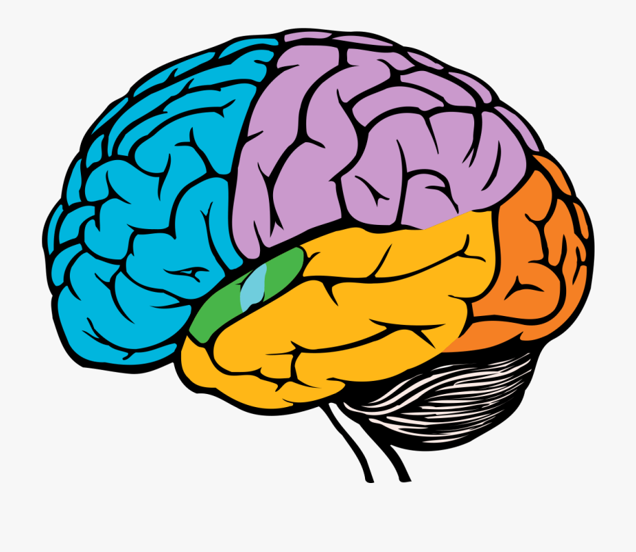
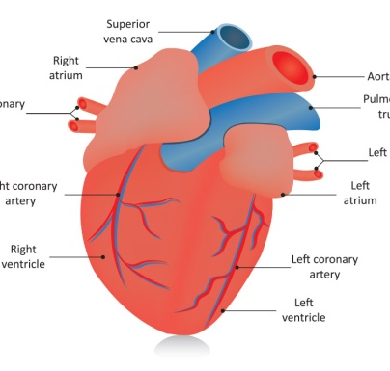
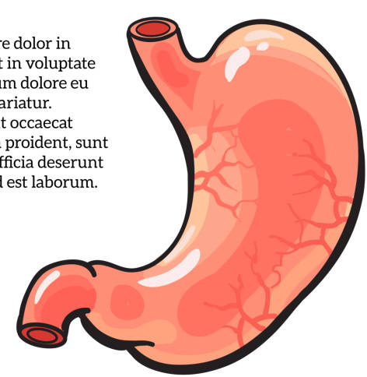
BRAIN SCIENCE
Notes:
This conforming to the pattern of Yeshua is the same thing as the renewing of the mind. In our day we can understand this somewhat through brain science. Science has discovered that our hearts and stomachs have clusters of neurons that function like a brain… the heart has a brain and so does the stomach. This gives news meaning to the phrases “gut feel” and “heart felt!” The way we think and feel and react to things all has to do with our nervous system and especially our brains. When I say the word “terrible” it brings up different images and feelings in every single person who hears me. The same is true if I said “wonderful” or any other word. The reason for this is our personal history. We associate words with experiences we have had. These experiences are stored in our brains in the form of neurons and synapses. Our experiences actually change our physical brains. That is why deep lasting change can be difficult.... it usually takes time to change the patterns in our brains. But our brains CAN change for the better. It is known that positive and joyful experiences and relationships cause our brains and our overall health to improve. ALL of our hearts and minds have been damaged by sin in one way or another. But Yeshua knows it all and can heal it all. In most cases this takes time... it takes consistent time in the word and prayer and encounters with Yeshua. With the focus on the Messiah and his word our hearts and minds get better, more joyful, more confident, more loving and tender, more patient. This is the fruit of the Spirit of Yeshua, the fruit of spending time with him. I can testify that in my case progress has been SLOW, but it has been real. You can ask my wife of 38 years‼ I know for sure that she will agree about the slow part!

Slide 23
AN EXAMPLE
Notes:
Let’s apply this to the idea of the Torah being written on our hearts. How does this happen? We start with divided broken hearts, with selfish hearts. Let’s say we are driving to the synagogue and we see someone alongside the road who needs help. We start having a conversation in our head. Our selfish side doesn’t want to stop. It might make us late, we might miss something, or it might be dangerous to stop, or we think someone else will help. Does this remind you of any famous Bible story? Our unselfish side wants to help. But by the time we have had this conversation the person who needs help is far behind us and it is too late to stop. Let’s replay this scenario but with hearts and minds fully conformed to the Son of God. In other words, the Torah is written on our hearts as in Jeremiah 31. Let’s assume that it is reasonably safe to stop. In this scenario, with transformed hearts, we don’t have to have the conversation in our mind. Instead, our mind is so conformed to the Messiah that we simply stop to help without a prolonged discussion in our minds. We immediately know what is right and we do it.

Slide 24
RUACH / SPIRIT
IN US
Notes:
Another way we can conceive of the Torah being written on our hearts is by the Ruach HaKodesh - the Holy Spirit. Since we have the Ruach living inside of us, the more we recognize and hear and obey his voice the more the Torah is written on our hearts. After all, the Ruach is the Spirit of Messiah, and the Messiah is the living Torah. If we hear and obey, we will hear more. If we hear and do not obey, we will hear less.

Slide 25
BEYOND CONNECTION
Notes:
We have been talking about connecting with the Messiah. But the goal is actually even beyond that.

Slide 26
I became a servant of the Good News because God gave me this work to do for your benefit….. To them God wanted to make known how great among the Gentiles is the glorious richness of this secret. And the secret is this: the Messiah is united with you people! In that rests your hope of glory! Col 1:25-27
Notes:
In Col 1: 25- 29 Paul / Shaul writes “I became a servant of the Good News because God gave me this work to do for your benefit….To them God wanted to make known how great among the Gentiles is the glorious richness of this secret. And the secret is this: the Messiah is united with you people! In that rests your hope of glory!

Slide 27
We, for our part, proclaim him; we warn, confront and teach everyone in all wisdom; so that we may present everyone as having reached the goal, united with the Messiah. It is for this that I toil, striving with all the energy that he stirs up in me so mightily.
Col 1:28-29
Notes:
We, for our part, proclaim him; we warn, confront and teach everyone in all wisdom; so that we may present everyone as having reached the goal, united with the Messiah. It is for this that I toil, striving with all the energy that he stirs up in me so mightily.” This is not a minor theme in the Shaul’s scriptures, on the contrary it is a major emphasis. He is striving mightily to get this message across!
In John 16:33 Yeshua said “I have said these things to you so that, united with me, you may have shalom. ” When we accept Yeshua as Savior, we are united with him. And then the process of dying to the flesh, dying to ourselves - in other words sanctification, starts.

Slide 28
THE NEW COVENANT AND THE KINGDOM
Notes:
We are living in the time of the New Covenant. The time of the Kingdom of God has started, but it is not fully here. We ARE in the Kingdom, but most of the world is not. We are still powerfully affected by the sin of the world and our own brokenness. BUT, in spite of that, the Torah is being written on our hearts. It may be a slow process, but if you are pursuing the Messiah, and spending time in the Word and in prayer, it is happening. Your heart and mind is being conformed to that of the Messiah. We are living in the beginning of the time of Jeremiah 31. That time will reach it’s fullness when He returns to this earth as King.

Slide 29
My purpose is that they may be encouraged, that they may be joined together in love, and that they may have all the riches derived from being assured of understanding and fully knowing God’s secret truth, which is — the Messiah! It is in him that all the treasures of wisdom and knowledge are hidden.
Col . 2:2-3
Notes:
In the meantime, we have GREAT hope. In Col. 2:2-3 Shaul writes “ My purpose is that they may be encouraged, that they may be joined together in love, and that they may have all the riches derived from being assured of understanding and fully knowing God’s secret truth, which is — the Messiah! It is in him that all the treasures of wisdom and knowledge are hidden.”

Slide 30
RESCUED!
He has rescued us from the domain of darkness and transferred us into the Kingdom of his dear Son.
Col . 1:13
Notes:
In Colossians 1:13 he writes “He has rescued us from the domain of darkness and transferred us into the Kingdom of his dear Son.” We are in the kingdom. We have access to the throne of the Father.

Slide 31
BUT DO
WE
KNOW IT?
Notes:
We are in the Kingdom, but do we know it? I think of one of C.S. Lewis’ Narnia tales in which a grumpy group of dwarves are in Narnia(heaven) but they stay in their dark little shack because they think someone is tricking them. Are we a bit like that? I am! Our access to the Kingdom is unlimited but how much do we access? Ahh... back to the renewing of the mind. This is a lifelong process - we will never be finished with it in this age anyway. The process entails both pain and joy. But becoming more like him yields benefits that are incomparably better than anything the world has to offer.
Will the prayer ministers please come forward?

Slide 32
HE
WANTS
YOU
Notes:
Many of you have been living as devoted followers of the Messiah for many years. What I’ve been sharing is hopefully a reminder and an encouragement to you. If you are newer on the path, I’m hoping you are picking up some inspiration through these words and the Ruach, the Holy Spirit. But perhaps you do not know the Messiah, perhaps you have never accepted Jesus / Yeshua into your life. Then this message is for you. He is waiting for you, calling out to you. He created you with great love and he deeply desires that you have the benefits of his life: especially love, joy and peace. The world cannot offer these, but he does. He is the source of all the good things in life. He wants you to have it, to share his life. If you are in this room or watching on the web, and you don’t know him, invite him into your life today. Receive the gift of life, of eternal life, of the Kingdom of God. He will never stop reaching out to you, but you have to say yes. If you don’t know him, will you ask him into your life today? Tell him that you want him to be your savior. Confess to him that you are broken and that you sin. Turn away from sins that you know of and ask him to forgive your sins and teach you to live in better way. Ask him to be your savior, and your teacher and the Lord of your life. Start living a new and better life today, one that leads to joy. You may not think this is possible, but I assure you it is possible. Do it today, do it now. I’m going to pause to allow you to ask Yeshua / Jesus into your life right now. ..... If you prayed to invite Yeshua /Jesus into your life , or if you want to pray it, and you are in this room, please come forward and one of our prayer ministers with talk with you and pray with you. Feel free to come forward for other prayer requests as well. If you prayed this prayer and you are out there on the web, find a believer who is devoted and has been walking this path for awhile and share your decision with them and let us know as well. Find someone who will encourage you and help you enter into a transformed life. Read your Bible and pray. Come to OrHaOlam if you can, or keep attending online. We care for you! We will welcome you here!
Thank you and the service is ended. We will be starting our 3rd hour of prayer at 12:30.

