Slide 1
e-handout
To have these notes
without taking notes
Go to OrHaOlam.com
Click on downloads,
messages, 2020

Slide 2
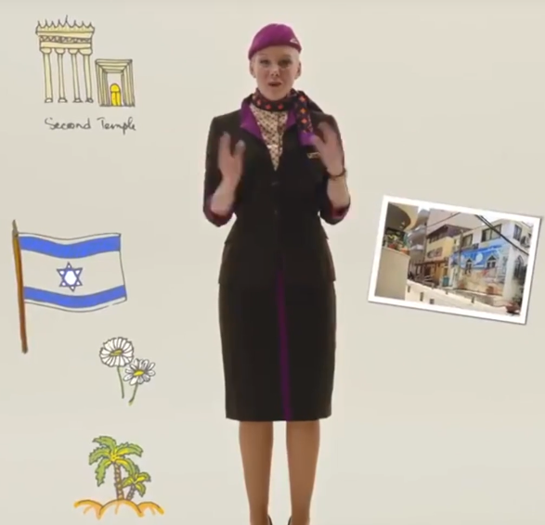
Unexpected assumption of the UAE, in advertising visits to Israel
Notes:
One of the Emirates’ world-class airlines, Etihad, has already established daily scheduled flights between Abu Dhabi and Tel Aviv, to begin service in March of next year, assuming the COVID-19 pandemic is under control by then.
Etihad this week posted to social media a video advertisement welcoming Emiratis to book flights on the new route and enjoy all Israel has to offer.

Slide 3
They described the tourist wonders of Israel, including the site of Herod’s Temple. Who can doubt that? Nevertheless, the PA went into an uproar, and the Emiratis took down the ad.
Notes:
First time any Arab government has acknowledged the Jewish Temple.

Slide 4
Having a dog named shark at the beach was a mistake.
Notes:
Mark Hughes

Slide 5
Notes:
Jeremiah Pena.

Slide 6
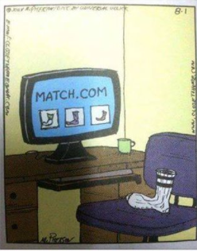
The new matchmaking.
Notes:
I forgot who sent it. Sorry.
I have a weekly Zoom prayer meeting with JB, Winograd, and a some other rabbis. A few weeks ago, one was really passionate that this was the Week of prayer for Persecuted Believers, and few participate. Nov. 1. In fact, in 25 years of Or HaOlam, I don’t think we’ve ever had a focus on that. Maybe once in 1996, we had a rep from Voice of the Martyrs. So my friends cry sort of sat in my mind. Besides, that week we had Orphan Shabbat, and Oxana’s worship concert, then the next week Miriam Chernak. However, today’s verse speaks to it.

Slide 7
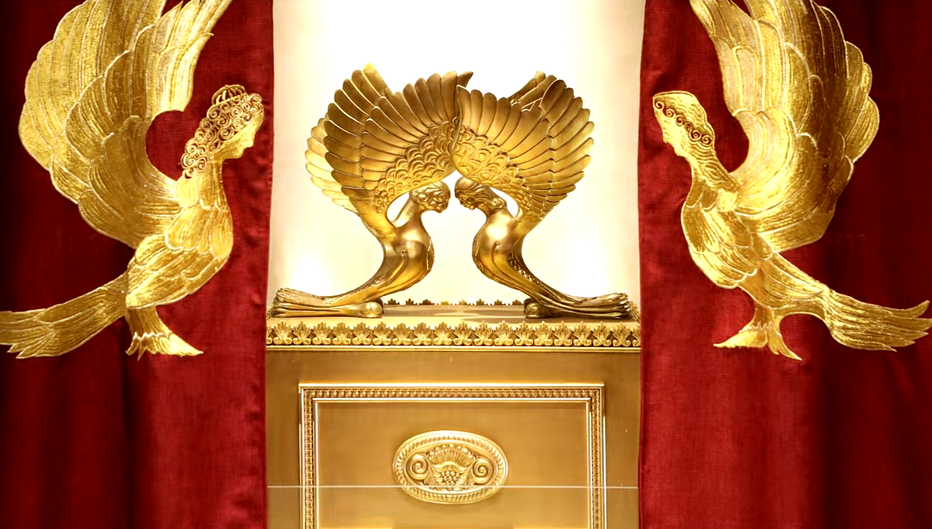
Letter to the Messianic Jews
[Hebrews] MJ 6.3
If G-d Permits
Notes:
https://www.templeinstitute.org/new-location.htm

Slide 8
^{MJ 6.1-3} Therefore, leaving behind the initial lessons about the Messiah, let us go on to maturity… And, God willing, this is what we will do.
^{NKJV}And this we will do if God permits.
^{NiV}And God permitting, we will do so.
Notes:
That is, we don’t know how much ministry, business, family plans, etc. we can do. It’s really out of our hands.

Slide 9
^{Yaakov /Jas 4. 14-15} You do not know what your life will be like tomorrow. What is your life? For you are a vapor that appears for a little while and then vanishes. Instead you ought to say, “If Adoni wills, we will live and also do this or that.”
Notes:
Right now, with COVID increasing lock downs, contested election, the uncertainty of life is a bit more apparent. Nevertheless, we can plan with some degree of hope. Not in most places in the world
[pray]

Slide 10
One population that faces the greatest uncertainty are our persecuted brothers and sisters in the faith.

Slide 11
We typically don’t express ourselves part of the world Christian movement, but theologically, we have LOTS in common. We flow with Evangelicals, Charismatics, and Synagogues.
Notes:
You are confused! No, we just have the synergy of the covenants and the energy of the Ruakh!
Important to NOT disrespect the believing world, even if they aren’t aware of Torah, etc.

Slide 12
Outline
Life is uncertain, especially if persecuted.
MUCH persecution of believers
Will it come to the USA?
Prepare…by exercising!!

Slide 13
Intl Day of Prayer for the
Persecuted Church
Notes:
https://www.opendoorsusa.org/christian-persecution/stories/the-10-most-dangerous-places-for-christians/
We are doing it three weeks late. That gives it a Jewish spin.
Persecution of believers is NOT a surprise to Yeshua…

Slide 14
^{Yn 15.19-20} If you were of the world, the world would love you as its own. But you are not of the world, since I have chosen you out of the world; therefore the world hates you. “Remember the word I spoke to you: ‘A servant is not greater than his master.’ If they persecuted Me, they will persecute you also. If they kept My word, they will keep yours also.

Slide 15
^{1 Thes. 1.6} You also became imitators of us and of the Lord, having accepted the message in much tribulation [severe troubles], with the joy of the Ruach ha-Kodesh.

Slide 16
^{Acts 14.22} They were strengthening the souls of the talmidim / disciples, encouraging them to persevere in faith, and saying, “It is through many persecutions that we must enter the kingdom of God.”

Slide 17
So, is there persecution of the followers of Messiah
in the 21st century?

Slide 18
Hungarian Foreign Minister Péter Szijjártó noted that “Christianity is still the most persecuted religion on Earth.” Speaking at Monday’s online conference of the International Religious Freedom Alliance, he claimed some “260 million Christians faced persecution in the world today, and 3,000 had been killed this year [2020].”
Notes:
https://www.worthynews.com/54185-hungary-warns-of-christian-persecution-in-europe

Slide 19
Azbej told an online conference of rights group International Christian Concern that the number of Christians facing persecution globally rose from 245 million to 260 million over the past year.
Notes:
https://www.worthynews.com/54185-hungary-warns-of-christian-persecution-in-europe

Slide 20
Minister Szijjártó said, “eight Christians were killed daily on average.” He reported 9,500 attacks against Christian churches and facilities over the last year.
Notes:
https://www.worthynews.com/54185-hungary-warns-of-christian-persecution-in-europe

Slide 21
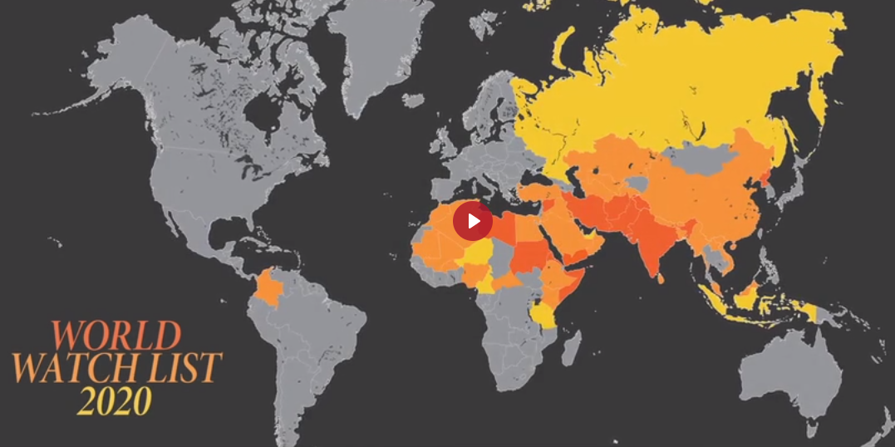
Notes:
https://www.opendoorsusa.org/christian-persecution/stories/the-10-most-dangerous-places-for-christians/

Slide 22
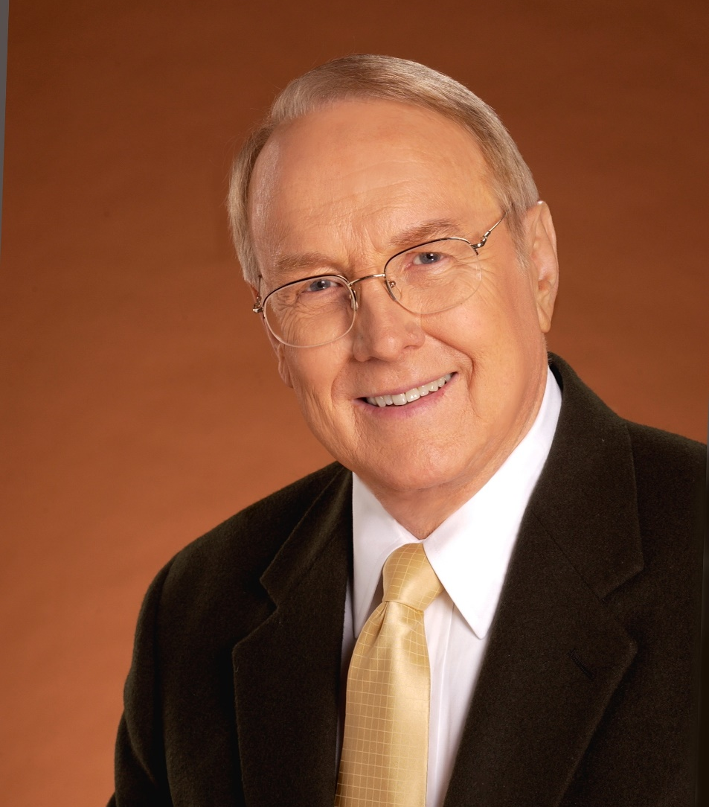
Monday and Tuesday, Nov. 16-17, Dr. James Dobson hosted
Johnnie Moore.

Slide 23
Johnnie Moore. He is my very, very good friend, a man I respect very highly. He's also, for the last four years, been a colleague of mine on the White House Faith Advisory Board.
Notes:
https://familytalk.widen.net/view/pdf/gg4ei1x069/11162020THENEXTJIHAD1.pdf?t.download=true

Slide 24
Johnnie serves on the United States Commission for International Religious Freedom. He serves as president of the Congress on Christian Leaders. He is also a founder of the KAIROS organization, company, a communication and public relations consultant firm that works with us.
Notes:
https://familytalk.widen.net/view/pdf/gg4ei1x069/11162020THENEXTJIHAD1.pdf?t.download=true

Slide 25
Johnnie Moore: When I was a child, my family went through a traumatic divorce. It caused me to ask a lot of questions about my faith. I found the answers to those questions in the persecuted church
Notes:
https://familytalk.widen.net/view/pdf/gg4ei1x069/11162020THENEXTJIHAD1.pdf?t.download=true

Slide 26
Just before my parents divorced, I was laying in my bed one night. I rolled over, and I looked at the wall. I can see it in my head now. I said, "God, I'm not really sure I've given my life to you, and so I want to do that right now." I count that as my salvation, when I was about 12. Then I started studying the Bible every night from 9:00 to 9:30.
Notes:
https://familytalk.widen.net/view/pdf/gg4ei1x069/11162020THENEXTJIHAD1.pdf?t.download=true

Slide 27
My parents were in church every time the doors were open. We were a very, very Christian family, yet it didn't hold their marriage together. What I found was sometimes in America, we can have a form of godliness with no power. When you might lose your life today just because of being a believer,
Notes:
https://familytalk.widen.net/view/pdf/gg4ei1x069/11162020THENEXTJIHAD1.pdf?t.download=true

Slide 28
you don't have the luxury of having a form of godliness with no power. You either believe it or you don't. My passion for the persecuted church... I say I sort of found my faith again by finding the testimony of the persecuted believers.
Notes:
https://familytalk.widen.net/view/pdf/gg4ei1x069/11162020THENEXTJIHAD1.pdf?t.download=true
I just decided at the very beginning, I was going to have a relationship with both of them. I was doing shuttle diplomacy. I was picking up the phone, talking to my mom, talking to my dad, negotiating between the two of them, eventually allowed my parents to sort of find their faith again.
My mom went out to the mailbox one day. We were in Florence, South Carolina. We were at the end of our rope. I mean, people bringing us food... We couldn't pay the power bill. We were in poverty. There was a scholarship in the mail for my mom to attend a Bible institute at Liberty University. We moved on faith to Lynchburg, Virginia. We stayed in the dorms that summer until Mom could find a house and a job.

Slide 29
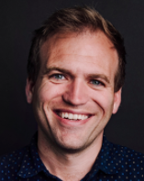
Johnnie Moore
Time Magazine named him one of the 25 Most Influential Evangelicals in America, and he is the youngest recipient of the Simon Wiesenthal Center’s prestigious Medal of Valor
Notes:
https://thekcompany.co/who-we-are/
What is the Simon Wiesenthal Center?

Slide 30
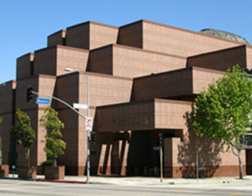
The Simon Wiesen-thal Center
Toronto, Ontario, Canada

Slide 31
The Simon Wiesenthal Center (SWC) is a Jewish, pro-Israel, human rights organization established in 1977 by Rabbi Marvin Hier. The Center is known for Holocaust research and remembrance, hunting Nazi war criminals, combating anti-Semitism, tolerance education, defending Israel, and its Museum of Tolerance.
Notes:
https://en.wikipedia.org/wiki/Simon_Wiesenthal_Center

Slide 32
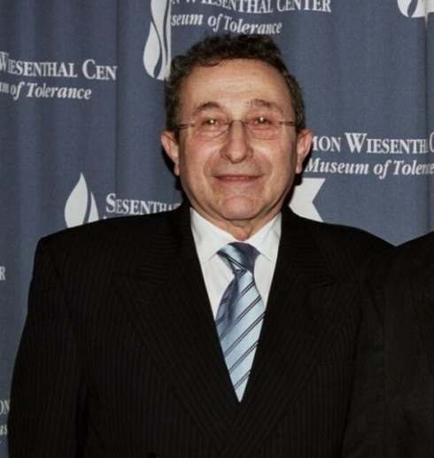
Newsweek describes Marvin Hier as the following, "Hier is one phone call away from almost every world leader, journalist and Hollywood studio head. He is the dean and founder of the Simon Wiesenthal Center.
Notes:
Premier Nazi Hunter of the World

Slide 33
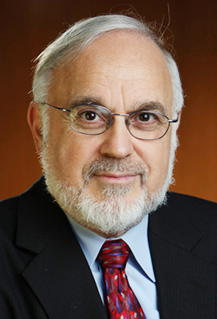
Rabbi Abraham Cooper (successor to Heir) is the associate dean and director of Global Social Action Agenda for the Simon Wiesenthal Center.

Slide 34
Johnnie Moore: Rabbi Cooper and I are separated by 45 years. He lives on one side of the country, I live on a different side of the country. He's an Orthodox Jewish rabbi. I'm an evangelical Christian, and yet we're united together in our passion for action.
Notes:
https://familytalk.widen.net/view/pdf/ulmxuvxjd8/11172020THENEXTJIHAD2.pdf?t.download=true

Slide 35
The Simon Wiesenthal Center where Rabbi Cooper is, was the first organization in the world, a Jewish organization, not a Christian one, that said that ISIS was guilty of genocide against Christians in Iraq and Syria. It was Rabbi Cooper who encouraged me to go to Nigeria with him.
Notes:
https://familytalk.widen.net/view/pdf/ulmxuvxjd8/11172020THENEXTJIHAD2.pdf?t.download=true
So, the rabbi and the pastor are on a planeflight…
Rabbi Cooper told me his stories about being an advocate for Jews trapped in the Soviet Union, as a leader of the Soviet Jew Removement, and it was a part of history I didn't even know about. As I was watching socialism become a fixation of American politics suddenly

Slide 36
Right before COVID-19 shut down the world Rabbi Abraham Cooper from Los Angeles, and I traveled to Nigeria. We spent days meeting with victims and hearing the most horrific stories I've ever heard in my life.
Notes:
https://familytalk.widen.net/view/pdf/gg4ei1x069/11162020THENEXTJIHAD1.pdf?t.download=true

Slide 37
One whole village came to see us. We thought a representative of the village was going to come. The whole village crowded in our hotel room. Two weeks before, everything had been burned down. There's still adult men in clinical shock sitting across from us.
Notes:
https://familytalk.widen.net/view/pdf/gg4ei1x069/11162020THENEXTJIHAD1.pdf?t.download=true

Slide 38
They had hoped that as a couple of Americans, a rabbi and a Christian pastor, that just somehow, somehow that America could be their hope. The only promise I made them was, "We will be your voice." Their voice is silent.
Notes:
https://familytalk.widen.net/view/pdf/gg4ei1x069/11162020THENEXTJIHAD1.pdf?t.download=true

Slide 39
I told Rabbi Cooper, I don't know that we can solve the problem in Nigeria, but we can make sure that a day doesn't go by when the Nigerian government isn't feeling heat from people all around the world to get their act together. We decided to immediately write a book.
Notes:
https://familytalk.widen.net/view/pdf/gg4ei1x069/11162020THENEXTJIHAD1.pdf?t.download=true

Slide 40
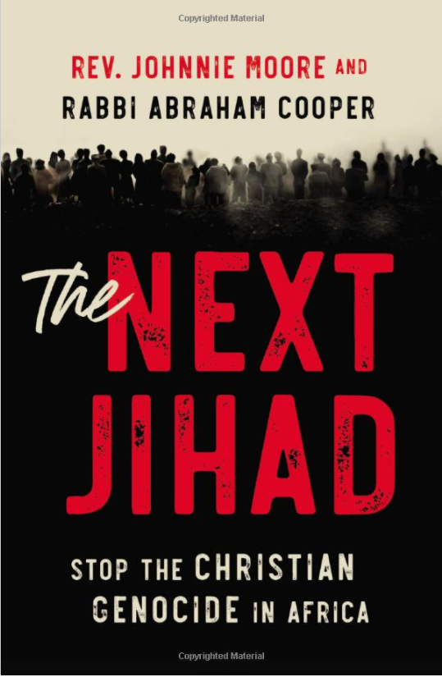

Slide 41
The rest of the story:
Nigeria is the largest country in Africa, has the largest economy in Africa, 10th largest oil reserves in the world. It's a very, very important country.
Notes:
https://familytalk.widen.net/view/pdf/gg4ei1x069/11162020THENEXTJIHAD1.pdf?t.download=true

Slide 42
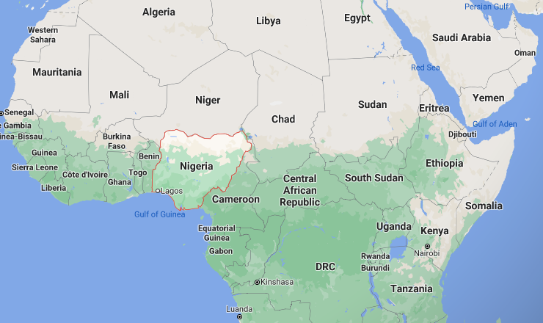

Slide 43
7 out of 10 persecuted Christians in the world that will die this year will die in Nigeria.
Notes:
https://familytalk.widen.net/view/pdf/gg4ei1x069/11162020THENEXTJIHAD1.pdf?t.download=true

Slide 44
Boko Haram has caused Christian churches in Nigeria to be burned down, homes ransacked, their children abducted, women and young girls savagely raped, and thousands have been grotesquely murdered. Others have simply vanished.
Notes:
https://familytalk.widen.net/view/pdf/gg4ei1x069/11162020THENEXTJIHAD1.pdf?t.download=true

Slide 45
Boko Haram killed more Christians in Northeast Nigeria than ISIS did at their height in Iraq and Syria. whole villages, thousands of villages, totally burned to the ground.
Notes:
https://familytalk.widen.net/view/pdf/gg4ei1x069/11162020THENEXTJIHAD1.pdf?t.download=true

Slide 46
Cars being pulled over on the side of the road... They ask if you're a Christian or a Muslim. The Muslims are let free. The Christian men are killed. The women are sold as slaves.
Notes:
https://familytalk.widen.net/view/pdf/gg4ei1x069/11162020THENEXTJIHAD1.pdf?t.download=true

Slide 47
One state alone in Nigeria has had 700 or 800 churches burned to the ground. In this village they had burned, they found the cell phone of one of the perpetrators. In his contacts on the cell phone were members of the government and the police. No one's prosecuted. Nothing ever happens.
Notes:
https://familytalk.widen.net/view/pdf/gg4ei1x069/11162020THENEXTJIHAD1.pdf?t.download=true

Slide 48
Just last year, where Boko Haram went in. They kidnapped over 100 young women. They let every one of them go except for one. Her name is Leah Sharibu. We were there on the second anniversary of her captivity. Leah Sharibu wasn't released because she refused to convert to Islam.
Notes:
https://familytalk.widen.net/view/pdf/gg4ei1x069/11162020THENEXTJIHAD1.pdf?t.download=true
One of the girls said, "We begged Leah to convert. She refused to convert, so they're keeping her." While we're talking right now, that young woman with more faith than anybody I know, is in the captivity of Boko Haram for one reason: she will not deny Jesus.

Slide 49
A previous administration fought tooth and nail against designating Boko Haram a terrorist organization.
Notes:
https://familytalk.widen.net/view/pdf/ulmxuvxjd8/11172020THENEXTJIHAD2.pdf?t.download=true

Slide 50
In a UN report, not some right-wing religious freedom organization, a United Nations report said that between 50 and 70 little children had bombs strapped to them and were remotely blown up in the middle of Christian cities, and they wouldn't designate this group a terroristorganization?
Notes:
https://familytalk.widen.net/view/pdf/ulmxuvxjd8/11172020THENEXTJIHAD2.pdf?t.download=true

Slide 51
A previous administration refused to designate ISIS guilty of genocide in Iraq and Syria, despite what they were doing. However, because of the pressure put on Congress, we had a unanimous resolutions passed in the House and in the Senate saying that ISIS was guilty of genocide.
Notes:
https://familytalk.widen.net/view/pdf/ulmxuvxjd8/11172020THENEXTJIHAD2.pdf?t.download=true

Slide 52
The US militarily eliminated the caliphate in Iraq and Syria, ISIS is gone, but we have a problem brewing in Western Africa. If you think the Syrian refugee crisis caused a problem in the world and the Syrian civil war, you haven't seen anything yet if Western Africa fails.
Notes:
https://familytalk.widen.net/view/pdf/gg4ei1x069/11162020THENEXTJIHAD1.pdf?t.download=true

Slide 53
Besides Nigeria…China

Slide 54
The country that worries me the most in the world when you take everything into account, is China. You have the second most powerful country in the world, a huge rival of the United States of America.
Notes:
https://familytalk.widen.net/view/pdf/ulmxuvxjd8/11172020THENEXTJIHAD2.pdf?t.download=true

Slide 55
Right now, we're having a relapse of the Cultural Revolution in China. In the last year and a half, the Chinese government has shut down every large evangelical church in the country.
Notes:
https://familytalk.widen.net/view/pdf/ulmxuvxjd8/11172020THENEXTJIHAD2.pdf?t.download=true

Slide 56
When ISIS was moving across Syria and Iraq tearing down crosses off of churches and doing all these horrible things to people, in one state in China, the Chinese government removed 1,200 crosses from churches. It's not just Christians, I mean,
Notes:
https://familytalk.widen.net/view/pdf/ulmxuvxjd8/11172020THENEXTJIHAD2.pdf?t.download=true

Slide 57
in the Western part of the country, they're between four and 500, what the Chinese government call “reeducation centers.” What they actually are, are concentration camps, where they have put Chinese Muslims to try to forcibly change their beliefs.
Notes:
https://familytalk.widen.net/view/pdf/ulmxuvxjd8/11172020THENEXTJIHAD2.pdf?t.download=true

Slide 58
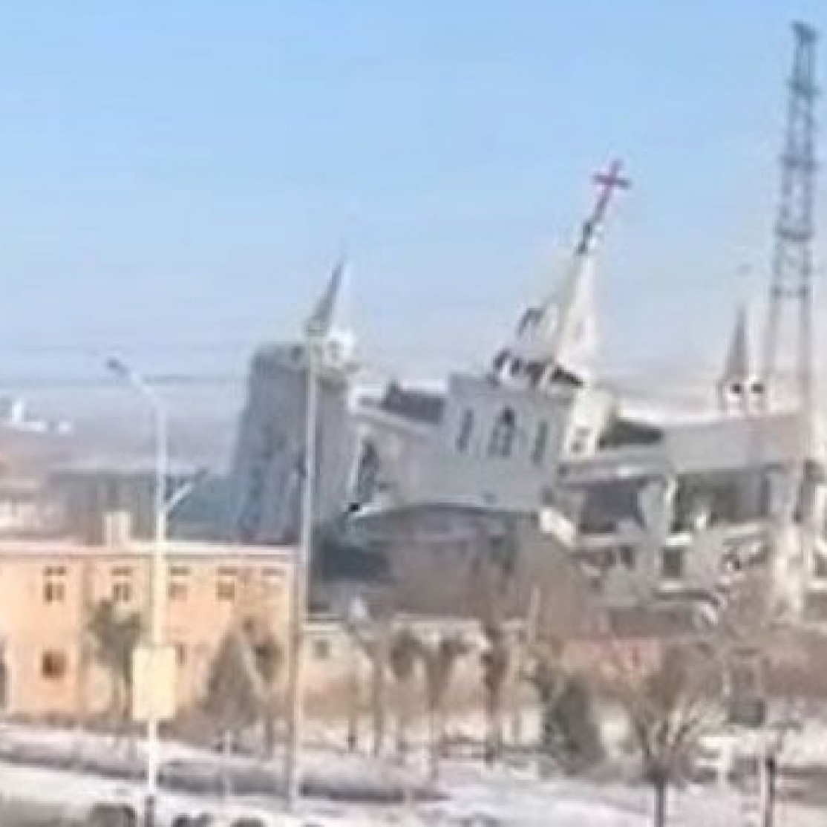
Golden Lampstand
Church
Notes:
https://www.americamagazine.org/politics-society/2018/01/25/chinese-christian-churches-face-new-threats-state-religious-code

Slide 59
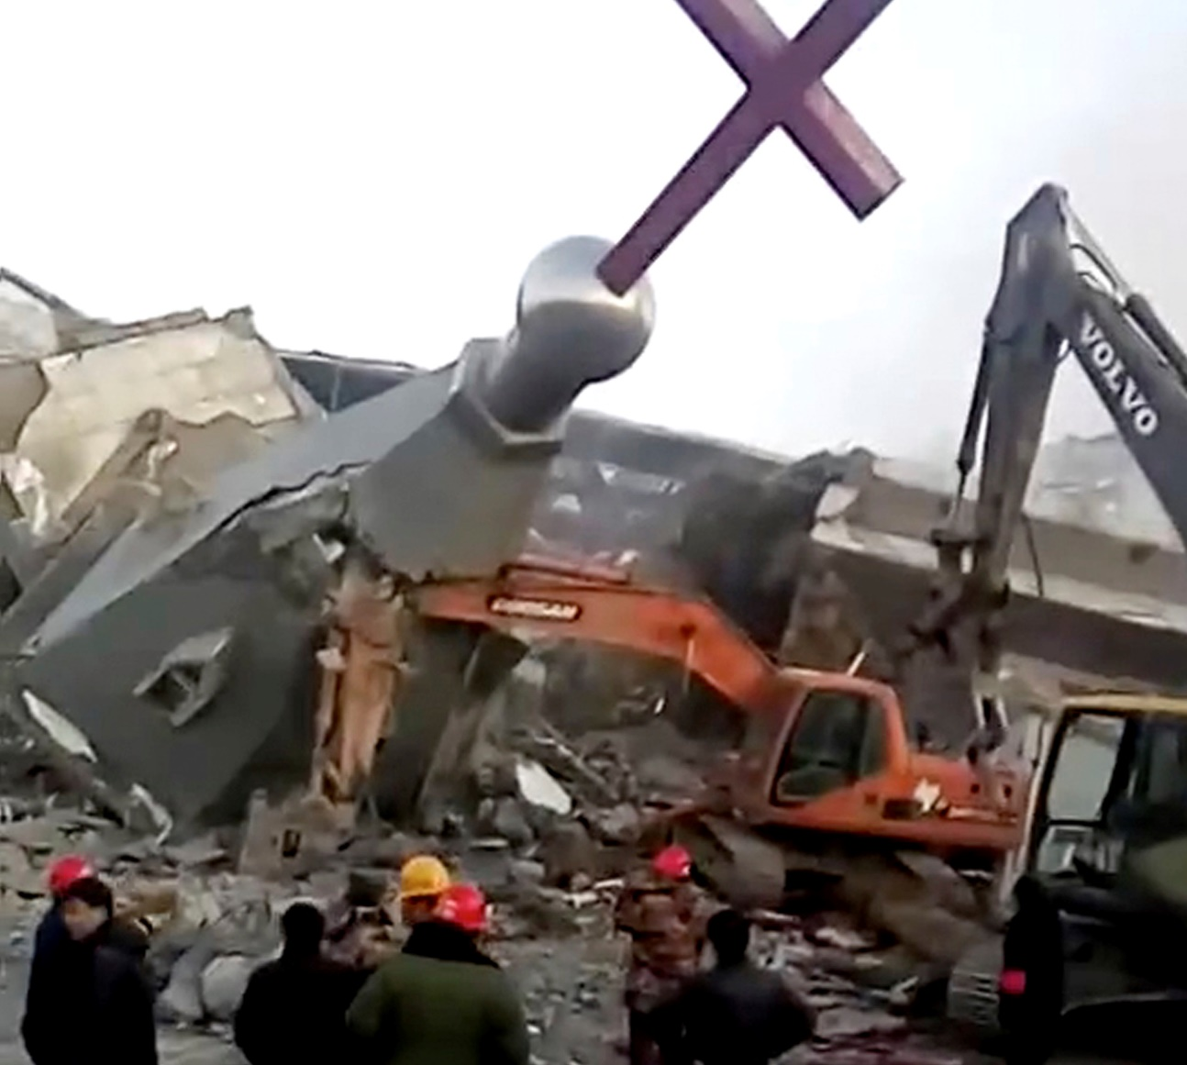
Remains of the Golden Lampstand Church in Linfen in northern China's Shanxi province. (China Aid via AP)
Notes:
https://www.americamagazine.org/politics-society/2018/01/25/chinese-christian-churches-face-new-threats-state-religious-code

Slide 60
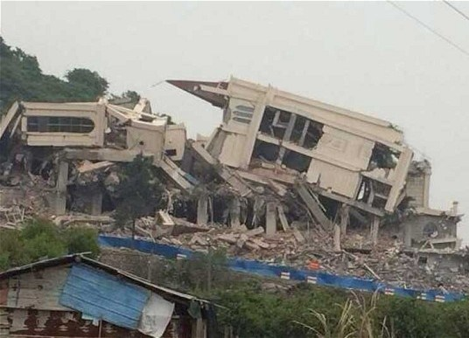
Despite an agreement to dismantle only part of its annex, local officials proceeded with a full-scale demolition of a church in Sanjiang, near Wenzhou in Zhejiang province.
Notes:
http://www.beyondchinatown.com/2014/12/30/sanjiang-church-demolished/

Slide 61
Yet, the faith has never grown at such a rapid pace. In the same China where they keep shutting down all these churches and taking religious symbols off of churches, there are now more Christians in China than there are members of the Communist Party.
Notes:
https://familytalk.widen.net/view/pdf/ulmxuvxjd8/11172020THENEXTJIHAD2.pdf?t.download=true

Slide 62
It's not just China, it's North Korea, it's Iran. It’s several other Arab countries. the US Commission for International Religious Freedom, we have more than a dozen countries in the very top category. We have like 20 others in the second category.
Notes:
https://familytalk.widen.net/view/pdf/ulmxuvxjd8/11172020THENEXTJIHAD2.pdf?t.download=true

Slide 63
The most dangerous places for Believers
N. Korea 19 consecutive years.
Afghanistan: Mental hospitals
Somalia
Libya, 5. Pakistan, 6. Eritrea
Notes:
https://www.opendoorsusa.org/christian-persecution/stories/the-10-most-dangerous-places-for-christians/

Slide 64
This year, as the United Nations estimates half of North Korea’s population is in need and 41 percent is undernourished, North Koreans are bracing for the worst. North Korea reduced rations for its people in February,
Notes:
https://www.opendoorsusa.org/christian-persecution/stories/the-secret-plan-to-save-north-korea/

Slide 65
and in May the regime took the rare step of publicly admitting there was a crippling drought. A typhoon in early September has made the problem even worse, destroying crops and farmland.
Notes:
https://www.opendoorsusa.org/christian-persecution/stories/the-secret-plan-to-save-north-korea/

Slide 66
For Christians in North Korea, the threat is even greater. Already forced underground because of their faith, their access to even the small food rations provided by the government will be taken away if it’s discovered they follow Messiah.
Notes:
https://www.opendoorsusa.org/christian-persecution/stories/the-secret-plan-to-save-north-korea/

Slide 67
If Christians are found out, they can immediately be sent to prison camps, where they work and live in subhuman conditions, forced to eat even less than drought conditions might provide.
Notes:
https://www.opendoorsusa.org/christian-persecution/stories/the-secret-plan-to-save-north-korea/

Slide 68
It’s no wonder that believing parents can’t even share their faith with their children. To be a Christian in North Korea is to worship Messiah in isolation, with limited access to God’s Word. Open Doors estimates there are around 300,000 secret Christians in North Korea, all of whom live and worship in unthinkable conditions.
Notes:
https://www.opendoorsusa.org/christian-persecution/stories/the-secret-plan-to-save-north-korea/
They share with their kids when teens, and hopefully can keep secrets.

Slide 69
An Open Doors co-worker recently met a North Korean underground leader we’ll call “Brother Yi.” “I met him in China for the second time this year,” says this Open Doors partner. “Last year, he received an audio device with the Bible and other materials on it from me. He takes care of a network of 15 people.
Notes:
https://www.opendoorsusa.org/christian-persecution/stories/the-secret-plan-to-save-north-korea/

Slide 70
He shared a lot of food with the people around him—so much so that he was called for interrogation by the authorities. He still uses the audio Bible we gave him for his personal Bible study. I also supported him with food, medicine and clothes.”
Notes:
https://www.opendoorsusa.org/christian-persecution/stories/the-secret-plan-to-save-north-korea/

Slide 71
Iran

Slide 72
Abouzar Soltani, an Iranian Christian, and his 11-year-old-son Armin. Soltani had been living in blue containers since late 2018 after asking for asylum on political and religious grounds. Soltani recently ”thanked God" after he was moved to a reception center following
Notes:
https://www.worthynews.com/54185-hungary-warns-of-christian-persecution-in-europe

Slide 73
17 months of detention in a container camp on the Hungarian-Serbian border. However his legal case continues, the Hungarian Helsinki Committee rights group told Worthy News. Soltani could face a lengthy prison term and potentially execution in Iran for abandoning Islam.
Notes:
https://www.worthynews.com/54185-hungary-warns-of-christian-persecution-in-europe

Slide 74
Every day, an average of eight Christians were killed for their faith and 23 Christians were raped or sexually harassed for faith-related reasons. Every week, an average of 182 Churches or Christian buildings were attacked, and 102 Christian homes, shops or businesses attacked, burned or destroyed. Every month, an average of 309 Christians were unjustly imprisoned for their faith.
Notes:
https://www.opendoorsusa.org/christian-persecution/stories/the-10-most-dangerous-places-for-christians/

Slide 75
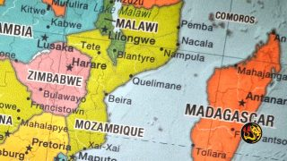
(Worthy News) - Aid workers say thousands of desperate people, many of them Christians, have fled an area in northern Mozambique after Islamist fighters killed dozens of villagers.
Police confirmed that militants linked to the Islamist State terrorist group beheaded and dismembered over 50 people in Mozambique’s Cabo Delgado province last week.
Notes:
https://www.worthynews.com/54239-thousands-flee-after-militants-behead-christians-in-mozambique

Slide 76
In the peace accord between Israel and the kingdom of Bahrain, the first paragraph of the Abraham Accord includes religious freedom.
Notes:
https://familytalk.widen.net/view/pdf/gg4ei1x069/11162020THENEXTJIHAD1.pdf?t.download=true
We are used to this in the USA, tend to think it’s normative. First Amendment

Slide 77
First Amendment Congress shall make no law respecting an establishment of religion, or prohibiting the free exercise thereof; or abridging the freedom of speech, or of the press; or the right of the people peaceably to assemble, and to petition the Government for a redress of grievances.

Slide 78
Persecution is actually a norm.
In early American history, every family had two books. They had a Bible, and they had Foxe's Book of Martyrs.
Notes:
https://familytalk.widen.net/view/pdf/gg4ei1x069/11162020THENEXTJIHAD1.pdf?t.download=true

Slide 79
Christian persecution around the world is worse, at its all-time worst, two times a year, Christmas and Easter. That's when the churches are bombed. That's when people are kidnapped. It's predictable. It's like clockwork.
Notes:
https://familytalk.widen.net/view/pdf/ulmxuvxjd8/11172020THENEXTJIHAD2.pdf?t.download=true

Slide 80
So, will this ever apply
to us in America?
Notes:
We are already out of sync with the culture. Conceivable it could be viewed as a hate crime to say, however lovingly, that sex is glorious in a marriage between an XX woman and an XY man, but otherwise, a sin in the sight of G-d.
Vocabulary of the media is “transgender rights.” That makes people who want separate men’s and women’s bathrooms and locker rooms seem aggressors. The term should be “gender privacy rights.”
A minor but sort of scary incident to me this week.

Slide 81
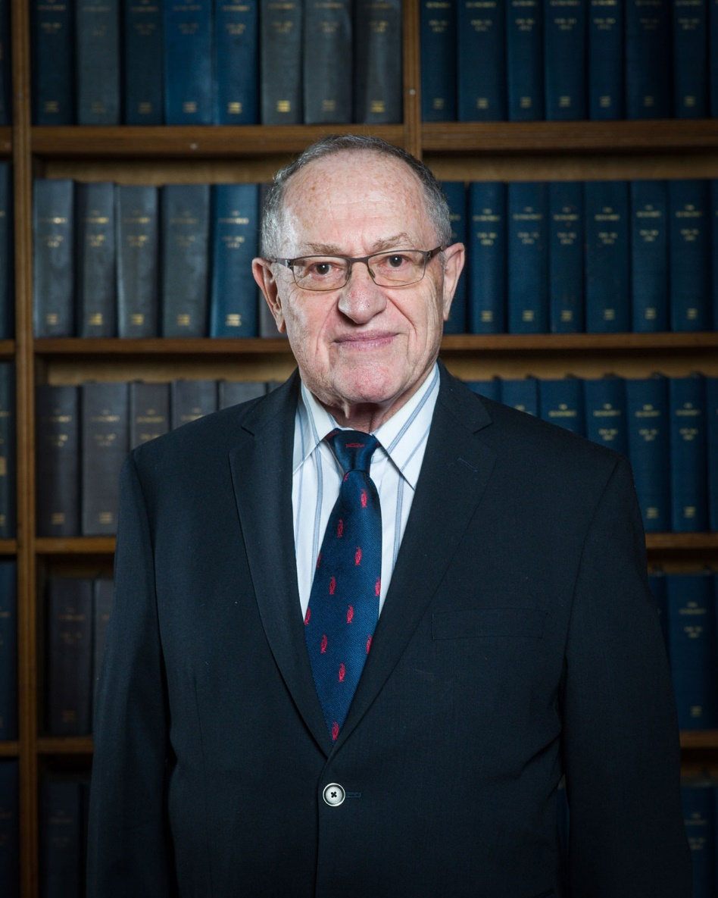
Alan Morton Dershowitz is an American lawyer and legal scholar known for his scholarship of U.S. constitutional law and American criminal law, and a noted advocate of civil liberties. He taught at Harvard Law School from 1964 through 2013, where he was appointed as the Felix Frankfurter Professor of Law in 1993.

Slide 82
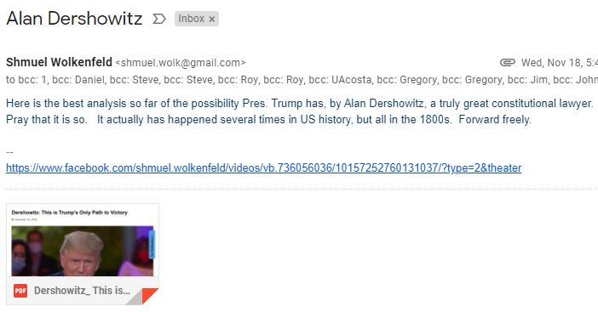

Slide 83
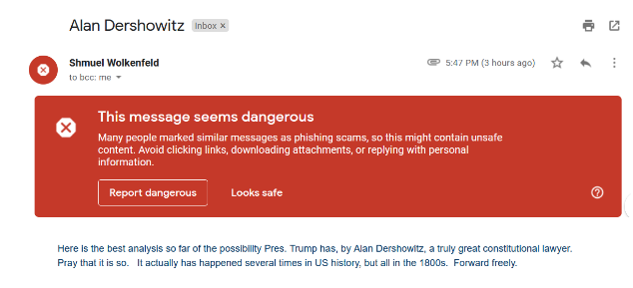
Notes:
Consider John MacArthur and defying California Governor Gavin Newsome to have service. 4000 people and 3 cases of COVID.

Slide 84
Outline
Life is uncertain, especially if persecuted.
MUCH persecution of believers
Will it come to the USA?
Prepare by exercising!!

Slide 85
^{Yer. 12.5} If racing men on foot exhausts you, how will you compete against horses? You may feel secure in a land at peace, but how will you do in the Yarden’s thick brush?

Slide 86
^{1 Cor 9.25-27} Now every athlete in training submits himself to strict discipline, and he does it just to win a laurel wreath that will soon wither away. But we do it to win a crown that will last forever. Accordingly, I don’t run aimlessly but straight for the finish line;
Notes:
Discipline: Presence: prayer and Shma: hearing from G-d in the Word.

Slide 87
^{1 Cor 9.25-27} I don’t shadow-box but try to make every punch count. I treat my body hard and make it my slave so that, after proclaiming the Good News to others, I myself will not be disqualified.
The first steps are the hardest.

Slide 88
Chuck Colson said to me over and over again when I saw us losing ground is, that despair is a sin. It means that you're no longer depending on the Lord.
Notes:
https://familytalk.widen.net/view/pdf/ulmxuvxjd8/11172020THENEXTJIHAD2.pdf?t.download=true
Personally, I’ve been living in a sort of apocalyptic sense of judgment coming since my teens. Remember this? It’s sort of back in the consciousness.

Slide 89
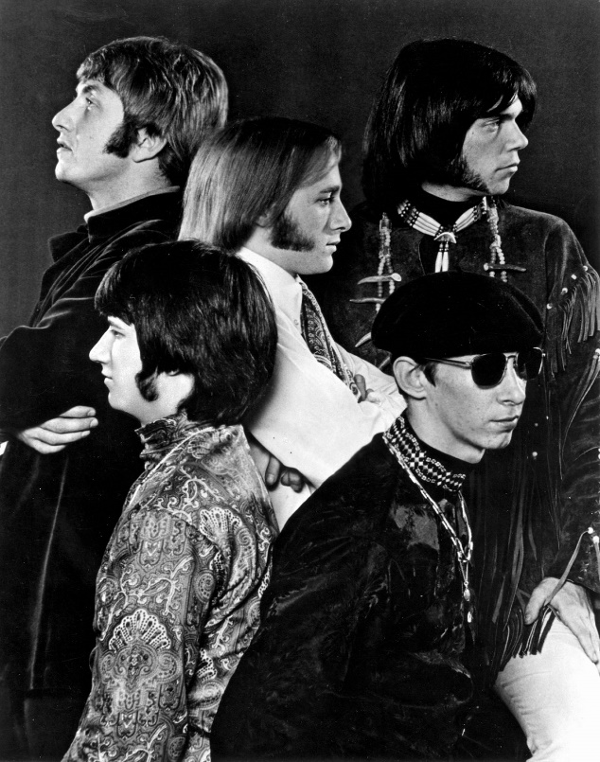
Buffalo Springfield were a Canadian–American rock band formed in Los Angeles by three Canadians and two Americans. The group, widely known for the song “For What It's Worth”, released three albums and several singles from 1966–1968.
Notes:
https://www.youtube.com/watch?v=vRdMa5U8M-0

Slide 90
^{Rev. 6.9-11} When the Lamb broke the fifth seal, I saw underneath the altar the souls of those who had been put to death for proclaiming the Word of God, that is, for bearing witness…of them was given a white robe;

Slide 91
^{Rev. 6.9-11} and they were told to wait a little longer, until the full number of their fellow-servants should be reached, of their brothers who would be killed, just as they had been.

Slide 92
^{1Tim.4.7-8} Train, exercise yourself in godliness. For physical exercise has some benefit; but godliness is beneficial for all things, holding promise for both the present life and the one to come.
We don’t achieve godliness, but we grow in it or NOT!

Slide 93
Outline
Life is uncertain, especially if persecuted.
MUCH persecution of believers
Will it come to the USA?
Prepare by exercising!!

Slide 94
^{MJ 13.1-3} Let brotherly love continue. Do not neglect to show hospitality to strangers—for in doing so, some have entertained angels without knowing it. Remember the prisoners as if you were fellow prisoners, and those who are mistreated as if you also were suffering bodily.

