Slide 1
e-handout
To have these notes
without taking notes
Go to OrHaOlam.com
Click on downloads,
messages, 2020

Slide 2
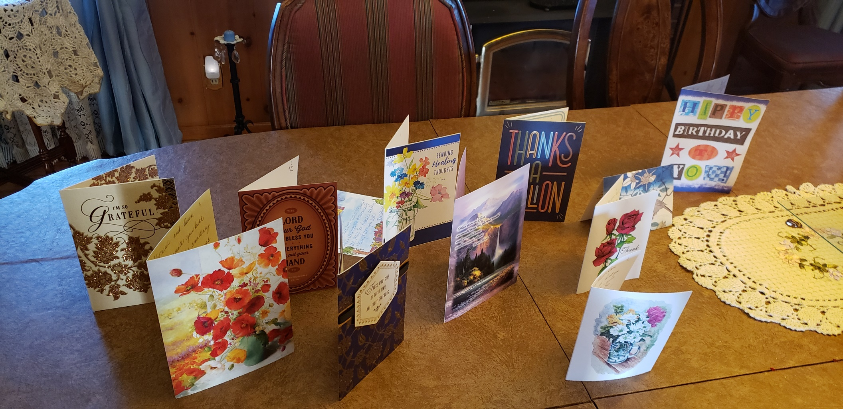
Some of the Rabbi appreciation cards! You are a GREAT blessing!
Notes:
Dawn and I are DEEPLY appreciative.

Slide 3
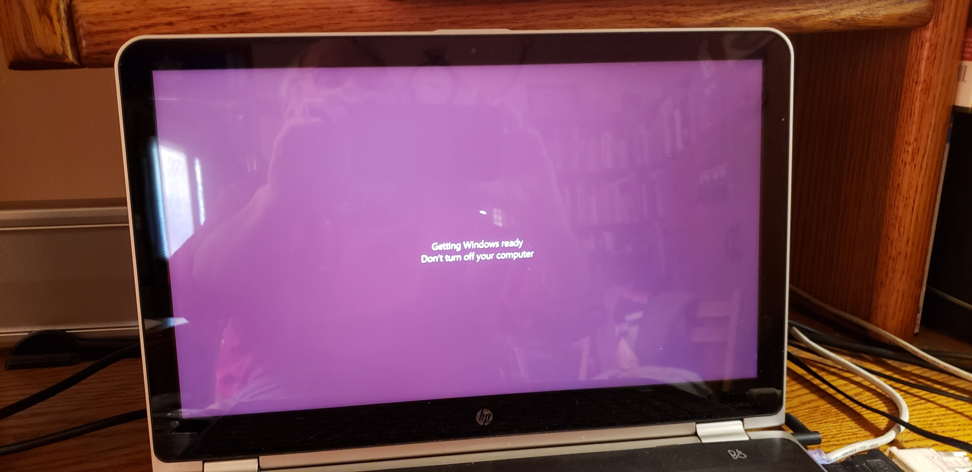
Notes:
At about 8:00 or earlier last week, Shabbat morning, [Oct. 31, 2020] I powered up my computer to review and rehearse my message. It was running really slow, so I rebooted. Then it went into this. So, I waited.

Slide 4
Notes:
And waited. About 8:30 I texted Brett, who said, just wait. If you turn it off, “You can brick your computer.” Have to reinstall Windows. So waited. Nothing to do except pray and praise. No notes to review. No emails. About 9:00 I phone Rukhel, Cantor of the day, to tell her that she may have to do announcements. I may preach by phone. Then waited. Meanwhile, Brett told me that he was in the attic above the Youth Room and library, since the furnace fan wasn’t blowing. What else can go wrong?
About 9.30, [over an HOUR of spinning] with Brett’s advice, I took the gamble and turned it off. Holding power button and forcing power down. Then a half minute later I restarted.
About 9:40 I had a computer. After an hour of shutdown and stress, and praise. Opened Zoom meeting. Quick review of message.

Slide 5
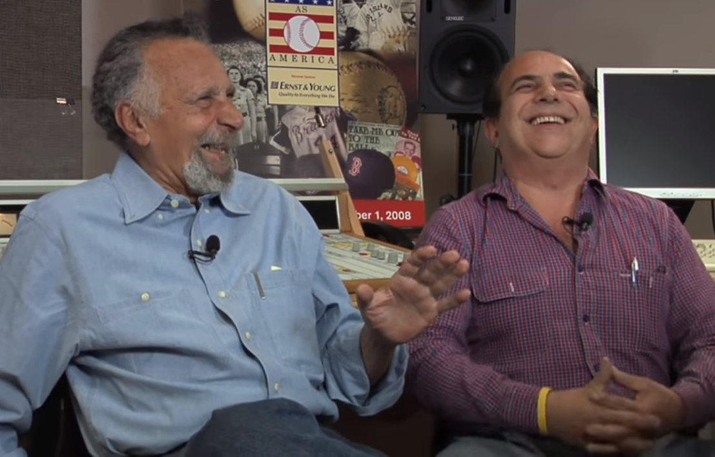
Does anyone remember Car Talk?
Notes:
Its subjects were automobiles and automotive repair, discussed often in a humorous way. It was hosted by brothers Tom and Ray Magliozzi, known also as "Click and Clack, the Tappet Brothers".
Off air now. One of brothers died. Lives on a bit in emails….

Slide 6
Why do chicken coops have two doors?
Because if they had four, they'd be chicken sedans!
Peter Tardiff CarTalk.com
Notes:
https://www.cartalk.com/content/lame-jokes-8

Slide 7
When asked by a young patrol officer, "Do you know you were speeding?" The 83-year-old woman talked herself out of a ticket by stating, "Yes, but I had to get there before I forgot where I was going."
George Piscitello CarTalk.com
Notes:
https://www.cartalk.com/content/lame-jokes-8

Slide 8
Not from Car Talk…

Slide 9
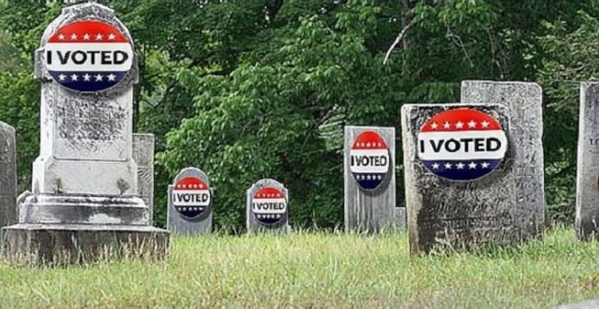
The Dead Can Vote in New York
Notes:
https://thejewishvoice.com/2020/11/proof-the-dead-can-vote-in-new-york/

Slide 10
A Writer for the Jewish Voice’s Grandmother who died in 2011, received an express voting card and polling location in Brooklyn, NY.
Notes:
https://thejewishvoice.com/2020/11/proof-the-dead-can-vote-in-new-york/
My kids moved out and still registered at my address for years!

Slide 11
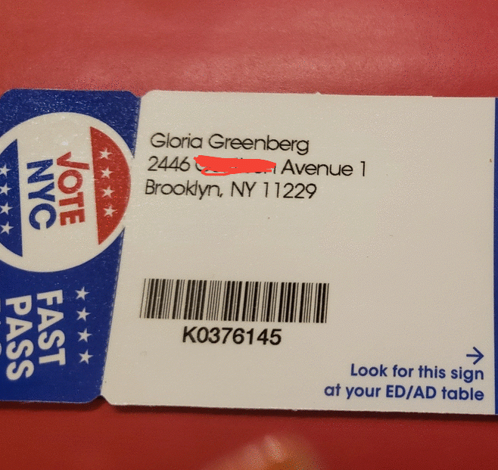
Notes:
https://thejewishvoice.com/2020/11/proof-the-dead-can-vote-in-new-york/

Slide 12
Nevertheless, concerning
the election…

Slide 13
^{Mishlei/Prov 8.14-15} Counsel and sound wisdom are mine. I have understanding and power. By me kings reign and princes decree justice.

Slide 14
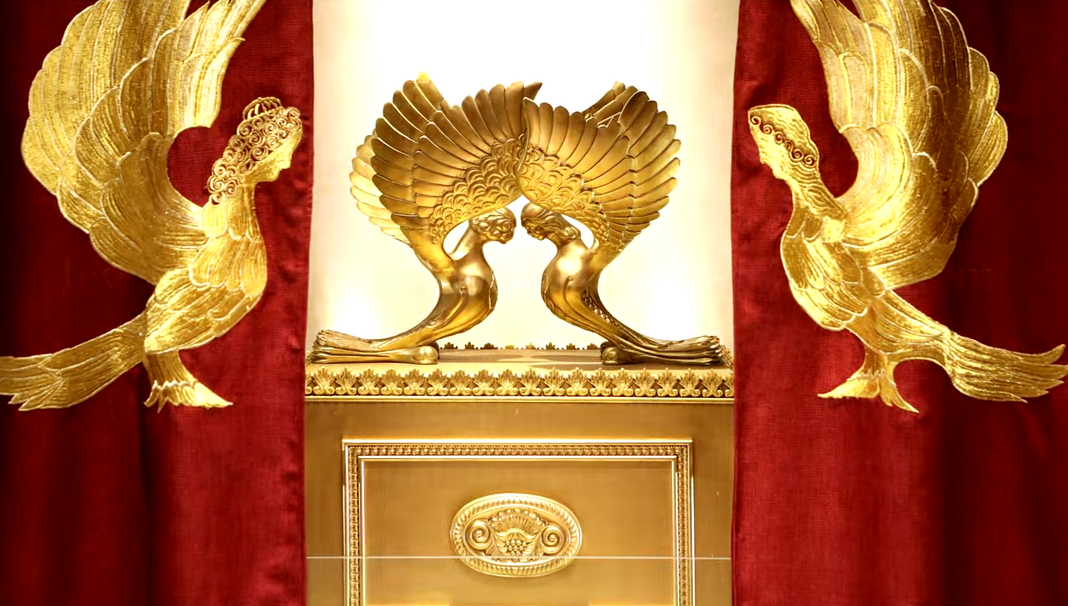
Letter to the Messianic Jews
[Hebrews] MJ 6.1-6.3
First Principles Part 5
Eternity
Notes:
https://www.templeinstitute.org/new-location.htm

Slide 15
^{MJ 6.1-3} Therefore, leaving behind the initial lessons about the Messiah, let us go on to maturity, not laying again the foundation of [Note six foundations]
₁turning from works that lead to death,
₂trusting God, and
Notes:
Six principles

Slide 16
^{MJ 6.1-3} and ₃instruction about washings, ₄s’mikhah, ₅the resurrection of the dead and ₆eternal punishment. And, God willing, this is what we will do.

Slide 17
The first of the first principles is repentance.
Notes:
Do you, do I, have the sense of life without Messiah, whoever noble it may appear, is wrought in the context of death: ego, lust, materialism.

Slide 18
^{MJ 6.1} ₂trusting God
This is MUCH MORE than mental assent to truth. Faith is also a decision to receive believe and trust the revelation. Live by it!

Slide 19
Immersion: radical commitment to learn Messiah and His holy ways.

Slide 20
₄s’mikhah סְמִיכָה noun
Receiving blessing and empowerment to serve in JOY

Slide 21
Is there a pattern of power?
Repentance from dead works.
Faith in G-d thru resurrected Messiah.
Instruction in obedience expressed in immersion.
Laying on of hands for joy and service.

Slide 22
Other early sources of initiation into the faith of Messiah:
The Didache first century
Justin Martyr’s First Apology 150 CE second centure
Apostolic Constitutions 200s CE Third century
Notes:
D. Thomas Lancaster Elementary Principles Ch 7
Similar to Grow Conf: Love G-d, Healing in Discipleships/Home groups, training, engagement.

Slide 23
Lost people reborn | Cup of Sanctifica-tion | Know G-d | Yokhanan/ John Lion | Main service | Repen-tance
Reborn people healed | Cup of judgment | Find Freedom Emotionally Jewishly | Luke Man | Home groups | Faith/ Healing
Healed people trained | Cup of Redemp-tion | Discover Develop your calling | Matthew Eagle | Training | Immer-sion/ Teaching
Trained people mobilized | Cup of fulfilment | Make a Difference | Mark Ox: plow or sacrifice | Dream team | Hands-on: joy and service
Notes:
Cups:
out of Egypt,
Egypt out of you / deliverance,
back to original intention/after supper,
Praise
10 other scriptures where this pattern appears.
• Know G-d: the main weekend service
• Find freedom: intimacy and community of the small groups
• Discover purpose: discipleship and training
• Make a difference: Dream team

Slide 24
We’re not done with Chris Hodges and the Grow Conference.
“Not yet begun to fight.” John Paul Jones on the Bonhomme Richard 1779 against the superior British ships.
We will win souls, and win moral battles!
Notes:
"I have not yet begun to fight!" This was the immortal retort of Captain John Paul Jones to a request to surrender as he and his crew engaged in a desperate battle with a British frigate off the northern coast of England during the American Revolution.

Slide 25
So, What is
₅the resurrection of the dead and ₆eternal punishment.
First of all, what it is not.
Notes:
This takes the discussion into another dimension, somewhat implied in the first four, but needing to be articulated. Judgment and eternal punishment and hell and heaven are not popular topics, maybe as an overreaction to the morbid fascination with such in the Medieval and even Reformation days.

Slide 26
Stereotypes:
Heaven is a place in the sky, or another dimension, where Kefa/Peter sits at the pearly gates and grants admission.
Everyone has a mansion.
There will be an eternal worship service.

Slide 27
People will be unrecognizable.
People will have no gender identity.
Peter sits and grants admission to the pearly gates.

Slide 28
1. New Jerusalem is NOT heaven. The gates of heaven are not pearly gates. ^{Rev. 21.21} And the twelve gates were twelve pearls—each of the gates was from a single pearl. And the street of the city was pure gold, transparent as glass.
Notes:
New Jerusalem is a city, a cubical city descending from G-d, near to the current Jerusalem. We don’t know the details, but it’s not heaven as commonly conceived.

Slide 29
2. ^{Yn 14.1} “Do not let your heart be troubled. Trust in God; trust also in Me. In My Father’s house there are many dwelling places.
In King James’ era, mansion = dwelling.
Notes:
“A mansion just over the hilltop” Me -- I want my residence to be in the heart of downtown New Jerusalem, where the Throne is and the traffic is!

Slide 30
3. ^{Rev 20.6} Blessed and holy is anyone who has a part in the first resurrection; over him the second death has no power. On the contrary, they will be cohanim of God and of the Messiah, and they will rule with him for the thousand years.
Notes:
We won’t be only worshiping, but serving and ruling the universe! Quasars, pulsars, galaxies, black holes. You will easily go where no one has gone before.

Slide 31
4 & 5. So he cried out and said, ‘Father Abraham, have mercy on me! And send Lazarus so he may dip the tip of his finger in water and cool off my tongue, because I am suffering torment in this flame
Notes:
So in eternity there is recognizable identity, and gender. Not say “Parent Abe.”

Slide 32
^{Mtt. 22.30} For in the Resurrection, neither men nor women will marry; rather, they will be like angels in heaven.
6. ^{Mtt. 16.18-19} you are Peter, and upon this rock I will build My community; and the gates of Sheol will not overpower it. I will give you the keys of the kingdom of heaven.
Notes:
No marriage, no physical intimacy.
Keys [according to Adam Clarke] at ordination, smikhah, the rabbi was given a key to where the Torah scrolls were stored, the Aron. So, really means the Word, which Kefa /Peter powerfully handles on the great Shavuot Acts 2 brought 3000 people into the faith of the Messiah.

Slide 33
Much of the time, in the B’sorot/Gospels ‘heaven’ is a circumlocution for ‘G-d’.
Notes:
Circumlocution = word in place of another word. In place of saying the Name.

Slide 34
Kingdom of heaven = Kingdom of G-d. Jews were used to circumlocution. NOT using the Sacred Name. Yeshua followed this. Never said it.
^{Mtt 6.20} Store up for yourselves wealth in heaven, where neither moth nor rust destroys, and burglars do not break in or steal. [=wealth in G-d.]
Notes:
No heavenly ATM were you can draw on your tithes and offerings. Relational.

Slide 35
^{Phil 3.20} For our citizenship is in heaven, and from there we eagerly wait for the Savior, the Lord Yeshua the Messiah.
Similar to Roman citizenship.
Notes:
Not about going to Rome, or going to heaven.

Slide 36
^{Mtt 19.12} Some…have renounced marriage for the sake of the Kingdom of Heaven.
For the sake of G-d.
For land’s sake.
For Pete’s sake
Notes:
The phrase essentially uses Pete a mild substitute for God…in this expression of annoyance or frustration. It’s similar to the less-common, “for the love of Mike.” For Land’s sake.

Slide 37
So, what really is:
₅the resurrection of the dead and ₆eternal punishment.
Going to heaven ≠ entering the kingdom of heaven.
Notes:
We enter the kingdom of heaven when we received Yeshua in repentance, faith, immersion/learning, ordination to service.

Slide 38
There is a temporary place for the not yet resurrected deceased.

Slide 39
^{Lk 16.19-23} “Once there was a rich man who used to dress in the most expensive clothing and spent his days in magnificent luxury. At his gate had been laid a beggar named El‘azar who was covered with sores…In time the beggar died and was carried away by the angels to Avraham’s side;

Slide 40
^{Lk 16.19-23,25-26} “the rich man also died and was buried. “In Sh’ol, where he was in torment, the rich man looked up and saw Avraham far away…now he is comforted here, and you are tormented. Besides all this, between us and you a great chasm is firmly set.
Notes:
So there is a place after death, before the resurrection.

Slide 41
Jewish burial.
Hevra kadishah חֶבְרָה קַדִישָא
organization of Jewish men and women who see to it that the bodies of deceased Jews are prepared for burial according to Jewish tradition and are protected from desecration, willful or not,

Slide 42
until burial. Two of the main requirements are the showing of proper respect for a corpse, and the ritual cleansing of the body and subsequent dressing for burial. It is usually referred to as a burial society in English.
Notes:
In a terrorist event, ALL body parts and fluids must be found and buried.

Slide 43
My בטחון bitakhon vest, means security, but worn by the members of the Hevra Kadisha when gathering up body parts after a terrorist bombing.
Notes:
I thought it was cool, as an Israeli security outfit, until one Israeli lady told me she was a bit traumatized by it, told me the use after a Pigua פיגוע suicide bombing. Other times too, but that was the most dramatic.

Slide 44
^{Acts 9.36-37} In Joppa, there was a disciple named Tabitha (which translates as gazelle). She was full of mitzvot and tzedakah [charity], which she continually did. In those days, she became ill and died. When they had washed her for burial, they placed her in an upstairs room.

Slide 45
^{Yn 19.39-40} Nicodemus, who had first visited Yeshua at night, also came bringing a mixture of myrrh and aloes, about a hundred pounds. Then they took the body of Yeshua and wrapped it in linen with the spices, as is the Jewish burial custom.

Slide 46
The Hevra Kadisha members begin by immersing themselves in a mikvah. Then they gather up and wash and dress the deceased, reciting Psalms. Bodies are buried in 24 hours, unless time is needed for family to gather.

Slide 47
Burial is in a cloth or pine box with no nails. Nothing to hinder “dust returning to dust.” Those who washed the body then have another immersion.
^{1 Cor. 15.29} Were it otherwise [no resurrection], what would the people accomplish who are immersed on behalf of the dead?
Notes:
Honoring the deceased in front of them and hoping/preparing for the resurrection of the dead.

Slide 48
If the dead are not actually raised, why are people immersed for them?
Cf Mormon custom of being immersed for the salvation of deceased relatives, and ancestral search.
Notes:
Honoring the deceased in front of them and hoping/preparing for the resurrection of the dead.

Slide 49
Mourners stay at the gravesite until the body is lowered, then throw in the shovels full of dirt, then say Kaddish.
^{Acts 8.2} Some godly men buried Stephen and mourned him deeply

Slide 50
^{1 Cor 15.51-53} We shall not all sleep,
but we shall all be changed— in a moment, in the twinkling of an eye,
at the last shofar. For the shofar will sound, and the dead will be raised incorruptible, and we will be changed. For this corruptible must put on incorruptibility, and this mortal must put on immortality.
Notes:
This body is significant. Although will return to dust. Orthodox do not cremate. Personally, I think that cremation just expedites the return to dust process. G-d does not need an intact body to resurrect us. So someone dies at sea, and body eaten by sea life. G-d can find us. So, take care of your body. Eat well and healthy. E

Slide 51
So, what really is:
₅the resurrection of the dead and ₆eternal punishment.

Slide 52
Our hope of eternal life is not heaven. It is resurrection!
Messiah was first resurrected.
^{1 Cor 15.23-26} But each in its own order: Messiah the firstfruits; then, at His coming, those who belong to Messiah; then the end,

Slide 53
^{1 Cor 15.23-26} when He hands over the kingdom to God the Father after He has destroyed all rule and all authority and power. For He must reign until He has put all His enemies under His feet. The last enemy to be destroyed is death.

Slide 54
^{Acts 3.31-33} [David] was speaking in advance about the resurrection of the Messiah, that it was he who was not abandoned in Sh’ol and whose flesh did not see decay. God raised up this Yeshua! And we are all witnesses of it! “Moreover, he has been exalted

Slide 55
^{Acts 3.31-33} to the right hand of God; has received from the Father what he promised, namely, the Ruakh HaKodesh; and has poured out this gift, which you are both seeing and hearing.
Notes:
So, ultimately He went into heaven…G-d’s presence, but only for a time. Key issue is the resurrection. And, we are walking in resurrection power NOW, if we choose to receive it.

Slide 56
^{Rev. 5.9-10} “You are worthy to take the scroll and break its seals; because you were slaughtered; at the cost of blood you ransomed for God persons from every tribe, language, people and nation. You made them into a kingdom for God to rule, cohanim to serve him; and they will rule over the earth.”
Notes:
What about eternal judgment?

Slide 57
^{Yn 5.22-23} The Father does not judge anyone but has entrusted all judgment to the Son, so that all may honor the Son as they honor the Father.
Notes:
We have this image of the gentle Yeshua and stern Father.

Slide 58
Two resurrections

Slide 59
^{Yn 5.25-27} Yes, indeed! I tell you that there is coming a time — in fact, it’s already here — when the dead will hear the voice of the Son of God, and those who listen will come to life. For just as the Father has life in himself, so he has given the Son life to have in himself. Also he has given him authority to execute judgment, because he is the Son of Man.

Slide 60
^{Yn 5.28-29} “Do not be amazed at this, for an hour is coming when all who are in their graves will hear His voice and come out! Those who have done good will come to a resurrection of life, and those who have done evil will come to a resurrection of judgment.

Slide 61
^{Daniel 12.2-3} Multitudes who sleep in the dust of the earth will awake—some to everlasting life, and others to shame and everlasting contempt. Those who are wise will shine like the brightness of the heavenly expanse. And those who turn many to righteousness will be like the stars forever and ever.
Notes:
The duration of resurrection to life is equivalent to the duration of the resurrection of the punishment of the lost.

Slide 62
Resurrection of the righteous
[not in ourselves righteous, but receiving righteousness by the Blood of the Lamb.]
^{Ro 6:5} For if we have become joined together in the likeness of His death, certainly we also will be joined together in His resurrection—

Slide 63
^{1 Cor. 15-49-50} And just as we have borne the image of the one made from dust,
so also shall we bear the image of the One from heaven. Now I say this, brothers and sisters, that flesh and blood cannot inherit the kingdom of God, and what decays cannot inherit what does not decay.

Slide 64
So, is there justice in the universe?

Slide 65
^{Rev 20.11-14} I saw a great white throne and the One sitting on it. Earth and heaven fled from his presence, and no place was found for them. And I saw the dead, both great and small, standing in front of the throne. Books were opened; and another book was opened, the Book of Life; and the dead were judged from what was written in the books,

Slide 66
^{Rev 20.11-14} according to what they had done. The sea gave up the dead in it; and Death and Sh’ol gave up the dead in them; and they were judged, each according to what he had done. Then Death and Sh’ol were hurled into the lake of fire. This is the second death — the lake of fire.

Slide 67
^{Rev. 1.12-16} I turned around to see who was speaking to me; and when I had turned, I saw seven gold menorahs; and among the menorahs was someone like a Son of Man, wearing a robe down to his feet and a gold band around his chest. His head and hair were as white as snow-white wool, his eyes like a fiery flame,

Slide 68
^{Rev. 1.12-16} his feet like burnished brass refined in a furnace, and his voice like the sound of rushing waters. In his right hand he held seven stars, out of his mouth went a sharp double-edged sword, and his face was like the sun shining in full strength.

Slide 69
^{Rev. 1.17-19} When I saw Him, I fell at His feet like a dead man. But He placed His right hand on me, saying, “Do not be afraid! I am the First and the Last, and the One who lives. I was dead, but look—I am alive forever and ever! Moreover, I hold the keys of death and Sheol.

Slide 70
Justice is achieved in the Person of the Kingdom of G-d in the King of the Universe.
Yeshua IS justice, and will bring justice.

Slide 71
^{Yeshayahu/Is 9.6} For a child is born to us, a son is given to us; dominion will rest on his shoulders, and he will be given the name
פֶּלֶא יוֹעֵץ, אֵל גִּבּוֹר, אֲבִי-עַד, שַׂר-שָׁלוֹם.
Pele-Yo‘etz El Gibbor, Avi-‘Ad, Sar-Shalom
[Wonder of a Counselor, Mighty God, Father of Eternity, Prince of Peace].
Notes:
We have become disconnected from the eternal Father. Lost.

Slide 72
Justice is the re-establishment of the righteous rule of the Father of eternity.

Slide 73
^{T’hillim/Ps 10.16-18} Adoni is king forever and ever!...to give justice to the fatherless and oppressed,
so that no one on earth will strike terror again.

Slide 74
^{T’hillim/Ps 146.9-10} Adoni protects outsiders, upholds the fatherless and the widow, but thwarts the way of the wicked. Adoni will reign forever, your God, O Zion, from generation to generation.
Halleluyah!

Slide 75
Rejection is the deepest, most underlying form of pain. RTF founders.
Fatherlessness.

Slide 76
We are honoring Orphan Shabbat today.
These are the stories of four little girls.

Slide 77
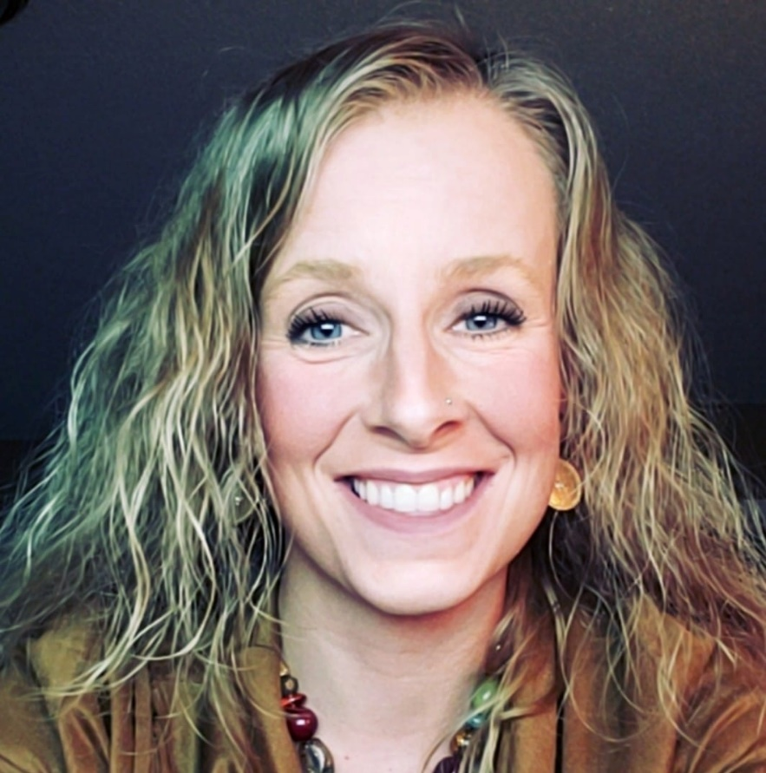
Bekki Goulart

Slide 78
We are honoring Orphan Shabbat today.
These are the stories of four little girls.

Slide 79
Ann Sneary

Slide 80
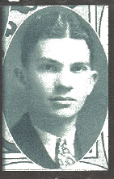

Slide 81
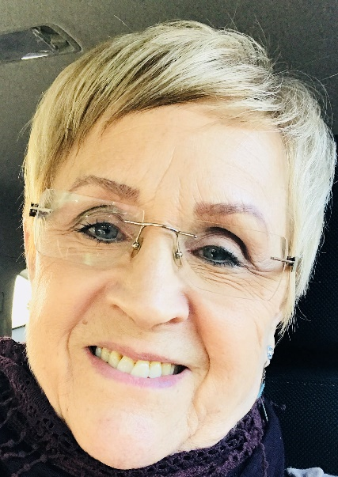
Louise Ballard

Slide 82
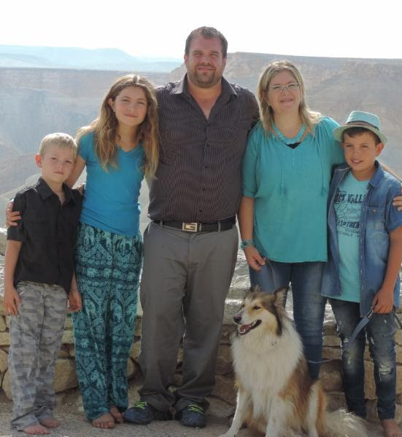
Sean & Ayelet Steckbeck, Maayan and sons.
Notes:
BLM story: a rally was being set up, and Sean’s team got there first to set up sound system. BLM asked if they could speak. Sean said OK if you won’t disrupt or leave. Sean said, “I know you are concerned about justice for George Floyd, Breonna Taylor, Ahmaud Arbery. But what about justice for yourself. What about justice for your selfishness, rage, lust, unfairness. Only Jesus can give you freedom from the justice we all merit.
Sean called for repentance, and BLM, transgender, were kneeling in prayer!

Slide 83
So, what really is:
₅the resurrection of the dead and ₆eternal punishment.
It is the establishment of the reign of the eternal Father.

Slide 84
^{Rev. 21.2-7} I also saw the holy city—the New Jerusalem—coming down out of heaven from God, prepared as a bride adorned for her husband. I also heard a loud voice from the throne, saying, “Behold, the dwelling of God is among men, and He shall tabernacle among them. They shall be His people,

Slide 85
^{Rev. 21.2-7} and God Himself shall be among them and be their God. He shall wipe away every tear from their eyes, and death shall be no more. Nor shall there be mourning or crying or pain any longer, for the former things have passed away.”

Slide 86
^{Rev. 21.2-7} And the One seated upon the throne said, “Behold, I am making all things new!” Then He said, “Write, for these words are trustworthy and true.” Then He said to me, “It is done! I am the Alpha and the Omega, the Beginning and the End.

Slide 87
^{Rev. 21.2-7} To the thirsty I will freely give from the spring of the water of life. The one who overcomes shall inherit these things, and I will be his God and he shall be My son. But for the cowardly and faithless and detestable and murderers and sexually immoral and sorcerers and idolaters and all liars—their lot is in the lake that burns with fire and brimstone, which is the second death.”

Slide 89
