Slide 1
e-handout
To have these notes
without taking notes
Go to OrHaOlam.com
Click on downloads,
messages, 2020

Slide 2
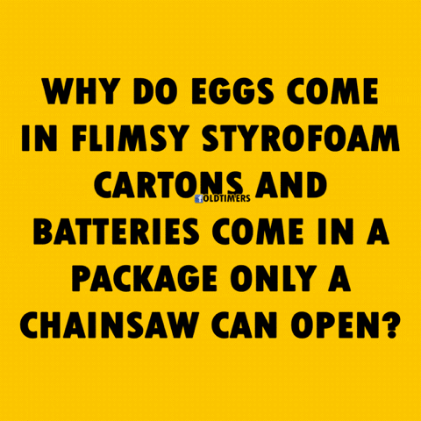
Notes:
MaryAnn Dixon

Slide 3
New Israeli spin on cattle ranching
Notes:
https://youtu.be/hLrrty7owFY

Slide 4
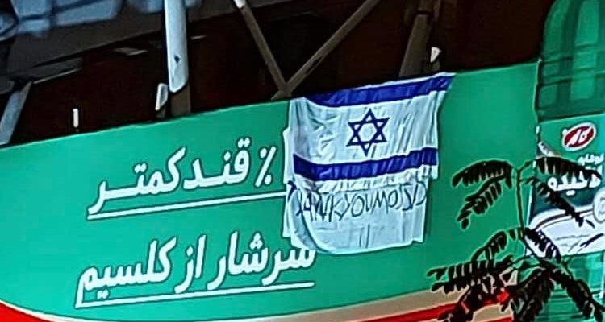
“Thank you Mossad,” hung in
Teheran on overpass!
Notes:
https://worldisraelnews.com/israeli-flag-and-banner-thank-you-mossad-hung-on-bridge-in-tehran/
Can see the English
For assassinations of terror rulers!
Zooming in…

Slide 5
“Thank you Mossad,” hung in Teheran on an overpass!
Notes:
https://worldisraelnews.com/israeli-flag-and-banner-thank-you-mossad-hung-on-bridge-in-tehran/
Can see the English

Slide 6
Notes:
Disclaimer: I will use some terminology that might have political implications. Just hear me out.

Slide 7
Ancient Fake news
Ancient Real news: resets
Greek resets were bad
Hebrew resets were good
Repeat [Déjà vu all over again]

Slide 8
The earliest known fake news…

Slide 9
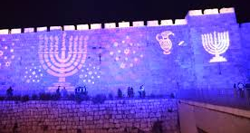
The earliest known fake news… Hanukkah is the festival of lights.
Notes:
Wall of the Old City of Jerusalem, by the Jaffa Gate, Paris
It’s not a bad idea, just not a historically true idea.

Slide 10
Notes:
https://www.google.com/url?sa=i&url=https%3A%2F%2Fwww.globetrottinkids.com%2Fhanukkah%2F&psig=AOvVaw3UOcw2i65nkK6g6bVL_Kzn&ust=1607804373408000&source=images&cd=vfe&ved=0CAIQjRxqFwoTCOjWo5rgxu0CFQAAAAAdAAAAABAt

Slide 11
The real meaning of Hanukkah..

Slide 13
The real original history had no story of eight days waiting for oil.
The following (2 Maccabees 10:5-8) written apparently written sometime around 100 BCE about events of 168 BCE.
Notes:
Almost contemporary account. One generation away at most.

Slide 14
in 2 Maccabees, “on the very same date on which the Temple was profaned by foreigners, there occurred the purification of the Temple – on the 25th day of the ninth month (that is, Kislev). Joyfully they held an eight-day celebration after the pattern of Sukkot [Tabernacles] …
Notes:
Delayed Sukkot according to 2 Mac written

Slide 15
remembering how a short time before, they spent the Festival of Sukkot like beasts… Therefore, holding wreathed wands and branches bearing ripe fruit, and palm fronds, they offered songs of praise to Him
Notes:
Delayed Sukkot according to 2 Mac written
Eight days from Sukkot pattern, not oil.

Slide 16
Who had victoriously brought about the purification of His Place. By vote of the commonwealth they decreed a rule for the entire nation of the Jews to observe these days annually”

Slide 17
The ‘fake news’ Hanukkah oil miracle was added on 400 years after the Maccabean revolt of 168 B.C.E. By that time the Maccabees were no longer a revival movement; they had succumbed to the very Greek Hellenistic spiritual forces that they had originally opposed.
Notes:
Avner Boskey.

Slide 18
This ‘creative’ re-interpretation of Hanukkah thus sidestepped the Maccabean military deliverance, focusing instead on an unconnected ‘miracle’ unknown to Jews of that day.
Notes:
It wasn’t a bad idea, The oil story is not an evil idea. It’s kind of cute. Without it, no latkes, no donuts/sufganiot. But it was invented, apparently, to minimize honor to the now corrupt descendants of the Maccabees.
The real Hanukkah story was prophesied by Daniel

Slide 19
Ancient Fake news
Ancient Real news: resets
Greek resets were bad
Hebrew resets were good
Repeat [Déjà vu all over again]

Slide 20
^{Daniel 11.32} The people who know their God shall be strong, and carry out great exploits.
וְעַם יֹדְעֵי אֱלֹהָיו, יַחֲזִקוּ וְעָשׂוּ.
Notes:
This is the real theme: we are called to be STRONG to face adversity and cultural resets!!
Intimately know
Be strong
DO!

Slide 21
^{Daniel 11.32} The people who know their God shall be strong, and carry out great exploits.
What does it mean to know their G-d?

Slide 22
^{Daniel 11.32} The people who know their God shall be strong, and carry out great exploits.
What does it mean to know G-d
How will they be strong?

Slide 23
^{Daniel 11.32} The people who know their God shall be strong, and carry out great exploits.
What does it mean to know G-d
How will they be strong?
What exploits?

Slide 24
Notes:
Naval interference of Romans → fury of Antiochus the Syrian
In 175 BC, a new king, Antiochus IV (also called "Epiphanes") ascended the throne in Syria. Under the "auspices" of his regime, Jerusalem began to look more and more like a Greek city as Hellenistic culture was officially promoted. Antiochus allowed Hellenistic Jews to have prominent roles in the Holy Temple - so much so that even a non-priest (named Menelaus) was given the role of being the Temple's Kohen Gadol (High Priest). This enraged many Jews, however, who then called for Egyptian rule instead of Syrian (the Egyptians were more tolerant of local customs and did not force Hellenization). Later, when Antiochus returned from an unsuccessful military campaign against Egypt, he decided to quell the Jewish call for Egyptian rule and murdered some 40,000 people in Jerusalem.

Slide 25
^{Daniel 11:7, 29-30} “At the appointed time he (ed., Antiochus IV, the Seleucid King of the North) will return and come into the South, but this last time it will not turn out the way it did before. For ships of Kittim (Roman ships from Cyprus) will come against
Notes:
https://en.wikipedia.org/wiki/Kittim)
This is NOT narrative, it’s prophetic writing by Daniel in Babylon 100’s miles east and 400 years earlier!!

Slide 26
^{Daniel 11:7, 29-30} him. Therefore he will be disheartened and will return and become enraged at the holy covenant and take action.
Notes:
https://en.wikipedia.org/wiki/Kittim)

Slide 27
Real problem: Why the rage against the holy covenant?
Paul before revelation of Messiah?
^{Acts 26.11} I tried to cause them to blaspheme by punishing them often in the synagogues. In furious rage against them, I persecuted them even in foreign cities.
Notes:
Paul had an elegant Perush/Pharasiaic philosophy of religious righteousness that was threatened.
Syrian/Greek king Antiochus has just suffered defeat PLUS the holy covenant is generally an offense to the world.
People who have a satisfying lifestyle religious system are
sometimes enamored with being BETTER with the G-d and Messiah of Israel
Sometimes threatened and enraged

Slide 28
The Greek civilization of Alexander the Great saw itself as the zenith of human achievement: geometry, astronomy, anatomy, medicine, inventions, theater, music, athletics. Many expressions of sexuality to explore, many gods to know.
Notes:
Feel the energy, feel the freedom.

Slide 29
The Jews, however, were seen as barbarians (βάρβαροι / barbaroi), a nation who did not speak Greek or follow Greek customs. Narrow minded monotheists!!
Notes:
My relatives when I came to faith. So narrow.
Maybe narrow, but GOOD. High and lofty One…

Slide 30
Alexander of Macedon had a dream…a ‘one world’ culture, and the glue to unify his world dictatorship would be Greek – Greek language, art, philosophy, education, town planning, local government, religion, etc. Persia (modern Iran) and Galatia (modern Turkey) were the laboratory

Slide 31
for his first experiment – a ‘Great Grecian Reset’ for the planet. Alexander planned to homogenize the populations of Asia and Europe into one huge world-encompassing Hellenistic empire.
Notes:
He had an ideal. A wrong ideal, but an ideal.
Marxists have an ideal: from each according to his ability, to each according to his needs. Egalitarian society. Pure socialism. Sounds glorious. Everyone contribute as they can, everyone receive as they need.
I toyed with it as an idealistic teen.
Sounds idealistic. Problem is that it doesn’t work.

Slide 32
Greeks had a GREAT cultural ideal that they wanted to impose on the world.
Refining reset of the primitive world of Jews and other barbarians!

Slide 33
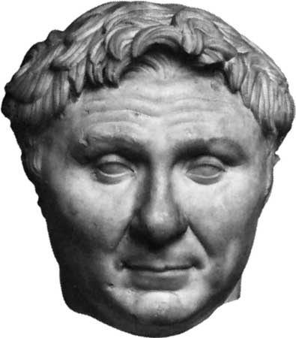
The Romans picked up this cause: Pompey [106 BCE to 48 BCE] searched conquered lands of the east for Alexander's 260-year-old cloak, which he then wore as a sign of greatness and authority

Slide 34
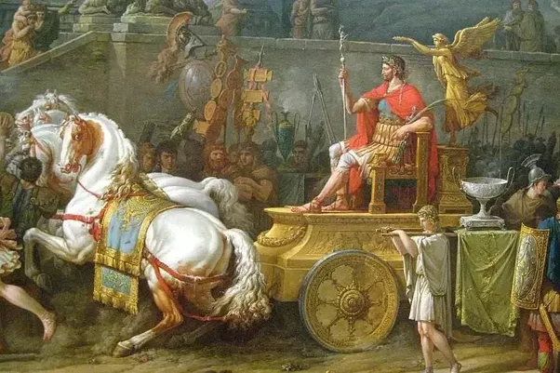
Pompey in Alexander’s cloak
Notes:
https://qph.fs.quoracdn.net/main-qimg-4a8cb1535e2b07beb4e1c08e11fb0dd0

Slide 35
Julius Caesar had an equestrian bronze statue of Alexander on horseback, re-dedicated, replacing Alexander's head with his own.
Notes:
Avner Boskey

Slide 36
Ancient Fake news
Ancient Real news: resets
Greek resets were bad
Hebrew resets were good
Repeat [Déjà vu all over again]

Slide 37
Israel refused to bow the knee to Greece because they had already bowed the knee to Adoni and His strategy. For the God of Jacob also had a dream, and His prophetic dream predates and supersedes Alexander’s.
Notes:
Avner Boskey

Slide 38
Adoni gave gifts and a calling to the Jewish people, and promised that they would bring life from the dead to the entire planet ^{(Ro 11:28-29)}. Adoni vowed to make Jerusalem the capital of the world.
Notes:
Avner Boskey Light to the Nations, Or LaGoyim in Isaiah, later Yeshua Light of the World

Slide 39
The God of Jacob’s biblical and prophetic description of this future vision could be called His ‘Great Hebrew Reset.’
Notes:
Avner Boskey

Slide 40
^{Yeshayahu/Is 2.1-3} It will come to pass in the last days that the mountain of Adoni’s House will stand firm as head of the mountains and will be exalted above the hills. So all nations will flow to it. Then many peoples will go and say:

Slide 41
^{Yeshayahu/Is 2.1-3} “Come, let us go up to the mountain of Adoni, to the House of the God of Jacob! Then He will teach us His ways, and we will walk in His paths.” For Torah will go forth from Zion and the word of Adoni from Jerusalem.

Slide 42
^{Yeshayahu /Is 2. 4-5} He will judge between the nations and decide for many peoples. They will beat their swords into plowshares, and their spears into pruning knives. Nation will not lift up sword against nation, nor will they learn war any more. Come house of Jacob, let us walk in the light of Adoni.

Slide 43
^{Yeshayahu/Is 11.9} For the earth will be full of the knowledge of Adoni, as the waters cover the sea.

Slide 44
There is massive spiritual warfare, emotional distress, discouragement, weakness of faith, near defeat, at the intersections of the two plans of resetting the world.
Border wars!
Notes:
That’s where we are. Not defeated by our culture, not victims of it, but warriors in the Ruakh, in the Spirit, to live and present Truth to our culture.

Slide 45
Thomas Jefferson once wrote, “The tree of liberty must be refreshed from time to time with the blood of patriots and tyrants. It is it’s natural manure.” The Bible does not shrink from revealing that the God of the Hebrews is a God who is prepared to fight His enemies and defend His children
Notes:
Avner Boskey

Slide 46
^{Eph 6.10-12} Finally, grow powerful in union with the Lord, in union with his mighty strength! Use all the armor and weaponry that God provides, so that you will be able to stand against the deceptive tactics of the Adversary.

Slide 47
^{Eph 6.10-12} For we are not struggling against human beings, but against the rulers, authorities and cosmic powers governing this darkness, against the spiritual forces of evil in the heavenly realm.

Slide 48
^{Mes Jew/Heb 11.33-34} By faith they … administered justice, obtained promises, shut the mouths of lions, quenched the power of fire, escaped the edge of the sword, were made strong out of weakness, became mighty in war, and made foreign armies flee.

Slide 49
Antiochus Epiphanes IV, the Syrian Greek emperor, would strengthen the hand of Hellenistic Jewish apostates, those who sided with Alexander’s Greek ‘one-world vision.’ Scripture describes those assimilated and ‘secularized’ Jews as those “who abandon the

Slide 50
holy (Mosaic) covenant and act wickedly toward it.” But those who were faithful to Adoni and to His covenant commands were valiant in teaching, as well as courageous on the battlefield.

Slide 51
^{Dan 11.30} So he will come back and pay attention to those who abandon the holy covenant. Forces from him will arise, desecrate the sanctuary fortress, and do away with the regular sacrifice.

Slide 52
Isaiah foresees what will happen when the Jewish people embrace Messiah their Light, and then spread that light across the globe in a ‘Great Hebrew Reset:’ “Arise, shine; for your light has come, and the glory of Adoni has risen upon you.
Notes:
This is a modern day, end times prophecy! For US, for NOW!

Slide 53
For behold, darkness will cover the earth and deep darkness the peoples. But Adoni will rise upon you and His glory will appear upon you. Nations will come to your light, and kings to the brightness of your rising” ^{Isaiah 60:1-3}. The fulfilment of Hanukkah is on its way!

Slide 54
Ancient Fake news
Ancient Real news: resets
Greek resets were bad
Hebrew resets were good
Repeat [Déjà vu all over again]

Slide 55
Current use
of the term “reset”
Notes:
This is news that is out there. How much it will affect us is unknown, but possible, so be aware.

Slide 56
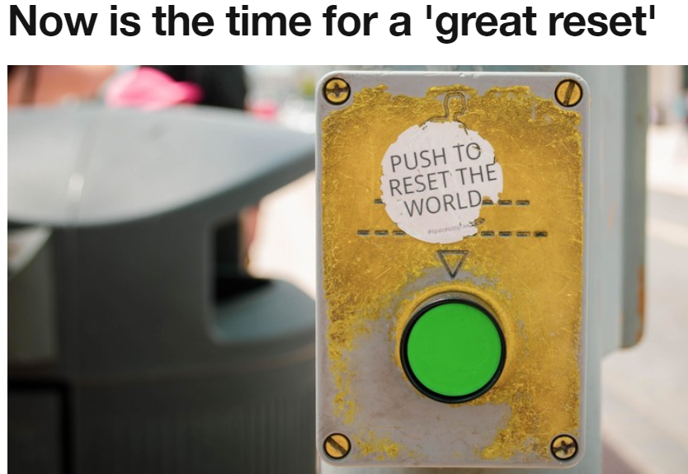
The changes we have already seen in response to COVID-19 prove that a reset of our economic and social foundations is possible.
Notes:
https://www.weforum.org/agenda/2020/06/now-is-the-time-for-a-great-reset/

Slide 57
A new proposal called the “Great Reset” – is from a virtual meeting earlier in June hosted by the World Economic Forum,
Notes:
https://thehill.com/opinion/energy-environment/504499-introducing-the-great-reset-world-leaders-radical-plan-to

Slide 58
the high-profile group said the world should adopt more socialistic policies, such as wealth taxes, additional regulations and massive Green New Deal-like government programs.
Notes:
https://thehill.com/opinion/energy-environment/504499-introducing-the-great-reset-world-leaders-radical-plan-to

Slide 59
Klaus Schwab, the founder and executive chairman of the World Economic Forum, also said that “all aspects of our societies and economies” must be “revamped,” “from education to social contracts and working conditions.”
Notes:
https://thehill.com/opinion/energy-environment/504499-introducing-the-great-reset-world-leaders-radical-plan-to

Slide 60
Joining Schwab at the WEF event was Prince Charles, one of the primary proponents of the Great Reset.
Notes:
https://thehill.com/opinion/energy-environment/504499-introducing-the-great-reset-world-leaders-radical-plan-to

Slide 61
Every country, from the United States to China, must participate, and every industry, from oil and gas to tech, must be transformed. In short, we need a “Great Reset” of capitalism, from shareholder to stakeholder.
Notes:
https://thehill.com/opinion/energy-environment/504499-introducing-the-great-reset-world-leaders-radical-plan-to

Slide 62
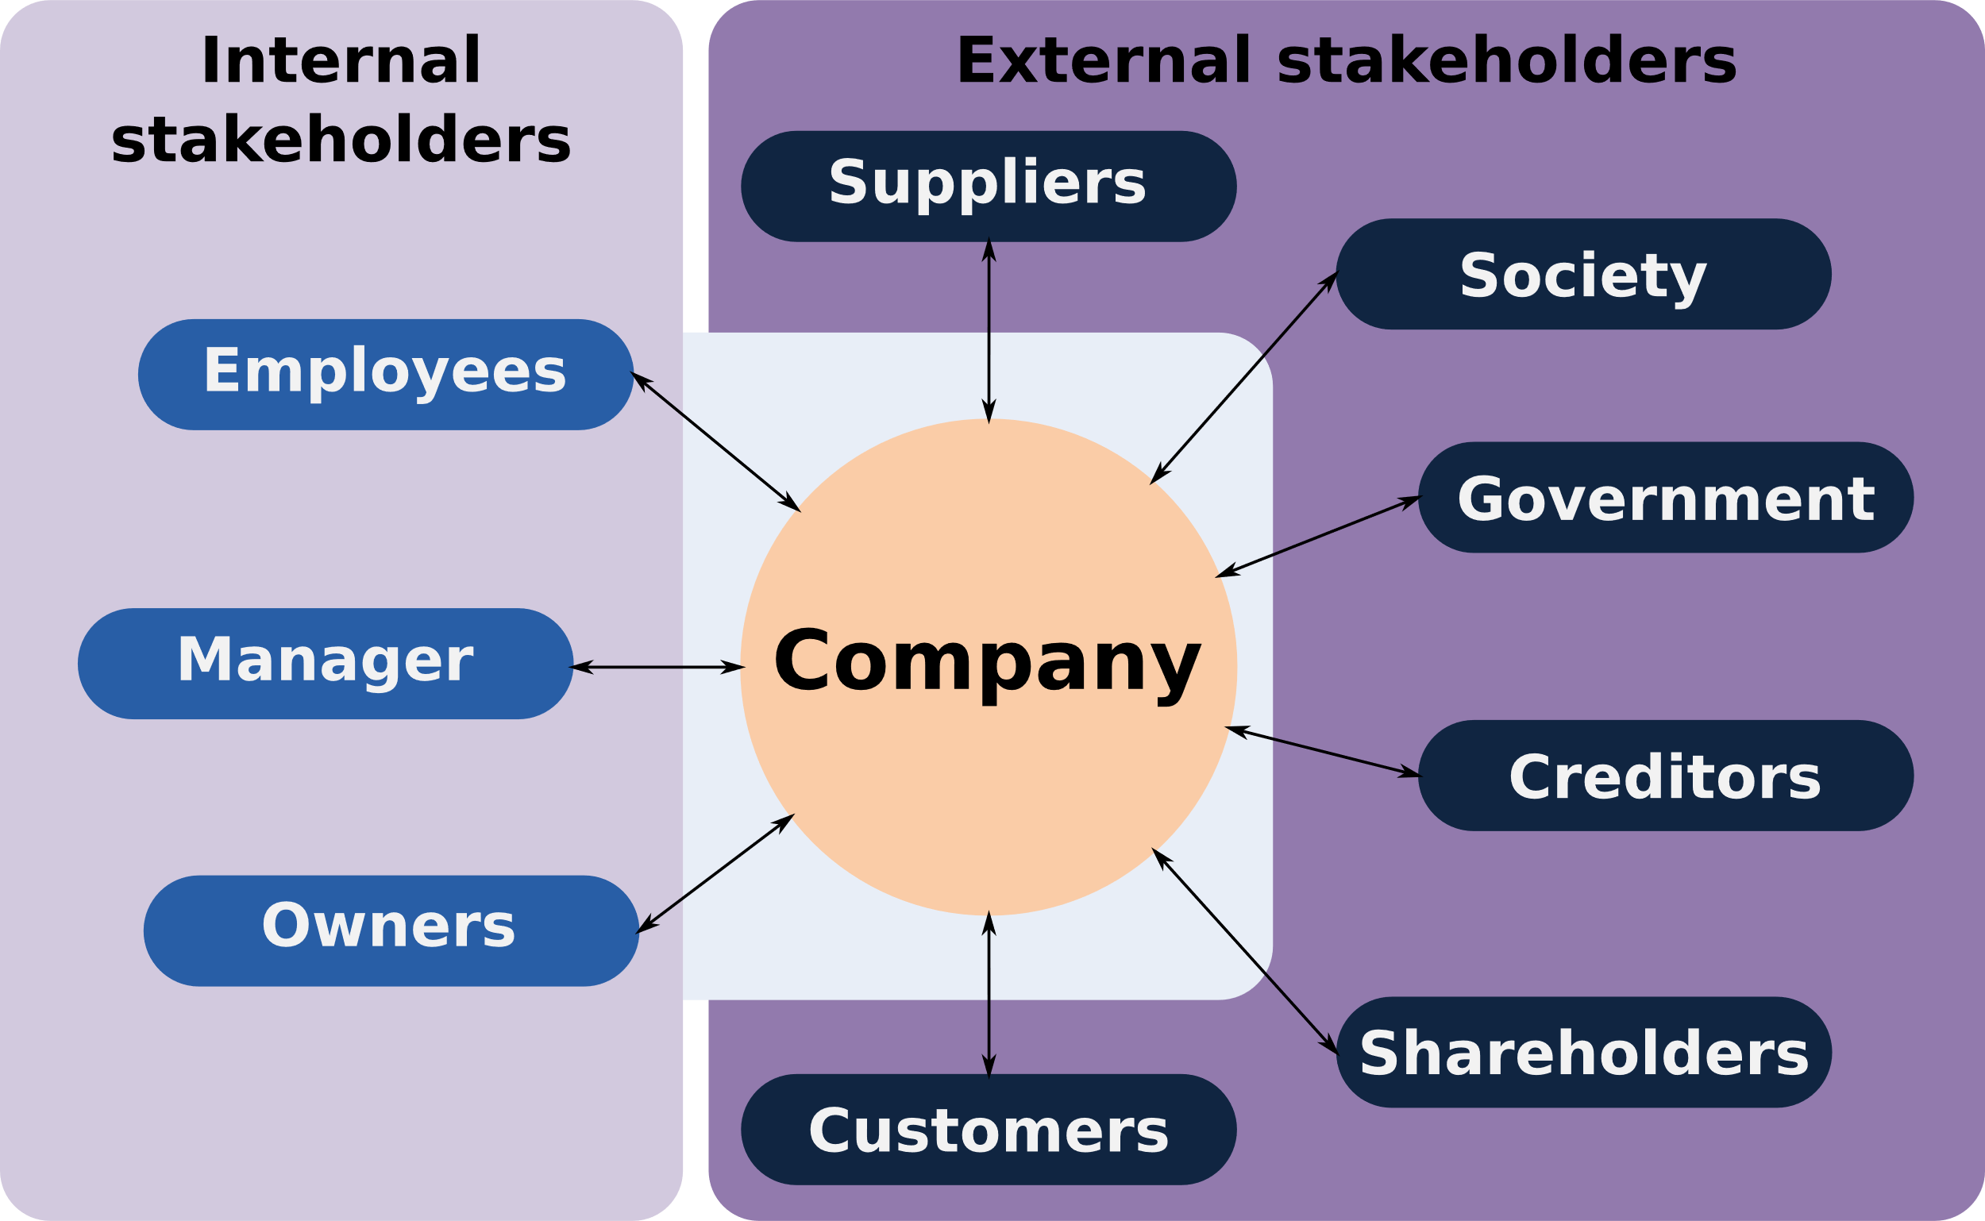
Notes:
By Grochim - Commons, CC BY-SA 3.0, https://commons.wikimedia.org/w/index.php?curid=44754443
The most troubling, was the description of shareholders…as merely providers of capital. This is a bit like calling your parents mere genetic contributors to your existence. It is disrespectful and, frankly, wrong. People who invest in you deserve your appreciation and respect. If you fail them, they lose everything. You are not simply takers of their capital but have a deeper and more fundamental obligation to them.
By Charles M. Elson, Director, University of Delaware's John L. Weinberg Center for Corporate Governance
https://www.bidenschool.udel.edu/bideninstitute/bcblog/Pages/Three-Problems-With-the-Stakeholder-Theory.aspx

Slide 63
Regarding the Coronavirus Pandemic, WHO guidance states that nations should issue a State of Emergency when the WHO declares a Level 5 or 6 Pandemic, which is when there is “sustained community level outbreak”, thus triggering ECHR Article 15 and ICCPR Article 4,
Notes:
https://westonaprice.london/articles/great-reset/

Slide 64
both of which allow the suspension of human rights during an emergency.
Notes:
https://westonaprice.london/articles/great-reset/

Slide 65
Reset-er, Green New Dealers, socialists, may be idealist and sincere, but they are extreme at best and really wrong.
A surprising illustration from the beginnings of America!

Slide 66
The Pilgrim's journey to America was funded by a group of venture capitalists who provided the ship and supplies for their journey to the New World. In return, the Pilgrims agreed to live in [socialist] communally with everyone receiving the same
Notes:
https://www.charismanews.com/culture/83320-how-the-pilgrims-tried-socialism-and-it-almost-destroyed-them?utm_source=In%20the%20Line%20of%20Fire&utm_medium=email&utm_content=subscriber_id:5194514&utm_campaign=Blogger%20-%20Michael%20Brown%20-%202020-11-12

Slide 67
recompense for their work, and with everything above their necessities going into a common fund to be used to pay their creditors.
Notes:
https://www.charismanews.com/culture/83320-how-the-pilgrims-tried-socialism-and-it-almost-destroyed-them?utm_source=In%20the%20Line%20of%20Fire&utm_medium=email&utm_content=subscriber_id:5194514&utm_campaign=Blogger%20-%20Michael%20Brown%20-%202020-11-12

Slide 68
This didn’t work: killed initiative, bred irresponsibility, hopelessness, arrogance and quarreling!
Notes:
https://www.charismanews.com/culture/83320-how-the-pilgrims-tried-socialism-and-it-almost-destroyed-them?utm_source=In%20the%20Line%20of%20Fire&utm_medium=email&utm_content=subscriber_id:5194514&utm_campaign=Blogger%20-%20Michael%20Brown%20-%202020-11-12

Slide 69
After much prayer and discussion, they dispensed with that part of the agreement with their creditors that required them to live communally until their debt was paid. In its place, they implemented a free entrepreneurial system that included private ownership of property ^{(Hyatt, The Pilgrims, 52-53).}
Notes:
https://www.charismanews.com/culture/83320-how-the-pilgrims-tried-socialism-and-it-almost-destroyed-them?utm_source=In%20the%20Line%20of%20Fire&utm_medium=email&utm_content=subscriber_id:5194514&utm_campaign=Blogger%20-%20Michael%20Brown%20-%202020-11-12

Slide 70
Socialism was an apparently good idea that utterly failed.
G-d’s idea for labor and reward:
^{Ber/Gen 3.19} In the sweat of your face you shall eat bread
Sweat: work hard or smart
Your face: not others
Notes:
https://www.charismanews.com/culture/83320-how-the-pilgrims-tried-socialism-and-it-almost-destroyed-them?utm_source=In%20the%20Line%20of%20Fire&utm_medium=email&utm_content=subscriber_id:5194514&utm_campaign=Blogger%20-%20Michael%20Brown%20-%202020-11-12

Slide 71
The ultimate end time danger of a controlled life and economy.

Slide 72
^{Rev 13.1-2} And now, in my vision, I saw a strange Creature rising up out of the sea. It had seven heads and ten horns, and ten crowns upon its horns. And written on each head were blasphemous names, each one defying

Slide 73
^{Rev 13.1-2} and insulting God. This Creature looked like a leopard but had bear’s feet and a lion’s mouth! And the Dragon gave him his own power and throne and great authority.
Notes:
Dragon, plus creature out of the sea.

Slide 74
^{Rev 13.11-18} Then I saw another strange animal, this one coming up out of the earth, with two little horns like those of a lamb but a fearsome voice like the Dragon’s. He exercised all the authority of the Creature whose death-wound had been healed, whom he required all the world to worship.
Notes:
Third creature.

Slide 75
^{Rev 13.11-18} He did unbelievable miracles such as making fire flame down to earth from the skies while everyone was watching. By doing these miracles, he was deceiving people everywhere…And he ordered the people of the world to make a great statue of the first Creature,

Slide 76
^{Rev 13.11-18} who was fatally wounded and then came back to life. He was permitted to give breath to this statue and even make it speak! Then the statue ordered that anyone refusing to worship it must die! He required everyone—great and small, rich and poor,

Slide 77
^{Rev 13.11-18} slave and free—to be tattooed with a certain mark on the right hand or on the forehead. And no one could get a job or even buy in any store without the permit of that mark, which was either the name of the Creature or the code number of his name.

Slide 78
^{Rev 13.11-18} Here is a puzzle that calls for careful thought to solve it. Let those who are able, interpret this code: the numerical values of the letters in his name add to 666!
Notes:
I don’t know how this is going to play out, but a highly controlled economy, a reset of sorts is coming.

Slide 79
Ancient Fake news
Ancient Real news: resets
Greek resets were bad
Hebrew resets were good
Repeat [Déjà vu all over again]
We are called to reset our culture in holiness.
Notes:
We are already counter cultural many ways. Sexually, covenantally re Israel, re marriage.

Slide 80
From Messianic Jewish Alliance of America General Secretary – Joel Chernoff December 6, 2020
Then he commissioned Joshua son of Nun and said, “Hazak (be strong)! Be courageous! For you will bring the sons of Israel into the land I swore to them – and I will be with you.” Dvarim/Dt 31:23
Notes:
Copyright © 2016 Messianic Publishing Company. Use by permission only. All rights reserved.

Slide 81
Nosh: Godly and successful leadership requires three things; confidence in God’s calling on our lives, complete trust in His faithful partnership, and the willingness to take many future steps of faith
Notes:
Copyright © 2016 Messianic Publishing Company. Use by permission only. All rights reserved.

Slide 82
in the face of seemingly impossible challenges that arise to oppose the successful fulfillment of our assigned mission.
Notes:
Copyright © 2016 Messianic Publishing Company. Use by permission only. All rights reserved.

Slide 83
Tuesday, December 8, 2020
The U.S. Supreme Court on Monday refused to take the case…As a result, a lower court ruling stands. That ruling, affirmed by the 9th Circuit Court of Appeals, found that transgender students have the right to use the bathroom or locker room that aligns with their gender identity.
Notes:
https://www.worthynews.com/54643-scotus-refuses-to-hear-case-involving-transgender-student-restroom-dispute

Slide 84
But God: They are two of the most powerful words in the Bible—words that change everything. One moment, there is despondency and despair; All hope is lost, and the worst case scenario is about to unfold.
But God had other plans. But God intervened. But God turned the tables. But God!
Notes:
https://www.charismanews.com/opinion/in-the-line-of-fire/83314-when-it-looks-the-worst-god-shows-up-and-does-his-best?utm_source=In%20the%20Line%20of%20Fire&utm_medium=email&utm_content=subscriber_id:5194514&utm_campaign=Blogger%20-%20Michael%20Brown%20-%202020-11-12

Slide 85
Here are some examples from Scripture: "The patriarchs, moved with envy, sold Joseph into Egypt. But God was with him" ^{(Acts 7:9)}.
"My flesh and my heart fails, but God is the strength of my heart and my portion forever" ^{(Ps. 73:26)}.
Notes:
https://www.charismanews.com/opinion/in-the-line-of-fire/83314-when-it-looks-the-worst-god-shows-up-and-does-his-best?utm_source=In%20the%20Line%20of%20Fire&utm_medium=email&utm_content=subscriber_id:5194514&utm_campaign=Blogger%20-%20Michael%20Brown%20-%202020-11-12

Slide 86
"They put him to death by hanging him on a tree, but God raised him on the third day" (Acts 10:39-40, ESV). The story was over and the dream had died. But God.
Notes:
https://www.charismanews.com/opinion/in-the-line-of-fire/83314-when-it-looks-the-worst-god-shows-up-and-does-his-best?utm_source=In%20the%20Line%20of%20Fire&utm_medium=email&utm_content=subscriber_id:5194514&utm_campaign=Blogger%20-%20Michael%20Brown%20-%202020-11-12

Slide 87
We were by nature children of wrath, like the rest of mankind. But God, being rich in mercy, because of the great love with which he loved us, even when we were dead in our trespasses,
Notes:
https://www.charismanews.com/opinion/in-the-line-of-fire/83314-when-it-looks-the-worst-god-shows-up-and-does-his-best?utm_source=In%20the%20Line%20of%20Fire&utm_medium=email&utm_content=subscriber_id:5194514&utm_campaign=Blogger%20-%20Michael%20Brown%20-%202020-11-12

Slide 88
made us alive together with Messiah—by grace you have been saved" (Eph. 2:1-5, my emphasis).
We were beyond down and out. We were buried and spiritually dead—But God.
Notes:
https://www.charismanews.com/opinion/in-the-line-of-fire/83314-when-it-looks-the-worst-god-shows-up-and-does-his-best?utm_source=In%20the%20Line%20of%20Fire&utm_medium=email&utm_content=subscriber_id:5194514&utm_campaign=Blogger%20-%20Michael%20Brown%20-%202020-11-12

Slide 89
Ancient Fake news
Ancient Real news: resets
Greek resets was bad
Hebrew resets was good
Repeat [Déjà vu all over again]
We are called to reset our culture in holiness.

Slide 91
^{Daniel 11.32} The people who know their God shall be strong, and carry out great exploits.
וְעַם יֹדְעֵי אֱלֹהָיו, יַחֲזִקוּ וְעָשׂוּ.
Hanukkah message: know Messiah, walk in His joyful purity and power. Filled with His Spirit!
Notes:
Intimately know
Be strong
DO!

