Slide 1
e-handout
To have these notes
without taking notes
Go to OrHaOlam.com
Click on downloads,
messages, 2020

Slide 2
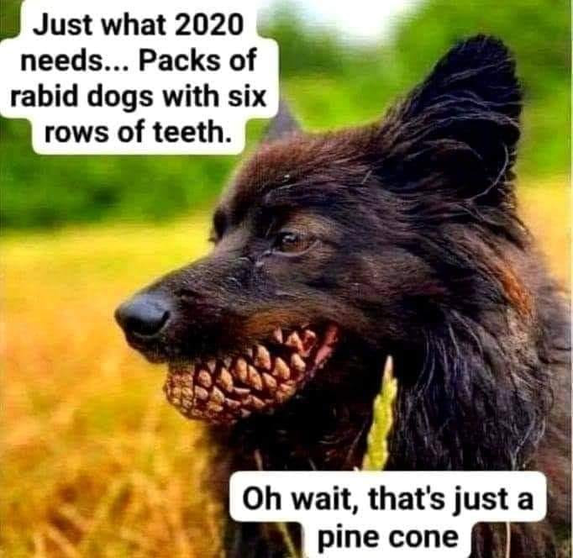
Notes:
Lori Wilson

Slide 3
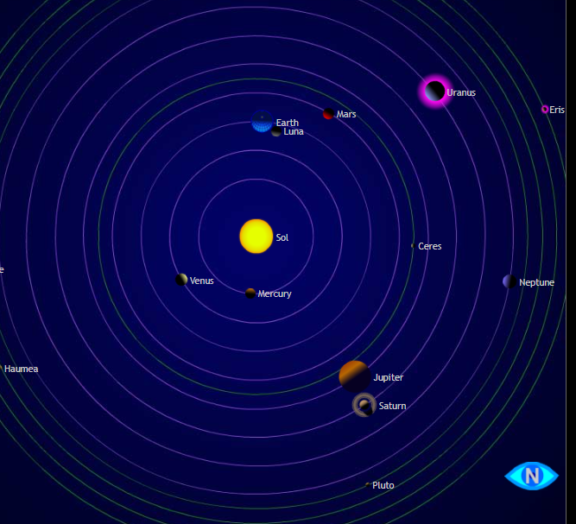
The solar system viewed from way above the North Pole. Not to scale. Dec 18, 2020
Notes:
Note that Jupiter and Saturn are in line.
The earth’s rotation is counterclockwise as viewed from the north. So we see this conjunction of Jupiter and Saturn just before sunset.

Slide 4
First Time in 800 Years, on Dec 21 Jupiter and Saturn will line up so perfectly in the night sky that they’ll appear to touch, creating the appearance of what has been described as a “double planet.” The last time these two planets appeared so visibly close, from Earth’s perspective, was March 4, 1226
Notes:
https://www.theepochtimes.com/mkt_app/extraordinary-planetary-alignment-to-grace-the-night-sky-for-first-time-in-800-years-on-dec-21_3596532.html?v=ul

Slide 5
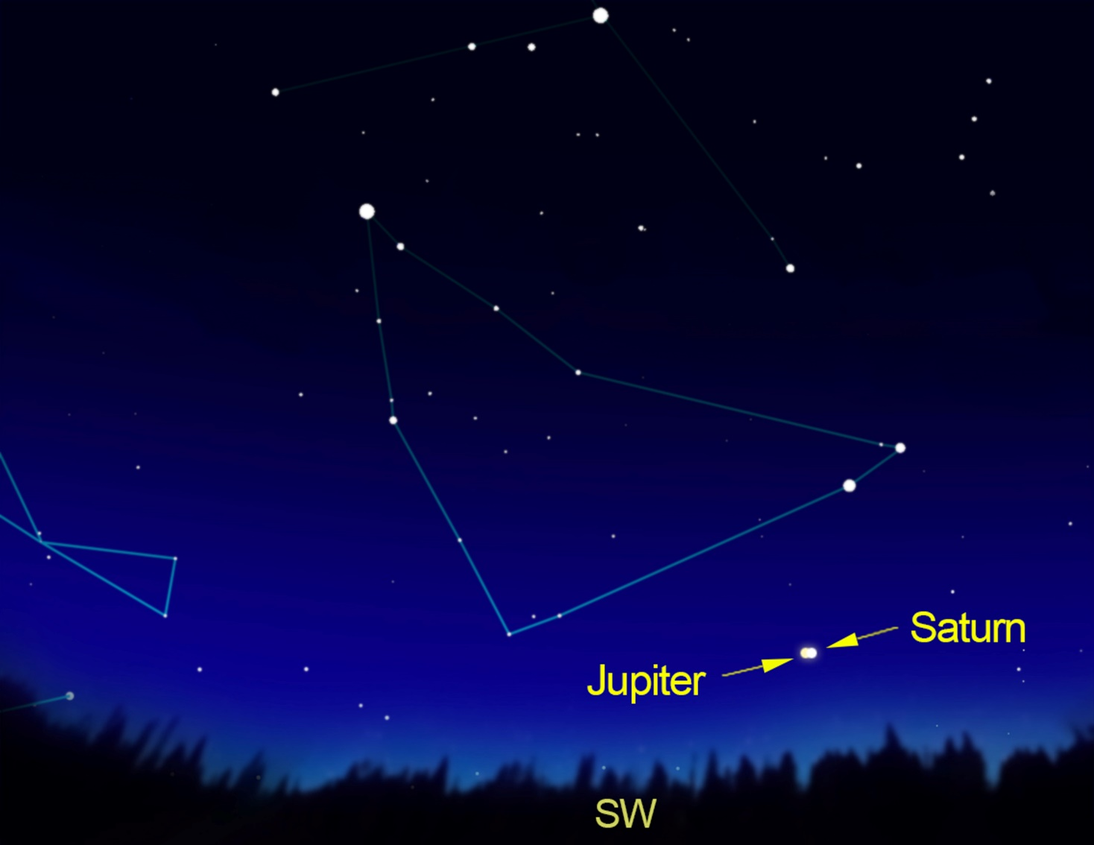
Night sky
Dec. 21, 2020, about 6 p.m.
Notes:
In fact, some, like the famous German astronomer Johannes Kepler, claim that a remarkable triple alignment of Jupiter, Saturn, and Venus may have been the “Star of Bethlehem” in the account of the Magi or “Three Wise Men.
https://www.theepochtimes.com/mkt_app/extraordinary-planetary-alignment-to-grace-the-night-sky-for-first-time-in-800-years-on-dec-21_3596532.html?v=ul

Slide 6
Pastor Andrew Brunson, who was detained in Turkey for two years for this faith, on trumped-up terrorism and spying charges before being released in October 2018, told CBN News recently that persecution and harassment toward Messiah followers in America is about to intensify and that we should prepare.
Notes:
https://www.charismanews.com/us/83711-cn-morning-rundown-andrew-brunson-sends-stern-warning-to-all-christ-followers?utm_source=Charisma%20News%20Daily&utm_medium=email&utm_content=subscriber_id:5160390&utm_campaign=CNO%20daily%20-%202020-12-18

Slide 7
"Many leaders in our society now—the corporate world, entertainment, media, politics and academia—do not honor God and, in fact, they openly defy Him. They are increasingly hostile to those who identify clearly with Yeshua and His teaching.
Notes:
https://www.charismanews.com/us/83711-cn-morning-rundown-andrew-brunson-sends-stern-warning-to-all-christ-followers?utm_source=Charisma%20News%20Daily&utm_medium=email&utm_content=subscriber_id:5160390&utm_campaign=CNO%20daily%20-%202020-12-18

Slide 8
“One way they exhibit this is in marginalizing, shaming and canceling people,” Brunson says. "A big issue for us in the future is how we're going to be able to get our message out to believers and nonbelievers. What if you're banned from social media, or no one will host your website or podcast?

Slide 9
Concerning a controlled culture and economy,
as in last week’s message…

Slide 10
Israeli Health Ministry Director Hezy Levy yesterday insisted to reporters that "we won't force people to take a vaccine. Israeli law doesn't allow for it," speaking before the Special Knesset Coronavirus Committee.
Notes:
https://www.israelnationalnews.com/News/News.aspx/292039
.

Slide 11
The issue of how to "motivate" vaccine compliance has generated increasing interest. “Government won’t force you to take vaccine. Amazon will. Airlines will. Banks will. You won’t be able to buy, sell, or trade without the vaccine.”
Notes:
https://www.israelnationalnews.com/News/News.aspx/292039

Slide 12
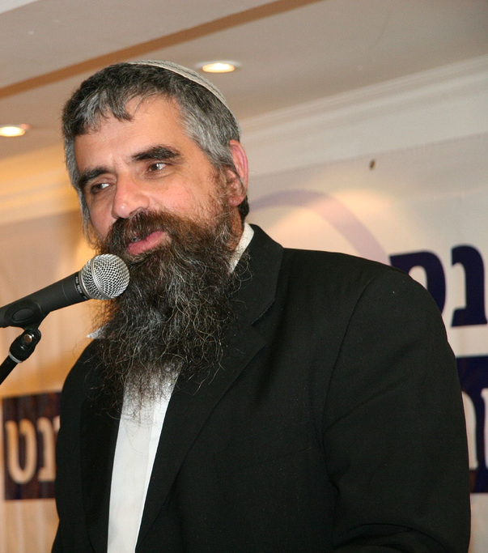
Rabbi Yuval Cherlow, who is a leading Orthodox ethicist in Israel, teaches,
Notes:
https://www.jpost.com/health-science/israeli-rabbi-urges-limited-sanctions-on-covid-19-vaccine-refusers-651994

Slide 13
“Businesses should be allowed to ask customers for proof that they've been vaccinated, and public transport and flights have an ethical obligation to turn away those who haven't been vaccinated.”
Notes:
https://www.jpost.com/health-science/israeli-rabbi-urges-limited-sanctions-on-covid-19-vaccine-refusers-651994

Slide 15
^{MJ 6.4-8} For it is impossible for those who once were enlightened—having tasted of the heavenly gift and become partakers of the Ruakh ha-Kodesh, and having tasted the good word of God and the powers of the עולם הבא olam ha-ba / world to come and then having fallen away—to renew again to repentance,
Notes:
https://www.charismanews.com/us/83711-cn-morning-rundown-andrew-brunson-sends-stern-warning-to-all-christ-followers?utm_source=Charisma%20News%20Daily&utm_medium=email&utm_content=subscriber_id:5160390&utm_campaign=CNO%20daily%20-%202020-12-18

Slide 16
^{MJ 6.4-8} since they are again crucifying Ben-Elohim / the Son of G-d themselves and publicly disgracing Him. For the earth—having soaked up the rain frequently falling on it—brings forth vegetation useful to those for whom it is farmed; and it shares in God’s blessing
Notes:
https://www.charismanews.com/us/83711-cn-morning-rundown-andrew-brunson-sends-stern-warning-to-all-christ-followers?utm_source=Charisma%20News%20Daily&utm_medium=email&utm_content=subscriber_id:5160390&utm_campaign=CNO%20daily%20-%202020-12-18

Slide 17
^{MJ 6.4-8} But if it produces thorns and thistles, it is worthless and near to being cursed—its end is to be burned over.
Notes:
https://www.charismanews.com/us/83711-cn-morning-rundown-andrew-brunson-sends-stern-warning-to-all-christ-followers?utm_source=Charisma%20News%20Daily&utm_medium=email&utm_content=subscriber_id:5160390&utm_campaign=CNO%20daily%20-%202020-12-18

Slide 18
Outline
What type of people described?
What did they do?
Is there a remedy?
Does this apply to us?

Slide 19
^{MJ 6.4-8} For it is impossible for those who once were enlightened
light up,
illumine,
bring to light,
make evident, reveal
Notes:
These are enlightened people.
Once hapax aorist tense once for all
Not merely intellectual

Slide 20
^{Col. 1.12-14} With joy we give thanks to the Father, who qualified you to share in the inheritance of the kedoshim holy people in the light. He rescued us from the domain of darkness and brought us into the kingdom of the Son whom He loves. In Him we have redemption—the release of sins.
Notes:
Fairest of 10,000

Slide 21
Pilgrim Holiness Church
Notes:
Golden glow up in the laminated rafters. “Cloud of liquid love.” April 13, 1969 I experienced New Birth. Many young people similarly seeking. Holy, Holy, Holy
Went home few weeks later. “Mom, Dad, I’ve found the answer to life’s problems. It’s not in drugs, or revolution, but in the love of Jesus Christ.”
Sent me to psychiatrist.
“You’re worse than Hitler. He destroyed our bodies. You are destroying our souls.”

Slide 22
^{Yn 8.12} Yeshua spoke to them again, saying, “I am the light of the world. The one who follows Me will no longer walk in darkness, but will have the light of life.”
Notes:
Ulises re his dad.
So many of us. To be enlightened is radical.
So, are you enlightened? I mean are we ablaze? Is Messiah the fairest of 10,000?

Slide 23
^{MJ 6.4-8} having tasted of the heavenly gift
^{T’hillim/Ps 34.9} Taste, and see that Adoni is good. How blessed are those who take refuge in him!
^{1 Kefa/Peter 2.3} For you have tasted that Adoni is good.
Notes:
Is to taste different from to drink deeply? We’ll come back to that.

Slide 24
of the the heavenly gift
^{Ro 6.23} Eternal life is what one receives as a free gift from God, in union with the Messiah Yeshua, our Lord.

Slide 25
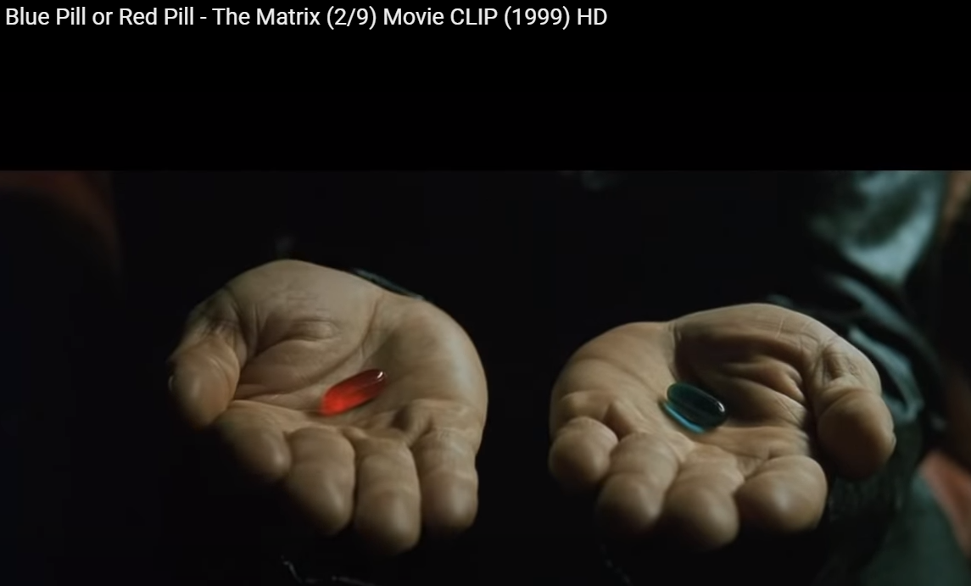
Notes:
https://www.youtube.com/watch?v=zE7PKRjrid4
Red pill opened Neil’s mind to reality. Blue maintains illusion.
1970s Harvard young man heard about us, drove with friends 3 hours to a Wednesday night prayer meeting to find the TRUTH. Got saved, left Harvard for Bible College!

Slide 26
^{Yn 8.31} Yeshua said to the Judeans who had trusted him, “If you obey what I say, then you are really my talmidim, you will know the truth, and the truth will set you free.”
^{Yn 17.3} And eternal life is this: to know you, the one true God, and him whom you sent, Yeshua the Messiah.
Notes:
When I was a searching teen, I used to think that there should be a reality store. Then I found Century 21 Reality. But it was realty.

Slide 27
^{MJ 6.4-8} become partakers of the Ruakh ha-Kodesh
^{Ro 8.15-17} For you did not receive the spirit of slavery to fall again into fear; rather, you received the Spirit of adoption, by whom we cry, “Abba! Father!” The Ruakh Himself bears witness with our spirit that we

Slide 28
are children of God. And if children, also heirs—heirs of God and joint-heirs with Messiah—if indeed we suffer with Him so that we may also be glorified with Him.

Slide 29
^{MJ 6.4-8} and having tasted the good word of God
^{1 Kefa/P 2.2-3} As newborn babes, long for pure spiritual milk,[a] so that by it you may grow toward salvation— now that you have tasted that the Lord is good.

Slide 30
^{119:103} How sweet is Your word to my taste — yes, sweeter than honey to my mouth!

Slide 31
^{MJ 6.4-8} [having tasted…] the powers of the עולם הבא olam ha-ba world to come
^{Yeshayahu/Is 33.24} No inhabitant will say, “I am sick.”

Slide 32
Outline
What type of people described?
What did they do?
Is there a remedy?
Does this apply to us?
Notes:
Enlightened, tasters of the heavenly gift, Ruakh HaKodesh sharers, Word consumers, knowing the power…
Were these born again, truly saved believers?

Slide 33
Outline
What type of people described?
What did they do?
Is there a remedy?
Does this apply to us?

Slide 35
^{MJ 6.4-8} and then have fallen away

Slide 36
to fall in, into or away, to fail,
fall back (into the unbelieving and godless ways of the old time).
Notes:
https://biblehub.com/greek/3895.htm
Aorist
Specifically, decisively.

Slide 37
This is not:
^{1 Yn 2.1-2} But if anyone does sin, we have an Advocate with the Father—the righteous Messiah Yeshua. He is the atonement for our sins
It’s rather fleeing from the Advocate

Slide 38
^{Hos 4.6} My people are destroyed for lack of knowledge. Since you rejected knowledge, I will also reject you from being My kohen. Since you forgot the Torah of your God.

Slide 39
David Stern: When people who have experienced salvation in such a deep way and then have fallen away from faith by trusting not in Yeshua's own sacrificial death

Slide 40
and high-priestly office
but in animal sacrifices and the system of cohanim which the Torah set up to administer them — then it is impossible to renew them so that they turn from their sin,
Notes:
https://kifakz.github.io/eng/bible/stern/stern_evreyam_06.html

Slide 41
as long as for themselves they keep on executing the Son of G-d on the stake all over again. they keep holding him up to public contempt by not glorifying his death as an atoning death but seeing it as having no special significance, so that his execution as a criminal becomes the dominant fact about it.
Notes:
https://kifakz.github.io/eng/bible/stern/stern_evreyam_06.html

Slide 42
God has given him everything he can give, yet he now refuses to accept his status as righteous with God, along with the implied responsibility of living a holy life.
Notes:
https://kifakz.github.io/eng/bible/stern/stern_evreyam_06.html

Slide 43
^{MJ 6.4-8} and then have fallen away — it is impossible to renew them so that they turn from their sin, since they are again crucifying Ben-Elohim / the Son of G-d themselves and publicly disgracing Him.
Notes:
There is no other acceptable atoning sacrifice, now that the Messiah Yeshua has come.

Slide 44
^{MJ 6.4-8} For the earth—having soaked up the rain frequently falling on it—brings forth vegetation useful to those for whom it is farmed; and it shares in God’s blessing

Slide 45
^{MJ 6.4-8} But if it produces thorns and thistles, it is worthless and near to being cursed—its end is to be burned over.

Slide 47
Similar passages in other places in the Messianic scriptures…

Slide 48
^{Mtt. 12.31-32} I tell you that people will be forgiven any sin and blasphemy, but blaspheming the Ruakh HaKodesh will not be forgiven. One can say something against the Son of Man and be forgiven;

Slide 49
^{Mtt. 12.31-32} but whoever keeps on speaking against the Ruakh HaKodesh will never be forgiven, neither in the `olam hazeh this world nor in the `olam haba the next world.
Notes:
willfully continuing to deny the Gospel when the Holy Spirit has made clear to you that it is true, or
(2) attributing the works of the Holy Spirit to the Adversary

Slide 50
^{1 Yn 5.16} If anyone sees his brother committing a sin that does not lead to death, he will ask; and God will give him life for those whose sinning does not lead to death. There is sin that does lead to death; I am not saying he should pray about that.
Notes:
it is a most difficult point to know when a man has sinned it, the apostle expresses himself with great caution.

Slide 51
There is a place in our spirit and in G-d’s Spirit where we are so hard that G-d “gives us up.”

Slide 52
^{MJ/Heb 10.30-31} For we know the One who said, “Vengeance is Mine; I will repay,” and again, “Adonai will judge His people.” It is a terrifying thing to fall into the hands of the living God.

Slide 53
Similar to an
unrepentant nation…

Slide 54
^{Yekhezkel /Ezek 14.12-14} The word of Adonai came to me saying, “Son of man, suppose a land sins against Me by trespassing grievously and I stretch out My hand over it, break off its staff of bread, send famine upon it and cut it off from man and beast.

Slide 55
^{Yekhezkel /Ezek 14.12-14} Even if these three men—Noah, Daniel and Job—be in it, they would only deliver their own souls by their righteousness.” It is a declaration of Adoni.
“Point of no return” for a nation!
Notes:
Pause for prayer.

Slide 56
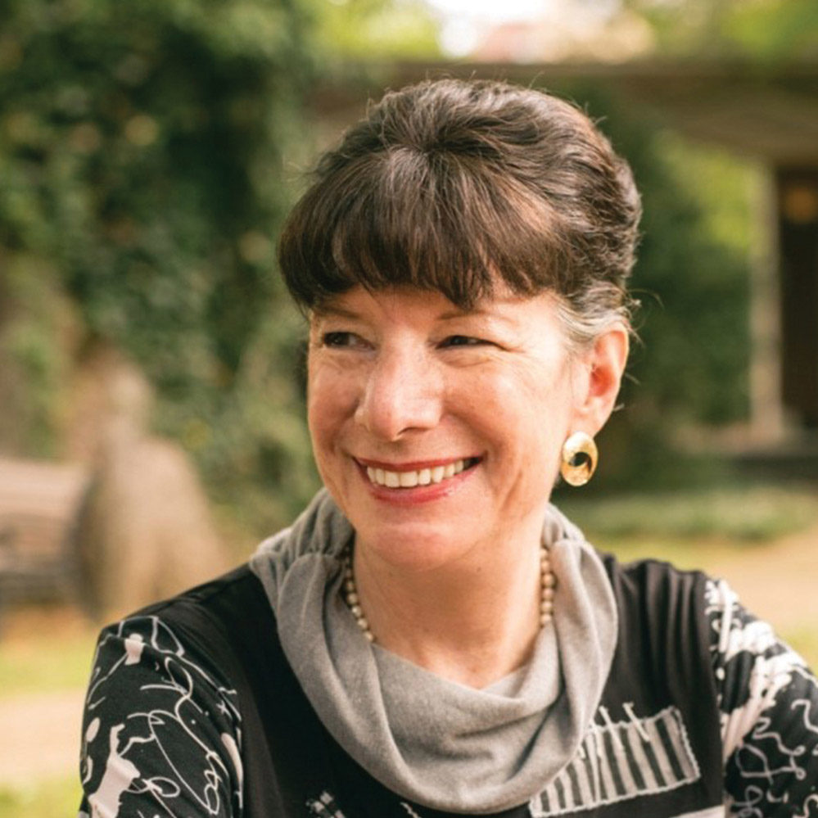
Amy-Jill Levine is Professor of New Testament Studies at Vanderbilt University Divinity School, Department of Religious Studies, and Graduate Department of Religion. NOT Messianic. She compares this section of Messianic Jews to the extensive karet verses in the Tanakh.
Notes:
https://www.google.com/url?sa=i&url=https%3A%2F%2Fnews.vanderbilt.edu%2F2017%2F07%2F28%2Flevines-scholarship-on-jesus-parables-featured-in-new-childrens-book%2F&psig=AOvVaw1-hPuAuctbwY5wpCCPLCuV&ust=1608435926009000&source=images&cd=vfe&ved=0CAIQjRxqFwoTCIDXkfKQ2e0CFQAAAAAdAAAAABAS

Slide 57
^{Shmot/Ex 12.15} "'For seven days you are to eat matzah - on the first day remove the leaven from your houses. For whoever eats hametz [leavened bread] from the first to the seventh day is to be cut off from Isra'el.

Slide 58
כָּרֵת karet
dying young (before the age of 60),
dying without children,
Or being spiritually "cut off" from your people in the World to Come.
Notes:
Various interpretations of which meaning in which passage.

Slide 59
^{Beresheet/Gen 17.13-14} The slave born in your house and the person bought with your money must be circumcised; thus my covenant will be in your flesh as an everlasting covenant.

Slide 60
^{Beresheet/Gen 17.13-14} Any uncircumcised male who will not let himself be circumcised in the flesh of his foreskin -that person will be cut off from his people, because he has broken my covenant."

Slide 61
`if a father does not circumcise his son, the sanhedrim are bound to circumcise him; and if they do not circumcise him, he is obliged when he is grown up to circumcise himself; and if he does not circumcise himself, he is guilty of cutting off,''

Slide 62
^{Shmot/Ex 31.14} Therefore you are to keep my Shabbat, because it is set apart for you. Everyone who treats it as ordinary must be put to death; for whoever does any work on it is to be cut off from his people.
Notes:
Death and world to come??

Slide 63
^{Vayikra/Lev 7:21} Anyone who touches something unclean - whether the uncleanness be from a person, from an unclean animal or from some other unclean detestable thing - and then eats the meat from the sacrifice of peace offerings for ADONI, that person will be cut off from his people.'"
Notes:
Ie touches a carcass of an animal, or a corpse of a person.

Slide 64
^{Vayikra/Lev 7.25-27} For whoever eats the fat of animals of the kind used in presenting an offering made by fire to ADONI will be cut off from his people. You are not to eat any kind of blood, whether from birds or animals, in any of your homes. Whoever eats any blood will be cut off from his people.'

Slide 65
^{Vayikra 20.6} "'The person who turns to spirit-mediums and sorcerers to go fornicating after them -I will set myself against him and cut him off from his people.

Slide 66
^{Vayikra/Lev 20.30-31} "Say to the people of Isra'el, 'If someone from the people of Isra'el or one of the foreigners living in Isra'el sacrifices one of his children to Molekh, he must be put to death; the people of the land are to stone him to death.

Slide 67
^{Vayikra/Lev 20.30-31} "I too will set myself against him and cut him off from his people, because he has sacrificed his child to Molekh, defiling my sanctuary and profaning my holy name.
Notes:
SRA Speaking about Baal worship few weeks ago and someone came up to me about their history SRA

Slide 68
^{Vayikra/Lev 23.28-29} "The tenth day of this seventh month is Yom-Kippur; you are to have a holy convocation, you are to deny yourselves, and you are to bring an offering made by fire to ADONI.

Slide 69
^{Vayikra/Lev 23.28-29} You are not to do any kind of work on that day, because it is Yom-Kippur, to make atonement for you before ADONI your God. Anyone who does not deny himself on that day is to be cut off from his people;

Slide 70
^{Bamidbar/Nu 15.30-31} "'But an individual who does something wrong intentionally, whether a citizen or a foreigner, is blaspheming ADONI. That person will be cut off from his people.

Slide 71
^{Bamidbar/Nu 15.30-31} "'Because he has had contempt for the word of ADONI and has disobeyed his command, that person will be cut off completely; his offense will remain with him.'"

Slide 72
But you are to keep my laws and rulings and not engage in any of these disgusting practices…For those who engage in any of these disgusting practices, whoever they may be, will be cut off from their people.

Slide 73
Outline
What type of people described?
What did they do?
Is there a remedy?
Does this apply to us?

Slide 75
^{Acts 13.13} Having set sail from Paphos, Sha'ul and his companions arrived at Perga in Pamphylia…went on from Perga to Pisidian Antioch, and on Shabbat they went into the synagogue and sat down. After the reading from the Torah and from the Prophets,

Slide 76
^{Acts 13} The synagogue leaders sent them a message, "Brothers, if any of you has a word of exhortation for the people, speak!" So Sha'ul stood, motioned with his hand, and said: "Men of Isra'el and God-fearers, listen!...

Slide 77
^{Act 13.27-30} The people living in Yerushalayim and their leaders did not recognize who Yeshua was or understand the message of the Prophets read every Shabbat, so they fulfilled that message by condemning him.

Slide 78
^{Act 13.27-30} They could not find any legitimate ground for a death sentence; nevertheless they asked Pilate to have him executed; and when they had carried out all the things written about him, he was taken down from the stake

Slide 79
^{Act 13.27-30} and placed in a tomb. “But God raised him from the dead! He appeared for many days to those who had come up with him from the Galil to Yerushalayim; and they are now his witnesses to the people.

Slide 80
^{Acts 13.34-35} And as for his raising him up from the dead, to return to decay no more, he said, “I will give the holy and trustworthy things of David to you.” his is explained elsewhere: “You will not let your Holy One see decay.”
Notes:
Resurrection in Tanakh by hints. Was rabbinic style to draw from hints.
Ie whole system of separation of meat and dairy. Shaul’s exegesis much more sound.

Slide 81
^{Acts 13.36-37} For David did indeed serve God's purposes in his own generation; but after that, he died, was buried with his fathers and did see decay. However, the one God raised up did not see decay.

Slide 82
^{Acts 13.38-39} Therefore, brothers, let it be known to you that through this man is proclaimed forgiveness of sins! That is, God clears everyone who puts his trust in this man, even in regard to all the things concerning which you could not be cleared by the Torah of Moshe.
Notes:
According to the Mishna, “There are thirty-six transgressions for which the Torah specifies the punishment of karet,” that is, being “cut off” from Israel (K’ritot 1:1).

Slide 83
Outline
What type of people described?
What did they do?
Is there a remedy?
Does this apply to us?

Slide 84
^{MJ 6.4-8} But if it produces thorns and thistles, it is worthless and near to being cursed—its end is to be burned over.
Consider: fruitlessness

Slide 85
^{T’hillim/Ps 51.19} My sacrifice to God is a broken spirit; God, you won’t spurn a broken, chastened heart.

Slide 86
^{Mishlei Prov 4:23} Guard your heart diligently, for from it flow the springs of life.
Notes:
Keep yourself from the “clickables”

Slide 87
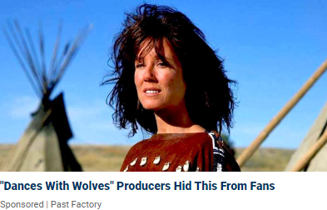

Slide 88
Notes:
Below a Lou Dobbs security report
“I’ve gotta know. How bad could a wedding fail be?”
“No you don’t”
Just one click…curiosity.

Slide 89
^{Mishlei Prov 4:23} Guard your heart diligently, for from it flow the springs of life.
Notes:
Keep yourself from the “clickables”

Slide 90
^{T’hillim/Ps 43.3-4} Bring me to Your holy mountain and to Your dwelling places. Then I will come to the altar of God, to the God of my exceeding joy, and praise You upon the harp — O God, my God.
Notes:
Is G-d your exceeding joy? Do you praise Him?

Slide 91
John the Immerser, the cousin and forerunner of Yeshua, perhaps sometimes depicted as stern and unforgiving, was actually a man of joy. In the very first description of him, the angel is recorded as saying: “He will be a joy and delight to you

Slide 92
and many will rejoice because of his birth. This is clearly linked with being “filled with the Holy Spirit.” Even as a baby in the womb he “leaped for joy” at the greeting of Yeshua’s mother.

Slide 93
The coming of Messiah, the shepherds were told, was “good news of great joy” (Luke 2:10) and they duly “glorified and praised God” (v20).

Slide 94
^{Lk 14.10-11} When you are invited, go and sit in the least important place; so that when the one who invited you comes, he will say to you, ‘Go on up to a better seat.’

Slide 95
^{Lk 14.10-11} Then you will be honored in front of everyone sitting with you. Because everyone who exalts himself will be humbled, but everyone who humbles himself will be exalted.”

Slide 96
^{Acts 13.38-39} Therefore, brothers, let it be known to you that through this man is proclaimed forgiveness of sins! That is, God clears everyone who puts his trust in this man, even in regard to all the things concerning which you could not be cleared by the Torah of Moshe.
Notes:
According to the Mishna, “There are thirty-six transgressions for which the Torah specifies the punishment of karet,” that is, being “cut off” from Israel (K’ritot 1:1).

Slide 97
Trust & Praise,
Purity and Praise
Humble service and Praise

Slide 98
Outline
What type of people described?
What did they do?
Is there a remedy?
Does this apply to us?

Slide 99
^{Jude 20-21} But you, dear friends, build yourselves up in your most holy faith, and pray in union with the Ruakh HaKodesh. Thus keep yourselves in God’s love, as you wait for our Lord Yeshua the Messiah to give you the mercy that leads to eternal life.

