Slide 1
e-handout
To have these notes
without taking notes
Go to OrHaOlam.com
Click on downloads,
messages, 2020

Slide 2
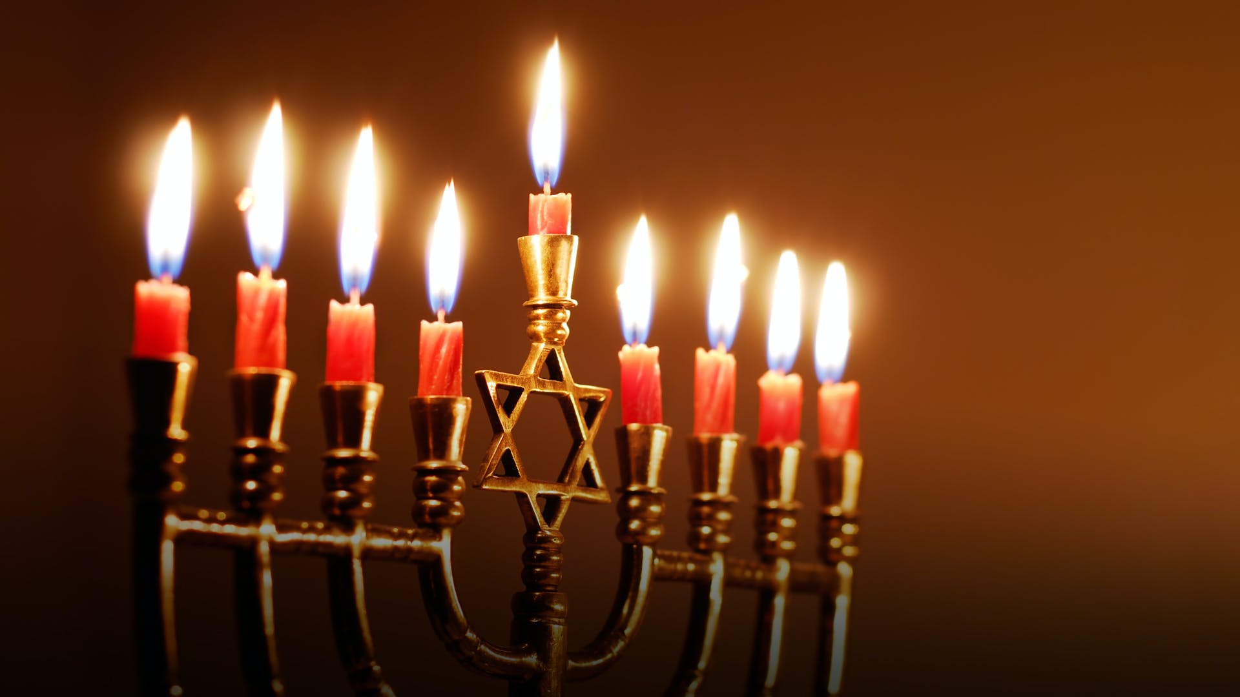
This Thursday evening, Dec. 10, Kislev כסלו 25, we will light the first Hanukkah candle.
Notes:
https://imageproxy.themaven.net//https%3A%2F%2Fwww.history.com%2F.image%2FMTY5MTE2NjA5ODU0NTgwMDAx%2Fhanukkah-gettyimages-157389389.jpg

Slide 3
Wednesday night, Dec. 2, we had a community Zoom discussion on the synagogue policy relative to masks and distancing. Leadership wanted to hear your hearts and minds.

Slide 4
^{Act 15.6-9} The emissaries and the elders met to look into this matter. After lengthy debate, After much debate…So we have decided unanimously … For it seemed good to the Ruakh HaKodesh and to us
Notes:
We didn’t decide unanimously, but

Slide 5
Conclusion: was that there is great and passionate divergence, of opinion and as Tevye said, “You are also right.” Obey the executive order or resist the over-reach.
However, there is an underlying passionate principle:
Notes:
Greg nor I could discern the Holy Spirit’s clear leading either way.

Slide 6
^{Eph 4.2-4} Always be humble, gentle and patient, bearing with one another in love, and making every effort to preserve the unity the Spirit gives through the binding power of shalom. There is one body and one Spirit, just as when you were called you were called to one hope.
Notes:
Add: at the feet of Yeshua
J4j on Jewish arguing Issues Mag 23-04 p 12-13

Slide 7
Besides, the detailed regulation of religious institutions may end shortly.

Slide 8
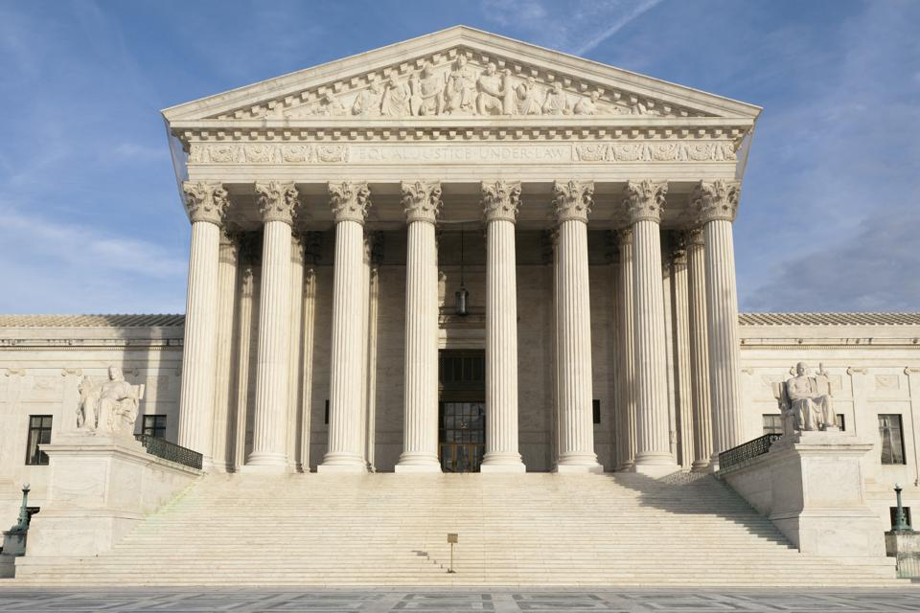
Supreme Court of the United States

Slide 9
"Today’s [Thursday, Dec. 3] ruling by the Supreme Court provides great relief for churches and places of worship. The handwriting is now on the wall. The final days of Governor Gavin Newsom's 'color-coded executive edicts' banning worship are numbered and coming to an end. It is past time to end these unconstitutional restrictions on places of worship.""
Notes:
https://www1.cbn.com/cbnnews/us/2020/december/us-supreme-court-steps-in-after-months-of-california-discrimination-against-churches
So if the regulation ends, will we have wounds of anger and bitterness to address?

Slide 11
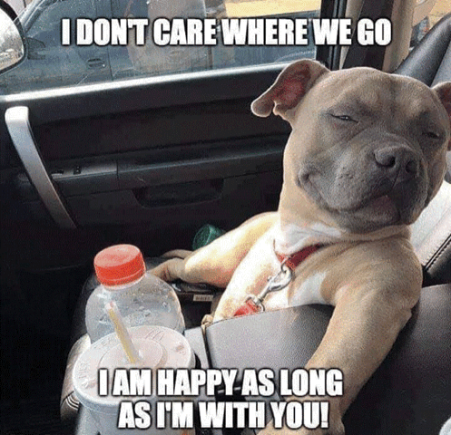
Notes:
MaryAnn Dixon

Slide 12
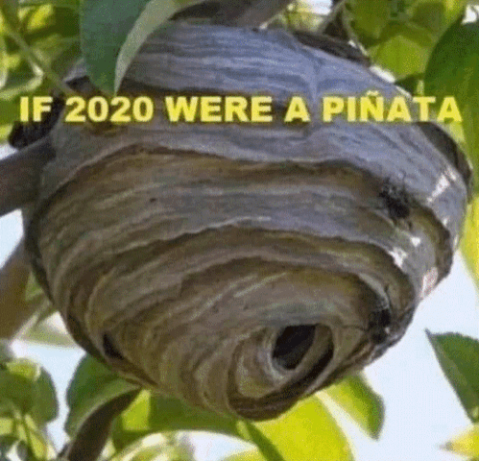
Notes:
MaryAnn Dixon
When message over last Shabbat, lots of material not covered. It happens. Then someone approached me with a confirmation. Then, the Ruakh just seemed to prompt me to spend another Shabbat on the subject of thankfulness blessings, and ingratitude.

Slide 14
Outline of this message
Why we give thanks and praise.
Meaning of the word “Jew.”
Americana Thanksgiving
Exhortations

Slide 15
Why do we thank and praise Him?
^{1 Yn 4.19} We love him, because he first loved us.
Notes:
Reason we were created. He gave His life for us so we could have life, continues to give us life!

Slide 16
^{1 Thes. 5.17-18} Always be joyful. Pray regularly. In everything give thanks, for this is what God wants from you who are united with the Messiah Yeshua.
This = circumstances or attitude?

Slide 17
Ingratitude is the basis of ALL sin, starting in Gan Eden / the Garden of Eden.
You can’t have a heart of gratitude AND a heart of rebellion.
You can’t have a heart of gratitude AND raging lust, anger, pride, greed.

Slide 18
^{Ro 1.20-21} For ever since the creation of the universe his invisible qualities — both his eternal power and his divine nature — have been clearly seen, because they can be understood from what he has made. Therefore, they have no excuse; because, although they know who God is, they do not glorify him as God or thank him.

Slide 19
Instead of worship, praise, gratitude, the human race sunk into craving perversion.

Slide 20
^{Ro 1.21-24} On the contrary, they have become futile in their thinking; and their undiscerning hearts have become darkened. Claiming to be wise, they have become fools! In fact, they have exchanged the glory of the immortal God for mere images…

Slide 21
^{Ro 1.21-24} This is why God has given them up to the vileness of their hearts’ lusts, to the shameful misuse of each other’s bodies.

Slide 22
^{Ro 1.26-27} This is why God has given them up to degrading passions; so that their women exchange natural sexual relations for unnatural; and likewise the men, giving up natural relations with the opposite sex, burn with passion for one another.

Slide 23
ANYONE could be gay. Result of [generational] lack of gratitude.
Three causes of same sex attraction.
Indulgence without gratitude.
Wrong response to abuse.
Epigenitics:

Slide 25
In an attempt to cope with stress, sex, alcohol and drugs can be used as an escape. Once substance use commences, however, epigenetic alterations may further exacerbate the biological and behavioral changes associated with addiction.
Notes:
[http://en.wikipedia.org/wiki/Behavioral_epigenetics]

Slide 26
Even short-term substance use can produce long-lasting epigenetic changes in the brain of rodents, via DNA methylation and histone modification.
Notes:
[http://en.wikipedia.org/wiki/Behavioral_epigenetics]

Slide 27
Epigentics doesn’t change the underlying guanine, cytosine, adenine, thiamine. But DOES affect expressions: on/off switch. Behavior of past generations affects your tendency to behave a certain way. TENDENCY.]
Notes:
No one is born gay. Some have tendency.

Slide 28
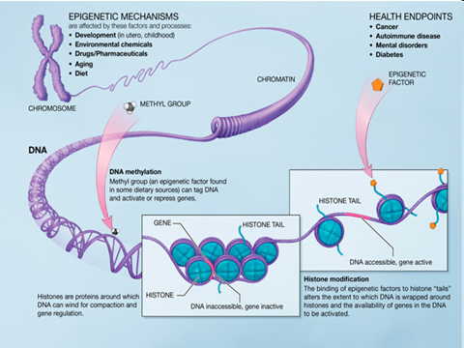

Slide 29
^{Shmot/Ex 34.6-7} Then Adoni passed before him, and proclaimed, “Adoni, Adoni, the compassionate and gracious God, slow to anger, and abundant in lovingkindness and truth…bringing the iniquity of the fathers upon the children, and upon the children’s children, to the third and fourth generation.”

Slide 30
ANYONE could be gay. Result of [generational] lack of gratitude.
Three causes of same sex attraction.
Indulgence without gratitude.
Wrong response to abuse.
Epigenitics:

Slide 31
^{Ro 1.20-21} although they know who God is, they do not glorify him as God or thank him.

Slide 32
Starting point of healthy prayer:
^{Mtt 6.9-10} “Therefore, pray in this way: ‘Our Father in heaven, May your Name be kept holy. May your kingdom come, your will be done…
Notes:
Image of Fatherhood.
A thought experiment: Say “father” What comes to mind? Should be: supportive, strong, loving, comforting.
Many of us are broken relative to this image of fatherhood. Me at Promise Keepers, they spoke about a plague of fatherlessness. “Why are these guys here?”

Slide 33
First congregational praise:

Slide 34
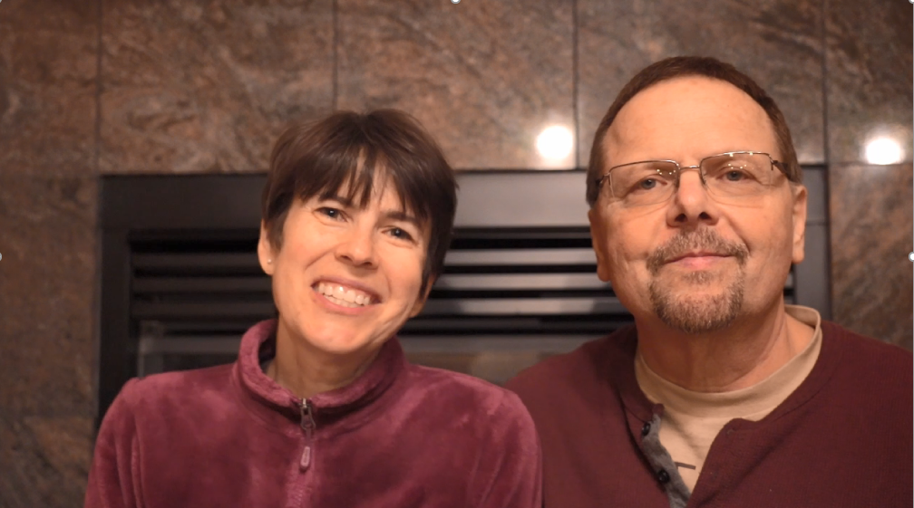

Slide 35
If you are Jewish, or have joined with the Jewish people in the Messianic awakening, you have committed yourself to an identity of praise.

Slide 36
^{Ro 2.28-29} For the real Jew is not merely Jewish outwardly: true circumcision is not only external and physical. On the contrary, the real Jew is one inwardly; and true circumcision is of the heart, spiritual not literal; so that his praise comes not from other people but from God.
Notes:
Pun here.

Slide 37
Ioudaios: Jewish, a Jew, Judea
Original Word: Ἰουδαῖος, αία, αῖον
Phonetic Spelling: (ee-oo-dah'-yos)
Greek misses the point.
יְהוּדִי Yehudi הוֹד glory, splendor majesty
Notes:
Above is the spiritual meaning of the word “Jew.” There is also the covenantal…

Slide 38
^{Ro 3.1-2} Then what advantage has the Jew? What is the value of being circumcised? Much in every way! In the first place, the Jews were entrusted with the very words of God.

Slide 39
Second congregational praise:

Slide 40
Mike & Melody Anne Boatright

Slide 41
Mike Boatright’s “praise and thanksgiving”
In an attitude of Praise and Thanksgiving, I wanted to thank the Ruakh / the Holy Spirit for allowing us as participants this year in the Drive-In Prayer Outreach initiative to members of the community, our neighbors

Slide 42
and the total strangers that the Ruakh prompted to drive in and to share their Prayer Requests, their hurts, their frustrations, their concerns and their heartfelt requests for prayer and intercession from the Ruakh and most assuredly from the Throne Room of G-d.

Slide 43
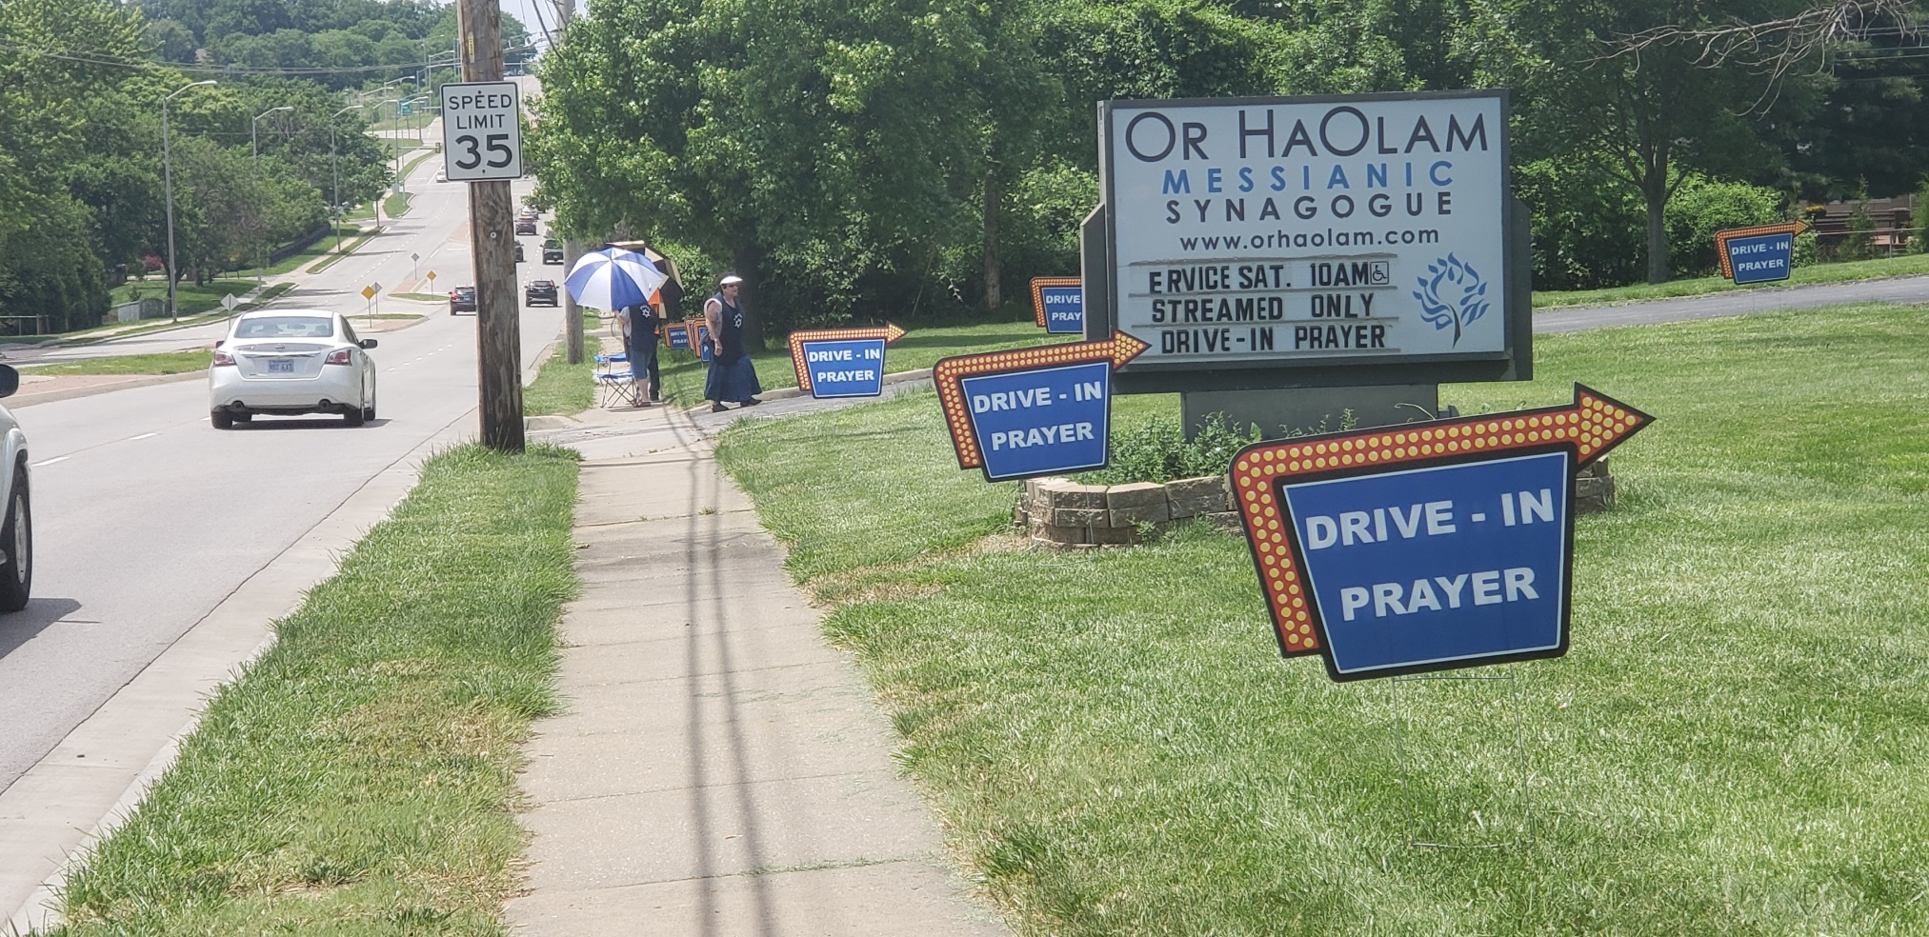

Slide 44
As the Coordinator of these activities, aside from assigned moments of placing and removing the signs and a few other chores, many times my activity merely entailed “getting out of the way” as the Ruakh positioned those whom He wanted to be in position to pray with those who drove in.

Slide 45
Without fail, the Ruakh is the world’s best “Traffic Cop.” As was always the case, the person that our “Guests” needed to pray with, was in position at the precise or near precise moment when the “Guests” arrived.

Slide 46
As was often the case time and again, many of the “Guests” would make the same statement; “The Holy Spirit told me to turn around and go back for prayer” as well as the occasional “G-d told me to turn in!”

Slide 47
The “Ladies with the umbrellas on 95th Street” became a weekend fixture in the eyes of our neighbors and many would stop in to visit, to see what we were up to, to find out who we are, what we believed, “who” we prayed to; many people “walking by”

Slide 48
(even in Johnson County) would stop and pray with the ladies and guys of the prayer team wavers, if just to receive a prayer for their concerns and worries. On many an occasion, it would seem that those seeking prayer just needed prayer time with their “grandma” or their “aunt”, something that G-d had provided in this instance and their countenance and their spirit being refreshed or confronted in that moment

Slide 49
Throughout the summer heatwave conditions that plagued our efforts, the Ruakh would always provide a breeze at just the right moment, as we prayed with and were blessed in providing and receiving overwhelming examples of “Lovingkindness” that was truly a gift from the Ruakh and the Throne Room of G-d.

Slide 50
On a couple of Shabbat’s, people driving in would tell of a passage of scripture that G-d had placed in their hearts and their minds, and in several occasions the passage of scripture was the same as the people in the car before them, a gentle reminder of the Ruakh that He was truly at work in the lives and concerns of all who drove in.

Slide 51
And there was that one afternoon, when two total strangers pulled in, got out of their car with the words, “we need to be saved.” In all of my days, I never would have imagined, but in all of my days of standing in the blistering sun, on the parking lot in 105 degree heat, I wouldn’t have missed this for the world and all its riches.

Slide 52
There were many who drove in; the homeless, penniless, lost in the world and lost in their sins and knowing they needed the saving grace of their Messiah if they were ever to see heaven. Those who had loved ones sick with COVID,

Slide 53
sick in the hospital, those who had loves ones die and those who had loved ones who had ended their lives way to early, they all needed prayer and love that could only have come from G-d.
This “Season of Outreach” took its toll on each of us who participated, but we were strengthened and refreshed, as G-d through the presence of the Ruakh led us and guided us and lifted us through these times.
I look forward to the “Seasons of Outreach” in the summers to come.

Slide 54
The sun will be hot, the challenges many, the enemy will have his hackles up and the attacks are coming, but as my grandmother would say, “if the enemy isn’t hittin’ you from all sides, then you must be sittin’ in the wrong pew.”

Slide 55
I thank G-d for his blessing, grace, tender mercies and this Praise of Thanksgiving this year, would be coupled with the prayer, that we might be afforded the opportunity to do it all again, next year.
See you on the Parking Lot !!!

Slide 56
Thanksgiving Americana

Slide 57
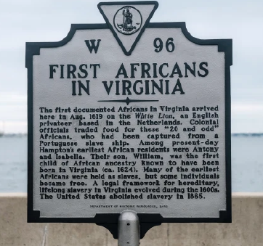

Slide 58
In August 1619, a pirate ship, the White Lion, stopped at Jamestown and traded 20-some captive Africans for food. The Africans were treated as indentured servants and most were soon released.
Notes:
https://nypost.com/2020/11/07/america-wasnt-founded-on-slavery-but-on-pilgrims-ideals/

Slide 59
Fifteen months later, in November 1620, an English ship blown off course on its way to Virginia ended up off the barren coast of Massachusetts. It landed more than 100 men, women and children. Those voyagers founded Plymouth Colony.
Notes:
https://nypost.com/2020/11/07/america-wasnt-founded-on-slavery-but-on-pilgrims-ideals/

Slide 60
Which event mattered more? Last year, the New York Times declared that the arrival of the captives in Virginia was the “true beginning” of America — an America that the Times characterized as a “slavocracy.” The Times calls its campaign to promote this story The 1619 Project.
Notes:
https://nypost.com/2020/11/07/america-wasnt-founded-on-slavery-but-on-pilgrims-ideals/

Slide 61
Notes:
https://www.prageru.com/video/whats-wrong-with-the-1619-project/?utm_source=Main+Mailing+List&utm_campaign=19210dd225-EMAIL_CAMPAIGN_2020_04_09_06_29_COPY_01&utm_medium=email&utm_term=0_f90832343d-19210dd225-164356353

Slide 62
In this video, Wilfred Reilly, Associate Professor of Political Science at Kentucky State University, responds to The 1619 Project’s major claims.
Notes:
https://www.prageru.com/video/whats-wrong-with-the-1619-project/?utm_source=Main+Mailing+List&utm_campaign=19210dd225-EMAIL_CAMPAIGN_2020_04_09_06_29_COPY_01&utm_medium=email&utm_term=0_f90832343d-19210dd225-164356353

Slide 63
Notes:
https://www.prageru.com/video/whats-wrong-with-the-1619-project/?utm_source=Main+Mailing+List&utm_campaign=19210dd225-EMAIL_CAMPAIGN_2020_04_09_06_29_COPY_01&utm_medium=email&utm_term=0_f90832343d-19210dd225-164356353

Slide 64
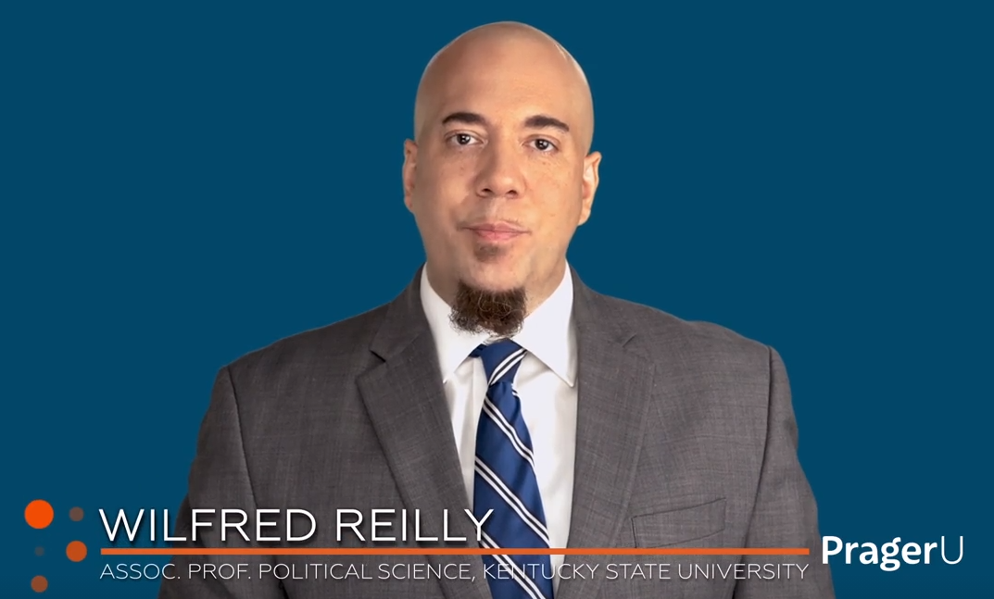
Notes:
https://www.prageru.com/video/whats-wrong-with-the-1619-project/?utm_source=Main+Mailing+List&utm_campaign=19210dd225-EMAIL_CAMPAIGN_2020_04_09_06_29_COPY_01&utm_medium=email&utm_term=0_f90832343d-19210dd225-164356353

Slide 65
Victor Glover, astronaut on the ISS, from Space X, 250 mi. up.
Notes:
Launched a few weeks ago on SpaceX.

Slide 66
Lori Wilson testimony

Slide 67
We need to turn thanksgiving into thanks-living.
And yet in America all around we can find those who are grumbly hateful rather than humbly grateful.
Notes:
Adrian Rogers

Slide 68
You do not come to service to praise the Lord. You are to bring your praise with you to service. You don't commence your praise here, you continue.

Slide 69
^{T’hillim/Ps 34.2} I will bless Adoni at all times. His praise is continually in my mouth.

Slide 70
^{T’hillim Ps 43} I will come to the altar of God, to G-d my exceeding joy,
I will bring the fruit of my lips
אָבוֹא אֶל מִזְבֵּחַ אֱלֹהִים אֶל אֵל שִׂמְחַת גִּילִי
Avo el mizbakh Elohim
el El simkhat gili
אַקְרִיב פְּרִי שְׂפָתַי לְפָנֶיךָ
Akriv pri sfati lefaneikha
Notes:
Sarah Liberman

Slide 71
^{1Tim.4.7-8} Train, exercise yourself in godliness. For physical exercise has some benefit; but godliness is beneficial for all things, holding promise for both the present life and the one to come.
We don’t achieve godliness, but we grow in it or NOT!

Slide 72
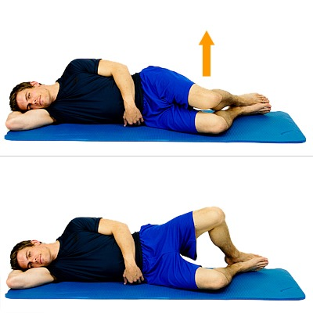
Clamshell exercise
After hip surgery, my physical therapist said that this muscle is traumatized and atrophied, as is the part of the brain that signals to it.
Notes:
So, he said, used what’s left of your brain to communicate with what’s left of your muscle to lift your leg.
Similarly, our praise “muscle” gets atrophied by lack of use, and by trauma.
https://www.google.com/url?sa=i&url=https%3A%2F%2Flillypt.com%2Fclamshell-exercise-for-knee-back-hip-ankle-pain%2F&psig=AOvVaw2Akb6MbtG2fE9i866K8kZo&ust=1607228258993000&source=images&cd=vfe&ved=0CAIQjRxqFwoTCOjxooP-te0CFQAAAAAdAAAAABAD

Slide 73
^{1Tim.4.7-8} Train, exercise yourself in godliness. For physical exercise has some benefit; but godliness is beneficial for all things, holding promise for both the present life and the one to come.
We don’t achieve godliness, but we grow in it or NOT!

Slide 74
Come and rejoice and give Him glory
נָגִילָה וְנִשְׂמְּחָה וְנִתַּן לוֹ כָּבוֹד
Nagila v’nis’mekha V’nitan lo kavod
Rejoicing and giving Yeshua praise, is warfare that glorifies G-d!
Notes:
But there are some people…that always hurt. This is a powerful formula, although you may need help to invoke. “The Blood of Yeshua the Messiah

Slide 75
^{T’hillim/Ps 69.31-32} I will praise God’s Name with a song, and magnify Him with praise. It will please Adonai better than an ox or a bull with horns and hoofs.
Notes:
G-d wants your praise even more than he wants your money!!

Slide 76
^{T’hillim/Ps 141.2} May my prayer be set before You like incense. May the lifting up of my hands be like the evening sacrifice.
Notes:
We don’t have such a stellar turn out at our Teerosh prayer. Beautiful anointed music, passionate insightful prayer leaders, easy access from Zoom or this beautiful sanctuary.

Slide 77
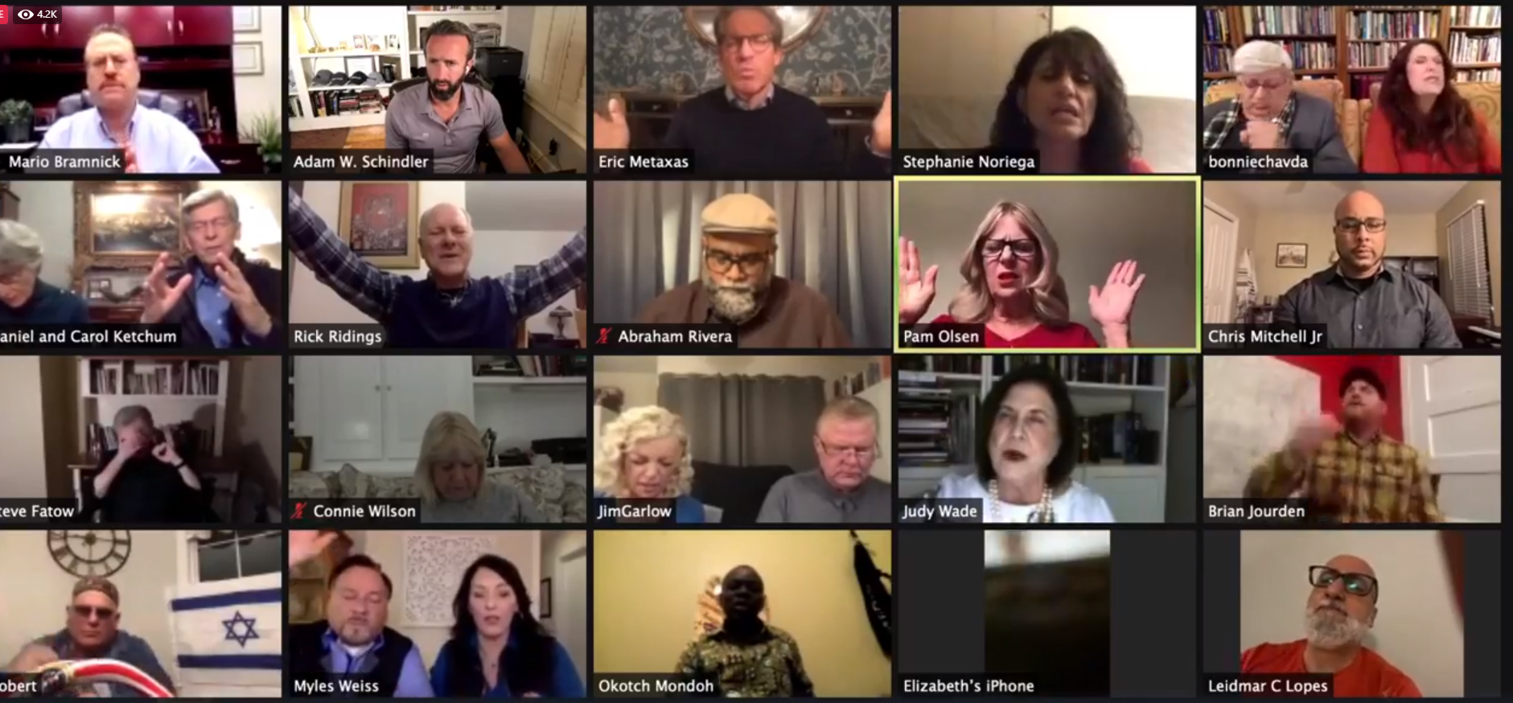
Notes:
4.1 K

Slide 78
Outline of this message
Why we give thanks and praise.
Meaning of the word “Jew.”
Americana Thanksgiving
Exhortations

Slide 79
^{Luke 17:11-17} Now one of them, when he saw that he was healed, came back, glorifying God with a loud voice. And he fell at Yeshua’s feet, facedown, giving Him thanks. And he was a Samaritan.

Slide 80
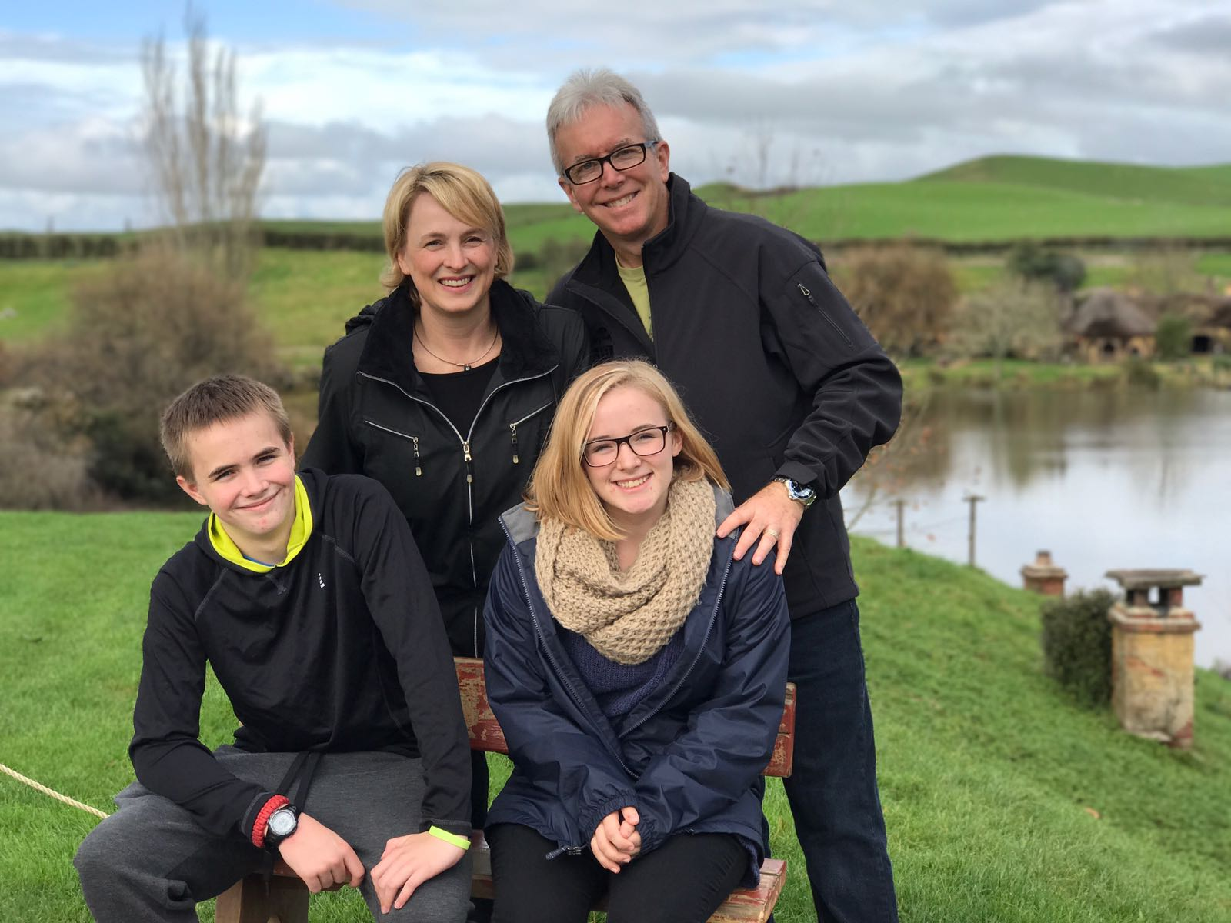
Shaunti & Jeff Feldhahn & kids
For Men Only
Kindness Challenge

Slide 81
Shaunti Feldhan Yep, it’s official. I was sick all last week and received my lab results back on Friday night with the news that I have COVID-19. It has been quite a journey, as I have been pretty sick for most of the past week and although slightly better now, it seems to be a lingering type of illness.
Notes:
Copyright © 2020 Shaunti Feldhahn, All rights reserved.

Slide 82
But while this can be troublesome, I am also very aware that there is a command in scripture that says we are supposed to rejoice in our sufferings. We’re supposed to be thankful, even for our trials—and God really means that!
Notes:
Copyright © 2020 Shaunti Feldhahn, All rights reserved.

Slide 83
So, I made a list of reasons why I’m thankful I have COVID-19. And I want to share it with you, to encourage you to also look for things to be thankful for when your Thanksgiving may not look the way you imagined:
Notes:
Copyright © 2020 Shaunti Feldhahn, All rights reserved.

Slide 84
It is forcing me to slow down and have literal quiet time.
I appreciate family and community so much more now and will do so even more when I am out of quarantine.
Being sick makes me appreciate how much my body does for me during normal times. I will never take breathing for granted again!
Notes:
Copyright © 2020 Shaunti Feldhahn, All rights reserved.

Slide 85
