Slide 1
e-handout
To have these notes
without taking notes
Go to OrHaOlam.com
Click on downloads,
messages, 2020

Slide 2
Spring is coming

Slide 3
Winter
Football

Slide 4
Spring
Flowers in her hair

Slide 5
Messiah the Divine Cohen

Slide 6
Summary of MJ quotes about Deity of Mashiakh in Chap 1
at the right hand Ps 110 → deity
is called “son.” Ps 2 → deity
is the royal son. 2 Sam 2.14
is worshipped by angels Ps 97
is the Lord of light. Ps 104
Notes:
Proof of deity
Proof of deity
Midrash of deity
Midrash of deity
Midrash of deity

Slide 7
G-d of God and a warrior, lover, bridegroom ^{Ps 45}
Notes:
6. Proof of deity
Model marriage

Slide 8
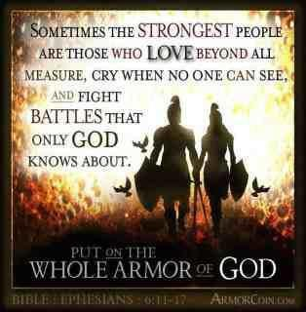
Notes:
https://www.google.com/search?q=husband+and+wife+warriors&safe=active&sxsrf=ACYBGNTkhwmw9_9vLRyHwm5EoHZMYRla_g:1581705193470&tbm=isch&source=iu&ictx=1&fir=VPU2ZA9BTXMhoM%253A%252CuNyDU8fym4xm8M%252C_&vet=1&usg=AI4_-kTUippg0ERnNwEfj_jMxSFcB4It5Q&sa=X&ved=2ahUKEwj8x8iB19HnAhVBX60KHWVaAbQQ9QEwAHoECAoQIg#imgrc=VPU2ZA9BTXMhoM
Fight in prayer, in love, in wisdom, in presentation, in communication of the Word for your marriage, your community, for Israel.

Slide 9
Husband and wife duo Amanda and Zack Zakharia | Australian Ninja Warrior 2017
Notes:
https://youtu.be/eJHwUruZYag
They have each others’ back! Pray, serve, give, love TOGETHER!!

Slide 10
Will outlast the created earth and universe. “like a garment” Yeshayahu/Is 50.6-9 T’hillim/Ps 102.24-28
Notes:
7. Midrash of deity

Slide 11
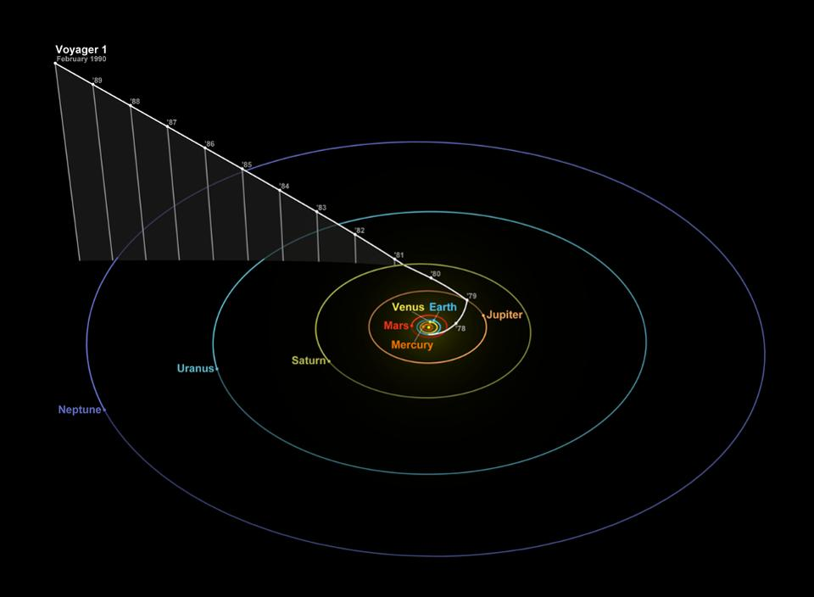
30th anniversary of Pale Blue dot photo
Notes:
Voyager 1 was 4 billion miles/6.4 billion kilometers from Earth and 32º above the ecliptic—the plane of the solar system where all of the planets orbit, more or less—when it snapped the images that became known as “Pale Blue Dot.” Earth is pictured within a light ray from the sun because, as seen from Voyager 1’s perspective, Earth was close to the sun. So Voyager 1’s wide-angle camera had to take a photo that also included the sun. Voyager 1 is now 13 billion miles distant, firmly in interstellar space.
https://www.forbes.com/sites/jamiecartereurope/2020/02/12/voyager-1s-iconic-pale-blue-dot-photo-is-30-years-old-so-nasa-made-a-new-one/#1d3481401ac6

Slide 12
Earth
Notes:
https://www.forbes.com/sites/jamiecartereurope/2020/02/12/voyager-1s-iconic-pale-blue-dot-photo-is-30-years-old-so-nasa-made-a-new-one/#1d3481401ac6
Yanel: I did signal analysis involved in the telemetry from both Vogayers and the Pioneers missions. But I was in high school or college while trajectories were being worked out.

Slide 13
Application #1
We are the royal bride of the Heavenly King, who will soon conquer this world. Divest ourselves of the thinking of this culture. We belong to the King!
Notes:
Negative view.
Travesties of our time. 60 million abortions. Impurity. Servant hearts. Loving hearts. Giving hearts.

Slide 14
Our King is at war with our cultural practices and thoughts. He has come to rescue a warrior bride that is engaged with Him.
Application #2 Are you engaged in prayer, in outreach, in service in war against our flesh, and the culture?
Notes:
Positive view. We ARE winning.
Today’s text…

Slide 15
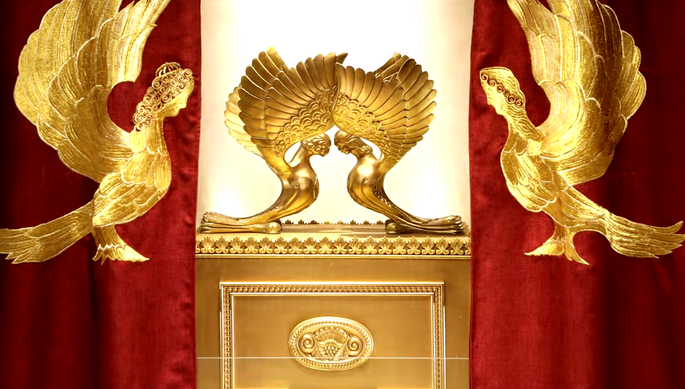
Letter to the Messianic Jews [Hebrews] MJ 2.1-4
Notes:
https://www.templeinstitute.org/new-location.htm

Slide 16
^{MJ 2.1-4} Therefore, we must pay much more careful heed to the things we have heard, so that we will not drift away. For if the word God spoke through angels became binding, so that every violation and act of disobedience received its

Slide 17
^{MJ 2.1-4} just deserts in full measure, then how will we escape if we ignore such a great deliverance? This deliverance, which was first declared by the Lord, was confirmed to us by those who heard him;

Slide 18
^{MJ 2.1-4} while God also bore witness to it with various signs, wonders and miracles, and with gifts of the Ruakh HaKodesh which he distributed as he chose.
Notes:
Go back through this text and expound, explain it point by point.

Slide 19
Therefore
More careful heed
Not drift away
Through angels?
Ignore deliverance
GREAT deliverance.
Notes:
Go back through this text and expound, explain it point by point.

Slide 20
Therefore, we must pay much more careful heed to the things we have heard
“Therefore” infers that we should see what the word is there for

Slide 21
Summary we just did:
at the right hand, called Son, Davidic dynasty, worshipped by angels, the Lord of light, the G-d of God and a warrior, lover, bridegroom; will outlast the created earth and universe
Notes:
Important guy! If Patrick Mahomes walked into our service, would we honor him?

Slide 22
Stern: because he is God's Son and "much better than angels" ^{(1:4, proved by 1:5-13),} Therefore, we must pay much more careful heed to the things we have heard.

Slide 23
Therefore
More careful heed
Not drift away
Through angels?
Ignore deliverance
GREAT deliverance.

Slide 24
^{Ps 119.162} I rejoice in Your word, as one who finds great spoil.
שָׂשׂ אָנֹכִי עַל-אִמְרָתֶךָ--כְּמוֹצֵא שָׁלָל רָב.
^{BBE} I am delighted by your sayings, like a man who makes discovery of great wealth.

Slide 25
Van Halen rock band

Slide 26
In the early 1980s rock band Van Halen had in their contract with each concert venue that they must have M&M candy in the dressing room, but it stipulated no brown M&Ms. Eddie Van Halen had a large and complicated stage show, one that demanded the attention of promoters and the people moving the band’s equipment.
Notes:
http://commandyourbusiness.com/2013/11/22/do-details-matter-veterans-know-the-answer/

Slide 27
To ensure that those responsible for staging their concerts had thoroughly read about the many technical needs, band members inserted the M&M reference in their contracts as a test. If the candy wasn’t right, they had reason to be concerned about similar inattention to serious issues like electricity and load stress.”
Notes:
They were wanting to deliver a certain sound. We are wanting to receive a certain glorious message of holiness, uncontaminated.
Pay attention!
http://commandyourbusiness.com/2013/11/22/do-details-matter-veterans-know-the-answer/

Slide 28
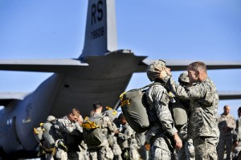
Army Jump Masters Conducting An Inspection Prior To A Jump. They Know Details Matter
Notes:
http://commandyourbusiness.com/2013/11/22/do-details-matter-veterans-know-the-answer/

Slide 29
Improvised Explosive Devices or IEDs posed a great threat to our troops who served in Iraq and Afghanistan. These explosive devises are hidden among the every day trash and debris found along the roads and trails that soldiers travel every day.
Notes:
http://commandyourbusiness.com/2013/11/22/do-details-matter-veterans-know-the-answer/

Slide 30
They must pay attention to the most minute detail; trash that does not belong, earth recently moved, tiny wires along the roadway. The results can be deadly if they miss the details.
Notes:
http://commandyourbusiness.com/2013/11/22/do-details-matter-veterans-know-the-answer/
We can miss the way. There are ideas that sound right, but teach a Yeshua who will not empower and save us: is Messiah but NOT G-d. Or delete a book of the Bible. Or exalt other writings. Pay attention to Him!

Slide 31
^{Thillim Ps 119.11} I have treasured Your word in my heart, so I might not sin against You.
^{Thillim Ps 119.111} I take your instruction as a permanent heritage, because it is the joy of my heart.

Slide 32
Time Mag this week talke about “contaminated time” – when we’re doing one thing but thinking about something else.
When someone talks to you…
During worship or message…
Worship: do we envision Yeshua hearing, receiving us?
Notes:
we must pay much more careful heed

Slide 33
Therefore
More careful heed
Not drift away
Through angels?
Ignore deliverance
GREAT deliverance.

Slide 34
^{MJ 2.1-4} Therefore, we must pay much more careful heed to the things we have heard, so that we will not drift away.

Slide 35
^{2 Tim 3.1 CEB} Understand that the last days will be dangerous times.
^{CJB} Moreover, understand this: in the last days akharit-hayamim will come trying times.
Notes:
In 1969 I was a sophomore at Union College, a men’s college. Parietals: rules governing visits from members of the opposite sex the men’s dormitory. Women allowed in the dorm till 10 p.m on weekday nights, midnight on weekends. I about Mar 1969 we had a vote about modifying parietals. Voted them out. I got saved and left for Bible college by Aug 1969, but the report. Locker room type showers. Shocking then. Drift! Get used to things.
Now transgender RIGHTS!
Novel came out called Harrad Experiment.

Slide 36
House Hunters made HGTV history on Wednesday when it featured its first throuple—three people in a polyamorous romantic relationship—on one of its episodes.
Notes:
https://www.charismanews.com/opinion/in-the-line-of-fire/79971-as-we-mindlessly-careen-our-way-down-the-slippery-slope?utm_source=In%20the%20Line%20of%20Fire&utm_medium=email&utm_content=subscriber_id:5194514&utm_campaign=Blogger%20-%20Michael%20Brown%20-%202020-02-18

Slide 37
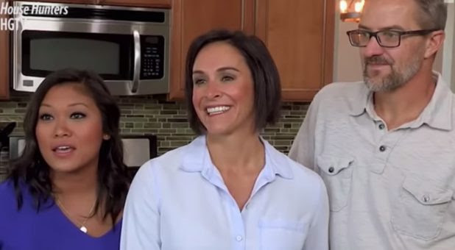
Geli, Lori and Brian on "House Hunters" (YouTube/PeopleTV)
Notes:
They are in love. All three of them. Now normative in our culture.
https://www.charismanews.com/opinion/in-the-line-of-fire/79971-as-we-mindlessly-careen-our-way-down-the-slippery-slope?utm_source=In%20the%20Line%20of%20Fire&utm_medium=email&utm_content=subscriber_id:5194514&utm_campaign=Blogger%20-%20Michael%20Brown%20-%202020-02-18

Slide 38
Dr. Michael Brown: “For years we were vilified for saying that the redefining of marriage to include homosexual unions would soon lead to more radical redefinitions.”
Notes:
https://www.charismanews.com/opinion/in-the-line-of-fire/79971-as-we-mindlessly-careen-our-way-down-the-slippery-slope?utm_source=In%20the%20Line%20of%20Fire&utm_medium=email&utm_content=subscriber_id:5194514&utm_campaign=Blogger%20-%20Michael%20Brown%20-%202020-02-18

Slide 39
The original husband and wife in this throuple have two children. As People reported, "Brian and Lori, who are legally married, fell in love with Geli after meeting her at a bar. The trio entered into a relationship with Brian and Lori exchanging vows with Geli in a commitment ceremony attended by their children."
Notes:
You might say: This is just polygamy, that’s been around since Cain. Not so, this is worse. It’s not just a man and two women by turns, it’s a threesome. I don’t want to be anymore specific.
https://www.charismanews.com/opinion/in-the-line-of-fire/79971-as-we-mindlessly-careen-our-way-down-the-slippery-slope?utm_source=In%20the%20Line%20of%20Fire&utm_medium=email&utm_content=subscriber_id:5194514&utm_campaign=Blogger%20-%20Michael%20Brown%20-%202020-02-18

Slide 40
There is also now “self marriage.”
http://www.selfmarriageceremonies.com/
Solagamy
Self-Marriage is a profound rite of passage into wholeness, trust, self-responsibility, self-liberation, and love sourced from within.
Notes:
https://www.charismanews.com/opinion/in-the-line-of-fire/79971-as-we-mindlessly-careen-our-way-down-the-slippery-slope?utm_source=In%20the%20Line%20of%20Fire&utm_medium=email&utm_content=subscriber_id:5194514&utm_campaign=Blogger%20-%20Michael%20Brown%20-%202020-02-18

Slide 41
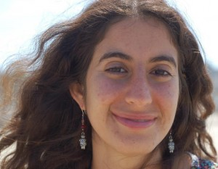
I am Dominique Youkhehpaz, the founder of Self-Marriage Ceremonies. I have guided hundreds of people into marrying themselves and am thrilled to offer Self-Marriage now in way that is globally accessible. I first facilitated Self-Marriage ceremonies for women at Burning Man in 2011.

Slide 42
It is a ritual of transformation, of proclaiming what is true in your heart and being celebrated as you make it known that you are ready to live your full potential.
Notes:
http://www.selfmarriageceremonies.com/

Slide 43
You must be anchored in the Word of G-d, or you don’t know where the current of the world may take you.
“Not me.” “Not in conservative Johnson County.”
“You think this is NYC Greenwich Village?”
Notes:
Story of ferry crossing the Tennessee River. Captain pointed the nose of the boat way upstream from the target, because he knew there was a strong current to move them downstream.

Slide 44
Notes:
https://youtu.be/gm4Wh16twhw
Continuing in the text…

Slide 45
Therefore
More careful heed
Not drift away
Through angels?
Ignore deliverance
GREAT deliverance.

Slide 46
^{MJ 2.1-4} Therefore, we must pay much more careful heed to the things we have heard, so that we will not drift away. For if the word God spoke through angels became binding, so that every violation and act of disobedience received its

Slide 47
^{MJ 2.1-4} just deserts in full measure, then how will we escape if we ignore such a great deliverance?
Notes:
Word spoken through angels?

Slide 48
^{Gal. 3.19} The Torah…was handed down through angels and a mediator.

Slide 49
^{Dvarim/Dt 33.1.2-3} “Adonai came from Sinai; from Se‘ir. He dawned on his people, shone forth from Mount Pa’ran; and with him were myriads of holy ones; at his right hand was a fiery law for them. He truly loves the peoples.

Slide 50
^{Acts 7.37-38} Moshe…is the man who was in the assembly in the wilderness, accompanied by the angel that had spoken to him at Mount Sinai and by our fathers, the man who was given living words to pass on to us.
Notes:
Zekhariah, father of Yokhanan/John the immerser, who doubted the angel’s words, and was struck mute.

Slide 51
Therefore
More careful heed
Not drift away
Through angels?
Ignore deliverance
GREAT deliverance.

Slide 52
^{MJ 2.1-4} How will we escape if we ignore such a great deliverance?
Ignore
Receiving
Spreading, sharing, supporting, serving

Slide 53
^{Rev 6.15-17} Then the kings of the earth and the great men and the military commanders and the rich and the mighty and everyone—slave and free—hid themselves in the caves and among the rocks of the mountains.

Slide 54
^{Rev 6.15-17} And they tell the mountains and the rocks, “Fall on us, and hide us from the face of the One seated on the throne and from the wrath of the Lamb. For the great day of their wrath has come, and who is able to stand? [People who neglect salvation.]
Notes:
Ignore deliverance, their own salvation

Slide 55
^{2 Cor 5.11-21} So it is with the fear of the Lord before us that we try to persuade people… If we are insane, it is for God’s sake; and if we are sane, it is for your sake. For the Messiah’s love has hold of us, because we are convinced that one man died on behalf of all mankind (which implies that all mankind was already dead),
Notes:
Ignore spreading, sharing, serving, supporting deliverance

Slide 56
^{2 Cor 5.11-21} and that he died on behalf of all in order that those who live should not live any longer for themselves but for the one who on their behalf died and was raised. So from now on, we do not look at anyone from a worldly viewpoint. Therefore, if anyone is united with the Messiah,
Notes:
So, if Patrick Mahomes came to our service, we wouldn’t just fawn over him, and ask for autographs. We’d ask about his walk with Yeshua.
[He is a professing believer of sorts, but living with his girlfriend?]

Slide 57
^{2 Cor 5.11-21} he is a new creation — the old has passed; look, what has come is fresh and new! And it is all from God, who through the Messiah has reconciled us to himself and has given us the work of that reconciliation, which is that God in the Messiah was reconciling mankind to himself, not counting their sins against them,

Slide 58
^{2 Cor 5.11-21} and entrusting to us the message of reconciliation. Therefore we are ambassadors of the Messiah; in effect, God is making his appeal through us. What we do is appeal on behalf of the Messiah, “Be reconciled to God! God made this sinless man be a sin offering on our behalf, so that in union with him we might fully share in God’s righteousness.”

Slide 59
Therefore
More careful heed
Not drift away
Through angels?
Ignore deliverance
GREAT deliverance.
Notes:
Go back through this text and expound, explain it point by point.

Slide 60
^{MJ 2.1-4} …such a great deliverance? This deliverance, which was first declared by the Lord, was confirmed to us by those who heard him;

Slide 61
^{MJ 2.1-4} while God also bore witness to it with various signs, wonders and miracles, and with gifts of the Ruakh HaKodesh which he distributed as he chose.

Slide 62
Stern: The deliverance [is] called great because it spares us the terrible condemnation we richly deserve.

Slide 63
Great deliverance because
The Divine Person Who accomplished it.
The completeness of forgiveness from all sin.
from the eternal penalty.
The gloriousness of the inheritance.

Slide 64
5. The great power of it’s transformation.

Slide 65
Three stadiums were needed to hold the people coming together to worship Messiah and then go out into the world to spread the Gospel this past weekend.
Notes:
https://chvnradio.com/christian-news/revival-in-brazil-140-000-people-attend-christian-gathering

Slide 66
Organizers of The Send Brazil say that 140,000 people packed into three stadiums throughout the country on Saturday. Speakers and worship groups from around the world took part in the 12-hour event, and over 2 million people watched the live streams.
Notes:
https://chvnradio.com/christian-news/revival-in-brazil-140-000-people-attend-christian-gathering

Slide 67
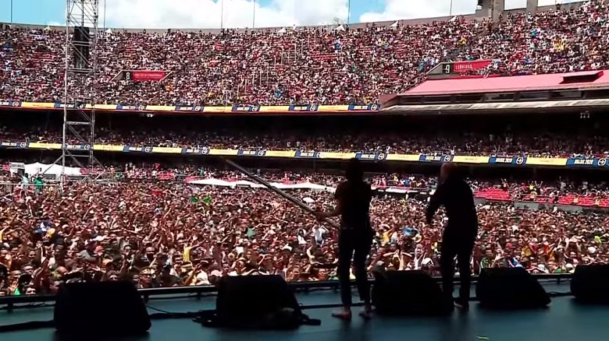
The Send, Brazil

Slide 68
Coming to Kansas City
Notes:
Local planning session, afterward I went to leadership and asked, do y

Slide 69
Turkish Pastor Ismail and
Messianic Israeli Israel Pochtar
Notes:
https://beit-hallel.org/2020/02/18/true_lasting_peace/

Slide 70
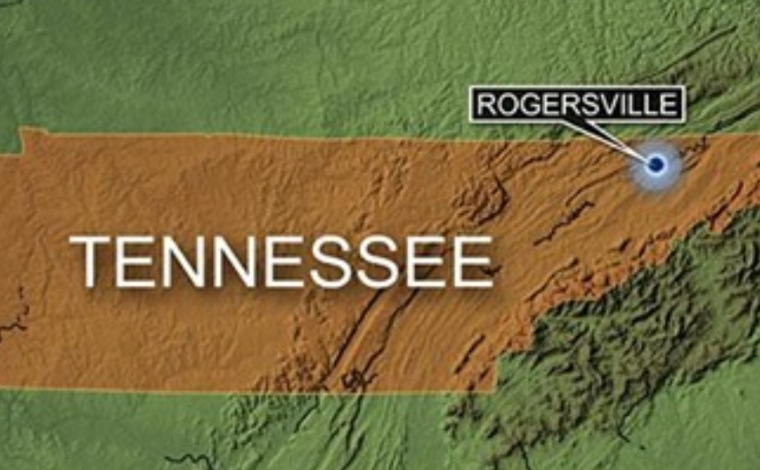

Slide 71
'Wave After Wave of People, Broken Before the Lord': TN Pastor Tells CBN News of Revival Sweeping His City

Slide 72
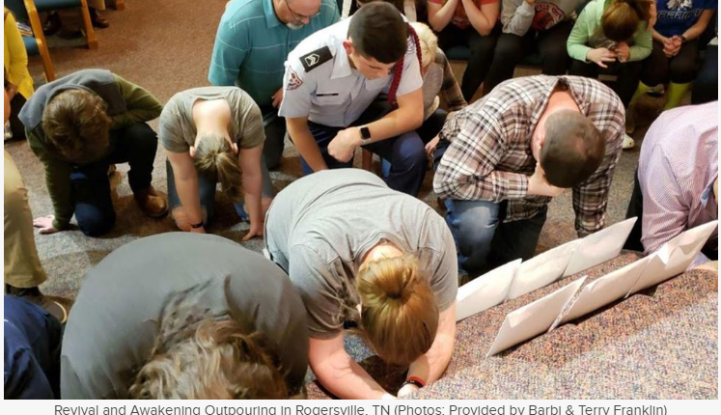
Notes:
https://www1.cbn.com/cbnnews/us/2020/february/wave-after-wave-of-people-broken-before-the-lord-tn-pastor-tells-news-about-revival-sweeping-his-city-nbsp?cpid=%3AID%3A-35952-%3ADT%3A-2020-02-18-19%3A14%3A48-%3AUS%3A-SW1-%3ACN%3A-CP1-%3APO%3A-NC1-%3AME%3A-SU1-%3ASO%3A-FB1-%3ASP%3A-NW1-%3APF%3A-TX1-&fbclid=IwAR2Mm7rFfyoQ2YolwcW98lrR8yq-3z7U_Xi9JekUNaaOGkJUzm_nyZmWEV8

Slide 73
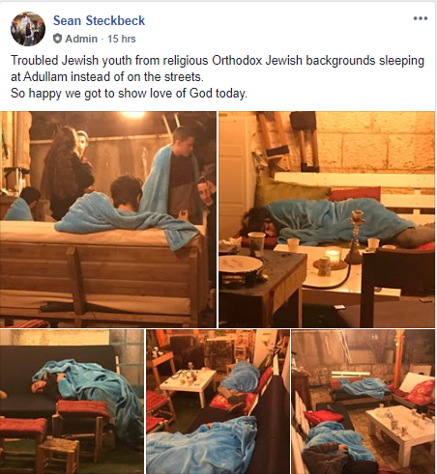
Notes:
From Sean’s Facebook

Slide 74
Notes:
From Sean’s Facebook

Slide 75
On the other hand, regions that neglect or oppose salvation and Messiah…

Slide 76
“Off the coast of Yemen and Oman there is a desert region with no water and last year they got hit by torrential rainfall then had two cyclones hit that very region,” CBN foreign correspondent George Thomas said of the swarm's move eastward. “This is very unusual and those conditions gave rise and allowed these locusts to multiply by the millions.”
Notes:
https://www.worthynews.com/47227-locust-plague-begins-to-spread-from-africa-to-middle-east-and-asia?utm_source=Worthy+Brief&utm_campaign=a3351cfd2d-EMAIL_CAMPAIGN_2020_02_19_05_02&utm_medium=email&utm_term=0_d1151ee7ea-a3351cfd2d-104018657

Slide 77
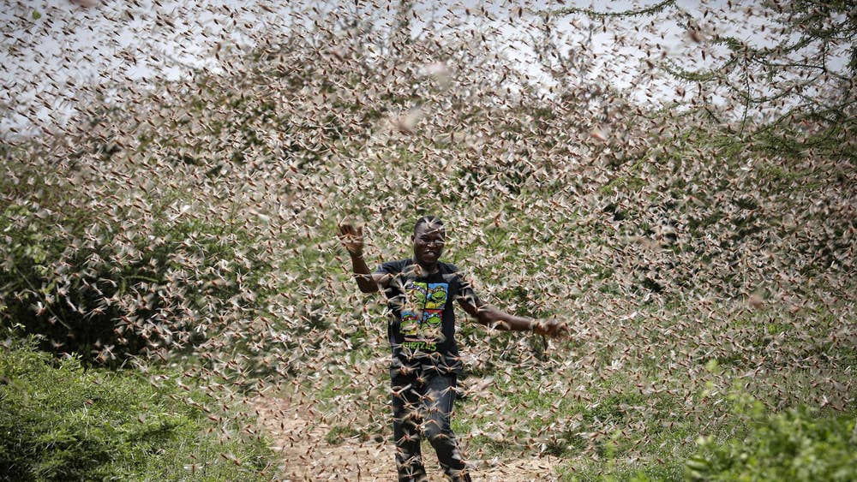
Notes:
https://www.google.com/search?q=locust+swarms+in+africa&safe=active&sxsrf=ACYBGNTKVEzGUO10Y5loQX3X3VJReI7q7Q:1581695654183&source=lnms&tbm=isch&sa=X&ved=2ahUKEwiazfC8s9HnAhUOS6wKHYkjCq0Q_AUoAXoECA0QAw&biw=1280&bih=902&dpr=1#imgrc=oyunmiZf7g_N4M

Slide 78
Christian aid groups, along with pesticide-wielding UN troops, are deploying to eastern Africa to fight a locust swarm that experts say is the worst to hit the region in 70 years and could grow by 500 times between now and June.
Notes:
https://www.worthynews.com/47138-christians-deploy-to-help-east-africans-against-locust-swarms-as-big-as-major-cities?utm_source=Worthy+Brief&utm_campaign=ee779e6038-EMAIL_CAMPAIGN_2020_02_14_04_15&utm_medium=email&utm_term=0_d1151ee7ea-ee779e6038-104018657

Slide 79
Swarms 250 times the size of a football field are able in a single day to eat "the same amount of food as the entire population of Kenya," according to Keith Cressman of the UN's Food and Agriculture Organization (FAO).
Notes:
https://www.worthynews.com/47138-christians-deploy-to-help-east-africans-against-locust-swarms-as-big-as-major-cities?utm_source=Worthy+Brief&utm_campaign=ee779e6038-EMAIL_CAMPAIGN_2020_02_14_04_15&utm_medium=email&utm_term=0_d1151ee7ea-ee779e6038-104018657

Slide 80
Three of the countries affected are in the top ten nations where Christian persecution is the worst, according to Open Doors USA's 2020 World Watch List.
Notes:
https://www.worthynews.com/47138-christians-deploy-to-help-east-africans-against-locust-swarms-as-big-as-major-cities?utm_source=Worthy+Brief&utm_campaign=ee779e6038-EMAIL_CAMPAIGN_2020_02_14_04_15&utm_medium=email&utm_term=0_d1151ee7ea-ee779e6038-104018657

Slide 81
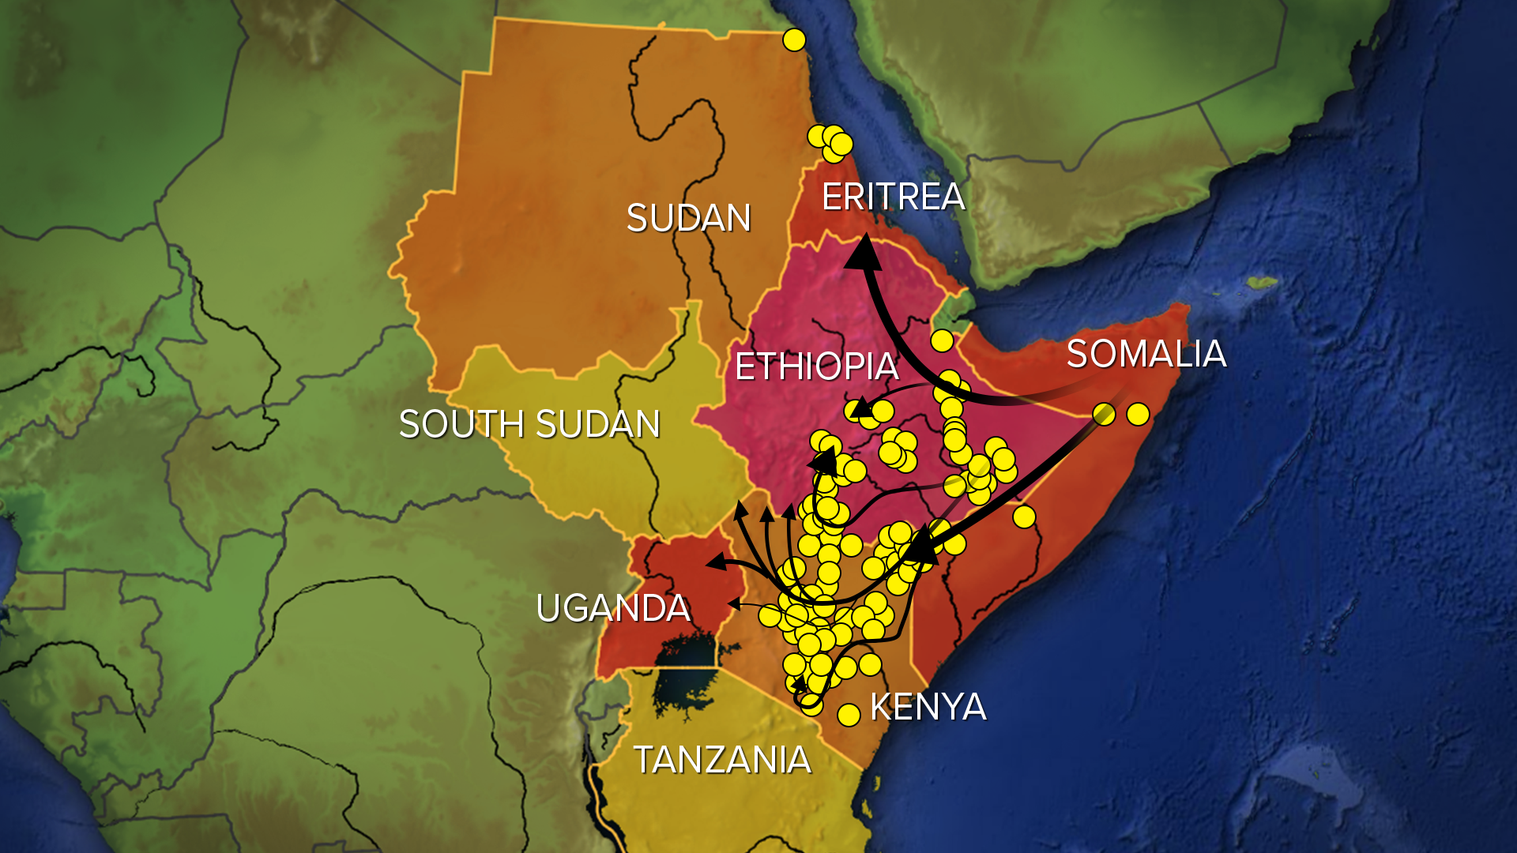
Notes:
https://www.google.com/search?q=locust+swarms+in+africa&safe=active&sxsrf=ACYBGNTKVEzGUO10Y5loQX3X3VJReI7q7Q:1581695654183&source=lnms&tbm=isch&sa=X&ved=2ahUKEwiazfC8s9HnAhUOS6wKHYkjCq0Q_AUoAXoECA0QAw&biw=1280&bih=902&dpr=1#imgrc=6tqss-KyIbOEaM&imgdii=iPQCnyd8qBgEDM

Slide 82
Therefore
More careful heed
Not drift away
Through angels?
Ignore deliverance
GREAT deliverance.
Notes:
Go back through this text and expound, explain it point by point.

Slide 83
Summary of all:
^{8.1-2} Here is the whole point of what we have been saying: we do have just such a cohen gadol as has been described. And he does sit at the right hand of HaG'dulah in heaven. There he serves in the Holy Place, that is, in the true Tent of Meeting, the one erected not by human beings but by ADONI.

