Slide 1
e-handout
To have these notes
without taking notes
Go to OrHaOlam.com
Click on downloads,
messages, 2020

Slide 2
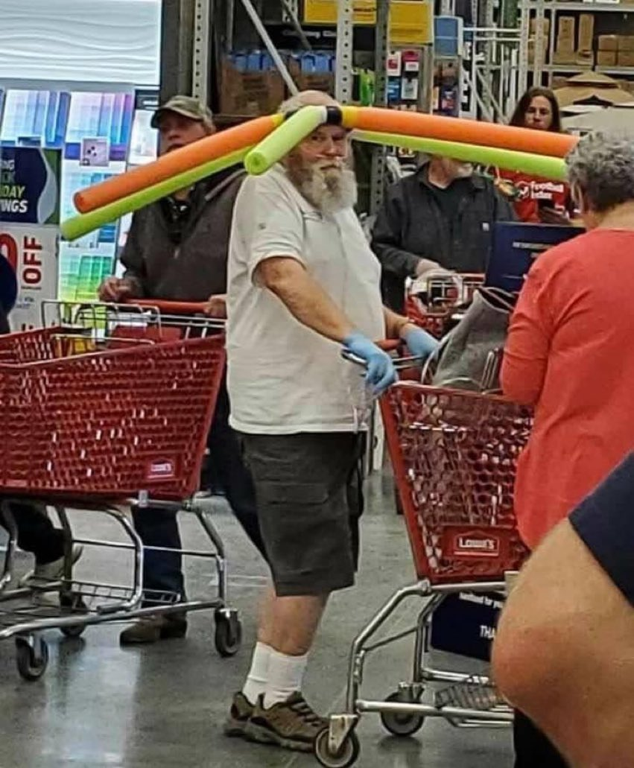
Social distancing protector

Slide 4
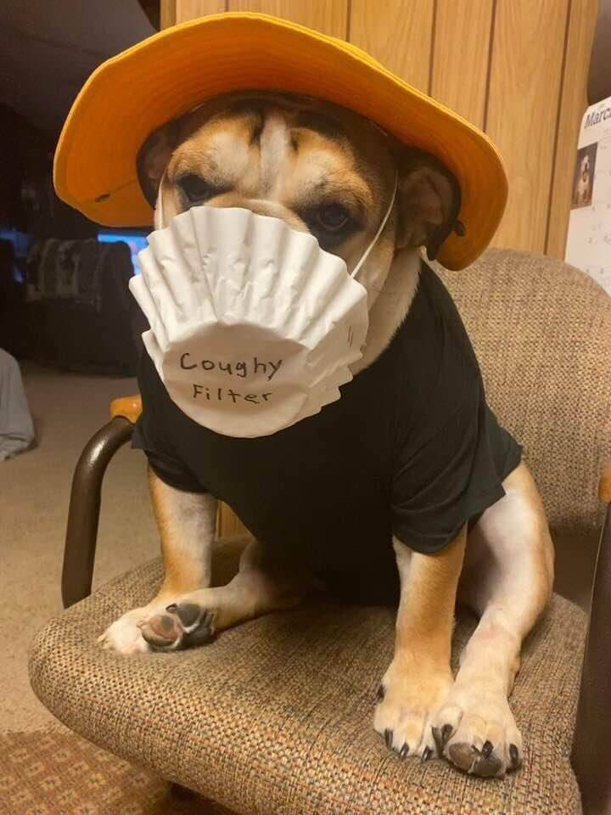
Coughy filter

Slide 5
A dentist and a manicurist married. They fought tooth and nail.
A thief who stole a calendar got twelve months.
When the smog lifts in Los Angeles U.C.L.A.
The dead batteries were given out free of charge.
Notes:
Peter van der Steur

Slide 6
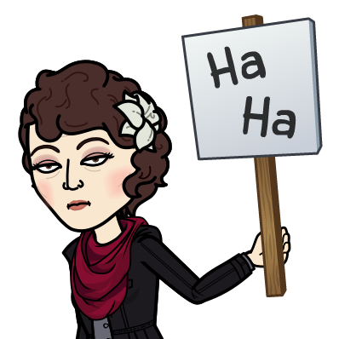
Notes:
Continuing our series in Messianic Jews

Slide 8
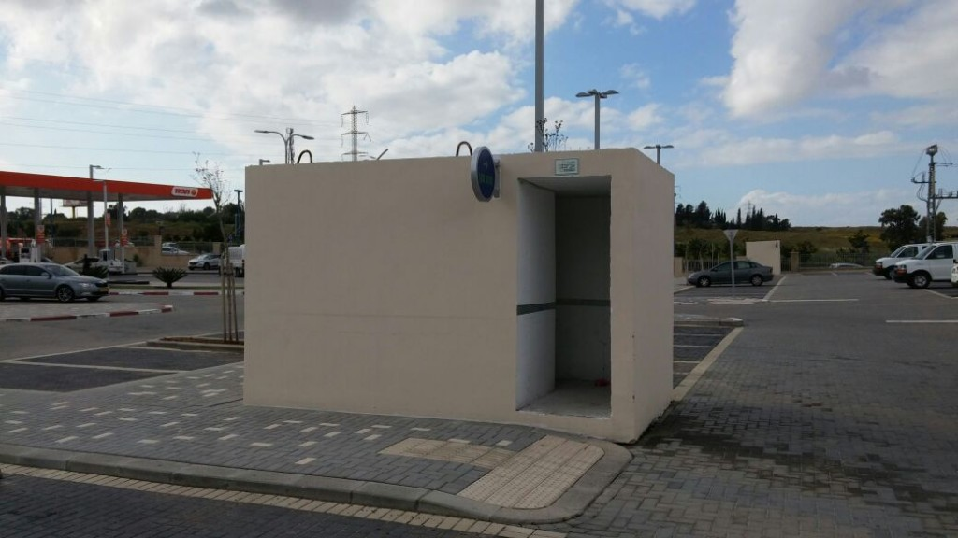
Gaza Border Residents Get 15-Second
Mortar Warning April 11, 2016
Notes:
A technological advance will give residents 15 seconds to find shelter, a great improvement over the present situation, in which they have no advance warning.
https://hamodia.com/2016/04/11/gaza-border-residents-get-15-second-mortar-warning/

Slide 9
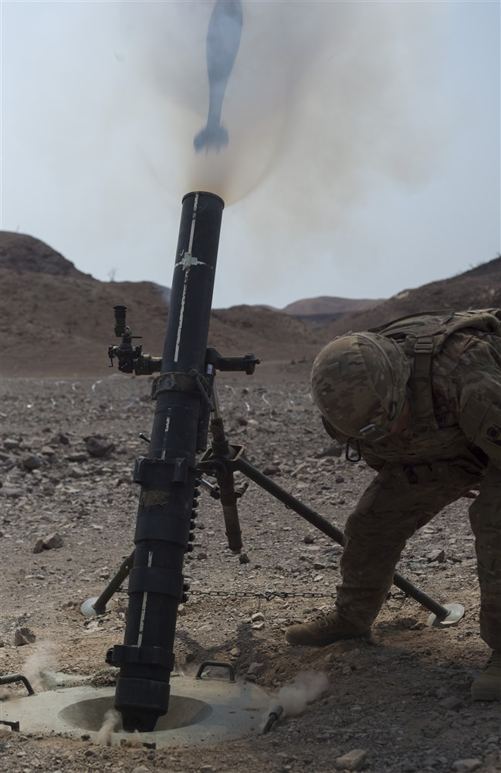
A mortar is usually a simple, lightweight, man-portable, muzzle-loaded weapon, They launch explosive shells in high-arcing ballistic trajectories.
Notes:
15 seconds to target. Or from time of detection to target.

Slide 10
Are there things in the Kingdom of Messiah that are urgent,
time sensitive?

Slide 11
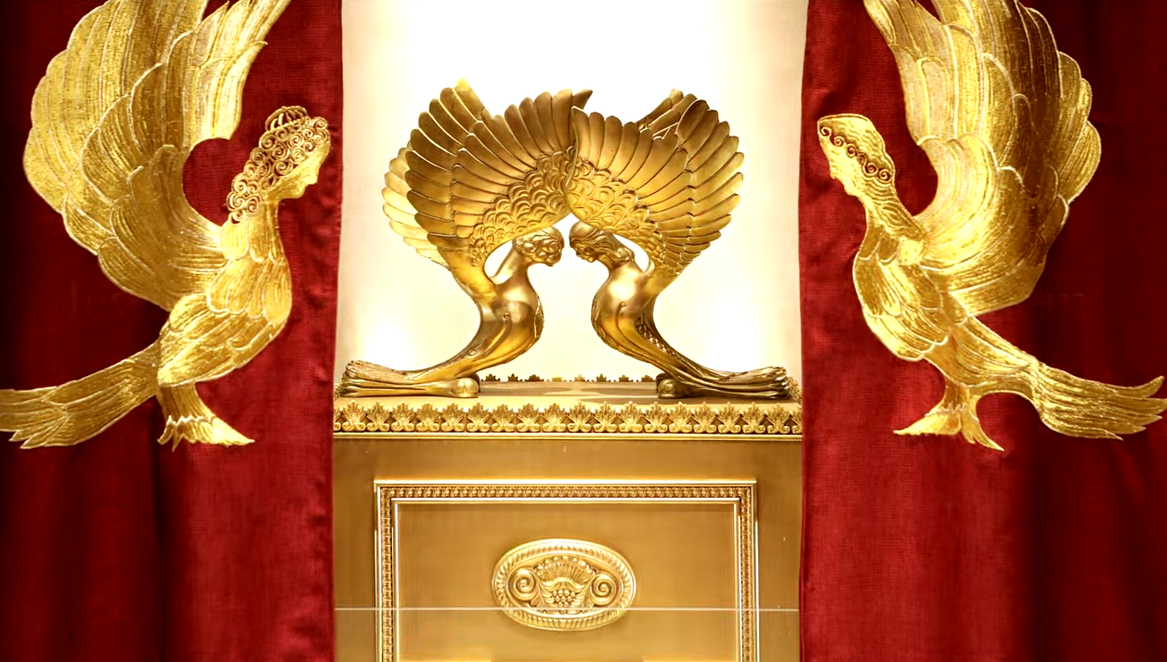
Letter to the Messianic Jews [Hebrews] MJ 3.7-4.11
Notes:
https://www.templeinstitute.org/new-location.htm

Slide 12
Seems the author of MJ, probably Luke, was reading the Shabbat liturgy. In celebratory worship mode…

Slide 13
Opening of Shabbat Siddur worship
T’hillim / Psalm 95
לְכוּ נְרַנְּנָה לַיְיָ L’khu n’ranna la’Adoni
נָרִיעָה, לְצוּר יִשְׁעֵנוּ. Nariah l’tsur yeshanu
Come, let’s sing to Adoni!
Let’s shout for joy to the Rock of our salvation!
Notes:
VERY worshipful, uplifting words. Set to music LOTS. I know 4…
Traditional?
Dauermann 1972 O, Come and Let us sing
Paul Wilbur 1978 Come let us sing with joy unto the L-rd…
Miqedem

Slide 14
^{T’hillim /Ps 95} Let’s come into his presence with thanksgiving; let’s shout for joy to him with songs of praise. For Adoni is a great God, a great king greater than all gods. He holds the depths of the earth in his hands; the mountain peaks too belong to him.

Slide 15
^{T’hillim /Ps 95} The sea is his — he made it — and his hands shaped the dry land. Come, let’s bow down and worship; let’s kneel before Adoni who made us. For he is our God, and we are the people in his pasture, the sheep in his care.
Notes:
Then, next verse, transition…

Slide 16
^{T’hillim /Ps 95 MJ 3.7-11} If only today you would listen to his voice: “Don’t harden your hearts, as you did at M’rivah [quarrel], as you did on that day at Massah [test] in the desert, when your fathers put me to the test; they challenged me, even though they saw my work.
Notes:
Luke quotes these words in the book of MJ, spends two chapters expanding on the word,כְּיוֹם , "today" found in Psalm 95.7
Apparently he had a revelation that this was about Yeshua’s people and kingdom, entering into rest just as Joshua was commissioned to bring Israel into Canaan rest! Based on David writing “Today” ~700 years after Joshua.

Slide 18
^{MJ 4.8} For if Joshua had given them rest, God would not have spoken of another day later on.

Slide 19
^{T’hillim /Ps 95 MJ 3.7-11} For forty years I loathed that generation; I said, ‘This is a people whose hearts go astray, they don’t understand how I do things.’ Therefore I swore in my anger that they would not enter my rest.”
Notes:
Luke applied…had a vision of URGENCY, that the body of Messiah, believers, were wandering in the wilderness, Sinai, not fruitful, not powerful, not influential. Maybe disgraceful. Shanda. SHANDA: A shame, a scandal. The expression "a shanda fur die goy" means to do something embarrassing to Jews where non-Jews can observe it.
Therefore urgent to enter into rest, out of wilderness.

Slide 20
Time sensitive warning.
^{Lk 19.41-42} As He drew near and saw Jerusalem, He wept over her, saying, “If only you had recognized today the things that lead to shalom!
Notes:
Sderot 15 second warning

Slide 21
Robot warning ~10 year old boy
Notes:
https://youtu.be/1IPPn9t6dyE

Slide 22
in MJ 3.7-4.11
4xהַיּוֹם hayom today
Something urgent!
8x מְנוּחָתִי m’nukhati my rest [respite; quiet, calm, serenity]
Notes:
Rest is urgent? Seems a contradiction!
Context of psalm is the Yisrael under Moshe, against Moshe, didn’t enter Canaan. Warfare, fear, way beyond their faith. Can’t do it!! Are we in a time of incapacition?

Slide 23
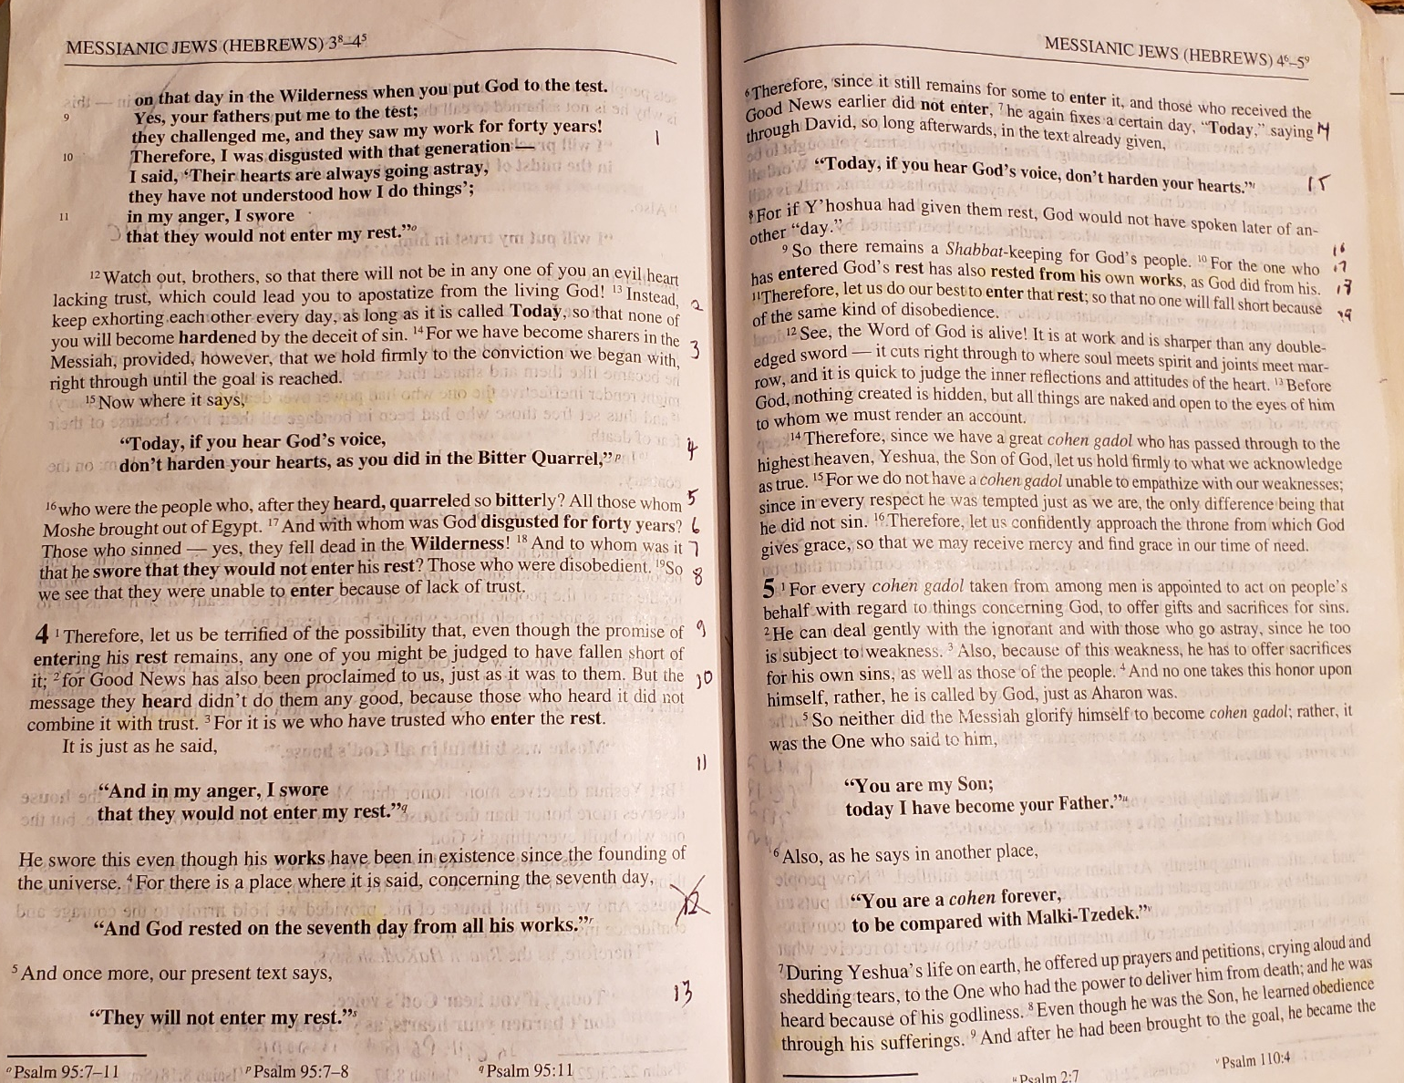
18x
Ps 95 quoted in MJ Ch 3-4
Notes:
Showing urgency

Slide 24
^{MJ 4. 9-11} So there remains a Shabbat- keeping for God’s people. For the one who has entered God’s rest has also rested from his own works, as God did from his. Therefore, let us do our best to enter that rest; so that no one will fall short because of the same kind of disobedience.

Slide 25
What kind of rest are we called urgently to enter into TODAY?
What are the hindrances?
How do we enter?
“rested from his own works”

Slide 26
^{MJ 3.12} evil heart of unbelief that falls away
^{MJ 3.13} encourage one another day by day—as long as it is called “Today”—so that none of you may be hardened by the deceitfulness of sin
Notes:
Build faith: personal discipline reading praying daily. Like an athlete.
Need mutual encouragement. Home groups → Zoom groups. Teerosh been better attended. 25 last time. If you’re listening, in our constituency, and NOT in a home group, email admin@orhaolam.com and we’ll get you in.
We’ll buy Zoom for leaders $15/mo to keep home groups going.

Slide 27
^{MJ 3.16} After they heard, quarreled so bitterly
^{MJ 3.19} They were not able to enter in because of lack of trust.
^{MJ 4.1} Therefore, let us be terrified of the possibility that…any one of you would seem to have fallen short of it.
Notes:
Possibly NOTHING that weakens like hurts, quarrels, unforgiven issues. Quarrel with G-d also.
Terrified, fallen short of what?

Slide 28
^{MJ 4.3-4} It is just as he said, “And in my anger, I swore that they would not enter my rest.” …Concerning the seventh day, “And God rested on the seventh day from all his works.”
Combination: rest of Canaan entrance, and Shabbat entrance.

Slide 29
^{MJ 4.6-8} So then it remains for some to enter into it…Again, God appoints a certain day—“Today”—saying through David after so long a time, just as it has been said before, “Today, if you hear His voice, do not harden your hearts.” For if Joshua had given them rest, God would not have spoken of another day later on.
Notes:
So at the time of David, 700 or so years AFTER Moshe, the offer is made again. Apparently a prophetic offer that the writer of MJ picked up on and applied.

Slide 30
^{MJ 4.9-10} So there remains a Shabbat rest for the people of God.
a keeping of Shabbat, a Sabbath rest Means? 3 dimensions:
Notes:
This is what is urgent? “Today” It is equivalent in the Ruakh/Spirit to the people of Israel entering the Land of Israel/Canaan.

Slide 31
FIRSTLY ^{Shmot/Ex 31.12-14} V’shamru ‘You are to keep/observe/guard my Shabbats; for this is a sign between me and you through all your generations; so that you will know that I am Adoni, who sets you apart for me. Therefore you are to keep my Shabbat, because it is set apart for you. Everyone who treats it as ordinary must be put to death.
Notes:
Shabbat kept Israel survival as Israel kept Shabbat.
We’re not in a theocracy where disobedience is literally punished, but there is a spiritual weakening for non-observance of Shabbat. No commercial dealings.

Slide 32
SECONDLY ^{Mtt. 11.28-30} “Come to me, all of you who are struggling and burdened, and I will give you rest. Take my yoke upon you and learn from me, because I am gentle and humble in heart, and you will find rest for your souls. For my yoke is easy, and my burden is light.”
Notes:
His yoke? Rest time in Him daily. His purity!
Cf: Accuser’s yoke. Never do enough.
I used to say, “If you see the need you feel the call.” Learned that from Delmar Kaufman. Radiant Bible teacher /farmer at Bible College If you do כי need, you’ll hurt yourself and your family. Partially true כי G-d causes you to notice.
If you do service כי Yeshua, you’ll have joy!
Accuser others against you, disrespecting you. Maybe. If you worry a lot about what people think of you, really, they don’t.
Compare→ pride or jealousy. Better gratefulness.

Slide 33
^{Galatians 5.19-23} Now the deeds [works] of the flesh are clear: sexual immorality, impurity, indecency, idolatry, witchcraft, hostility, strife, jealousy, rage, selfish ambition, dissension, factions, envy, drunkenness, carousing, and things like these.
Notes:
“Cease from his own works”

Slide 34
^{Galatians 5.19-23} I am warning you, just as I warned you before, that those who do such things will not inherit God’s kingdom.

Slide 35
^{Galatians 5.19-23} But the fruit of the Ruakh is love, joy, peace, patience, kindness, goodness, faithfulness, gentleness, and self-control—against such things there is no law. Now those who belong to Messiah have crucified the flesh with its passions and desires.

Slide 36
THIRDLY ^{Mark 6.31} He [Yeshua] said to them, “Come with me by yourselves to an isolated place where we can be alone, and you can get some rest.”
Extended rest: Sabbatical. Me and books and prayer. No email, no texts, no phone.

Slide 37
^{MJ 4.9-10} So there remains a Shabbat rest for the people of God. For the one who has entered God’s rest has also ceased from his own work, just as God did from His.
Shabbat rest of time.
Shabbat rest of fleshly corruption.
Shabbat rest of extended time.

Slide 38
What kind of rest are we called to enter into TODAY?
What are the hindrances?
How do we enter?
“rested from his own works”

Slide 39
Life in Messiah: free from
lustfulness [porn, impurity]
Anger and offense
Pride
is supernatural. Fruit of the Spirit. Urgent to get out of Sinai and into Canaan/Israel rest.

Slide 40
^{MJ4.11} Therefore, let us do our best to enter that rest; so that no one will fall short because of the same kind of disobedience.
^{Gal. 5.24} Now those who belong to Messiah have crucified the flesh with its passions and desires.
Particularly in this time of COVID-19 lockdown…

Slide 41
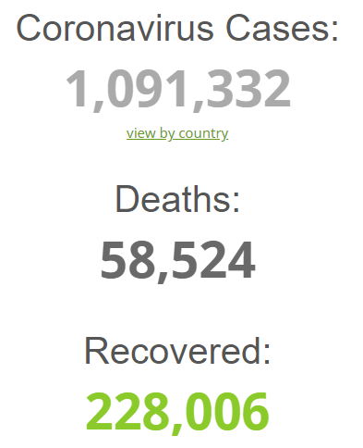
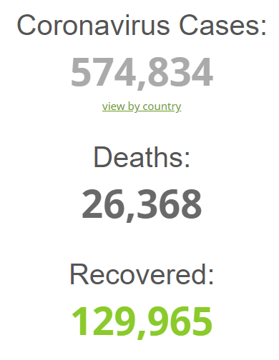
Friday, April 3, 2020 4 p.m.
Friday, March 27,
2020 noon
90%
Weekly
increase
Notes:
https://www.worldometers.info/coronavirus/

Slide 42
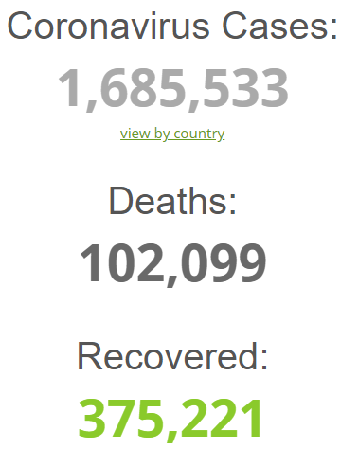
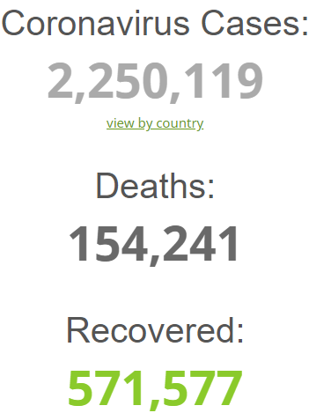
Friday, Apr. 17,
2020 8:30 p.m.
Friday, April 10,
2020 4 p.m.
+54%
Weekly
+33%
weekly
Notes:
https://www.worldometers.info/coronavirus/

Slide 43
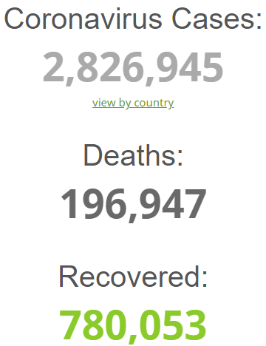
Friday, Apr. 24,
2020 8:30 p.m.
+ 26%
weekly

Slide 44
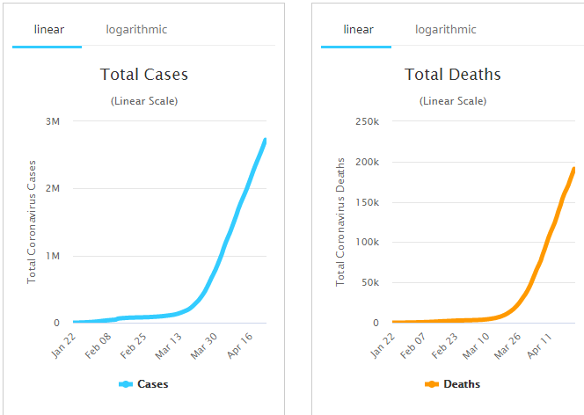

Slide 45
Johnson County COVID-19 Statistics
Sun., Mar 29, 108 cases, 2 deaths
Sun., Apr 5, 192 cases, 8 deaths
Fri., Apr 10, 263 cases, 12 deaths
Fri., Apr 17, 355 cases 23 deaths
Fri., Apr 24, 415 cases 37 deaths

Slide 46
Israeli COVID-19 treatment 100% success
Notes:
https://youtu.be/XROlDQ-dZ0g

Slide 48
Just something to think about: Lockdown began from march 25th at midnight 🕛... And [initially] extended till 3rd May
*Thats exactly 40 DAYS
QUARANTINE
The Latin root of the word "quarantine" is "forty".
Notes:
From Oxana Eliahu (borrowed from Kelley Lower Mahon)

Slide 49
The word quarantine comes from quarantena, meaning "forty days", used in the 14th–15th-centuries Venetian language and designating the period that all ships were required to be isolated before passengers and crew could go ashore during the Black Death 1348 plague epidemic.
Notes:
https://en.wikipedia.org/wiki/Quarantine#Etymology_and_terminology

Slide 50
SO WHAT DOES THE BIBLE SAY ABOUT 40?
The rain lasted 40 days when Noah was in the ark.
40 years Moses fled Egypt.
40 days Moses stayed on Mount Sinai to receive the Commandments.
Exodus lasted 40 years.
Yeshua fasted for 40 days.
Notes:
From Oxana Eliahu (borrowed from Kelley Lower Mahon)

Slide 51
40 days for a woman to rest after giving birth.
Yeshua appeared to his disciples for 40 days after He rose from the dead.
A group of theologians thinks the number 40 represents "change”. It is the time of preparing a person, or people, to make a fundamental change.
Notes:
From Oxana Eliahu (borrowed from Kelley Lower Mahon)

Slide 52
Or HaOlam did a 40 day fast in the summer of 2018.
Omer time for prayer and fasting.
Something will happen after these 40 days. Just believe and pray. Remember, whenever the number 40 appears in the Bible, there is a "change".
Notes:
From Oxana Eliahu (borrowed from Kelley Lower Mahon)

Slide 53
Please know that during this "quarantine" rivers are cleaning up, vegetation is growing, the air is becoming cleaner because of less pollution, there is less theft and murder, healing is happening, and most importantly, people are turning to Messiah.
Notes:
From Oxana Eliahu (borrowed from Kelley Lower Mahon)

Slide 54
So, during this time, enjoy it with your loved ones and return to the family altar together. Family prayer is a great blessing. Through prayer you will see the changes God can work in you and in your home. Messiah promises us that everything works together for the good for those who love God: Romans 8:28!
Notes:
From Oxana Eliahu (borrowed from Kelley Lower Mahon)

Slide 55
Remember we are in the year 2020, and 20 + 20 = 40.
Also, 2020 is the year of the United States Census. Yeshua the Messiah, the savior of the world, was born during a census.
Notes:
From Oxana Eliahu (borrowed from Kelley Lower Mahon)

Slide 56
Lastly, 2020 is perfect vision. May our sight focus on the Lord and living according to His perfect vision for us knowing He holds us in the palm of His hand.
May these days of "quarantine" bring spiritual liberation to our souls, our nation, and our world.
Notes:
From Oxana Eliahu (borrowed from Kelley Lower Mahon)

Slide 57
Dwight Widaman, MetroVoice: This week I flipped through a news magazine from early January. I was struck by what news was considered important then, but that has now faded from the headlines and memory:
Paris crippled by strikes
World climate talks collapse
Notes:
https://mail.google.com/mail/u/0?ui=2&ik=9f4a945fb9&view=lg&permmsgid=msg-f%3A1664843854305253401&ser=1

Slide 58
Australian fires rage
Lebanon protests turn deadly
Britain begins Brexit
Boeing stops 737MAX production
US economy sees historic growth
Plus, a tremendous amount of sports and Hollywood gossip. historic growth
Notes:
https://mail.google.com/mail/u/0?ui=2&ik=9f4a945fb9&view=lg&permmsgid=msg-f%3A1664843854305253401&ser=1

Slide 59
^{T’hillim/Ps 103.15-18} The life of humans is like grass, they flourish like a flower of the field; the wind blows over it and it is gone, and its place remembers it no more. But from everlasting to everlasting Adoni’s love is with those who fear him, and his righteousness with their

Slide 60
^{T’hillim/Ps 103.15-18} children’s children— with those who keep his covenant and remember to obey his precepts.

Slide 61
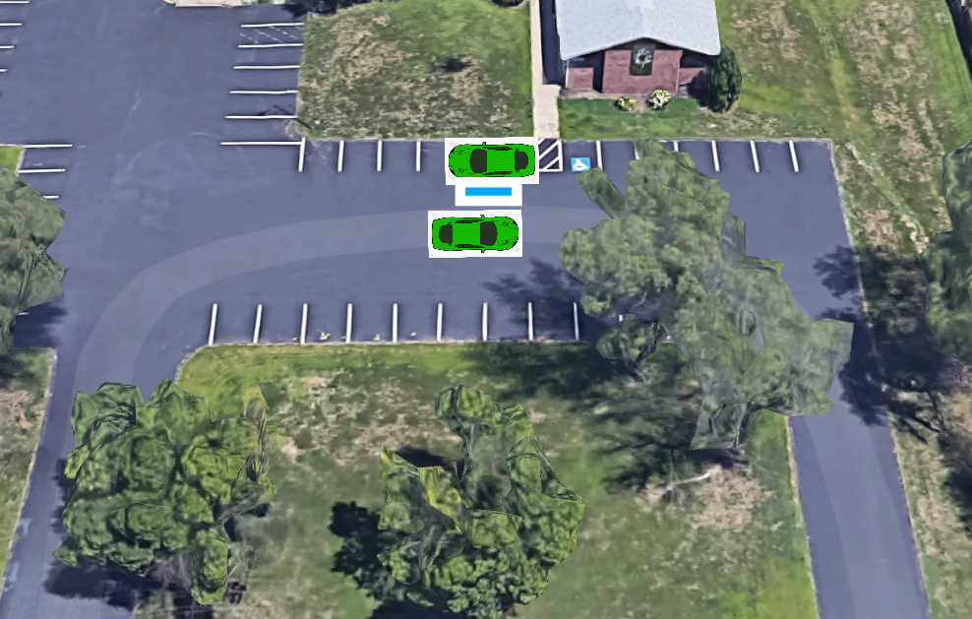

Slide 62
What are we called to enter into TODAY?
What are the hindrances?
How do we enter?
“rested from his own works”

Slide 63
Across Africa and Asia, millions of people in historically unengaged people groups are now in rapidly growing Disciple Making Movements. In 2000 there were 6 such movements, today there are now 1,035!
Notes:
https://www.christianpost.com/voices/christianity-is-growing-faster-than-any-time-in-history-why-is-the-church-in-europe-america-declining.html

Slide 64
Across Africa and Asia many thousands of former Muslim clerics have left Islam to become fearless disciples of Messiah. Not surprisingly, Christianity’s growth in Africa and Asia is explosive. On average, using data from The Status of Global Christianity, between 2000 to 2020, (7,300 days):
Notes:
https://www.christianpost.com/voices/christianity-is-growing-faster-than-any-time-in-history-why-is-the-church-in-europe-america-declining.html

Slide 65
Africa had 37,825 new Messiah Followers every day over the last 20 years
Latin America had 16,988
Asia had 13,443
North America had 1,999
Oceania had 473
Europe had 8
[ Source: Christian Post]
Notes:
https://www.christianpost.com/voices/christianity-is-growing-faster-than-any-time-in-history-why-is-the-church-in-europe-america-declining.html

Slide 66
What is it that the churches of the Global South are doing that makes so much difference?
1. Abundant, and Bold Prayer
2. Discipling to Conversion
3. Obedience-Based Discipleship
4. Empowering Ordinary People for Ministry
Notes:
https://www.christianpost.com/voices/christianity-is-growing-faster-than-any-time-in-history-why-is-the-church-in-europe-america-declining.html

Slide 67
5. Make Replicating Disciples, not Converts
6. Never Ending Leadership Training for All
Notes:
https://www.christianpost.com/voices/christianity-is-growing-faster-than-any-time-in-history-why-is-the-church-in-europe-america-declining.html

Slide 68
^{MJ4.11} Therefore, let us do our best to enter that rest; so that no one will fall short because of the same kind of disobedience.

Slide 69
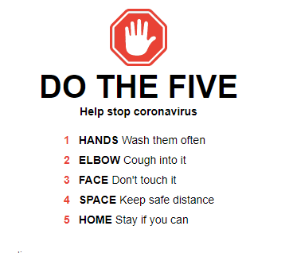
Notes:
https://www.google.com/search?q=coronavirus+tips&fbx=dothefive

