Slide 1
e-handout
To have these notes
without taking notes
Go to OrHaOlam.com
Click on downloads,
messages, 2020

Slide 2
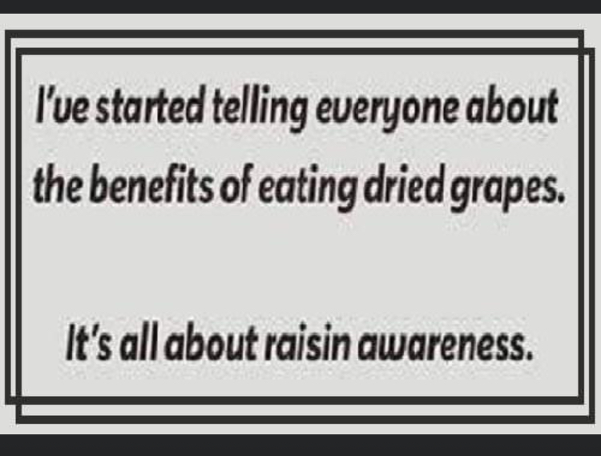
Notes:
From Jai Cohen

Slide 3
Notes:
From Jai Cohen

Slide 4
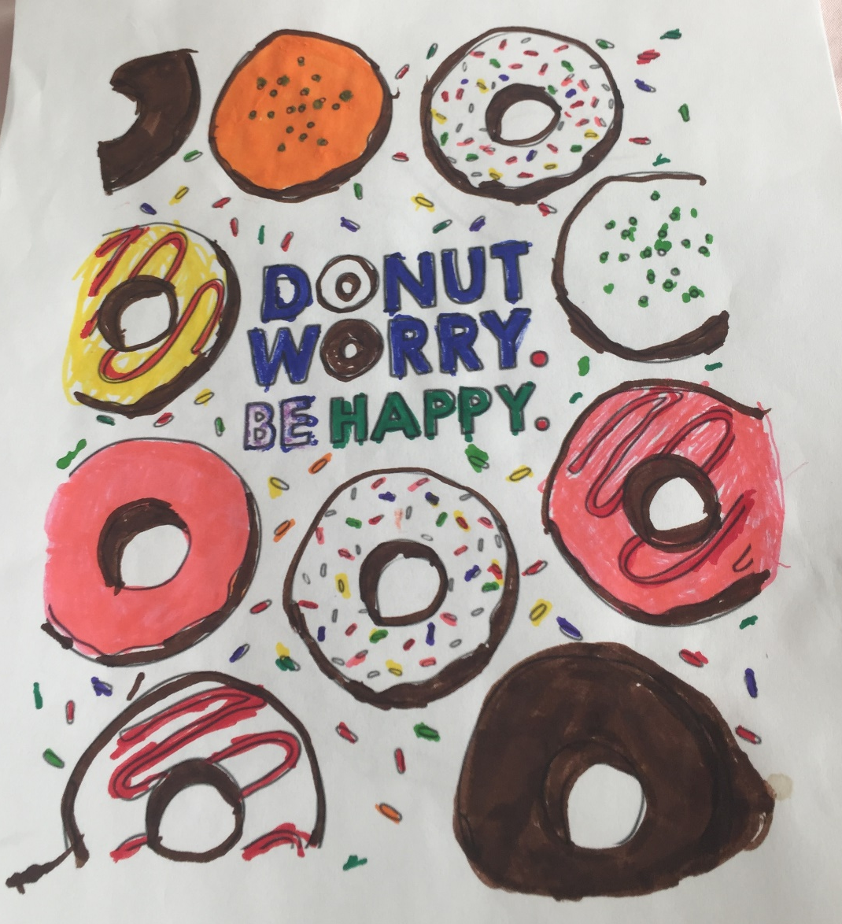
Notes:
Jai Cohen original

Slide 5
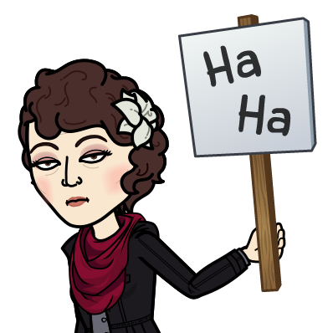

Slide 6
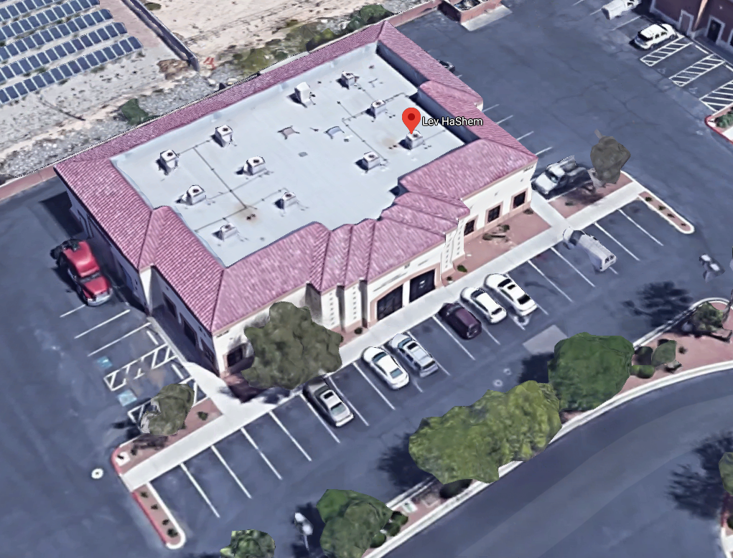
Lev HaShem Messianic Jewish Synagogue
3644 N. Rancho Dr. Suite 102 Las Vegas, NV
89130
Notes:
Early this morning, [Friday, July 17,2020] the office at our synagogue was broken into. The glass in the door was shattered. The alarm was sounded, yet I am well-pleased to report that nothing was damaged or taken, Baruch HaShem.
The police suspect it was a hate crime.
I have been in contact with the FBI as well as the Nevada chapter of the ADL. We have a good (if not uneasy) relationship, and it is getting better as she sees manifest the love we have for the Jewish people here.
R. Jered Hundley
Spiritual Leader
Lev HaShem Messianic Jewish Synagogue

Slide 7
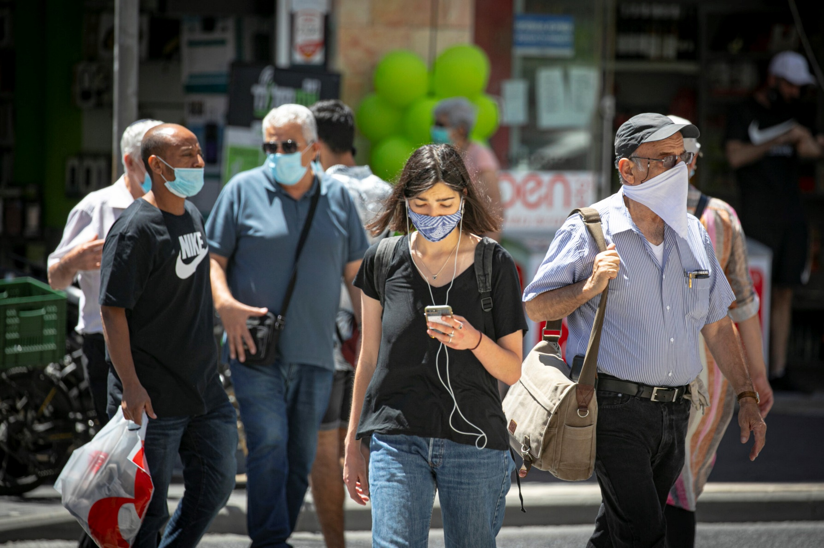
Israel’s intelligence services
can find you anywhere. Usually…
Notes:
https://www.israeltoday.co.il/read/the-only-way-to-beat-big-brother-in-israel/?utm_source=acfs&utm_medium=email&utm_term=all&utm_campaign=newsletter-2020-07-17

Slide 8
Israel’s domestic intelligence agency, the Shin Bet, has again been given permission to track the cellphones of people known to be infected, create movement profiles, and then quarantine anyone else who possibly came into contact with those people. It’s a tool typically used by the Shin Bet to combat terrorism.
Notes:
https://www.israeltoday.co.il/read/the-only-way-to-beat-big-brother-in-israel/?utm_source=acfs&utm_medium=email&utm_term=all&utm_campaign=newsletter-2020-07-17

Slide 9
The problem with the Shin Bet’s tracking method is that it has an error rate of 12-15%.
After hearing so many stories of frustration from those wrongly targeted, I decided to take action. I simply leave my cellphone at home or in the car.
Notes:
https://www.israeltoday.co.il/read/the-only-way-to-beat-big-brother-in-israel/?utm_source=acfs&utm_medium=email&utm_term=all&utm_campaign=newsletter-2020-07-17

Slide 10
Avi Mizrachi, Tel Aviv
Food bank story
Shelanu story: free advertising
Notes:
4 zoom meetings Thursday.

Slide 11
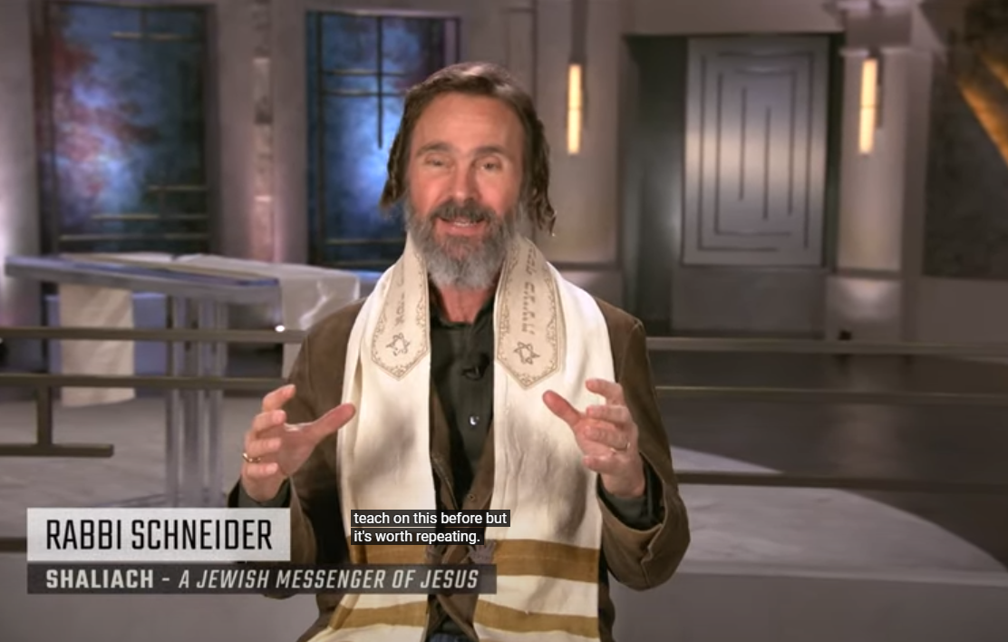
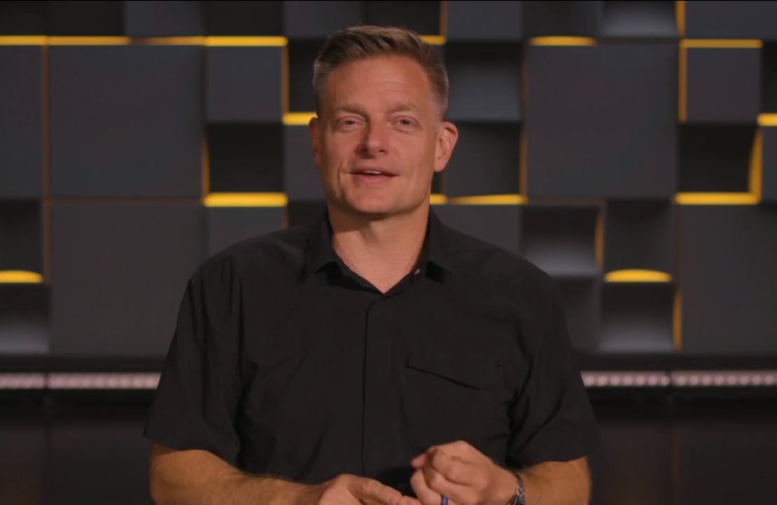
Today two guest speaker clips.
Note aesthetics!
Messaging
Aesthetics
Choreograpy
Notes:
Branding Committees few volunteers.

Slide 12
Notes:
https://www.templeinstitute.org/new-location.htm

Slide 13
Last Shabbat we discussed the objective working of the Cohen Gadol: Offered gifts and sacrifices, brought blessed atonement, ~Messiah Yeshua.
This week, the subjective working of the Cohen Gadol; how he carries us to the Holy.

Slide 14
Compassionate Cohen
Carries us like a shepherd
Carries us in compassion in community, in a flock.
Community builder.

Slide 15
^{MJ 4.15} For we do not have a cohen gadol unable to empathize with our weaknesses; since in every respect he was tempted just as we are, the only difference being that he did not sin.

Slide 16
^{MJ 4.16} Therefore, let us confidently approach the throne from which God gives grace, so that we may receive mercy and find grace in our time of need.

Slide 17
^{MJ 5.2-3} He can deal gently with the ignorant and deluded, since he himself also is subject to weakness. Also, because of this weakness, he has to offer sacrifices for his own sins, as well as those of the people.

Slide 18
empathize with our weaknesses
we may receive mercy and find grace in our time of need.
deal gently with the ignorant and deluded
Notes:
He is someone we CAN approach for redemption. The Cohen Gadol has the role of a shepherd.
Empathy, mercy, gentleness with my toxicity and delusions. Yeshua, gentle Cohen/priest shepherd.

Slide 19
Summary: the Cohen will carry us into the Presence, into safety, into joy, into the fulness of the Spirit. Gentle shepherd.
Carries ~ a shepherd carries…
Shepherd Psalm → How to be filled with the Ruakh HaKodesh / Holy Spirit through Psalm 23
Notes:
Priestly work of shepherding

Slide 20
תהילים פרק כג מִזְמוֹר לְדָוִד:
T’hillim/Psalm 23
A Song of David
The Shepherd [Priestly] Psalm

Slide 21
Adoni is my shepherd; I lack nothing. | יְיָ רֹעִי, לֹא אֶחְסָר.
Notes:
My shepherd ~ my cohen. Carrying me to the safe place, the holy place, where I can’t get to otherwise.
Sheep are dumb: not good at directions, not good at finding safe forage, all depends on the shepherd. We are not good at getting to the Holy Place.
Lack nothing: Do you lack nothing? This is the phrase that precipitated this message. What might we lack? Ache in your heart? Wayward and/or estranged loved ones, spouse, children, friends, job, finances, spiritual weakness, sin. Heart breaks. Gnawing pain, loss. Health, financial security. How do you need to be carried? We have no needs??! Really?
Ira and Gloria Brawer presented RTF a few years ago. Referred to a promise in scripture. Good promise, but no help unless believe it.

Slide 22
^{MJ 11.1} Now faith is the substance of things hoped for, the evidence of realities not seen.
Notes:
You have heard me talk about my birth family, and mother/women issues. Bill Gothard urged me to memorize scripture. So I memorized Prov 31, in Hebrew. Meditated on it. But I was still wrestling with lack of joyful release.
Ira Brawer, RTF, said the key spiritual help from scripture is not just reading, but believing it. BELIEVING IT. Sometimes just decide to believe.
At times in Sozo, when person has a great wound, and we ask them to forgive, we say, “Can you commit to that as a belief, as a grid,” that G-d will develop as an emotional bottom line? “I don’t feel it.”

Slide 23
Adoni is my shepherd; I lack nothing. | יְיָ רֹעִי, לֹא אֶחְסָר.
Notes:
I lack nothing…by faith.
About that unbelieving relative, that estranged loved one, that sin, bad habit, weakness?
Believe G-d is working. You are NOT bereft. You lack nothing. G-d reigns.
Halleluyah, for the L-rd G-d Almighty reigns.
Believe it in that issue. מלך יי אלהינו הללויה כי
Unseen, but working. Sometimes, when I walk into a secular environment, or a believing one…
Can you commit to that as a belief, as a grid, as a emotional bottom line? “I don’t feel it.”
Key to filling with the Spirit/Ruakh. Cohen carry.

Slide 24
He has me lie down in grassy pastures, He leads me by quiet water, | בִּנְאוֹת דֶּשֶׁא, יַרְבִּיצֵנִי; עַל-מֵי מְנֻחוֹת יְנַהֲלֵנִי.
Notes:
Work of the compassionate cohen:
Grassy pasture…lush meadow, grass between your toes
Quiet waters…my life is turbulent!
Can you commit to that as a belief, as a grid, as a emotional bottom line? “I don’t feel it.”

Slide 25
^{1 Thes 5.16-18} Rejoice always,
pray constantly,
in everything give thanks;
for this is God’s will for you in Messiah Yeshua.
4 points of opening our hearts

Slide 26
He restores my inner person. He guides me in right paths for the sake of his own name. | נַפְשִׁי יְשׁוֹבֵב; יַנְחֵנִי בְמַעְגְּלֵי-צֶדֶק לְמַעַן שְׁמוֹ.
Notes:
Work of the compassionate cohen:
Inner person: Nafshi נפשי mind, will, emotions. Love, joy, peace.
I’m believing and receiving. Faith guy? Sort of. Not for a rolex or a big gold ring, but for a ring of fire. Deep breath and look up! “I’m offended.”
For His Names sake. Rabbi, my mind, my attitudes, my bitterness, my impurity, my anger.
For His Names sake, confidence!! We repent to glorify Him, not just get His help with our problems!
Can you commit to that as a belief, as a grid, as a emotional bottom line? “I don’t feel it.”

Slide 27
Even if I pass through death-dark ravines, I will fear no disaster; For You are with me; | גַּם כִּי-אֵלֵךְ בְּגֵיא צַלְמָוֶת, לֹא-אִירָא רָע— כִּי אַתָּה עִמָּדִי;
Notes:
First of six negatives: Valley of wolves, bears, cayotes, snakes
No disaster…COVID jobs. Turned down CARES $, didn’t apply, thought…might be the end.
My dear mother was constantly expecting bankruptcy family business. I chose to receive her spirit: expecting disaster, panic.
You are with me. That’s the part that’s hard to describe to the world.
Can you commit to that as a belief, as a grid, as a emotional bottom line? “I don’t feel it.”

Slide 28
Notes:
https://youtu.be/dVtbWtN9-zA
interestingly, when it's playing the url changes to
https://www.youtube.com/watch?v=dVtbWtN9-zA&feature=youtu.be​
Continue to read this mizmor/psalm with FAITH

Slide 29
Even if I pass through death-dark ravines, I will fear no disaster; For You are with me; | גַּם כִּי-אֵלֵךְ בְּגֵיא צַלְמָוֶת, לֹא-אִירָא רָע— כִּי אַתָּה עִמָּדִי;
Notes:
Affirm this and have joy.
Messiah the Cohen/priest is carrying you!
Can you commit to that as a belief, as a grid, as a emotional bottom line? “I don’t feel it.”

Slide 30
Your rod and staff reassure me. You prepare a table for me, even as my enemies watch | שִׁבְטְךָ וּמִשְׁעַנְתֶּךָ, הֵמָּה יְנַחֲמֻנִי. תַּעֲרֹךְ לְפָנַי, שֻׁלְחָן נֶגֶד צֹרְרָי;
Notes:
2nd negative. Rod: for protection, discipline, inspection
Keller 93-96
Table before me neged same words as “Wife is helper negedo” in his presence.
3rd negative Enemies can be intimately near, people hurt and betray, G-d sets a feast.
How, LOOK to Him in FAITH. He’s the active cohen!
A table is typically a place of people > one. Family, friends. Prepare such! More on community soon.

Slide 31
You anoint my head with oil from an overflowing cup. | דִּשַּׁנְתָּ בַשֶּׁמֶן רֹאשִׁי כּוֹסִי רְוָיָה.
Notes:
In Ein Gedi park when I was 21. Mitigates heat.
Here is the spirit /ruakh filling. This context of faith-surrender:

Slide 32
Believe
He is your Shepherd. Surrender self pity.
No lack. Surrender ungratefulness, need.
Provides lush meadows. Abandon grouchiness.
Stills the torrents so you can drink. Surrender complaints, offenses.

Slide 33
Believe
Restores: Mind, will, emotions: I will rest in You!
Paths for His names sake. We don’t merit it.
No disaster! He is with you. Surrender calamity!
Enemies… No enemies matter. [apply]
RECEIVE THE OIL…FULL CUP
Notes:
Should stop here, but much more…

Slide 34
ONLY Goodness and love will pursue me every day of my life; | אַךְ טוֹב וָחֶסֶד יִרְדְּפוּנִי כָּל-יְמֵי חַיָּי;

Slide 35
and I will live in the house of Adoni For years and years to come. | וְשַׁבְתִּי בְּבֵית-יְיָ, לְאֹרֶךְ יָמִים.
Notes:
House of Adoni.
Houses usually more than one occupant. Even if just you and Adoni Yeshua, the cohen-shepherd.
Message of Messiah generally presented as love and kindness to a household, community…

Slide 36
^{Acts 13.43} …Sha’ul and Bar-Nabba, who spoke with them and urged them to keep holding fast to the love and kindness of God.
Notes:
Salvation of Yeshua in community.

Slide 37
Acts 13.43
בְּחֶסֶד הָאֱלֹהִים /xáris ("grace")
God freely extending Himself (His favor, grace), reaching (inclining) to people because He is disposed to bless (be near) them.

Slide 38
^{Acts 14:3} Therefore, Sha’ul and Bar-Nabba…bore witness to the message about his love and kindness by enabling them to perform signs and miracles.

Slide 39
^{Acts 15:11} No, it is through the love and kindness of the Lord Yeshua that we trust and are delivered — and it’s the same with them.”

Slide 40
^{Acts 20:24} But I consider my own life of no importance to me whatsoever, as long as I can… declare in depth the Good News of God’s love and kindness.

Slide 41
Compassionate Cohen
Carries us like a shepherd
Carries us in compassion in community, in a flock.
Community builder.

Slide 42
By exercising faith in the Cohen Gadol, Yeshua, He can carry us into the Holy of Holies. But, how can we stay there, bring others there?
^{MJ 10.23-24}Let us continue holding fast to the hope we acknowledge, without wavering;

Slide 43
^{MJ 10.23-24} for the One who made the promise is trustworthy. And let us keep paying attention to one another, in order to spur each other on to love and good deeds.

Slide 44
We have talked for 25+ years of G-d’s forgiving, healing, transforming power, and of building community in that mode. But it’s never been well implemented. I would like to introduce a system will help us build the cohen’s caring community.
Notes:
G-d works through systems: circulatory, respiratory, nervous, digestive…

Slide 45
Compassionate Cohen
Carries us like a shepherd
Carries us in compassion in community, flock.
Community builder.

Slide 46
Jonathan Bernis’ organization…
Nov. 2020 Messianic Leadership
Notes:
Jonathan Bernis breakthrough guy. Eastern European festivals started Congs multiplied. David and Philip Bouryi here spiritual grandchildren of Bernis.
Bernis started E. Eur. Movement, Stewart Winograd took nucleus and started Minsk Cong.

Slide 47
The Keynote speaker at the MLR in Nov. is to be Chris Hodges, whose great strength is community building through small groups.
He is offering this same material to all of us July 28-29 by Zoom.

Slide 48
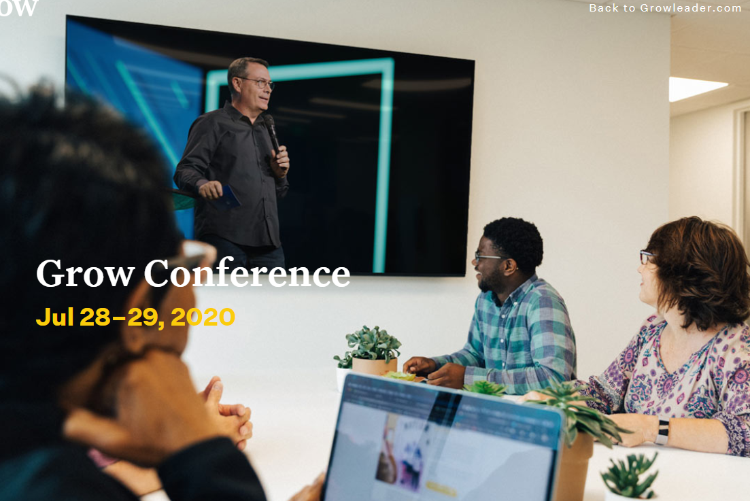
Grow Conference July 28-29
Notes:
Not Jewish Messianic terminology, so please bear with me in this

Slide 49
Notes:
https://www.growleader.com/what-we-do
Scroll down a bit

Slide 50
It’s nothing new, but it’s a system to IMPLEMENT growth.
that Jonathan Bernis will bring to the MLR, if it happens.

Slide 51
Tuesday, July 28 11:00 am-Session 1 12:00 pm - Lunch 1:00 pm - Session 2 2:00 pm - Session 3 3:00 pm - End Day | Wednesday, July 29 11:00 am - Session 4 12:00 pm - Lunch 1:00 pm - Session 5 2:00 pm - Session 6 3:00 pm – End Conf.

Slide 52
We are hoping for major OrHaOlam participation, growth, breakthrough.
To register:

Slide 53
growleader.com/growconference/
Click “register now”
Click “join a group”
Click “select a group”
Select “Or HaOlam Messianic Synagogue”
Passcode “Yeshua”
Notes:
Will be spammed to you

Slide 54
Tuesday, July 28 11:00 am-Session 1 12:00 pm - Lunch 1:00 pm - Session 2 2:00 pm - Session 3 3:00 pm - End Day | Wednesday, July 29 11:00 am - Session 4 12:00 pm - Lunch 1:00 pm - Session 5 2:00 pm - Session 6 3:00 pm – End Conf.

Slide 55
Follow up Or HaOlam Zoom
Thursday 6 pm July 30 90 min.
Is this for us?
How to implement [preliminary]
Obstacles
Notes:
2 minutes/comment

Slide 56
Summarize:
All based on letting Messiah the Cohen carrying us ~shepherd
Community building Grow Conf 11 a.m. July 28, 29
Follow up Zoom July 30 6 p.m.

Slide 57
Believe
He is your Shepherd. Surrender self pity.
No lack. Surrender ungratefulness.
Provides lush meadows. Surrender grouchiness.
Stills the torrents so you can drink. complaint
Restores: Mind, will, emotions

Slide 58
Believe
Paths for His names sake. We don’t merit it. Life is not for our comfort!
No disaster! He is with you. Surrender calamity!
Enemies… No enemies matter.
RECEIVE THE OIL…FULL CUP
Register for community upbuilding.

Slide 62
