Slide 1
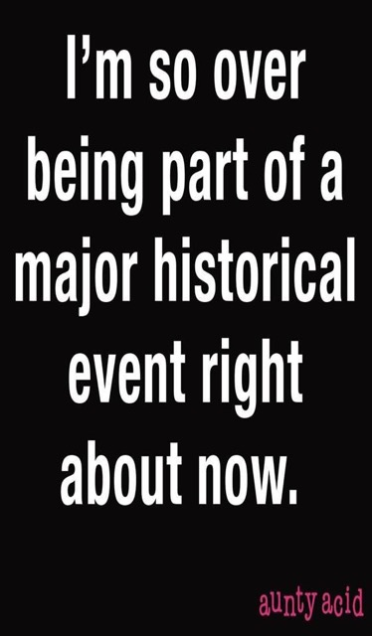

Slide 2
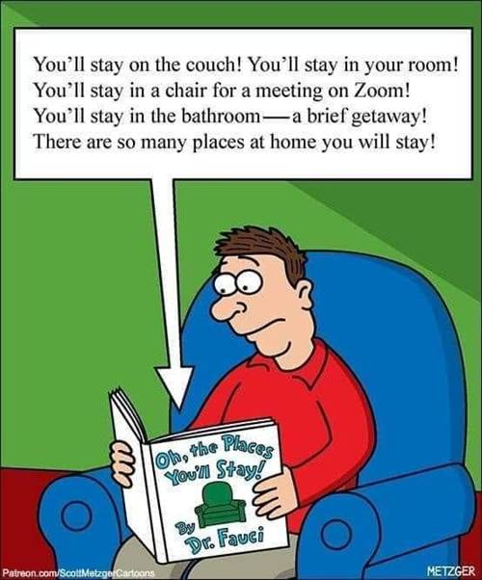
Notes:
Seriously, G-d has greatly blessed us through you over these last two months. Expanded my thinking. When I became a believer in 1969…

Slide 3
^{1 Cor. 2.4-5} My speech and my preaching were not with persuasive words of wisdom, but in demonstration of the Spirit and of power — so that your faith would not be in the wisdom of men but in the power of God.
Notes:
I believed that. Hippy convert, simplicity, even poverty mentality. However…

Slide 4
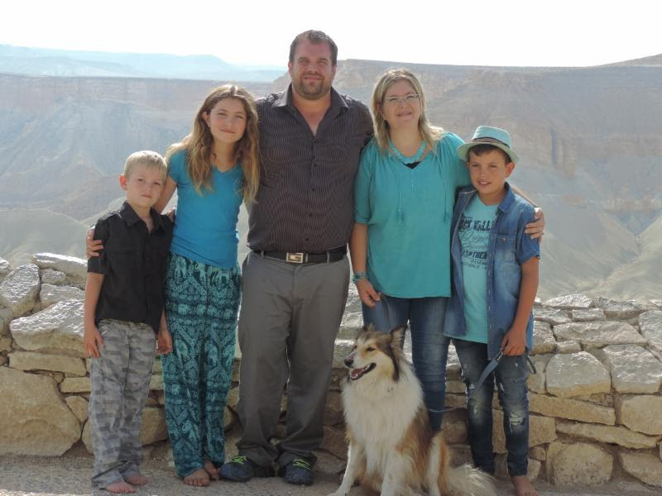
^{Shmot/Ex 25.1-8} Adoni said to Moshe, “Tell the people of Isra’el …They are to make me a sanctuary, so that I may live among them.”
וְשָׁכַנְתִּי בְּתוֹכָם
Sean & Ayelet Steckbeck
Notes:
Some of you have met Sean and Ayelet. Been here as guest speakers. Sean is one of the few who has a standing invitation to Or HaOlam. Effective outreach among Orthodox, secular Jews, Arabs, Bedouins, Thais
Ayelet in women’s yeshiva in Jerusalem. Here “live within them.” Few worthy. Wanted to be that one. Eventually, came to faith in Messiah Yeshua WHILE attending the yeshiva.
So, this image G-d made of a sanctuary to convey His glory…so that we can get a picture of His indwelling.
G-d has a branding, a style. Gavriel expanded my thinking.

Slide 5
Branding
Messaging
Aestheics
Chroeography
committees
Notes:
Not many volunteers yet. See Lori, or admin@orhaolam.com

Slide 6
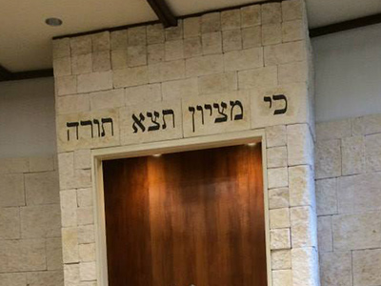
Branding
Notes:
https://jerusalemstoneusa.com/project-examples/

Slide 7
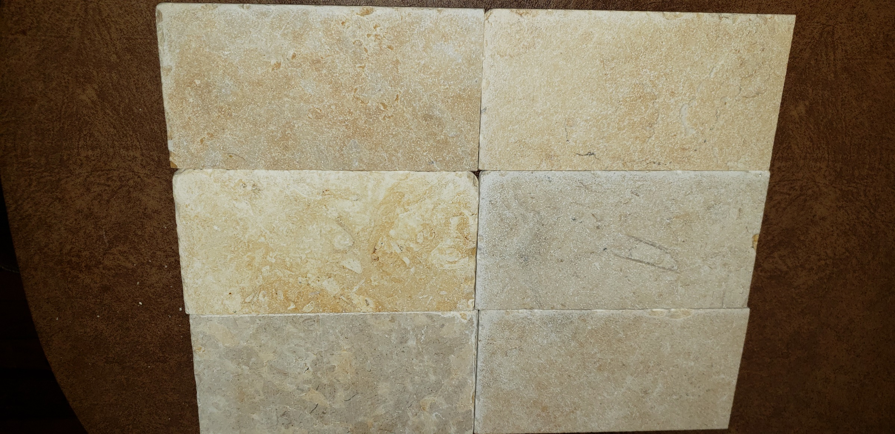
Jerusalem Stone to be installed
on the south wall.
Actual tiles 8” x varying lengths
Notes:
Luxury?

Slide 8
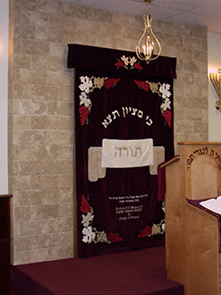
But not as rough textured.
Notes:
https://jerusalemstoneusa.com/project-examples/
All this to say that I’ve been Mr. Frugality. 1994 Mazda bought in 1997 kept till 2012. This will cost about $5K, but change the identity of the sanctuary greatly. First endemically Jewish major expression. Took down the steeple, the cross, but this…glorious.

Slide 9
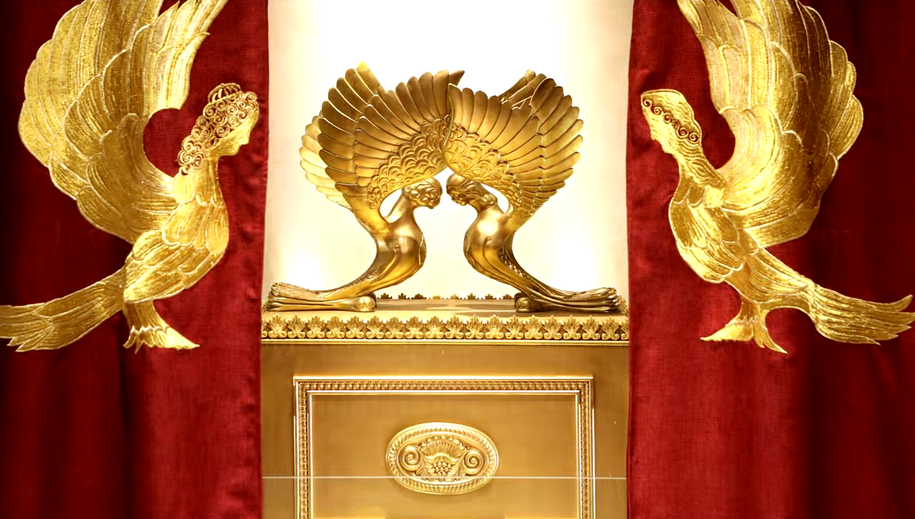
Letter to the Messianic Jews
[Hebrews] MJ 5.4-6
Called of G-d
Notes:
https://www.templeinstitute.org/new-location.htm
Essence of G-d’s branding, visual arts communication.

Slide 10
^{MJ 5.4-6} And no one takes this honor upon himself, rather, he is called by God, just as Aharon was.

Slide 11
^{MJ 5.4-6} So neither did the Messiah glorify himself to become Cohen Gadol; rather, it was the One who said to him, “You are my Son; today I have become Your Father.”

Slide 12
^{MJ 5.4-6} And He says in a different passage, “You are a Cohen forever, according to the order of Melkitzedek.”
What is the order of Melkitzedek? Next week.
Notes:
Back through these three verses to unpack.

Slide 13
^{MJ 5.4-6} And no one takes this honor upon himself, rather, he is called by God, just as Aharon was.
Notes:
This phrase, “called of G-d” was the Ruakh trigger / starting point for this message.
Yeshua was called of G-d, so are we.
Called as was Aharon/Aaron? Where was that exactly that Aharon was called?

Slide 14
^{Bamidbar/Nu 18.7} But you and your sons with you are to maintain your cohanut / priesthood for everything pertaining to the altar and inside the parokhet /curtain. I am giving you the ministry of cohen/ priest as a gift.
Notes:
Aharon was called to cohanut.

Slide 15
^{MJ 5.4-6} So neither did the Messiah glorify himself to become Cohen Gadol; rather, it was the One who said to him, “You are my Son; today I have become Your Father.”
Notes:
Wasn't God always Yeshua's Father? Why did he have to "become" his Father?
Insert explanatory words…

Slide 16
^{MJ 5.4-6} So neither did the Messiah glorify himself to become Cohen Gadol; rather, it was the One who said to him, “You are [recognized as] my Son; today I have become [recognized as] Your Father.”
Notes:
this refers to "the day of the Messiah's enthronement — the day when the Most High gave public notice: Therefore, let the whole house of Isra’el know beyond doubt that God has made him both Lord and Messiah — this Yeshua, whom you executed on a stake!” ^{(Ac 2:36).}
Two Qumran texts quote Ps 2.7 as referring to the Messiah.
Similar to Ro 1.3-4 His Son — he is descended from David physically; he was powerfully demonstrated to be Son of God spiritually, set apart by his having been resurrected from the dead; he is Yeshua the Messiah, our Lord.

Slide 17
^{MJ 5.4-6} And He says in a different passage, “You are a Cohen forever, according to the order of Melkitzedek.”

Slide 18
Yeshua was called by the Father into the Melkitsedek cohanut/ priesthood.
When? ^{Eph 1.4-5} In the Messiah he chose us in love before the creation of the universe to be holy and without defect in his presence. He determined in advance that through Yeshua the Messiah we would be his sons
Notes:
Calling of G-d is the theme of this message.
G-d didn’t scramble around after Adam and Hava/Eve sinned to figure out, “What do I do now?” The original creation was of redemptive, suffering, agape, khesed, love. Yeshua accepted this role < creation. Father planned, Son went forth.

Slide 19
Yeshua was called.
Are we called?

Slide 20
Called to holiness.
Called to service.
Called to identity.
Called to destiny.
Notes:
A LOT of dramatic material here. Probably too much. Fasten seat belt.

Slide 21
Called to holiness.
^{Eph 1.4-5} In the Messiah he chose us in love before the creation of the universe to be holy and without defect in his presence. He determined in advance that through Yeshua the Messiah we would be his sons.
Notes:
Two ways to interpret this choosing.
Chose ALL people to be holy in Messiah. No other way to please G-d and be holy, except to RECEIVE righteousness from Messiah. Those who reject Him are in their own sins.
He chose some people in Messiah in love. These will be saved. The rest G-d did not choose, and they are left without recourse.
I go with the first one. Theologically called Wesleyan Arminianism. We are called to holiness in the power and joy of the Ruakh imparted by Messiah. Receive Him. His salvation, His Spirit filling!

Slide 22
What is holiness?
Character. Fruit of the spirit. ^{Gal.5.22-23} But the fruit of the Spirit is love, joy, peace, patience, kindness, goodness, faithfulness, humility, self control. Nothing in the Torah stands against such things.

Slide 23
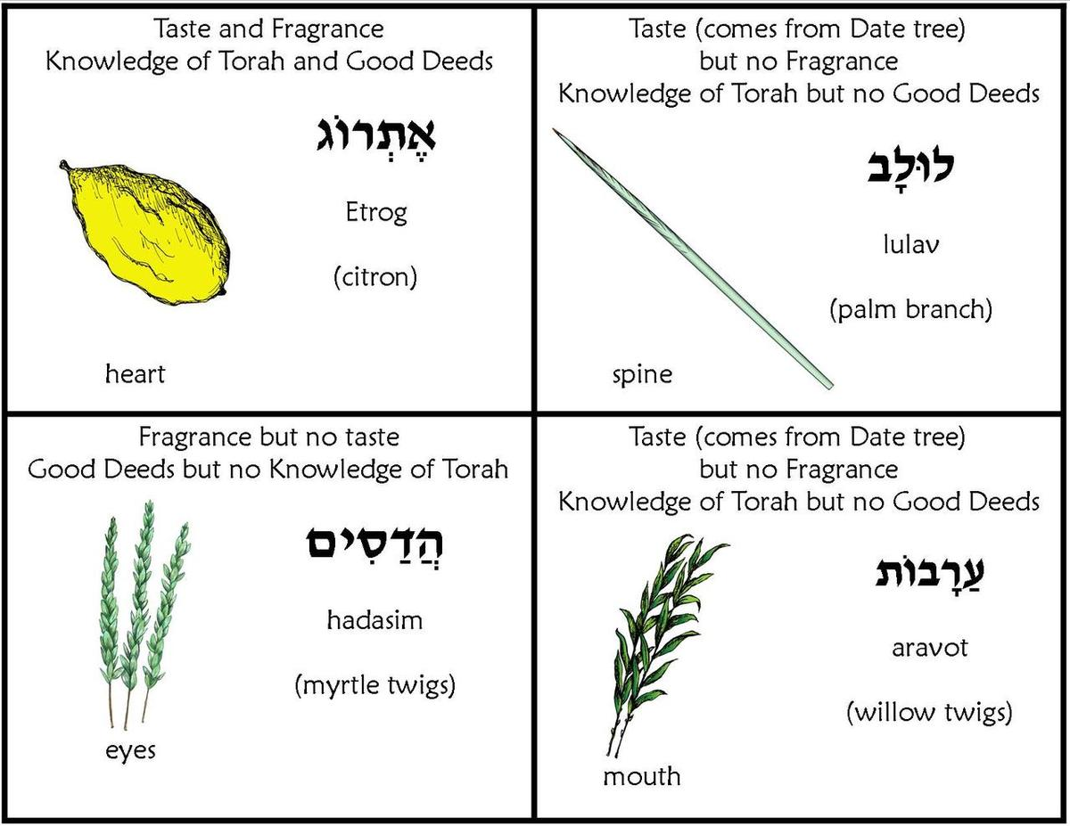
Notes:
https://www.google.com/url?sa=i&url=http%3A%2F%2Fwww.jeccmarketplace.com%2Fsukkot-four-species-pantomime-game-b-1%2F&psig=AOvVaw3DEx-KTpb1I9zyiPnn1Ze_&ust=1595729143689000&source=images&cd=vfe&ved=0CAIQjRxqFwoTCJjNsbio5-oCFQAAAAAdAAAAABAD

Slide 24
Character is expressed in the fruit of the spirit. Etrog of Sukkot. Pleasant.
Effectiveness: gifts of the spirit. Lulav: date palm of Sukkot. Food. Function.
Character >> effectiveness.
We will be judged by character.

Slide 25
Called to holiness: character.
Called to service.

Slide 26
Called to holiness: character.
Called to service.
^{Mtt 20.26-28} Whoever among you wants to be a leader must become your servant, and whoever wants to be first must be your slave! For the Son of Man did not come to be served, but to serve — and to give his life as a ransom for many.”
Notes:
I prove my commanding leadership most weeks because…
I make the final inspection of garbage and take out all contents of all cans. When full oneg going, volunteers. Now, self serve. People leave food garbage.

Slide 27
^{Eph. 4.1-3} Therefore I, a prisoner for the Lord, urge you to walk in a manner worthy of the calling to which you were called— with complete humility and gentleness, with patience, putting up with one another in love, making every effort to keep the unity of the Ruakh in the bond of shalom.
Notes:
We receive gifts to enable, empower us to do our calling.

Slide 28
^{Eph. 4.7-8} Each one of us, however, has been given grace to be measured by the Messiah’s bounty. This is why it says, “After he went up into the heights, he led captivity captive and he gave gifts to mankind.
Notes:
Gifts empower and confirm your calling.

Slide 29
We have a spiritual gifts inventory assessment on our website. Very helpful to determine your strengths, your calling.
OrHaOlam.com
Education tab
Or HaOlam, scroll down

Slide 30
https://orhaolam.com/index.php/education/or-haolam
Notes:
Get a result like mine…

Slide 31
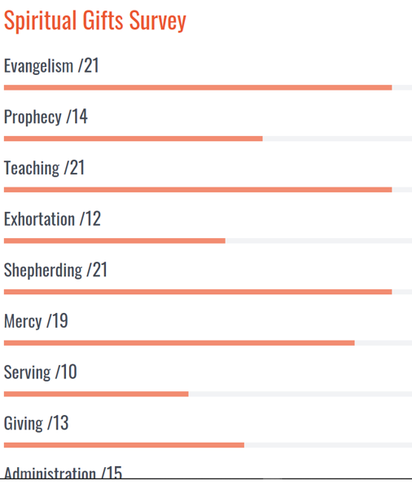

Slide 32
Called to holiness: character.
Called to service.

Slide 33
^{Mishlei /Prov 15.1} A gentle answer turns away wrath, but a harsh word stirs up anger.
Notes:
Works in arguments and discord. The first to say, “I see my fault in this matter in that I…”
Not a “you statement” just an “I statement”
Sometimes doesn’t work with a hostile or seductive or unreasonable person, but often it does. There is a place for justice and enforcement, but most of the time, we are called to humility.
Two huge examples in our day…

Slide 34
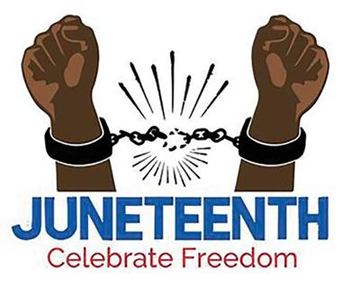
Notes:
https://www.google.com/imgres?imgurl=https%3A%2F%2Fbloximages.newyork1.vip.townnews.com%2Fmiamitimesonline.com%2Fcontent%2Ftncms%2Fassets%2Fv3%2Feditorial%2Ff%2Ffe%2Fffeb97d8-a5ad-11ea-ae71-07da9f44668d%2F5ed7c0933a63a.image.jpg%3Fresize%3D400%252C327&imgrefurl=https%3A%2F%2Fwww.miamitimesonline.com%2Flifestyles%2Fjuneteenth-a-time-honored-celebration-of-freedom%2Farticle_eca25e32-a5ad-11ea-9b67-3f4d274feb2e.html&tbnid=KY9ua7EmZ2WQpM&vet=12ahUKEwigzdWPrufqAhXFbqwKHW87B04QMygFegUIARDYAQ..i&docid=T-HY2hyvWBXSgM&w=400&h=327&q=juneteenth&safe=active&ved=2ahUKEwigzdWPrufqAhXFbqwKHW87B04QMygFegUIARDYAQ

Slide 35
Juneteenth A combination of the words June and 19th, the holiday marks the freedom of enslaved Black people in the US. It’s the anniversary date of the June 19, 1865 announcement by Union army general Gordon Granger, proclaiming freedom from slavery in Texas, the last slave state to hear.

Slide 36
Notes:
Kansas City, MO history: Annika Bergen p 43, 45, 47, 49-50

Slide 37
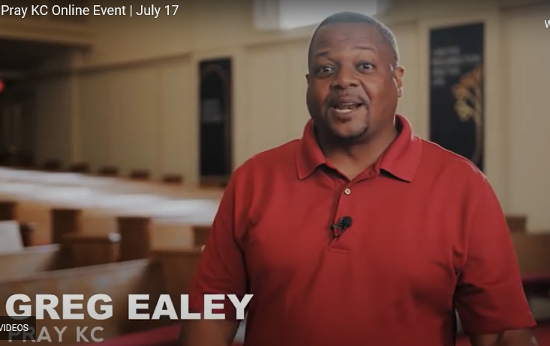
Notes:
Greg was senior pastor of Paseo Baptist in 2016, now on staff at Colonial Pres. Greg was a major friend and supporter of March of Remembrance. He is a friend of the Jews.

Slide 38
On this Juneteenth, Pray KC on the racial dividing line of our city, Troost Ave.
6000 people over 10 miles on Troost, in prayer and worship.
Clint Hall, former pastor in this building for ~20 years, great heart for reconciliation.
Notes:
I have been talking about finding G-d’s strategy in this time of chaos ~ 1970’s. Here it is:

Slide 39
Notes:
https://youtu.be/ZPvunzdJh18 Till 3.26 Greg Ealy
KC Racial Healing Networking Gathering 6 p.m. July 28 Life Mission Church
http://www.thesendingproject.org/july-28-kc-racial-healing-network-gathering
Or HaOlam will be hosting an Afro-American pastor soon.

Slide 40
We are called to humility, love, blessing, shalom.
^{Yeshayahu/Is 52.7} How beautiful on the mountains are the feet of him who brings good news, proclaiming shalom, bringing good news of good things, announcing salvation and saying to Tziyon, “Your God is King!”

Slide 41
Another major historical issue that G-d seems to be calling us to consider:
Dawn and I had an anniversary getaway last week…to Dodge City, KS.
Built on the Sante Fe Trail.

Slide 42
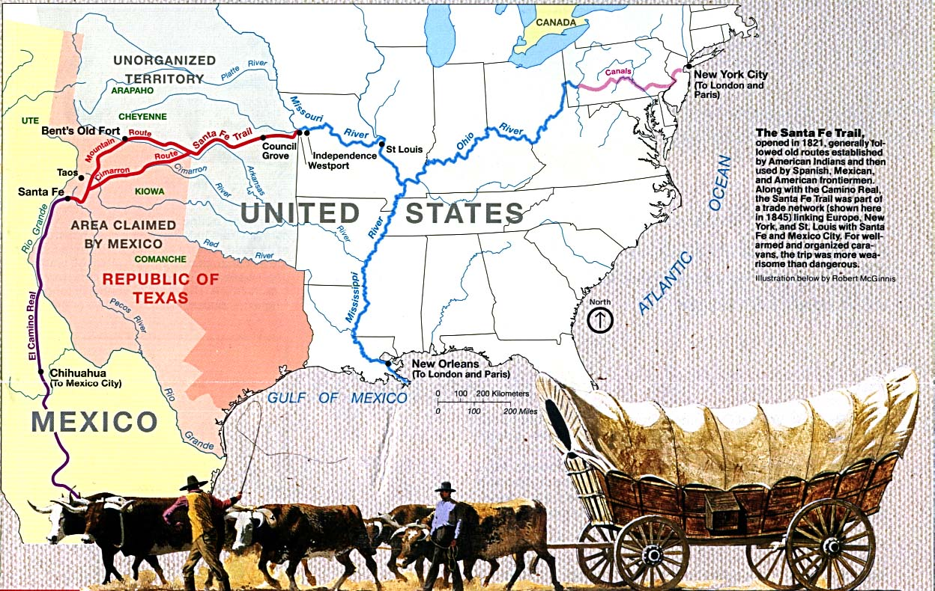
Opened 1821

Slide 43
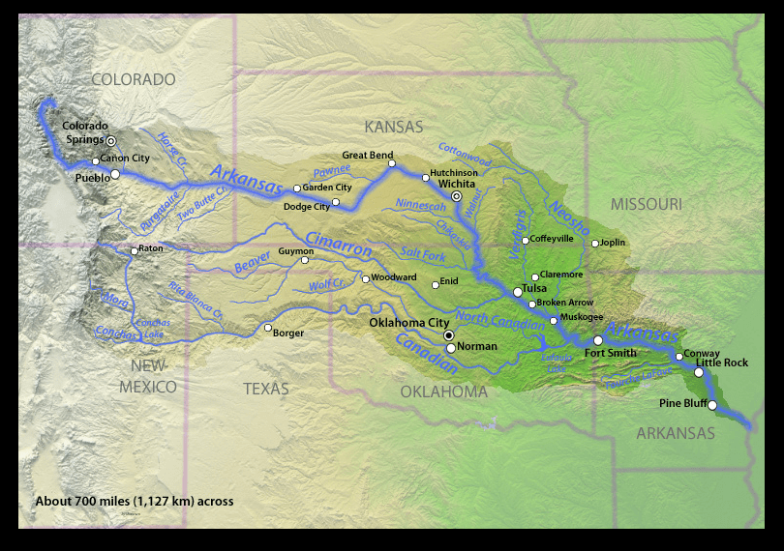
Notes:
There was a treaty that no buffalo would be hunted south of the Arkansas River.

Slide 44
In April 1865, the Indian Wars in the West began heating up, and the army constructed Fort Dodge to assist Fort Larned in providing protection on the Santa Fe Trail. No liquor was allowed there, so in June 1872 George Hoover brought a load of whiskey to found Dodge City. The railroad arrived in September, 1872.
Notes:
Booklet p 1

Slide 45
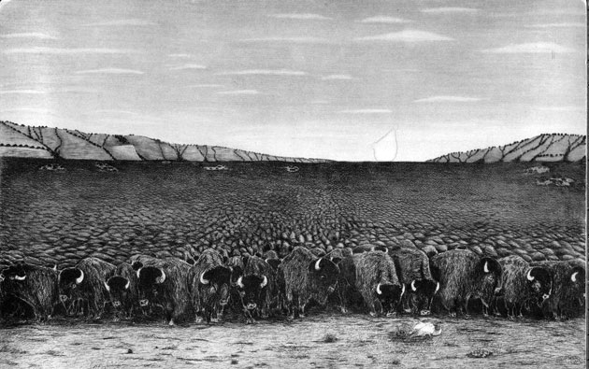
Notes:
https://www.google.com/url?sa=i&url=https%3A%2F%2Fwww.harmenliemburg.nl%2F2012%2F03%2F11%2Fbison-bison%2F&psig=AOvVaw3MQ3R0_dEuMW4qE1BLDeed&ust=1595551525675000&source=images&cd=vfe&ved=0CAIQjRxqFwoTCNjhi-WS4uoCFQAAAAAdAAAAABAZ
​In 1870, James McKay, a well-known Red River half-breed trader and hunter, reported that during the 1850s he had traveled for twenty days through a continuous herd of buffalo. The herd was so large that for as far as he could see on all sides was the landscape, black with the animals.

Slide 46
Dodge City had more famous (and infamous) gunfighters working at one time or another than any other town in the West. It also boasted [an] array of saloons, gambling halls, and brothels, including the famous Long Branch Saloon and China Doll brothel.

Slide 47
Government policy Exterminating the buffalo was convenient for the US government as it forced Plains Indians to become more like white settlers. Without the buffalo, Plains Indians had no reason to live a nomadic lifestyle. This made it easier for the US government to confine Plains Indians into small reservations.
Notes:
https://www.tutor2u.net/history/reference/the-extermination-of-the-buffalo#:~:text=Exterminating%20the%20buffalo%20was%20convenient,become%20more%20like%20white%20settlers.&text=Once%20they%20had%20been%20exterminated,for%20white%20settlers%20to%20farm.

Slide 48
Government policy Additionally, the buffalo was the Plains Indians main food source. Once they had been exterminated, Plains Indians were forced to learn how to farm effectively or they would starve. The extinction of buffalo also freed up more space for white settlers to farm.
Notes:
https://www.tutor2u.net/history/reference/the-extermination-of-the-buffalo#:~:text=Exterminating%20the%20buffalo%20was%20convenient,become%20more%20like%20white%20settlers.&text=Once%20they%20had%20been%20exterminated,for%20white%20settlers%20to%20farm.

Slide 49
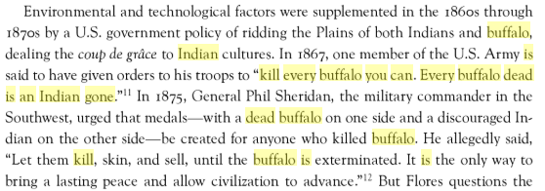
Notes:
https://books.google.com/books?id=pVGrAgAAQBAJ&pg=PA20&lpg=PA20&dq=Kill+every+buffalo+you+can!+Every+buffalo+dead+is+an+Indian+gone&source=bl&ots=R9On_o9HnQ&sig=JGxsXQ0W0NZ4QqBzJIPaqvdx6zs&hl=en&sa=X&ved=0ahUKEwjY0aWIo9fMAhUG4yYKHZ-vAs84ChDoAQgnMAI#v=onepage&q=Kill%20every%20buffalo%20you%20can!%20Every%20buffalo%20dead%20is%20an%20Indian%20gone&f=false

Slide 50
Economic In 1871, a process to turn buffalo skin into leather suitable for US industrial machines was discovered. People rushed to kill as many buffalo as possible to sell their hides. The railroads made it easy to transport buffalo skins back to the city to sell. White hunters usually just discarded the rest of the buffalo, leaving it to rot. Plains Indians found this highly disrespectful.
Notes:
https://www.tutor2u.net/history/reference/the-extermination-of-the-buffalo#:~:text=Exterminating%20the%20buffalo%20was%20convenient,become%20more%20like%20white%20settlers.&text=Once%20they%20had%20been%20exterminated,for%20white%20settlers%20to%20farm.

Slide 51
Following the construction of new railway lines that connected east and west, train operators offered tourists the opportunity to shoot at bison from the windows of their compartments, pausing only when the ammunition ran out or the barrel of the gun became too hot.
Notes:
https://www.harmenliemburg.nl/2012/03/11/bison-bison/

Slide 52
There were even contests. In one of them, someone from Kansas killed 120 bison in 40 minutes. A record! The scout ‘Buffalo’ Bill Cody shot more than 4,000 bison in two years.
Notes:
https://www.harmenliemburg.nl/2012/03/11/bison-bison/

Slide 53
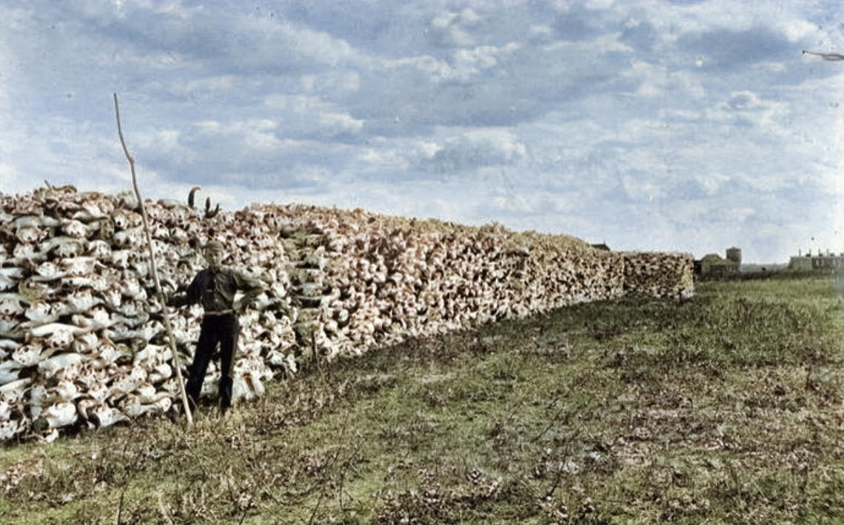
Buffalo Extermination
Was an Act of Genocide
Notes:
https://www.dibaajimowin.com/dibaajimowin-blog/buffalo-extermination-was-an-act-of-genocide

Slide 54
The prairie was littered with abandoned carcasses. When the stench of rotting flesh had faded, others earned a living by collecting the skulls and bones for use in the fertilizer and pigment industries.
Notes:
https://www.harmenliemburg.nl/2012/03/11/bison-bison/

Slide 55
By 1883 nearly every single buffalo on the Great Plains had been killed. In 1840, there was an estimated 35 million buffalo on the plains. By 1890, there were less than 1,000. The extermination of the buffalo had a huge impact on the Plains Indian’s way of life as the buffalo played such a pivotal role in their culture.
Notes:
https://www.tutor2u.net/history/reference/the-extermination-of-the-buffalo#:~:text=Exterminating%20the%20buffalo%20was%20convenient,become%20more%20like%20white%20settlers.&text=Once%20they%20had%20been%20exterminated,for%20white%20settlers%20to%20farm.

Slide 56
I love America, and I believe this country was built on GREAT principles of equality, liberty, and scripture. But not every line in our history reflects that.
We are called to sow peace by humility, prayer, worship, service.
Notes:
Could stop here. Tisha B’Av coming Wednesday evening. Time of lamenting Jewish tragedy, pray for restoration. This time, lament many tragedies, pray for healing of our land.

Slide 57
Called to holiness.
Called to service.
Called to identity.

Slide 58
^{Ro. 1.16} For I am not ashamed of the Good News, for it is the power of God for salvation to everyone who trusts—to the Jew first and also to the Greek.
Notes:
Or HaOlam was founded with a passion to reach the Jewish people first, not exclusively, but inclusively.
Sometimes accusation of 2nd class citizenship for non-Jews.

Slide 59
^{Ber/Gen 12.1-3} Now Adoni said to Avram, “Get yourself out of your country, away from your kinsmen and away from your father’s house, and go to the land that I will show you. I will make of you a great nation,

Slide 60
^{Ber/Gen 12.1-3} I will bless you, and I will make your name great; and you are to be a blessing. I will bless those who bless you, but I will curse anyone who curses you; and by you all the families of the earth will be blessed.”

Slide 61
G-d blesses Avram.
Avram blesses others.
Others are blessed for blessing Avram.
All the families are blessed by this reciprocal blessing.
Notes:
So, is there a difference?

Slide 62
^{Acts 15.19}“Therefore, my opinion is that we should not put obstacles in the way of the Goyim who are turning to God.
^{Acts 15.24} We have heard that some people went out from among us without our authorization, and that they have upset you with their talk, unsettling your minds.

Slide 63
^{Acts 15.28} For it seemed good to the Ruach HaKodesh and to us not to lay any heavier burden on you than the following requirements
^{Acts 21.25} Concerning the Gentiles who believe, we have written and decided that they should observe no such thing.
Notes:
Obstacles, unsettling, heavier burden, no such thing…
Keeping Torah. All invited to keep festivals, dietary laws.
I think it’s a burden of identity…

Slide 64
^{Ro 11.12,15} Now if their transgression leads to riches for the world, and their loss riches for the Gentiles, then how much more their fullness! …For if their rejection leads to the reconciliation of the world, what will their acceptance be but life from the dead?
Notes:
If a Jewish believer in Yeshua keeps Torah, he has the joy of fulfilling it, and fulfills his covenantal destiny and brings much more fulness and life from the dead. If a Gentile believer keeps Torah, he has the joy of fulfilling it.

Slide 65
Called to holiness.
Called to service.
Called to identity.
Called to destiny.

Slide 66
^{Est.4.14} Who knows whether you didn’t come into your royal position precisely for such a time as this.”
COVID-19 shut down and fear.
Racial cancel culture and rage.
Chinese ambitions.
Iranian genocidal aspirations.

Slide 67
Summary
Called to holiness.
Called to service.
Called to identity.
Called to destiny.

Slide 68
^{Est 4.14} For if you fail to speak up now, relief and deliverance will come to the Jews from a different direction; but you and your father’s family will perish. Who knows whether you didn’t come into your royal position precisely for such a time as this.”
Notes:
Afterthought of hope…

Slide 69
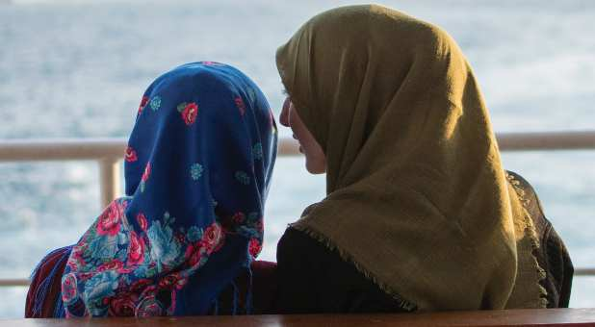
Spiritual 'Pandemic of Hope’
Grips Iran as Thousands Accept
Messiah Amidst COVID-19
Notes:
https://www.charismanews.com/world/81969-spiritual-pandemic-of-hope-grips-iran-as-thousands-accept-christ-amidst-covid-19?utm_source=Charisma%20News%20Daily&utm_medium=email&utm_content=subscriber_id:5160390&utm_campaign=CNO%20daily%20-%202020-07-23

Slide 70
Iran is facing a wave of internal turmoil and covert attacks that are undermining the radical regime's nefarious plans. Even as the violence escalates, hope is rising among Iranian citizens who are finding salvation in Messiah Yeshua.
Notes:
https://www.charismanews.com/world/81969-spiritual-pandemic-of-hope-grips-iran-as-thousands-accept-christ-amidst-covid-19?utm_source=Charisma%20News%20Daily&utm_medium=email&utm_content=subscriber_id:5160390&utm_campaign=CNO%20daily%20-%202020-07-23

Slide 71
Whether it's the exploding coronavirus, mysterious fires at nuclear and military facilities or protests, Iran's ruling Islamic clerics are facing unprecedented challenges as the regime tries to maintain an iron grip on the nation.
Notes:
https://www.charismanews.com/world/81969-spiritual-pandemic-of-hope-grips-iran-as-thousands-accept-christ-amidst-covid-19?utm_source=Charisma%20News%20Daily&utm_medium=email&utm_content=subscriber_id:5160390&utm_campaign=CNO%20daily%20-%202020-07-23

Slide 72
from one of the Messianic rabbis, Joe Bell.
I believe that God gave me a word about Parsha Korach and Parsha Pinchas. If President Trump and Mike Pence get on their faces and forgive the haters, looters, rioters, media, congress, etc. and ask God to take COVID-19. I believe that by virtue of President Trump’s office and power, God will hear and act.
Notes:
From my wife…

Slide 73
Maybe if the government repents of its historic violence against the Indians and the Blacks, we can be released from the plague of COVID. This is what King David had to do because of King Saul's violence when there was a plague in Israel. Tisha B’Av

Slide 74
Called to holiness.
Called to service.
Called to identity.
Called to destiny.

