Slide 1
e-handout
To have these notes
without taking notes
Go to OrHaOlam.com
Click on downloads,
messages, 2020

Slide 2
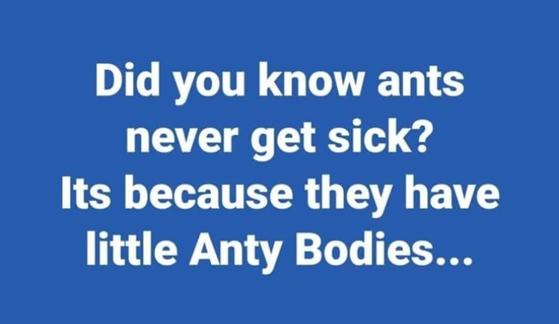
Notes:
Jai Cohen

Slide 3
Notes:
Jai Cohen

Slide 4
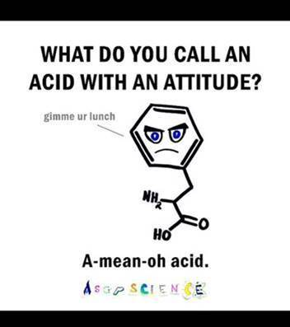
Notes:
Luann Ridgeway

Slide 5
Notes:
Luann Ridgeway

Slide 6
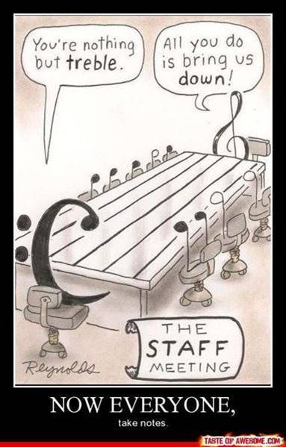
The music staff meeting
You’re nothing but treble.
All you do is bring us down
Everyone take notes.
Notes:
Luann Ridgeway

Slide 7
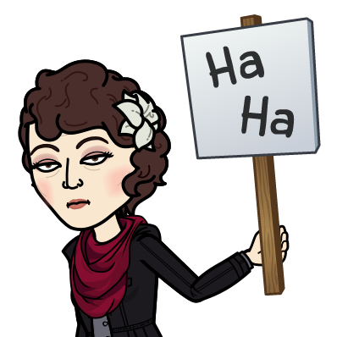

Slide 8
https://www.ashasexualhealth.org/sex-in-the-time-of-covid-19/
Recommendation from

Slide 9
Notes:
https://www.ashasexualhealth.org/sex-in-the-time-of-covid-19/
This relates to casual, multi-partner sex. Best practice, G-d’s practice, virginity till marriage, then monogamy afterward.

Slide 10
Save your kisses for your Mrs.
Then they will be most delicious.

Slide 11
Save your kisses for your Mrs.
Then they will be most delicious.
Save your kisses for your Mister.
You’ll be sure to get no blister.

Slide 12
Why is our culture going so insane? Where is “Where is Adoni, the God of Eliyahu?”

Slide 13
^{2 K 2 11-14} Suddenly, as they were walking on and talking, there appeared a fiery chariot with horses of fire; and as it separated the two of them from each other, Eliyahu went up into heaven in a whirlwind. Elisha saw it and cried out, “My father! My father! The chariots and horsemen of Isra’el!”…

Slide 14
^{2 K 2 11-14} Then he picked up Eliyahu’s cloak, which had fallen off him. Standing on the bank of the Yarden, he took the cloak that had fallen off Eliyahu, struck the water and said, “Where is Adoni, the God of Eliyahu?” But when he actually did strike the water, it divided itself to the left and to the right; then Elisha crossed over.

Slide 15
Why is our culture going so insane?
Where is “Where is Adoni, the God of Eliyahu?”
First Principles of LIFE.

Slide 16
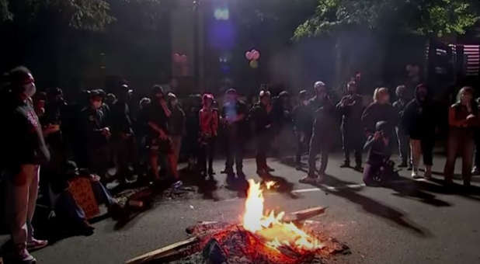
Protesters set Bibles and American flags on fire over the weekend in Portland, Oregon. (The Sun YouTube channel)

Slide 17
Dr. Michael Brown: When it comes to the Bible, for some, it is the ultimate symbol of oppression. Of religious tyranny. Of abusive authority.
Notes:
https://www.charismanews.com/opinion/in-the-line-of-fire/82117-michael-brown-and-then-they-burned-the-bibles?utm_source=In%20the%20Line%20of%20Fire&utm_medium=email&utm_content=subscriber_id:5194514&utm_campaign=Blogger%20-%20Michael%20Brown%20-%202020-08-05

Slide 18
It is the evil book on which America was founded, and it should be burned, along with the American flag. It is racist, homophobic and misogynist. It supports genocide and apartheid, and it the divinely sanctioned manual for slave owners. To the flames!
Notes:
https://www.charismanews.com/opinion/in-the-line-of-fire/82117-michael-brown-and-then-they-burned-the-bibles?utm_source=In%20the%20Line%20of%20Fire&utm_medium=email&utm_content=subscriber_id:5194514&utm_campaign=Blogger%20-%20Michael%20Brown%20-%202020-08-05

Slide 19
"Do not be under the illusion that these protests and riots are anything but an attempt to dismantle all of Western Civilization and upend centuries of tradition and freedom of religion."
Notes:
https://www.charismanews.com/opinion/in-the-line-of-fire/82117-michael-brown-and-then-they-burned-the-bibles?utm_source=In%20the%20Line%20of%20Fire&utm_medium=email&utm_content=subscriber_id:5194514&utm_campaign=Blogger%20-%20Michael%20Brown%20-%202020-08-05

Slide 20
Yes, it is beyond ludicrous to suggest that the burning of Bibles has any connection at all to the death of George Floyd, himself a professing Christian. And it is ridiculous to think there is any real connection between the Bible and police brutality.
Notes:
https://www.charismanews.com/opinion/in-the-line-of-fire/82117-michael-brown-and-then-they-burned-the-bibles?utm_source=In%20the%20Line%20of%20Fire&utm_medium=email&utm_content=subscriber_id:5194514&utm_campaign=Blogger%20-%20Michael%20Brown%20-%202020-08-05

Slide 21
when rightly applied, the Bible's principles have liberated women, slaves and other oppressed groups.
(See, for example, Rodney Stark's The Rise of Christianity: How the Obscure, Marginal Jesus Movement Became the Dominant Religious Force in the Western World in a Few Centuries.)
Notes:
https://www.charismanews.com/opinion/in-the-line-of-fire/82117-michael-brown-and-then-they-burned-the-bibles?utm_source=In%20the%20Line%20of%20Fire&utm_medium=email&utm_content=subscriber_id:5194514&utm_campaign=Blogger%20-%20Michael%20Brown%20-%202020-08-05

Slide 22
That's why I tweeted on Aug. 1, [Dr. Michael Brown] "First they burned the federal buildings, then they burned the churches, now they're burning Bibles. Rather than asking 'What is next?' we should ask, 'Who is next?'"
Notes:
https://www.charismanews.com/opinion/in-the-line-of-fire/82117-michael-brown-and-then-they-burned-the-bibles?utm_source=In%20the%20Line%20of%20Fire&utm_medium=email&utm_content=subscriber_id:5194514&utm_campaign=Blogger%20-%20Michael%20Brown%20-%202020-08-05

Slide 23
^{Yermiyahu/Jer 12.5}: “If you raced with those on foot and they wore you out, how can you compete with horses? If you are secure in a land of peace, how will you do in Jordan’s thickets? [Spring flood when lions emerge from the flood zone.]

Slide 25
Why is our culture going so insane?
Where is “Where is Adoni, the God of Eliyahu?”
First Principles of LIFE.

Slide 26
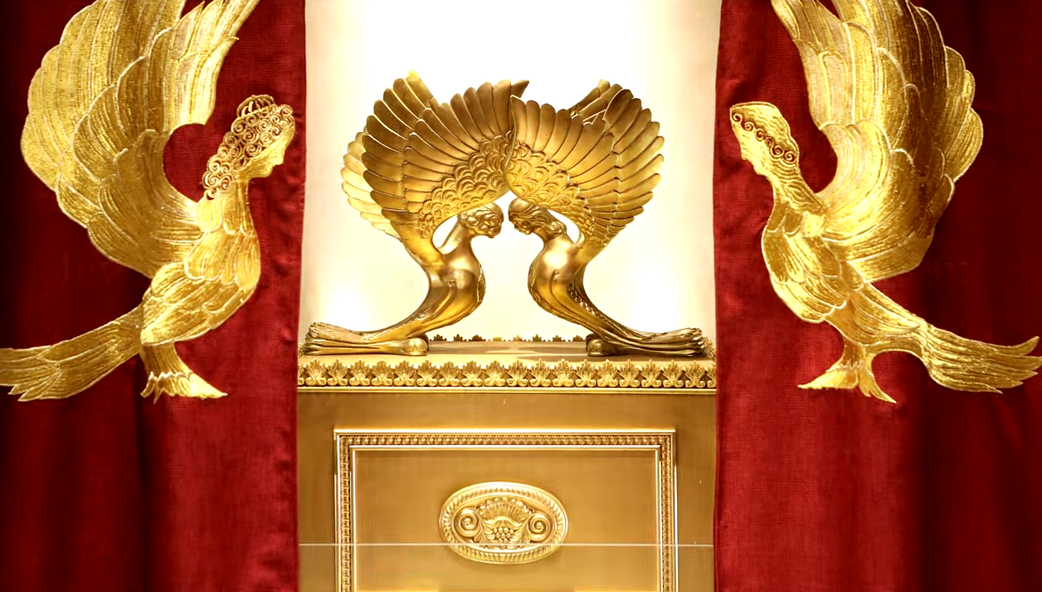
Letter to the Messianic Jews
[Hebrews] MJ 5.11-6.3
First Principles
Notes:
https://www.templeinstitute.org/new-location.htm
Essence of G-d’s branding, visual arts communication.

Slide 27
^{MJ 5.11-6.3} About this subject there is much for us to say, and it is hard to explain since you have become sluggish in hearing. For although you ought to be teachers by this time, again you need someone to teach you the basics of God’s sayings. You have come to need milk, not solid food.
Notes:
“This subject” is the cohanut priesthood of Melkitsedek. Author wants to explore deep teaching but troubles. A bit like the Book of Yehuda/Jude

Slide 28
^{MJ 5.11-6.3} For anyone living on milk is inexperienced with the teaching about righteousness—he is an infant. But solid food is for the mature, who through practice have their senses trained to discern both good and evil.

Slide 29
^{MJ 5.11-6.3} Therefore, leaving behind the initial lessons about the Messiah, let us go on to maturity, not laying again the foundation of ₁turning from works that lead to death, ₂trusting God,
Notes:
Six principles

Slide 30
^{MJ 5.11-6.3} and ₃instruction about washings, ₄s’mikhah, ₅the resurrection of the dead and ₆eternal punishment. And, God willing, this is what we will do.

Slide 31
Back through text to unpack, and find:
Why is our culture going so insane?
Where is “Where is Adoni, the God of Eliyahu?”
First Principles of LIFE.

Slide 32
^{MJ 5.11-6.3} About this subject there is much for us to say, and it is hard to explain since you have become sluggish in hearing. For although you ought to be teachers by this time, again you need someone to teach you the basics of God’s sayings. You have come to need milk, not solid food.
Notes:
Sluggish? A bit insulting?
Ought to be…saw Temple service, Yeshua Himself, Ruakh on Shavuot/Pcost. We are the Jews and friends. Ought to be the head, mega.
Stern: milk: receiving doctrine passively as opposed to actively putting out energy for the Kingdom. Listening to basic doctrine is milk, and anyone who has to drink milk only is still a baby. “I want to be fed.” That’s a half true statement. If it means I want to be pumped, encouraged, affirmed, that’s only half the balanced diet. We need to RECEIVE, but that’s not the end. Rather I want to be challenged to be more Messiah-like, a better servant, better attitudes, a GIVER.

Slide 33
^{MJ 5.11-6.3} For anyone living on milk is inexperienced with the teaching about righteousness—he is an infant.
Notes:
faculties have been trained by continuous exercise to distinguish good from evil.
gymnao a gymnasium workout sweat. Life habit: “What does the Word say in this situation?”

Slide 34
What is the meaning of spiritual milk?

Slide 35
Positive meaning
^{1 Kefa/P 2.2} Be like newborn babies, thirsty for the pure milk of the Word; so that by it, you may grow up into deliverance.
But also, not so positive…

Slide 36
^{1 Cor. 3.1-3} And I, brothers and sisters, could not speak to you as Spirit-filled but as worldly—as infants in Messiah. I gave you milk, not solid food, for you were not yet ready. Indeed, even now you are not yet ready, for you are still worldly. For since there is jealousy and strife among you, aren’t you worldly and walking in a human way?
Notes:
Strife and contention in the congregation. Jealousy and strife means we are infants.

Slide 37
A solid food congregation:
^{Yn 17.21} …that they may all be one. Just as you, Father, are united with me and I with you, I pray that they may be united with us, so that the world may believe that you sent me.
Life model: infant to elder…
Notes:
One of the BEST paradigms on spiritual growth ever…

Slide 38
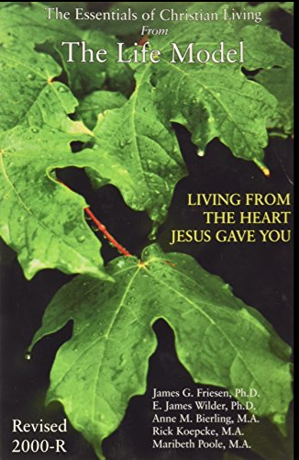
Stages of maturity:
Infant
Child
Adult
Parent
Elder

Slide 39
Stages of maturity:
Infant: receives / believes joyful affirmation

Slide 40
Stages of maturity:
Infant
Child: confidently meets some of his own needs and ask

Slide 41
Stages of maturity:
Infant
Child
Adult: Cares for self and others with joy

Slide 42
Stages of maturity:
Infant
Child
Adult
Parent: Cares for family without expectation of reciprocity.

Slide 43
Stages of maturity:
Infant
Child
Adult
Parent
Elder: Cares for a community.

Slide 44
Maturity = joyful giving
of your heart, your time, your energy, your resources to the King and the Kingdom.
Notes:
Most males in America are late stage infants, who are not sure that there is an affirming world out there that we can function in.

Slide 45
^{MJ 5.11-6.3} For anyone living on milk is inexperienced with the teaching about righteousness—he is an infant. But solid food is for the mature, who through practice have their senses trained to discern both good and evil.
Notes:
Solid food: Nature of G-d, calling of Israel, nature of the Messiah, death to self, Messiah like character and giving

Slide 46
^{Yn 4.34} Yeshua said to them, “My food is to do what the one who sent me wants and to bring his work to completion.
Notes:
We can conclude he was mature, eating strong meat.

Slide 47
^{MJ 5.11-6.3} Therefore, leaving behind the initial lessons about the Messiah, let us go on to maturity,
Notes:
Only other time this word, teleioteta, is found.

Slide 48
^{Col 3.14} Above all these, clothe yourselves with love, which binds everything together perfectly;
Notes:
Maturity is joyful, confident love.

Slide 49
^{MJ 5.11-6.3} Therefore, leaving behind the initial lessons about the Messiah, let us go on to maturity, not laying again the foundation of ₁turning from works that lead to death, ₂trusting God,

Slide 50
^{MJ 5.11-6.3} and ₃instruction about washings, ₄s’mikhah, ₅the resurrection of the dead and ₆eternal punishment. And, God willing, this is what we will do.

Slide 51
Six Foundational lessons
₁turning from works that lead to death

Slide 52
₁turning from works that lead to death
Does NOT mean turning from the Torah, the mitzvot. Common reading. Get rid of the Law. Khok olam חָק-עוֹלָם
Dead works = sin
Notes:
Common misinterp in the believing world.

Slide 53
^{Ro 6.23} For what one earns from sin is death
^{Dvarim/Dt 30.19} I have set before you life and death…Therefore choose life so that you and your descendants may live.
^{Mtt 4.17} From that time on, Yeshua began proclaiming, “Turn from your sins to God, for the Kingdom of Heaven is near!”
Notes:
Dead works = sin

Slide 54
Never stops.
^{Ro 8.13} For if you live according to your old nature, you will certainly die; but if, by the Spirit, you keep putting to death the practices of the body, you will live.
Notes:
Sin, pride, sensuality, self-indulgence, selfishness, materialism, hoarding, arrogance
FFOZ Elementary Principles p 41 Rabbi Berditchev story
Keep repenting? Enough?

Slide 55
^{Mtt 22.11-14} “Now when the king came in to look at the guests, he saw there a man who wasn’t dressed for a wedding; so he asked him, ‘Friend, how did you get in here without wedding clothes?’
Notes:
Kings would sometimes give banquets for their subjects and invite them all, regardless of status, providing suitable clothing for those unable to afford it.

Slide 56
^{Mtt 22.11-14} The man was speechless. Then the king said to the servants, ‘Bind him hand and foot, and throw him outside in the dark!’ In that place people will wail and grind their teeth, for many are invited, but few are chosen.”
Notes:
If we allow sin in our lives, and think we are in the kingdom, well will be GREATLY surprised. Evidently, Yeshua gave this parable because there are some.
Same imagery…

Slide 57
^{Rev. 19.7-9} Let us rejoice and be glad and give the glory to Him! For the wedding of the Lamb has come, and His bride has made herself ready, She was given fine linen to wear, bright and clean! For the fine linen is the righteous deeds of the kedoshim /holy ones.”

Slide 58
Initial lessons
₁turning from works that lead to death
Do we have an ongoing spirit of repentance, of self examination, not morbidly, but hopefully, to CHANGE!

Slide 59
Common mistake among believers today.
“Believe in Messiah and you will go to heaven.” Fire insurance.

Slide 60
^{Mtt 4.17} Yeshua began proclaiming, “Turn from your sins to God, for the Kingdom of Heaven is near!”
^{Ro.14.17-18} The Kingdom of God is… righteousness, shalom and joy in the Ruach HaKodesh. Anyone who serves the Messiah in this fashion both pleases God and wins the approval of other people.

Slide 61
Historical perspective on these six foundational principles.
There are ~2.4 billion Christians.
Notes:
https://www.google.com/search?q=number+of+christians+in+the+world&oq=number+of+Christians+in+the+world&aqs=chrome.0.0l3.8871j0j7&sourceid=chrome&ie=UTF-8

Slide 62
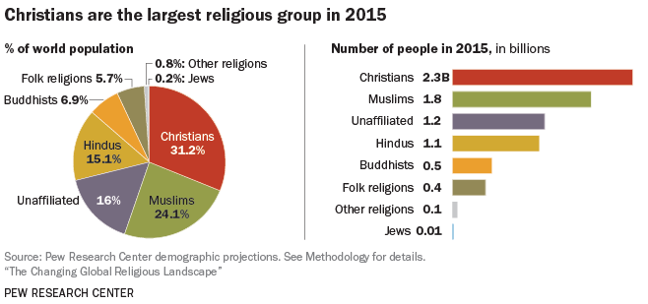
Notes:
We Messianics are the intersection of Christians in belief in Messiah, and Jews, in covenantal identity. Not on the chart.

Slide 63
One hundred million Christians, of 2.4 billion, identify as Evangelicals.
~25 million American identify as Evangelicals.
Notes:
FFOZ Elementary Principles p 21

Slide 64
Protestantism was very different prior to the Evangelical Awakening. [1700’s] In the time of the Reformation [1500s] there were the Roman Catholic armies and the Protestant armies. There were also the Anabaptists and other various nonconforming groups of the so-called “Radical Reformation.”
Notes:
http://www.foundationscourse.org/uploads/documents/reader/29_evangelical_awakening.pdf

Slide 65
The genius of evangelicalism introduced a personalization of the message of Messiah. Personal decision to follow Messiah. Not institutional affiliation, although that is a concomitant.
A very good innovation.
Notes:
FFOZ Elementary Principles p 21

Slide 66
However, many scholars observe that evangelicalism is a salvation culture, not a Good News of Messiah culture.
“Believe and go to heaven” has no need for a restored Israel, a literal kingdom, the Torah going forth from Jerusalem, radical repentance, discipleship.
Notes:
FFOZ Elementary Principles p 23

Slide 67
An encouraging example of evangelicalism done right, modified, having GREAT impact.

Slide 68
Across Africa and Asia, millions of people in historically unengaged people groups are now in rapidly growing Disciple Making Movements. In 2000 there were 6 such movements, today there are now 1,035!
Notes:
https://www.christianpost.com/voices/christianity-is-growing-faster-than-any-time-in-history-why-is-the-church-in-europe-america-declining.html

Slide 69
Across Africa and Asia many thousands of former Muslim clerics have left Islam to become fearless disciples of Messiah. On average, using data from The Status of Global Christianity, between 2000 to 2020, (7,300 days):
Notes:
https://www.christianpost.com/voices/christianity-is-growing-faster-than-any-time-in-history-why-is-the-church-in-europe-america-declining.html

Slide 70
Africa had 37,825 new Messiah Followers every day over the last 20 years
Latin America had 16,988
Asia had 13,443
North America had 1,999
Oceania had 473
Europe had 8
[ Source: Christian Post]
Notes:
https://www.christianpost.com/voices/christianity-is-growing-faster-than-any-time-in-history-why-is-the-church-in-europe-america-declining.html

Slide 71
What is it that the congregations of the Global South are doing that makes so much difference?
1. Abundant, and Bold Prayer
2. Discipling to Conversion
3. Obedience-Based Discipleship
4. Empowering Ordinary People for Ministry
Notes:
https://www.christianpost.com/voices/christianity-is-growing-faster-than-any-time-in-history-why-is-the-church-in-europe-america-declining.html
Note #2: not believe and be saved, but repent and believe. Not works based salvation, but empowered salvation. Not salvationism, but transformationism. [not exactly a word.]
Yeshua: Follow me and I’ll make you fishers of men.

Slide 72
5. Make Replicating Disciples, not Converts
6. Never Ending Leadership Training for All
Notes:
https://www.christianpost.com/voices/christianity-is-growing-faster-than-any-time-in-history-why-is-the-church-in-europe-america-declining.html

Slide 73
Grow Conference Chris Hodges
Notes:
https://www.google.com/search?q=grow20+growleader.com&oq=grow&aqs=chrome.3.69i60j69i57j35i39l2j46j0j69i60j69i61.8260j1j7&sourceid=chrome&ie=UTF-8

Slide 74
Lost people reborn | Cup of Sanctifica-tion | Know G-d | Yokhanan/ John Lion | Main service
Reborn people healed | Cup of judgment | Find Freedom Emotionally Jewishly | Luke Man | Home groups
Healed people trained | Cup of Redemption | Discover Develop your calling | Matthew Eagle | Training
Trained people mobilized | Cup of fulfilment | Make a Difference | Mark Ox: plow or sacrifice | Dream team
Notes:
Cups:
out of Egypt,
Egypt out of you / deliverance,
back to original intention/after supper,
Praise
10 other scriptures where this pattern appears.
• Know G-d: the main weekend service
• Find freedom: intimacy and community of the small groups
• Discover purpose: discipleship and training
• Make a difference: Dream team

Slide 75
Initial lessons
₁turning from works that lead to death
Do we have an ongoing spirit of repentance, of self examination, not morbidly, but hopefully, to CHANGE!

Slide 76
^{MJ 5.11-6.3} ₂trusting God, and ₃instruction about immersions, ₄s’mikhah, ₅the resurrection of the dead and ₆eternal punishment. And, God willing, this is what we will do.
Notes:
We’ll examine the others in coming weeks, leading into the Hebrew months of Elul and Tishri and the Fall Holidays. #4 immersions: someone inquired for themselves, so arranged Sept. 13 Sunday afternoon at Gardner Lake. Time Sunday and prep class tba

Slide 77
A call to repentance.

Slide 78
Notes:
From Jim Adler from Marc Hiatt

Slide 79
Notes:
From Jim Adler from Marc Hiatt from Jonathan Cahn

Slide 80
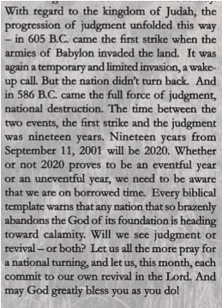
Notes:
From Jim Adler from Marc Hiatt from Jonathan Cahn

Slide 81
Notes:
From Jim Adler from Marc Hiatt from Jonathan Cahn

Slide 82
An grievous example of our cultural degeneration

Slide 83
The social media giant Facebook blocked a New York rabbi for teaching a class that uses Torah to help explain the spiritual dimensions of the coronavirus pandemic.
Notes:
https://unitedwithisrael.org/facebook-blocks-rabbi-for-teaching-spiritual-aspect-of-coronavirus/

Slide 84
By Ezra Stone, United with Israel
The class, explained the rabbi, discusses how “the Holy Temple in Jerusalem was destroyed because of hatred for one another,” exploring the Talmudic concept that equates “hatred to the three cardinal sins: idolatry, adultery, murder.”
Notes:
https://unitedwithisrael.org/facebook-blocks-rabbi-for-teaching-spiritual-aspect-of-coronavirus/
שנת חינם Sinat khinam baseless hatred

Slide 85
“Expansive, unconditional love will lead to the Redemption, the rebuilding of the Temple, and the end to all ailments and illnesses, including COVID-19,” added the rabbi, noting, “This is one of our most basic beliefs, found in our holy Torah. So yes, the cure for coronavirus is in fact in the Torah!”
Notes:
https://unitedwithisrael.org/facebook-blocks-rabbi-for-teaching-spiritual-aspect-of-coronavirus/

Slide 86
Facebook blocked this teaching:
“Expansive, unconditional love will lead to the Redemption, the rebuilding of the Temple, and the end to all ailments and illnesses, including COVID-19,”

Slide 87
An encouraging thank you note:

Slide 88
James and Sarah Rebbavarapu
Work with Operation Saturation
Or HaOlam gave $1000 a few months ago

Slide 89
Operation Saturation, India
​Dear OR Haolam Messianic Congregation, Wow, and thank you again! Your gift was put to good use, feeding two villages! We at Operation Saturation are so thankful that you gave to the rice relief project, and we wanted you to see the attached pictures. These are specific pictures of what YOUR gifts made possible. (No one else is receiving these same pictures )

Slide 90
Since COVID-19 began its sweep across the globe, the partnership with our church network in South Asia has, in total, provided food relief to 24,112 vulnerable families. Your contribution was a part of that!

Slide 91
As promised in Isaiah 58:10, we have faith that these efforts to care for those in need will result in “light rising in the darkness until it shines as bright as noon”. We believe that hope and joy will be restored and that many eyes will be pointed towards the brightness of Yeshua!

Slide 92
Our OpSat team is so excited to show you the fruit of your generosity! Again, below are photographs of rice distributions that your gift made possible. --

Slide 93
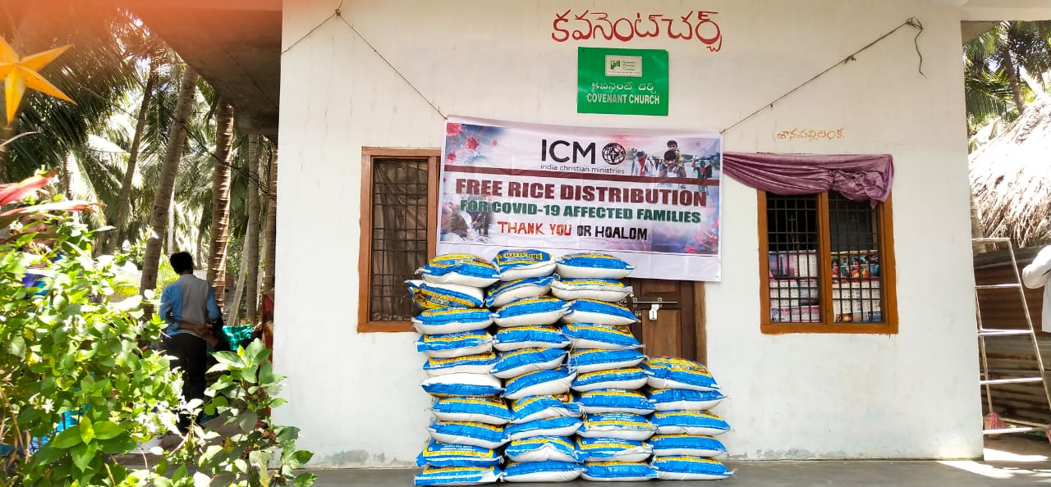

Slide 95
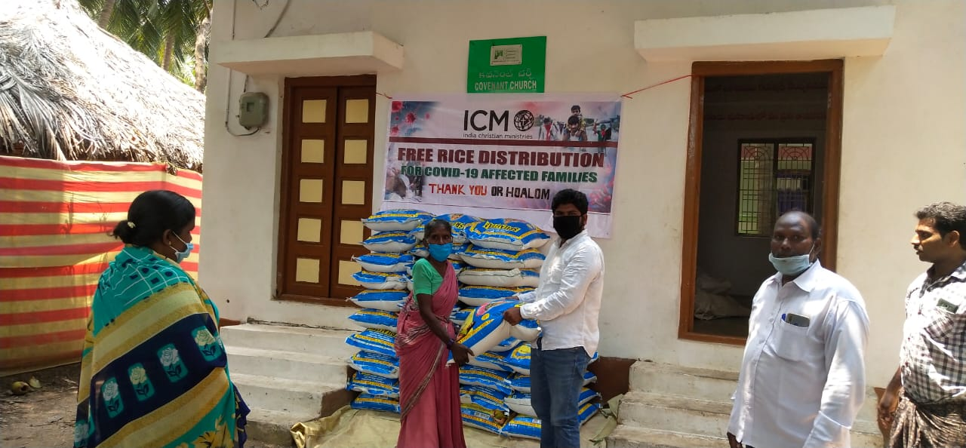

Slide 96
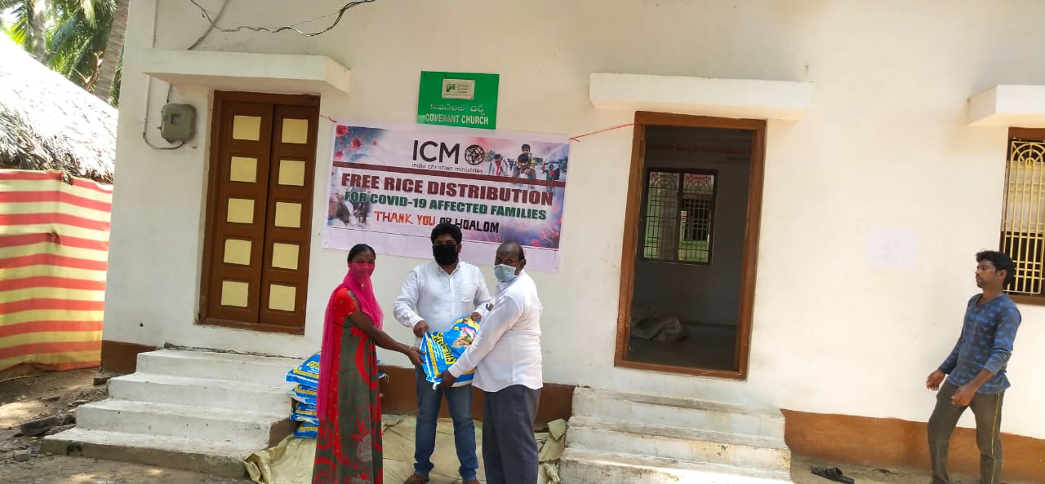

Slide 98
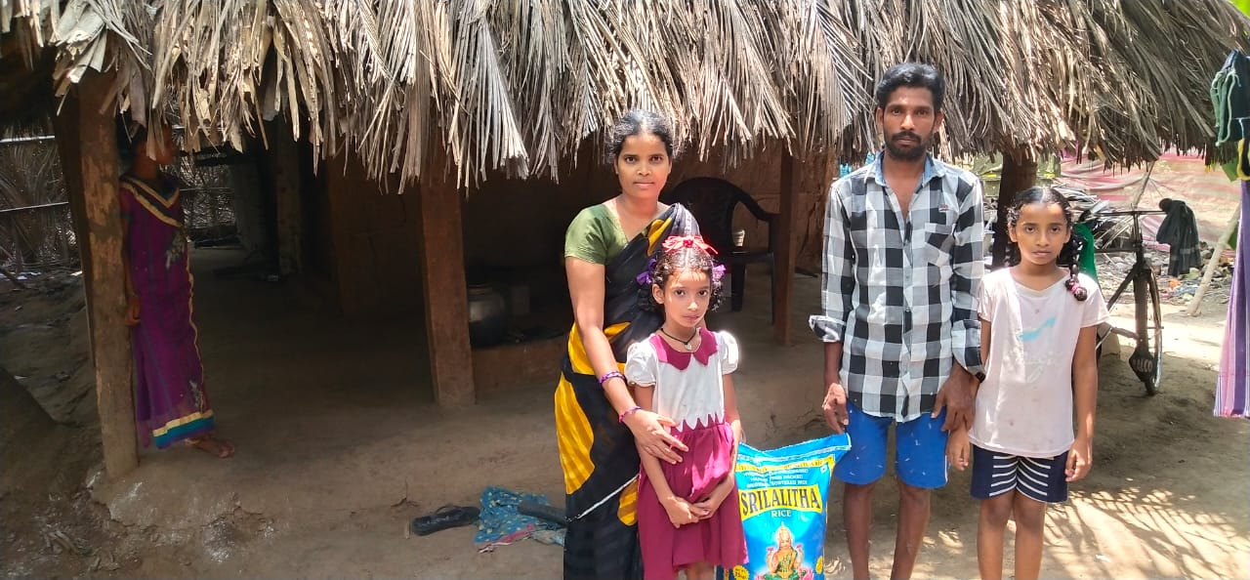

Slide 99
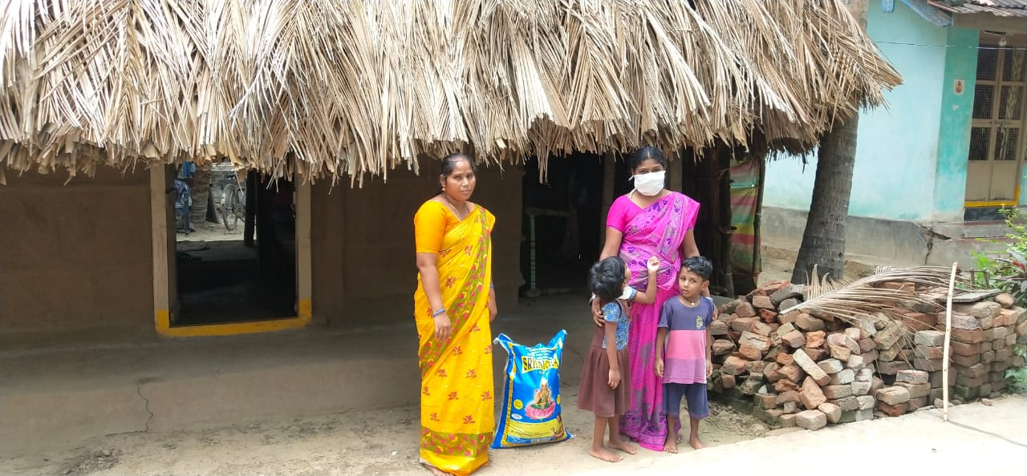

Slide 100
Tragic news, that may have an unexpected good consequence!
The recent Beirut firestorm explosion. 1/10 force Hiroshima, some say.
[Or HaOlam is giving $1000+ to help Beirut in Yeshua’s Name.]

Slide 101
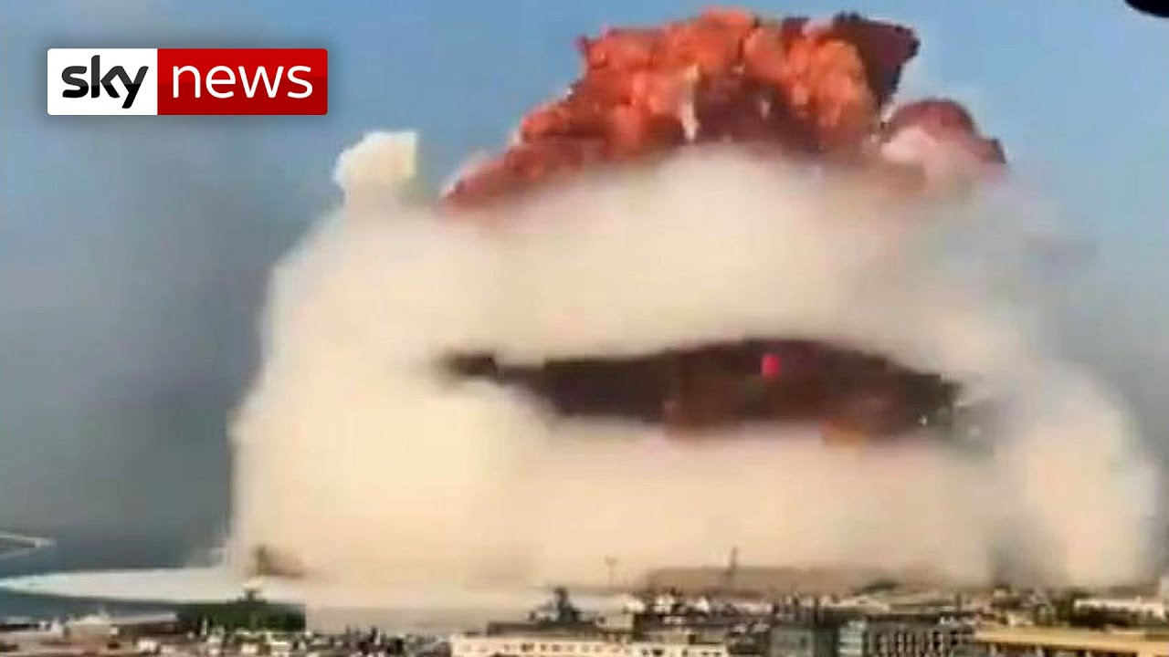
Notes:
https://www.google.com/url?sa=i&url=https%3A%2F%2Fwww.youtube.com%2Fwatch%3Fv%3DoKFupx9x0-k&psig=AOvVaw3wsK-tJ-2TY_R_nFcAYaLP&ust=1597556907694000&source=images&cd=vfe&ved=0CAIQjRxqFwoTCJjRos7BnOsCFQAAAAAdAAAAABAD

Slide 102
According to Lebanese media, workers were welding a door to a warehouse when sparks from the welding caught fire. When the fire reached fireworks stored in the warehouse, an explosion took place. It took about 30 seconds for that initial explosion to set off the secondary explosion of almost 3000 tons of ammonium nitrate
Notes:
https://myemail.constantcontact.com/Prayer-for-Lebanon-and-her-future.html?soid=1130986288219&aid=FaNme9vubzQ

Slide 103
stored from a ship that had been docked for six years on the edge of the Lebanese capital, Beirut. The massive secondary explosion was caught on several cameras and has ignited massive protests in Lebanon. Over 200 have already been declared dead and around 6000 wounded. But it’s not just the body count.
Notes:
https://myemail.constantcontact.com/Prayer-for-Lebanon-and-her-future.html?soid=1130986288219&aid=FaNme9vubzQ

Slide 104
Five hospitals were damaged—three completely. Embassies from a dozen nations were damaged –and most of all, the people’s trust was shattered.
We felt and heard the explosion here in Jerusalem, almost 150 miles from Beirut as if it had happened across town!
Notes:
https://myemail.constantcontact.com/Prayer-for-Lebanon-and-her-future.html?soid=1130986288219&aid=FaNme9vubzQ

Slide 105
Lebanon, whose government makeup used to reflect its half Christian/half Muslim Arab population, used to be a coveted vacation spot in the Middle East.
Maoz Israel Shani Ferguson
Notes:
https://myemail.constantcontact.com/Prayer-for-Lebanon-and-her-future.html?soid=1130986288219&aid=FaNme9vubzQ

Slide 106
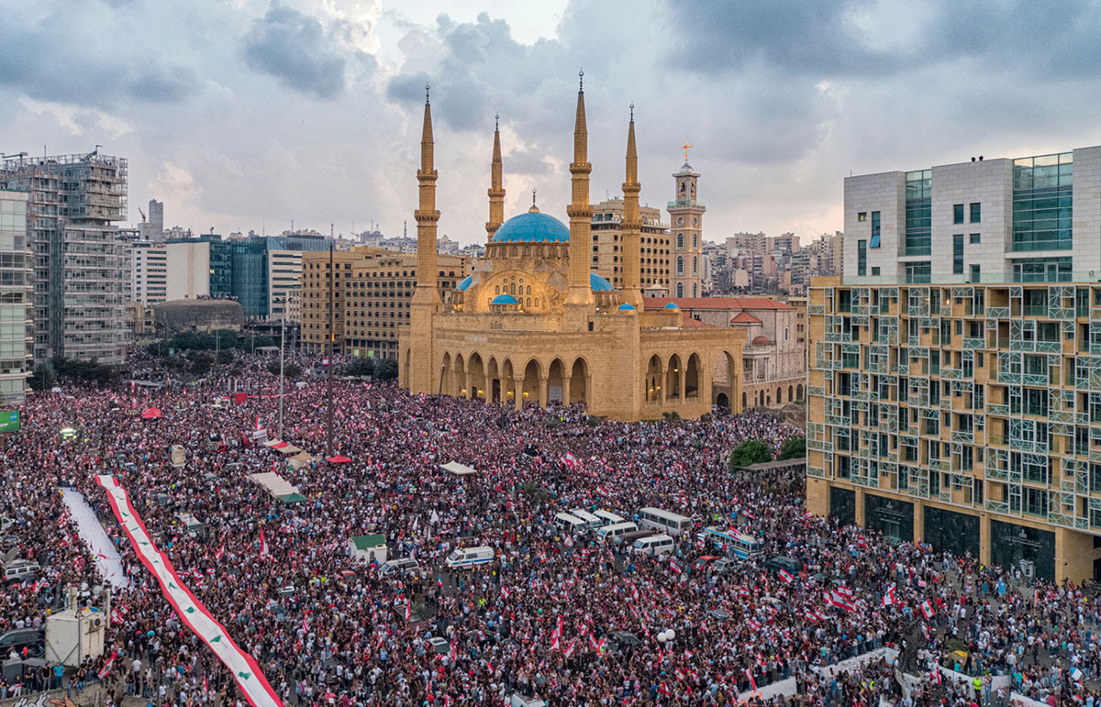
Just days after Lebanese were left reeling over the explosion in Beirut from a dangerous chemical that was stored at the dock for six years, thousands flooded the streets demanding the removal of Hezbollah from their government. (photo: shutterstock/diplomedia)
Notes:
https://myemail.constantcontact.com/Prayer-for-Lebanon-and-her-future.html?soid=1130986288219&aid=FaNme9vubzQ

Slide 107
Notes:
https://pulseofisrael.com/2020/04/22/lankford-jerusalem/

