Slide 1
e-handout
To have these notes
without taking notes
Go to OrHaOlam.com
Click on downloads,
messages, 2020

Slide 2
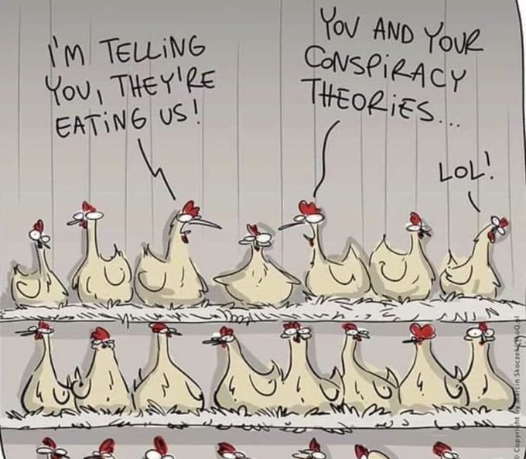

Slide 4
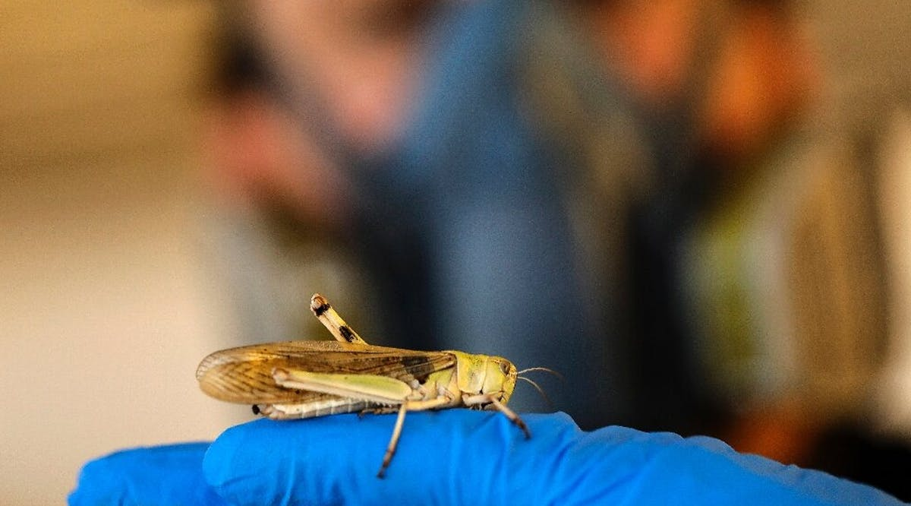
חַרְגּוֹל Khargol
Grasshopper / locust
Notes:
https://vfinews.com/en/news/august-7-2020/plague-to-protein-israeli-firm-puts-locusts-on-the
You have heard of the locust plague of “Biblical proportions” devastating East Africa and Central Asia: Kenya, Ethiopia, Uganda, Somalia, Eritrea, India, Pakistan, Iran, Yemen, Oman and Saudi Arabia.

Slide 5
At Hargol Foodtech's farm in the Israeli Golan Heights, a rectangular enclosure that once served as a chicken coop is filled with thousands of locusts, a grasshopper species that has a highly destructive swarming phase.
Notes:
https://vfinews.com/en/news/august-7-2020/plague-to-protein-israeli-firm-puts-locusts-on-the

Slide 6
Contained in a series of meticulously stacked, climate-controlled mesh cages, the insects are served wheatgrass through their three-month life-cycle, before being cooled, killed and baked.
Notes:
https://vfinews.com/en/news/august-7-2020/plague-to-protein-israeli-firm-puts-locusts-on-the

Slide 7
Hargol's chief executive Dror Tamir told AFP that he grew up hearing stories of how locusts destroyed the fields of his kibbutz in the 1950s. Yet the Yemenite Jews in the area did not view locusts as crop-ruining pests, but as an edible source of nutrients, Tamir recalled.
Notes:
https://vfinews.com/en/news/august-7-2020/plague-to-protein-israeli-firm-puts-locusts-on-the

Slide 8
Tamir said he founded Hargol—Hebrew for grasshopper—six and a half years ago after realizing the insects were the solution.
The company's goal is to be "the first in the world to grow grasshoppers on a commercial scale, and provide the world with a healthier and more sustainable source of protein." (INN / VFI News)
Notes:
https://vfinews.com/en/news/august-7-2020/plague-to-protein-israeli-firm-puts-locusts-on-the
If life gives you a lemon, make lemonade!

Slide 9
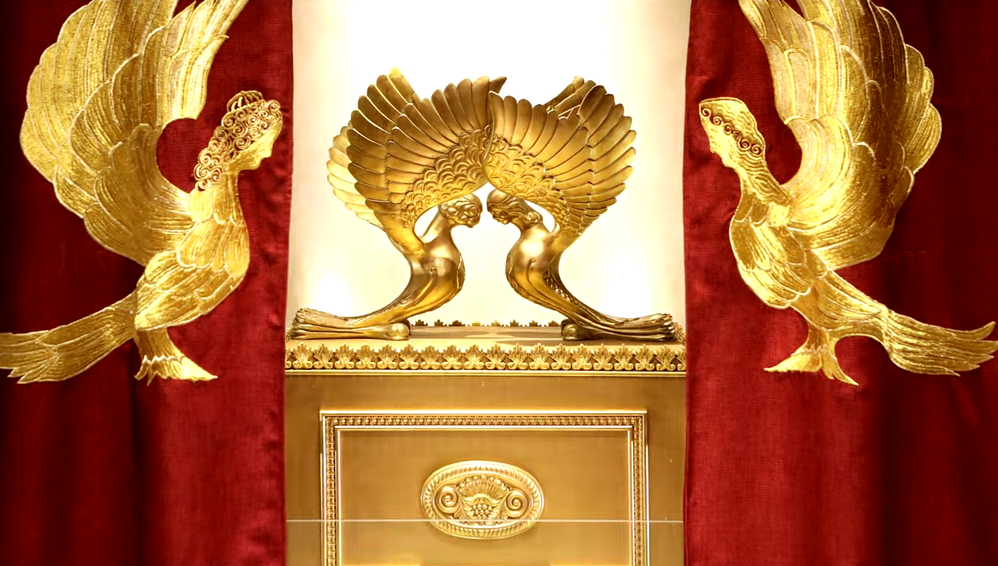
Letter to the Messianic Jews
[Hebrews] MJ 6.1-6.3
First Principles
Notes:
https://www.templeinstitute.org/new-location.htm

Slide 11
Immersion: radical commitment to Messiah and His holy ways.
We are a minority but not on the losing side!

Slide 12
^{MJ 6.1-3} Therefore, leaving behind the initial lessons about the Messiah, let us go on to maturity, not laying again the foundation of [Note six foundations]
₁turning from works that lead to death,
₂trusting God, and
Notes:
Six principles

Slide 13
^{MJ 6.1-3} and ₃instruction about washings, ₄s’mikhah, ₅the resurrection of the dead and ₆eternal punishment. And, God willing, this is what we will do.

Slide 14
The first of the first principles is repentance.
Notes:
Do you, do I, have the sense of life without Messiah, whoever noble it may appear, is wrought in the context of death: ego, lust, materialism.

Slide 15
Across Africa and Asia, millions of people in historically unengaged people groups are now in rapidly growing Disciple Making Movements. In 2000 there were 6 such movements, today there are now 1,035!
Notes:
https://www.christianpost.com/voices/christianity-is-growing-faster-than-any-time-in-history-why-is-the-church-in-europe-america-declining.html

Slide 16
What is it that the believers of the Global South are doing that makes so much difference?
1. Abundant, and Bold Prayer
2. Discipling to Conversion
3. Obedience-Based Discipleship
4. Empowering Ordinary People for Ministry
Notes:
https://www.christianpost.com/voices/christianity-is-growing-faster-than-any-time-in-history-why-is-the-church-in-europe-america-declining.html

Slide 17
5. Make Replicating Disciples, not Converts
6. Never Ending Leadership Training for All
Notes:
https://www.christianpost.com/voices/christianity-is-growing-faster-than-any-time-in-history-why-is-the-church-in-europe-america-declining.html

Slide 18
I have new strategy, I think a download from the Messiah, that we will train a cadre of mature believers to disciple newcomers to our community.

Slide 19
Repeat: The first of the first principles is total repentance: deny our self and following the Messiah. Commitment to discipleship.
The second is faith…

Slide 20
^{MJ 6.1} The foundation of ₁turning from works that lead to death, ₂trusting God
This is MUCH MORE than mental assent to truth.

Slide 21
^{Ro 8.15-17} For you did not receive a spirit of slavery to bring you back again into fear; on the contrary, you received the Spirit, who makes us sons and by whose power we cry out, “Abba!” (that is, “Dear Father!”).

Slide 22
^{Ro 8.15-17} The Spirit himself bears witness with our own spirits that we are children of God; and if we are children, then we are also heirs, heirs of God and joint-heirs with the Messiah — provided we are suffering with him in order also to be glorified with him.
Notes:
Do you have a 100% inner assurance that if you died now, and stood before G-d, you would be accepted?
On what basis?
Suffering is not extraneous, not surprising to the faith. Intrinsic. Love suffers long.

Slide 23
^{1 Kefa/P 1.8-9} Though you have not seen Him, you love Him. And even though you don’t see Him now, you trust Him and are filled with a joy that is glorious beyond words, receiving the outcome of your faith—the salvation of your souls.

Slide 24
Faith is also a decision to receive believe trust the revelation
Notes:
Eternal reward and punishment.

Slide 25
^{Acts 27.23-26} So, men, take heart! For I trust God and believe that what I have been told will come true. Nevertheless, we have to run aground on some island.”
Shaul/Paul made a choice.
14 days fasting, 276 people on the ship
Notes:
Choosing to believe that eternal truths are more real than visual ones!
Next foundation….

Slide 27
^{MJ 6.1-3} and ₃instruction about washings
Notes:
Note plural

Slide 28
Note plural

Slide 29
Many washings, immersions in Tanakh.

Slide 30
^{Vayikra/Lev 14.2,8} “This is to be the law concerning the person afflicted with tzara‘at on the day of his purification. He is to be brought to the cohen… He who is to be purified must wash his clothes, shave off all his hair and bathe himself in water. Then he will be clean; and after that, he may enter the camp;

Slide 31
^{Vayikra /Lev 15. 2, 5} ‘When any man has a discharge from his body, the discharge is unclean… Whoever touches his bed is to wash his clothes and bathe himself in water; he will be unclean until evening.

Slide 32
^{Vayikra/Lev 15:8} If the person with the discharge spits on someone who is clean, the latter is to wash his clothes and bathe himself in water; he will be unclean until evening.

Slide 33
^{Vayikra/Lev 16.23-24} “Aharon is to go back into the tent of meeting, where he is to remove the linen garments he put on when he entered the Holy Place, and he is to leave them there. Then he is to bathe his body in water in a holy place, put on his other clothes,
Notes:
Part of the Yom Kippur ceremony

Slide 34
^{Vayikra/Lev 16.23-24} come out and offer his burnt offering and the burnt offering of the people, thus making atonement for himself and for the people

Slide 35
^{Vayikra/Lev 17.15} “Anyone eating an animal that dies naturally or is torn to death by wild animals, whether he is a citizen or a foreigner, is to wash his clothes and bathe himself in water; he will be unclean until evening; then he will be clean.

Slide 36
^{Vayikra/Lev 22.4-6}“‘Any descendant of Aharon with tzara‘at or a discharge is not to eat the holy things until he is clean. Anyone who has touched a person made unclean by a dead body, or who has had a seminal emission,

Slide 37
^{Vayikra/Lev 22.4-6}“‘ or who has touched a reptile or insect that can make him unclean…will be unclean until evening and is not to eat the holy things unless he bathes his body in water.

Slide 38
^{1 Shmuel 20.25-26} The king sat at his usual place by the wall. Y’honatan stood up, and Avner sat next to Sha’ul, but David’s place was empty. However, Sha’ul didn’t say anything that day; because he thought, “Something has happened to him, he is unclean. Yes, that’s it, he isn’t clean.

Slide 39
After the destruction of the Temple, the mikveh's main uses remained as follows:
by Jewish women to achieve ritual purity after menstruation and childbirth
by Jewish men to achieve ritual purity after ejaculation;
Notes:
https://en.wikipedia.org/wiki/Mikveh#:~:text=Mikveh%20or%20mikvah%20(Hebrew%3A%20%D7%9E%D6%B4%D7%A7%D6%B0%D7%95%D6%B6%D7%94,Judaism%20to%20achieve%20ritual%20purity.

Slide 40
as part of the traditional procedure for conversion to Judaism;
to immerse newly acquired metal and glass utensils used in serving and eating food;
to immerse a corpse as part of the preparation for burial (taharah).
Notes:
https://en.wikipedia.org/wiki/Mikveh#:~:text=Mikveh%20or%20mikvah%20(Hebrew%3A%20%D7%9E%D6%B4%D7%A7%D6%B0%D7%95%D6%B6%D7%94,Judaism%20to%20achieve%20ritual%20purity.

Slide 41
Immersion place: מִקְוֶה mikveh
The verb of immersion: טָבַל taval
The noun has become a verb in common speech.
“I was mikeved.”
Same root as HOPE, Hatikvah.

Slide 42
^{Jeremiah 17:13} O Hashem, the Hope [mikveh] of Israel, all who forsake you will be ashamed... because they have forsaken Hashem, the fountain of living water.
מִקְוֵה יִשְׂרָאֵל יְיָ, כָּל-עֹזְבֶיךָ יֵבֹשׁוּ; וְסוּרַי בָּאָרֶץ יִכָּתֵבוּ, כִּי עָזְבוּ מְקוֹר מַיִם-חַיִּים אֶת-יְיָ.

Slide 43
^{Jeremiah 14:22} Are there any of the worthless idols of the nations, that can cause rain? or can the heavens give showers? Is it not you, Hashem our God, and do we not hope [nekaveh] in you? For you have made all these things.

Slide 44
New dimension in Messiah, starting with Yokhanan/ John the Immerser [Baptist]
Notes:
Not a Baptist, really John the Jew.

Slide 45
^{Mark 1. 4-5} Yokhanan/John the Immerser appeared in the desert, proclaiming an immersion involving turning to God from sin in order to be forgiven. People went out to him from all over Y’hudah, as did all the inhabitants of Yerushalayim. Confessing their sins, they were immersed by him in the Yarden River.
Notes:
Whole new definition

Slide 46
^{Acts 2.37-38} Now when they heard this, they were cut to the heart and said to Kefa/Peter and the rest of the emissaries, “Fellow brethren, what shall we do?” Peter said to them, “Repent, and let each of you be immersed in the name of Messiah Yeshua for the removal of your sins, and you will receive the gift of the Ruach ha-Kodesh.

Slide 47
^{Ro 6.3-4} Or do you not know that all of us who were immersed into Messiah Yeshua were immersed into His death? Therefore we were buried together with Him through immersion into death—in order that just as Messiah was raised from the dead by the glory of the Father, so we too might walk in newness of life.

Slide 48
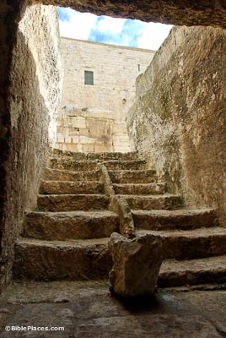
Southern Temple Mount Excavations
Notes:
https://www.bibleplaces.com/wp-content/uploads/2015/07/Mikveh-west-of-Robinsons-arch-tb123109378-bibleplaces.jpg
Archaeologists can identify an Jewish city in ruins by the mikveh

Slide 49
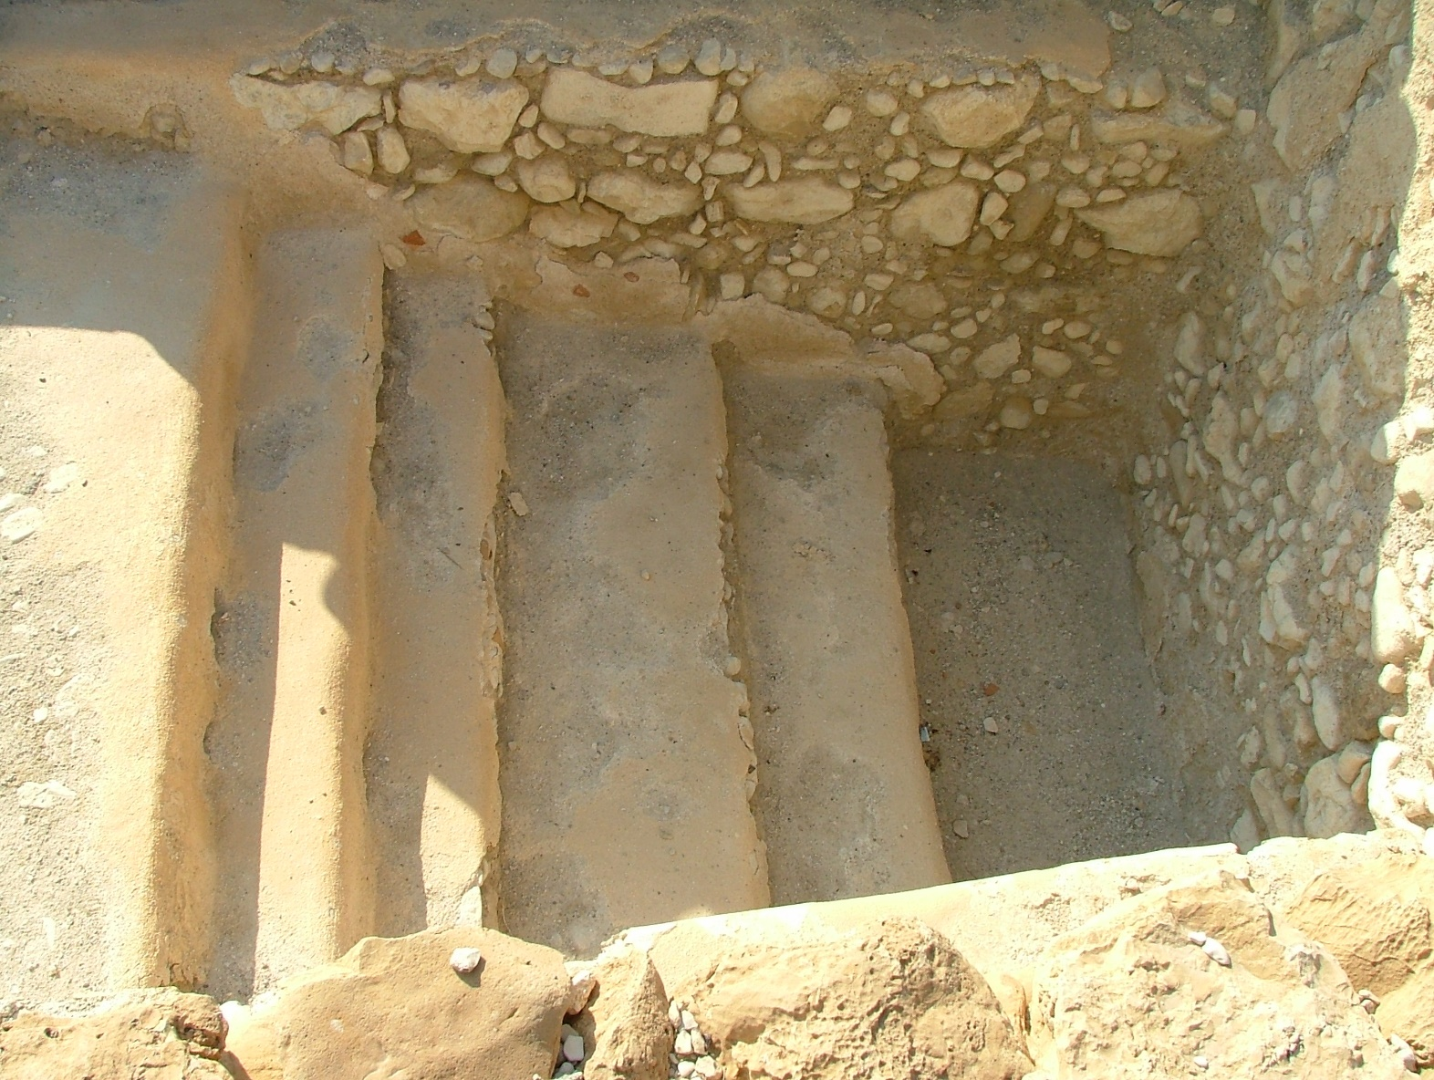
Mikveh at Qumran
Notes:
Wikimedia Commons
File:Qumran Mikveh 01.jpg - Wikimedia Commons
Essenese immersed themselves daily. But only after a year of learning the discipline of the life of an Essene.

Slide 50
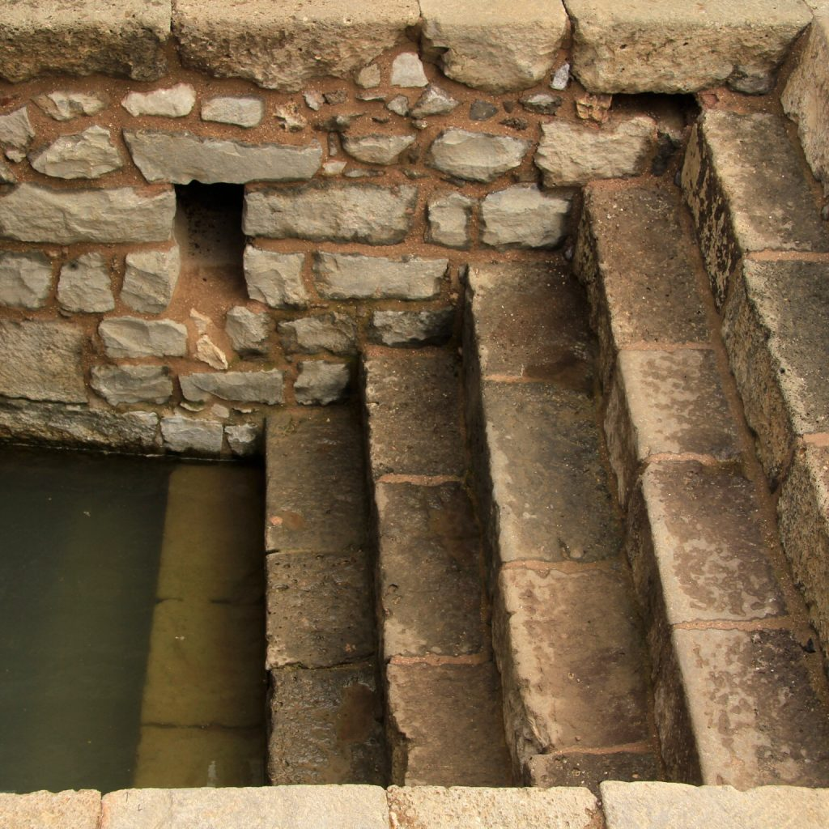
Mikvah at Magdala, Galil on the shore of Lake Kinneret
Notes:
Magdala Mikveh –
https://www.magdala.org/wp-content/uploads/2018/10/004-A-Mikveh-1024x1024.jpg

Slide 51
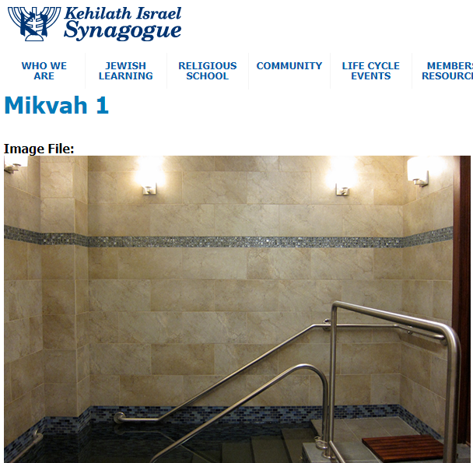
The Kansas City Community Mikvah is located at Kehilath Israel Synagogue, 10501 Conser St., Overland Park
Notes:
run by the Kansas Mikvah Association. Note the tile: Jerusalem Stone!

Slide 52
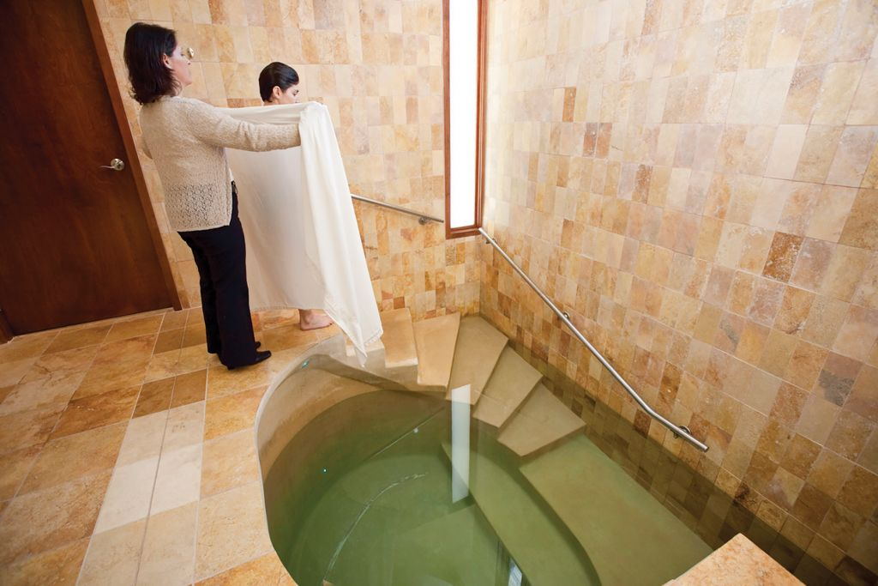
Modern Mikveh
Notes:
https://www.google.com/url?sa=i&url=https%3A%2F%2Fjewishweek.timesofisrael.com%2Fmikveh-can-solve-conversion-problem%2F&psig=AOvVaw2OmTiwUsAO6B85zbyDMBek&ust=1599944423326000&source=images&cd=vfe&ved=0CAIQjRxqFwoTCICS3M__4esCFQAAAAAdAAAAABAD

Slide 53
Conclusion: Immersion is a bold and serious statement of commitment to the spiritual immersion into the life, death, and resurrection of Yeshua, the Messiah King of Israel and Redeemer of all Nations.

Slide 54
To a Jewish family, the immersion of a child was equivalent to his death. Sometimes Kaddish said.
How is it done?

Slide 55
Many customs and rabbinical ordinances.
Fresh water, or running water, or rainwater
Three times.
Total contact with water.
Notes:
Among the Orthodox, totally naked. We don’t require that!

Slide 56
Didache
was a first century document describing life in Messiah for new Gentile believers.
Quoted in other church father documents, but lost
1873 discovered in a Constantinople library

Slide 57
1. Concerning immersion, immerse thus: Having first rehearsed all these things, immerse in the Name of the Father and of the Son and of the Holy Spirit, in living water;
2. But if you have no living water, immerse in other water, and if you can not in cold, then in warm.
Notes:
http://www.thedidache.com/

Slide 58
3. But if you have neither, pour water three times on the head "in the Name of the Father, Son and Holy Spirit.
4. And before the immersion let the one performing and him who is to be immersed fast, and any others who are able. And you shall bid him who is to be immersed to fast one or two days before.
Notes:
http://www.thedidache.com/

Slide 59
בָּרוּךְ אַתָּה יְיָ, אֶלהֵנוּ מֶלֶךְ הָעוֹלָם, אֲשֶׁר קִדְשָׁנוּ בְּמִצְווֹתָיו, וְצִוָּנוּ עַל הַטְּבִילָה.
Ba-rukh A-tah A-do-ni, E-lo-hay-noo Me-lekh ha-o-lam, a-sher keed-sha-nu b'mitz-vo-tav, v'tsee-va-nu al ha-t'vee-lah.

Slide 60
Blessed are You, Adoni our G-d, king of the Universe, Who sanctifies us with His commandments, and has commanded us concerning the immersion.

Slide 61
אֲנִי מַאֲמִין בְּאַב, וּבְבֵן, וּבְרוּחַ הַקּדֶשׁ.
Anee ma-a-meen b'av, oo-veh-bayn, u’v-roo-akh ha-ko-desh
I believe in the Father, and the Son, and the Holy Spirit.

Slide 62
A brief exclamation of testimony and praise!

Slide 63
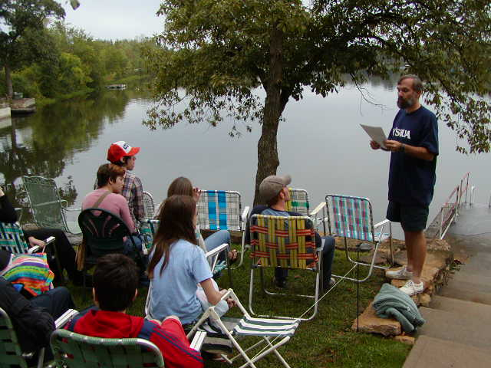
Sept 21, 2003

Slide 64
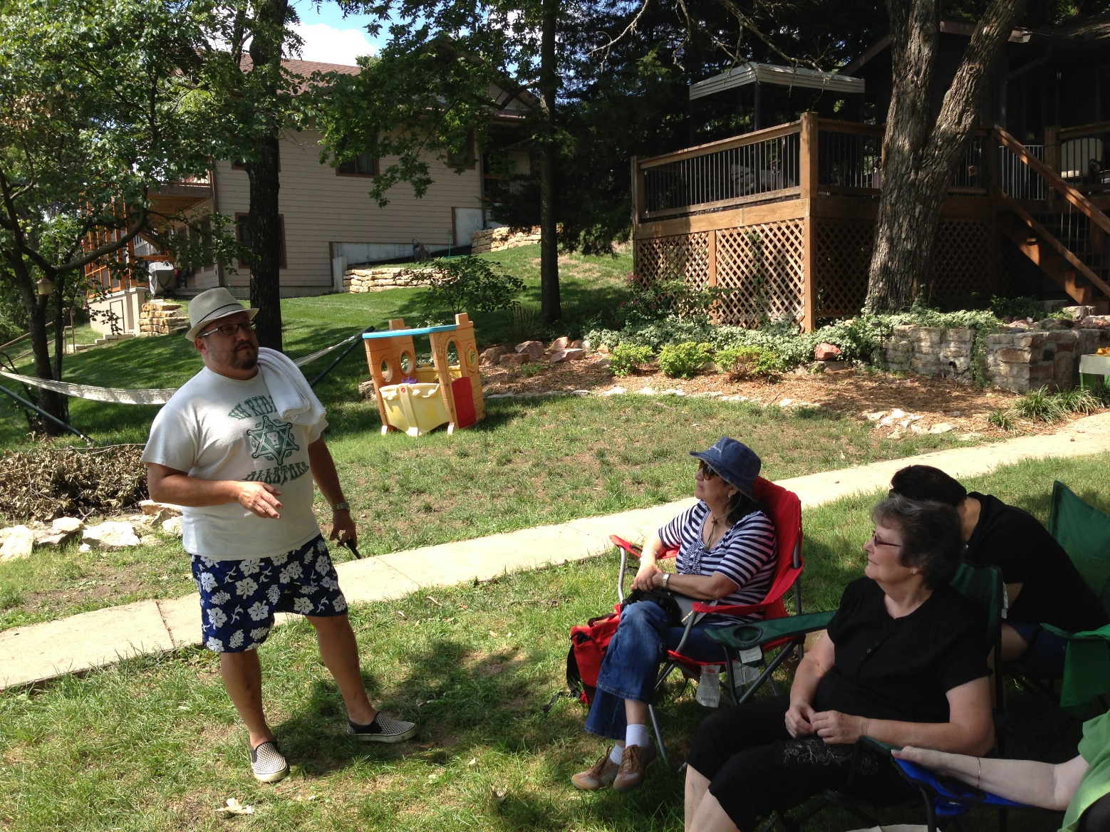
Pedro Castillo
2013

Slide 65
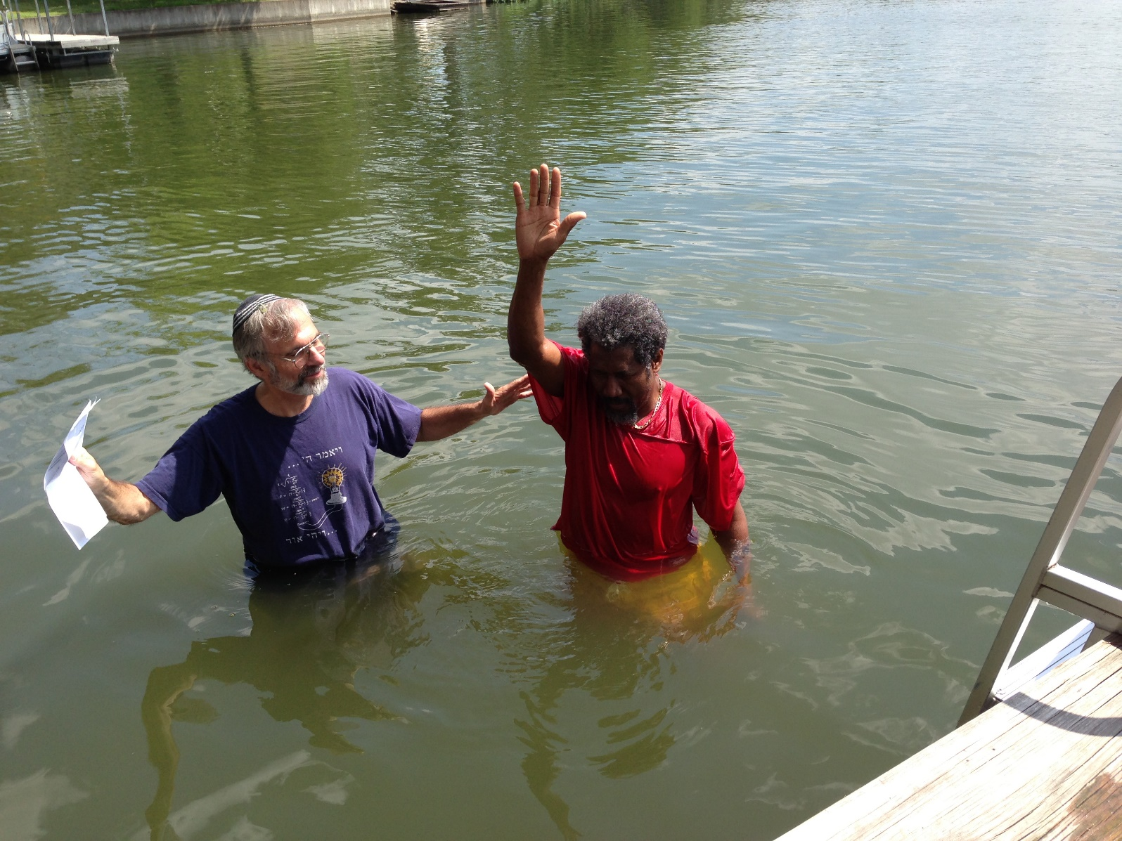
Ven Lamarre

Slide 66
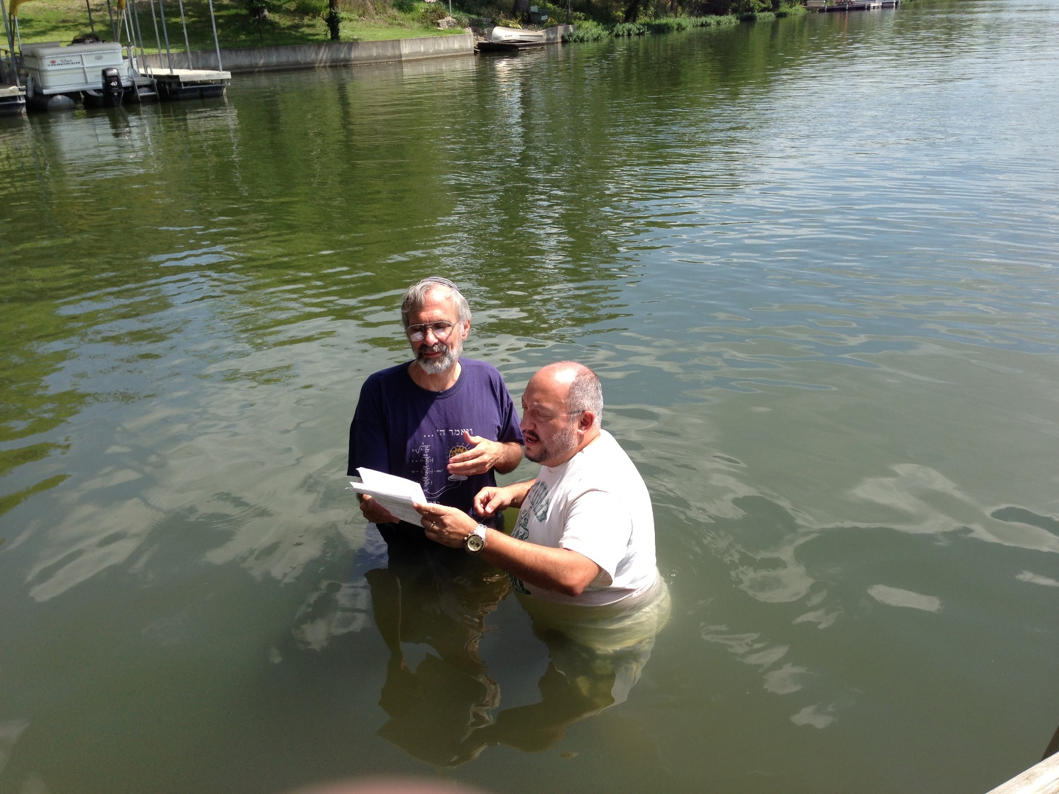
Pedro Castillo

Slide 67
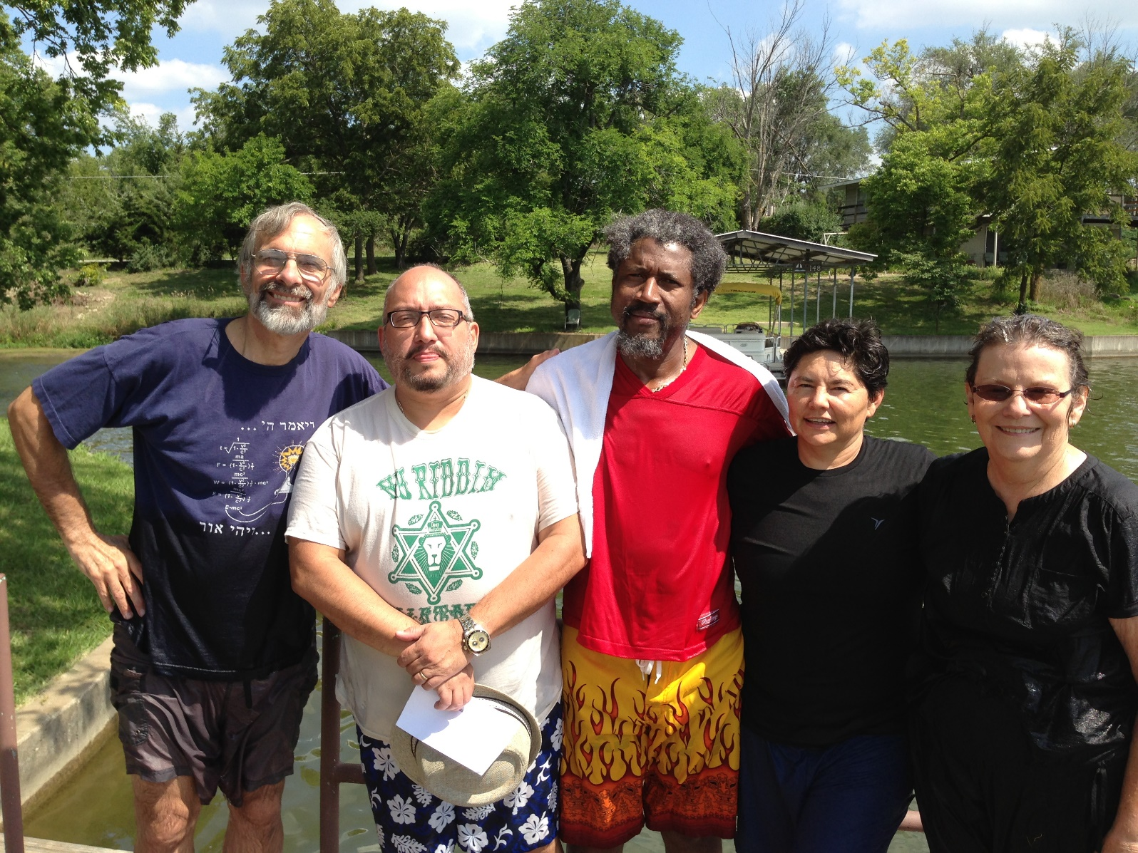
Pam Allen, Norma, Ven LaMarre,
Pedro Castillo

Slide 68
Tomorrow, 2:30 p.m., Gardner Lake, address in bulletin.
Following repentance and commitment to discipleship, faith in Messiah → assurance of salvation
Notes:
Essenes one year of instruction and commitment

Slide 70
Dr. Dobson: Our American culture has sought to deconstruct families and marriages through the media, through the sexual revolution, and even through law and policy. Consider these examples: In 1969, Congress foolishly created the Marriage Penalty Tax, requiring husbands and wives to pay higher taxes than cohabitating couples.
Notes:
https://familytalk.widen.net/s/qpd9pqoq8w

Slide 71
Or consider the media. Marriage and monogamy are mocked in music, television shows, and movies. Those who hold to any semblance of sexual ethics are ridiculed or dismissed as “old fashioned” and “prudish.”
Notes:
https://familytalk.widen.net/s/qpd9pqoq8w

Slide 72
Not only are the liberal media outlets bashing biblical masculinity and femininity, now the Hallmark channel is promoting movies that celebrate same-sex weddings.
Notes:
https://familytalk.widen.net/s/qpd9pqoq8w

Slide 73
Others are not just content to disincentivize or ridicule marriage and family—they aim to destroy it. In 2012, Marsha Gessen, a lesbian journalist, activist and author, stated during an interview with ABC Radio, “[I]t’s a no-brainer that the institution of marriage should not exist . . .”
Notes:
https://familytalk.widen.net/s/qpd9pqoq8w

Slide 74
Only six percent of the country has a biblical worldview, down from 12 percent 25 years ago. What's more, 58 percent of adults (including 23 percent of Christians) believe that moral truth is up to the individual to decide.
Notes:
https://www.frcaction.org/get.cfm?i=WA20I20&f=WU20I03

Slide 75
So what can we as committed believers do to influence America when we only make up six percent of the population? It turns out we can do a lot. As we've seen across human history, God only needs a committed remnant to change the world.
Notes:
https://www.frcaction.org/get.cfm?i=WA20I20&f=WU20I03

Slide 76
Psalm 31:2 – Be to me a rock of strength, a stronghold to save me.
Most adult Americans will remember where they were the morning of September 11, 2001. As horrific as the terrorist attacks were, they could have been much worse except for a heroic group of everyday people who were aboard Flight 93.

Slide 77
That flight, like others before it, had been taken over by hijackers whose aim was to “crash this airliner into symbols of the American Republic, the Capitol or the White House,” according to the 9/11 Commission. But those brave individuals decided to fight back against their hijackers. They sacrificed their lives but prevented an even greater blow to the nation than the two aircraft that struck the World Trade Center and the one that slammed into the Pentagon.

Slide 78
The cry of “Let’s Roll” was underpinned by their prior recitation together of The Lord’s Prayer. United Airlines Flight 93 crashed, upside down, at 563 miles an hour, outside the small town of Shanksville, Pennsylvania, just 20 minutes flying time from the nation’s capital, because those passengers held onto the strength of the Lord and did not panic.

Slide 79
Immersion: radical commitment to Messiah and His holy ways.
We are a minority but not on the losing side!

Slide 80
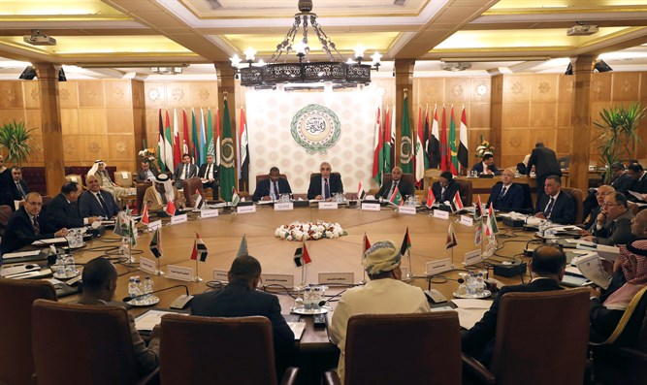
Permanent representatives of the Arab League take part in an emergency meeting

Slide 81
The Arab League on Wednesday failed to pass a resolution proposed by the Palestinian Authority (PA) which would have condemned the normalization deal between Israel and the United Arab Emirates, Times of Israel reports.
Notes:
https://www.israelnationalnews.com/News/News.aspx/286978

Slide 82
^{Y’khezkek / Ezk 37.5-6} Paras, Ethiopia and Put are with them, all with breastplates and helmets; Gomer with all its troops; the house of Togarmah in the far reaches of the north,
Notes:
Persia/Iran, Ethiopia, Libya, Germany, Turkey.

Slide 83
To begin with, some numbers: In France, around 15,000 Muslims convert annually to Christianity, according to a 2007 estimate. About 100,000 American Muslims abandon Islam each year, reports a 2017 Pew Research Center survey. This amounts to 24 percent of all Muslims in the United States, with Iranians disproportionately represented. These numbers roughly counterbalance those of non-Muslims converting to Islam.
Notes:
Copyright © 2020 Daniel Pipes, All rights reserved.

Slide 84
Reasons for leaving Islam vary: Pew finds 25 percent of American ex-Muslims have general issues with religion, 19 percent with Islam in particular, 16 percent prefer another religion, and 14 percent cite reasons of personal growth. Slightly more than half of those leaving (55 percent) abandon religion entirely and slightly less than a quarter (22 percent) convert to Christianity.
That’s 22,000 / year!
Notes:
Copyright © 2020 Daniel Pipes, All rights reserved.

Slide 85
PRAY WITH US…
In thanksgiving for God’s preservation of and mercy toward the United States.
For Americans to turn to the Lord and seek Him earnestly.
For courage for those in government to stand against all enemies, foreign and domestic.

Slide 86
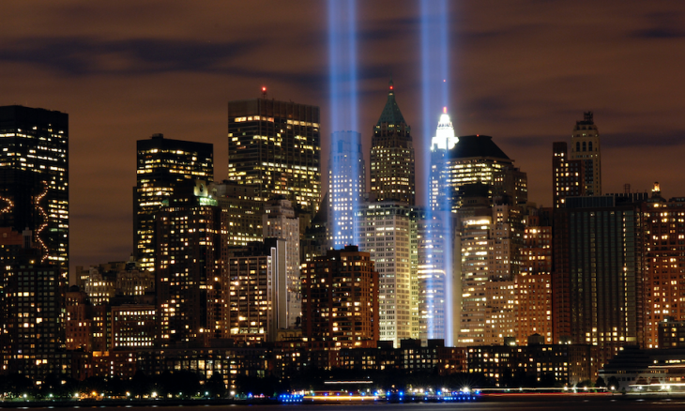

Slide 87
The Return will prominently feature the Messianic Movement - with people like Paul Wilbur – Marty Goetz – Michael Brown – Rivkah Whitten – and more.
There will be key times during The Return on the National Mall that I would love you who can make it to the National Mall – to join with me - I’ll be doing a number of Hebrew blessings – During that time I’ll call for Messianic Rabbis and leaders to gather around the stage area and bless the multitudes with me.

Slide 88
Do you remember the point of the 40 Day Fast two summers ago. Lou Engle said that it was time for the Jews to rise into leadership in the Body of Messiah? Initiated by 40 day fast! Reinforced this month!

Slide 89
Prayer points:
Have I truly repented of sin and the spirit of the world?
Do I have faith in Messiah?
Am I dead to self, and raised with Him?

