Slide 1
e-handout
To have these notes
without taking notes
Go to OrHaOlam.com
Click on downloads,
messages, 2020

Slide 2
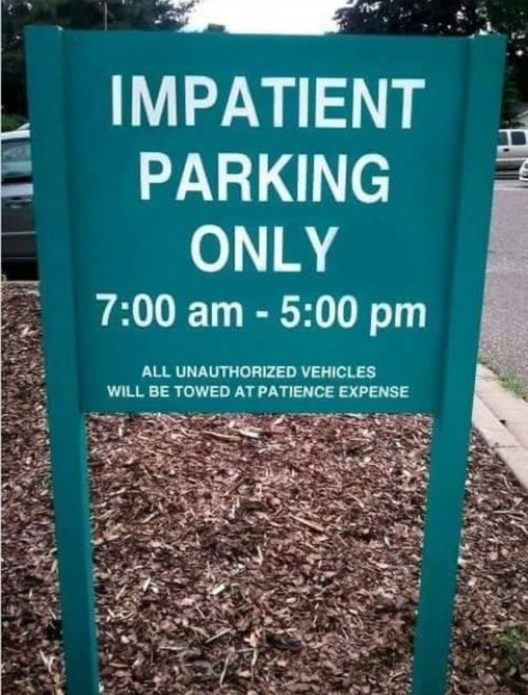
Notes:
Jai Cohen

Slide 3
Michael Brown writes the following: Michael Luo's article in The New Yorker…is entitled “American Christianity's White-Supremacy Problem,” and it raises some very serious concerns. What did Luo get right and what did he get wrong?
Notes:
https://www.charismanews.com/opinion/in-the-line-of-fire/82688-what-the-new-yorker-got-right-and-wrong-about-racism-in-the-white-american-church?utm_source=In%20the%20Line%20of%20Fire&utm_medium=email&utm_content=subscriber_id:5194514&utm_campaign=Blogger%20-%20Michael%20Brown%20-%202020-09-22

Slide 4
Luo begins his article with a disturbing anecdote from the life of Frederick Douglass while still a slave.
Notes:
https://www.charismanews.com/opinion/in-the-line-of-fire/82688-what-the-new-yorker-got-right-and-wrong-about-racism-in-the-white-american-church?utm_source=In%20the%20Line%20of%20Fire&utm_medium=email&utm_content=subscriber_id:5194514&utm_campaign=Blogger%20-%20Michael%20Brown%20-%202020-09-22

Slide 5
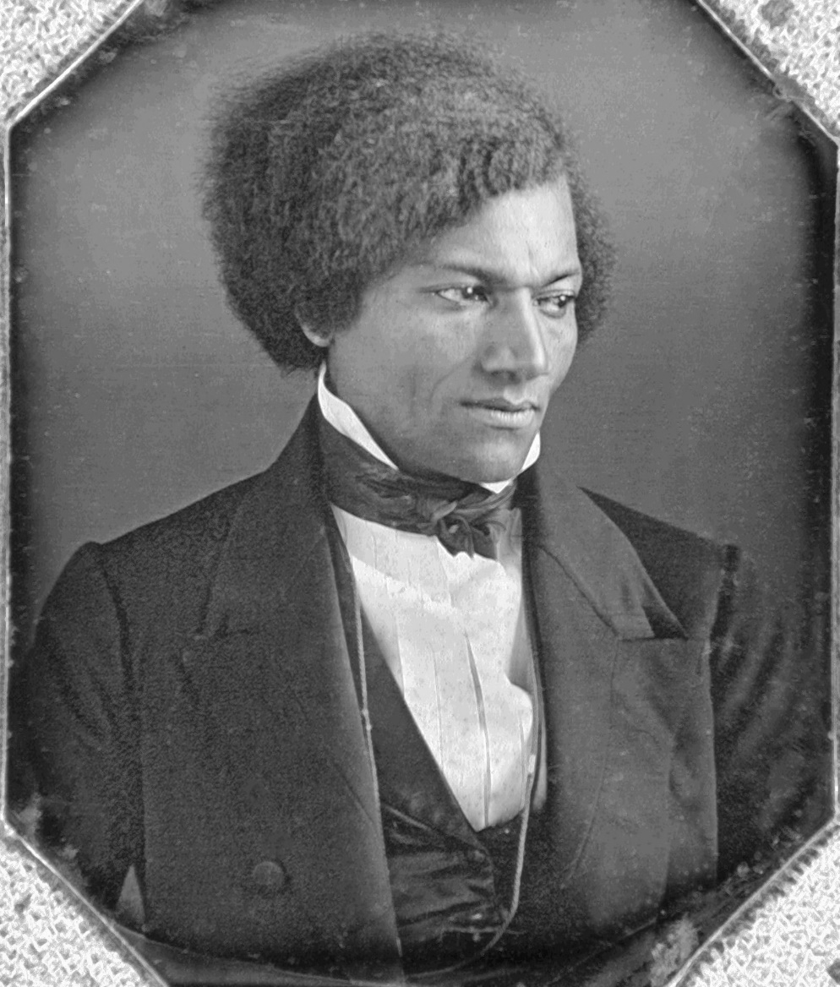
Frederick Douglass 1818 –1895 was an American social reformer, abolitionist, orator, writer, and statesman. After escaping from slavery in Maryland, he became a national leader of the abolitionist movement in Massachusetts and New York, becoming famous for his oratory. A strong Christian.

Slide 6
When his master became a Christian, rather than making him "more kind and humane," as Douglass had hoped, the reverse was true. Douglass wrote, "If it had any effect on his character, it made him more cruel and hateful in all his ways."
Notes:
https://www.charismanews.com/opinion/in-the-line-of-fire/82688-what-the-new-yorker-got-right-and-wrong-about-racism-in-the-white-american-church?utm_source=In%20the%20Line%20of%20Fire&utm_medium=email&utm_content=subscriber_id:5194514&utm_campaign=Blogger%20-%20Michael%20Brown%20-%202020-09-22

Slide 7
Worse still, Douglass’ master justified his cruel behavior with verses from the Bible, making his Christian profession all the more abhorrent.
Repented?
Blindness?
Notes:
https://www.charismanews.com/opinion/in-the-line-of-fire/82688-what-the-new-yorker-got-right-and-wrong-about-racism-in-the-white-american-church?utm_source=In%20the%20Line%20of%20Fire&utm_medium=email&utm_content=subscriber_id:5194514&utm_campaign=Blogger%20-%20Michael%20Brown%20-%202020-09-22

Slide 8
Luo faults abolitionists like Charles Finney in the 1800s and anti-segregationists like Billy Graham in the 1900s for putting soul winning ahead of fighting racism.
Partially right?
Notes:
https://www.charismanews.com/opinion/in-the-line-of-fire/82688-what-the-new-yorker-got-right-and-wrong-about-racism-in-the-white-american-church?utm_source=In%20the%20Line%20of%20Fire&utm_medium=email&utm_content=subscriber_id:5194514&utm_campaign=Blogger%20-%20Michael%20Brown%20-%202020-09-22

Slide 9
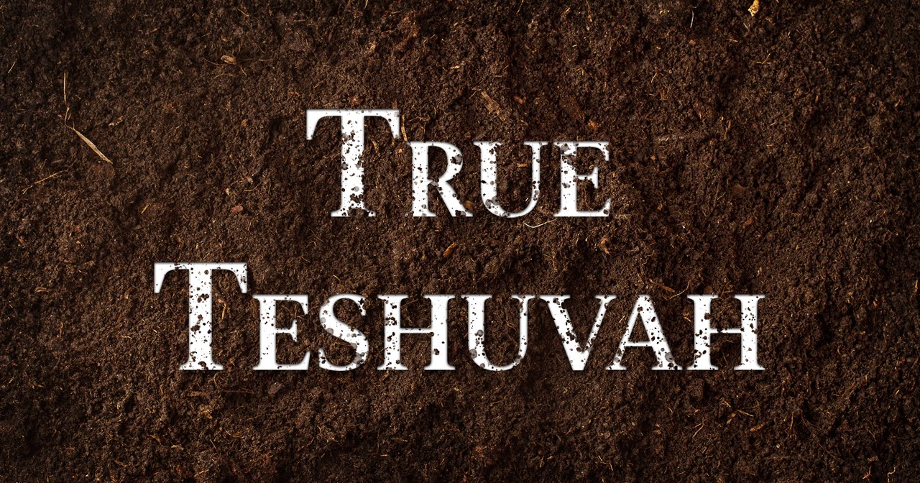
Notes:
It digs into the dirt!

Slide 10
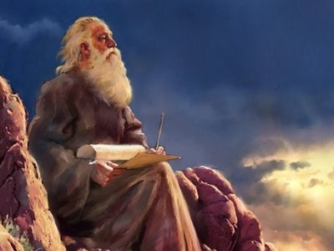
Yesha’yahu יְשַׁעְיָהוּ
(Isaiah) 57:14-15

Slide 11
Yesha’yahu (Isaiah) 57:14 (CJB)
ג כִּי שֵׁם יְהוָה אֶקְרָא ס הָבוּ גֹדֶל לֵאלֹהֵינוּ׃
וְאָמַ֥ר סֹֽלּוּ־סֹ֖לּוּ פַּנּוּ־דָ֑רֶךְ הָרִ֥ימוּ מִכְשׁ֖וֹל מִדֶּ֥רֶךְ עַמִּֽי׃
Then he will say, “Keep building! Keep building! Clear the way! Remove everything blocking my people’s path!”
Notes:
Repentance doesn’t stop.

Slide 12
Yesha’yahu (Isaiah) 57:15 (CJB)
ג כִּי שֵׁם יְהוָה אֶקְרָא ס הָבוּ גֹדֶל לֵאלֹהֵינוּ׃
כִּי֩ כֹ֨ה אָמַ֜ר רָ֣ם וְנִשָּׂ֗א שֹׁכֵ֥ן עַד֙ וְקָד֣וֹשׁ שְׁמ֔וֹ מָר֥וֹם וְקָד֖וֹשׁ אֶשְׁכּ֑וֹן
For thus says the High, Exalted One who lives forever, whose name is Holy: “I live in the high and holy place

Slide 13
Yesha’yahu (Isaiah) 57:15 (CJB)
ג כִּי שֵׁם יְהוָה אֶקְרָא ס הָבוּ גֹדֶל לֵאלֹהֵינוּ׃
וְאֶת־דַּכָּא֙ וּשְׁפַל־ר֔וּחַ לְהַחֲיוֹת֙ ר֣וּחַ שְׁפָלִ֔ים וּֽלְהַחֲי֖וֹת לֵ֥ב נִדְכָּאִֽים׃
but also with the broken and humble, in order to revive the spirit of the humble and revive the hearts of the broken ones.”
Notes:
Why was this picked by the ancient rabbis as a YK Haftorah? Because is shows the true nature of repentance.
How to get broken and humble spirit?

Slide 14
^{Yoel 2.12-13} “Yet even now” —it is a declaration of Adoni — “turn to Me with all your heart, with fasting, weeping and lamenting.” Rend your heart, not your garments, and turn to Adoni, your God. For He is gracious and compassionate, slow to anger, abundant in mercy,
and relenting about the calamity due.
Notes:
What is this exactly?

Slide 15
Notes:
It digs into the dirt!

Slide 16
^{Lam 5.21} Bring us back to You, Adoni,
and we will return.
Renew our days as of old.
הֲשִׁיבֵנוּ יְיָ אֵלֶיךָ וְנָשׁוּבָה, חַדֵּשׁ יָמֵינוּ כְּקֶדֶם.
Hashivenu Adoni Alekha, v’nashuva! Khadesh yamenu k’kedem!
Notes:
Causative verb form Hashivenu
Passive verb form v’nashuva

Slide 17
^{2 Tim 2.25-26} Also he should be gentle as he corrects his opponents. For God may perhaps grant them the opportunity [power] to turn from their sins, acquire full knowledge of the truth, come to their senses and escape the trap of the Adversary, after having been captured alive by him to do his will.
Notes:
We need G-d’s help, intervention, to truly repent. Do true teshuvah.

Slide 18
^{Song 1.4} “Take me with you. We will run after you.” The king has brought me into his rooms.
[Chorus] We will be glad and rejoice for you. We will praise your love more than wine. How right it is for them to love you!
Notes:
Draw me…asking the Lord to enlarge our spiritual hunger,

Slide 19
^{Mtt. 5.12-14} Forgive us what we have done wrong, as we too have forgiven those who have wronged us...For if you forgive others their offenses, your heavenly Father will also forgive you; but if you do not forgive others their offenses, your heavenly Father will not forgive yours.
Notes:
Sensing His forgiving love is the GREATEST cosmic, celestial, heavenly ecstasy that there IS!!
Heart of Sozo ministry. 1.5 hours of intense, detailed forgiving → great release.
In Yeshua’s Name, for His sake. Encounter your own unforgiveness → bitterness
Pause and do

Slide 20
^{1 Yn 1.7} But if we walk in the light as He Himself is in the light, we have fellowship with one another and the blood of His Son Yeshua purifies us from all sin.
Notes:
Confess, apologize to anyone you have wronged. Pause. Reciprocal of previous.
I know what it is to humble myself relative to people. For example, in discussing the sinful ways of the Chinese, I realize I should have said Chinese Communists, or CCP. I honor Chinese. Story of Chinese and Jewish guy…”Where Jews eat?”

Slide 21
Song of Songs
Divine progression

Slide 22
^{Song 2.16a} My beloved is mine, and I am his! דּוֹדִי לִי וַאֲנִי לוֹ
^{Song 6.3a} I am my beloved’s and my beloved is mine. אֲנִי לְדוֹדִי וְדוֹדִי לִי
^{Song 7.10} I am my beloved’s, and his desire is for me.
אֲנִי לְדוֹדִי, וְעָלַי תְּשׁוּקָתוֹ.
Notes:
^{Song 2.16a} her self-importance, her own benefit, obtains
^{Song 6.3a} puts him first
^{Song 7.10} for his own purposes

Slide 23
^{Phil 3.10} Yes, I gave it all up in order to know him, that is, to know the power of his resurrection and the fellowship of his sufferings as I am being conformed to his death,
Notes:
On bad idea!

Slide 24
^{Ro. 8.17} If we are children, then we are also heirs, heirs of God and joint-heirs with the Messiah — provided we are suffering with him in order also to be glorified with him.
Notes:
Preparation for rulership. Destined for the Throne.

Slide 25
^{Rev. 2.26-27a} To him who wins the victory and does what I want until the goal is reached, I will give him authority over the nations; he will rule them with a staff of iron
Notes:
Rule with Him if we have fully and unconditionally submitted ourselves to Him

Slide 26
^{Rev. 5.10} You made them into a kingdom for God to rule, cohanim to serve him; and they will rule over the earth.”
Notes:
Rule with Him if we have fully and unconditionally submitted ourselves to Him, serve as priests over sacrifice…of ourselves.

Slide 27
^{Iyov/Job 13.15} Even if He slays me, I will wait for Him. הֵן יִקְטְלֵנִי לוֹ אֲיַחֵל;
קָטַל katal to kill, to exterminate, to destroy; to criticize
יִחֵל yikhel hope for, to await, to look forward to

Slide 28
^{Song 3.1} On my bed in the night I longed for the one my soul loves. I looked for him but did not find him.
Notes:
The L-rd withdraws His felt presence. Ps 22

Slide 29
MoR 2016 anxieties
Luncheon at Brios only IHOP, Messianics, Dramatic Truth and one other there. Not the pastor’s outreach envisioned. Many $$!
Major pastoral network zero response, both to leadership presentation and to breakfast

Slide 30
Or HaOlam service only a few went forward to stand with us in prayer!! Amy Stewart came. She was worth it.
IHOP Thursday service just a pittance
Paseo Baptist smaller enrollment than expected.

Slide 31
Or Ha eviction notice
Or Ha worst deficits
Ticket sales SLOW.
Dream of empty ballroom plus one other doomsayer.

Slide 32
Ad rejected from Jewish Chronicle
Forgot KC Star advertising.
Music for string quartet tedious and tentative to put together.
Looked like huge financial bust, and Or HaOlam homeless, broke!
Notes:
Woke up 4 a.m. Decided to TRUST. Faith. Could sleep.
Series of miracles!!

Slide 33
^{1 Yn 1.7} But if we walk in the light as He Himself is in the light, we have fellowship with one another and the blood of His Son Yeshua purifies us from all sin.

Slide 34
The wrong way to seek G-d

Slide 35
^{1 Kings 18.26-29} So they took the bull that he gave them, prepared it, and called on the name of Baal from morning till noon, crying, “O Baal, answer us!” But there was no voice—no one was answering. They also danced leaping around the altar that was made.

Slide 36
^{1 Kings 18.26-29} Now when it was about noon…they shouted even louder and cut themselves with swords and spears, as was their custom, until the blood gushed over them. When midday was past, they kept prophesying ecstatically until the time of offering up the evening sacrifice. But there was no voice, no one answering, no one paying attention.
Notes:
But, we never do anything weird like that! Well..

Slide 37
Kundalini is a term you may or may not be familiar with- It is a demonic spirit which is known as a counterfeit Holy Spirit from the Hindus & incorporated into new age philopsophy & practice… under the influence of this demonic spirit people will testify to having “deep spiritual sensations”
Notes:
https://rooftopsandrafters.wordpress.com/fire-tunnels-kundalini-the-false-holy-spirit/

Slide 38
Kundalini such as “knowing” other peoples thoughts- full body & outer body feelings of bliss & ecstasy. Uncontrollable physical sensations such as crying laughing & jerking – vivid dreams, visions & trances.
Toronto Blessing?
Notes:
https://rooftopsandrafters.wordpress.com/fire-tunnels-kundalini-the-false-holy-spirit/

Slide 39
True teshuva
Truly politically correctly.

Slide 40
Martin Luther King, Jr. advised Graham to keep his focus on gospel preaching...We preach Yeshua and repentance first, and that leads directly to godly social action.
Notes:
https://www.charismanews.com/opinion/in-the-line-of-fire/82688-what-the-new-yorker-got-right-and-wrong-about-racism-in-the-white-american-church?utm_source=In%20the%20Line%20of%20Fire&utm_medium=email&utm_content=subscriber_id:5194514&utm_campaign=Blogger%20-%20Michael%20Brown%20-%202020-09-22

Slide 41
Graham held to a similar strategy, knowing that his primary calling and gifting was that of an evangelist, while also understanding that true Christian dedication would result in the end of segregation.
Notes:
https://www.charismanews.com/opinion/in-the-line-of-fire/82688-what-the-new-yorker-got-right-and-wrong-about-racism-in-the-white-american-church?utm_source=In%20the%20Line%20of%20Fire&utm_medium=email&utm_content=subscriber_id:5194514&utm_campaign=Blogger%20-%20Michael%20Brown%20-%202020-09-22

Slide 42
Charles Finney, [pre-Civil War] for his part, predicted a national bloodbath if abolitionism were put first and revivalism put second. He knew that without a massive change of hearts on a national level, a costly civil war would ensue.
Notes:
https://www.charismanews.com/opinion/in-the-line-of-fire/82688-what-the-new-yorker-got-right-and-wrong-about-racism-in-the-white-american-church?utm_source=In%20the%20Line%20of%20Fire&utm_medium=email&utm_content=subscriber_id:5194514&utm_campaign=Blogger%20-%20Michael%20Brown%20-%202020-09-22

Slide 43
Perhaps the war was inevitable. But Finney's method was to change society by changing hearts, while at the same time aggressively opposing slavery.
Notes:
https://www.charismanews.com/opinion/in-the-line-of-fire/82688-what-the-new-yorker-got-right-and-wrong-about-racism-in-the-white-american-church?utm_source=In%20the%20Line%20of%20Fire&utm_medium=email&utm_content=subscriber_id:5194514&utm_campaign=Blogger%20-%20Michael%20Brown%20-%202020-09-22

Slide 44
What about when new believers, converted sinners, don’t get the transformative lifestyle?
Discipleship! Talmidut!
Introducing…
Roy Moore Making Disciples

Slide 45
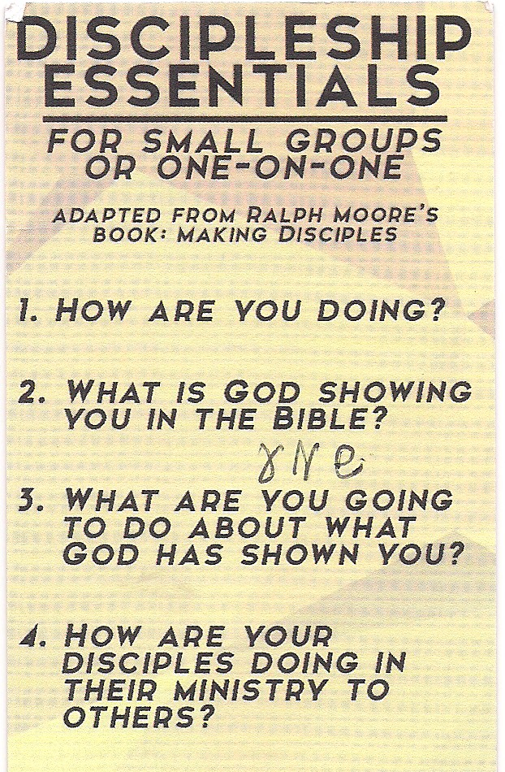

Slide 46
^{Yeshayahu 58.3-12} When you fast, you go about doing whatever you like, while keeping your laborers hard at work. Your fasts lead to quarreling and fighting, to lashing out with violent blows. On a day like today, fasting like yours will not make your voice heard on high.

Slide 47
^{Yeshayahu 58.3-12} “Is this the sort of fast I want, a day when a person mortifies himself? Is the object to hang your head like a reed and spread sackcloth and ashes under yourself? Is this what you call a fast, a day that pleases Adonai? “Here is the sort of fast I want — releasing those unjustly bound, untying the thongs of the yoke,

Slide 48
^{Yeshayahu 58.3-12} sharing your food with the hungry, taking the homeless poor into your house, clothing the naked when you see them, fulfilling your duty to your kinsmen!” Then your light will burst forth like the morning, your new skin will quickly grow over your wound; your righteousness will precede you, and Adonai’s glory will follow you

Slide 49
^{Yeshayahu /Isaiah 58.3-12} Then you will call, and Adoni will answer; you will cry, and he will say, “Here I am.” If you will remove the yoke from among you, stop false accusation and slander, generously offer food to the hungry and meet the needs of the person in trouble; then your light will rise in the darkness, and your gloom become like noon.

Slide 50
^{Yeshayahu /Isaiah 58.3-12} Adonai will always guide you; he will satisfy your needs in the desert, he will renew the strength in your limbs; so that you will be like a watered garden, like a spring whose water never fails. You will rebuild the ancient ruins, raise foundations from ages past, and be called “Repairer of broken walls,
Restorer of streets to live in.”

Slide 51
Notes:
It digs into the dirt!

Slide 53
