Slide 1
e-handout
To have these notes
without taking notes
Go to OrHaOlam.com
Click on Messages tab,
2023 Messages

Slide 2
Notes:
Vicki Kline

Slide 4
The hertz (symbol: Hz) is the physics unit of frequency, equivalent to one cycle per second
Notes:
Vicki Kline

Slide 5
About 30 years ago, the late Lubavitcher Rebbe told a young Netanyahu that “he, Benjamin Netanyahu, will be Israel’s prime minister, who will pass the scepter to the Messiah.”
Notes:
https://www.israeltoday.co.il/read/lubavitcher-rebbe-after-bibi-comes-the-messiah/?mc_cid=66448f8892&mc_eid=9f06d9f262

Slide 6
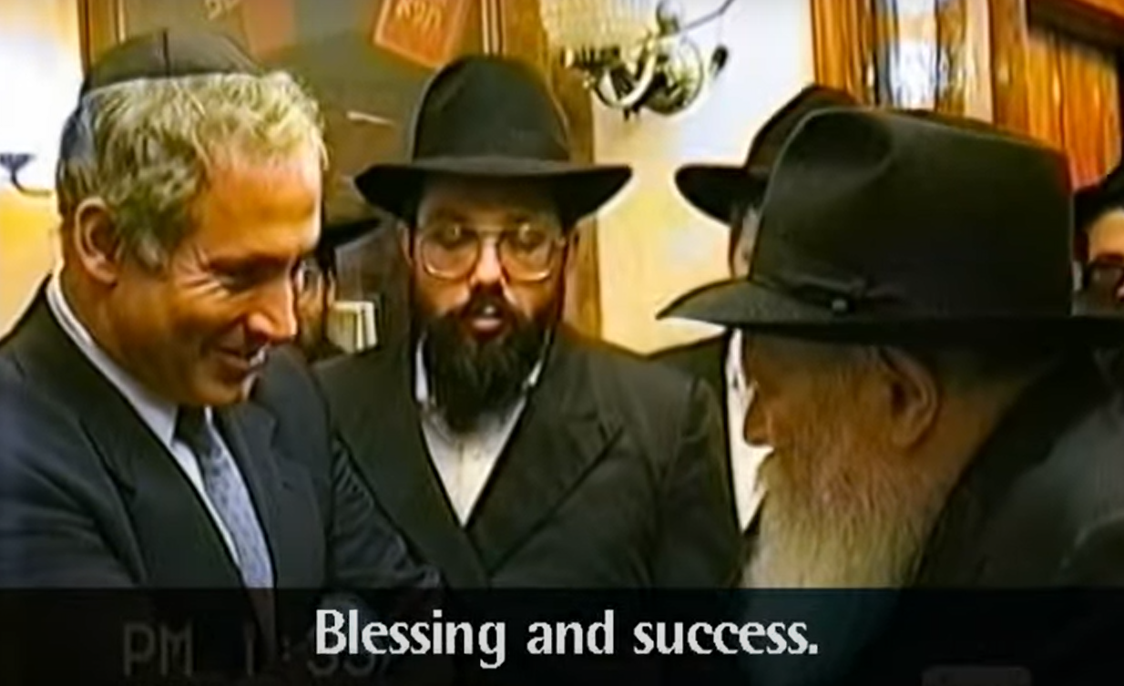
Notes:
https://www.israeltoday.co.il/read/lubavitcher-rebbe-after-bibi-comes-the-messiah/?mc_cid=66448f8892&mc_eid=9f06d9f262
https://youtu.be/rHBiT6eJaQQ

Slide 7
Ephesians 2.6-7
Showcase Us as His Trophy

Slide 8
^{Eph.2.6-7} G-d raised us up with Him and seated us with Him in the heavenly places in Messiah Yeshua— to exhibit in the עוֹלָם הַבָּא
olam ha-ba [the ages to come] the measureless richness of His grace in kindness toward us in Messiah Yeshua.
Notes:
I feel the Ruakh’s focus is the second part of these verses

Slide 9
^{Eph.2.6-7} G-d raised us up with Him and seated us with Him in the heavenly places in Messiah Yeshua— to exhibit in the עוֹלָם הַבָּא
olam ha-ba [the ages to come] the measureless richness of His grace in kindness toward us in Messiah Yeshua.
Notes:
To exhibit…us

Slide 10
Ephesians 2.6-7
Showcase Us as His Trophy
Notes:
There is the concept of a trophy wife. An exceedingly beautiful woman that turns heads. Show stopper. G-d considers you breathtakingly impressive. The difference is that He has given us that beauty, but nevertheless, we have to receive it. How?

Slide 11
There is warfare in the
spiritual world.
The warfare is about the
challenge to G-d’s righteous
rulership.
Humanity’s purpose is to
re-establish G-d’s kingdom.
Notes:
#3 is where the trophy status is.

Slide 12
There is warfare in the
spiritual world.
The warfare is about the
challenge to G-d’s righteous
rulership.
Humanity’s purpose is to
re-establish G-d’s kingdom.

Slide 13
Pre-creation universe

Slide 14
אֲדוֹן עוֹלָם אֲשֶׁר מָלַךְ
Ah-don o-lam a-sher ma-lakh
[Master of the universe who reigned]
בְּטֶֽרֶם כָּל יְצִיר נִבְרָא
B'te-rem kawl y'tseer neev-ra
[Before any form was created]
Notes:
Originally, before time and space were created, G-d existed in bliss. [I’m skipping a verse to focus on content.]

Slide 15
וְאַחֲרֵי כִּכְלוֹת הַכֹּל,
V’akharey kikhlot hakol [And after all has ceased to be]
לְבַדּוֹ יִמְלוֹךְ נוֹרָא.
l'vado yimlokh nora
[He alone will reign in awesomeness]

Slide 16
וְהוּא הָיָה, וְהוּא הוֶֹה
V'hu haya, v'hu hoveh
[And He was and He is]
וְהוּא יִהְיֶה, בְּתִפְאָרָה. v'hu yih'yeh b'tifara
[And shall be eternally in splendor]

Slide 17
בBen
ר Ruakh
א Av
Notes:
First word of the Bible has indication of the three in one. Not a plain sense teaching, pshat, פשת but a hint, remez רמז .
Together in eternal joy and harmony. Not lonely. Didn’t NEED anything. Out of abundant love created,
First, angelic world. Pre-Adamic world.

Slide 18
Angelic Creation corrupted
Yeshayahu / Isaiah’s vision
Notes:
I’m saying Angelic as a summary: cherubs, serifs, principalities, powers, all the sphirot

Slide 19
^{Yeshayahu / Is 14.12-14} “How did you come to fall from the heavens, morning star, son of the dawn? How did you come to be cut to the ground, conqueror of nations? You thought to yourself, ‘I will scale the heavens, I will raise my throne above God’s stars.

Slide 20
^{Yeshayahu / Is 14.12-14} I will sit on the Mount of Assembly far away in the north. I will rise past the tops of the clouds, I will make myself like the Most High.’
Notes:
The Enemy’s goal was not to be greater than G-d. That was unimaginable even to him, ha-satan. It was to be equal. Equally glorious. It is said that ha-satan never created anything new; just corrupts G-ds creations.
Origin of that evil thought in the mind of Lucifer, according to my prophecy teacher in Bible College, is a mystery that we may understand in eternity. Origin of evil in the mind of Lucifer, morning star, son of the dawn.

Slide 21
Angelic Creation corrupted
Ykhezkael / Ezekiel’s vision

Slide 22
^{Yekhezkel/Ezek 28.1-2} The word of Adoni came to me: “Human being, tell the prince of Tzor that Adoni Elohim says: ‘Because you are so proud and have said, “I am a god; I sit on the throne of God, surrounded by the sea”; yet you are a man, not God,
even though you think that you think like God.
Notes:
Same issue, you think that you think like G-d.

Slide 23
^{Yekhezkel/Ezek 28.11-15} The word of Adoni came to me saying: “Son of man, lift up a lament for the king of Tyre. Say to him, thus says Adoni Elohim: ‘You were the seal of perfection, full of wisdom and perfect in beauty. You were in Eden, the garden of God. Every precious stone was your covering —
Notes:
Not literally king of Tyre, but that king as a symbol.

Slide 24
^{Yekhezkel/Ezek 28.11-15} ruby, topaz and diamond, beryl, onyx and jasper, sapphire, turquoise and emerald— your settings and your sockets a workmanship of gold —in the day you were created they were prepared. You were an anointed guardian cheruv.

Slide 25
^{Yekhezkel/Ezek 28.11-15} I placed you on the holy mountain of God. You walked among stones of fire. You were perfect in your ways from the day that you were created, until unrighteousness was found
in you.
Notes:
Again, the cosmic mystery.
An example of the warfare, an unnamed angel and Michael vs the prince of Persia...

Slide 26
^{Daniel 10.12-13} He [an unnamed angel] said to me, ‘Don’t be afraid, Daniel! For from the first day that you set your heart to understand and to humble yourself before your God, your words were heard. I have come because of your words.

Slide 27
^{Daniel 10.12-13} However, the prince of the kingdom of Persia resisted me for days, but look, Michael, one of the chief princes, came to help me because I had been detained there with the kings of Persia.
Notes:
an unnamed angel and Michael vs the prince of Persia...

Slide 28
Human Creation corrupted

Slide 29
^{Beresheet/Gen 3.4-5} The serpent said to the woman, “It is not true that you will surely die; because God knows that on the day you eat from it, your eyes will be opened, and you will be like God, knowing good and evil.”

Slide 30
The issue is the same,
submission to G-d,
or
attempted equality with G-d

Slide 31
There is warfare in the
spiritual world.
The warfare is about the
challenge to G-d’s righteous
rulership.
Humanity’s purpose is to
re-establish G-d’s kingdom.

Slide 32
Claiming and attempting equality with God is the great violation of the fabric of the truth in the universe.

Slide 33
Claiming and attempting equality with God is the great violation of the fabric of the truth in the universe.
How to restore His order justly, without brute violence, is G-d’s great cosmic purpose.
Notes:
^{Ro. 8.22} We know that until now, the whole creation has been groaning as with the pains of childbirth;

Slide 34
There is warfare in the
spiritual world.
The warfare is about the
challenge to G-d’s righteous
rulership.
Humanity’s purpose is to
re-establish G-d’s kingdom.

Slide 35
Mankind was created to rebut Lucifer’s claim to be like G-d
and to reestablish G-d’s rulership through love.

Slide 36
Mankind was created to rebut Lucifer’s claim to be like G-d
and to reestablish G-d’s rulership through love.
We are intended to show that it is right to serve G-d, not for any reward, but for G-d Himself.

Slide 37
^{Matt 6.9-10} ‘Our Father in heaven! ¹May your Name be kept holy. ²May your Kingdom come,
³your will be done on earth as in heaven.
Notes:
His name is defiled and disrespected now. Nothing to do with pronunciation of His Name. It’s the grand defilement of His honor, His reputation.
His Kingdom rule is mocked and contradicted. Hasatan rules, dictates the norms of all cultures. From truth on taxes to purity in marriage. Cheating is OK. His praise not heard much.
His will is not considered.

Slide 38
^{Iyov/Job 1.6-11} One day the sons of God came to present themselves before Adoni, and the satan also came with them. Adoni said to the satan, “Where have you come from?” The satan responded to Adoni and said, “From roaming the earth and from walking on it.” Adoni said to the satan, “Did you notice my servant Iyov?

Slide 39
^{Iyov/Job 1.6-11} There is no one like him on the earth—a blameless and upright man, who fears God and spurns evil.” Then the satan responded to Adoni, saying, “Does Iyov fear God for nothing?
Notes:
This is the basic challenge of the universe. G-d is not worthy of praise.

Slide 40
^{Iyov/Job 1.6-11} Have you not made a hedge around him, his household, and everything he has? You have blessed the work of his hands and his possessions have increased in the land. But now, stretch out Your hand and strike everything he has, and he will certainly curse You to Your face!”
Notes:
This is not just an argument, it’s the assertion by the enemy of the rightness of his rebellion. That is, no intelligent creature would submit to You without great incentive. You, G-d, are NOT worthy of worship. Your worshippers are paid lackeys.
A statement of cosmic purpose. So G-d allowed the challenge. Iyov/Job had no idea how big the stakes were in his trials…

Slide 41
So Iyov lost it all, sons, daughters, sheep, camels, oxen, donkeys, servants. And with split second timing he receive sequential reports of the catastrophic losses.

Slide 42
^{Iyov 2.3-5} Adoni asked the Adversary, “Did you notice my servant Iyov, that there’s no one like him on earth, a blameless and upright man who fears God and shuns evil, and that he still holds on to his integrity, even though you provoked me against him to destroy him for no reason?”

Slide 43
^{Iyov 2.3-5} The Adversary answered Adoni, “Skin for skin! A person will give up everything he has to save his life. But if you reach out your hand and touch his flesh and bone, without doubt he’ll curse you to your face!”
Notes:
Make the suffering more intense, and You will see that I’m right. No one really worships you, except for benefits.

Slide 44
G-d allowed Iyov to have brutal diseases.
Iyov / Job continued to worship, but in pain and anguish doubted his role…

Slide 45
^{Iyov 19.19-27} “My wife can’t stand my breath, I am loathsome to my own family. Even young children despise me — if I stand up, they start jeering at me. All my intimate friends abhor me, and those I loved have turned against me. My bones stick to my skin and flesh; I have escaped by the skin of my teeth.
Notes:
Job’s Syndrome https://www.cincinnatichildrens.org/health/h/hyper-ige
Frequent skin infections
Abscesses in the skin or lungs that reoccur
Dry, itchy skin (eczema)
Frequent pneumonia
Yeast infections
Elevated IgE

Slide 46
^{Iyov 19.19-27} “Pity me, friends of mine, pity me! For the hand of God has struck me! Must you pursue me as God does, never satisfied with my flesh? I wish my words were written down, that they were inscribed in a scroll, that, engraved with iron and filled with lead, they were cut into rock forever!
Notes:
He wanted his sufferings to be documented, recognized. Honored. His sufferings seemed meaningless, purposeless, without comfort, without hope.

Slide 47
And they were indeed written down! His words were all recorded, and we are reading them now. And Iyov’s story and words restored the fabric of the universe with every suffering! Demonstrated that Iyov feared God for nothing, for no reward.
Notes:
Yet in the depths of his being, he cried…

Slide 48
^{Iyov 19.19-27} “But I know that my Redeemer lives, that in the end he will rise on the dust; so that after my skin has been thus destroyed, then even without my flesh, I will see God. I will see him for myself, my eyes, not someone else’s, will behold him. My heart grows weak inside me!

Slide 49
It’s the same for us.
Our struggles may seem meaningless, useless, purposeless, without comfort, without hope.

Slide 50
Yet our story is being recorded as the evidence that G-d is righteous and worthy to be served without reward. We restore the fabric of the universe with every suffering!
Notes:
We don’t do it in our own strength, but letting him work in invisible but vast and significant grace and power.

Slide 51
^{Phil 3.10} My aim is to know Him and the power of His resurrection and the sharing of His sufferings, becoming like Him in His death.

Slide 52
^{Eph.2.6-7} G-d raised us up with Him and seated us with Him in the heavenly places in Messiah Yeshua— to exhibit in the עוֹלָם הַבָּא
olam ha-ba [the ages to come] the measureless richness of His grace in kindness toward us in Messiah Yeshua.
Notes:
We don’t do it in our own strength, but letting him work in invisible but vast and significant grace and power.

Slide 53
That’s why we fast. There is no direct connection between fasting and answers to prayer, or improving a situation.
Fasting is entering into the abandonment of control, entering a bit into His death.

Slide 54
Love cannot be mandated or earned. No AI program for love.
Agape or khesed is freely given despite pain. “Love suffers”
Notes:
Bill Berg’s Founding Director of Or HaOlam corp, German Jew, sent in 1930s to US, saved during WW II military photog. Labored in Japan as missionary.
Wife, now deceased, incredible suffering. She said she can only offer her life as praise.
Pause for giving issue of pain to G-d as a form of worship and warfare. Tikkun Olam, repair of the universe, by our experiencing our suffering with praise and worship.

Slide 55
Suffering from moral evils: verbal abuse, physical abuse, abandonment, theft, murder, rape, war, genocide.
Suffering from physical events: hurricanes, earthquakes, fires, floods, diseases, accidents.
Notes:
We can learn forgiveness, justice, warfare.
We can learn trust.

Slide 56
^{Ro 8.28-29} We know that God causes everything to work together for the good of those who love God and are called in accordance with his purpose; because those whom he knew in advance, he also determined in advance would be conformed to the pattern of his Son, so that he might be the firstborn among many brothers.

Slide 57
^{Yeshayahu / Isaiah 53.} He was not well-formed or especially handsome; we saw him, but his appearance did not attract us. People despised and avoided him, a man of pains, well acquainted with grief. Like someone from whom people turn their faces, he was despised; we did not value him.

Slide 58
^{Yeshayahu / Isaiah 53.} In fact, it was our diseases he bore, our pains from which he suffered; yet we regarded him as punished, stricken and afflicted by God. But he was wounded because of our crimes, crushed because of our sins; the disciplining that makes us whole fell on him, and by his bruises

Slide 59
^{Yeshayahu / Isaiah 53.} we are healed. We all, like sheep, went astray; we turned, each one, to his own way; yet Adoni laid on him the guilt of all of us.

Slide 60
Oliver North describes a lance corporal in Iraq: Average age, 19 and a half years of age, not old enough to buy a beer. If we’re back here in the States, this youngster would be wearing cutoffs, and Nikes, and we call him a boy, but because he's in war, we call him a soldier, sailor, airman, Marine.
Notes:
https://familytalk.widen.net/view/pdf/lgfvvpbgqw/11102023HONORINGAMERICASVETERANS.pdf?t.download=true&u=o5dst7

Slide 61
He had a job in high school that he used to buy a car that was on average 10 years of age, used the car to take his high school sweetheart on dates. When he asked her to wait for him when he went off to war, she said she would, but she probably won't. When he gets back, she'll have a new boyfriend.
Notes:
https://familytalk.widen.net/view/pdf/lgfvvpbgqw/11102023HONORINGAMERICASVETERANS.pdf?t.download=true&u=o5dst7

Slide 62
He'll call him a wimp, and he'll be right, and she will know it. He writes to her about three times a week, actually writes about three letters a week. Two of those letters go to his girl. One of them goes to his mom, although he will never admit to the latter, never admit that he writes to Mom. He's got a short haircut, tight muscles,
Notes:
https://familytalk.widen.net/view/pdf/lgfvvpbgqw/11102023HONORINGAMERICASVETERANS.pdf?t.download=true&u=o5dst7

Slide 63
wears a four pound Kevlar helmet, 20 pound flak jacket with armor plates, can walk all day in 100 degree heat with a 50 pound pack in his back. He's gone weeks without bathing, but he cleans his weapon every day. He can use his own weapon like it was part of his body, and his body like it was a weapon, and he can use either or both to save a life or take one, because that is his job.
Notes:
https://familytalk.widen.net/view/pdf/lgfvvpbgqw/11102023HONORINGAMERICASVETERANS.pdf?t.download=true&u=o5dst7

Slide 64
Before he went in the military, this is a guy who couldn't have been bludgeoned into cleaning up his room, doing his laundry, or God knows, washing the dishes. But today he is remarkably self-sufficient. He prepares his own meals, washes and mends his own clothes, digs his own foxhole and latrine, and keeps his canteens full and his feet dry.
Notes:
https://familytalk.widen.net/view/pdf/lgfvvpbgqw/11102023HONORINGAMERICASVETERANS.pdf?t.download=true&u=o5dst7

Slide 65
The kid who once wouldn't share a candy bar with his little brother today will give his last drop of water to a wounded comrade. He'll give his only ration to a hungry Iraqi kid. And he'll split his ammo with a mate in a firefight because he knows they both need it.
Notes:
https://familytalk.widen.net/view/pdf/lgfvvpbgqw/11102023HONORINGAMERICASVETERANS.pdf?t.download=true&u=o5dst7

Slide 66
He's a remarkable young guy. He knows that grown men don't cry because that's part of what we've been taught in our culture, but I have seen him weep unashamed over a fallen comrade. I've watched him hold them in their arms as they died.
Notes:
https://familytalk.widen.net/view/pdf/lgfvvpbgqw/11102023HONORINGAMERICASVETERANS.pdf?t.download=true&u=o5dst7

Slide 67
After one such incident, the corpsman was trying to take the body of his squad leader from a young wounded Marine, squad leader was dead. They take the squad leader's body out of his arms.
Notes:
https://familytalk.widen.net/view/pdf/lgfvvpbgqw/11102023HONORINGAMERICASVETERANS.pdf?t.download=true&u=o5dst7

Slide 68
Young Lance Corporal stands up, and looks at me, and he says, "You know, Colonel, heroes aren't just defined by how they die, but by how they live.
Notes:
https://familytalk.widen.net/view/pdf/lgfvvpbgqw/11102023HONORINGAMERICASVETERANS.pdf?t.download=true&u=o5dst7

Slide 69
Why does the soldier live that way?
He’s serving his country.
Why do we suffer the things we are called to?
We are serving our King Yeshua.
Notes:
Without sacrificial service, there would be no army.
Without sacrificial service, there would be no cosmic defeat of ha-satan.

Slide 70
Avner Boskey: When Hamas slaughtered over 1,400 Israelis, they released an evil spiritual wind over the entire planet. There is no putting this anti-Semitic genie back into its Middle Eastern bottle. We are in a new season.
Notes:
Never thought I’d have occasion in a sermon to endorse a restaurant…

Slide 71
McDonald’s Israel said it has donated over 100,000 free meals, worth NIS 5 million (over $1.2 million), to the IDF.
Notes:
https://worldisraelnews.com/mcdonalds-israel-sparks-international-outrage-for-giving-free-food-to-idf-soldiers/

Slide 72
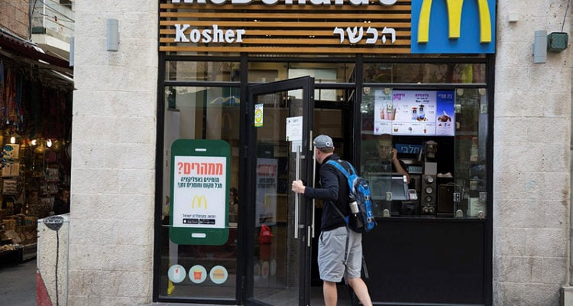

Slide 73
In response, branches of McDonald’s in Turkey, Lebanon, and Egypt were vandalized, according to photos and videos circulating on social media, and rallies in support of Hamas-controlled Gaza were held outside other McDonald’s restaurants in Malaysia and elsewhere.
Notes:
https://worldisraelnews.com/mcdonalds-israel-sparks-international-outrage-for-giving-free-food-to-idf-soldiers/
Not believers yet, but a similar spirit of selfless living…

Slide 74
As the war today marks one full month of hostilities, Israel is experiencing an unprecedented surge of births, marriage proposals and weddings, despite the war looming over its society. Why is that? We can sum it up in one Aramaic word – davka. Originally meaning “precision” in Hebrew, we use this word to express something that is done in spite of, or specifically because of.
Notes:
https://allisrael.com/proposals-weddings-births-israel-becomes-more-hopeful-and-jewish-davka-during-wartime

Slide 75
Hamas wants less Jews in Israel? We will davka create new families and make more babies.
Benny Maidan, 25, and Naomi Theodor, 20, had planned to get married in April or May of 2024, and this past September they were looking for a venue within their budget but were unable to find anything. And then the war broke out, Benny was called up to his reserve troop in the Golani Brigade, close to the Lebanese border.
Notes:
https://allisrael.com/proposals-weddings-births-israel-becomes-more-hopeful-and-jewish-davka-during-wartime

Slide 76
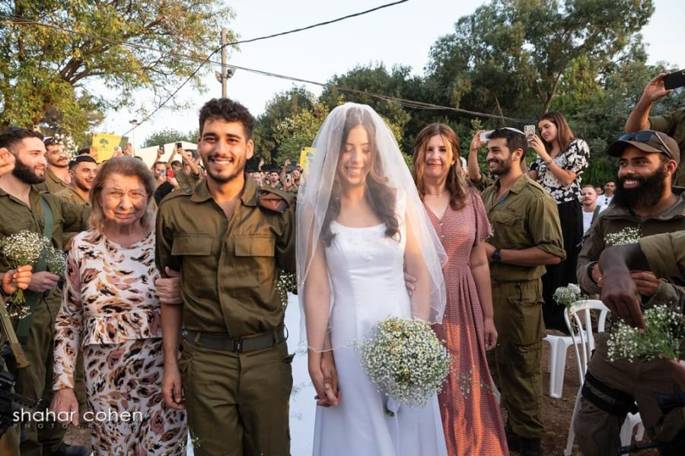

Slide 77
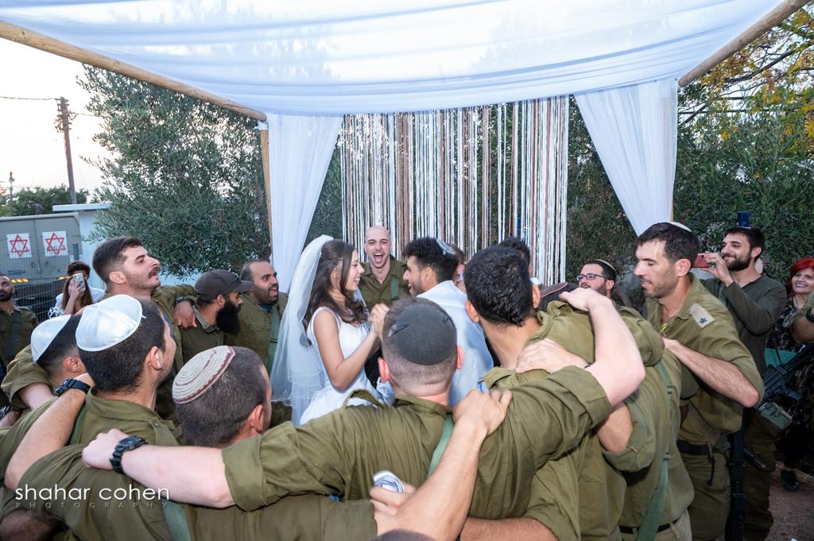
Notes:
https://allisrael.com/proposals-weddings-births-israel-becomes-more-hopeful-and-jewish-davka-during-wartime
Naomi shared that the lady in charge of making the chuppah told her that her husband had been at the nature festival that was brutally attacked by Hamas terrorists on Oct. 7. Her husband saw his friends being shot in front of his eyes, which was very traumatic.
Regarding the wedding chuppah, “She told me that she did this because what we’re doing gives hope again,” Naomi shared. “I really saw the heart people have to help in times of need.”

Slide 78
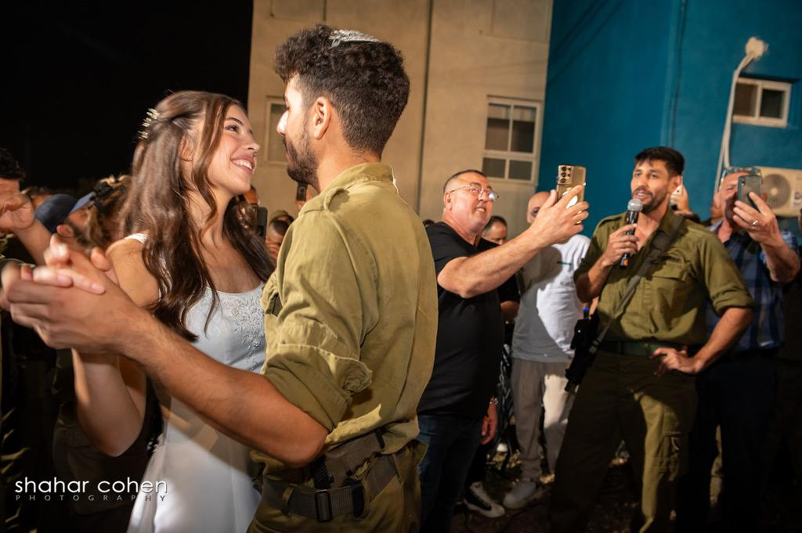

Slide 79
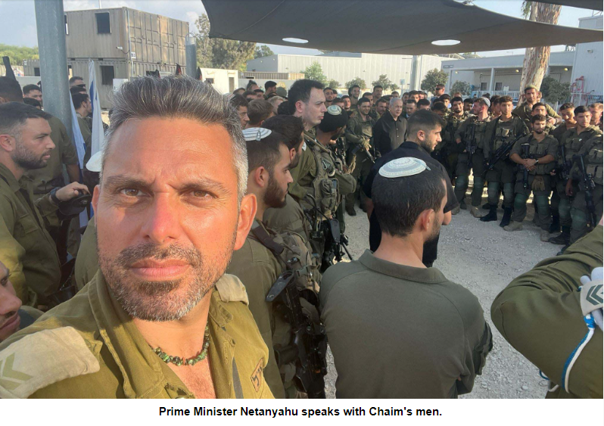

Slide 80
Israel's Aliyah and Integration Ministry reported on Tuesday that there is a notable increase of people interested in immigrating to Israel since the Oct. 7 Hamas attack, with the largest numbers of requests from France and North America.
Notes:
https://allisrael.com/more-significant-increase-in-jews-desiring-to-immigrate-to-israel-since-oct-7-hamas-attack-showing-interest-in-immigrating-to-israel-since-oct-7-hamas-attack

Slide 81
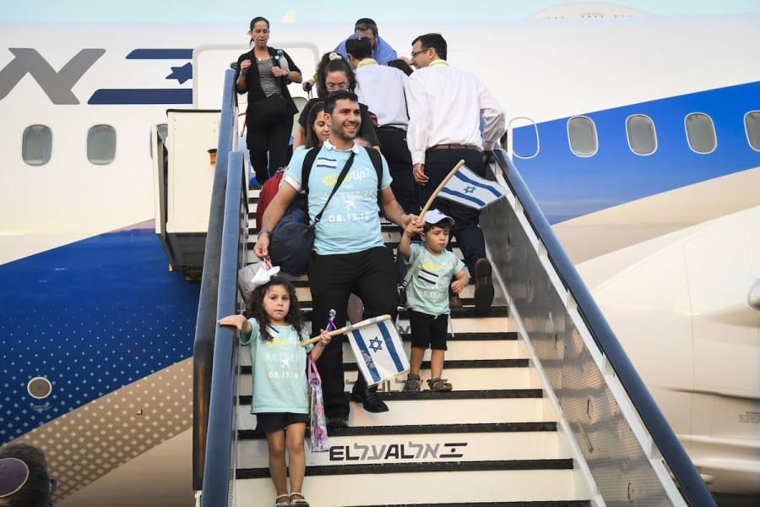

Slide 82
Of those considering the possibility of moving to Israel, the ministry reported a 149% increase in interest from Jewish French citizens and and an 81% increase from North American Jews.
Notes:
https://allisrael.com/more-significant-increase-in-jews-desiring-to-immigrate-to-israel-since-oct-7-hamas-attack-showing-interest-in-immigrating-to-israel-since-oct-7-hamas-attack

Slide 83
The pace could even pick up given the current wave of antisemitism sweeping the globe, as evidenced in the near pogrom in Dagestan, Russia on Sunday.
Notes:
Copyright © 2023, All rights reserved. Our mailing address is: International Christian Embassy Jerusalem P.O. Box 1192 Jerusalem, 9101002 Israel

Slide 85
Over coming weeks, the International Christian Embassy Jerusalem is supporting Aliyah flights for 111 Jewish youths ages 14 to 18 immigrating from the former Soviet republics. After they complete their study program, they will be eligible to become Israeli citizens and serve in the IDF to defend their new homeland.
Notes:
Copyright © 2023, All rights reserved. Our mailing address is: International Christian Embassy Jerusalem P.O. Box 1192 Jerusalem, 9101002 Israel

Slide 86
Aliyah and serve because it’s right, not for gain or comfort.
We serve and love Messiah, with His help, because it’s right, not for gain or comfort.

Slide 87
^{Eph.2.6-7} G-d raised us up with Him and seated us with Him in the heavenly places in Messiah Yeshua— to exhibit in the עוֹלָם הַבָּא
olam ha-ba [the ages to come] the measureless richness of His grace in kindness toward us in Messiah Yeshua.
Notes:
We don’t do it in our own strength, but letting him work in invisible but vast and significant grace and power.

Slide 88
^{Psalm 121} If I raise my eyes to the hills, from where will my help come? My help comes from Adoni, the maker of heaven and earth. He will not let your foot slip — your guardian is not asleep. No, the guardian of Isra’el never slumbers or sleeps.

Slide 89
^{Psalm 121} Adoni is your guardian; at your right hand Adoni provides you with shade — the sun can’t strike you during the day or even the moon at night. Adoni will guard you against all harm; he will guard your life. Adoni will guard your coming and going from now on and forever.

Slide 90
Do you KNOW Yeshua and the assurance of sins forgiven?
Are you hearing daily from His Word?
How are you applying what you heard?
Are you asking this of another?
Notes:
Who are you discipling, building up?4

