Slide 1
e-handout
To have these notes
without taking notes
Go to OrHaOlam.com
Click on Messages tab,
2023 Messages

Slide 2
Last week’s parasha was
Vayigash / וַיִּגַּשׁ
^{Beresheet/Gen 44.18} Then Y’hudah approached
One of the MOST dramatic scenes in the Bible.
Notes:
Parashat Vayigash 5783 / פָּרָשַׁת וַיִּגַּשׁ

Slide 3
In the parasha story, the brothers had betrayed and sold Yosef into slavery. Now their enslaved brother was [unbeknownst to them] their absolute master.

Slide 4
They didn’t recognize him because Yosef looked so foreign. Similar to how the Jewish people don’t recognize Yeshua because He looks so foreign.

Slide 5
He was their promised redeemer
Notes:
Just like Yeshua is the promised redeemer of Israel.

Slide 6
He was their promised redeemer
He looked Egyptian.

Slide 7
He was their promised redeemer
He looked Egyptian.
He dressed Egyptian.

Slide 8
He was their promised redeemer
He looked Egyptian.
He dressed Egyptian.
He spoke Egyptian.

Slide 9
He was their promised redeemer
He looked Egyptian.
He dressed Egyptian.
He spoke Egyptian.
He ate food ~Egyptian.

Slide 10
He was their promised redeemer
He looked Egyptian.
He dressed Egyptian.
He spoke Egyptian.
He ate food ~Egyptian.
He was an enemy foreigner.
He was their brother!
Notes:
In all church history, Jews have been tormented and killed in the name of Christ. Jesus is an enemy name to many/most Jewish people.

Slide 11
^{Ber/Gen 44.18-28} Then Y’hudah approached [Vayigash / וַיִּגַּשׁ]
Yosef and said, “Please, my lord! Let your servant say something to you privately; and don’t be angry with your servant, for you are like Pharaoh himself.
Notes:
Brother in extreme distress.

Slide 12
^{Ber/Gen 44.18-28} My lord asked his servants, ‘Do you have a father? or a brother?’ We answered my lord, ‘We have a father who is an old man, and a child of his old age, a little one whose brother is dead;

Slide 13
^{Ber/Gen 44.18-28} so that of his mother’s children he alone is left; and his father loves him.’ But you said to your servants, ‘Bring him down to me, so that I can see him.’ We answered my lord, ‘The boy can’t leave his father; if he were to leave his father, his father would die.’

Slide 14
^{Ber/Gen 44.18-28} You said to your servants, ‘You will not see my face again unless your brother is with you.’ We went up to your servant my father and told him what my lord had said; but when our father said,

Slide 15
^{Ber/Gen 44.18-28} ‘Go again, and buy us some food,’ we answered, ‘We can’t go down. Only if our youngest brother is with us will we go down, because we can’t see the man’s face unless our youngest brother is with us.’

Slide 16
^{Ber/Gen 44.18-28} Then your servant my father said to us, ‘You know that my wife bore me two sons: the one went out from me, and I said, “Surely he has been torn to pieces,” and I haven’t seen him since.
Notes:
Yehuda’s humble acknowledging Yaakov/ Jacob said “My wife.” Not one of my wives.
Yehuda’s humble acknowledging Yaakov/Jacob said, only “two sons.” Extreme self deprecation.

Slide 17
^{Ber/Gen 44.29-34} Now if you take this one away from me too, and something happens to him, you will bring my gray hair down to Sh’ol with grief.’ So now if I go to your servant my father, and the boy isn’t with us — seeing how his heart is bound up with the boy’s heart — when he sees that the boy isn’t with us,
Notes:
w/o jealousy

Slide 18
^{Ber/Gen 44.29-34} he will die; and your servants will bring the gray hair of your servant our father down to Sh’ol with grief. For your servant himself guaranteed his safety; I said, ‘If I fail to bring him to you, then I will bear the blame before my father forever.’
Notes:
Total aside: note gray hair as mark of honor twice.

Slide 19
^{Ber/Gen 44.29-34} Therefore, I beg you, let your servant stay as a slave to my lord instead of the boy, and let the boy go up with his brothers. For how can I go up to my father if the boy isn’t with me? I couldn’t bear to see my father so overwhelmed by anguish.”
Notes:
Yehuda was willing to take on vicarious atoning responsibility.
Yehuda could not bear to fail.

Slide 20
Yehuda offered himself in place of endangered, incarcerated, Benjamin.
Sacrificial love compared to the jealous betrayal [contemplated murder, sale into slavery] of Yosef years previous.

Slide 21
Is there anything comparable in our duty to endangered neighbors.
Jewish neighbors
Gentile neighbors

Slide 22
How can I go up to my father if the boy isn’t with me?

Slide 23
How can I go up to my father if the boy isn’t with me?
How can we go up to the Eternal Father if we haven’t brought some of our neighbors?
Notes:
Who is my neighbor?

Slide 25
^{Beresheet/Gen 45.3}Yosef said to his brothers, “I am Yosef! Is it true that my father is still alive?” His brothers couldn’t answer him, they were so panicked at seeing him.
וַיֹּאמֶר יוֹסֵף אֶל-אֶחָיו אֲנִי יוֹסֵף הַעוֹד אָבִי חָי; וְלֹא-יָכְלוּ אֶחָיו לַעֲנוֹת אֹתוֹ, כִּי נִבְהֲלוּ מִפָּנָיו.
Notes:
Has to be one of the MOST dramatic scenes in scripture!
Song Am Yisrael Khi.
הַעוֹד אָבִי חָי Haod avi khi→ Od avinu khi
עוֹד אָבִינו חָי

Slide 26
The brothers could now gasp to see that Yosef was their prophesied ruler and their flesh and blood.
The Jewish people will eventually see that Yeshua is their prophesied Messiah, and their own flesh and blood.

Slide 27
^{Zekh 12.9-10} “When that day comes, I will seek to destroy all nations attacking Yerushalayim; and I will pour out on the house of David and on those living in Yerushalayim a spirit of grace and prayer; and they will look to me, whom they pierced.” They will mourn for him as one mourns for an only son;
Notes:
Similar shocking recognition of the Messiah as their own brother. “That was YOU?!”

Slide 28
^{Acts 22.1-3} “Brothers and fathers! Listen to me as I make my defense before you now!” When they heard him speaking to them in Hebrew, they settled down more; so he continued:

Slide 29
^{Acts 22.1-3} “I am a Jew, born in Tarsus of Cilicia, but brought up in this city and trained at the feet of Gamli’el in every detail of the Torah of our forefathers…”

Slide 30
Revelation of Yosef ~ rev of Yeshua
Can we share the reality of the Jewish Messiah with our Jewish neighbors?
Do we need to? Jewish practice IS beautiful.
If so, how.
Notes:
Gentiles NOT excluded, but this is to the Jewish people first of all.

Slide 32
Do we need to share Yeshua with Jewish people. Jewish practice IS beautiful. First reason: Divine pattern “to the Jewish people first.”

Slide 33
^{Lk.24.46-47} “Here is what it says: the Messiah is to suffer and to rise from the dead on the third day; and in his name repentance leading to forgiveness of sins is to be proclaimed to people from all nations, starting with Yerushalayim.

Slide 34
^{Ro. 1.16} For I am not ashamed of the Good News, since it is God’s powerful means of bringing salvation to everyone who keeps on trusting, to the Jew especially, but equally to the Gentile.

Slide 35
^{Matt 28.18-20} Yeshua came and talked with them. He said, “All authority in heaven and on earth has been given to me. Therefore, go and make people from all nations into talmidim [disciples], immersing them into the reality of the Father, the Son and the Ruakh HaKodesh,

Slide 36
^{Matt 28.18-20} and teaching them to obey everything that I have commanded you. And remember! I will be with you always, yes, even until the end of the age.”
Notes:
Best way for Him to be “with us”

Slide 38
Do we need to share Yeshua with Jewish people. Jewish practice IS beautiful. Second reason: Subtle but great spiritual need.
Notes:
I am about to share one of the trickiest things in all of Paul/Shaul’s writings.

Slide 39
^{Ro. 10.2-5} I can testify to their zeal for God. But it is not based on correct understanding; for, since they are unaware of God’s way of making people righteous and instead seek to set up their own,

Slide 40
^{Ro. 10.2-5} they have not submitted themselves to God’s way of making people righteous. For the goal at which the Torah aims is the Messiah, who offers righteousness to everyone who trusts.
Notes:
Jewish worshipers look and seem so together familial-ly and spiritually.

Slide 41
^{Ro. 10.2-5} For Moshe writes about the righteousness grounded in the Torah that the person who does these things will attain life through them.
^{Vayikra/Lev 18.5} You are to observe my laws and rulings; if a person does them, he will have life through them; I am Adoni. אֲשֶׁר יַעֲשֶׂה אֹתָם הָאָדָם וָחַי בָּהֶם
Notes:
Contrasted to…

Slide 42
^{Ro 11.6-10} Moreover, the righteousness grounded in trusting says: “Do not say in your heart, ‘Who will ascend to heaven?’” — that is, to bring the Messiah down — or, “‘Who will descend into Sh’ol?’” — that is, to bring the Messiah up from the dead.,

Slide 43
^{Ro 11.6-10} What, then, does it say? “The word is near you, in your mouth and in your heart.”— that is, the word about trust which we proclaim, namely, that if you acknowledge publicly with your mouth that Yeshua is Lord

Slide 44
^{Ro 11.6-10} and trust in your heart that God raised him from the dead, you will be delivered. For with the heart one goes on trusting and thus continues toward righteousness, while with the mouth one keeps on making public acknowledgement and thus continues toward deliverance. [D’varim/Dt 30:11–14]

Slide 45
Two systems of salvation in the Torah
Lev 18.5 “live by obedience.”
Dt 30:11–14 “live by faith → imparted power to obey.
The two systems are intertwined, but Yeshua is the second.
No one can really succeed in the first.
Notes:
So, eternal issues are at stake here.

Slide 47
Do we need to share Yeshua with Jewish people. Jewish practice IS beautiful. Third reason: We are called to win people.

Slide 48
^{1 Thes 2.17-20} And as for us, brothers, when we were deprived of your company for a short time — in person, but not in thought — we missed you and tried hard to come and see you.

Slide 49
^{1 Thes 2.17-20} I, Sha’ul, tried more than once — but the Adversary stopped us. For when our Lord Yeshua returns, what will be our hope, our joy, our crown to boast about? Won’t it be you? Yes, you are our glory and our joy!

Slide 50
^{Ber./Gen 4.9} Adoni said to Cain, “Where is Abel, your brother?”
“I don’t know,” he said.
“Am I my brother’s keeper?”

Slide 51
^{Gal 5.13-15} For, brothers, you were called to be free [mature, empowered]. Only do not let that freedom become an excuse for allowing your old nature to have its way. Instead, serve one another in love. For the whole of the Torah is summed up in this one sentence:

Slide 52
^{Gal 5.13-15} “Love your neighbor as yourself”; but if you go on snapping at each other and tearing each other to pieces, watch out, or you will be destroyed by each other!

Slide 53
^{1 Yn 3.16} The way that we have come to know love is through Yeshua the Messiah having laid down his life for us. And we ought to lay down our lives for the brothers and sisters!

Slide 54
^{1 Thes 2.13-14} We also thank God constantly that when you received the word of God which you heard from us, you accepted it not as the word of men, but as it truly is—the word of God, which does its work in you who believe.

Slide 55
^{1 Thes 2.13-14} For you, brothers and sisters, became imitators of God’s communities in Messiah Yeshua that are in Judea—for you suffered the same things

Slide 56
^{Phil. 4.1} Therefore, my brothers and sisters whom I love and long for, my joy and crown—stand firm in the Lord in this way, my loved ones.

Slide 57
^{1 Thes 1.4-6} We know, brothers, that God has loved and chosen you; that the Good News we brought did not become for you a matter only of words, but also one of power, the Ruakh HaKodesh and total conviction —

Slide 58
^{1 Thes 1.4-6} just as you know how we lived for your sakes when we were with you. You, indeed, became imitators of us and of the Lord; so that even though you were going through severe troubles, you received the Word with joy from the Ruakh HaKodesh.

Slide 60
How can we Jewishly share that Yeshua is the Jewish Messiah?
Notes:
Not obscured by Egyptian costume.
The prophet Yeshayahu/Isaiah has the answer…

Slide 61
^{Yeshayahu/Is 40.3-8} A voice cries out: “Clear a road through the desert for Adoni! Level a highway in the ‘Aravah for our God! Let every valley be filled in, every mountain and hill lowered, the bumpy places made level and the crags become a plain.

Slide 62
^{Yeshayahu/Is 40.3-8} Then the glory of Adoni will be revealed; all mankind together will see it, for the mouth of Adoni has spoken.”

Slide 63
^{Yeshayahu/Is 40.3-8} A voice says, “Proclaim!” And I answer, “What should I proclaim?”

Slide 64
^{Yeshayahu/Is 40.3-8} “All humanity is merely grass, all its kindness like wildflowers: the grass dries up, the flower fades, when a wind from Adoni blows on it. Surely the people are grass! The grass dries up, the flower fades; but the word of our God will stand forever.”

Slide 65
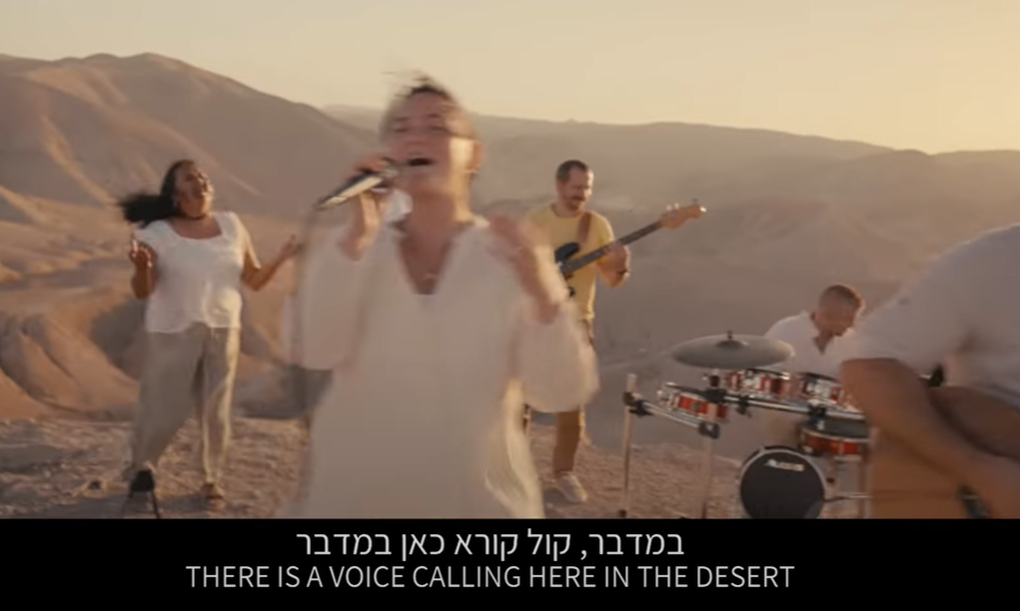
A voice cries out here in the desert.
e-handout
To have these notes
without taking notes
Go to OrHaOlam.com
Click on Messages tab,
2022 Messages
Notes:
These are Jewish Israeli kids, living out the redemption, and communicating it with their peers and the world.

Slide 66
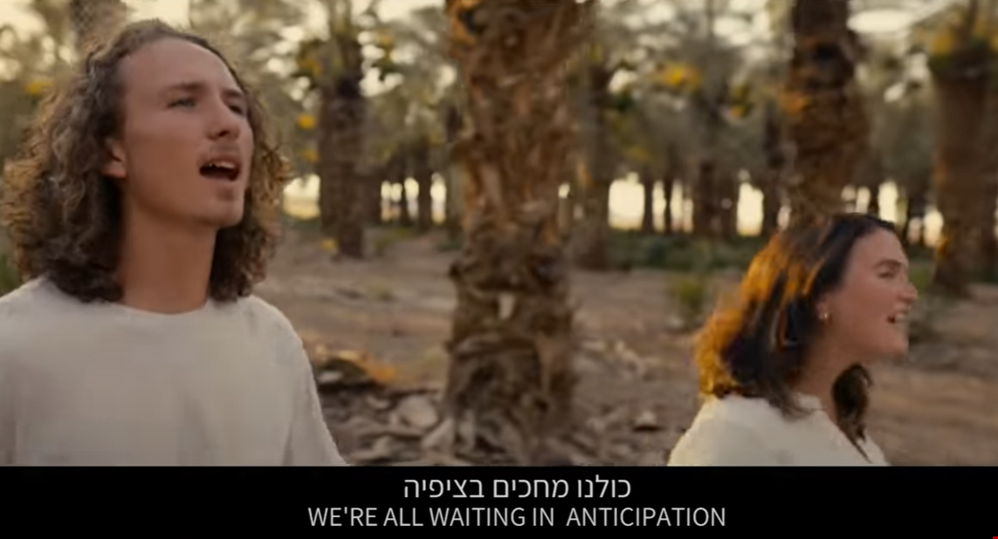
We are all awaiting
in anticipation
Notes:
https://www.youtube.com/watch?v=PwrUbvyRp2w

Slide 67
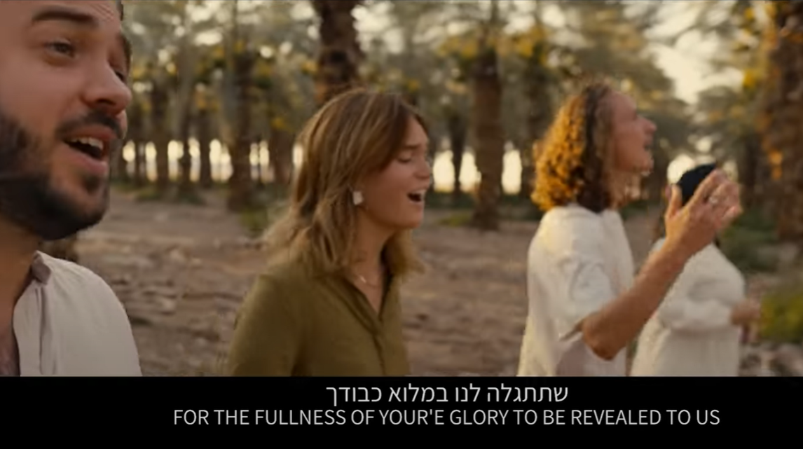
For the fullness of your glory
to be revealed to us
Notes:
https://www.youtube.com/watch?v=PwrUbvyRp2w

Slide 68
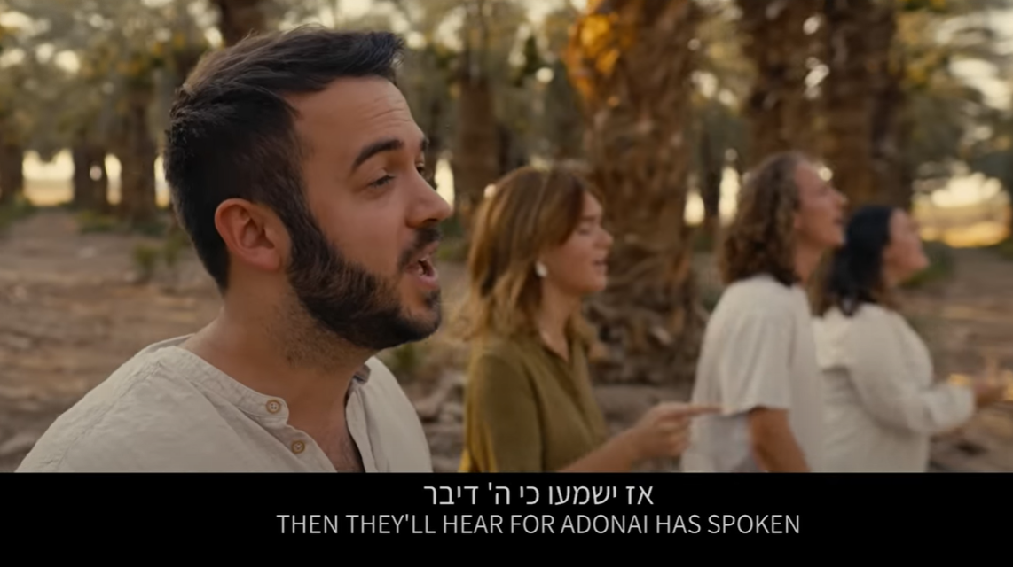
Then they’ll hear that
Adoni has spoken.

Slide 69
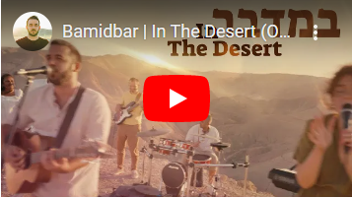
Notes:
https://www.youtube.com/watch?v=cHn1POJovZA
Especially 0:21-1.31

Slide 70
G-d of the heavens, He will give us success. We are His servants.
We will arise and build. There is no place for fear. There is no time to waste. A voice cries out here in the desert.
Notes:
https://www.youtube.com/watch?v=cHn1POJovZA
This is EXACTLY what we are doing, and about to do more!!

Slide 71
Build up a highway. Straighten for Him a path. Remove every obstacle. Behold He is coming. Awaken every sleeper. It’s time to arise. A voice cries out here in the desert.
Notes:
https://www.youtube.com/watch?v=cHn1POJovZA

Slide 72
We are all awaiting in anticipation for the fullness of your glory to be revealed to us. Then they’ll hear for Adoni has spoken.
A voice cries out here in the desert.
Notes:
https://www.youtube.com/watch?v=cHn1POJovZA

Slide 73
A voice cries out here in the desert.
e-handout
To have these notes
without taking notes
Go to OrHaOlam.com
Click on Messages tab,
2022 Messages

Slide 74
^{2 Cor. 4.6} For it is the God who once said, “Let light shine out of darkness,” who has made his light shine in our hearts, the light of the knowledge of God’s glory shining in the face of the Messiah Yeshua.
Notes:
This is what we have to offer, ideally, to the Jewish and Gentile world. This is what broke into my debauched secular heart in 1969. The method hasn’t changed. The revelation of GLORY has gotten antiquated, obsolete, passe, dated.
How do we do that?

Slide 75
^{Yeshayau / Is 57. 15} For thus says the High, Exalted One who lives forever, whose name is Holy: “I live in the high and holy place but also with the broken and humble, in order to revive the spirit of the humble and revive the hearts of the broken ones.

Slide 77
Methods and events to do this?
Notes:
Not obscured by Egyptian costume.
First of all, intercession, fasting, desperate prayer. Revelation of GLORY. LOVE among us.

Slide 78
The following outreach events are in the works, this afternoon a detailed planner:
Mishloakh Manot: Saturday, March 4
(prep day February 25)
2. Tuesday, May 9: A Different Lag B'Omer
Sunday, May 28: Shavu'ot/Memorial Day
Music Festival on our property with
band stand back facing the street.
4. Sunday, October 1: Sukkot Music
Festival on our property
Notes:
What is that?

Slide 79
^{Esther 9. 20-22} Mordekhi recorded these events and sent letters to all the Jews in all the provinces of King Akhashverosh, both near and far, instructing them to observe the fourteenth day of the month of Adar and the fifteenth day, every year,

Slide 80
^{Esther 9. 20-22} [to commemorate] the days on which the Jews obtained rest from their enemies and the month which for them was turned from sorrow into gladness and from mourning into a holiday;

Slide 81
^{Esther 9. 20-22} they were to make them days of celebrating and rejoicing, sending portions [of food] to each other and giving gifts to the poor.

Slide 82
^{Esther 9. 20-22} sending portions [of food] to each other
מִשְׁלֹחַ מָנוֹת אִישׁ לְרֵעֵהוּMishloakh manot
or shalakh manos

Slide 83
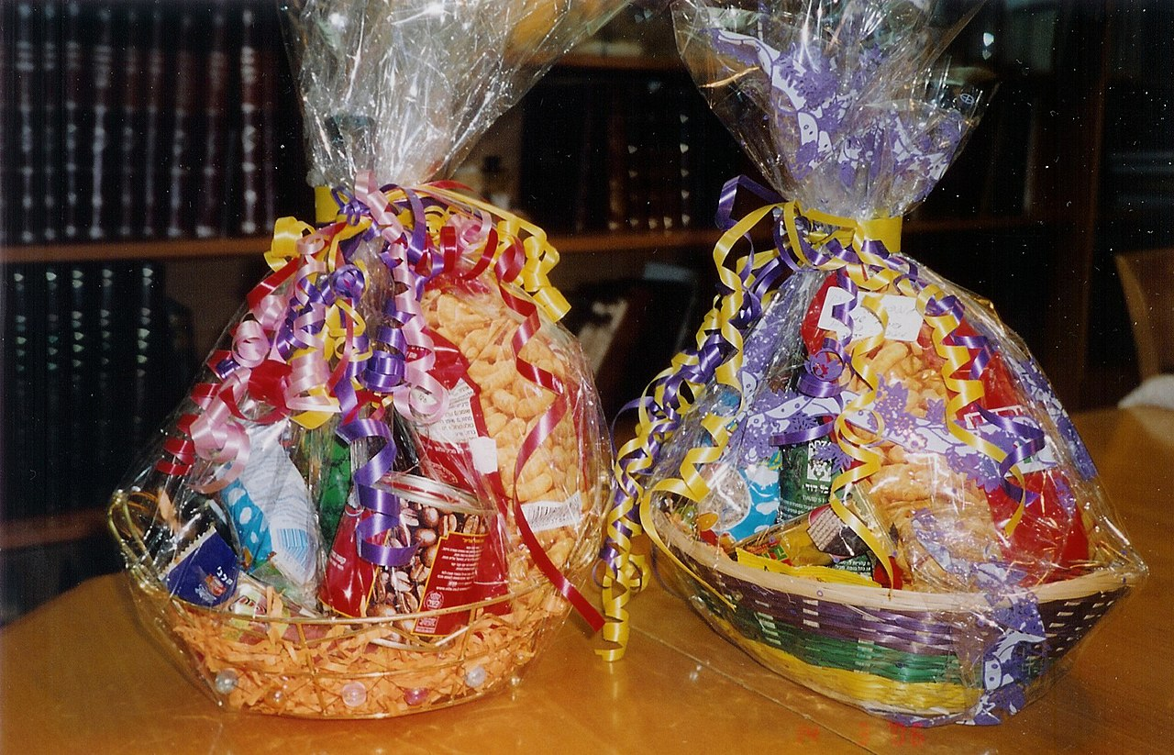
Gaily wrapped baskets of sweets,
drinks and other foodstuffs given
as mishloach
manot on Purim day
Notes:
https://en.wikipedia.org/wiki/Mishloach_manot#/media/File:2_Mishloach_Manot.jpg
Need teams to pack.
Teams to distribute.
Mike will make up neighborhood zones.
Sunday option.

Slide 84
The following outreach events are in the works:
Mishloakh Manot: Saturday, March 4
(prep day February 25)
2. Tuesday, May 9: A Different Lag B'Omer
Sunday, May 28: Shavu'ot/Memorial Day
Music Festival on our property with
band stand back facing the street.
4. Sunday, October 1: Sukkot Music
Festival on our property

Slide 85
Lag BaOmer לַ״ג בָּעוֹמֶר‎ is a Jewish religious holiday celebrated on the 33rd day of the Counting of the Omer, which occurs on the 18th day of the Hebrew month of Iyar.
This year Tues., May 9, 2023
Notes:
https://en.wikipedia.org/wiki/Lag_BaOmer
[phone Oxana]

Slide 86
According to some, it is the day on which the plague that killed Rabbi Akiva's 24,000 disciples came to an end, and for this reason the mourning period of Sefirat HaOmer concludes on Lag BaOmer in many communities.
Notes:
https://en.wikipedia.org/wiki/Lag_BaOmer
Because of disrespect.

Slide 87
Others suggest that the deaths of Rabbi Akiva's students was a veiled reference to the defeat of "Akiva's soldiers" by the Romans, and that Lag BaOmer was the day on which Bar Kokhba enjoyed a brief victory. ~130
Notes:
https://en.wikipedia.org/wiki/Lag_BaOmer

Slide 88
The most well-known custom of Lag BaOmer is the lighting of bonfires, possible signal fires of Bar Kokhba’s army.
Notes:
https://en.wikipedia.org/wiki/Lag_BaOmer

Slide 89
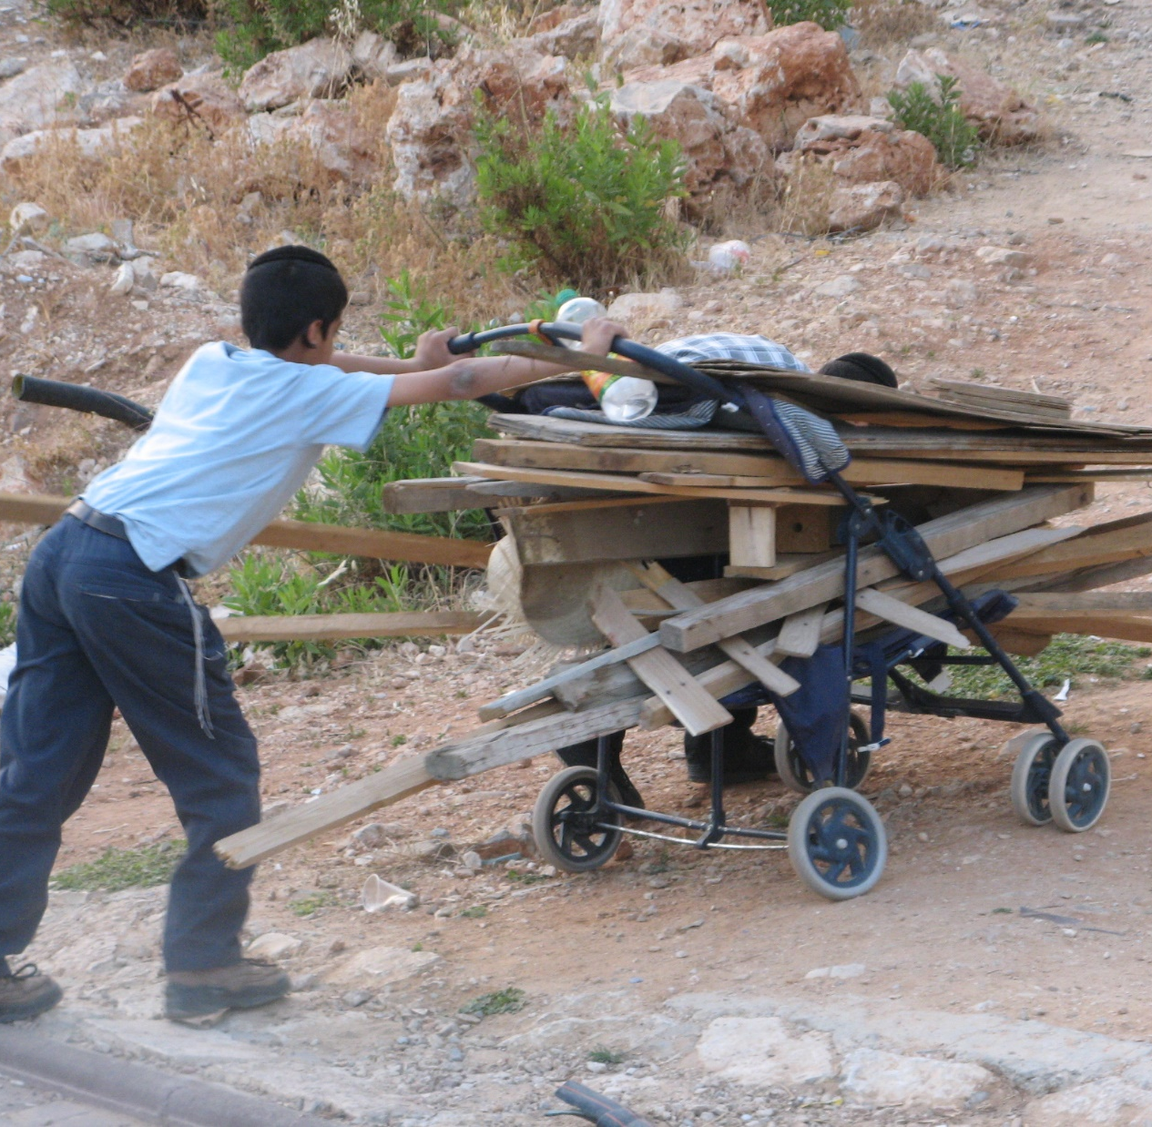
Israeli boys collect wood for a Lag BaOmer bonfire.
Notes:
https://en.wikipedia.org/wiki/Lag_BaOmer

Slide 90
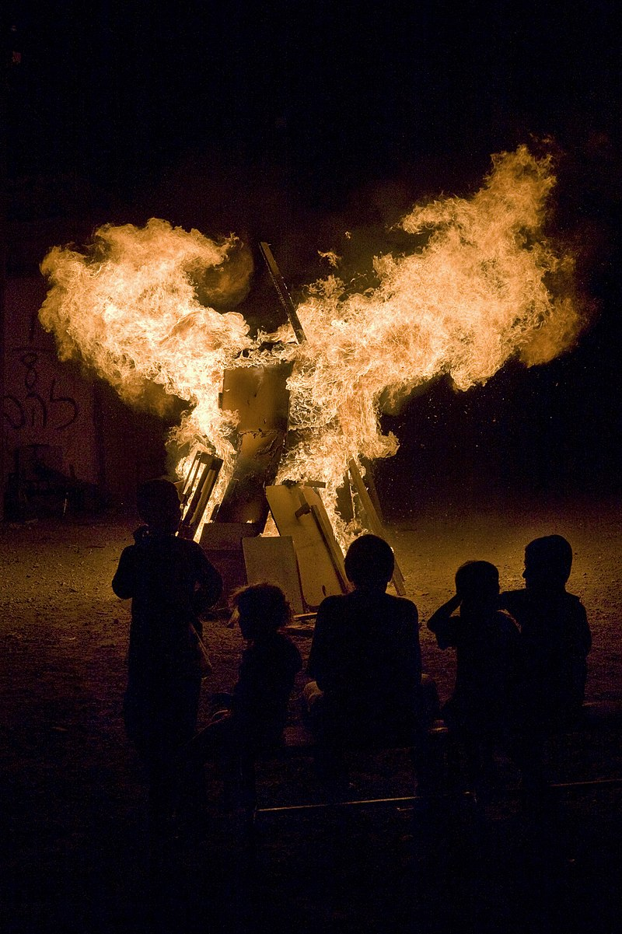
Children watch Lag BaOmer bonfire in Tel Aviv, Israel
Notes:
https://en.wikipedia.org/wiki/Lag_BaOmer
By Roi Boshi - Own work, CC BY-SA 3.0, https://commons.wikimedia.org/w/index.php?curid=16923216

Slide 91
The following outreach events are in the works:
Mishloakh Manot: Saturday, March 4
(prep day February 25)
2. Tuesday, May 9: A Different Lag B'Omer
Sunday, May 28: Shavu'ot/Memorial Day
Music Festival on our property with
band stand back facing the street.
4. Sunday, October 1: Sukkot Music
Festival on our property

Slide 93
Meeting at 1:30 today to do this!

Slide 94
A voice cries out here in the desert.
e-handout
To have these notes
without taking notes
Go to OrHaOlam.com
Click on Messages tab,
2022 Messages

Slide 95
How can I go up to my father if the boy isn’t with me?
How can we go up to the Eternal Father if we haven’t brought some of our neighbors?
Notes:
Who is my neighbor?

Slide 97
Do you KNOW Yeshua the Messiah and King?
Are you hearing daily from His Word?
How are you applying what you heard?
Are you offering that water of life to anyone?

