Slide 1
e-handout
To have these notes
without taking notes
Go to OrHaOlam.com
Click on Messages tab,
2023 Messages

Slide 2
David Zinn is an artist from Michigan . He runs around all day in the streets of Ann Arbor , with street construction, cracks, etc. on the road with chalk to create a lot of street fairy tales.
Notes:
Ted Alongi

Slide 3
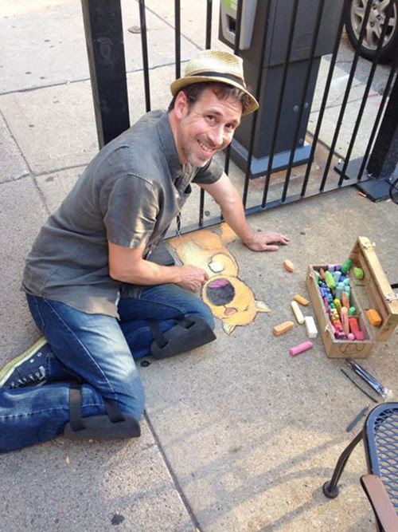
David Zinn, Ann Arbor, MI

Slide 4
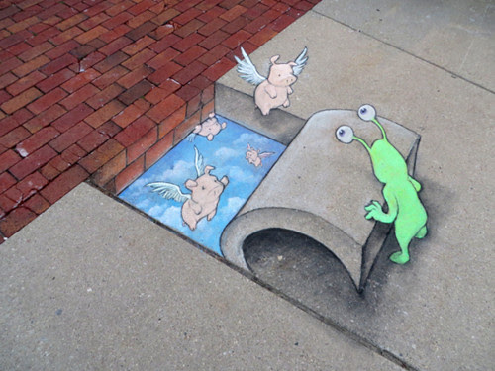

Slide 5
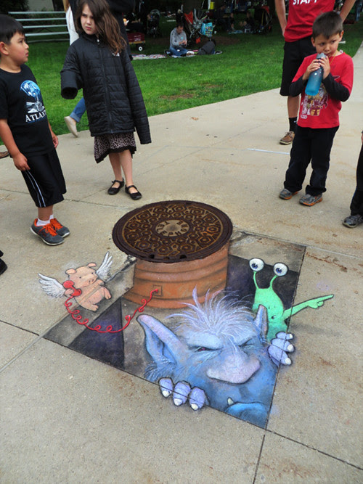

Slide 6
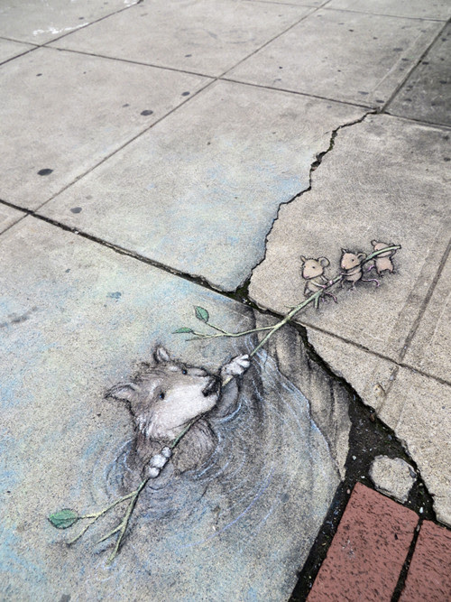

Slide 7
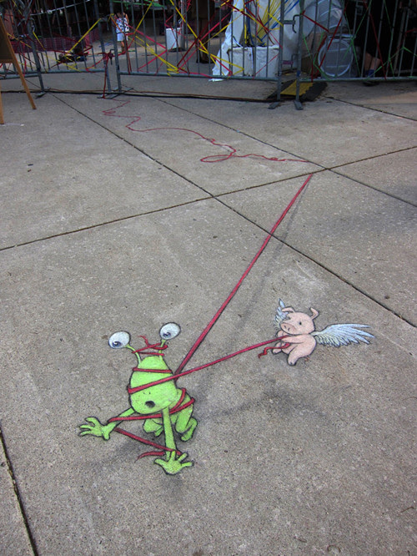

Slide 9
Outline
Procedures of counting
Importance of counting
Hazards during this counting
Relief of hazards
Augmentation of relief

Slide 10
Outline
Procedures of counting
Importance of counting
Hazards during this counting
Relief of hazards
Augmentation of relief

Slide 11
^{Lev 23.9-10} Adonai said to Moshe, "Tell the people of Isra'el, 'After you enter the land I am giving you and harvest its ripe crops, you are to bring a sheaf of the firstfruits of your harvest to the cohen.

Slide 12
Lev 23.11-12 He is to wave the sheaf before Adonai, so that you will be accepted; the cohen is to wave it on the day after the Shabbat. On the day that you wave the sheaf, you are to offer a male lamb without defect, in its first year, as a burnt offering for Adonai.

Slide 13
Lev 23.15-16 From the day after the day of rest — that is, from the day you bring the sheaf for waving — you are to count seven full weeks, until the day after the seventh week; you are to count fifty days; and then you are to present a new grain offering to Adonai .' "

Slide 14
This is the ninth day, which makes one week and two days of the Omer count.
הַיוֹם תִּשְׁעָה יָמִים שֶׁהֵם
שָׁבוּעַ אֶחַד וּשְׁנֵי יָמִים לָעֹמֶר:
Ha-yom teesh-ah ya-meem, sheh-haym
sha-voo-ah eh-khad
oo-shnay yameem la-Omer.

Slide 15
The Counting of the Omer begins on the second day of Passover (the 16th of Nisan) for Rabbinic Jews (Orthodox, Conservative, Reform), and after the weekly Shabbat during Passover for Karaite, Samaritan, Sadduccean Jews.
Notes:
https://en.wikipedia.org/wiki/Counting_of_the_Omer

Slide 16
Ethiopian Jews traditionally had yet another practice: they interpreted the "day of rest" to be the last day of Passover, rather than being the first day (as in rabbinic tradition) or else the Sabbath (as for Karaites).
Notes:
https://en.wikipedia.org/wiki/Counting_of_the_Omer

Slide 17
The counting is preferably done at night, at the beginning of the Jewish day. If one realizes the next morning or afternoon that they have not yet counted, the count may still be made, but without a blessing.
Notes:
https://en.wikipedia.org/wiki/Counting_of_the_Omer

Slide 18
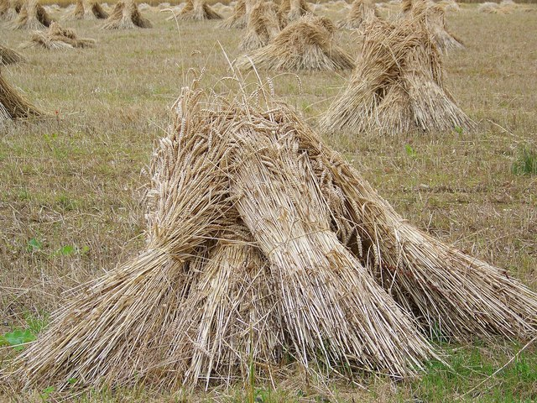
Modern day wheat sheaves.
Counting during the Omer gathering
Notes:
Not actually counting the Omer, although this is the terminology. Most of us don’t have any wheat to bundle into sheaves and count!

Slide 19
Omer counting app, available at the Google play store, iPhone App Store..
Notes:
Some screenshots from my phone, yesterday…

Slide 20
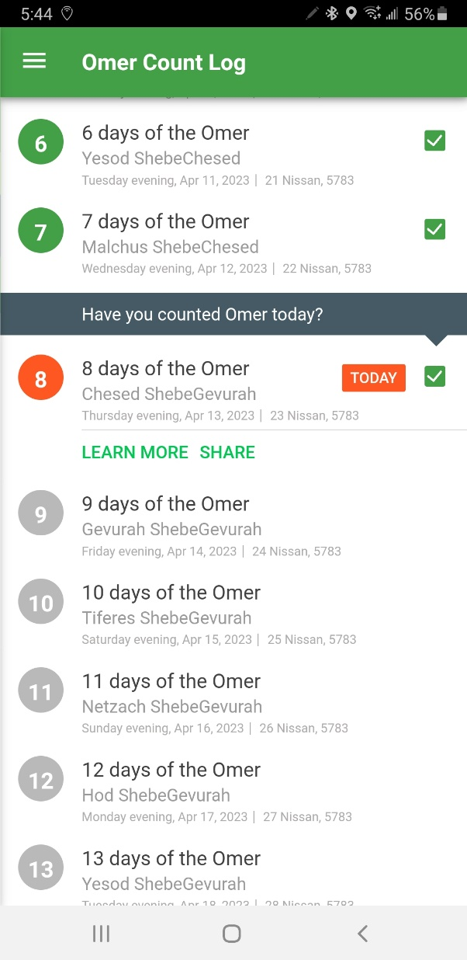

Slide 21
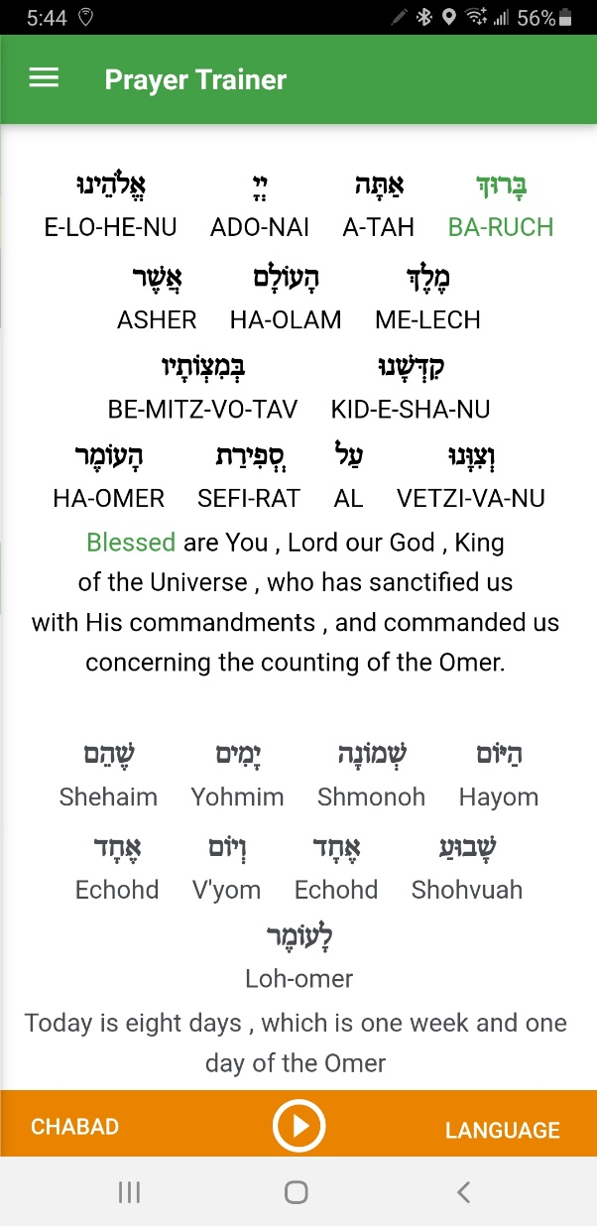

Slide 22
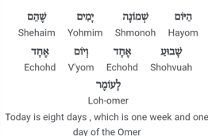

Slide 23
Omer counting app, available at the Google play store, iPhone App Store..
Notes:
Some screenshots from my phone, yesterday…

Slide 25
Outline
Procedures of counting
Importance of counting
Hazards during this counting
Relief of hazards
Augmentation of relief

Slide 26
A lot of things are counted in scripture.

Slide 27
Counted people in the book of Numbers [Bamidbar in Heb.]
David numbered Israel, without the half shekel tax, and brought great trouble
Notes:
Hence the name: G-d treasures

Slide 28
^{Tehillim/Ps 46.12-14} Walk through Tziyon, go all around it; count how many towers it has. Note its ramparts, pass through its citadels, so that you can tell generations to come that such is God, our God forever; he will guide us eternally.
Notes:
Count blessings → praise

Slide 29
^{T’hillim/Ps 79:8} Don't count past iniquities against us, but let your compassion come quickly to meet us, for we have been brought very low.
^{Tehillim/Ps 90.12} So teach us to count our days, so that we will become wise.
Notes:
Stop here, count our days

Slide 30
^{T’hillim/Ps22.17-18} I can count every one of my bones, while they gaze at me and gloat. They divide my garments among themselves; for my clothing they throw dice.
A prophetic picture of Yeshua’s death by the execution stake.
Notes:
Count humiliation → death for our atonement.

Slide 31
^{Yn 21.10-11}Yeshua said to them, “Bring some of the fish you have just caught.” Shim‘on Kefa went up and dragged the net ashore. It was full of fish, 153 of them.
How did he know, so fast?
You count the things you value.

Slide 32
^{1 Cor. 4.4-5} I am not aware of anything against me, but this does not make me innocent. The one who is evaluating me is the Lord. So don't pronounce judgment prematurely, before the Lord comes; for he will bring to light what is now hidden in darkness; he will expose the motives of people's hearts.
Notes:
Counting of himself: knows corruption of his heart
Sin offering Lev 1-6 for unintentional sins: corruption of our heart not intentional

Slide 33
^{Acts 2.1} When the Day of Shavuot had fully come συμπλεροο
soom-play-ro'-o
Definition συμπλεροο
to fill completely, of the hold of a ship
to complete entirely, be fulfilled: of time
Notes:
Ever done in the Messianic Scriptures?
Seemed talmidei Yeshua counted after He left
Seemed to work pretty well→ Ruakh HaKodesh FILLING, IMMERSION
Our Shalikhim, primary founding leaders

Slide 34
Yeshua’s followers were praying and counting up to Shavuot / Pentecost.
The Spirit came on that day of the Shavuot wheat harvest festival.

Slide 36
Outline
Procedures of counting
Importance of counting
Hazards during this counting
Relief of hazards
Augmentation of relief

Slide 37
In Israel, the omer period coincides with the final ripening period of wheat before it is harvested around Shavuot. In this period, the quality of the harvest is very sensitive, and can easily be ruined by bad weather. Thus, the omer period stresses human vulnerability and dependence on God.
Notes:
https://en.wikipedia.org/wiki/Counting_of_the_Omer

Slide 38
Risky time of year: wheat crop is maturing, in danger of frost, hail, thunderstorm, insects “white to harvest”

Slide 39
^{1 Smu 12.17-19} Now is wheat harvest time, isn’t it? I am going to call on Adoni to send thunder and rain. Then you will understand and see how wicked from Adoni’s viewpoint is the thing you have done in asking for a king.” Sh’mu’el called to Adoni,

Slide 40
^{1 Smu 12.17-19} and Adoni sent thunder and rain that day. Then all the people became very much afraid of Adoni and Sh’mu’el. All the people said to Sh’mu’el, “Pray to Adoni your God for your servants, so that we won’t die;
Notes:
Ie lose our harvest.

Slide 41
Time of semi-mourning: disasters especially first 33 days
Holocaust Memorial 6 million
Yom HaZikaron Israeli War dead
Notes:
In 2010 Yom Hazikaron, Israel honored the memory of 22,684 Israeli soldiers and pre-Israeli Palestinian Jews killed since 1860 in the line of duty for the independence, preservation and protection of the nation, and 3,971 c.ivilian terror victims
https://en.wikipedia.org/wiki/Israeli_casualties_of_war

Slide 42
Rabbi Akiva, one of the greatest Sages of the Mishnah (the oral Torah) lived in approximately 50-135 CE. In the weeks between Passover and Shavuot, his 24,000 disciples died tragically. Because of this, the mourning practices that one would observe after the death of a family member are also observed during the Omer.
Notes:
https://www.thepostathens.com/article/2023/04/opinion-haddy-the-hebrew-purpose-counting-omer

Slide 43
The Sephardic manuscript of Iggeret [letter] of Rabbi Sherira Gaon describes them as dying due to "persecution" (shmad), and based on this some modern scholars have suggested that they died in the Bar Kokhba revolt, as military heroes. Later Zionist view.
Notes:
https://en.wikipedia.org/wiki/Counting_of_the_Omer

Slide 44
Among the Orthodox marriages and wedding celebrations are prohibited, as well as cutting one’s hair, listening to instrumental music and purchasing and wearing new clothes or accessories.
[We don’t follow this, but FYI.]
Notes:
https://www.thepostathens.com/article/2023/04/opinion-haddy-the-hebrew-purpose-counting-omer

Slide 45
Traditionally, the mourning is in memory of the death of Rabbi Akiva's 24,000 students, as described in the Talmud. (According to the Talmud they died in a "plague" as punishment for not honoring one another properly.
Notes:
https://en.wikipedia.org/wiki/Counting_of_the_Omer

Slide 46
Are we in a risky time, as we count our way to Shavuot?

Slide 47
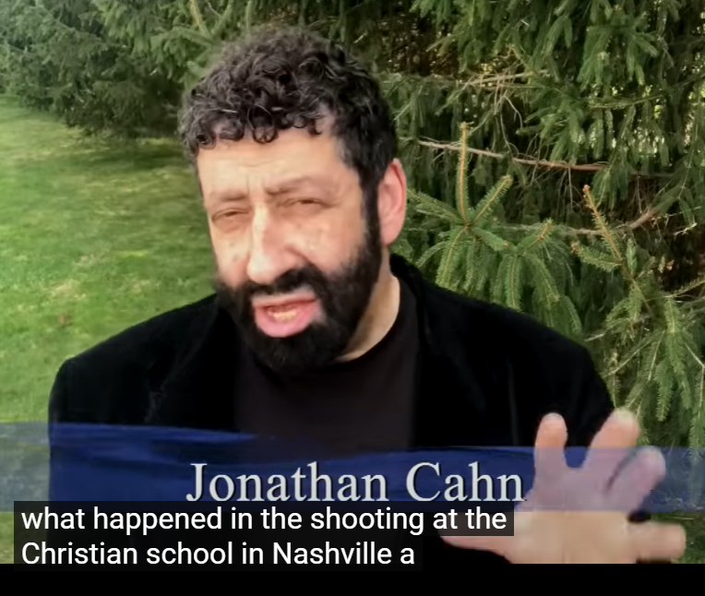
Notes:
https://www.youtube.com/watch?v=_TMhHIqfrrA

Slide 48
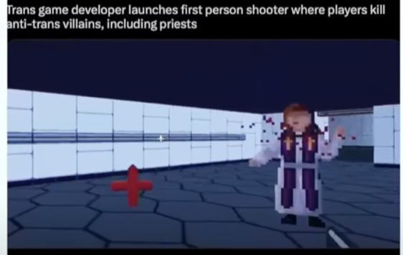
Months before…
Notes:
Https://www.youtube.com/watch?v=_TMhHIqfrrA

Slide 49
שֵׁדים
They tend to move the individual they possess from their nature or purpose. Gender, humanity. Bots. [Yuval Harrari and AI]
שֵׁדים Demons behind ancient gods.

Slide 50
Western Civilization was redeemed from these spirit in the early years of Christianity.
Mt 12 “Now when an unclean spirit goes out of a man, it passes through waterless places looking for rest and doesn’t find it. Then it says, ‘I’ll go back home where I came from.’
Notes:
Https://www.youtube.com/watch?v=_TMhHIqfrrA

Slide 51
^{Mt 12} And when it comes, it finds the house vacant, swept clean, and put in order. Then it goes and brings along seven other spirits more evil than itself, and they go in and live there. And that man’s last condition becomes worse than the first. So also will it be for this evil generation.”

Slide 52
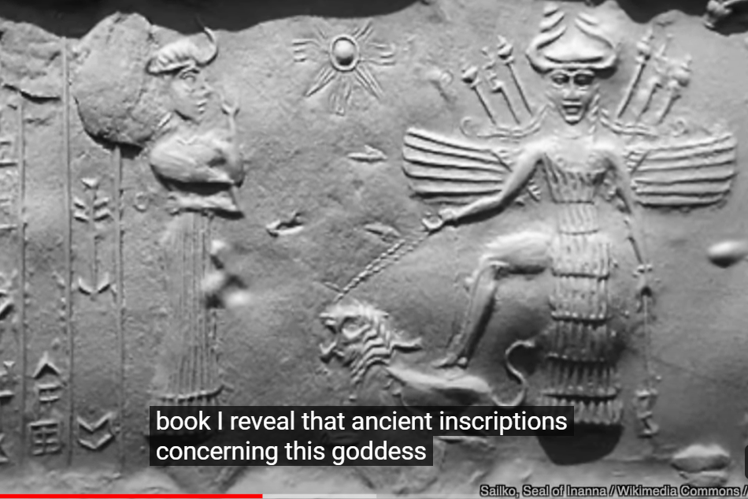
Notes:
Https://www.youtube.com/watch?v=_TMhHIqfrrA

Slide 53
She possessed the month of June.
as women, some surgically transitioned. Some dancing in front of the goddess with scalpels, celebrating transition.
Notes:
https://www.youtube.com/watch?v=_TMhHIqfrrA

Slide 54
Transwoman Nashville shooter was one of those confused women.
Audrey Hale = the one who dwells in the hollows.
Notes:
https://www.youtube.com/watch?v=_TMhHIqfrrA

Slide 55
The number of the anti-Messiah 666.
She killed 6 people. Adults ages 60, 61, 60. She didn’t know, but spirits did.
Three children: 9, 9, 9 inverted 6.
The demons are after the culture. After you and me.
Notes:
https://www.youtube.com/watch?v=_TMhHIqfrrA

Slide 56
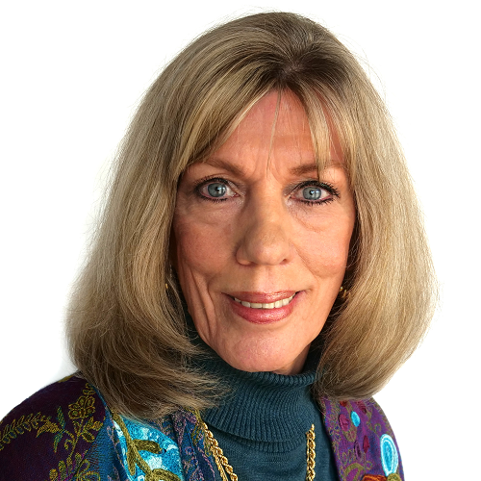
Lela Gilbert, reporter for Tony Perkins January 16, 2023
Did you know that assaults, harassment, and vandalism against Jews take place in the United States seven times a day?
Notes:
https://washingtonstand.com/commentary/what-every-christian-needs-to-know-about-antisemitism-

Slide 57
Are you aware that lies and distortions about religious Jews and their educational institutions are being published in prestigious news publications, including The New York Times? Have you heard that Jews are targeted for more hate crimes in the U.S. than any other group?
Notes:
https://washingtonstand.com/commentary/what-every-christian-needs-to-know-about-antisemitism-

Slide 58
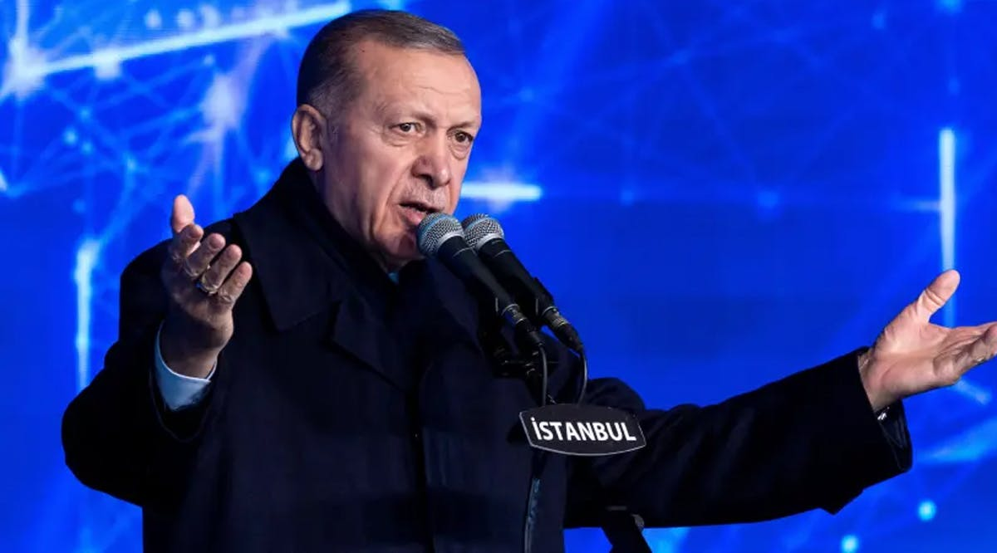
Turkish President
Recep Tayyip
Erdogan
Notes:
https://images.prismic.io/vfi-news/982e67b3-bfa9-415c-9279-1915a30c5203_4.jpg?auto=compress,format&rect=0,0,1200,666&w=1200&h=666

Slide 59
Turkish president Recep Tayyip Erdogan told his Iranian counterpart Ebrahim Raisi over the phone that the "Islamic world should be united against Israel's attacks in Palestine," Turkish media reported.
Notes:
https://vfinews.com/news/lucys-organs-were-donated-pa-will-pay-her-killers/muslim-world-must-unite-against-israel-erdogan-says?subscribed=true&mc_cid=71f6cbfc98&mc_eid=UNIQID

Slide 60
UPDATE: Hostility against churches continues to grow.
2018: 50 acts of hostility
2019: 83 acts of hostility
2020: 54 acts of hostility
2021: 96 acts of hostility
2022: 191 acts of hostility
First quarter of 2023: 69 acts of hostility

Slide 62
Outline
Procedures of counting
Importance of counting
Hazards during this counting
Relief of hazards
Augmentation of relief

Slide 63
Lag BaOmer, the thirty-third day of the Omer, is considered to be the day on which the students stopped dying, so all the rules of mourning are lifted.
Notes:
https://www.thepostathens.com/article/2023/04/opinion-haddy-the-hebrew-purpose-counting-omer
Military victory, or cessation of the plague, or repentance of disrespect not known for sure.

Slide 64
Lag BaOmer לַ״ג בָּעוֹמֶר‎ = 33rd day of the Omer count
ל = 30
ג = 3
לַ״ג = 33

Slide 65
Cessation of plague 24,000
battlefield gain,
repentance of disrespect.

Slide 66
Personal note

Slide 67
Since no weddings were allowed during the Omer Count, except during Lag B’Omer, before my Dad was shipped off to Saipan for WW II, he came back to NYC for a religious wedding on Lag B’Omer.
Notes:
They already had had a civil ceremony on an Army base in Kansas.

Slide 68
Irving and Miriam Wolkenfeld,
Lag B’Omer wedding 1943?

Slide 69
Irving and Miriam Wolkenfeld,
Lag B’Omer wedding 1943?

Slide 70
In modern Israel, Lag BaOmer is "a symbol for the fighting Jewish spirit". Remembers the Bar Kokhba revolt againt the Romans in 132 CE, successful for 3 years.
Parades
Barbecues
Songs around bonfires
Notes:
https://en.wikipedia.org/wiki/Lag_BaOmer
Also first haircut at age three, shooting arrows, visits to the tombs of Rabbi Shimon bar Yochai in Meron, Israel, or at the Jerusalem grave of Shimon Hatzaddik for those who cannot travel to Meron.[15]

Slide 71
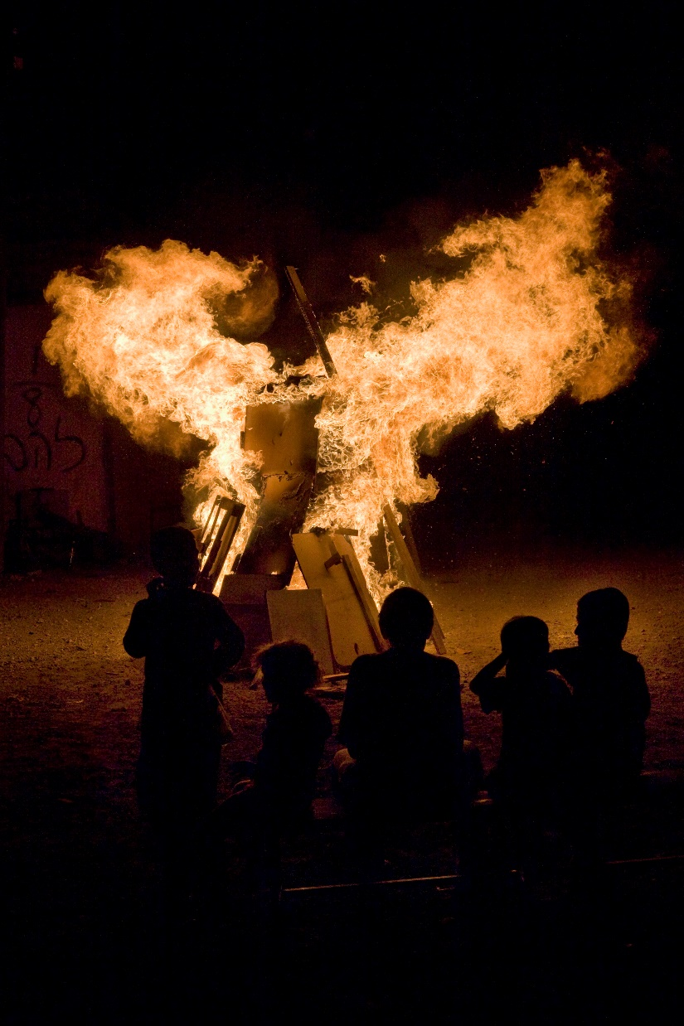
Children watch Lag BaOmer bonfire in Tel Aviv, Israel.
Families go on picnics and outings.
Notes:
https://en.wikipedia.org/wiki/Lag_BaOmer

Slide 72
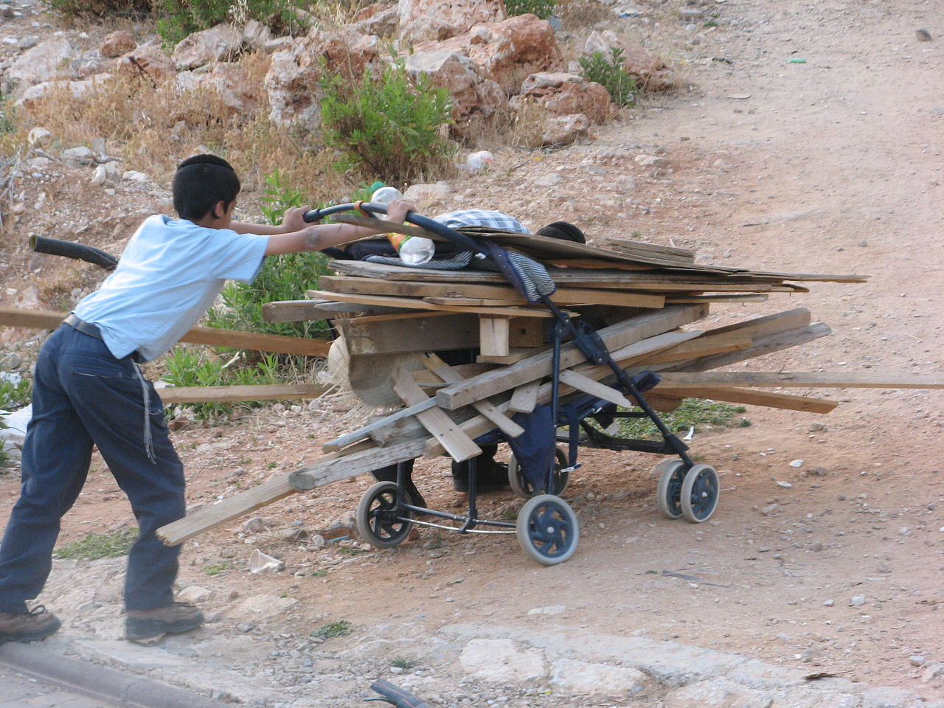
Israeli boy collects wood for a
Lag BaOmer bonfire.
Notes:
https://en.wikipedia.org/wiki/Lag_BaOmer

Slide 73
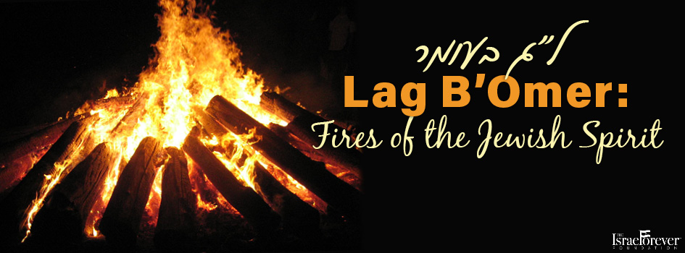
Notes:
https://external-content.duckduckgo.com/iu/?u=http%3A%2F%2Fisraelforever.org%2Fisrael%2Fcelebrating%2FLag_BOmer_945x350.jpg&f=1&nofb=1&ipt=4650c1e101d7ff0451b23417e1317b9bd4a9b764091224781c14593738a071dc&ipo=images

Slide 74
Singing around the bonfire.
Notes:
https://i.ytimg.com/vi/-UuVjYcuiRA/maxresdefault.jpg
https://www.youtube.com/watch?v=-UuVjYcuiRA

Slide 75
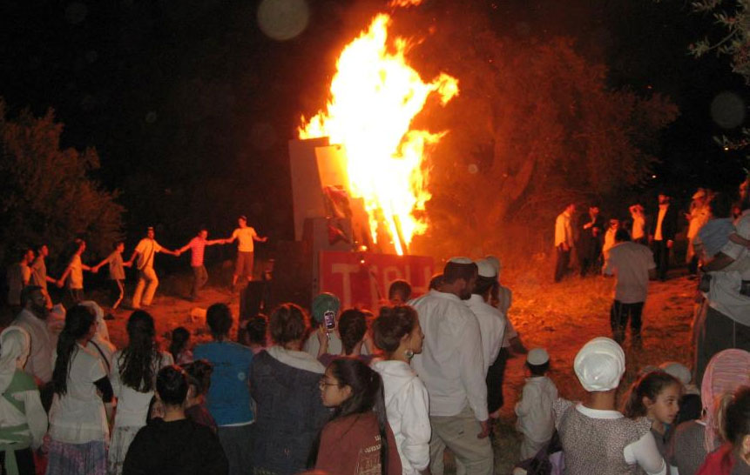
Lag B'Omer Bonfire in Tel Hebron,
on Saturday night, April 27.

Slide 76
Or HaOlam Messianic Synagogue will have its first Lag B’Omer bonfire barbecue celebrating the victory of Messiah in preserving Israel, militarily and spiritually!
6 p.m. May 8th
Not the Kabbalistic meanings!

Slide 77
Or HaOlam will have a combined Shavuot / Memorial Day Ingathering May 28, noon to 5 p.m.
Notes:
Better term than outreach.

Slide 78
Shavuot, / Memorial Day May 28
Bandshell
Food truck
Bounce house
Vendors
Prayer station
Meeting 4/29 1:30 pm

Slide 80
Outline
Procedures of counting
Importance of counting
Hazards during this counting
Relief of hazards
Augmentation of relief

Slide 81
What is augmented about our Omer counting this year as we count our way with GREAT anticipation to Shavuot / Pentecost??

Slide 82
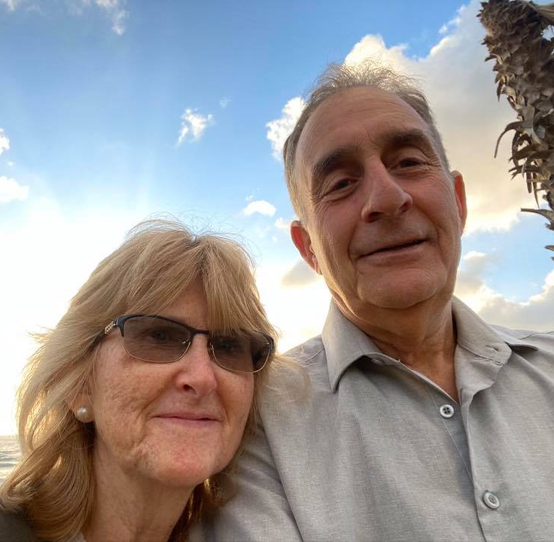
Shmuel and Chaya Birnbaum
Messianic leader, Bat Yam, Israel
Notes:
On a Zoom prayer meeting Thursday, Shmuel longed for the conviction of sin that we, the alta menschen, not young men in the Zoom, experienced. He said it only comes by TIME spent before the Holy One, Yeshua. Yeshua is the Adoni of Isaiah 6. He is making intercession at the right hand of the father, and bids us to the same. Omer count in the first chapter of Acts was prayer. “These all devoted themselves single-mindedly to prayer.”

Slide 83
Dan Juster
Cong leader for over 27 years
Founding President (1979-1986) of the Union of Messianic Jewish Congregations (UMJC)
Notes:
https://en.wikipedia.org/wiki/Daniel_Juster

Slide 84
Dan Juster
General Secretary (1996-1998) of the UMJC
Co-founder of Messianic Jewish Biblical Institute
Notes:
https://en.wikipedia.org/wiki/Daniel_Juster

Slide 85
Juster is also a founding board member of Toward Jerusalem Council II.
presently serves as the Founder and Director of Tikkun International, a network of congregations and ministries in the United States and abroad dedicated to the restoration of Israel and the Church.
Notes:
https://en.wikipedia.org/wiki/Daniel_Juster

Slide 86
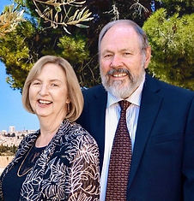
The prophetic word
given to Mike Bickle
40 years ago was that his calling was to raise up 100 million intercessors
to pray for the
salvation of Israel
Notes:
1983

Slide 87
in May 1983, and which led to a great fasting and prayer time. It was quite beyond him, for he did not even yet have clarity on the election of the Jewish people. Of course, over time Mike gained greater and greater clarity of his calling with regard to Israel.
Notes:
https://www.tikkunglobal.org/restorationfromzion

Slide 88
A supernatural connection was made between Mike and the founding leaders of Tikkun in January 1990. We have walked in relationship for 33 years. The great announcement is that through networking and media not even to be conceived 40 years ago, intercessory ministries around the world have been joined together
Notes:
https://www.tikkunglobal.org/restorationfromzion

Slide 89
with IHOP to bring 100 million people into unified prayer and fasting for the salvation of Israel on May 28th. The 21 days leading up to this will also be days dedicated to fasting and prayer, a growing contingent estimated to include one million people. We in Israel are joining in these days of prayer.
Notes:
https://www.tikkunglobal.org/restorationfromzion

Slide 90
For us, May 9-24

Slide 91
Join over 1 million believers who will engage in prayer for Israel for at least one hour a day for 21 days. For us, May 9-24. for the increase of God’s salvation promises and plans for Jerusalem and Israel and the diaspora Jews. Some will pray alone and others will pray with 2 or more virtually or in-person—in their home, office, dorm, or at their congregation, etc.

Slide 92
During the Omer counting time, we will enter into Yeshayahu Is. 62

Slide 93
^{Yeshayahu/Is 62.6-7} On your walls, Jerusalem, I have set watchmen. All day and all night, they will never hold their peace. “You who remind Adoni, take no rest for yourselves, And give Him no rest until He establishes and makes Jerusalem a praise in the earth.

Slide 94
When to fast and pray?
Fast as you choose: water, liquids, light fruit
Pray one extra hour / day
Meet Wednesdays?
Visit the IHOPKC prayer room

Slide 95
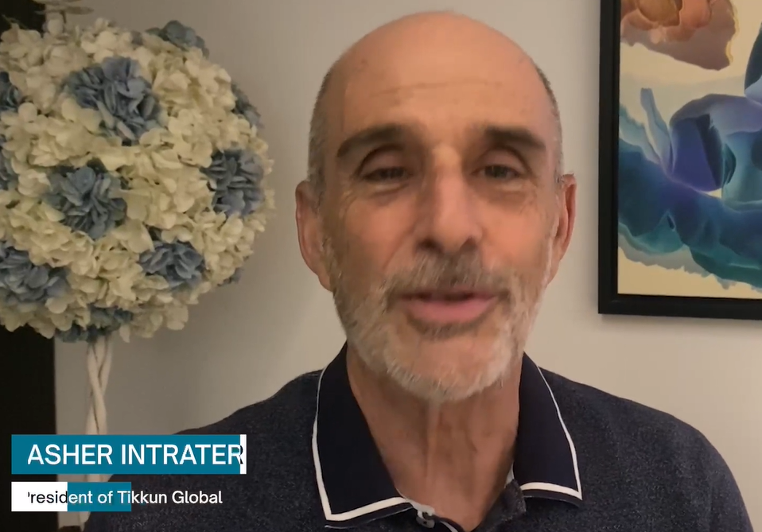
Notes:
https://video.wixstatic.com/video/c39fc4_7417427fc163421090c9b605f1ca64e7/1080p/mp4/file.mp4

Slide 96
הַאֲנִי אַשְׁבִּיר וְלֹא אֹולִיד יֹאמַר יי ^{Isaiah 66:9}
“Will I bring to the breach and not cause to give birth?” says the LORD.

Slide 97
The word for bring to breach is maSHBiR. The word for crisis in Hebrew is maSHBeR מַשׁבֵּר.
The root isש-ב-ר Sh-B-R meaning break. This is also the same root for broken, broken-hearted, breaking bread, provision.

Slide 98
Crisis is a moment to give birth. When we feel broken, God can bring a breakthrough.

Slide 100
Outline
Procedures of counting
Importance of counting
Hazards during this counting
Relief of hazards [Ingathering]
Augmentation of relief

Slide 101
Do you KNOW Yeshua and drinking the water of LIFE?
Are you hearing daily from His Word?
How are you applying what you heard?
Are you offering that water of life to anyone?

