Slide 1
e-handout
To have these notes
without taking notes
Go to OrHaOlam.com
Click on Messages tab,
2023 Messages
Notes:
I promised those who came Sunday morning that we’d see the Grand Finale prayer on the South Steps of the Temple. Rather, we saw the King of Kings Clall Building alternating with IHOP KC, which was OK. Nevertheless, here is what I promised. Pretty exciting.

Slide 2
Culmination of 21 Day
Isaiah 62 Fast

Slide 3
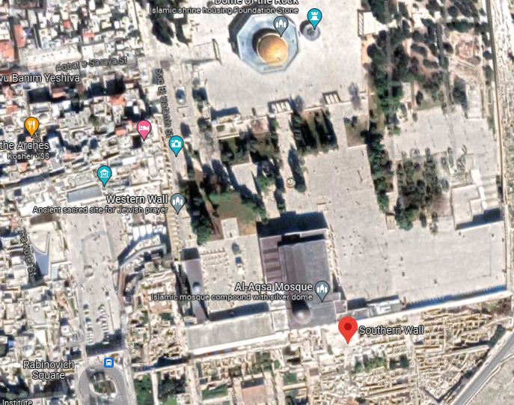
Notes:
Davidson Museum to the west/left.

Slide 4
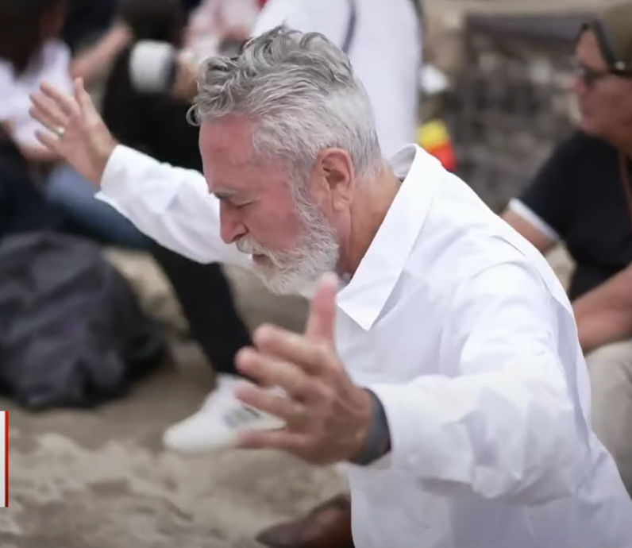
Messianic Rabbi
Hylan Slobodkin
Notes:
https://www.youtube.com/watch?v=ncPbWwvBri0
0.22 to 3.21

Slide 5
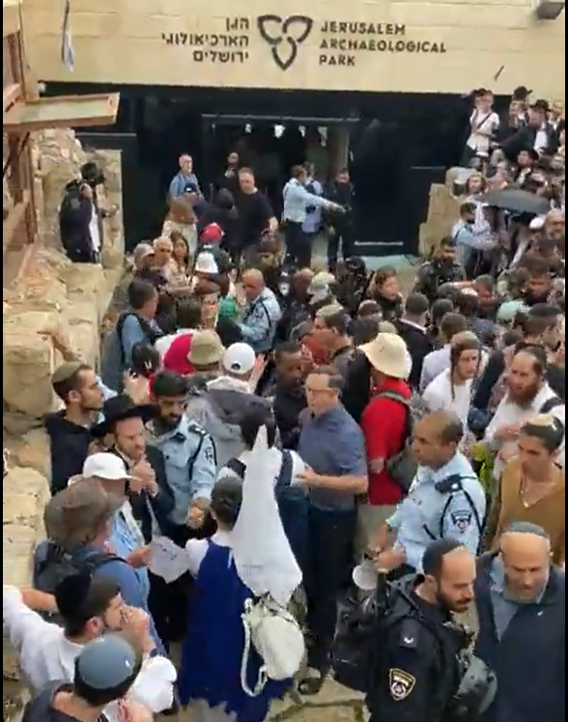
“Missionaries, go home!”
Notes:
https://twitter.com/i/status/1662712915613327360
Davidson Center = Jerusalem Archeological Park

Slide 6
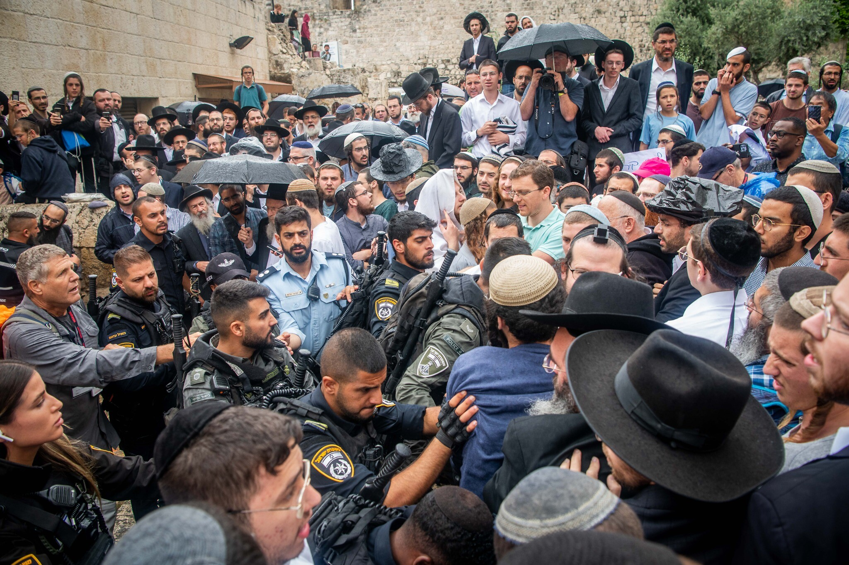
Notes:
Radical Jewish activists clash with police during a protest against a conference of Christians outside the Davidson Center in Jerusalem, Israel, on May 28, 2023. (Arie Leib Abrams/ Flash90)

Slide 7
Notes:
https://youtu.be/vRlOU-Hw_6M
Ron Cantor

Slide 8
Notes:
https://youtu.be/vRlOU-Hw_6M

Slide 9
Notes:
https://youtu.be/vRlOU-Hw_6M
Powerful women’s ministry in Nazarth with Christian Arab and Messianic Jewish women.

Slide 10
Notes:
https://youtu.be/vRlOU-Hw_6M
Who married one of our One Thing kids, Venessa Leif from the Tampa congregation.

Slide 11
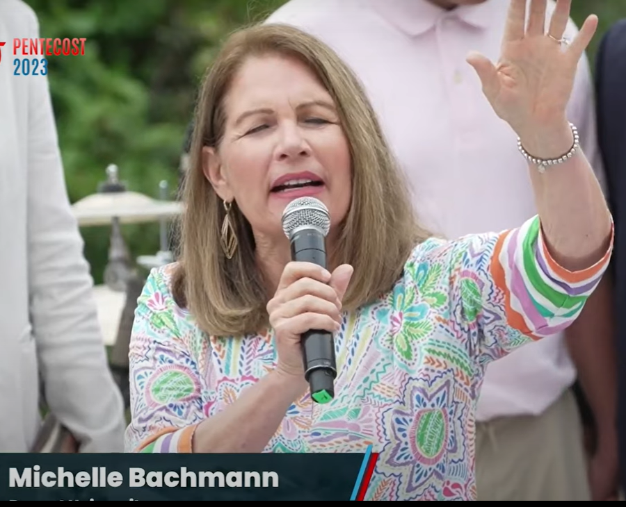
Notes:
https://youtu.be/vRlOU-Hw_6M

Slide 12
So what does it all mean?

Slide 13
No Levitical holidays,
No big events for the summer. [Tisha B’Av]

Slide 14
^{Yn 4.35-38} Don’t you say, ‘Four more months, and then comes the harvest’? Look, I tell you, lift up your eyes and look at the fields! They are white and ready for harvest. “The reaper receives a reward and gathers fruit for eternal life, so that the sower and reaper may rejoice together.

Slide 16
^{Shmot/Ex 34.22} “Observe the festival of Shavu‘ot with the first-gathered produce of the wheat harvest, and the Festival of Ingathering at the turn of the year. חַג הָאָסִיף Khag Ha-asif
אָסִיף harvest; harvest time; compilation (literature)

Slide 17
Four months till Fall Holidays, harvest
Notes:
https://www.chabad.org/holidays/default_cdo/jewish/holidays.htm
Equivalent break before Pesakh. In any case, four months with no Levitical holiday. Tisha B’Av

Slide 18
Four months till Fall Holidays, harvest
Notes:
https://www.chabad.org/holidays/default_cdo/jewish/holidays.htm
Equivalent break before Pesakh. In any case, four months with no Levitical holiday. Tisha B’Av

Slide 19
Slack time at the beach?

Slide 20
^{Yn 4.35-38} Don’t you say, ‘Four more months, and then comes the harvest’? Look, I tell you, lift up your eyes and look at the fields! They are white and ready for harvest. “The reaper receives a reward and gathers fruit for eternal life, so that the sower and reaper may rejoice together.

Slide 21
^{Yn 4.35-38} They are white and ready for harvest. The reaper receives a reward and gathers fruit for eternal life.
Notes:
Colors change when the crop is ripe.

Slide 22
They are white and ready for harvest. The reaper receives a reward and gathers fruit for eternal life.
What harvesting can we do at slack time?
Notes:
Jonathan Cahn Book of Mysteries page/day118 top half.
Saga of short stories in the desert, Teacher and talmid, student. Story about observing a bride.
Read
Comment on Ps 45..

Slide 24
Our goal for the four months
Internal beauty of character
Notes:
Look good for the beach?

Slide 25
^{Tehillim/Ps 45.11-15} Listen, daughter! Think, pay attention! Forget your own people and your father’s house, and the king will desire your beauty; for he is your lord, so honor him.

Slide 26
^{Tehillim/Ps 45.11-15} Then the daughter of Tzor, the richest of peoples, will court your favor with gifts. Inside [the palace], the king’s daughter looks splendid, attired in checker-work embroidered with gold. In brocade, she will be led to the king.
You're here to become beautiful!

Slide 27
^{Col 3.1-4} Therefore, if you have been raised up with Messiah, keep seeking the things above—where Messiah is, sitting at the right hand of God. Focus your mind on things above, not on things on the earth. For you have died, and your life is hidden with Messiah in God. When Messiah, who is your life, is revealed, then you also will be revealed with Him, in glory!
Notes:
Balance Jon Cahn Mysteries p 118

Slide 28
^{Gal 5.22-26} But the fruit of the Spirit is love, joy, peace, patience, kindness, goodness, faithfulness, humility, self control. Nothing in the Torah stands against such things. Moreover, those who belong to the Messiah Yeshua have put their old nature to death on the stake,
Notes:
Take a deep breath, and consider, is my life exemplified by…

Slide 29
^{Gal 5.22-26} along with its passions and desires. Since it is through the Spirit that we have Life, let it also be through the Spirit that we order our lives day by day. Let us not become conceited, provoking and envying each other.

Slide 30
^{Song of Songs 4:16} Awake, north wind, and come, south wind! Blow on my garden, Let its fragrance spread out. Let my lover come into his garden and eat its choicest fruit.
Spiritual beauty is mostly achieved in suffering and humility.
Notes:
Suffering is what enriches our fragrance.

Slide 31
^{Gal 2.20} When the Messiah was executed on the stake as a criminal, I was too; so that my proud ego no longer lives. But the Messiah lives in me, and the life I now live in my body I live by trusting in the Son of God, who loved me and gave himself up for me.

Slide 32
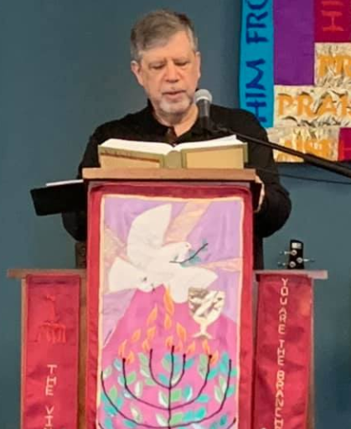
A Passover insight from David Harwood, Jewish Messianic pastor friend in Glen Cove, NY
Notes:
From David Harwood

Slide 33
^{Lk 22.14-27} When the time came, Yeshua and the emissaries reclined at the table, and he said to them, “I have really wanted so much to celebrate this Seder with you before I die! For I tell you, it is certain that I will not celebrate it again until it is given its full meaning in the Kingdom of God.”
Notes:
The following is from David Harwood, a Jewish pastor in Glen Cove, Long Island, NY.

Slide 34
^{Lk 22.14-27} Then, taking a cup of wine, he made the b’rakhah and said, “Take this and share it among yourselves. For I tell you that from now on, I will not drink the ‘fruit of the vine’ until the Kingdom of God comes.” Also, taking a piece of matzah, he made the b’rakhah, broke it, gave it to them and said,

Slide 35
^{Lk 22.14-27} “This is my body, which is being given for you; do this in memory of me.” He did the same with the cup after the meal, saying, “This cup is the New Covenant, ratified by my blood, which is being poured out for you.
Notes:
Special, sacred moment. Initiated a ritual that would commemorate His atonement!
Response??

Slide 36
^{Lk 22.14-27} “But look! The person who is betraying me is here at the table with me! The Son of Man is going to his death according to God’s plan, but woe to that man by whom he is being betrayed!” They began asking each other which of them could be about to do such a thing.
Notes:
Dreadful thought of a traitor in the midst. Then….

Slide 37
^{Lk 22.14-27} An argument arose among them as to which of them should be considered the greatest.
Notes:
They all missed the point of the Seder of Messiah, and the warning about the traitor. They were all traitors and corrupted.

Slide 38
^{Lk 22.14-27} But Yeshua said to them, “The kings of the Goyim lord it over them; and those in authority over them are given the title, ‘Benefactor.’ But not so with you! On the contrary,

Slide 39
^{Lk 22.14-27} let the greater among you become like the younger, and one who rules like one who serves. For who is greater? The one reclining at the table? or the one who serves? It’s the one reclining at the table, isn’t it? But I myself am among you like one who serves.
Notes:
Sometimes I take out the garbage at Oneg, just to establish my spiritual authority!
I’m going to make a segue that is reasonable, but not authoritative.

Slide 40
^{Yn 13.2-11} They were at supper, and the Adversary had already put the desire to betray him into the heart of Y’hudah Ben-Shim‘on from K’riot [Judas]. Yeshua was aware that the Father had put everything in his power, and that he had come from God and was returning to God.
Notes:
Doesn’t say that they just walked in. Feet dusty, itchy, gross, from the road. Notice the timing.
Yeshua did not wash their feet before the meal.
It is written that He “got up from supper”.
They were already reclining.
Most likely their feet were already clean, after all, they were in the midst of their meal.

Slide 41
^{Yn 13.2-11} So he rose from the table, removed his outer garments and wrapped a towel around his waist. Then he poured some water into a basin and began to wash the feet of the talmidim and wipe them off with the towel wrapped around him. He came to Shim‘on Kefa, who said to him, “Lord! You are washing my feet?”
Notes:
Maybe at this point of their contending who was the greatest.

Slide 42
^{Yn 13.2-11} Yeshua answered him, “You don’t understand yet what I am doing, but in time you will understand.” “No!” said Kefa, “You will never wash my feet!” Yeshua answered him, “If I don’t wash you, you have no share with me.” “Lord,” Shim‘on Kefa replied, “not only my feet, but my hands and head too!”

Slide 43
^{Yn 13.2-11} Yeshua said to him, “A man who has had a bath doesn’t need to wash, except his feet — his body is already clean. And you are clean, but not all of you.” (He knew who was betraying him; this is why he said, “Not all of you are clean.”)
Notes:
There was something in the room more foul than the stench of dirty feet pervading that room.
The seeds of the Leadership in the new faith community’s destruction had germinated and needed to be uprooted. Contending for greatness.

Slide 44
Consider this, according to the timing: He loved them by washing their feet, but He was not loving them by washing their dusty feet – It was a prophetic demonstration It was Philippians 2 type of humility This was as low as a person could go in status. Why did Yeshua demonstrate humility?

Slide 45
^{Phil 2.6-8} Though he was in the form of God, he did not regard equality with God something to be possessed by force. On the contrary, he emptied himself, in that he took the form of a slave by becoming like human beings are. And when he appeared as a human being, he humbled himself still more by becoming obedient even to death death on a stake as a criminal!

Slide 46
The Messiah was guarding their destiny. He was preserving them as a community. He loved them as individuals, and He loved them corporately, as a body. He loved their present. He loved their future. He loved what they were and what they would become. He also loved them as the nucleus of mission,

Slide 47
as preservers of the Word of the Kingdom and as the earthly nexus of Heaven’s activity amongst Israel and the nations. He loved them enough to call them to be the foundational people of the Messianic Community. Their relationships would become the pattern for the believers throughout the ages... and they were being derailed!

Slide 48
I can imagine His heart calling out to Father for wisdom. Then, in a moment of prophetic insight, Yeshua “got up from supper” and through the most humiliating, least skilled, “taken for granted” labor, He changed the dynamic of the meal. This was direct divine intervention. It was a shocking prophetic act that would help form them forever.

Slide 49
He did not love them by washing dusty feet. The Lord loved them through washing their feet.
Through washing their feet, He was preserving God’s purposes for their lives. This was inspired prophetic action.

Slide 50
^{1 Thes. 3.12-13} May the Lord make you increase and overflow in love toward each other, indeed, toward everyone, just as we do toward you; so that he may give you the inner strength to be blameless, by reason of your holiness, when you stand before God our Father at the coming of our Lord Yeshua with all his angels. For these four months, increase in beaty by humility, in joy.

Slide 51
There were two warring kingdoms at the Last Supper. There was an undercurrent of conflict as the adversary viciously sought his opportunity to destroy the apostolic community to derail their destiny To make them unfit for mission. The Messiah saw the state of the disciples and looked beyond His resurrection and ascension to the

Slide 52
time the community would no longer have His physical presence. With inspired strategic love Yeshua washed their feet.
That same evening He said,
^{Yn 13.34} “A new commandment I give to you, that you love one another, even as I have loved you, that you also love one another”.

Slide 53
Who can you humble yourself to?

Slide 54
Another dimension
of beauty treatment.

Slide 55
^{2 Kefa 1.3-7} God’s power has given us everything we need for life and godliness, through our knowing the One who called us to his own glory and goodness. By these he has given us valuable and superlatively great promises,
Notes:
Through intimacy with Him

Slide 56
^{2 Kefa 1.3-7} so that through them you might come to share in God’s nature and escape the corruption which evil desires have brought into the world.
Notes:
Saving faith
Goodness moral goodness, virtue, a gracious act, virtue, uprightness.
Knowledge: knowledge, doctrine, wisdom. Gnósis

Slide 57
I have always loved the story of the little girl who was with her father, about to cross a busy street. The father told her to hold his hand tightly. She replied, “No, Daddy, you hold my hand!” The father said, “Isn’t that the same?” To which she replied,
Notes:
George Whitten

Slide 58
“No!” “If I hold your hand, I might get frightened and let go, but if you hold my hand, you’ll never let go.” Covenant love. Strong. Faithful. Forever.

Slide 59
^{2 Kefa 1.3-7} so that through them you might come to share in God’s nature and escape the corruption which evil desires have brought into the world. For this very reason, try your hardest to furnish your faith with goodness, goodness with knowledge,
Notes:
Saving faith
Goodness moral goodness, virtue, a gracious act, virtue, uprightness. You can’t be G-dly and have sex outside of marriage. Emotional adultery. Alone in building.
Knowledge: knowledge, doctrine, wisdom. Gnósis

Slide 60
^{2 Kefa 1.3-7} knowledge with self-control,

Slide 61
Record Credit Card Debt
As lawmakers in Washington debate over the federal debt, Americans are dealing with a debt crisis of their own, as credit card debt this quarter hit a record high. According to new data from the first quarter of 2023,
Notes:
Sometimes this just reflection of desperate measures. Not wanting to throw stones at distress. But if you can survive on cash, just DO it.
Morning Wire Ben Shapiro

Slide 62
Americans have never been more in the red as personal credit card debt hit $986 billion last quarter, according to the Fed. Some estimates put the true number even higher: WalletHub, for example, says it’s actually over $1.2 trillion.
Notes:
Morning Wire Ben Shapiro

Slide 63
All told, the average U.S. household now carries around $10,000 in credit card debt.
I think we're going to start to see more and more families declaring bankruptcy to get out from underneath this debt,” Nelles said.
Notes:
Morning Wire Ben Shapiro economist and supply chain expert Jim Nelles told Morning Wire.

Slide 64
^{2 Kefa 1.3-7} self-control with perseverance, perseverance with godliness, godliness with brotherly affection, and brotherly affection with love. For if you have these qualities in abundance, they keep you from being barren and unfruitful in the knowledge of our Lord Yeshua the Messiah. Character beauty in Messiah!
Notes:
Self control: self-mastery, self-restraint, self-control, continence
Perseverance: endurance, steadfastness, patient waiting for
Godliness: piety (towards God), godliness, devotion, godliness.
Brotherly affection: brotherly love, love of believing brethren
Love: love, benevolence, good will, esteem

Slide 65
^{2 Kefa 1.3-7} self-control with perseverance, perseverance with godliness, godliness with brotherly affection, and brotherly affection with love. For if you have these qualities in abundance, they keep you from being barren and unfruitful in the knowledge of our Lord Yeshua the Messiah.
Notes:
Self control: self-mastery, self-restraint, self-control, continence
Perseverance: endurance, steadfastness, patient waiting for
Godliness: piety (towards God), godliness, devotion, godliness, passion in worship.
Brotherly affection: brotherly love, love of believing brethren
Love: love, benevolence, good will, esteem

Slide 67
Our goal for the four months
Internal beauty of character
Confidence in Messiah.

Slide 68
A new study shows that the percentage of US adults with a worldview based on the Bible dropped to just 4% during the pandemic, Christian Headlines reports. Part of the 2023 American Worldview Inventory, the study was led by George Barna at the Cultural Research Center of Arizona Christian University.
Notes:
https://www.worthynews.com/83641-just-4-of-us-adults-now-hold-worldview-based-on-bible-report-shows

Slide 69
“They no longer teach about the birds and the bees but about the birds and the birds and the bees and the bees and the bees that used to be birds and the birds that used to be bees.”
Notes:
https://askdrbrown.org/article/the-common-sense-wisdom-of-a-sixteen-year-old-girl

Slide 70
Those were the spontaneous comments of our 16-year-old granddaughter as she explained to my wife and I what was being taught in her high school.
Dr. Michael Brown
Notes:
https://askdrbrown.org/article/the-common-sense-wisdom-of-a-sixteen-year-old-girl

Slide 71
Notes:
https://external-content.duckduckgo.com/iu/?u=https%3A%2F%2Fkingstonbarnes.com%2Fwp-content%2Fuploads%2F2023%2F06%2Fpride-month-800x675.jpg&f=1&nofb=1&ipt=886c9977707293d96f454cf19c3840e967715b009b2415487aa00065e439810a&ipo=images

Slide 72
Notes:
https://youtu.be/ChDl2Fz5Qss

Slide 73
Notes:
https://youtu.be/ChDl2Fz5Qss

Slide 75
Our goal for the four months
Internal beauty of character
Confidence in Messiah.
Ingathering

Slide 77
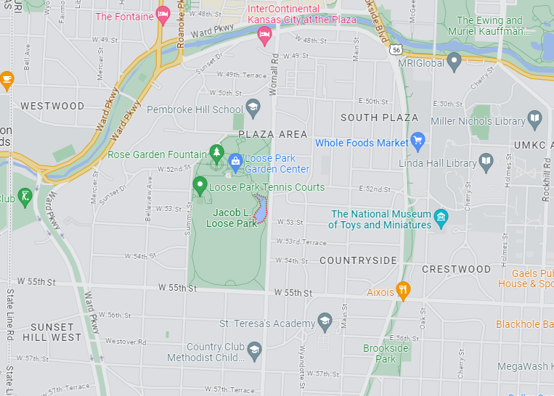
Make
Music Festival June 21

Slide 78
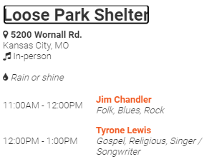

Slide 80
Our goal for the four months
Internal beauty of character
Confidence in Messiah.
Ingathering

Slide 81
Do you KNOW Yeshua?
Are you hearing daily from His Word?
How are you applying what you heard and growing in beauty?
Are you offering that to anyone?

