Slide 1
e-handout
To have these notes
without taking notes
Go to OrHaOlam.com
Click on Messages tab,
2024 Messages

Slide 2
Previous Shabbat was on Rescue:
We are rescued by Messiah
We are rescuers for Messiah
The result is:

Slide 3
^{Eph 4.11-13} He Himself gave some to be emissaries, some as prophets, some as proclaimers of the Good News, and some as shepherds and teachers— to equip the kedoshim, the holy people, for the work of service, for building up the body of Messiah.

Slide 4
^{Eph 4.11-13} This will continue until we all come to the unity of the faith and of the knowledge of Ben-Elohim, the Son of G-d, to mature adulthood, to the measure of the stature of Messiah’s fullness.

Slide 5
The real meaning of mature adulthood.

Slide 6
Notes:
https://youtu.be/pOeD6uq-qRs
From 0.11 to 2.49

Slide 7
The movie uses the word “Person” but that’s not the real expression of the spirit of the culture. The word really used there in Europe or in Yinglish America is
Mensch (Yiddish:מענטש mentsh),
Notes:
Yinglish = Yiddish English, the language of my grandparents in Brooklyn.
There is similarly Spanglish.

Slide 9
Mensch (Yiddish:מענטש mentsh), from Middle High German Mensch, means "a person of integrity and honor". A particularly good person, a person with the qualities one would hope for in a friend or trusted colleague.
Notes:
Wikipedia
Menches, Menchy
https://www.merriam-webster.com/dictionary/mensches
Jonah is a mensch for engaging constructively with his critics.—Ed Yong, Discover Magazine, 31 Mar. 2012
Pray for a menschy congregation.

Slide 10
^{Eph 4.11-13} He Himself gave some to be emissaries, some as prophets, some as proclaimers of the Good News, and some as shepherds and teachers— to equip the kedoshim, the holy people, for the work of service, for building up the body of Messiah.

Slide 11
^{Eph 4.11-13} This will continue until we all come to the unity of the faith and of the knowledge of Ben-Elohim, the Son of G-d, to mature adulthood, to the measure of the stature of Messiah’s fullness.

Slide 12
A Real Mensch (Yiddish: מענטש),
Meaning of mature adulthood from parallel passages
Meaning of mature adulthood in this context
How we get there.

Slide 13
A Real Mensch (Yiddish: מענטש),
Meaning of mature adulthood from parallel passages
Meaning of mature adulthood in this context
How we get there.

Slide 14
FIRST ^{1 Cor. 3.1-3} As for me, brothers, I couldn’t talk to you as spiritual people but as worldly people, as babies, so far as experience with the Messiah is concerned. I gave you milk, not solid food, because you were not yet ready for it.

Slide 15
^{1 Cor. 3.1-3} But you aren’t ready for it now either! For you are still worldly! Isn’t it obvious from all the jealousy and quarrelling among you that you are worldly and living by merely human standards?
Notes:
Is there jealousy and quarreling…correction. We so want to be admired, appreciated. When people tell you that you are wrong, in error. When you spouse tells you….
Menschy people receive correction with grace, maturity. Improve if at all possible. Opposite of narcissism. New word to me. People who have to be in the spotlight. Admired, inability to empathize.
Mensch or narcissist?

Slide 16
SECOND ^{1 Cor 13.11-13} When I was a child,I spoke like a child, I thought like a child, I reasoned like a child. When I became a man I put away childish things. For now we see in a mirror dimly, but then face to face. Now I know in part, but then I will know fully,

Slide 17
^{1 Cor 13.11-13} even as I have been fully known. But now these three remain— faith, hope, and love. And the greatest of these is love.
Notes:
Essence of menschy maturity is love.

Slide 18
THIRD ^{1 Cor 14.19-20} In a congregation meeting I would rather say five words with my mind in order to instruct others than ten thousand words in a tongue! Brothers, don’t be children in your thinking. In evil, be like infants; but in your thinking, be grown-up.
Notes:
Showy prophetic gifts cf help others.

Slide 19
FOURTH ^{Phil 3.13-15} One thing I do: forgetting what is behind me and straining forward toward what lies ahead, I keep pursuing the goal in order to win the prize offered by God’s upward calling in the Messiah Yeshua. Therefore, as many of us as are mature, let us keep paying attention to this.
Notes:
Leave behind failures and sins in repentance as necessary, and reaching toward Yeshua.

Slide 20
Summary of maturity menschy:
Not self centered & quarrelling
Focus on love for others
Not showy “spirituality” rather teaching, helpful.
Forgive self & others and reach for Melekh Messiah Yeshua
Notes:
Birgitta Veksler song

Slide 22
A Real Mensch (Yiddish: מענטש),
Meaning of mature adulthood from parallel passages
Meaning of mature adulthood in this context
How we get there.

Slide 23
^{Eph 4.11-13} He Himself gave some to be emissaries, some as prophets, some as proclaimers of the Good News, and some as shepherds and teachers— to equip the ¹kedoshim, the holy people, for the ²work of service, ³for building up the body of Messiah.

Slide 24
^{Eph 4.11-13} This will continue until we all ⁴come to the unity of the faith and of ⁵the knowledge of Ben-Elohim, the Son of G-d, to mature adulthood, to the measure of the stature of Messiah’s fullness.

Slide 25
the kedoshim, the holy people,
for the work of service,
for building up the body of Messiah.
unity of the faith and
of the knowledge of Ben-Elohim, the Son of G-d

Slide 26
Identity as קדושים kedoshim, holy people
Separate: language, jokes
Undefiled
Bright
Notes:
RW Dunn, Business Mgr and Bible teacher, in whose office where Dawn and I met, was asked one time, “Are you one of those holy people?” with a sneer.
He told us he responded, “Are you one of those unholy people?”
Group I got saved in, focus on character, ethics [touching the opposite gender]
Modesty. Don’t be an eye popper. Ask your husband or mother.
Kadosh really undefinable. The G-dness of G-d.

Slide 27
Work of the service
How do we serve?
Little things: paper coffee cup, drop food, hang up coat, courtesy stand up, ladies first.
Purim mishloakh manot, food gifts, Passover table hosts
When do we serve? When asked, consider. Lowest job.
Notes:
Not me. I’m a scholar. A creative…prima donna. I pay people to do that. Narcissist cf mensch

Slide 28
3. For building up the body of Messiah.
Work to make people feel loved, accepted, important.
Encourage those that may seem to be in difficulty.
Look for those eating alone.

Slide 29
^{2 Cor 7.5-7} For indeed when we came into Macedonia, our bodies had no rest. On the contrary, we faced all kinds of troubles — altercations without, apprehensions within. But God, who encourages the downhearted, encouraged us with the arrival of Titus!
Notes:
I thought you are supposed to get encouragement from G-d?
Well, that primarily, but people help. “People who need people…”

Slide 30
^{2 Cor 7.5-7} However, it was not only his arrival which encouraged us, but also how encouraged he was about you, as he told us how you long to see me, how distressed you are over my situation, how zealous you are in my defense — this news made me even happier!
Notes:
So Paul/Shaul had detractors who affected him!

Slide 31
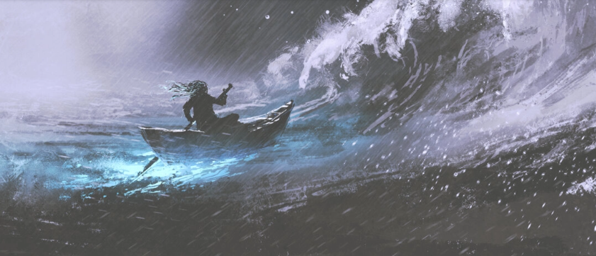
Resilience the power to turn hardship into strength
Notes:
https://www.theepochtimes.com/health/resilience-the-power-to-turn-hardship-into-strength-5604084?src_src=Health&src_cmp=health-2024-03-14&est=AAAAAAAAAAAAAAAAcuomYBYAh9bH4LguuWhYArg0yEwDi4CakWZxJkVclaEQIH3YkA%3D%3D

Slide 32
Life is hard and tends to get harder as we go. But we also get stronger as we go. We learn to deal with hardship. We gain skills, wisdom, and fortitude. And critically, we become more resilient.
Notes:
https://www.theepochtimes.com/health/resilience-the-power-to-turn-hardship-into-strength-5604084?src_src=Health&src_cmp=health-2024-03-14&est=AAAAAAAAAAAAAAAAcuomYBYAh9bH4LguuWhYArg0yEwDi4CakWZxJkVclaEQIH3YkA%3D%3D

Slide 33
Resiliency is built into your biology.
When your muscles are strained, they grow stronger.
When your bones are put under load, they become denser.
When you get an infection, your body learns how to contend with a new virus or bacteria.
Notes:
https://www.theepochtimes.com/health/resilience-the-power-to-turn-hardship-into-strength-5604084?src_src=Health&src_cmp=health-2024-03-14&est=AAAAAAAAAAAAAAAAcuomYBYAh9bH4LguuWhYArg0yEwDi4CakWZxJkVclaEQIH3YkA%3D%3D
Similar for your joy muscle. Praise Yeshua in difficulty…

Slide 34
However,
some people suffer traumas that dysregulate their stress response and undermine this process.
Our current culture, where comfort and distraction reign supreme, also stunts the rise of our resiliency.
Notes:
https://www.theepochtimes.com/health/resilience-the-power-to-turn-hardship-into-strength-5604084?src_src=Health&src_cmp=health-2024-03-14&est=AAAAAAAAAAAAAAAAcuomYBYAh9bH4LguuWhYArg0yEwDi4CakWZxJkVclaEQIH3YkA%3D%3D

Slide 35
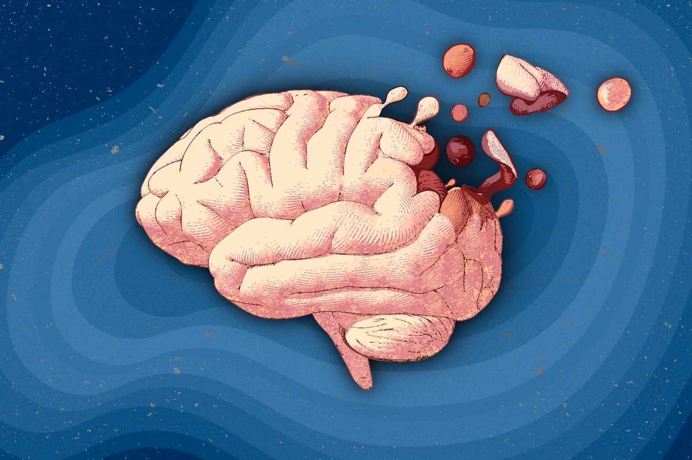
The Silent Epidemic Eating Away
American Minds
Notes:
https://www.theepochtimes.com/health/the-silent-epidemic-eating-away-americans-minds-5560857
Screen time. Books, memorize.
Billy was a bright 10-year-old boy with two Ivy League-educated parents. He was book smart—got straight A’s in school—but lacked street smarts.
He was also a poor sport. Billy would frequently lie and cheat when playing board games or participating in team activities and have full-blown meltdowns when he lost. His friends, who had been with him since kindergarten, began to lose patience. His parents recognized that something had to be done.
So Billy’s parents brought him to Dr. Victoria Dunckley, a pediatric psychiatrist specializing in screen use.
After a four-week “screen fast” prescribed by Dr. Dunckley, which eliminated all access to TVs, phones, and video games, Billy’s problems miraculously cleared up. His parents were so pleased that they decided to maintain the fast.
Six months passed, and Billy’s friends were no longer avoiding him; his sportsmanship had improved markedly. Billy decided to run for class president and delivered a speech, something that would have previously terrified him.

Slide 36
Consider the one of the worst distresses known in history, the Nazi attempt at world conquest. Defeated France, Holland, Belgium. Sent the British army barely fleeing from them at Dunkirk.

Slide 37
Notes:
https://external-content.duckduckgo.com/iu/?u=https%3A%2F%2Fd3n8a8pro7vhmx.cloudfront.net%2Faustralianconservatives%2Fpages%2F3829%2Fmeta_images%2Foriginal%2FPOST_180511_ACTIONPLAN_winston_churchill.jpg%3F1527145981&f=1&nofb=1&ipt=43bf7ca0c92d540150ffdc01d041b49e45c0126316579835cd036f1151701be7&ipo=images

Slide 38
Even though large tracts of Europe and many old and famous States have fallen or may fall into the grip of the Gestapo and all the odious apparatus of Nazi rule, we shall not flag or fail.
Notes:
https://www.nationalchurchillmuseum.org/we-shall-fight-on-the-beaches.html

Slide 39
We shall go on to the end, we shall fight in France, we shall fight on the seas and oceans, we shall fight with growing confidence and growing strength in the air, we shall defend our Island, whatever the cost may be,
Notes:
https://www.nationalchurchillmuseum.org/we-shall-fight-on-the-beaches.html

Slide 40
we shall fight on the beaches, we shall fight on the landing grounds, we shall fight in the fields and in the streets, we shall fight in the hills; we shall never surrender!!
Notes:
https://www.nationalchurchillmuseum.org/we-shall-fight-on-the-beaches.html

Slide 41
We shall fight Satan and the spirit of the world culture in prayer,
We shall fight in scripture learning,
We shall fight in loving each other,
We shall fight in outreach/ ingathering
We shall fight in worship and praise.
We shall NEVER surrender
Notes:
To depression, discouragement, backbiting, bitterness, unkindness.

Slide 42
Everyone will face pain, suffering, and tragedy, but resilient people don’t fall into a passive victim mentality so easily.
Belief in Messiah’s help.
Belief in your G-d given abilities.
Belief in your community.

Slide 43
^{2 Cor 1.1-5} Praised be God, Father of our Lord Yeshua the Messiah, compassionate Father, God of all encouragement and comfort; who encourages us in all our trials, so that we can encourage others in whatever trials they may be undergoing

Slide 44
^{2 Cor 1.1-5} with the encouragement we ourselves have received from God. For just as the Messiah’s sufferings overflow into us, so through the Messiah our encouragement also overflows

Slide 45
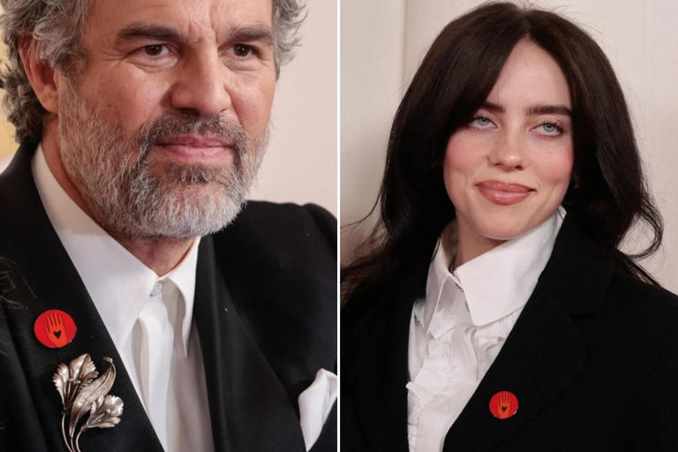
Celebrities like Mark Ruffalo and Billie
Eilish wore “Artists for Cease-Fire”
pins to the Oscars.
Notes:
https://www.msn.com/en-us/movies/news/you-ll-be-shocked-at-the-true-meaning-of-the-pin-worn-by-billie-eilish-and-mark-ruffalo/ar-BB1jMIZu

Slide 46
Back in 2000, two Jewish IDF reservists mistakenly drove through Ramallah and were detained by Palestinian police — and then brutally murdered in their jail cell by a crowd of savage, blood-hungry thugs, one of whom showed his bloodied hand in a now-infamous photo.
Notes:
https://www.msn.com/en-us/movies/news/you-ll-be-shocked-at-the-true-meaning-of-the-pin-worn-by-billie-eilish-and-mark-ruffalo/ar-BB1jMIZu

Slide 47
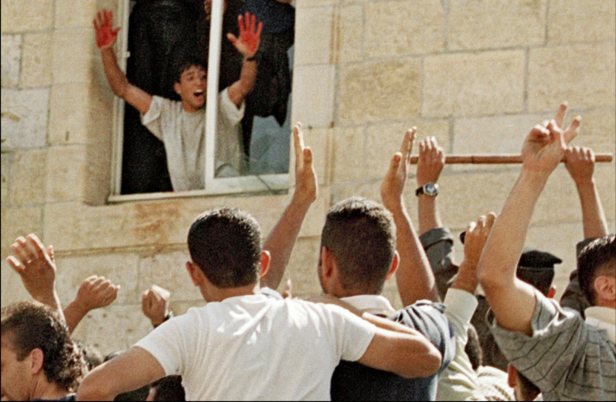
Notes:
https://external-content.duckduckgo.com/iu/?u=https%3A%2F%2Fimages.jpost.com%2Fimage%2Fupload%2Ff_auto%2Cfl_lossy%2Ft_JD_ArticleMainImageFaceDetect%2F521943&f=1&nofb=1&ipt=8aeb9de0187a1eb46ec82df240e12978eb53df1341417de2be745f2a5f5b9bde&ipo=images

Slide 48
from Barry Segal
Notes:
https://vfinews.com/news/hezbollah-continues-to-fire-on-israel-netanyahu-is/ceasefire-pin-symbol-is-the-bloody-hand-of-a-lynch?subscribed=true&mc_cid=3e30951875&mc_eid=UNIQID

Slide 49
Notes:
https://youtu.be/AJLoO3jzxBA

Slide 50
Premiered Mar 7, 2024 A group of Israeli believers gathered from all over the Land, together with believers from the nations, for this song of prayer in the city of Sderot, located approximately one kilometer from the Gaza border.
Sign the "I pray #Isaiah61" petition at https://setthecaptivesfree.allisrael.com
Notes:
Tell believers by raising hands.

Slide 51
The believers gathered on the site of the former police station that was attacked by Hamas terrorists who took the lives of more than thirty policemen and civilians on October 7th.

Slide 52
Song: Ruach Adonai Alai - The Spirit of the Lord is Upon Me
Music: Tony Sperandeo and Noam Waxman ©1987 [Mes Cong leader]
Words: Isaiah 61:1-3
Recorded: 61 Herzl St, Sderot, Israel on Feb 26, 2024

Slide 53
Notes:
https://youtu.be/AJLoO3jzxBA

Slide 54
4. Unity of the faith
Two Jews…three opinions

Slide 55
4. Unity of the faith
Two Jews…three opinions
Two Jews…ten views

Slide 56
4. Unity of the faith
Two Jews…three opinions
Two Jews…ten views
NOT ecumenical decrees

Slide 57
^{1 Kefa 2.1-5} Therefore, rid yourselves of all malice, of all deceit, hypocrisy and envy, and of all the ways there are of speaking against people; and be like newborn babies, thirsty for the pure milk of the Word; so that by it, you may grow up into deliverance.
Notes:
That’s why we have Torah study, Anglo and Hispanic, and Torah club, and other studies. Not that people can’t still go aberrant, but a bit less likely. Nothing guarantees TRUTH, except the Ruakh presence. Even that can be faked, apparently. I’m reeling from some recent losses in the Kingdom.

Slide 58
^{1 Kefa 2.1-5} For you have tasted that Adoni is good. As you come to him, the living stone, rejected by people but chosen by God and precious to him, you yourselves, as living stones, are being built into a spiritual house

Slide 59
5. The knowledge of Ben-Elohim, the Son of G-d
^{Phil 3.7-11} But whatever things were gain to me, these I have considered as loss for the sake of the Messiah. More than that, I consider all things to be loss in comparison to the surpassing value of the knowledge of Messiah Yeshua my Lord.

Slide 60
5. The knowledge of Ben-Elohim, the Son of G-d
^{Phil 3.7-11} Because of Him I have suffered the loss of all things; and I consider them garbage in order that I might gain Messiah and be found in Him not having my righteousness derived from Torah,

Slide 61
5. The knowledge of Ben-Elohim, the Son of G-d
^{Phil 3.7-11} but one that is through trusting in Messiah—the righteousness from God based on trust. My aim is to know Him and the power of His resurrection and the sharing of His sufferings,

Slide 62
5. The knowledge of Ben-Elohim, the Son of G-d
^{Phil 3.7-11} becoming like Him in His death— if somehow I might arrive at the resurrection from among the dead.

Slide 63
Summary of maturity menschy:
Kedoshim, the holy people,
The work of service,
Building up the body of Messiah.
Unity of the faith and
Knowledge of Ben-Elohim, the Son of G-d
Notes:
This summary from the context in Ephesians, previous was from parallel passages about maturity.

Slide 65
A Real Mensch (Yiddish: מענטש),
Meaning of mature adulthood from parallel passages
Meaning of mature adulthood in this context
How we get there.

Slide 66
^{Eph 4.11-13} He Himself gave some to be ₁emissaries, some as ₂prophets, some as ₃proclaimers of the Good News, and some as ₄shepherds and ₅teachers— to equip the kedoshim, the holy people, for the work of service, for building up the body of Messiah.

Slide 67
^{Eph 4.11-13} This will continue until we all come to the unity of the faith and of the knowledge of Ben-Elohim, the Son of G-d, to mature adulthood, to the measure of the stature of Messiah’s fullness.

Slide 68
₁emissaries
₂prophets
₃proclaimers of the Good News, ₄shepherds and
₅teachers
Notes:
Breakthrough guys. In our world, Martin Chernoff, Jonathan Bernis, Stewart Winograd. All the founding rabbis in a measure, though I had about 20 people to help me start.
Prophets: foretelling and forthtelling. Several with that gift here. Can be abused and controlling. Whom you will marry, money issues. In a sense, all musicians prophecy: communicate G-d’s message in the Ruakh.

Slide 69
Divrei Hayamim 1 Chron 25.1 TLV Moreover, David and the commanders of the army, set apart for avodah the sons of Asaph, Heman, and Jeduthun who prophesied with lyres, harps and cymbals.
Avodah?

Slide 70
Avodah?
וַיַּבְדֵּ֣ל דָּוִיד֩ וְשָׂרֵ֨י הַצָּבָ֜א לַעֲבֹדָ֗ה
work, labor, toil, travail; employment, job, service, situation; occupation, trade; worship; paper
Notes:
Milon.co.il

Slide 71
Divrei Hayamim 1 Chron 25.1 TLV Moreover, David and the commanders of the army, set apart for avodah the sons of Asaph, Heman, and Jeduthun who prophesied with lyres, harps and cymbals.
Avodah?

Slide 72
₁emissaries, some as
₂prophets, some as
₃proclaimers of the Good News, ₄and some as shepherds and
₅teachers
Notes:
3. Proclaimers: gift to bring Yeshua seamlessly and winsomely into unexpected situations. Zvi, Jude, Jeff Bernstein,

Slide 73
Notes:
https://www.foi.org/zvikalisher/
As a 10-year-old Jewish boy living in Poland in 1939, Zvi Kalisher found himself facing the evils of the Holocaust.
Miraculously, he survived and, in 1948, settled in Israel, the country he would call his new home. It was there Zvi was introduced to Yeshua the Messiah, whom he loved and served wholeheartedly and spent the rest of his life introducing to others.

Slide 74
₁emissaries, some as
₂prophets, some as
₃proclaimers of the Good News, ₄and some as shepherds and
₅teachers
Notes:
4. Local leaders. I try to do.

Slide 75
These five types will get it done!

Slide 76
These five types will get it done!
Not at all.
These five types will make us ALL into mensches, fruitful.

Slide 78
A Real Mensch (Yiddish: מענטש),
Meaning of mature adulthood from parallel passages
Meaning of mature adulthood in this context
How we get there.

Slide 79
^{Eph 4.11-13} He Himself gave some to be emissaries, some as prophets, some as proclaimers of the Good News, and some as shepherds and teachers— to equip the ¹kedoshim, the holy people, for the ²work of service, ³for building up the body of Messiah.

Slide 80
^{Eph 4.11-13} This will continue until we all ⁴come to the unity of the faith and of ⁵the knowledge of Ben-Elohim, the Son of G-d, to mature adulthood, to the measure of the stature of Messiah’s fullness.

Slide 81
Do you KNOW Yeshua and drinking the water of LIFE?
Are you hearing daily from His Word?
How are you applying what you heard?
Are you offering that water of life to anyone?

Slide 82
Prayer points for third hour

Slide 83
Summary of maturity menschy:
Not self centered & quarrelling
Focus on love for others
Not showy “spirituality” rather teaching, helpful.
Forgive self & others and reach for Melekh Messiah Yeshua
Notes:
Birgitta Veksler song

Slide 84
Summary of maturity menschy:
Kedoshim, the holy people,
The work of service,
Building up the body of Messiah.
Unity of the faith and
Knowledge of Ben-Elohim, the Son of G-d

Slide 85
Our menschiness as a cong.
Our Purim Ingathering
Israel’s Iron Swords Hamas War
Military victory
Spiritual transformation

