Slide 1
e-handout
To have these notes
without taking notes
Go to OrHaOlam.com
Click on Messages tab,
2024 Messages

Slide 3
Notes:
Brian Kaufman

Slide 4
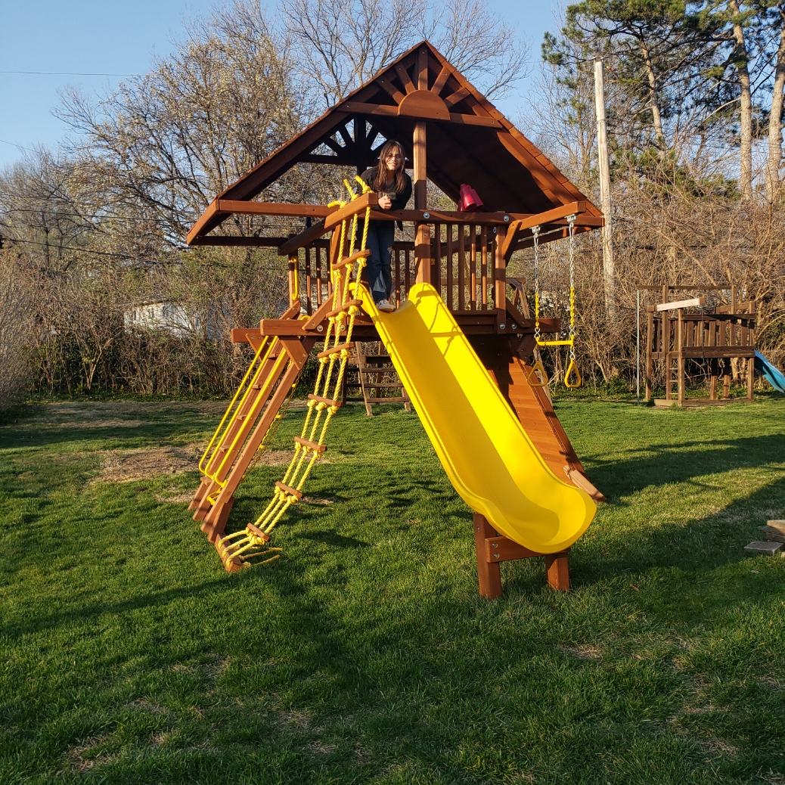

Slide 5
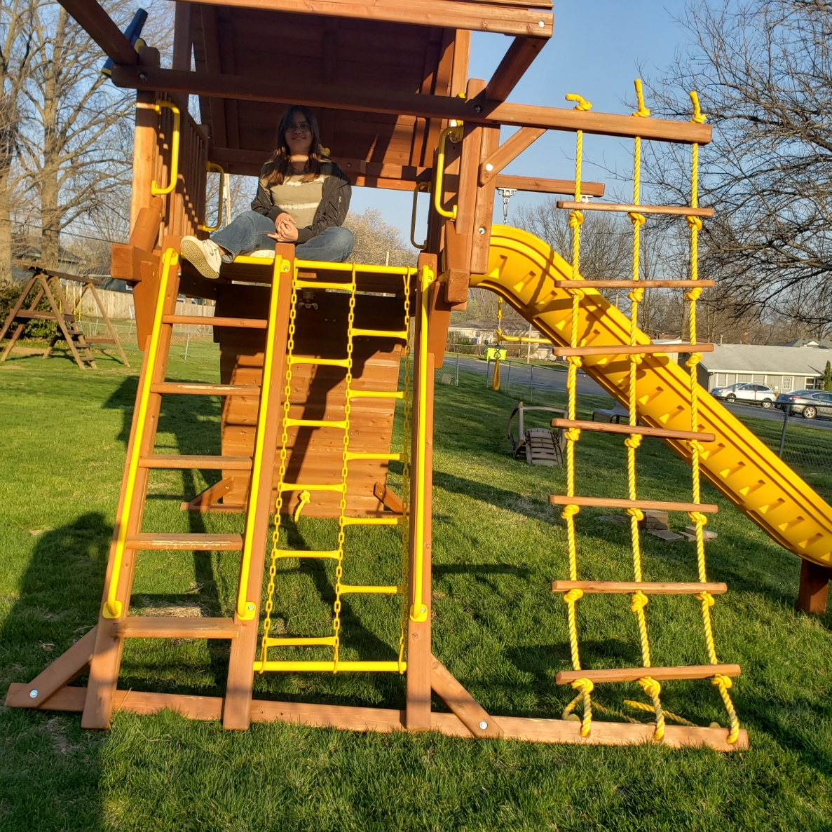

Slide 6
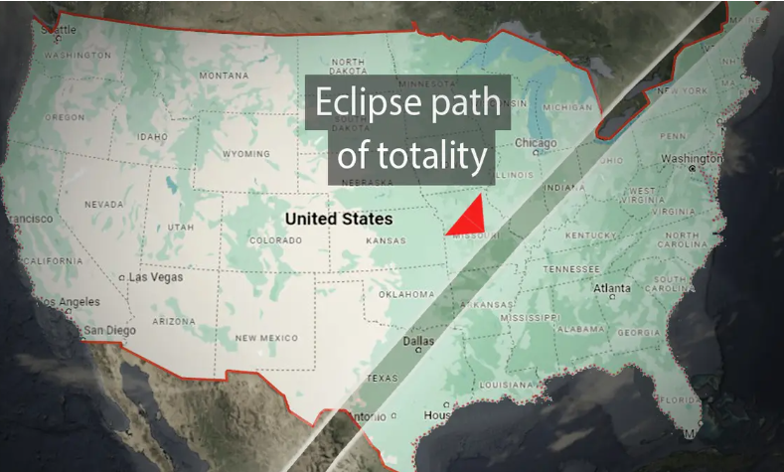
Monday, April 8, between 1:07 and 2:46 p.m. CST, epic proportions
Notes:
A few hundred miles away is the nearest totality, so NOT an Or HaOlam event.
https://www.theepochtimes.com/bright/total-eclipse-of-sun-to-cross-10-states-reach-32-million-americans-in-april-heres-what-to-know-5599837?src_src=Bright&src_cmp=bright-2024-03-16&est=AAAAAAAAAAAAAAAAcuomYBYAh9bH4LguuWhYArg0yEwDi4CakWZxJkVclaEQIH3YkA%3D%3D

Slide 7
Dubbed the “Great North American Eclipse,” the celestial event is expected to be more impressive than the one in 2017, lasting longer, being wider, and traversing more highly populated parts of North America.
Notes:
https://www.theepochtimes.com/us/faa-issues-warning-for-air-travel-disruptions-during-total-solar-eclipse-on-april-8-post-5612468?src_src=News&src_cmp=breaking-2024-03-22-2&est=AAAAAAAAAAAAAAAAcuomYBYAh9bH4LguuWhYArg0yEwDi4CakWZxJkVclaEQIH3YkA%3D%3D

Slide 8
On April 8, it will begin over the South Pacific Ocean and move across North America, spanning across Mexico, the United States, and Canada. The 2024 event will move in a different direction than the 2017 event, marking a cross on the United States.
Notes:
https://www.theepochtimes.com/us/faa-issues-warning-for-air-travel-disruptions-during-total-solar-eclipse-on-april-8-post-5612468?src_src=News&src_cmp=breaking-2024-03-22-2&est=AAAAAAAAAAAAAAAAcuomYBYAh9bH4LguuWhYArg0yEwDi4CakWZxJkVclaEQIH3YkA%3D%3D

Slide 9
The moon’s shadow will create a relatively narrow ribbon—the path of totality—of about 100 miles over Earth’s surface. To experience a 100 percent total solar eclipse, viewers should be located in this narrow band. This will reveal “the star’s outer atmosphere, called the corona,” according to NASA.
Notes:
https://www.theepochtimes.com/us/faa-issues-warning-for-air-travel-disruptions-during-total-solar-eclipse-on-april-8-post-5612468?src_src=News&src_cmp=breaking-2024-03-22-2&est=AAAAAAAAAAAAAAAAcuomYBYAh9bH4LguuWhYArg0yEwDi4CakWZxJkVclaEQIH3YkA%3D%3D

Slide 10
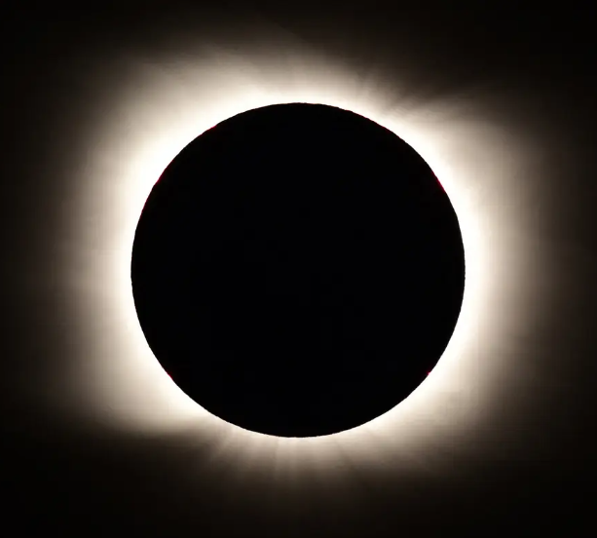
Need welders’ filter shades 12, 13, and 14, but no lower.
Notes:
For sale during our Hanukkah party.
Spiritual meaning of the eclipse? That G-d loves math. Messiah is the Logos = calculations, sort of.

Slide 11
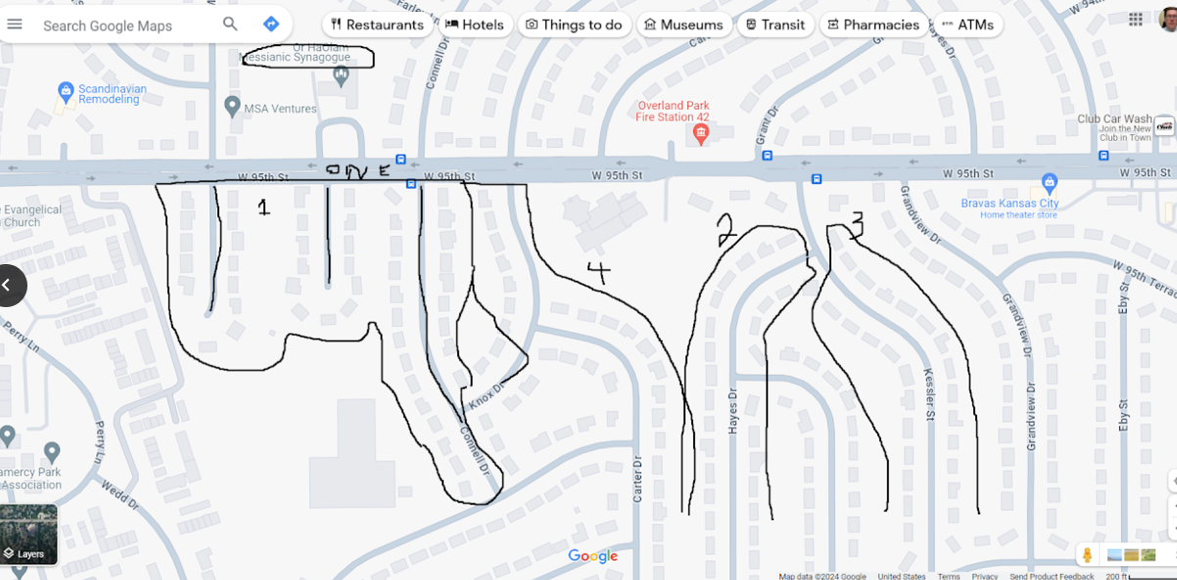
Notes:
These were to be days of feasting & celebration and sending presents of food to one another and giving gifts to the poor.

Slide 13
Summary of this message:
Purim is about an event caused by Lashon HaRa, evil speaking.
Purim Lashon HaRa
How we can avoid doing such.

Slide 14
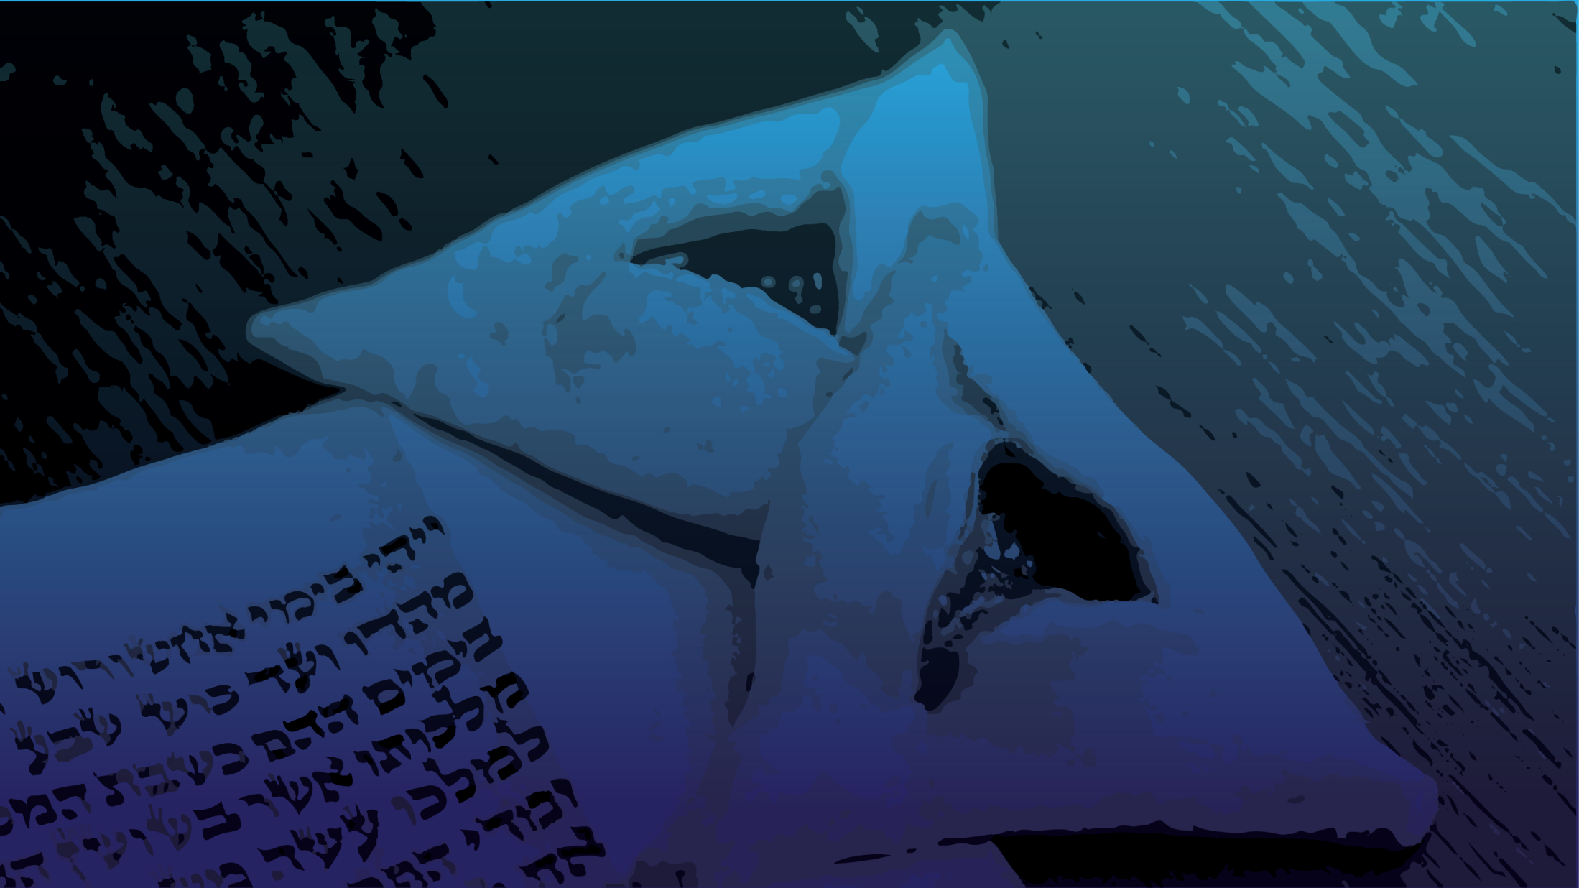
Purim: a Lashon HaRa Event
Evil originates from a perception of violation → defense.
2.Truly overcome evil with faith
3. Address evil with Charity

Slide 15
Purim: a Lashon HaRa Event
Evil originates from a perception of violation → defense.
2.Truly respond to evil with faith
3. Address evil with Charity
Notes:
All the biggest weapons are in the Department of Defense. Formerly called the Dept of War. Once people are offended, they are defensive.

Slide 16
All the king’s courtiers in the palace gate knelt and bowed low to Haman, for such was the king’s order concerning him

Slide 17
All the king’s courtiers in the palace gate knelt and bowed low to Haman, for such was the king’s order concerning him; but Mordekhi would not kneel or bow low.
וְכׇל־עַבְדֵ֨י הַמֶּ֜לֶךְ אֲשֶׁר־בְּשַׁ֣עַר הַמֶּ֗לֶךְ כֹּרְעִ֤ים וּמִֽשְׁתַּחֲוִים֙ לְהָמָ֔ן כִּי־כֵ֖ן צִוָּה־ל֣וֹ הַמֶּ֑לֶךְ וּמׇ֨רְדֳּכַ֔י לֹ֥א יִכְרַ֖ע וְלֹ֥א יִֽשְׁתַּחֲוֶֽה׃

Slide 18
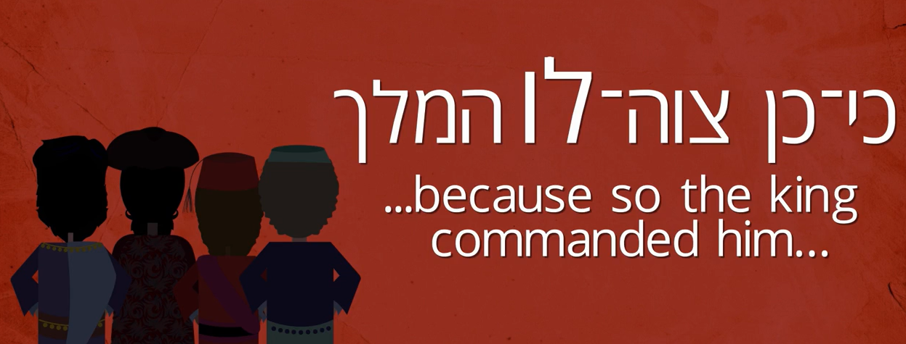
Notes:
https://members.alephbeta.org/playlist/mordechais-hidden-story
Rabbi David Fohrman points out the object pronoun HIM, the king commanded Haman, not that the king commanded the people. Implying there was no royal decree for the people to bow to Haman.

Slide 19
Notes:
Rabbi David Fohrman suggests that the King told Haman it would be OK, since you are representing me, but NEVER made a royal decree. Only the King should be bowed to, so bowing to Haman was really disloyal to the King. And Mordekhi’s response was a bit like Joseph, who was being solicited to be disloyal to Potiphar.

Slide 20
Notes:
https://members.alephbeta.org/playlist/mordechais-hidden-story
Lots of truth here about avoiding adulterous temptation
Apparently possibility that Haman’s expectation of everyone’s bowing to him was an exaggeration of the King’s word to him, not the King’s decree and was sort of taking royal privilege.

Slide 22
Purim: a Lashon HaRa Event
Evil originates from a perception of violation → defense.
2.Truly respond to evil with faith
3. Address evil with Charity
Notes:
All the biggest weapons are in the Department of Defense. Formerly called the Dept of War.

Slide 23
^{Ester 3.5} When Haman saw that Mordekhi was not bowing down or paying him honor, Haman was filled with rage…So Haman sought to destroy all the Jews, the people of Mordekhi, who were throughout the whole kingdom of Akhashverosh.
Notes:
Haman felt violated. Could be that Haman’s claim to obeisance, bowing down, was contrived or exaggerated from the king, nevertheless he perceived it as an insult. Some of our perceptions of being insulted are from an erroneous view of ourselves, or the circumstances, nevertheless, once insulted…Haman’s defense or response was…

Slide 24
^{Ester 3.8-9} Haman then said to King Akhashverosh: “There is a certain people scattered and dispersed among the peoples in all the provinces of your kingdom whose laws differ from those of every other people

Slide 25
^{Ester 3.8-9} and who do not obey the king’s laws. It is not in the king’s interest to tolerate them. If it pleases the king, let an edict be written to destroy them.

Slide 26
Jews were defined as a threat BECAUSE they kept Torah.
Total misunderstanding. They were a blessing because they did so.

Slide 27
Purim: a Lashon HaRa Event
Evil originates from a perception of violation → defense.
2.Truly respond to evil with faith
3. Address evil with Charity

Slide 28
^{Yermiyahu/Jer 29.4-7} “Here is what Adoni-Tzva’ot, the God of Isra’el, says to all those in exile, whom I have caused to be carried off captive from Yerushalayim to Bavel: ‘Build yourselves houses, and live in them. Plant gardens, and eat what they produce.

Slide 29
^{Yermiyahu/Jer 29.4-7} Choose women to marry, and have sons and daughters…Seek the welfare of the city to which I have caused you to go in exile, and pray to Adoni on its behalf; for your welfare is bound up in its welfare.’

Slide 30
^{Kohelet/Eccles 8.2-4} Keep the king’s command because of the oath before God. Don’t be quick to leave his presence, and don’t persist in doing what is wrong, for he does whatever he pleases. After all, his word is final; who can challenge him, “Why are you doing that?”

Slide 31
Jews were defined as a threat BECAUSE they kept Torah.
Total misconstruction. They were a blessing because they did so.

Slide 32
^{Yeshayahu/Is 5.20-21} Oy to those who call evil good and good evil, who present darkness as light and light as darkness, who present bitter as sweet, and sweet as bitter! Oy to those who are wise in their own eyes, and clever in their own sight!

Slide 33
Benefits of following Tanakh
Literacy ^{Ro 3.1-2} Then what is the advantage of being Jewish? Or what is the benefit of circumcision? Much in every way. First of all, they were entrusted with very words of God.

Slide 34
Benefits of following Tanakh
Compassion [hospitals, educ.]
Hope >> visible distress “For everything written in the past was written to teach us, so that with the encouragement of the Tanakh we might patiently hold on to our hope.” ^{Ro 15.4}

Slide 35
In an 1808 letter, President John Adams expressed his respect for ancient Jewry. Adams wrote of Voltaire, "How is it possible [that he] should represent the Hebrews in such a contemptible light? They are the most glorious nation that ever inhabited this Earth…
Notes:
http://www.jewishvirtuallibrary.org/president-john-adams-embraces-a-jewish-homeland-1819-2

Slide 36
…The Romans and their Empire were but a Bauble in comparison of the Jews. They have given religion to three quarters of the Globe and have influenced the affairs of Mankind more, and more happily, than any other Nation ancient or modern."
Notes:
Letter from Pres. John Adams
http://www.jewishvirtuallibrary.org/president-john-adams-embraces-a-jewish-homeland-1819-2

Slide 37
^{2 Cor.11.4-15} Satan masquerades as an angel of light. It is no great thing therefore if his servants also masquerade as servants of righteousness. Their end will be according to their deeds.
Perceived offenses→ defense.
Notes:
Satanic light pretends to be Divine light.
Humanistic righteousness pretends to be G-d’s righteousness.
Purim time. Lots of masquerades.
Lots of events where offense is construed falsely.
I’m going to comment on the headlines of the day. Like our founding fathers, of them many preachers!

Slide 38
We have a world of moral terminology reversals.
Frequent media wording:
Pro-choice or anti-abortion
Really:
Pro-life or pro-abortion
Notes:
Makes anti-abortionists look like negativists. Against choice. Hurt and defensive people.

Slide 39
Notes:
https://www.pinterest.com/explore/good-slogans/
Seems reasonable

Slide 40
Notes:
Female body.
Really??

Slide 41
Notes:
G-d chose the unborn.
Not really pro-choice. Pro-abortion.

Slide 42
Frequent media wording:
Transgender rights
Really:
Gender privacy protection
Notes:
Perceived offense → defense

Slide 43
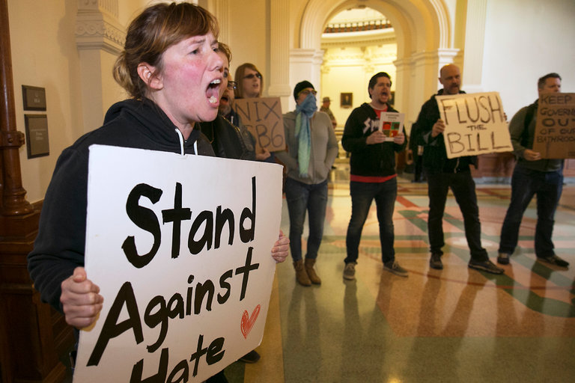
Notes:
“Protect transgender people”
Seems reasonable.

Slide 44
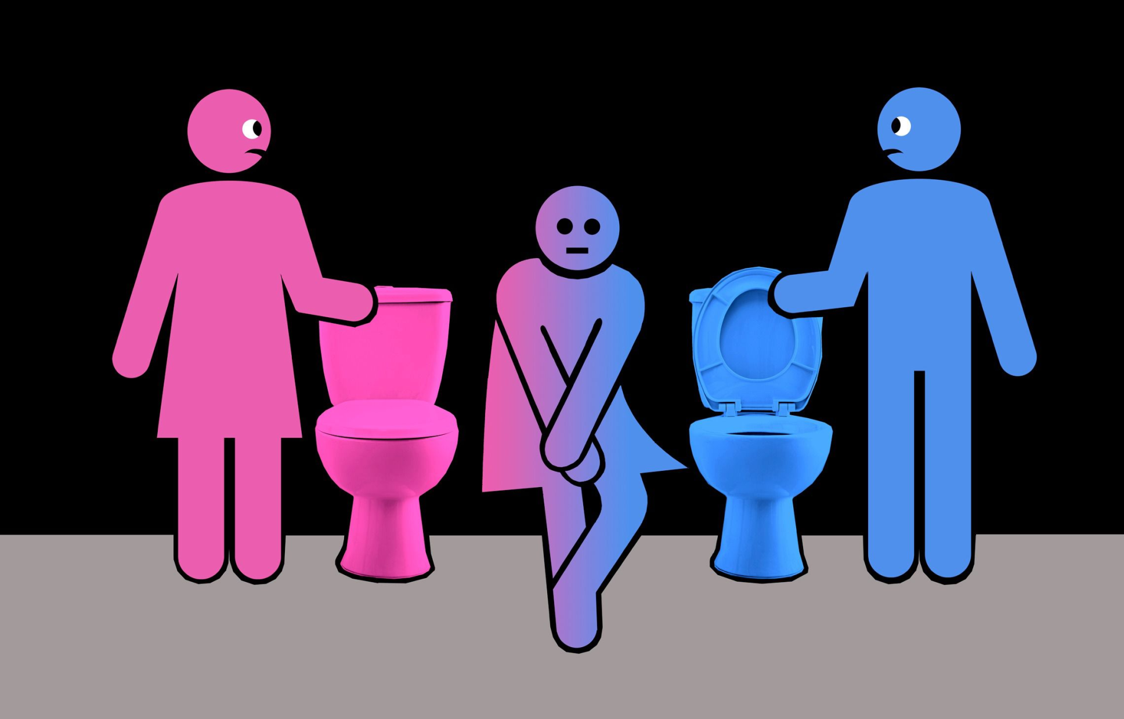
Notes:
Hard to find a good illustration that wasn’t obscene.

Slide 45
Frequent media wording:
Transgender rights
Really:
Gender privacy protection
Notes:
Headline makes for a policy bias. Transgender rights? Safety.
Perceived offense → defense

Slide 46
Frequent media wording:
Israeli settlements causing terrorism, intifada, Oct. 7 attack
Rather:
Palestinian refusal, incitement causing terrorism, intifada

Slide 47
In December 2000, Israeli and Palestinian negotiators were brought to Washington. And on December 23, President Clinton presented a new plan to them. The Palestinians would get 97 percent of the West Bank, Arab neighborhoods in East Jerusalem
Notes:
http://www.weeklystandard.com/myths-of-the-intifada/article/2461

Slide 48
would become the capital of the new Palestinian state, refugees would be allowed to return to Palestine but not Israel, and a $30 billion fund would be established to compensate refugees. This was the final offer: The separated cantons were gone and a land link to Gaza was included.
Notes:
http://www.weeklystandard.com/myths-of-the-intifada/article/2461

Slide 49
After Clinton left the meeting, Dennis Ross stayed behind to make certain the Palestinian negotiators had gotten "every single word." They had. A footnote: Ross insists the Palestinian negotiators were ready to accept the offer.
Notes:
http://www.weeklystandard.com/myths-of-the-intifada/article/2461

Slide 50
They "understood this was the best they were ever going to get. They wanted [Arafat] to accept it." He refused. Why? Ross believes Arafat simply didn't want to end the conflict with Israel.
Notes:
http://www.weeklystandard.com/myths-of-the-intifada/article/2461

Slide 51
His career was governed by struggle and leaving his options open. "For him to end the conflict is to end himself," Ross said.
Notes:
http://www.weeklystandard.com/myths-of-the-intifada/article/2461

Slide 52
Frequent media wording:
Israeli settlements causing intifada
Rather:
Palestinian refusal, incitement causing terrorism, intifada
Notes:
One more…

Slide 53
Frequent media wording:
Anti-Islam
Really:
Anti-Islamist

Slide 54
In Western media usage the term tends to refer to groups who aim to establish a sharia-based Islamic state, often with implication of violent tactics and human rights violations, and has acquired connotations of political extremism.
Notes:
https://en.wikipedia.org/wiki/Islamism
Islamism is dangerous. Islam is not, per se. Can be poetic. Sufi mystics. Poem The Rubaiyat By Omar Khayyam
A Jug of Wine, a Loaf of Bread--and Thou Beside me singing in the Wilderness-- Oh, Wilderness were Paradise enow!
Similar truth reversal though not headlines, private:

Slide 55
Frequent media wording:
Right to die.
Really:
Physician assisted suicide.

Slide 56
End of life lies:
^{Thillim /Ps 116.15 NAS} Precious in the sight of Adoni Is the death of His godly ones.
^{2 Cor. 5.6-7} So we are always confident — we know that so long as we are at home in the body, we are away from

Slide 57
our home with the Lord; for we live by trust, not by what we see. We are confident, then, and would much prefer to leave our home in the body and come to our home with the Lord.

Slide 58
End of life lies of the enemy:
^{Ps 73.3-4} ^{NIV} For I envied the arrogant when I saw the prosperity of the wicked. They have no struggles at death; their bodies are healthy and strong.
Notes:
End of life Satanic attack: accusations, condemnation. Encourage resting in Yeshua, trusting in His Blood Atonement, mercy!!

Slide 59
So, how do we
discern truth
restore truth
live in truth?
Avoid Perceived offense → defense…lashon hara evil speaking

Slide 60
Know that whenever truth is rejected, it’s NEVER 100% rejected. First, realize:
Resisting Transgender rights is NOT rejecting & rudeness to transgender people.
Resisting Islamism is NOT lack of love to Muslims.

Slide 61
The BEST of actions and principles can be tainted with bad attitudes: hostility, pride, anger.
The WORST behaviors and principles can have loving attitudes.
Notes:
Always a bit of mixture that seems to undermine clear thinking and differentiation.

Slide 62
^{Ro. 11.20} You stand by faith. Do not be arrogant, but fear.
People who are wrong are not usually 100% wrong. Listen and learn with humility.
When you are doing right, it’s usually not 100% right.
Notes:
Consider someone who irritates you. Try to respect and learn from them. Don’t cut people off. Don’t reject people!
When you are doing right, and being corrected, don’t resent it. Learn and do better!

Slide 63
^{T’hillim/Ps.139.1-4} Adoni, You searched me and know me. Whenever I sit down or stand up, You know it. You discern my thinking from afar. You observe my journeying and my resting and You are familiar with all my ways. Even before a word is on my tongue, behold, Adoni, You know all about it.

Slide 64
^{Mes. Jews/Heb.4.12-13} See, the Word of God is alive! It is at work and is sharper than any double-edged sword — it cuts right through to where soul meets spirit and joints meet marrow, and it is quick to judge

Slide 65
^{Mes. Jews/Heb.4.12-13} the inner reflections and attitudes of the heart. Before God, nothing created is hidden, but all things are naked and open to the eyes of him to whom we must render an account.

Slide 67
Purim: a Lashon HaRa Event
Evil originates from a perception of violation → defense.
2.Truly respond to evil with faith
3. Address evil with Charity

Slide 68
Haman responded with murderous rage to a contrived insult.
Scripture on responding to apparent evil behavior…

Slide 69
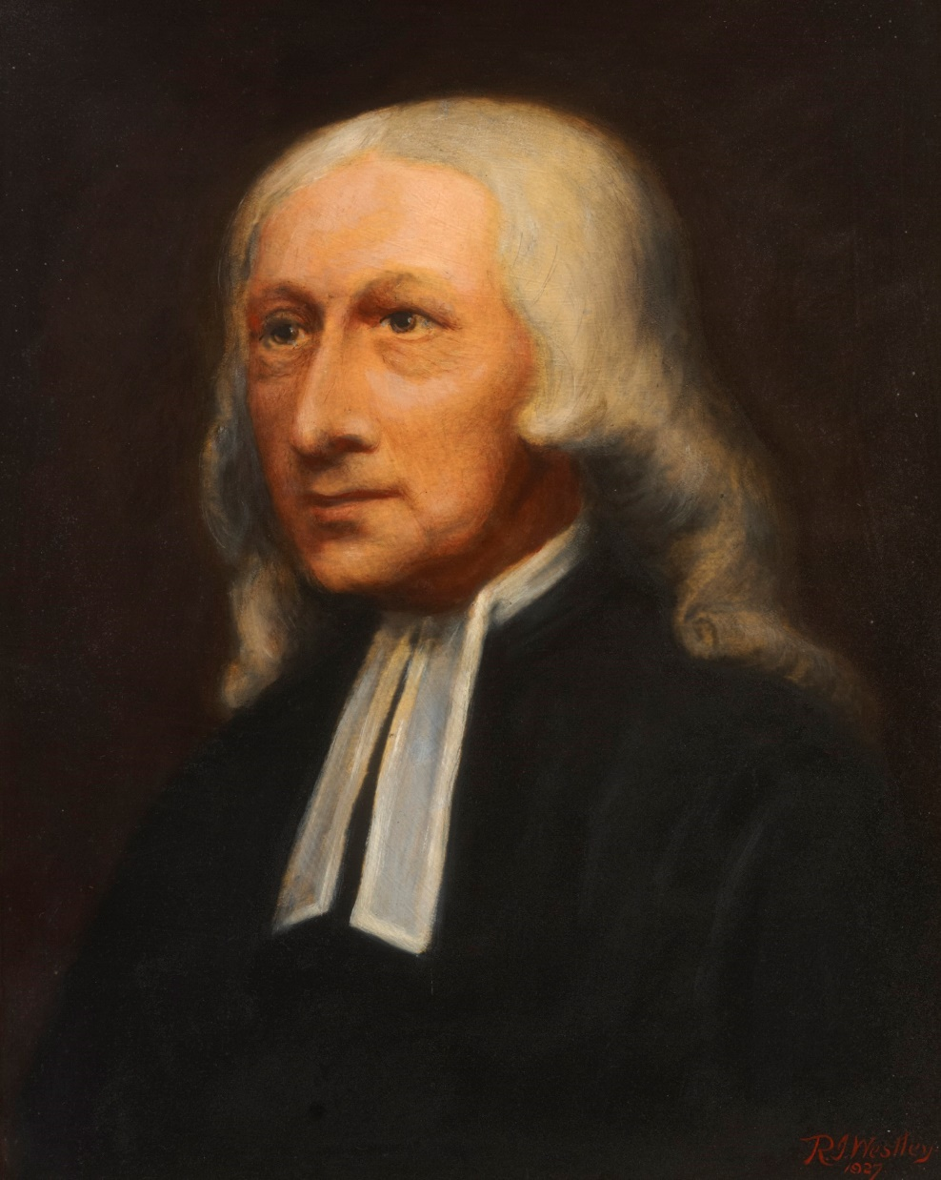
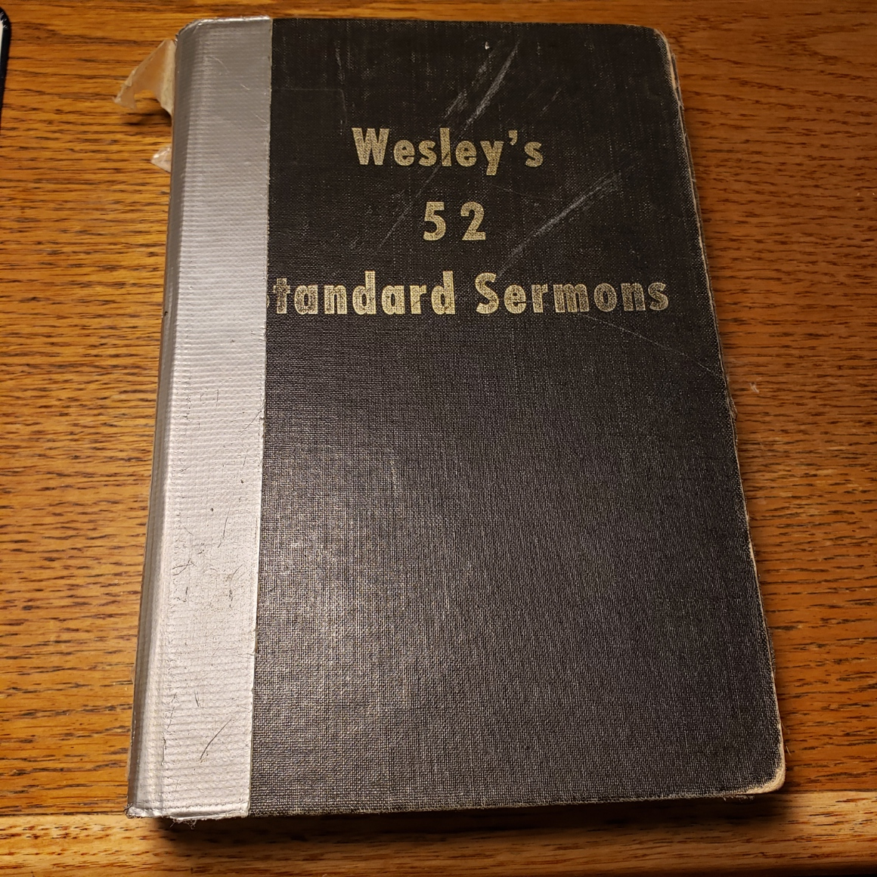
John Wesley, 1703, Epworth, England, to 1791
Notes:
https://www.wesleysheritage.org.uk/os/wp-content/uploads/2020/04/LNE_WCMM_LDWMM_1993_1619-Wesley-by-Westley.jpg
My first year as a believer, I got really confused and overwhelmed by the terminology of being filled with the Spirit, sanctified, sanctified wholly, baptized in the Spirit.
Decided to spend my lunch hours with John Wesley. He really was my mentor in the faith.

Slide 71
John Wesley on 1 Cor 13
Love…rejoices not in iniquity
Yea, weeps at either the sin or folly of even an enemy; takes no pleasure in hearing or in repeating it, but desires it may be forgotten for ever.
Notes:
https://www.studylight.org/commentaries/eng/wen/1-corinthians-13.html
MOST positive construction of people’s words. =
“You are naïve to follow that.” Maybe, but so is scripture. Think the best of people.

Slide 72
John Wesley on 1 Cor 13
But rejoices in the truth — Bringing forth its proper fruit, holiness of heart and life. Good in general is its glory and joy, wherever diffused in all the world.
Notes:
https://www.studylight.org/commentaries/eng/wen/1-corinthians-13.html
Love delights to believe the BEST of people

Slide 73
Verse 7 Bears all things, Love covereth all things - Whatever evil the lover of mankind sees, hears, or knows of any one, he mentions it to none; it never goes out of his lips, unless where absolute duty constrains to speak.
Notes:
https://www.studylight.org/commentaries/eng/wen/1-corinthians-13.html
I would like to offer something novel that will address evil speaking.

Slide 74
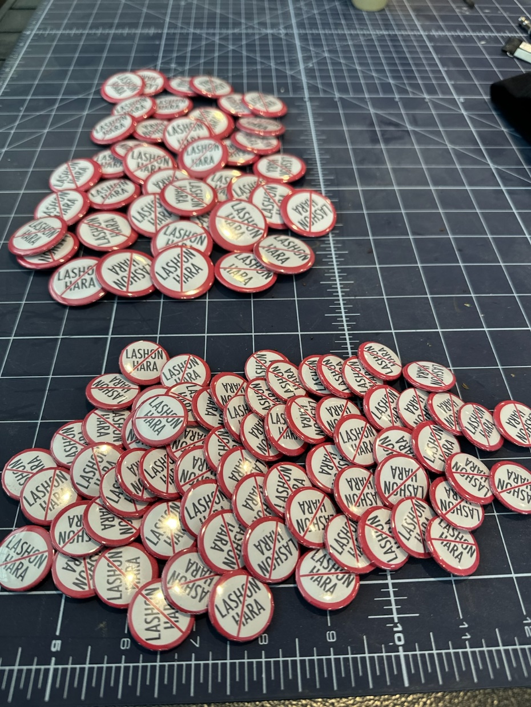
I would like to offer something novel that will address evil speaking.

Slide 75
אזור חופשי לשון הרע
Azor khofshi
Lashon HaRa
Defamation free zone
Notes:
Originally Jan Rosenberg, NJ Mes Rabbi, idea.

Slide 76
Verse 7 Bears all things, Love covereth all things - Whatever evil the lover of mankind sees, hears, or knows of any one, he mentions it to none; it never goes out of his lips, unless where absolute duty constrains to speak.
Notes:
https://www.studylight.org/commentaries/eng/wen/1-corinthians-13.html

Slide 77
If someone starts to tell you negative information, say:
Why are you telling me this?
Notes:
Easier to say, “Wow. Awful. Tell me more.”
Better: “How can we go to this individual and address this?”

Slide 78
If someone starts to tell you negative information, say:
Why are you telling me this?
Can we verify this with the party you are talking about? He’s over there. Or…let me phone him/her.

Slide 79
If someone starts to tell you negative information, say:
Why are you telling me this?
Can I verify this with the party you are talking about?
How can we help the party you are talking about?

Slide 80
Believeth all things — Puts the most favourable construction on everything, and is ever ready to believe whatever may tend to the advantage of any one character.
Notes:
https://www.studylight.org/commentaries/eng/wen/1-corinthians-13.html
What if I give the benefit of the doubt to a guilty party? And I suffer wrong?
So, love suffers long.

Slide 81
And when it can no longer believe well, it hopes whatever may excuse or extenuate the fault which cannot be denied. Where it cannot even excuse, it hopes God will at length give repentance unto life.
Notes:
https://www.studylight.org/commentaries/eng/wen/1-corinthians-13.html

Slide 82
Meantime it endures all things — Whatever the injustice, the malice, the cruelty of men can inflict. He can not only do, but likewise suffer, all things, through Messiah who strengthens him.
Notes:
https://www.studylight.org/commentaries/eng/wen/1-corinthians-13.html

Slide 83
Charity / love never fails: but whether there be prophecies, they shall fail; whether there be tongues, they shall cease; whether there be knowledge, it shall vanish away.
Love never fails — It accompanies to, and adorns us in, eternity; it prepares us for, and constitutes, heaven.
Notes:
https://www.studylight.org/commentaries/eng/wen/1-corinthians-13.html
This was the approach to community, in small groups, that transformed British and world history. Wesleyan awakening ended the slave trade in England.

Slide 84
אזור חופשי לשון הרע
Azor khofshi
Lashon HaRa
Defamation free zone

Slide 86
Purim: a Lashon HaRa Event
Evil originates from a perception of violation → defense.
2.Truly respond to evil with faith
3. Address evil with Charity

Slide 87
Rabbi trail: Why are we paying no attention to Good Friday and the Resurrection this weekend?
Exactly this issue. The Jews and the Jewish New Moon calendar has been negated and the Jews slandered at the Council of Nicaea, etc.
What do we have to say? NOTHING. Just walk in truth.
Notes:
Dan Gruber: The Church and the Jews p 28
You will NEVER hear from this pulpit a slander of the believers in the wider, Gentile body of Messiah. We just don’t follow their error, and forgive their attitudes.

Slide 88
^{Mtt 18.15-17} “Moreover, if your brother commits a sin against you, go and show him his fault — but privately, just between the two of you. If he listens to you, you have won back your brother.

Slide 89
^{Gal 6.1-2} Brothers, suppose someone is caught doing something wrong. You who have the Spirit should set him right, but in a spirit of humility, keeping an eye on yourselves so that you won’t be tempted too. Bear one another’s burdens — in this way you will be fulfilling the Torah’s true meaning, which the Messiah upholds.

Slide 90
^{Mtt 18.15-17} If he doesn’t listen, take one or two others with you so that every accusation can be supported by the testimony of two or three witnesses. If he refuses to hear them, tell the congregation; and if he refuses to listen even to the congregation, treat him as you would a pagan or a tax-collector

Slide 91
Wesley’s commentary:
But how can we avoid giving offence to some? or being offended at others!
Notes:
https://www.studylight.org/commentaries/eng/wen/matthew-18.html

Slide 92
Wesley’s commentary:
Especially suppose they are quite in the wrong? Suppose they commit a known sin? Our Lord here teaches us how: he lays down a sure method of avoiding all offences. Whosoever closely observes this threefold rule, will seldom offend others, and never be offended himself.
Notes:
https://www.studylight.org/commentaries/eng/wen/matthew-18.html
When people tell me, “I am offended.”
I’m nervous because they are hurt and upset, and I want everyone to like me.
I don’t think they are following these principles of gracious interaction.

Slide 93
Wesley’s commentary:
If any do any thing amiss, of which you are an eye or ear witness, thus saith the Lord,
Notes:
https://www.studylight.org/commentaries/eng/wen/matthew-18.html

Slide 94
Go and reprove him alone — If it may be in person; if that cannot so well be done, by your messenger [phone, zoom]; or in writing [text, email HAZARDOUS!!]. Observe, our Lord gives no liberty to omit this; or to exchange it for either of the following steps.
Notes:
https://www.studylight.org/commentaries/eng/wen/matthew-18.html

Slide 95
If this does not succeed,
2. Take with you one or two more — Men whom he esteems or loves, who may then confirm and enforce what you say; and afterward, if need require, bear witness of what was spoken.
Notes:
https://www.studylight.org/commentaries/eng/wen/matthew-18.html

Slide 96
If even this does not succeed, then, and not before,
3. Tell it to the elders of the congregation - Lay the whole matter open before those who watch over yours and his soul.
Notes:
https://www.studylight.org/commentaries/eng/wen/matthew-18.html

Slide 97
4. If all this avail not, have no farther interaction with him, only such as you have with heathens. Can any thing be plainer?
Notes:
https://www.studylight.org/commentaries/eng/wen/matthew-18.html

Slide 98
Messiah does here as expressly command all believers who see a brother do evil, to take this way, not another, and to take these steps, in this order, as he does to honour their father and mother.
Notes:
https://www.studylight.org/commentaries/eng/wen/matthew-18.html

Slide 99
If we proceed from the private carriage of man to man, to proceedings of a more public nature, in what galaxy are believers conformed to this rule? Is this the form in which ecclesiastical judgments appear? Are these the methods used even by those who boast the most loudly of the authority of Messiah to confirm their sentences?
Notes:
https://www.studylight.org/commentaries/eng/wen/matthew-18.html

Slide 100
Let us earnestly pray, that this dishonour to the Messiah’s name may be wiped away, and that common humanity may not, with such solemn mockery, be destroyed in the name of the Lord! Luke 17:3.
Notes:
https://www.studylight.org/commentaries/eng/wen/matthew-18.html

Slide 101
^{Yn 17.22-23} The glory that You have given to Me I have given to them, that they may be one just as We are one — I in them and You in Me—that they may be perfected in unity, so that the world may know that You sent Me and loved them as You loved Me.
Notes:
We’ll NEVER win the world if we are have divisions, mad at each other.

Slide 104
Summary of this message:
Purim is about an event caused by Lashon HaRa, evil speaking.
Purim Lashon HaRa
How we can avoid doing such.

Slide 105
Purim: a Lashon HaRa Event
Evil originates from a perception of violation → defense.
2.Truly overcome evil with faith
3. Address evil with Charity

