Slide 1
To download these notes, follow message more easily, please log on to
Wifi: mycci01 p/w: ancientquail060
Go to OrHaOlam.com
[not case sensitive]

Slide 2
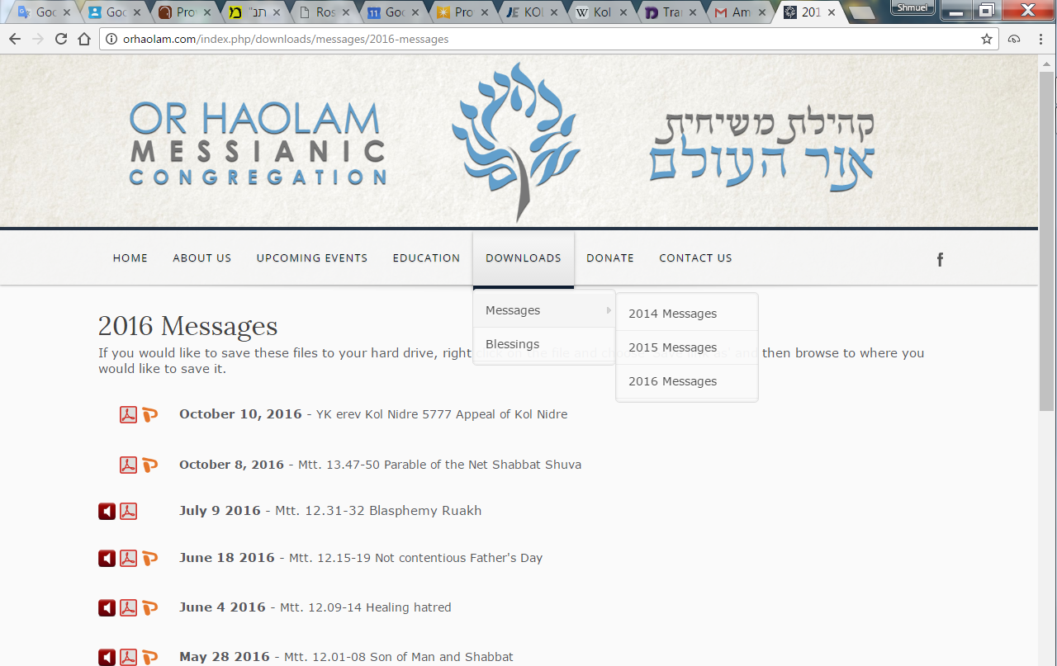

Slide 3
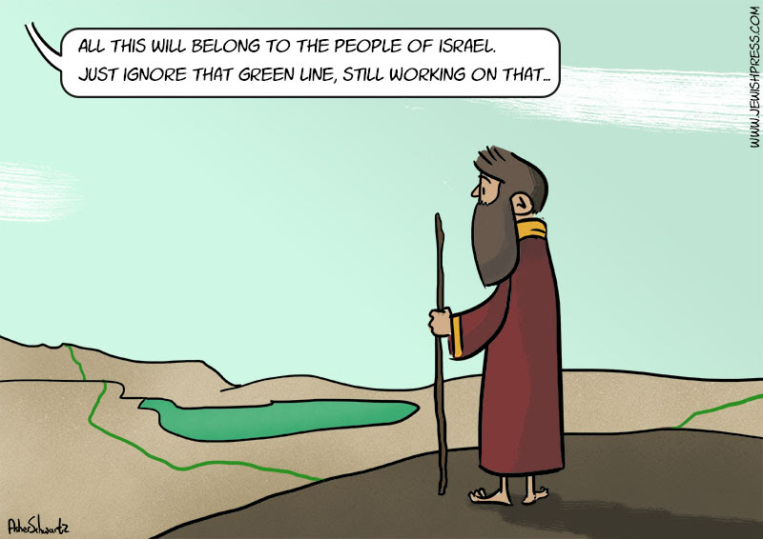

Slide 4
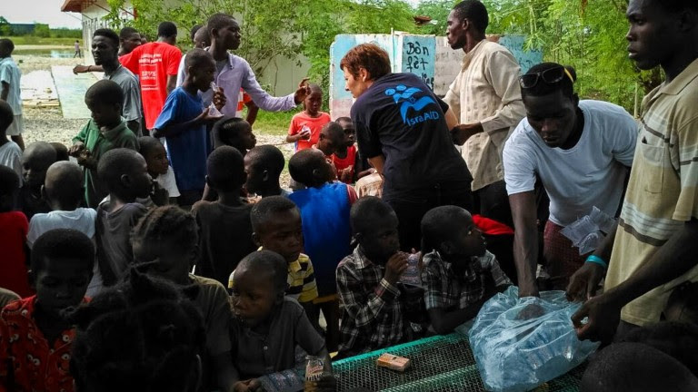
An IsraAID worker handing out
necessities to Haitian children
on October 7, 2016.
Notes:
http://unitycoalitionforisrael.org/?p=19274
After Hurricane Matthew

Slide 5
Israelis didn’t have far to go in the rush to get aid to the people of Haiti following Hurricane Matthew’s destructive brush with the island country. That’s because they were already there.
Notes:
http://unitycoalitionforisrael.org/?p=19274

Slide 6
A crew from the nonprofit organization IsraAID has been in Haiti for more than six years, having arrived just after the January 2010 earthquake to help in rescue and recovery operations.
Notes:
http://unitycoalitionforisrael.org/?p=19274

Slide 7
Only two months ago, MASHAV, the Israel Foreign Ministry’s agency for international development cooperation, sent a new shipment of medical supplies to re-equip the trauma unit it established in one of Haiti’s main government hospitals three years ago.
Notes:
http://unitycoalitionforisrael.org/?p=19274

Slide 8
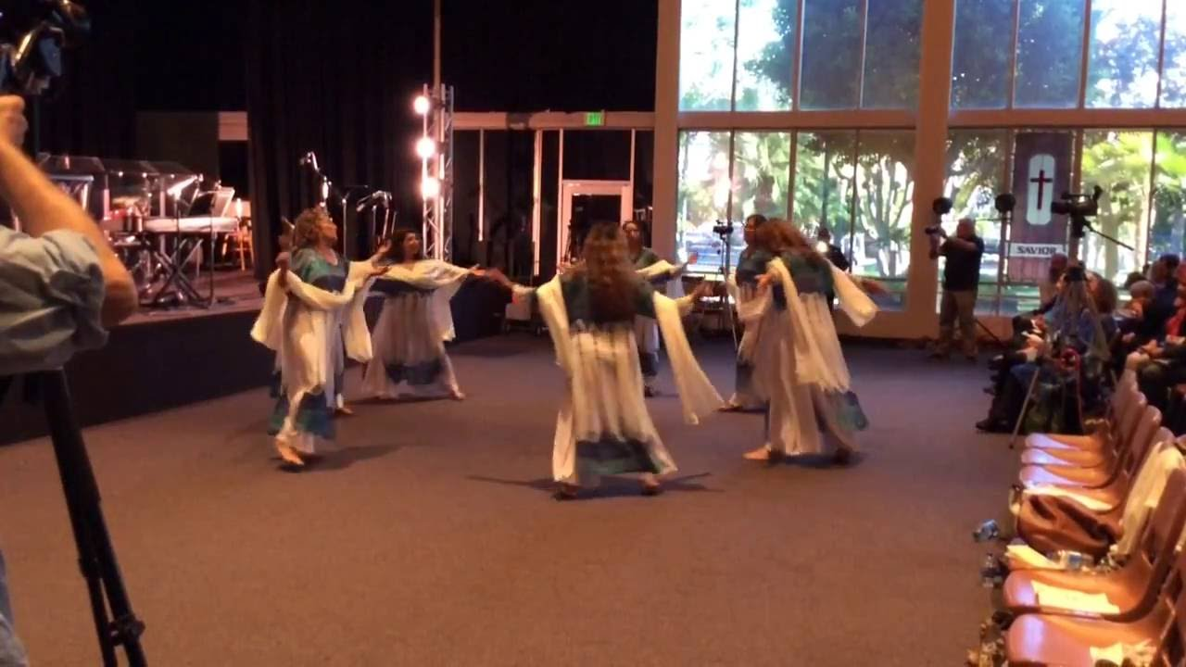
Notes:
This year's celebration of the Day of Trumpets (Yom HaTeruah) in Jerusalem turned out to be quite a success, and almost everyone mentioned that they felt we had experienced a truly historic breakthrough. The attendance on Saturday night, October 1, included representatives from some 6-7 Arab congregations and 9-10 Jewish congregations. The main auditorium at the Pavilion was filled.
The event was cooperatively led by Arab Christians and Messianic Jews, entirely in Arabic and Hebrew from the stage, with translation in headphones for internationals. This cooperation in leadership as well as the local language was a breakthrough in and of itself.

Slide 9
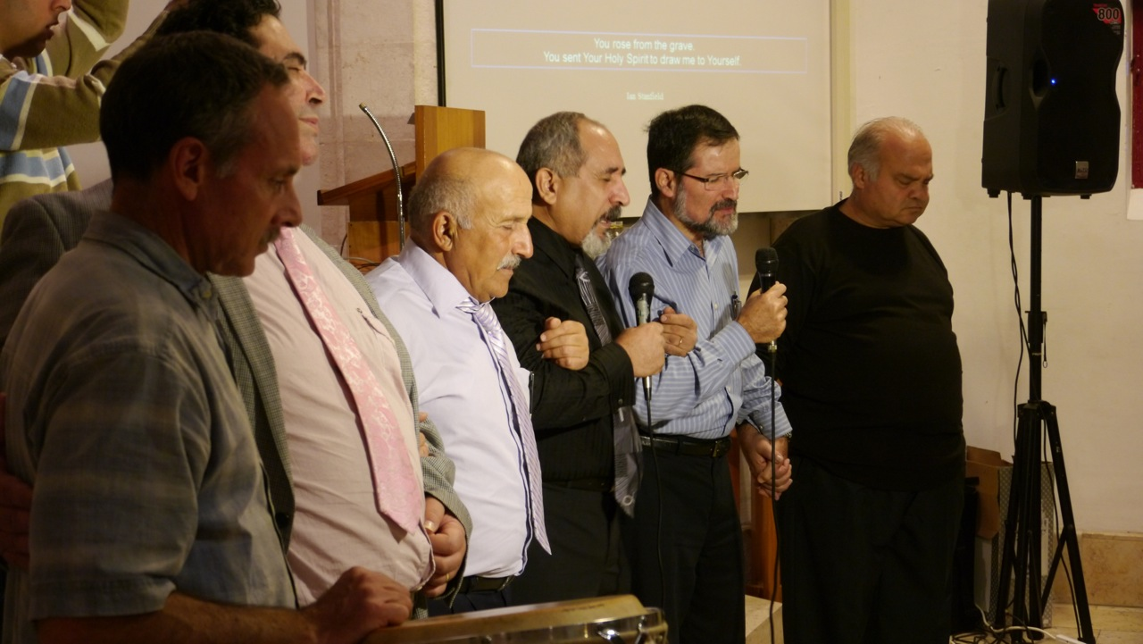
Notes:
We praised the Lord together for almost an hour in blended Arabic and Hebrew songs. Then the Arabic and Jewish leaders came on to the stage, held hands in unity, and began to pray spontaneously for half an hour. There was a brief message in Arabic, and a brief message in Hebrew. Then we sounded the shofar together, with shouts of "Blessed is He who comes in the name of the Lord" (Matthew 23:39).

Slide 10
UNESCO says Jews have no connection to temple mount: Thurs. 13 Oct. 2016, denying the Jewish connection to the Temple Mount and the Western Wall. The resolution maintains that the Western Wall and Temple Mount will be referred to by their Arabic names and
Notes:
(Arutz-7)

Slide 11
the Hebrew terms for the sites will only appear in quotation marks in UN references.
"It's like saying that the Chinese have no connection to the Great Wall of China and the Egyptians have no connection to the pyramids," said Netanyahu.

Slide 12
D’varim בדְּבָרִים
(Deuteronomy) 32.29-31
(from) Ha’azinu / Hear הַאֲזִינוּ
Notes:
Haazinu is the closing song of Moshe’s teaching. Some think that this is the basis that all the Torah is sung.

Slide 13
D’varim (Deuteronomy) 32:29

Slide 14
D’varim (Deuteronomy) 32:29-31 CJB
29 If they were wise they could figure it out and understand their destiny.

Slide 15
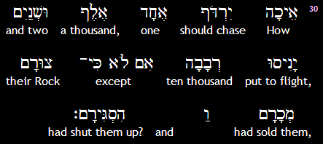
D’varim (Deuteronomy) 32:30
יְיָ
ADONI

Slide 16
D’varim (Deuteronomy) 32:29-31 CJB
30 After all, how can one chase a thousand and two put ten thousand to rout,
Notes:
This line really intrigued me, I think in the Ruakh, and was the Ruakh basis of this message.

Slide 17
One chase a thousand
Two chase ten thousand
→ 1,000
→ 10,000
???
10 ^{(n+2)}
Notes:
How to relate these two lines???

Slide 18
Formula |  | 10 ^{(n+2)}
one | Thou- Sand | 10 ⁽¹⁺²⁾ 10³
Two | Ten Thou- Sand | 10 ⁽²⁺²⁾ 10 ⁴

Slide 19
One chase a thousand
Two chase ten thousand 10 ^{(n+2)}
→ 1,000 = 10³
→ 10,000 = 10⁴
→ 100,000 = 10⁵
→ 1,000,000 = 10⁶
Power of unity Exponential +

Slide 20
D’varim (Deuteronomy) 32:30
יְיָ
ADONI

Slide 21
D’varim (Deuteronomy) 32:29-31 CJB
unless their Rock sells them to their enemies, unless Adonai hands them over?

Slide 22
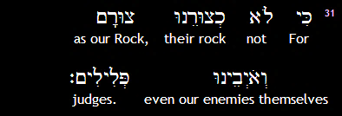
D’varim (Deuteronomy) 32:31

Slide 23
D’varim (Deuteronomy) 32:29-31 CJB
31 For our enemies have no rock like our Rock - even they can see that!
If we are walking in unity…

Slide 24
^{Yn 17.20-23} “I pray not only for these, but also for those who will trust in me because of their word, that they may all be one. Just as you, Father, are united with me and I with you, I pray that they may be united with us, so that the world may believe that you sent me.
Notes:
Key words, “Trust in me.” This doesn’t mean that we are in unity with every denomination, but particularly in our own house, community,
and then with those of like minded faith.

Slide 25
^{Yn 17.20-23} The glory which you have given to me, I have given to them; so that they may be one, just as we are one — I united with them and you with me, so that they may be completely one, and the world thus realize that you sent me, and that you have loved them just as you have loved me.
Notes:
Primarily with those on your left and right.

Slide 26
Consider the p’sukim, passages in scripture about unity.
“One another”

Slide 27
^{Beresheet/Gen 11:3-6} They said to one another, “Come, let’s make bricks and bake them in the fire.” So they had bricks for building-stone and clay for mortar. Then they said, “Come, let’s build ourselves a city with a tower that has its top reaching up into heaven,

Slide 28
^{Beresheet/Gen 11:3-6} so that we can make a name for ourselves and not be scattered all over the earth.” Adoni came down to see the city and the tower the people were building. Adoni said, “Look, the people are united,

Slide 29
^{Beresheet/Gen 11:3-6} they all have a single language, and see what they’re starting to do! At this rate, nothing they set out to accomplish will be impossible for them!
Notes:
Bad but unlimited application of unity

Slide 30
^{Mishlei /} ^{Prov 27:19} Just as water reflects the face, so one human heart reflects another.
Notes:
A true friend will tell you your faults, without rancor, and without flattery. It will be helpful!

Slide 31
^{Ro 1.11-12} For I long to see you, so that I might share with you some spiritual gift that can make you stronger — or, to put it another way, so that by my being with you, we might, through the faith we share, encourage one another.
Notes:
Shaliakh, epochal leader, looks to mutual edification! Upbuilding.

Slide 32
^{Ro 16.15-16} Greet Philologus, Julia, Nereus and his sister, and Olympas, and all of God’s people who are with them. Greet one another with a holy kiss. All the Messiah’s congregations send their greetings to you.
Notes:
3x in Mes Scriptures
This can be a cultural conundrum. Kissing, hugging, not in everyone’s comfort zone.
Great movie.

Slide 33
Notes:
Her father is British royalty, her mother an American traveler. Romance. Married by some desert sheikh and she was born, but marriage was split up by royals, and she was brought up by single mom, with great father hunger. Finally manipulated credit card and flew to London. Met family. Grandmother her greatest ally. But…

Slide 34
No hugs, dear. I'm British. We only
show affection to dogs and horses.
Notes:
But, it’s OK to hug here. Side hugs or neck hugs male/female.
Kissing…not so much

Slide 35
^{1 Cor 11.33-34} So then, my brothers, when you gather together to eat, wait for one another. If someone is hungry, he should eat at home, so that when you meet together it will not result in judgment.

Slide 36
^{Gal 5.13} For, brothers, you were called to be free. Only do not let that freedom become an excuse for allowing your old nature to have its way. Instead, serve one another in love.

Slide 37
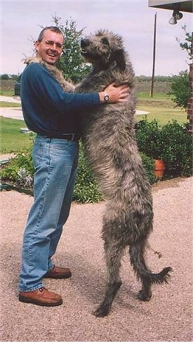
Irish Wolfhound
Loyal, Sweet-
Tempered, Generous,
Dignified, Thoughtful,
Patient

Slide 38
Gal 6.2 Bear one another’s burdens — in this way you will be fulfilling the Torah’s true meaning, which the Messiah upholds.

Slide 39
^{Eph 4.2-4} Always be humble, gentle and patient, bearing with one another in love, and making every effort to preserve the unity the Spirit gives through the binding power of shalom. There is one body and one Spirit, just as when you were called you were called to one hope.

Slide 40
^{Eph 5.21-25} Submit to one another in fear of the Messiah. Wives should submit to their husbands as they do to the Lord; because the husband is head of the wife, just as the Messiah, as head of the Messianic Community

Slide 41
^{Eph 5.21-25} is himself the one who keeps the body safe. Just as the Messianic Community submits to the Messiah, so also wives should submit to their husbands in everything. As for husbands, love your wives, just as the Messiah loved the Messianic Community,
Notes:
Doesn’t say, “Collect and enforce submission.” Totally voluntary.

Slide 42
^{Phil 2.3-6} Do nothing out of rivalry or vanity; but, in humility, regard each other as better than yourselves — look out for each other’s interests and not just for your own. Let your attitude toward one another

Slide 43
^{Phil 2.3-6} be governed by your being in union with the Messiah Yeshua: Though he was in the form of God, he did not regard equality with God something to be possessed by force.

Slide 44
^{Col 3.9-10} Never lie to one another; because you have stripped away the old self, with its ways, and have put on the new self, which is continually being renewed in fuller and fuller knowledge, closer and closer to the image of its Creator.
Notes:
Hard when telling a story

Slide 45
^{Col 3.12-13} Therefore, as God’s chosen people, holy and dearly loved, clothe yourselves with feelings of compassion and with kindness, humility, gentleness and patience. Bear with one another; if anyone has a complaint

Slide 46
^{Col 3.12-13} against someone else, forgive him. Indeed, just as the Lord has forgiven you, so you must forgive.

Slide 47
^{Ro 13.7-8} Pay everyone what he is owed: if you owe the tax-collector, pay your taxes; if you owe the revenue-collector, pay revenue; if you owe someone respect, pay him respect;
Notes:
We’ll come back to this, but first…

Slide 48
^{Ro 13.7-8} if you owe someone honor, pay him honor. Don’t owe anyone anything — except to love one another; for whoever loves his fellow human being has fulfilled Torah.

Slide 49
A societal responsibility

Slide 50
In the national popular vote Kennedy beat Nixon by just one tenth of one percentage point (0.1%) – the closest popular-vote margin of the twentieth century. Kennedy carried 11 states by three percentage points or less, while Nixon won 5 states by the same margin.
Notes:
http://www.toptenz.net/top-10-closest-presidential-elections.php

Slide 51
In 1880 James Garfield (R) defeats Winfield Hancock (D) by 59 Electoral Votes and won the popular vote by .1%.
Notes:
http://www.toptenz.net/top-10-closest-presidential-elections.php

Slide 52
In 2004 George W. Bush (R) defeats John Kerry (D) by 35 Electoral Votes1 and wins the popular vote by 2.4%. After an intense recount process and the decision of the United States Supreme Court in Bush v. Gore,
Notes:
http://www.toptenz.net/top-10-closest-presidential-elections.php
https://en.wikipedia.org/wiki/United_States_presidential_election_in_Florida,_2000

Slide 53
Governor George W. Bush officially won Florida's electoral votes, by a margin of only 537 votes out of almost 6 million cast, and as a result, the entire presidential election.
Notes:
http://www.toptenz.net/top-10-closest-presidential-elections.php
https://en.wikipedia.org/wiki/United_States_presidential_election_in_Florida,_2000

Slide 54
Ravi Zacharias:
So I must speak my heart. It will all come down to the place and meaning of law, life at its essence, and moral worth. We must vote. Vote if not for the now, at least for the future. But…”Neither candidate represents my values.”

Slide 55
Ravi Zacharias:
I agree. So with what philosophers would call “Hobson's Choice,” I ask three questions.

Slide 56
In the late 16th and early 17th centuries, Thomas Hobson kept horses and rented them to university students when he wasn't using them. Of course, the students always wanted their favorite mounts, and a few of Hobson's horses became overworked.

Slide 57
To correct the situation, Hobson began a strict rotation system, giving each customer the choice of taking the horse nearest the stable door or none at all. This rule became known as Hobson's choice, and soon people were using that term to mean "no choice at all" in all kinds of situations.

Slide 58
Ravi Zacharias:
First, which of the two candidates is more likely to surround the highest office with those with a hint at moral reasoning? That may at least give a glimmer of hope.

Slide 59
Ravi Zacharias:
Second, who is more likely to appoint as keepers of the law [Supreme Court justices] those who go back to our roots in order to secure the future? That will at least recognize a beginning.

Slide 60
Ravi Zacharias:
Third, who stands on a platform of values that guards my essence and my existence [and that of Israel]?
That may at least guide our destiny.

Slide 61
^{2 Thes 1} We have to keep thanking God for you always, brothers, as is appropriate; because your trust continues to grow greater, and the love you each have for one another continues to increase.
Notes:
I’m irritated

Slide 62
^{Heb 10.24-25} And let us keep paying attention to one another, in order to spur each other on to love and good deeds, not neglecting our own congregational meetings, as some have made a practice of doing, but, rather, encouraging each other.And let us do this all the more as you see the Day approaching.
Notes:
Juster on Congregational importance.

Slide 63
^{Yaakov 5.8-9} You too, be patient; keep up your courage; for the Lord’s return is near. Don’t grumble against one another, brothers, so that you won’t come under condemnation — look! the Judge is standing at the door!

Slide 64
^{1 Kefa/Peter 4.8-10} More than anything, keep loving each other actively; because love covers many sins. Welcome one another into your homes without grumbling. As each one has received some spiritual gift, he should use it to serve others,
Notes:
Big test of fellowship

Slide 65
^{1 Peter 5:5} Likewise, you who are less experienced, submit to leaders. Further, all of you should clothe yourselves in humility toward one another, because God opposes the arrogant, but to the humble he gives grace.

Slide 66
^{1 Yn 3.23} This is his command: that we are to trust in the person and power of his Son Yeshua the Messiah and to keep loving one another, just as he commanded us.
4x more in 1 & 2 Yn

Slide 67
1 John 4:7 Beloved friends, let us love one another; because love is from God; and everyone who loves has God as his Father and knows God.
Notes:
This is NOT just a matter of the will and wisdom, but the Ruakh by the atonement of the Messiah. It’s all about Yeshua, ultimately.

Slide 68
1 John 4:11 Beloved friends, if this is how God loved us, we likewise ought to love one another.

Slide 69
1 John 4:12 No one has ever seen God; if we love one another, God remains united with us, and our love for him has been brought to its goal in us.

Slide 70
2 John 1:5 And now, dear lady, I am requesting that we love one another — not as if this were a new command I am writing you, for it is the one which we have had from the beginning.

Slide 71
One chase a thousand
Two chase ten thousand 10 ^{(n+2)}
→ 1,000 = 10³
→ 10,000 = 10⁴
→ 100,000 = 10⁵
→ 1,000,000 = 10⁶
Power of unity Exponential +

