Slide 3
Notes:
From Suzanne Alongi

Slide 4
The leader of the Palestinian terrorist organization Hamas, Kaled Mashal, sent a gift to the Prime Minister of Israel, Benjamin Netanyahu, in a fancy box with a note. After being inspected for reasons of security, Prime Minister Netanyahu opened the box and saw that the content was cow manure. He opened the note, handwritten in Arabic by the own Mashal, saying:

Slide 5
"For you and those proud of the Zionist entity". PM Netanyahu thought of what would be the best way to respond.
He sent the leader of Hamas, a very nice package, also with a personal note. Mr. Mashal and his subordinates of Hamas were very surprised to receive the package and opened it carefully, suspecting that it might contain a bomb.

Slide 6
But to their surprise, they saw that it contained a small computer Pen Drive. It was rechargeable with solar energy, had a 1.8 terabyte memory, and had a 3D screen hologram capable of running on any type of mobile phone, tablet or laptop. It was one of the most advanced technologies in the world, and came with a small label, "invented and produced in Israel."

Slide 7
The note of Netanyahu, hand-written personally and in Arabic, Hebrew, French and English, said politely: "each leader can only give the best that his people can produce."

Slide 8
מַתִּתְיָהוּ Mattityahu
(Matthew) 10:11-13
Notes:
Last Shabbat, message on…sending with little provision, physical resources, in faith. Various interpretations of living in poverty, in wealth.
This week, what they’re to do when then go.
In order to understand this passage, we need to look at a similar passage in Luke. There Y is sending 70 with almost the same instructions, but a few details added.

Slide 9
Mattityahu (Matthew) 10.11
בְּכָל עִיר וּכְפָר שֶׁתִּכָּנְסוּ אֲלֵיהֶם בָּרְרוּ מִי רָאוּי בְּתוֹכָם וּשְׁבוּ שָׁם עַד צֵאתְכֶם.
"When you come to a town or village, look for someone trustworthy and stay with him until you leave.
Notes:
Someone trustworthy??

Slide 10
Mattityahu (Matthew) 10.12
כְּשֶׁאַתֶּם נִכְנָסִים לְבַיִת בָּרְכוּהוּ בְּ'שָׁלוֹם'.
When you enter someone's household, say, 'Shalom aleikhem!'
Notes:
In Hebrew thinking, this is not just a greeting. It’s a blessing. Communication of shalom: wholeness, wellness, prosperity, tranquility. People have come into our home and said it felt peaceful. Even with our Chihuahua.

Slide 11
Mattityahu (Matthew) 10.13
אִם רָאוּי הַבַּיִת יָבוֹא עָלָיו הַ'שָּׁלוֹם' שֶׁלָּכֶם, אַךְ אִם אֵינֶנּוּ רָאוּי יָשׁוּב הַ'שָּׁלוֹם' שֶׁלָּכֶם אֲלֵיכֶם.
If the home deserves it, let your shalom rest on it; if not, let your shalom return to you."
Notes:
Parallel or similar instructions in Luke

Slide 12
^{Lk. 10.6} If a seeker of shalom is there, your `Shalom!' will find its rest with him; and if there isn't, it will return to you
“son of shalom [peace]”
Means?
a person who has a peaceable nature, or

Slide 13
(2) “a man worthy of, destined for shalom.” …an individual who is willing to receive salvation, an individual “whose heart is ready to welcome the kingdom.” A person of influence and integrity.
Notes:
No one is really inherently worthy, but we can resist or receive the wooing of the Ruakh.
Yn 6.44 No one can come to me unless the Father — the One who sent me — draws him.
Two basic theological grids in the Kingdom
G-d predestines those who follow Him and who don’t
G-d opens our hearts so we choose to receive His Kingdome. Not worthy of it. Just willing. Called Arminianism. David Stern says closer to Messianic Judaism than other.
Do what when in such a home:

Slide 14
^{Lk. 10.9-10} "Whenever you come into a town where they make you welcome, eat what is put in front of you. Heal the sick there, and tell them, `The Kingdom of God is near you.'
Publish the presence of the King, and power of joy coming.
Home based community.
Notes:
Supernatural endument to heal. Tell them: King’s power is here. King is here, or coming soon. Cf “yoke of the Kingdom of Heaven” rabbinic term, LIBERTY, the King is near. Power of the King!
Did it happen? People drawn to power of the King at His home?

Slide 15
^{Mtt. 9.1-2} So he stepped into a boat, crossed the lake again and came to his own town. Some people brought him a paralyzed man lying on a mattress.
Notes:
People seemed to be used to gathering for help at Yeshua’s home/headquarters in KfarNahum.
Another example of a home centered ministry:

Slide 16
^{Mtt. 9.9-10} As Yeshua passed on from there he spotted a tax-collector named Mattityahu sitting in his collection booth. He said to him, "Follow me!" and he got up and followed him. While Yeshua was in the house eating, many tax-collectors and sinners came and joined him and his talmidim at the meal.

Slide 17
^{Yn 12.1-2, 9} Six days before Pesach, Yeshua came to Beit-Anyah, where El`azar lived, the man Yeshua had raised from the dead; so they gave a dinner there in his honor…A large crowd of Judeans learned that he was there; and they came not only because of Yeshua, but also so that they could see El`azar, whom he had raised from the dead.
Notes:
Seems not out of order that a crowd would converge. Maybe this was His home base in Yehuda.

Slide 18
Ever done this way since Yeshua’s time?
^{Acts 10.22-24} "Cornelius...a Roman army officer, an upright man and a God-fearer, a man highly regarded by the whole Jewish nation…was told by a holy angel to have you come to his house and listen to what you have to say."

Slide 19
^{Acts 10.22-24} So Kefa …arrived at Caesarea the day after that. Cornelius was expecting them - he had already called together his relatives and close friends.
Notes:
So, Cornelius was such a “man of peace.” Faith branched out from there.

Slide 20
^{Acts 16.14-15} One of those listening was a woman from the city of Thyatira named Lydia, a dealer in fine purple cloth. She was already a "God-fearer," and the Lord opened up her heart to respond to what Sha'ul was saying. After she and the members of her household had been immersed,

Slide 21
^{Acts 16.14-15} she gave us this invitation: "If you consider me to be faithful to the Lord, come and stay in my house.“ And she insisted till we went.
Notes:
Ethnicity: G-d fearer, not fully converted to Judaism. Really tempted to define ethnicity by last line.

Slide 22
^{1 Cor 1.16} I did also immerse Stephanas and his household
^{Acts 5.32}
^{Acts 20.20} I taught you both in public and from house to house
Notes:
Home base to home base

Slide 23
How did they find the “ben shalom, man of peace”??
^{Mtt. 9.39-38} When he saw the crowds, he had compassion on them because they were harried and helpless, like sheep without a shepherd. Then he said to his talmidim, "The harvest is rich, but the workers are few. Pray that the Lord of the harvest will send out workers to gather in his harvest."
Notes:
Key bases for growth. Paul would seek the Jews or G-d fearers whose hearts were open, and set up base there.

Slide 24
“in the ancient Jewish, Messianic, and Hellenistic world, a private home often provided the meeting place for religious and intellectual dialogue and instruction”; the oikos (household)
Some formal synagogues were located in private houses.

Slide 25
Does this model of outreach fit? What can we learn from this “man of shalom” model?
Was this example descriptive, or prescriptive? [Shaul preached till midnight…]
Culture in ancient Israel was collectivist / community
Western culture is individualistic.
Notes:
In eastern cultures, village cultures, this still works well.

Slide 26
One missionary in Asia, following the instructions of Yeshua in Luke 10, declared, “We prayed, ‘God we know you’re at work here ... We need a man of peace...I started my stopwatch. We walked into the center of the village where the well was. A person approached me out of nowhere and said, ‘Have you eaten?’

Slide 27
We said, ‘Not yet.’ He said, ‘Well, come to my home.’ His name was Li, and he was the person of peace we wanted. I stopped my watch: three minutes, 21 seconds.” Of course, this is not always the case.

Slide 28
Another organization meets needs, and engages people, until they find their man of peace.
Boris Grysenko, in Kiev
Notes:
March of Remembrance sort of like this.

Slide 29
R
RWANDA Peace Through Reconciliation and Forgiveness

Slide 30
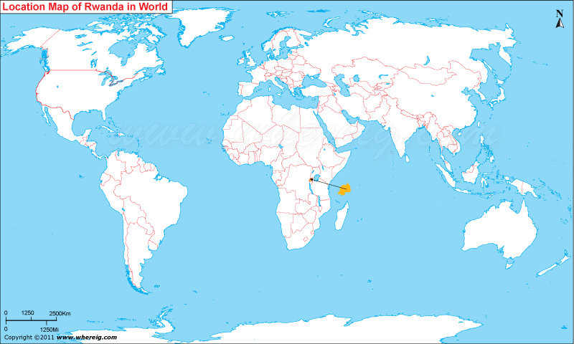

Slide 31
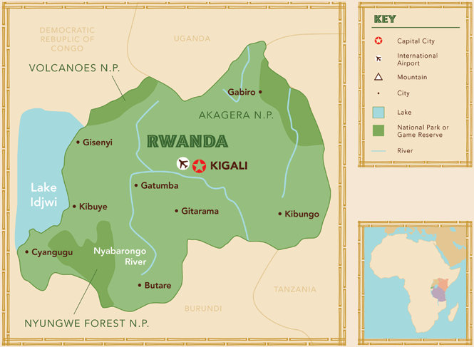

Slide 34
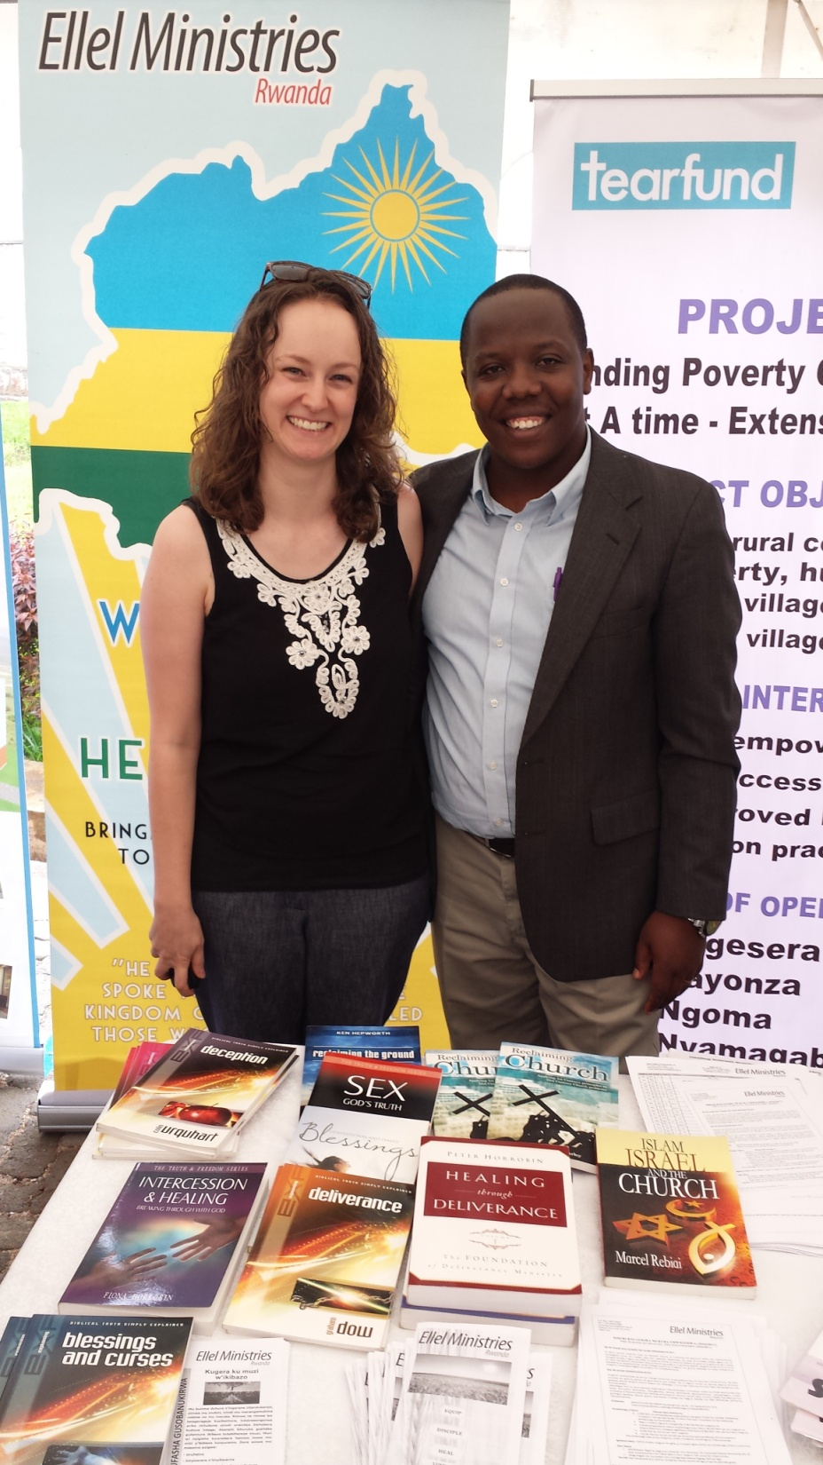
http://ellel.org/za/about/ellel-rwanda/

Slide 35
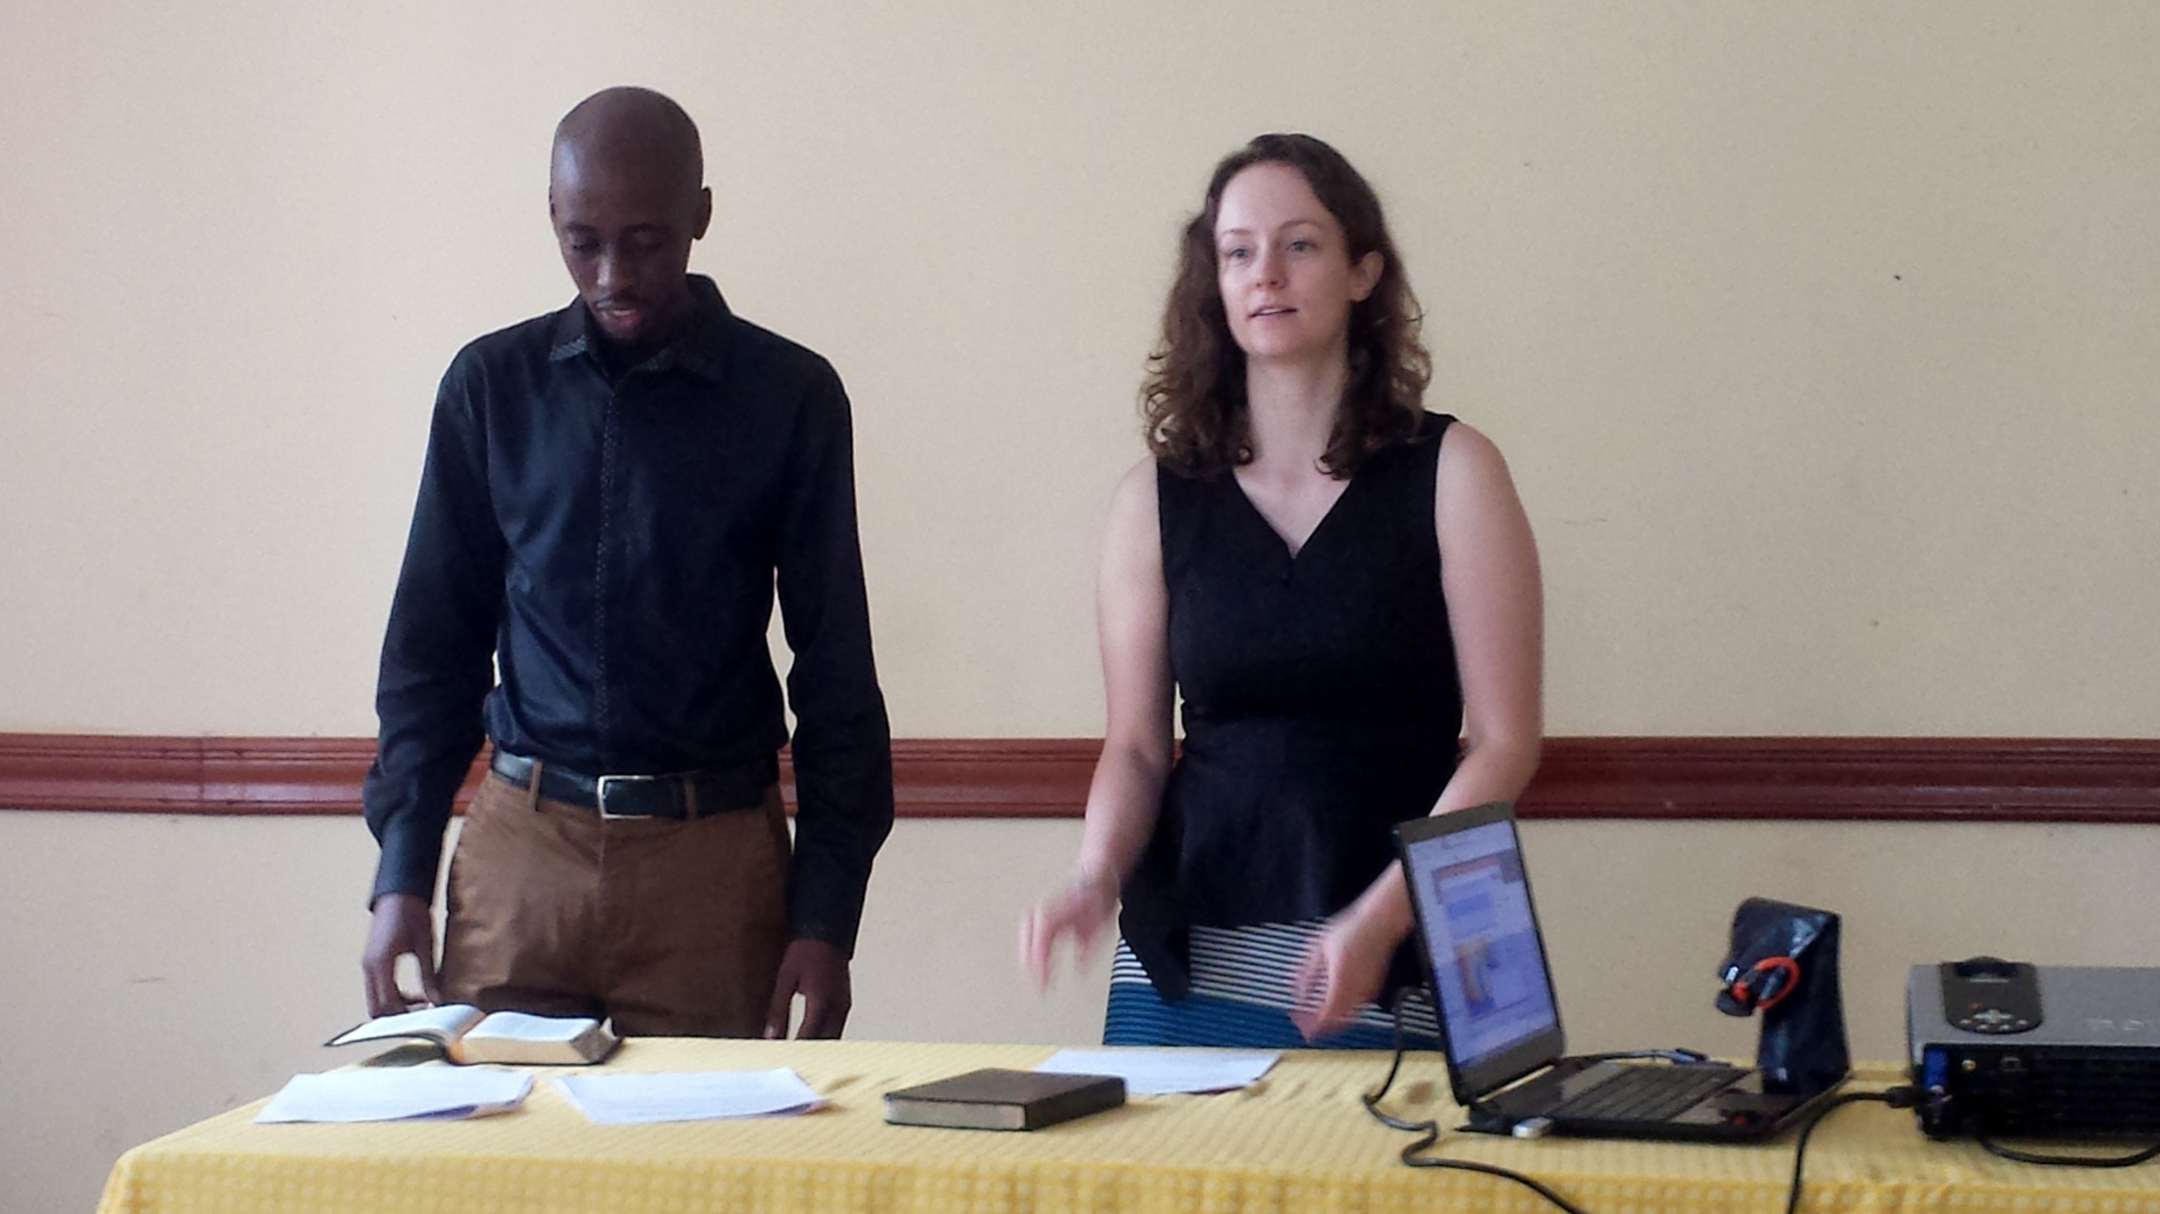
Teaching a course on Israel and the Church.

Slide 36
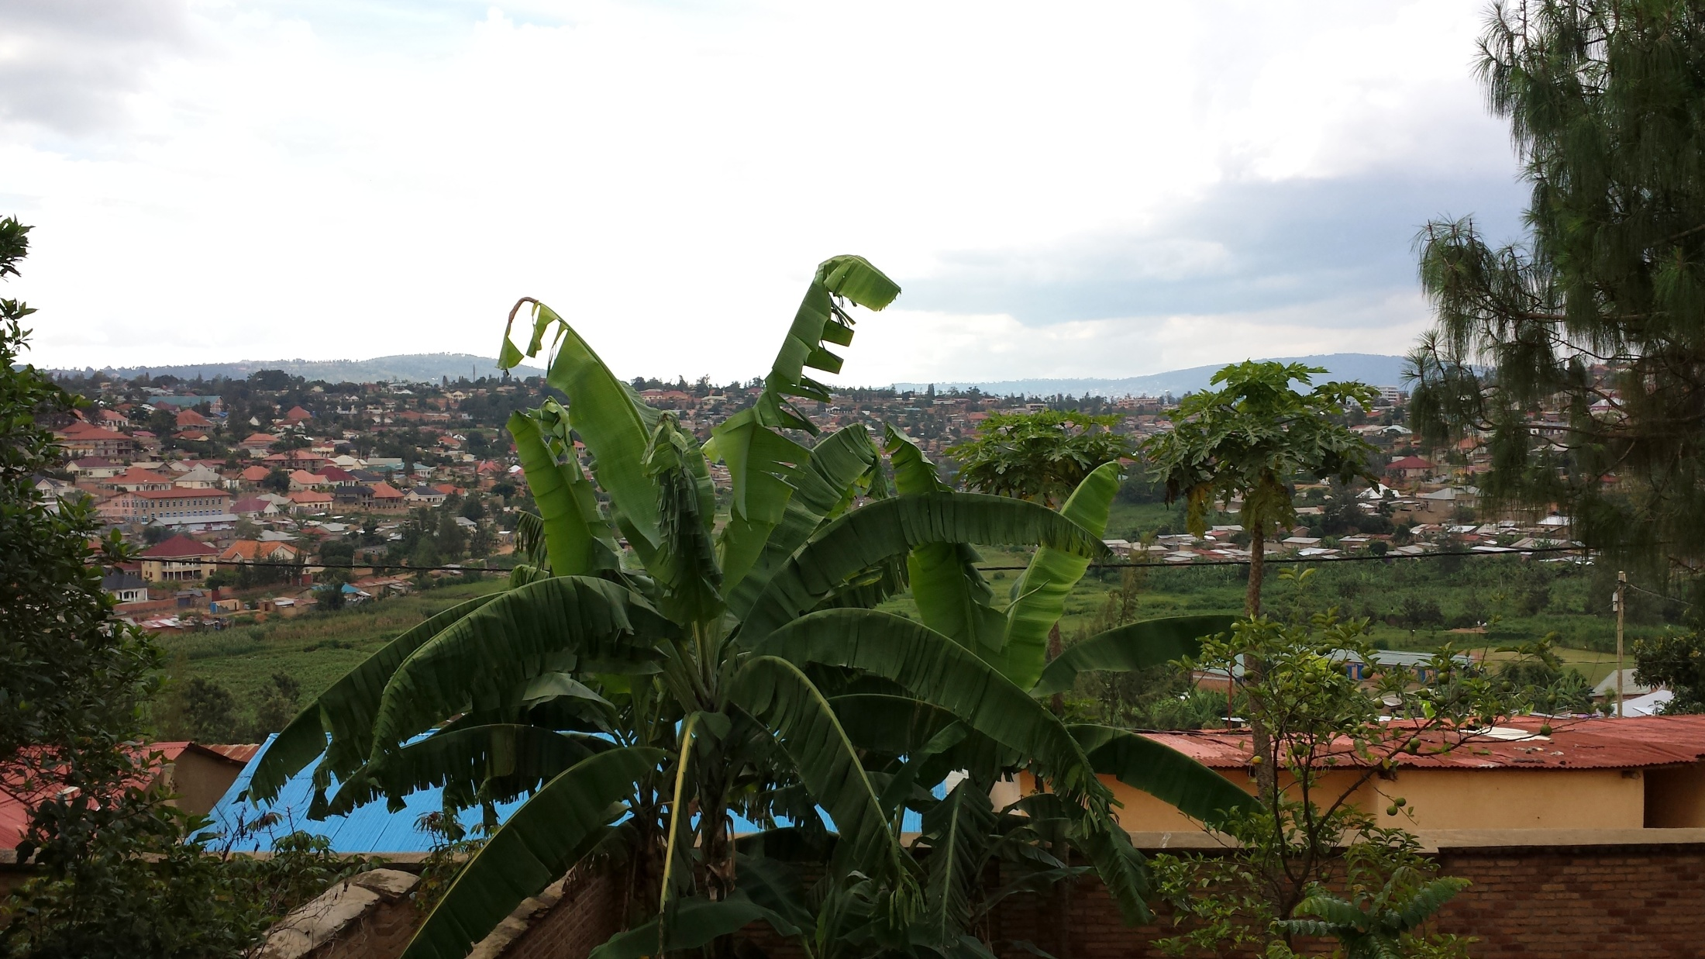

Slide 37
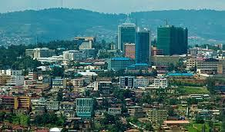

Slide 38
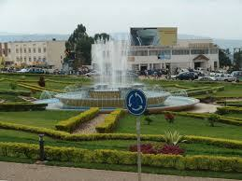

Slide 39
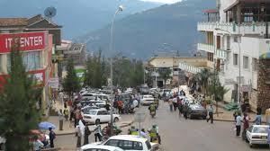

Slide 40
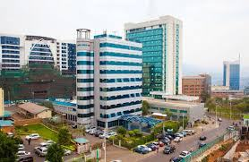

Slide 41
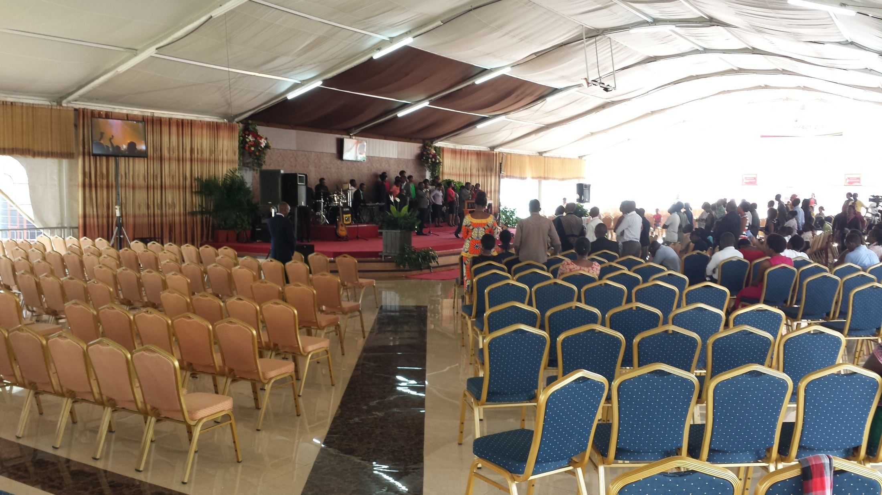

Slide 42
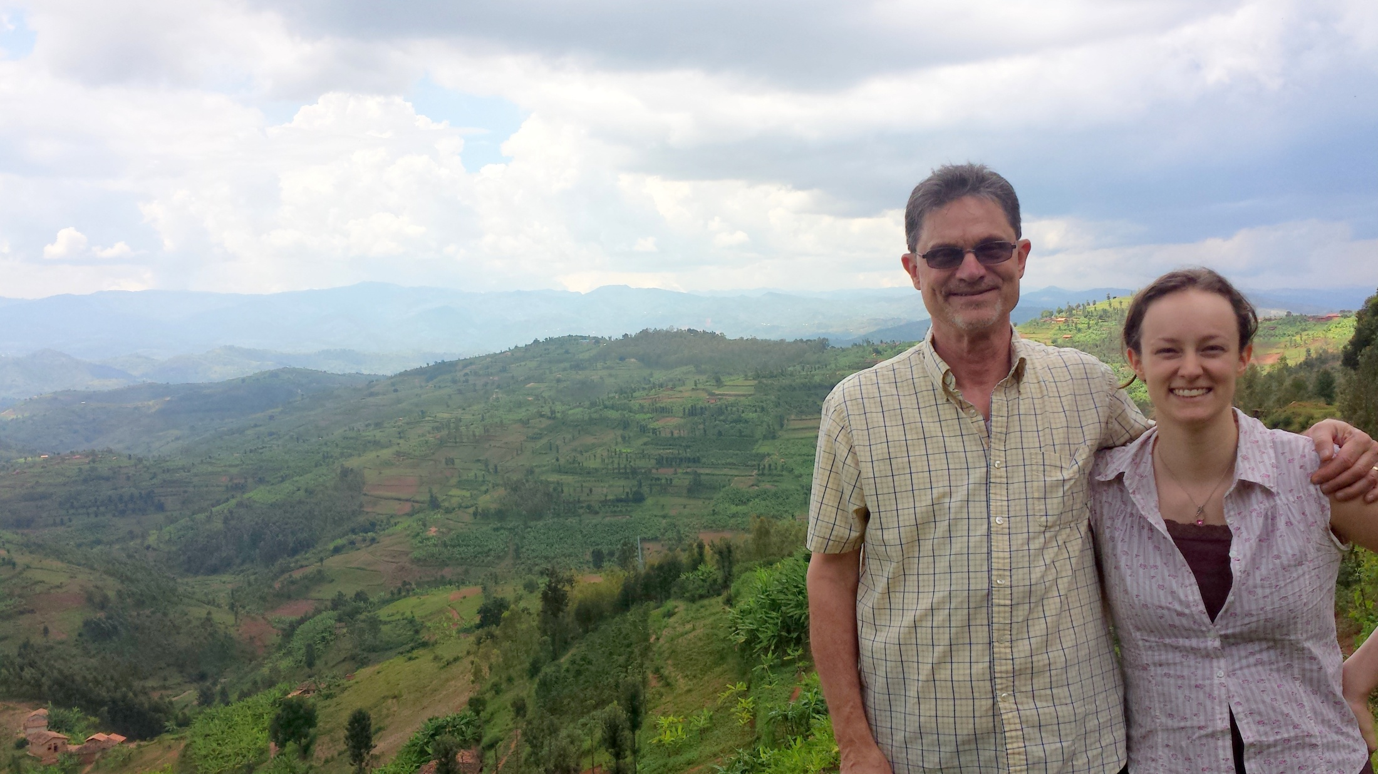

Slide 43
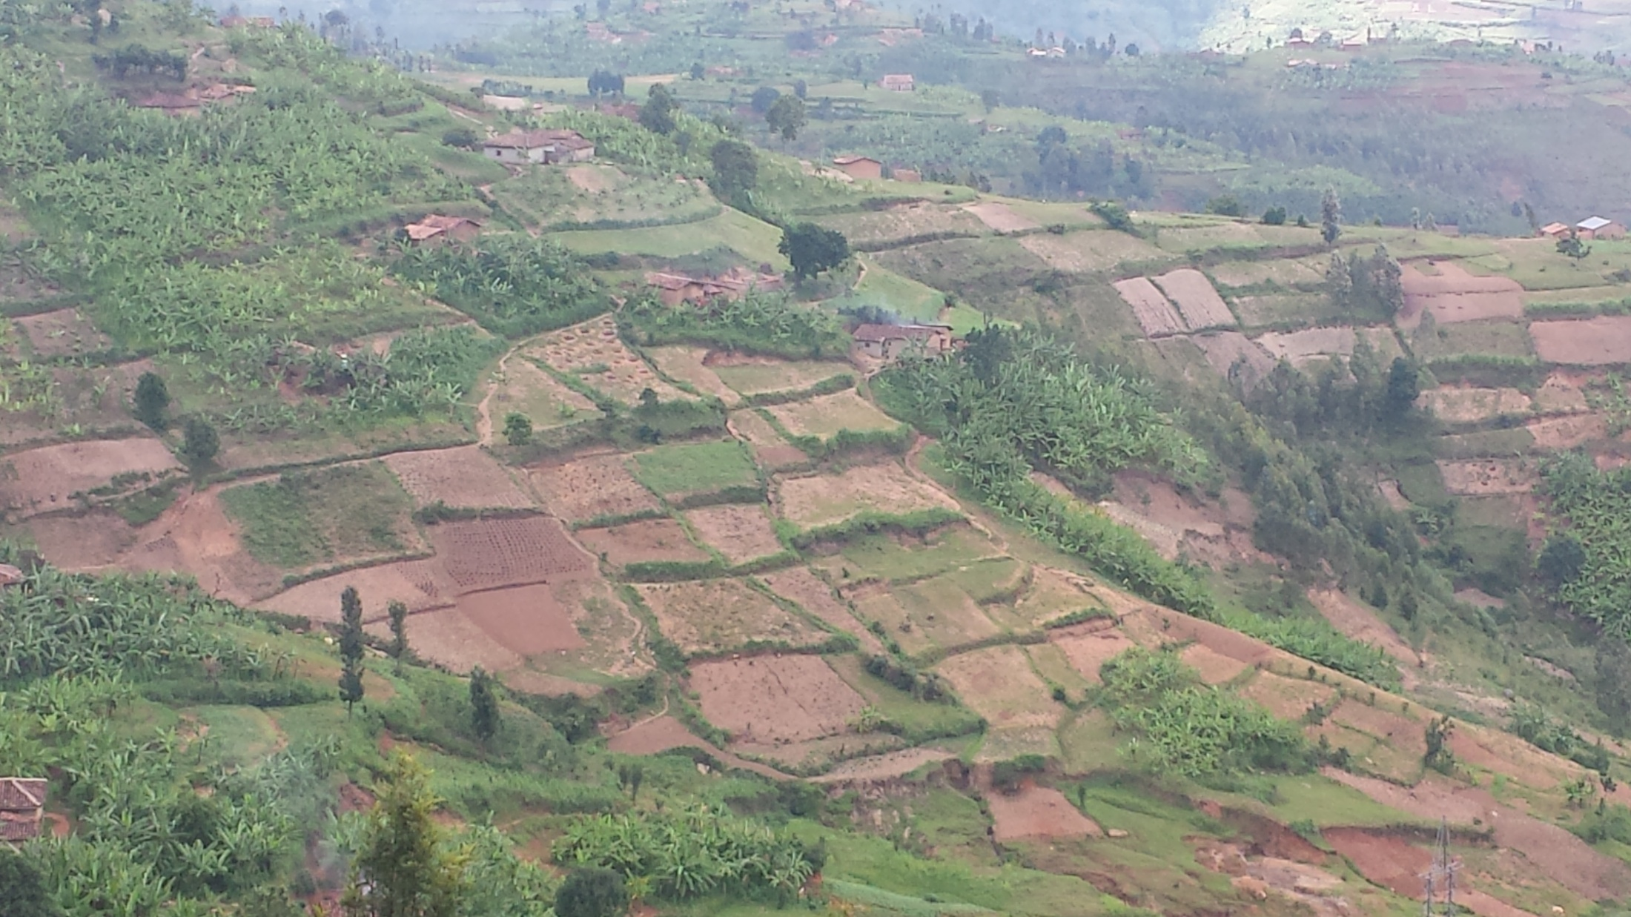

Slide 44
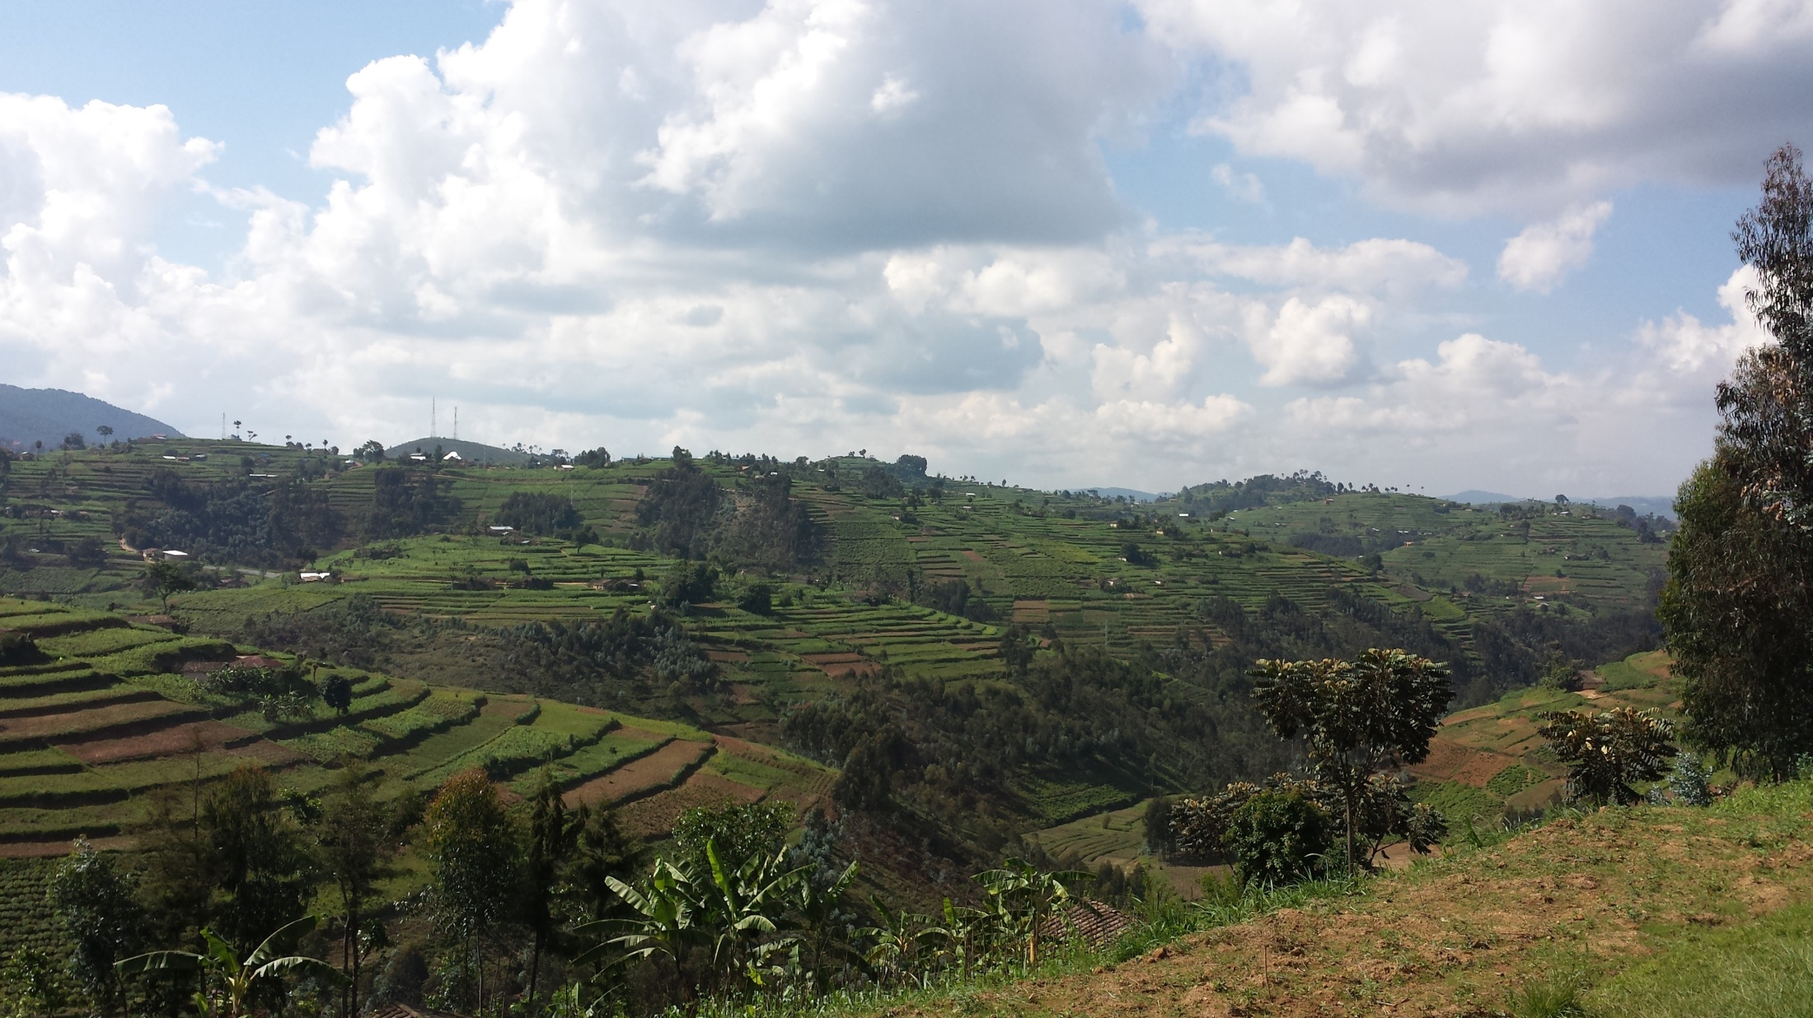

Slide 45
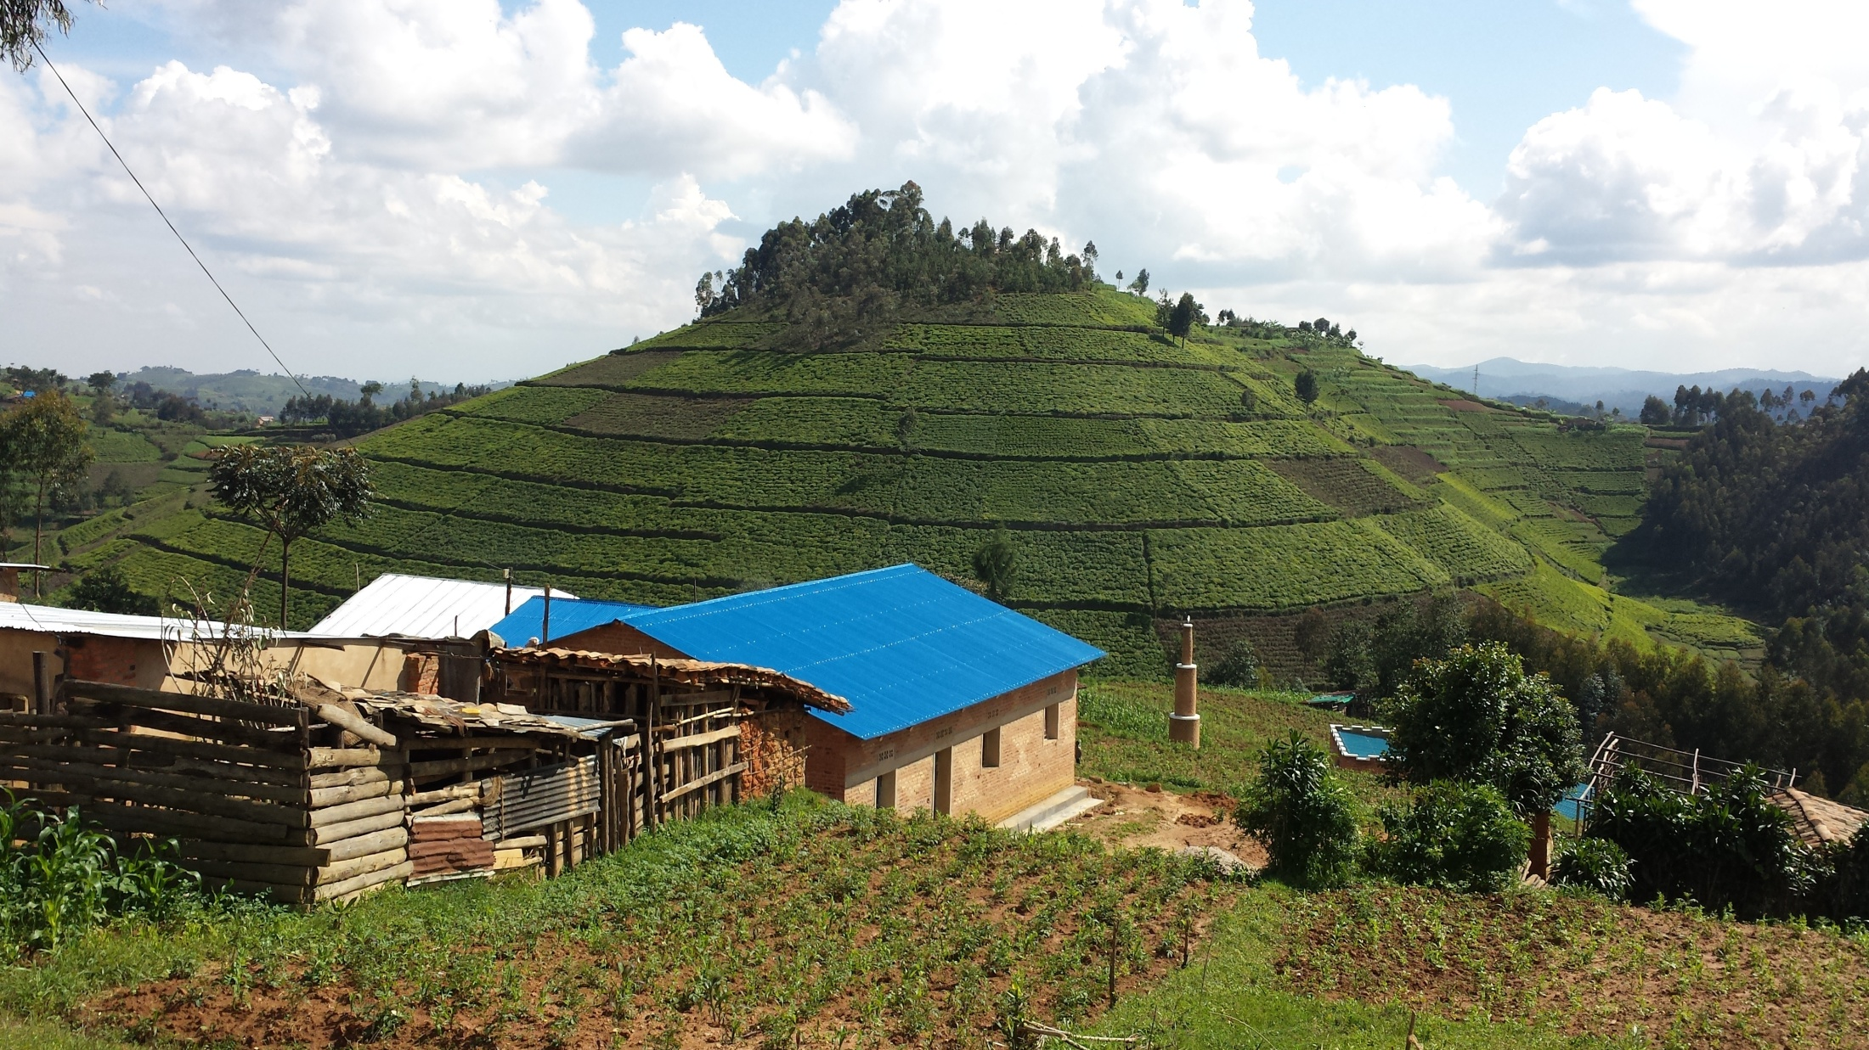

Slide 46
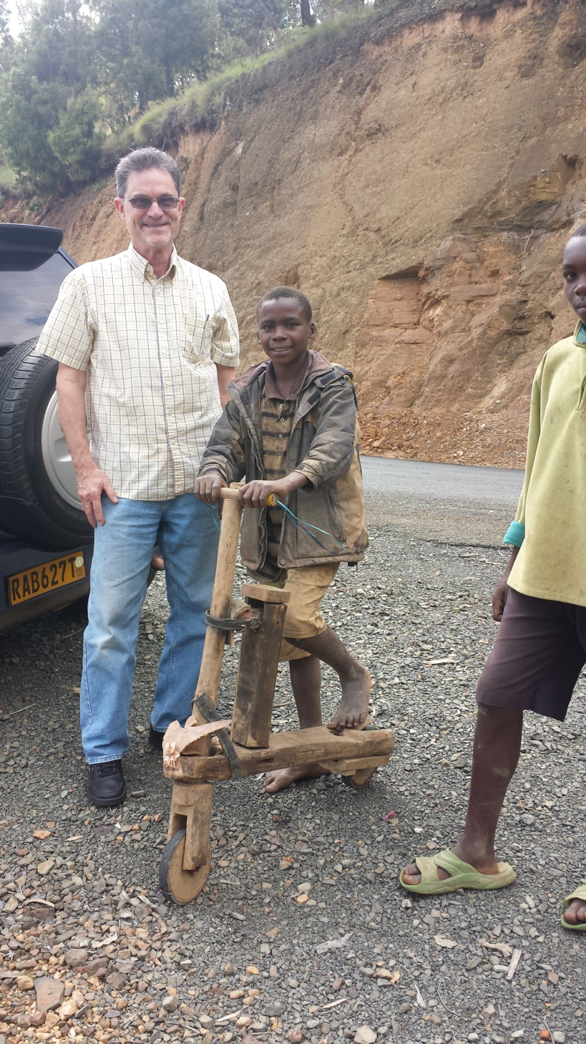

Slide 48
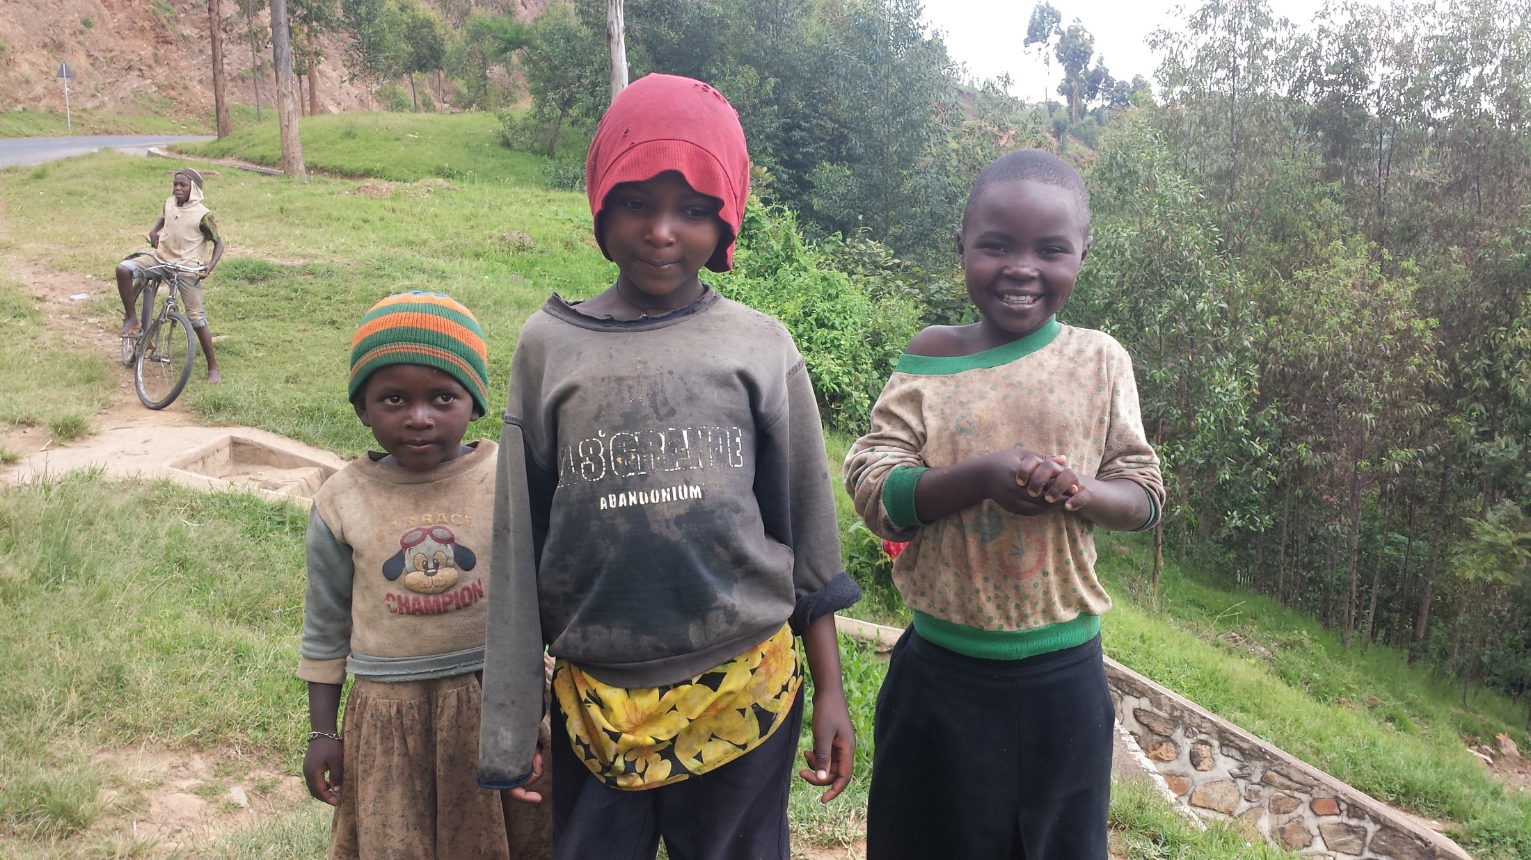

Slide 49
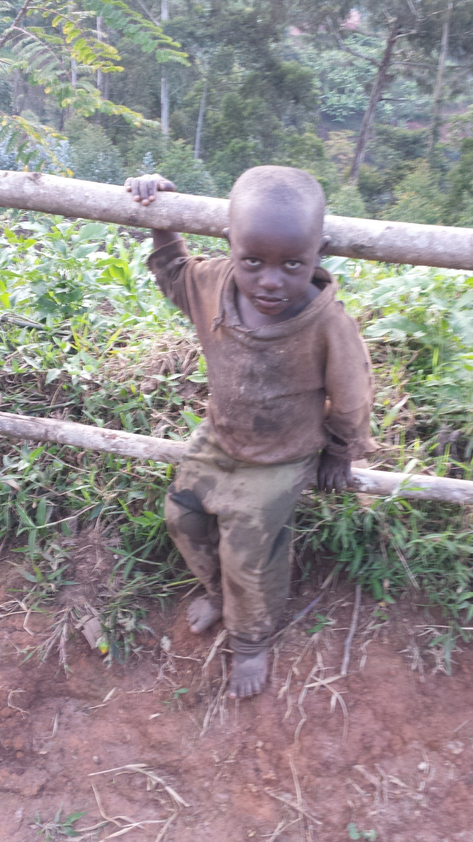

Slide 50
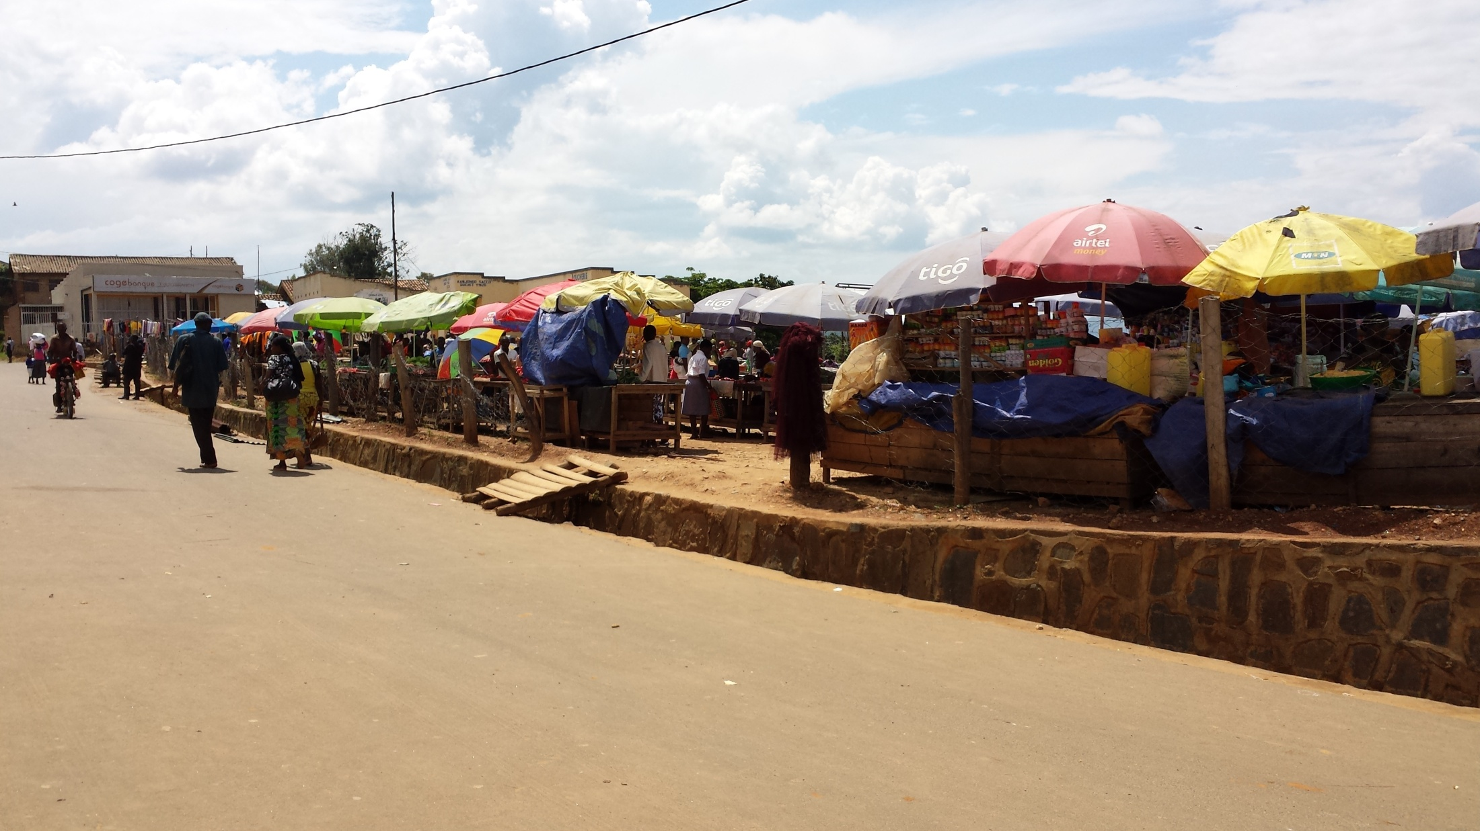

Slide 51
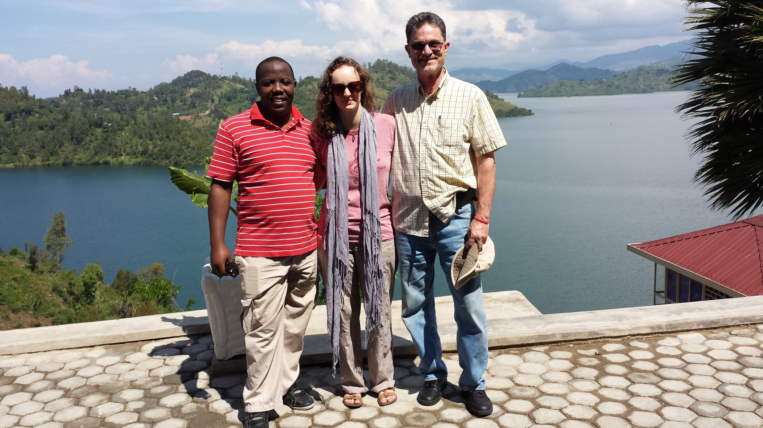

Slide 54
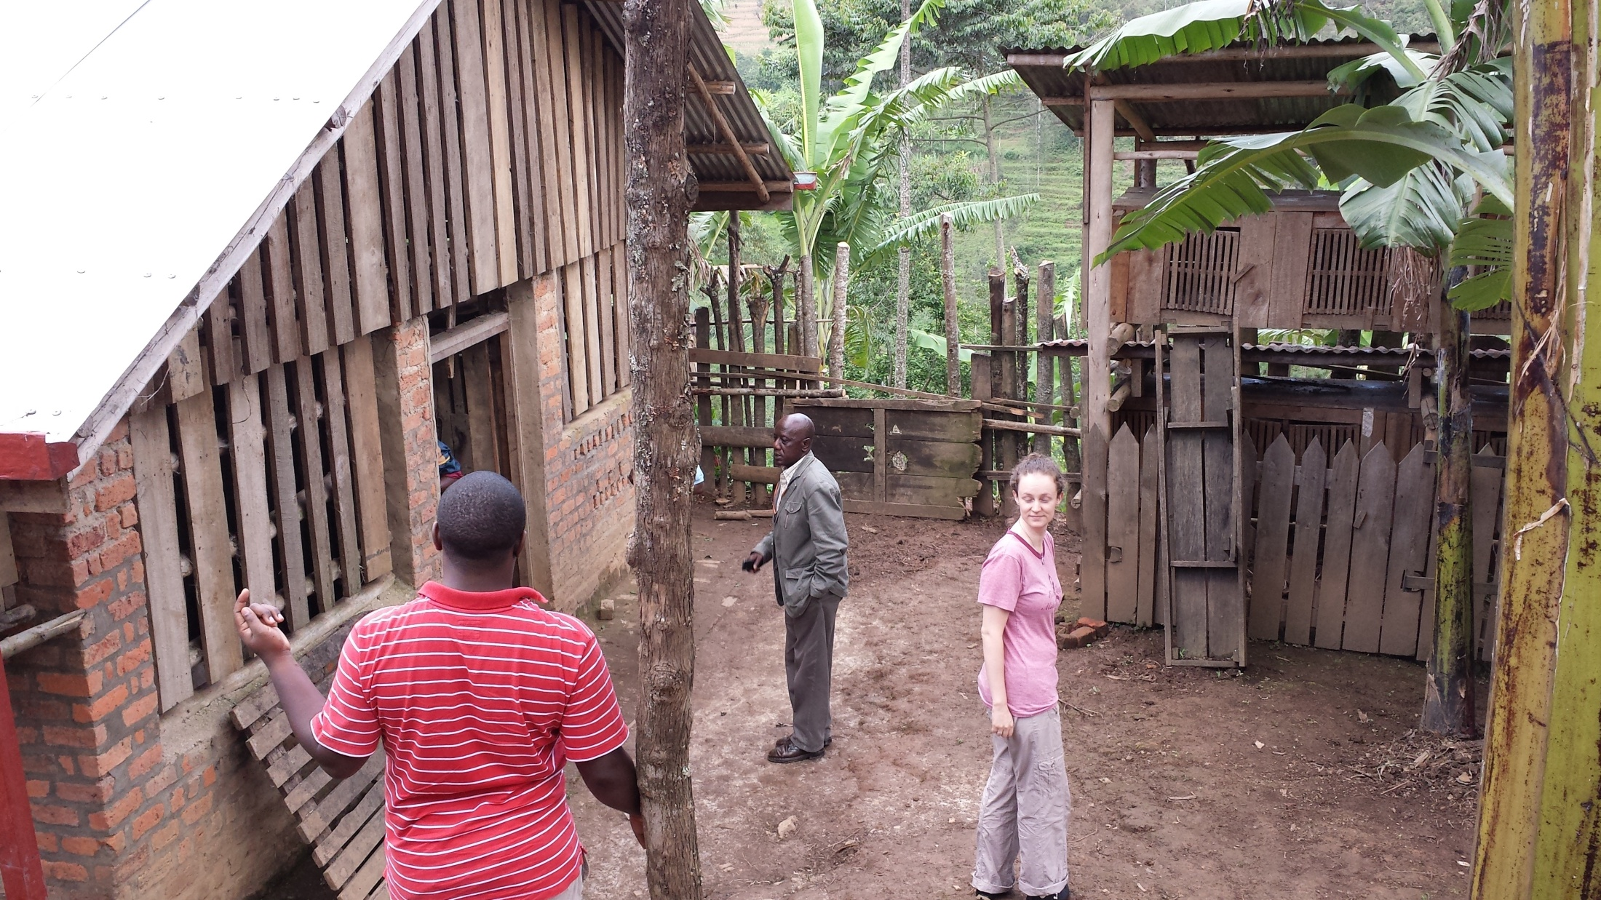

Slide 55
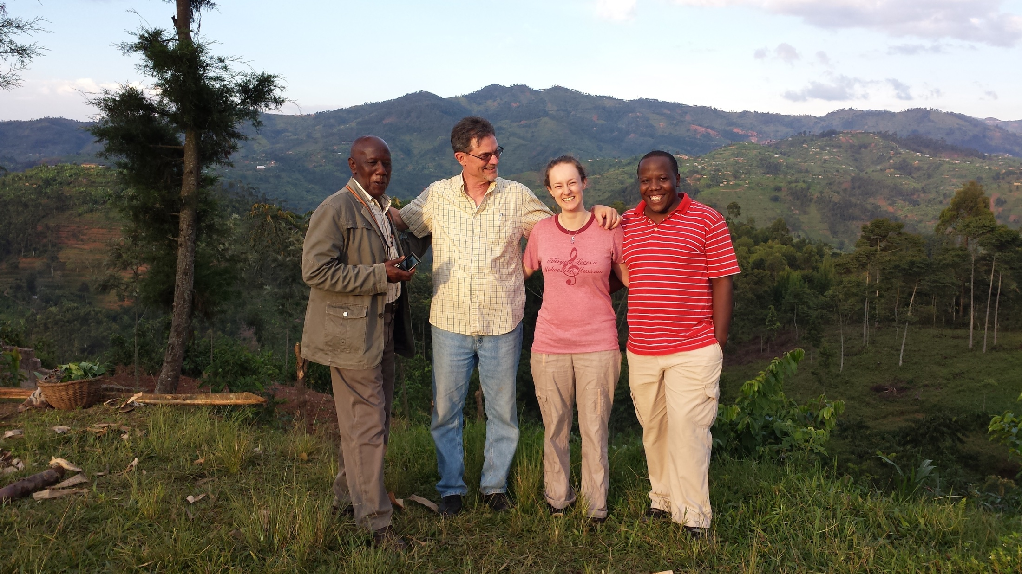

Slide 56
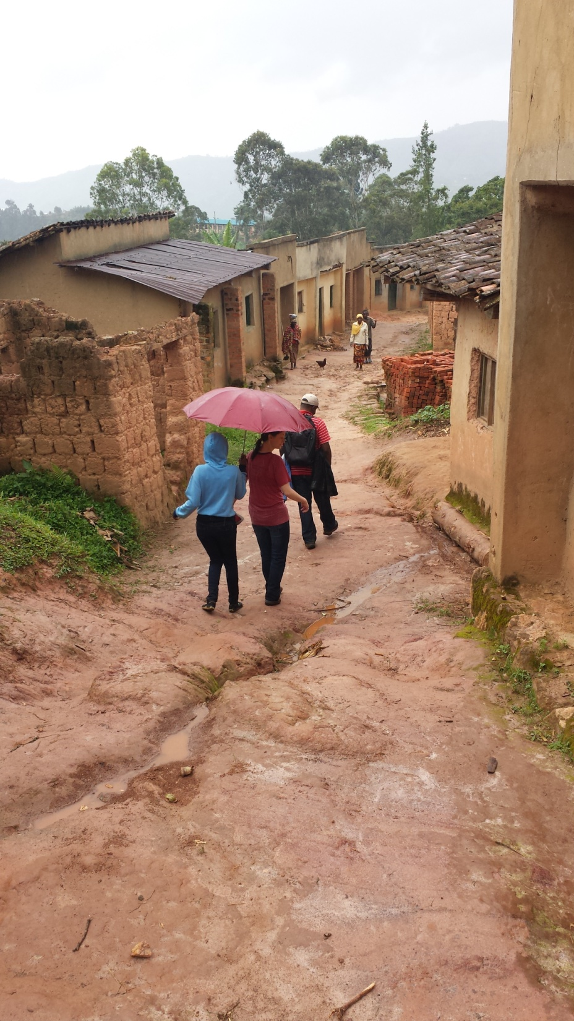

Slide 60
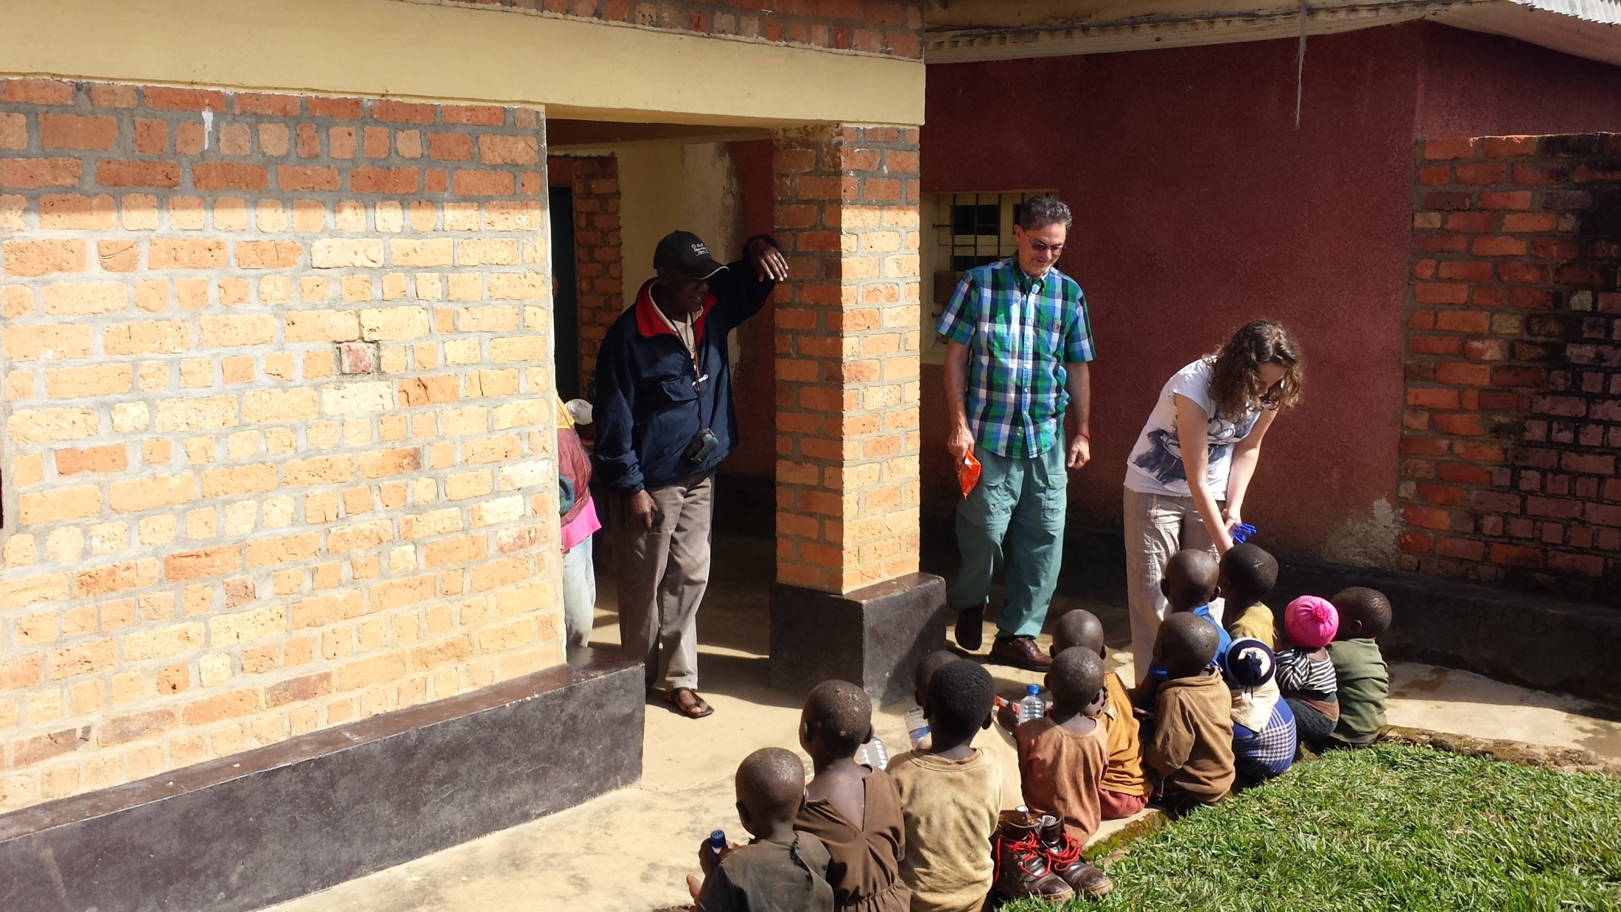

Slide 61
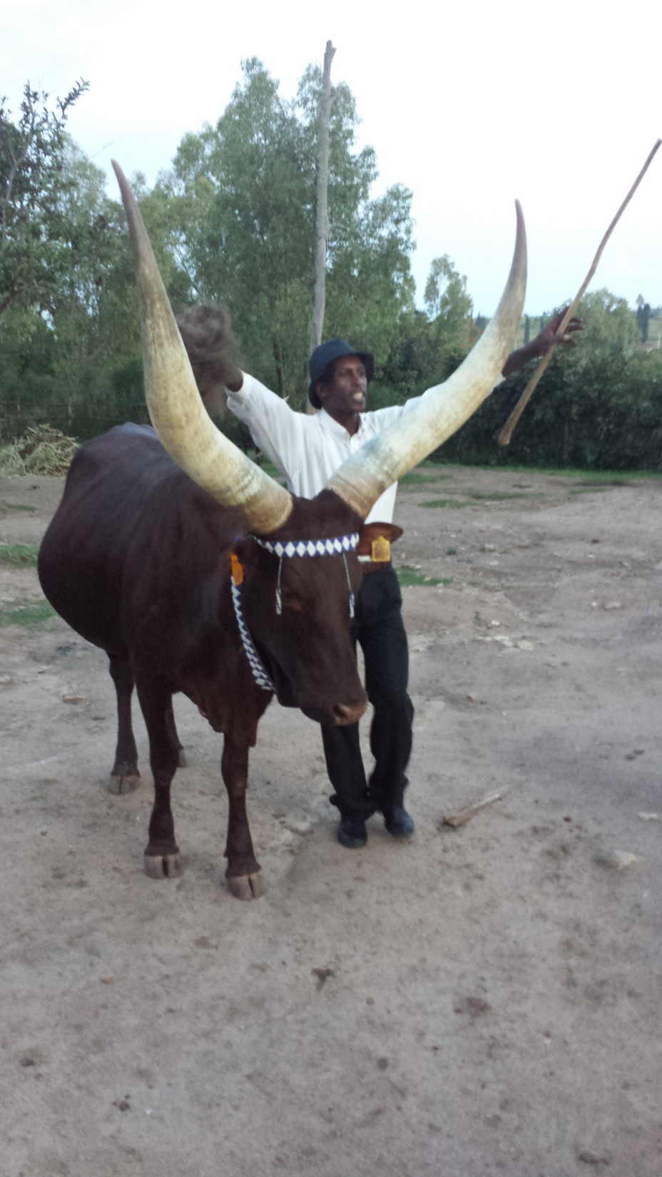

Slide 62
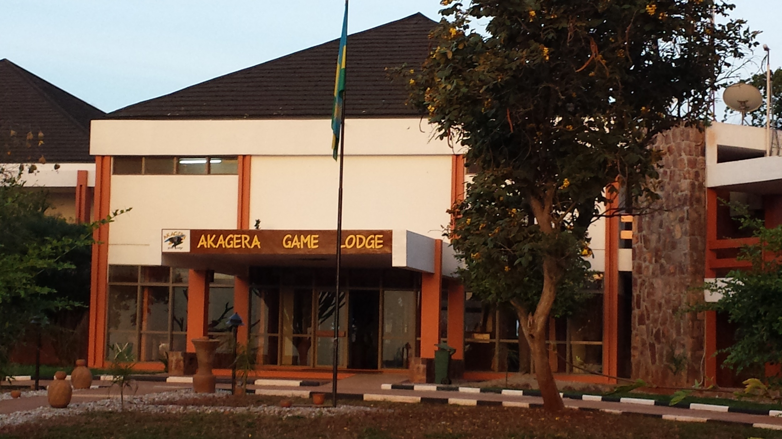

Slide 64
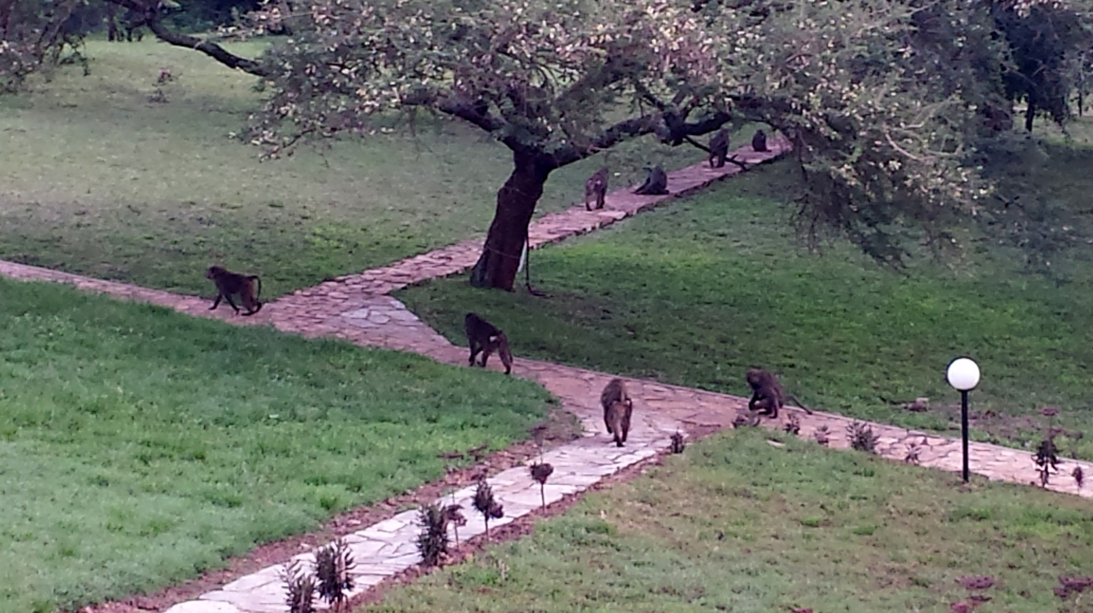

Slide 65
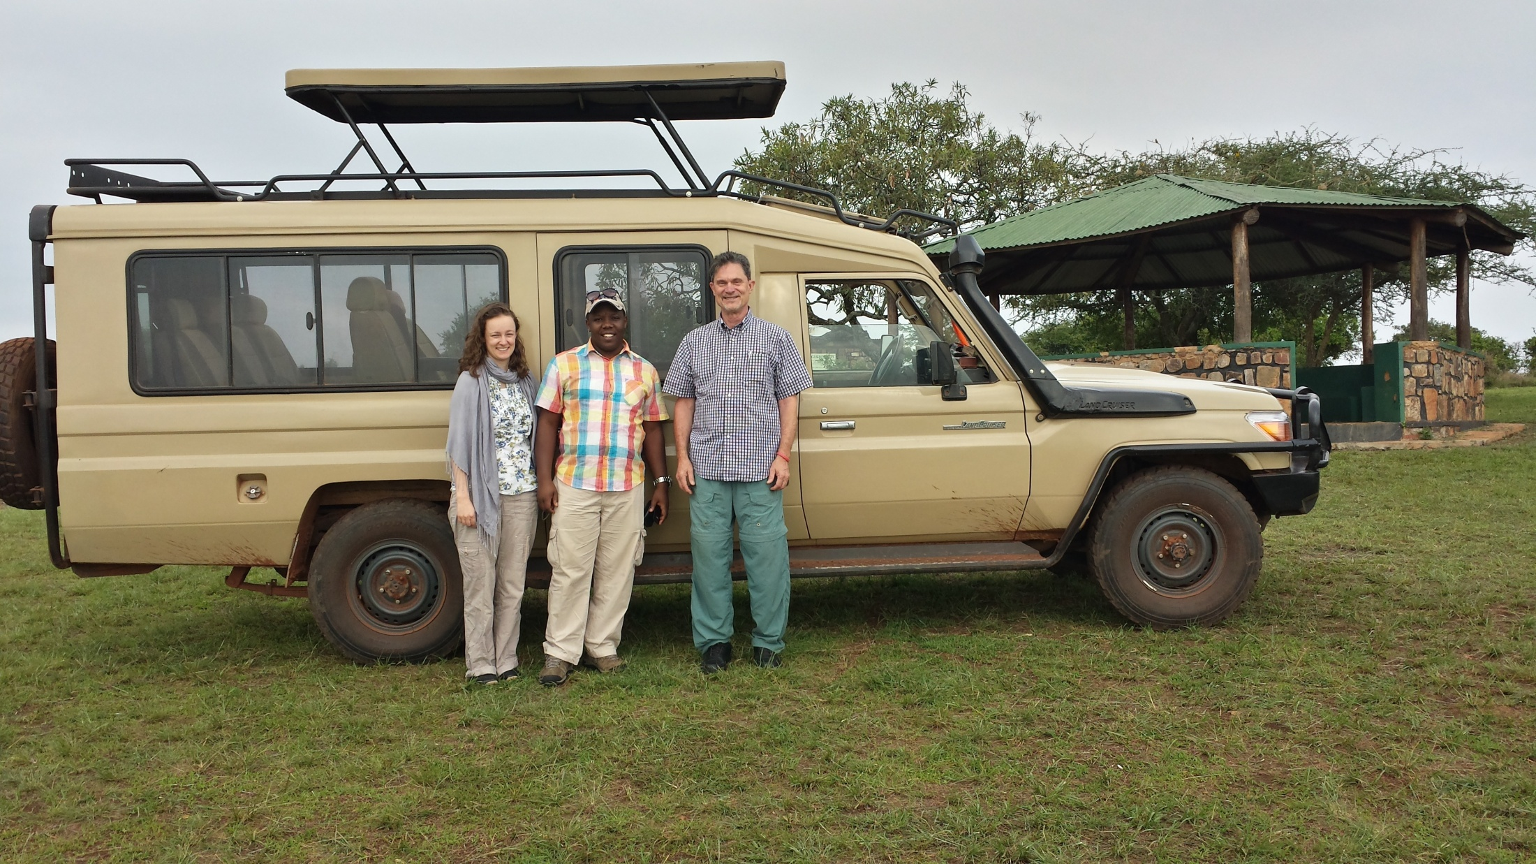

Slide 67
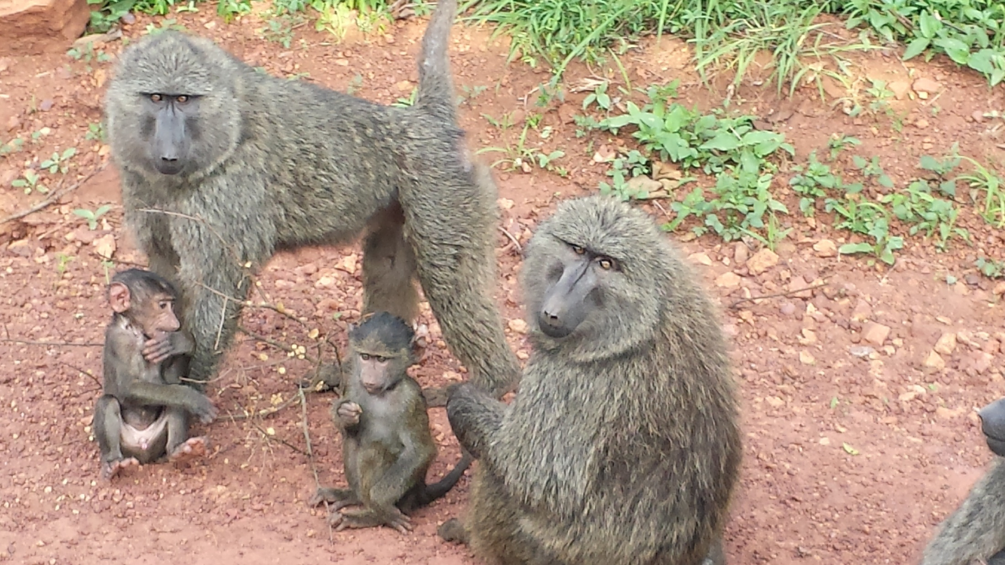

Slide 69
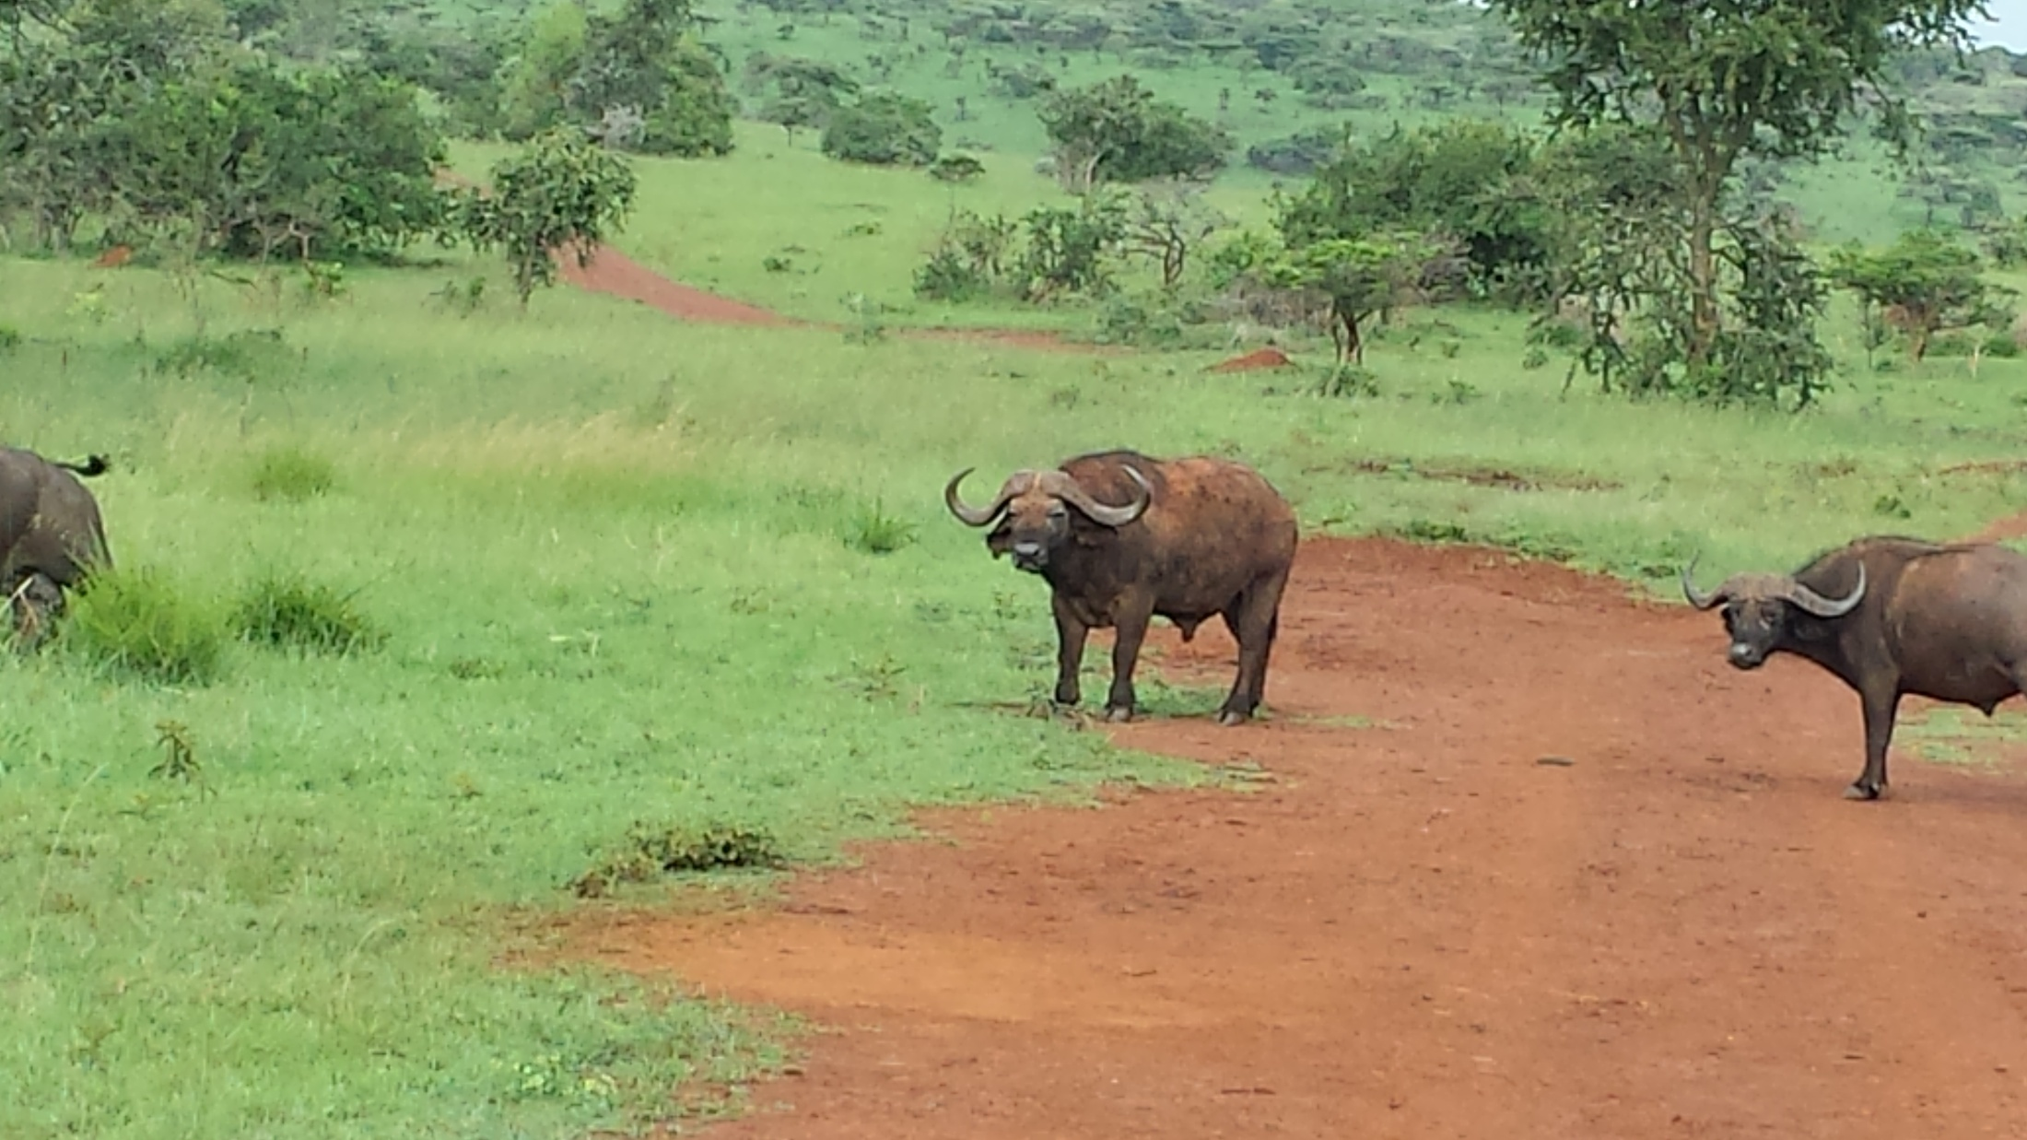

Slide 72
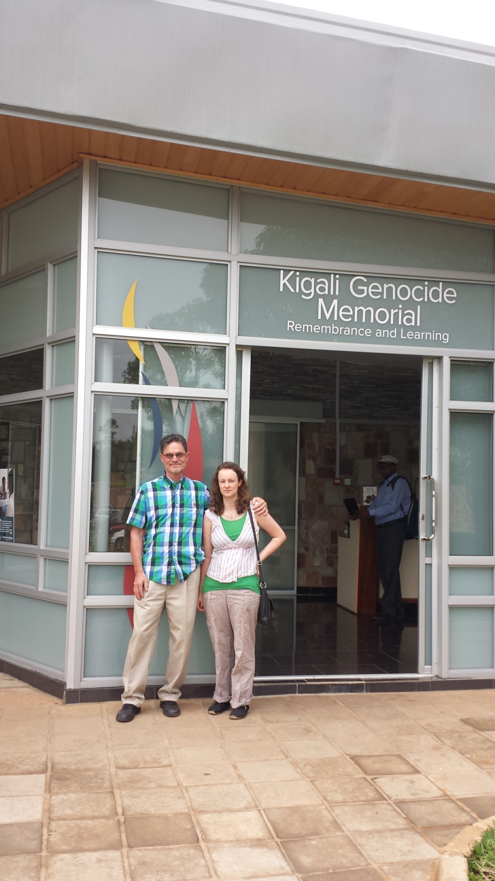
For more info:
Genocide Archive of Rwanda
http://www.genocidearchiverwanda.org.rw/

Slide 73
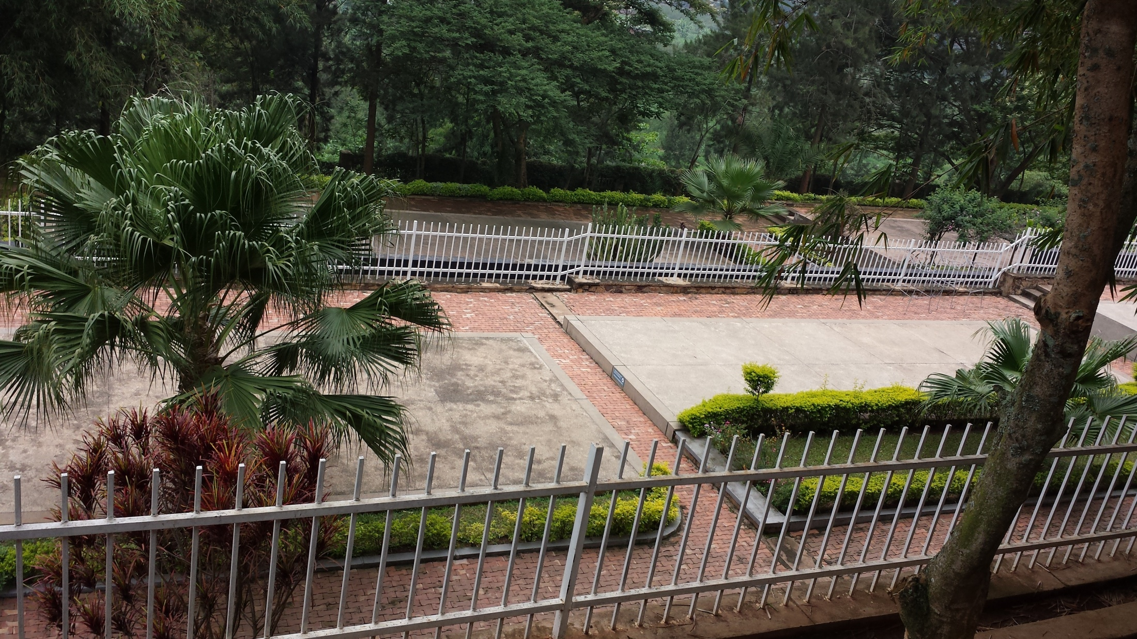

Slide 74
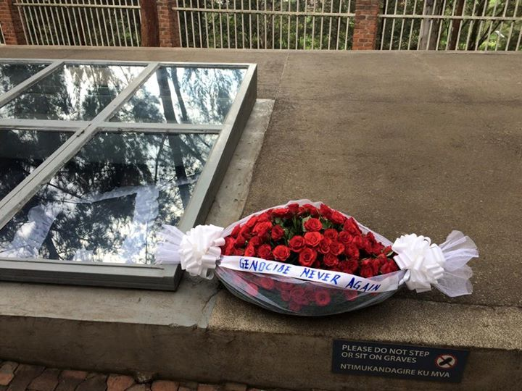

Slide 75
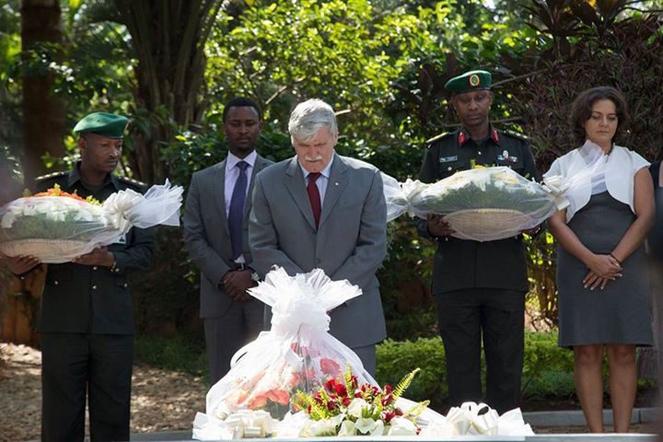
Lt. Gen. Romeo Dallaire, former commander of the UN Force during the genocide

Slide 76
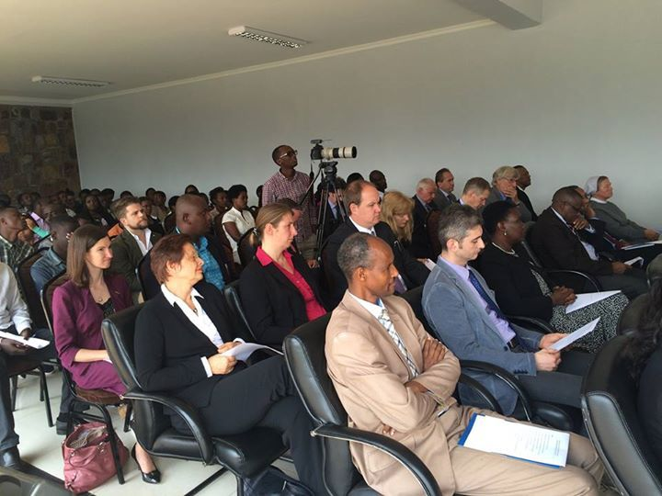
April 2015. In partnership with the German and Israel Embassies, The Kigali Genocide Memorial hosted an event for #Auschwitz70 The holocaust international commemoration day; happening for the first time in Rwanda.

Slide 78
R
RWANDA Peace Through Reconciliation and Forgiveness

Slide 79
Mattityahu (Matthew) 10.14-15
But if the people of a house or town will not welcome you or listen to you, leave it and shake its dust from your feet! Yes, I tell you, it will be more tolerable on the Day of Judgment for the people of S'dom and `Amora than for that town!

Slide 80
Someone onetime said, “There is one department in this congregation, the department of outreach.”
Are we a man/woman of shalom, influencing a community?
Are we seeking such, to bless a community?
Notes:
It’s the first service of 2016. My Dad used to take inventory every year. Count all the tools and cotton buffing wheels he had. Take inventory: have you lead anyone to Yeshua this year? More important, have you tried?

