Slide 1
Yesha’yahu יְשַׁעְיָהוּ
(Isaiah) 6.1-6

Slide 2
Notes:
This is the week of the Torah reading of the giving of the 10 commandments on Mt Sinai. The only foundational revelation of any religion that was seen by a public multitude. Cp: Mohammed, Buddha, Joseph Smith angel Moroni. No one can affirm or deny. But Sinai [and Y’s resurrection] seen by a huge crowd. Two alternative sites of Mt. Sinai, one above in red, one in Saudi Arabia.
The Haftorah reading our rabbis selected for this week is about another revelation of G-d. This one private to the prophet.

Slide 3
Notes:
Note flat area to the south where the tribes may have been assembled to view Sinai revelation.

Slide 4
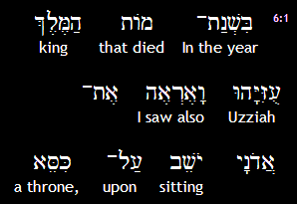
Yesha’yahu (Isaiah) 6:1a
ADONI
Adoni
Notes:
He SAW!! No one SEES!

Slide 5
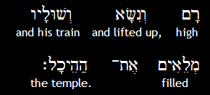
Yesha’yahu (Isaiah) 6:1b
ADONI
Notes:
Transcendent. High and lifted.

Slide 6
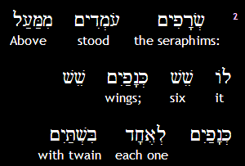
Yesha’yahu (Isaiah) 6:2a
ADONI

Slide 7
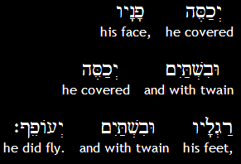
Yesha’yahu (Isaiah) 6:2b

Slide 8
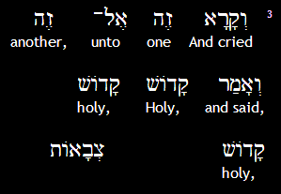
Yesha’yahu (Isaiah) 6:3a
Kadosh 3x, Adoni tsvaot
יְיָ
ADONI
Tzva’ot:
Notes:
Let’s stand and do this

Slide 9
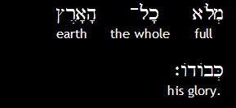
Yesha’yahu (Isaiah) 6:3b
ADONI
M’lo khawl ha-arets k’vodo

Slide 10
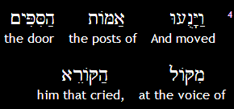
Yesha’yahu (Isaiah) 6:4a

Slide 11
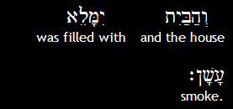
Yesha’yahu (Isaiah) 6:4b
ADONI
Notes:
G-d really knows theater effects!! Rock concert!
Proper response from prophet observing revelation of His holiness:

Slide 12
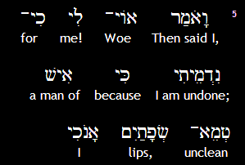
Yesha’yahu (Isaiah) 6:5a
Notes:
Not so unclean, just wrote 5 chapters of his book, yet after seeing HaKadosh!!

Slide 13
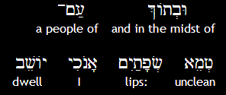
Yesha’yahu (Isaiah) 6:5b
ADONI
Notes:
And my environment…

Slide 14
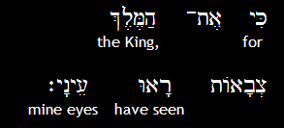
Yesha’yahu (Isaiah) 6:5c
יְיָ
ADONI
Tzva’ot.
Notes:
In Yokhanan 12 we learn specifically that this was a vision of Yeshua

Slide 15
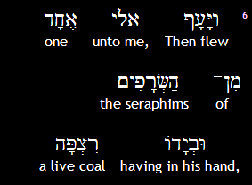
Yesha’yahu (Isaiah) 6:6a

Slide 16
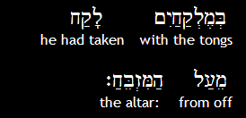
Yesha’yahu (Isaiah) 6:6b

Slide 17
^{2 Cor 3.18} All of us, with faces unveiled, see as in a mirror the glory of the Lord; and we are being changed into his very image, from one degree of glory to the next, by Adoni the Spirit.
Notes:
Stop right here, to receive His cleansing.

Slide 18
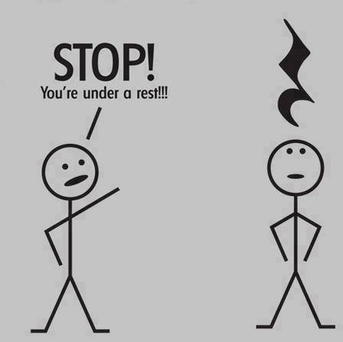
Notes:
For musicians only

Slide 19
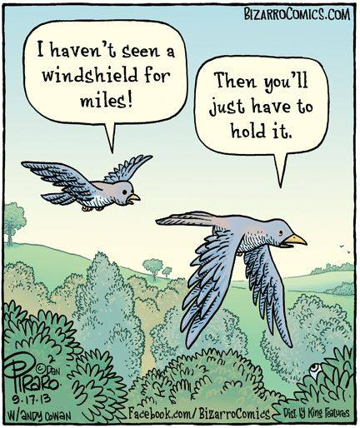

Slide 20
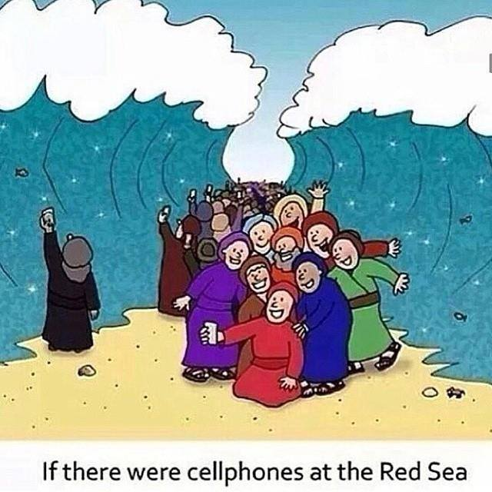
Notes:
Next is NOT really funny. But the Jewish cartoon Dry Bones made it into a parody. Deeply tragic. You are aware of what is called the “Knife Intifada?”

Slide 21
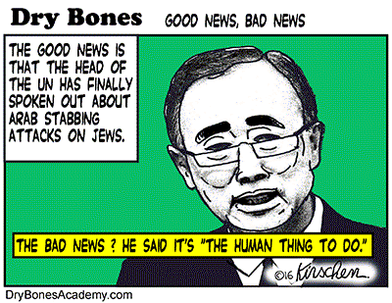
Notes:
That is, Ban Ki Moon said it was expected by people frustrated by the occupation.
The Israelis would negotiate and give up anything if they had a real peace partner.
No diplomatic frustration justifies a 15 year old boy stabbing a mother in front of her daughters. The mother in a town near Hevron held the knife in her body so that the attacker could not continue to use it to attack the daughters. He ran, and was later caught by the Israeli special forces.

Slide 22
מַתִּתְיָהוּ Mattityahu
(Matthew) 10:24-26
Notes:
We’ve been working our way through Mtt 10. Y sending his 12 out as emissaries, sent ones. Missionary has become a dirty word in Jewish circles since it’s gotten associated with assimilation, make you into a Christian, and even forced conversions. Emissary a bit tougher to learn, but a better word. Rivka Hare is described by Stewart Winograd as the new ‘emissary’ of Reach International.

Slide 23
Mattityahu (Matthew) 10.21-23
"A brother will betray his brother to death, and a father his child; children will turn against their parents and have them put to death. Everyone will hate you because of me, but whoever holds out till the end will be preserved from harm. When you are persecuted in one town, run away to another.
Notes:
What a great job prospect!

Slide 24
Mattityahu (Matthew) 10.24
תַּלְמִיד אֵינֶנּוּ גָּדוֹל מִן הַמּוֹרֶה אַף לֹא הָעֶבֶד גָּדוֹל מֵאֲדוֹנָיו.
A talmid is not greater than his rabbi, a slave is not greater than his master.

Slide 25
Mattityahu (Matthew) 10.25
דַּי לוֹ לַתַּלְמִיד שֶׁיִּהְיֶה כְּרַבּוֹ וְהָעֶבֶד כַּאֲדוֹנָיו. אִם לְבַעַל הַבַּיִת קָרְאוּ בַּעַל-זְבוּל, כָּל שֶׁכֵּן לְאַנְשֵׁי בֵּיתוֹ.
It is enough for a talmid that he become like his rabbi, and a slave like his master. Now if people have called the head of the house Ba`al-Zibbul, how much more will they malign the members of his household!
Notes:
Literally, “Lord of the flies.”
So, have you been maligned for following Y. Jewish or Gentile?

Slide 26
https://en.wikipedia.org/wiki/Apostasy_in_Judaism
meshumad (משומד lit. "destroyed one")
Meshugah (משוגה lit. “crazy”)
poshea Yisrael (פושע ישראל, lit. "transgressor of Israel")
http://www.whatjewsbelieve.org/explanation9.html "Jews" for Jesus, Messianic "Jews", and "Hebrew" Christians are no longer Jews, even if they were once Jews.
Notes:
My mother said that I was worse than a Nazi. “The Nazis destroyed our bodies, you are destroying our souls.”

Slide 27
Mattityahu (Matthew) 10.26
לָכֵן אַל תִּפְחֲדוּ מִפְּנֵיהֶם, כִּי אֵין דָּבָר מְכֻסֶּה שֶׁלֹּא יִגָּלֶה וְאֵין נִסְתָּר שֶׁלֹּא יִוָּדַע.
So do not fear them; for there is nothing covered that will not be uncovered, or hidden that will not be known.
Notes:
Truth will set you free.
In Y’s day, there was no reason for the Jewish population to malign His followers. They and Yeshua did nothing but good: heal, teach, feed, restore the dead!
However, maligning followers of Y took a different perspective over the centuries. Not all the seemingly Spirit filled followers understood the place of Israel.

Slide 28
One of the most well-known detractors of Jews was the Church father [golden tongue revivalist!] John Chrysostom (354-430), who accused the Jews of, among other things, idolatry and housing the Devil himself in their synagogues.
Notes:
http://int.icej.org/news/commentary/sad-legacy-christian-anti-semitism

Slide 29
In his “First Homily Against the Jews”,Chrysostom insisted that, “Jews are dogs, stiff-necked, gluttonous, drunkards. They are beasts unfit for work… The Jews had fallen into a condition lower than the vilest animals… The synagogue is worse than a brothel and a drinking shop;
Notes:
http://int.icej.org/news/commentary/sad-legacy-christian-anti-semitism

Slide 30
it is a den of scoundrels, a temple of demons, the cavern of devils, a criminal assembly of the assassins of Christ…. I hate the Jews, because they violate the Law… It is the duty of all Christians to hate the Jews.”
This was in the 300’s CE
I’m just hitting some highlights of history. “Wandering Jews”
Notes:
http://int.icej.org/news/commentary/sad-legacy-christian-anti-semitism
Exiled from England, France, etc.

Slide 31
The First Crusade started out from France in 1095. However, when some of the Crusaders reached Germany, their mood changed drastically. Among many Crusaders the feeling grew rapidly that before they attacked the heathens in far-off Palestine, there were infidels much closer to home with whom they should contend.
Notes:
http://www.chabad.org/library/article_cdo/aid/2617029/jewish/The-Bloody-Crusades.htm
Crusades were at least in part dealing with Islamic atrocities. Some think Crusaders are heroes. This is why term “crusade” or “Campus Crusade” NOT Jewish friendly term.

Slide 32
In May, 1096, in a period of four weeks frenzied bands of Crusaders struck the Jewish communities of Speyer, Worms, Mainz, and Cologne. The Jews were offered the option of conversion to Christianity or death; the vast majority chose the path of Kiddush HaShem, sanctification of G‑d's name. Estimates of the toll taken on the Jewish communities range from 3,000 to 10,000 deaths.
Notes:
http://www.chabad.org/library/article_cdo/aid/2617029/jewish/The-Bloody-Crusades.htm
Sad to say, Jews remember these wounds. All of us remember wounding experiences.
Skipping lots of incidents to 1500’s

Slide 33
At the beginning of his career,1523, Martin Luther was apparently sympathetic to Jewish resistance to the Catholic Church. However, he expected the Jews to convert to his purified Christianity; when they did not, he turned violently against them.
Notes:
https://www.jewishvirtuallibrary.org/jsource/anti-semitism/Luther_on_Jews.html
Cited to me by my mother, when I was a believer ~2 months. I thought…impossible, maybe the Roman Catholics.

Slide 34
Therefore be on your guard against the Jews, knowing that wherever they have their synagogues, nothing is found but a den of devils in which sheer self­ glory, conceit, lies, blasphemy, and defaming of God and men are practiced most maliciously and veheming his eyes on them.
Notes:
https://www.jewishvirtuallibrary.org/jsource/anti-semitism/Luther_on_Jews.html

Slide 35
Moreover, they are nothing but thieves and robbers who daily eat no morsel and wear no thread of clothing which they have not stolen and pilfered from us by means of their accursed usury. Thus they live from day to day, together with wife and child, by theft and robbery, as arch-­thieves and robbers, in the most impenitent security.
Notes:
https://www.jewishvirtuallibrary.org/jsource/anti-semitism/Luther_on_Jews.html

Slide 36
I brief, dear princes and lords, those of you who have Jews under your rule­­ if my counsel does not please your, find better advice, so that you and we all can be rid of the unbearable, devilish burden of the Jews, lest we become guilty sharers before God in the lies, blasphemy, the defamation,

Slide 37
and the curses which the mad Jews indulge in so freely and wantonly against the person of our Lord Jesus Christ, this dear mother, all Christians, all authority, and ourselves. Do not grant them protection, safe­ conduct, or communion with us.... .With this faithful counsel and warning I wish to cleanse and exonerate my conscience.
Notes:
Words of the “godly” Martin Luther!! Quoted by Hitler as justification for his anti-Semitism.
“There would have been no Holocaust without a foundation of centuries of Christian anti-Semitism.”
1500’s
Fast forward to 20th century Russia.

Slide 38
The New York Times described the First Kishinev pogrom of Easter, 1903:
"The anti-Jewish riots in Kishinev, Bessarabia [modern Moldova], are worse than the censor will permit to publish. There was a well laid-out plan for the general massacre of Jews on the day following the Orthodox Easter. The mob was led by priests, and the general cry,
Notes:
https://en.wikipedia.org/wiki/Anti-Jewish_pogroms_in_the_Russian_Empire
All this was with the blessing, or at best the silence of the Russian Orthodox clergy. Remember that issue of the silence of the godly.
Easter has always been a dangerous time for European Jews. Christ killers.

Slide 39
"Kill the Jews", was taken up all over the city. The Jews were taken wholly unaware and were slaughtered like sheep. The dead number and the injured about 500. The scenes of horror attending this massacre are beyond description. Babies were literally torn to pieces by the frenzied and bloodthirsty mob. The local police made no attempt to check the reign of terror. At sunset the streets were piled with corpses and wounded.
Notes:
https://en.wikipedia.org/wiki/Anti-Jewish_pogroms_in_the_Russian_Empire

Slide 40
This series of pogroms affected 64 towns (including Odessa, Kiev,
Kishinev, Simferopol, Kremenchug, Nikolayev, Chernigov, and 626 small towns (Russian: городок) and villages, mostly in Ukraine and Bessarabia.
Notes:
https://en.wikipedia.org/wiki/Anti-Jewish_pogroms_in_the_Russian_Empire

Slide 41
A much bloodier wave of pogroms broke out from 1903 to 1906, leaving an estimated 2,000 Jews dead and many more wounded, as the Jews took to arms to defend their families and property from the attackers. The 1905 pogrom against Jews in Odessa was the most serious pogrom of the period, with reports of up to 2,500 Jews killed.
Notes:
https://en.wikipedia.org/wiki/Anti-Jewish_pogroms_in_the_Russian_Empire
Dan Juster once said that that main Jewish objections to Yeshua were the Crusades, the Inquisition, the Pogroms, and the Holocuast. Christian persecution. Not really theological objections per se. Character and life objections.
This is dramatically portrayed in Rukhel’s book.

Slide 42
Notes:
You should get one and read it.

Slide 43
^{1 Kefa/Peter 2.12-15} But to live such good lives …that even though they now speak against you as evildoers, they will, as a result of seeing your good actions, give glory to God on the Day of his coming…For it is God's will that your doing good should silence the ignorant talk of foolish people.
Notes:
This is really the point of the message. We are going to reverse historical perspectives!!

Slide 44
^{1Thes 1.1-3} From: Sha'ul, Sila and Timothy To: The Messianic Community of the Thessalonians, united with God the Father and the Lord Yeshua the Messiah: Grace to you and shalom. We always thank God for all of you, regularly mentioning you in our prayers, calling to mind before God our Father

Slide 45
^{1Thes 1.1-3} what our Lord Yeshua the Messiah has brought about in you - how your trust produces action, your love hard work, and your hope perseverance.
Notes:
Our committee people: Mike and Jan, Teri, Bekki, Jong, have done a LOT of hard work.
In the newspapers this week…

Slide 46
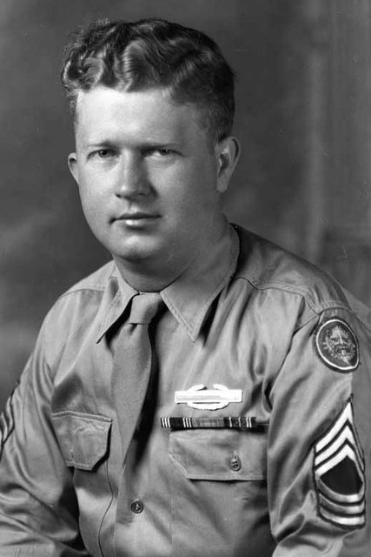
Master Sgt.
Roddie Edmonds
Notes:
http://www.nytimes.com/2016/01/28/world/middleeast/obama-honor-americans-effort-to-save-jews-the-holocaust.html?_r=0

Slide 47
In a German prison camp 71 years ago, Master Sgt. Roddie Edmonds stared down the barrel of his Nazi captor’s pistol and refused to say which of his fellow prisoners of war were Jewish. “We are all Jews here,” said Sergeant Edmonds, the highest-ranking American noncommissioned officer at Ziegenhain stalag that day
Notes:
http://www.nytimes.com/2016/01/28/world/middleeast/obama-honor-americans-effort-to-save-jews-the-holocaust.html?_r=0

Slide 48
instead ordering more than 1,000 of his fellow prisoners to stand together in front of their barracks.
That act of defiance in January 1945 spared the lives of as many as 200 Jews.
President Obama repeated those words.
Notes:
http://www.nytimes.com/2016/01/28/world/middleeast/obama-honor-americans-effort-to-save-jews-the-holocaust.html?_r=0
If you kill any of us, you’ll have to face trail for war crimes when we win this war. The Nazi backed down. Sgt Edmonds is the first American service member to be named Righteous Among the Nations, an honor bestowed on non-Jews who risked their lives to save Jews during the Holocaust by Yad VaShem, the Israel Holocaust Museum.

Slide 49
^{Luke 7.2-4} A Roman army officer there had a servant he regarded highly, who was sick to the point of death. Hearing about Yeshua, the officer sent some Jewish elders to him with the request that he come and heal his servant. They came to Yeshua and pleaded earnestly with him, “He really deserves to have you do this, for he loves our people — in fact, he built the synagogue for us!”

Slide 50
^{T’hillim/Ps 122.6-9} Pray for shalom in Yerushalayim; may those who love you prosper. May shalom be within your ramparts, prosperity in your palaces. For the sake of my family and friends, I say,“Shalom be within you!” For the sake of the house of Adoni our God, I will seek your well-being.
What does it mean to love Jerusalem?
Notes:
Location [view], Temple and means of salvation, population. I submit that this prayer is about loving the Jewish population. Covenantal, bagel and lox and humus eating Ashkenaz, Sephardic, Ethiopian, Bnai Menashe from northeastern India.
If not Jewish, easy to ask, “What about me?” That’s a great question. Eitan Shiskoff wrote a book exactly on that subject. Another message. Right now, about loving Israel, redemptively undoing history.

Slide 51
It’s possible to love Jewish things, without loving and blessing the Jewish people.
It’s great to love Torah, but that doesn’t change covenantal identity.
Notes:
Vision of Or HaOlam…

Slide 52
Working to bring Jewish people, and those grafted in, to their covenantal identity in Messiah. Implies:
Salvation through the Atonement of the Messiah. Personal faith in the atoning death and resurrection of Yeshua. It’s all about the King;
Covenantal identity of Jewish people, not replacement;

Slide 53
Restoration to Torah lifestyle;
Restoration/survival of the nation of Israel.

Slide 54
^{Yeshayahu/Is 61.1,6-8} For Tziyon's sake I will not be silent, for Yerushalayim's sake I will not rest, until her vindication shines out brightly… I have posted watchmen on your walls, Yerushalayim; they will never fall silent, neither by day nor by night. You who call on ADONI,
Notes:
Silence story of Jobst Bittner, Tubingen.

Slide 55
^{Yeshayahu/Is 61.1,6-8} give yourselves no rest; and give him no rest till he restores Yerushalayim and makes it a praise on earth. ADONI has sworn by his right hand and by his mighty arm: "Never again will I give your grain to your enemies as food; nor will strangers drink your wine,
Notes:
Silence story of Jobst Bittner, Tubingen.

Slide 56
^{Yeshayahu/Is 40.1-2} "Comfort and keep comforting my people," says your God. "Tell Yerushalayim to take heart; proclaim to her that she has completed her time of service, that her guilt has been paid off, that she has received at the hand of ADONI double for all her sins."

Slide 57
March of Remembrance

Slide 58
Taking the lessons of the Holocaust to break the silence of fear, pain and shame caused by prejudice and indifference.
Serving the Jewish community of Kansas City to say to the Holocaust survivors and their descendants, "You are not forgotten. You are not alone. We will remember and we will not be silent for Zion's sake".
Notes:
In a real sense, EVERY Jewish person is a Holocaust survivor. We only survived since Hitler lost the war. We all feel it.

Slide 59
MoRKC.org

Slide 60
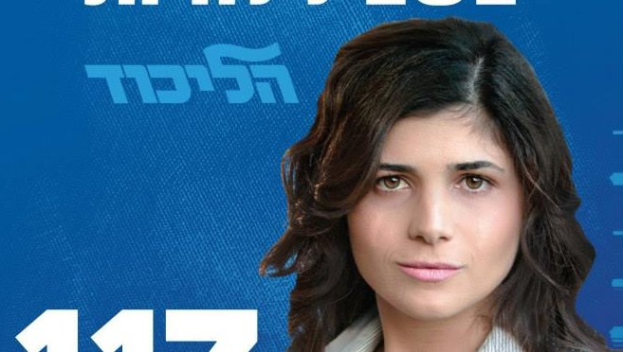
Likud Knesset Member
Sharren Haskel
Notes:
She is a secular Jewish woman who has morphed from Peace Now, supporting Oslo, to realizing that the Jewish people have a historic claim to Judea and Samaria and Jerusalem. She’ll be speaking to hopefully 500 Christians about Jewish survival. First time EVER in KC history a sitting Knesset member [equivalent to a Congresswoman] here. Highest ranking Israeli ever, except for Israel Ambassador Michael Oren about 4 years ago.
From the website:

Slide 61
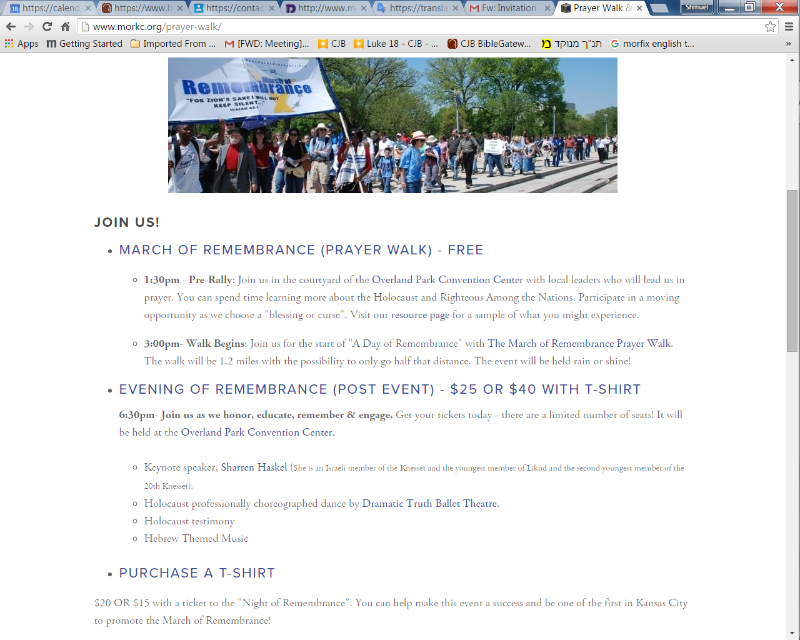

Slide 62
March of Remembrance (Prayer Walk) – Free Registration http://www.morkc.org/register
1:30pm - Pre-Rally: Join us in the courtyard of the Overland Park Convention Center with local leaders who will lead us in prayer. You can spend time learning more about the Holocaust and Righteous Among the Nations. Participate in a moving opportunity as we choose a "blessing or curse".
Notes:
Also, 10 am till 1:30 p.m. intercessory teams.

Slide 63
March of Remembrance (Prayer Walk) – Free Registration http://www.morkc.org/register
3:00pm- Walk Begins: Join us for the start of "A Day of Remembrance" with The March of Remembrance Prayer Walk. The walk will be 1.2 miles with the possibility to only go half that distance. The event will be held rain or shine!

Slide 64
Evening of Remembrance - $25 Or $40 With T-shirt http://www.morkc.org/register
6:30pm- Join us as we honor, educate, remember & engage. Get your tickets today - there are a limited number of seats! It will be held at the Overland Park Convention Center.

Slide 65
Evening of Remembrance - $25 Or $40 With T-shirt http://www.morkc.org/register
Keynote speaker, Sharren Haskel (She is an Israeli member of the Knesset and the youngest member of Likud and the second youngest member of the 20th Knesset).

Slide 66
Evening of Remembrance - $25 Or $40 With T-shirt http://www.morkc.org/register
Holocaust professionally choreography by Dramatic Truth Ballet Theatre.
Holocaust testimony
Hebrew Themed Music

Slide 68
https://www.facebook.com/RemembranceKC/?fref=ts
Notes:
Like us on Facebook.

Slide 69
^{Mtt. 25.31-35, 39} "When the Son of Man comes in his glory, accompanied by all the angels, he will sit on his glorious throne. All the nations will be assembled before him, and he will separate people one from another as a shepherd separates sheep from goats. The `sheep' he will place at his right hand and the `goats' at his left.
Notes:
Judgement illustration analogy to sheep and goats. We know an Israeli goat farmer, makes great cheese, took exception to the illustration.

Slide 70
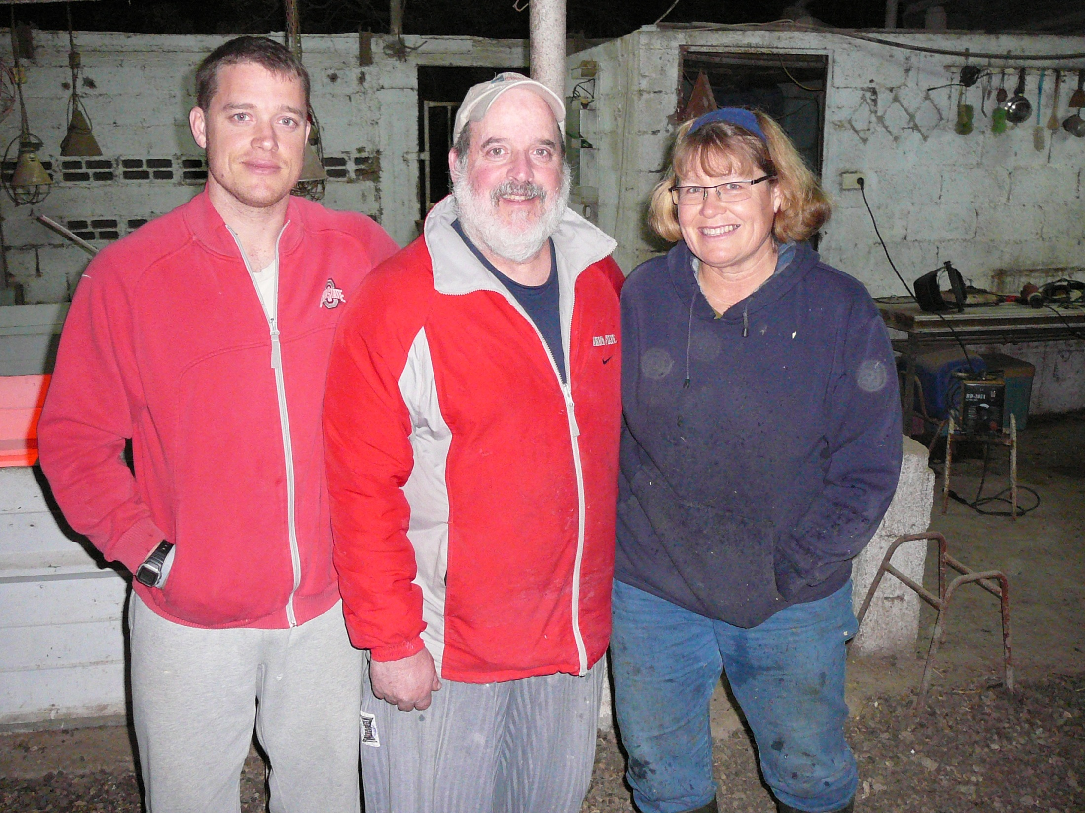
Notes:
Boaz Ellis was part of Or HaOlam for about 2 years. He grew up on a goat farm in Israel with his parents, Adi and ???. He took great exception to the labelling of the goats as so negative. However…

Slide 71
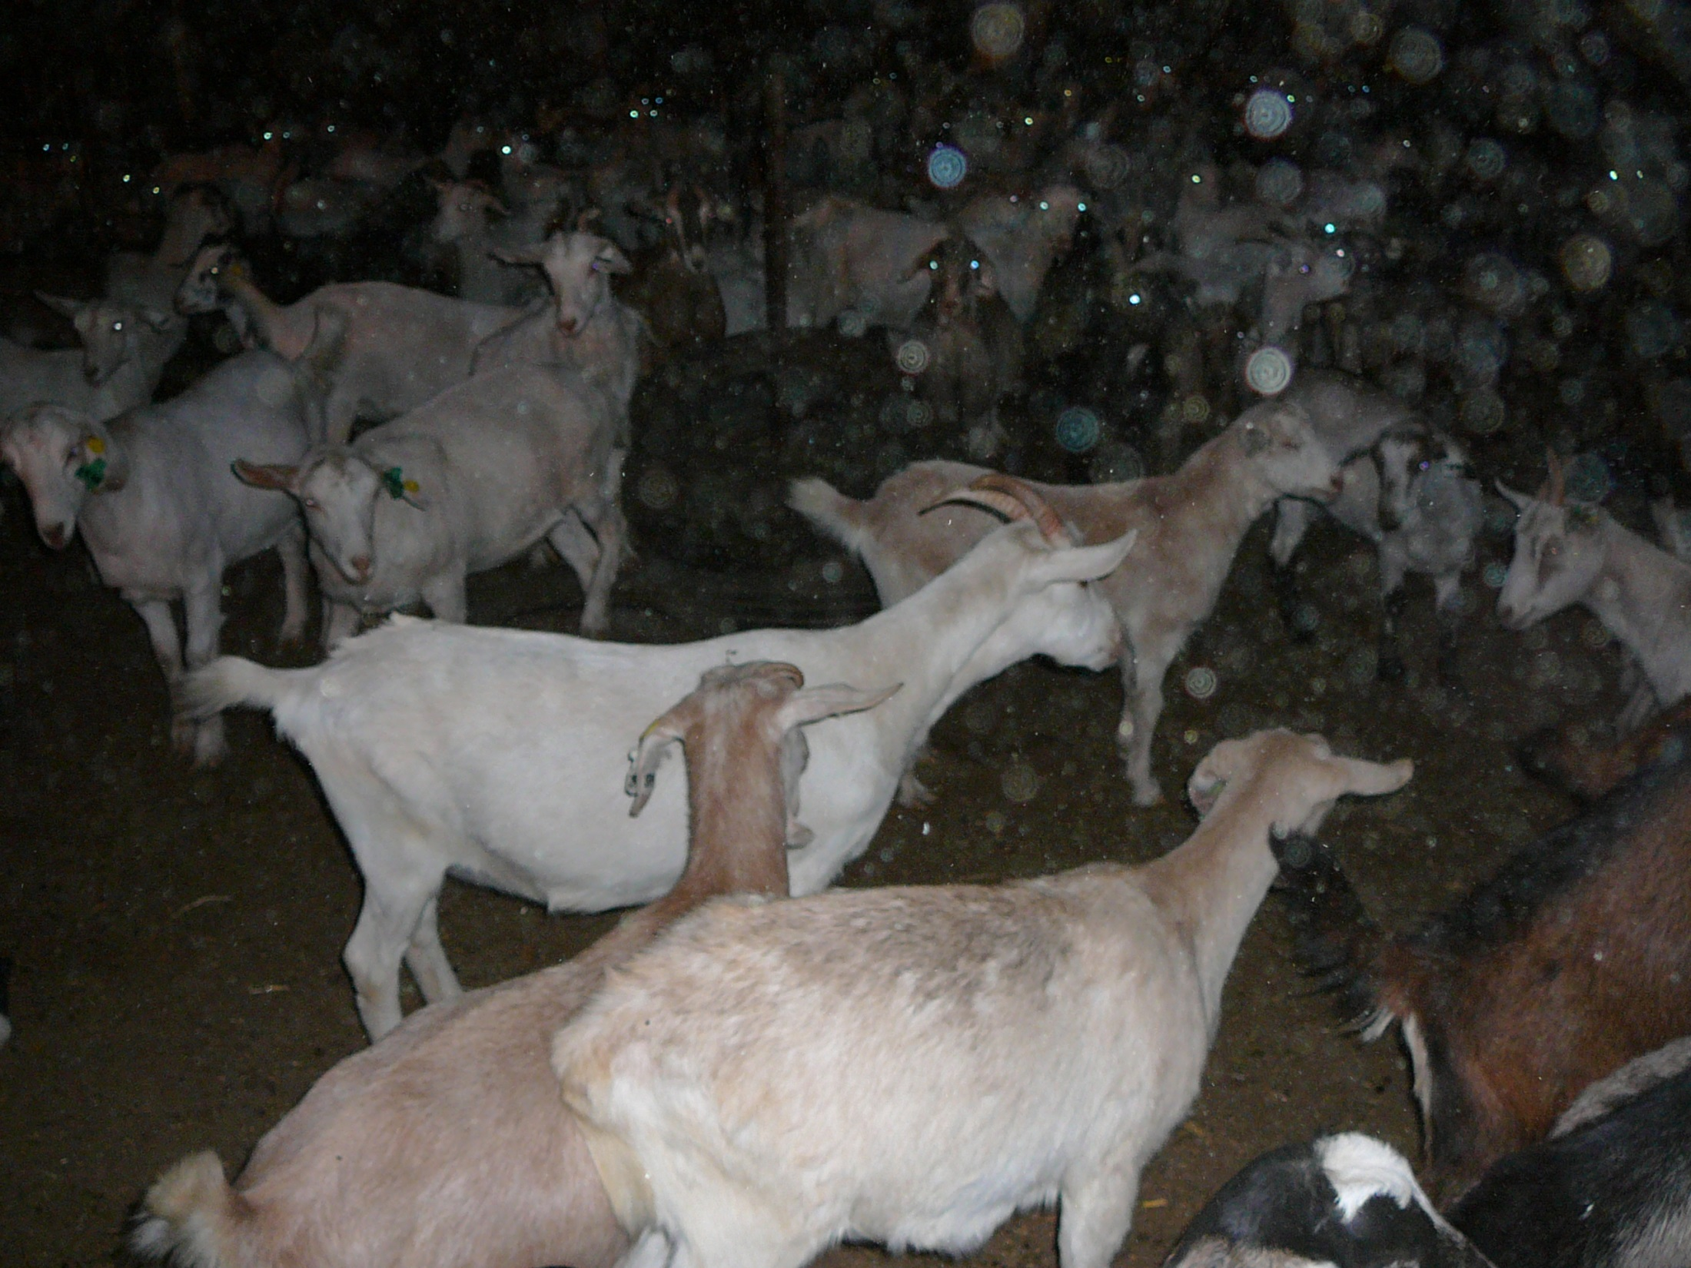
Notes:
Here are the goats, and a beautiful goatherder…

Slide 72
^{Mtt. 25.31-35} "Then the King will say to those on his right, `Come, you whom my Father has blessed, take your inheritance, the Kingdom prepared for you from the founding of the world. For I was hungry and you gave me food, I was thirsty and you gave me something to drink, I was a stranger and you made me your guest…
Notes:
One highly esteemed interpretation of this is that the Jewish people are these ones.

Slide 73
^{Mtt. 25.31-35, 39} The King will say to them, ‘Yes! I tell you that whenever you did these things for one of the least important of these brothers of mine, you did them for me!’

Slide 74
We are looking for
Prayer partners: see Jong Kim
Volunteers: see Mike Schmid
Early enrollees: go to MoRKC.org
Notes:
Salvation in Messiah implied!!

