Slide 1
A man is driving down a country road in Nebraska, when he spots a farmer standing in the middle of a huge field of grass doing nothing. The man gets out of the car, walks all the way out to the farmer and asks him, "Excuse me mister, but what are you doing?" The farmer replies, "I'm trying to win a Nobel Prize." "How?" asks the man.

Slide 2
"Well, I heard they give the Nobel Prize to people who are out-standing in their field, and I’ve been trying for a year now.

Slide 3
מַתִּתְיָהוּ Mattityahu
(Matthew) 12:12-14
Notes:
Last week, in the life of Yeshua, we considered his dialogue with the Perushim/ Pharisees about Shabbat and legalism
Two streams of righteousness in Torah: Effort and empowerment. Intertwine, but Primary is??
He was accused and 4 responses
Example of David and Temple bread
Example of Cohaneem/priests
Prophetic call to mercy
Who He was!
This Shabbat, next verses, He continued discussion, different venue, intensified response! Title:

Slide 4
Redemption Releases Rage

Slide 5
^{Mtt 12.9-11} Going on from that place, he went into their synagogue. A man there had a shriveled hand.
Causing and Healing shrivelled hands were emblematic of great authority and power in Bible history.
Notes:
Outdoors prev. Wheatfield
Y seemed to knew how to engage controversy.
For example...

Slide 6
^{1 K 13.4-7} When the king heard…the man of God denounce the altar in Beit-El, King Yarov‘am took his hand away from the altar and said, “Seize him!” But his hand, the one he had stretched out against him, shriveled up; so that he could not draw it back to himself…The king then responded to the man of God. “Ask now the favor of Adoni your God,” he said,

Slide 7
^{1 K 13.4-7} “and pray for me, that my hand will be restored to me.” The man of God prayed to Adoni, and the king’s hand was restored to him and became as it had been before. The king then said to the man of God, “Come home with me, and refresh yourself, and I will give you a reward.
Notes:
High impact. Could have been, should have been, real revival...

Slide 8
^{Mtt 12.9-11} ...a shriveled hand.
Talmud [not written yet but Oral]
healing permitted on Shabbat if a life or death issue...so this not OK
Healing permitted on Shabbat if no medicinal prep...so this was OK
Shammai: no prayer for sick on Shabbat
Hillel: Prayer for sick OK on Shabbat
Notes:
Outdoors prev. Wheatfield
Y seemed to knew how to engage controversy

Slide 9
^{Mtt 12.9-11} Looking for a reason to accuse him of something, they asked him, “Is healing permitted on Shabbat?”
Heavy & light / Kal v’khomer קַל וְחֹמֶר
discussion:
But he answered, “If you have a sheep that falls in a pit on Shabbat, which of you won’t take hold of it and lift it out?
Notes:
They knew what was permitted.

Slide 10
Mattityahu (Matthew) 12:12
" וְכַמָּה חָשׁוּב הָאָדָם יוֹתֵר מִן הַכֶּבֶשׂ! לָכֵן מֻתָּר לַעֲשׂוֹת אֶת הַטּוֹב בְּשַּׁבָּת."
"How much more valuable is a man than a sheep! Therefore, what is permitted on Shabbat is to do good."
Notes:
Similar to how a child is more valuable than even an endangered species gorilla. Harambe 450 lb. I dropped a Pringles can into a moat at that zoo, but didn’t go after it. In ~1972.

Slide 11
Mattityahu (Matthew) 12:13
אָז אָמַר אֶל הָאִישׁ: "הוֹשֵׁט יָדְךָ!" הוּא הוֹשִׁיט אֶת יָדוֹ וְאָמְנָם שָׁבָה לְאֵיתָנָהּ וְהָיְתָה בְּרִיאָה כְּמוֹ הַשְּׁנִיָּה.
Then to the man he said, "Hold out your hand." As he held it out, it became restored, as sound as the other one.
Notes:
Yeshua healed, but not with medicine, or even with prayer! By speech.

Slide 12
Craig Keener’s Commentary p 357: «He simply ordered the man to stretch forth his hand, an act that was not considered work by anyone’ standard; G-d alone performs work in this.»
No medicine
No hands layed
No prayer
Response:
Notes:
According to the Talmud, still oral law, not yet written.

Slide 13
Notes:
https://en.wikipedia.org/wiki/Talmud
Shabbat

Slide 14
Mattityahu (Matthew) 12:14
יָצְאוּ הַפְּרוּשׁים וְטִכְּסוּ עֵצָה לְהַכְחִיד אֶת יֵשׁוּעַ.
But the P'rushim went out and began plotting how they might do away with Yeshua.
Notes:
Disproportionate response.
Arguable that plotting a death is working on Shabbat.
Brings me to my theme:

Slide 15
Redemption Releases Rage
Notes:
This response to Messiah, or by Messianics, or by believers in highly defined groups: Mormons, RC’s.
It’s the real source of anti-Semitism

Slide 16
^{Acs 26.11} “I used to think it was my duty to do all I could to combat the name of Yeshua from Natzeret...I myself threw many of God’s people in prison; when they were put to death, I cast my vote against them. Often I went from one synagogue to another, punishing them and trying to make them blaspheme...in my wild fury against them
Notes:
The message of Yeshua just makes some people rage. Jewish people others.
Underlying cause...

Slide 17
^{Rev 12.12,17} The Adversary has come down to you, and he is very angry, because he knows that his time is short!” ¹⁷ The dragon was infuriated over the woman and went off to fight the rest of her children, those who obey God’s commands and bear witness to Yeshua.
Notes:
Wrath out there. Floating cloud of charged particles, strike lightning if right conditions. Wrath of the enemy in the atmosphere.

Slide 18
Two objects of the rage:
The Messiah
The people to whom the Messiah would come [BCE] and
The people to whom the Messiah will return.
The channel of his rage is almost always people, wounded people.
Notes:
All believers Jewish and Gentile, but doubly to Jewish believers.
Raleigh Washington’s famous statement that Messianic Revival support is like plowing concrete. He regrets it? Not a bit.
It’s the real source of anti-Semitism
Context of rage...

Slide 19
^{Rev 12.12,17} The Adversary has come down to you, and he is very angry, because he knows that his time is short!” ¹⁷ The dragon was infuriated over the woman and went off to fight the rest of her children, those who obey God’s commands and bear witness to Yeshua.
Notes:
Note same chapter...

Slide 20
^{Rev 12.10-11} “Now have come God’s victory, power and kingship, and the authority of his Messiah; because the Accuser of our brothers, who accuses them day and night before God, has been thrown out! “They defeated him because of the Lamb’s blood and because of the message of their witness. Even when facing death they did not cling to life.
Notes:
Atonement empowerment and integrity!!
Rage against Yeshua, and against His people, is NOT logical.
I like having victory, power, kingship for G-d, authority of Messiah
Lamb’s blood? Trust in His loving empowerment
Message: integrity.
Opposition and glory
JB bklet P 8.
Not logical...don’t need Jews to have anti-Semitism

Slide 21
According to an ADL telephone survey [~2014] of 500 people, 23% +/- 4.4% of the adult population in Japan harbor anti-Semitic attitudes. Furthermore, the study reveals that 46% of the population agree with the statement "Jews think they are better than other people", and that almost half of the respondents (49%) think that "Jews are more loyal to Israel than to Japan".
Notes:
https://en.wikipedia.org/wiki/Antisemitism_in_Japan
However, this survey has been critiqued for being unreasonably simplistic in its classification of "harboring anti-Semitic attitudes»«
You don’t need Jews to have anti-Semitism.

Slide 22
Jewish poplustion of Japan: one Jewish person / 127,103 Japanese.
About 1000 in the whole country
Notes:
Context of all the hatred

Slide 23
^{Beresheet/Gen 3.14-15} Adonai, God, said to the serpent, “Because you have done this, you are cursed more than all livestock and wild animals. You will crawl on your belly and eat dust as long as you live. I will put animosity between you and the woman, and between your descendant and her descendant; he will bruise your head, and you will bruise his heel.”

Slide 24
To understand the dynamic, you must grasp the beginning of the current universe.
G-d made a perfect world.
No evil.
No curruption.
No thorns.
No entropy?
Notes:
No need of clothing.

Slide 25
G-d gave mankind the gift of choice, so we could know love.
If we succeeded → bliss.
If we failed, excruciating atonement of G-d in Messiah → greater redeemed bliss.
Notes:
You have to accept that G-d is good to have allowed all this suffering by our choice.

Slide 26
^{Beresheet/Gen 3.15} I will put animosity between you and the woman, and between your descendant and her descendant; he will crush your head, and you will crush his heel.”
Notes:
Implication of virgin birth, descendent of a woman. Atoning death

Slide 27
The seed will restore everything. Stop His birth
Pharoah
Haman
Jewish apostasy
Antiiochus
Herod

Slide 28
Stop His return to Jerusalem
Replacement theology
Crusades
Holocaust
Internal strife: David Ben Gurion to Mickey Marcus Cast a Giant Shadow starring Kirk Douglas

Slide 29
שִׂנְאַת חִנָּם Sinat Khinam
Notes:
When Jerusalem was under seige in 70 CD by Titus, the groups were jealous and burned each other’s food.
https://en.wikipedia.org/wiki/Siege_of_Jerusalem_(AD_70)
We face baseless hatred from HaSatan, but worse from within

Slide 30
Steven Spielberg, In Harvard Commencement Speech, Says Anti-Semitism On The Rise, Speaking at Harvard University’s commencement on Thurs. 26 May 2016
Speaking at Harvard University’s commencement on Thurs. 26 May 2016, filmmaker Steven Spielberg said he was “wrong” as a kid to think anti-Semitism “was fading.” “As a kid, I was bullied for being Jewish.”
Notes:
In the 1990’s it was thought that the Anti-Defamation League and Simon Wiesenthal Center were winding down their work.

Slide 31
Steven Spielberg, In Harvard Commencement Speech, Says Anti-Semitism On The Rise, Speaking at Harvard University’s commencement on Thurs. 26 May 2016
“This was upsetting, but compared to what my parents and grand-parents had faced, it felt tame because we truly believed that anti-Semitism was fading. But we were wrong. Over the last two years, nearly 20,000 Jews have left Europe to find higher ground.
Notes:
In the 1990’s it was thought that the Anti-Defamation League and Simon Wiesenthal Center were winding down their work.

Slide 32
Steven Spielberg, In Harvard Commencement Speech, Says Anti-Semitism On The Rise, Speaking at Harvard University’s commencement on Thurs. 26 May 2016
And earlier this year, I was at the Israeli embassy when President Obama stated the sad truth. He said: ‘We must confront the reality that around the world, anti-Semitism is on the rise. We cannot deny it.’” The 69-year-old creator of award-winning films like “Schindler’s List” and “Saving Private Ryan,”
Notes:
In the 1990’s it was thought that the Anti-Defamation League and Simon Wiesenthal Center were winding down their work.

Slide 33
Steven Spielberg, In Harvard Commencement Speech, Says Anti-Semitism On The Rise, Speaking at Harvard University’s commencement on Thurs. 26 May 2016
also spoke about his Shoah Foundation. The foundation has taken video testimonies of over 53,000 Holocaust survivors and witnesses in 63 countries since he founded it in 1994. (J. Post)
Notes:
In the 1990’s it was thought that the Anti-Defamation League and Simon Wiesenthal Center were winding down their work.

Slide 34
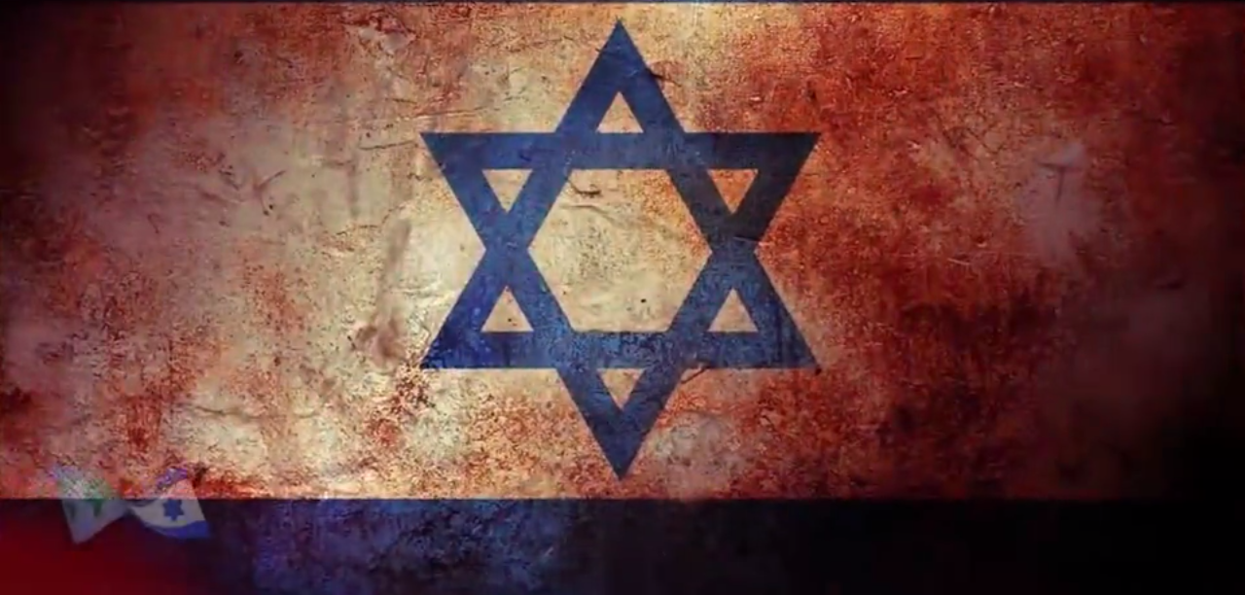
https://www.causematch.com/en/projects/unitedwithisrael/

Slide 35
What’s the answer to baseless hatred?
It’s almost always through people.
If people external to the community:

Slide 36
^{Rev 12.10-11} “Now have come God’s victory, power and kingship, and the authority of his Messiah; because the Accuser of our brothers, who accuses them day and night before God, has been thrown out! “They defeated him because of the Lamb’s blood and because of the message of their witness. Even when facing death they did not cling to life.
Notes:
Atonement empowerment and integrity!!
Rage against Yeshua, and against His people, is NOT logical.
I like having victory, power, kingship for G-d, authority of Messiah
Lamb’s blood? Trust in His loving empowerment
Message: integrity.

Slide 37
If it’s from human sources we can get close to, such as Yeshua faced in our text.
Islam / Ishmael pre-eminent religion of fatherlessness bitterness

Slide 38
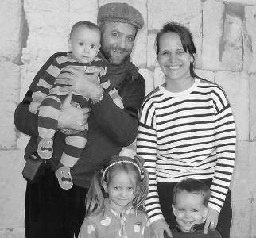
Ariel and Vered Blumenthal May 2016, in Thailand
Notes:
As so often happens in this Gathering movement, the Holy Spirit moved powerfully on the group through prophetic, "identificational" acts of reconciliation, intercession and unity - this time bringing healing to the Abrahamic family by us repenting (especially Vered "standing in" as Sarah) and welcoming Hagar and Ishmael (the Egyptians) back into the family.

Slide 39
On the third day of our meeting we had a clear sense that God had brought us together "for such a time as this" (Esther 4:14). As it was with Esther, this time we were led by the women in our midst.

Slide 40
"Egyptian women willingly identified with Hagar and confessed the rejection, envy and resentment she felt when Abraham cast her out of the family as Sarah demanded. (This spirit of rejection has dogged the Arab peoples every generation since. Those who have been set free from it are often magnificent people, but the ethnic type prevails.) Agonized tears were wept by the Egyptians and everyone else as we experienced a measure of those emotions.

Slide 41
They confessed that they had hated and mocked "Isaac" and his offspring. Then an Israeli mother [Vered] stepped forward to plead, "There are two empty places at our family table. Won't you come home? Our family is not complete. Isaac needs his older brother, who was blessed by God first." These words don't begin to express the depth of significance and emotion of the moment. I hope you can imagine a bit of the atmosphere

Slide 42
There was much weeping and rejoicing following this time of sharing. And then, the Egyptians began to sing over us, while our 8 month old boy, Lavi, sat on my shoulders giggling and smiling (as he almost always does). It was as if Hagar and Ishmael were singing and rejoicing over Isaac! (Perhaps that's what we should have named our laughing boy.)

Slide 43
Possibly for the first time in history, descendants of Abraham, Isaac, and Jacob came together with the family of Hagar and Ishmael, all of us secure in our eternal inheritance because of our faith in our great, older brother, Abraham's greatest Son, Yeshua (Romans 8:29-30).

Slide 44
^{Mark 11.24-25} Therefore, I tell you, whatever you ask for in prayer, trust that you are receiving it, and it will be yours. And when you stand praying, if you have anything against anyone, forgive him; so that your Father in heaven may also forgive your offenses
Notes:
Bruce Wilkinson: forgive each thing.

Slide 45
^{Rev 12.10-11} “Now have come God’s victory, power and kingship, and the authority of his Messiah; because the Accuser of our brothers, who accuses them day and night before God, has been thrown out! “They defeated him because of the Lamb’s blood and because of the message of their witness. Even when facing death they did not cling to life.
Notes:
Atonement empowerment and integrity!!
Rage against Yeshua, and against His people, is NOT logical.
I like having victory, power, kingship for G-d, authority of Messiah
Lamb’s blood? Trust in His loving empowerment
Message: integrity.

