Slide 1
To easily follow these notes, log on to our Wifi
Wifi: mycci01 p/w: ancientquail060
Go to OrHaOlam.com
Click on downloads, messages, 2017

Slide 2
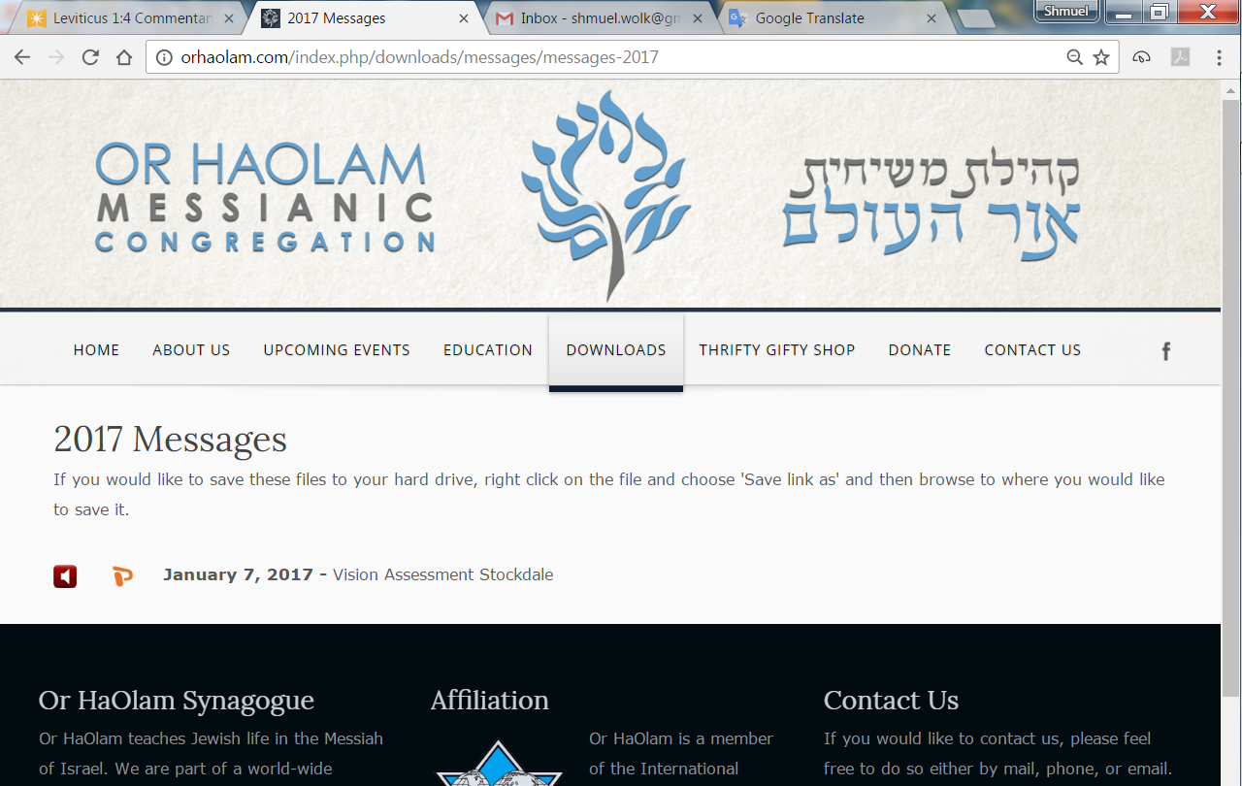

Slide 3
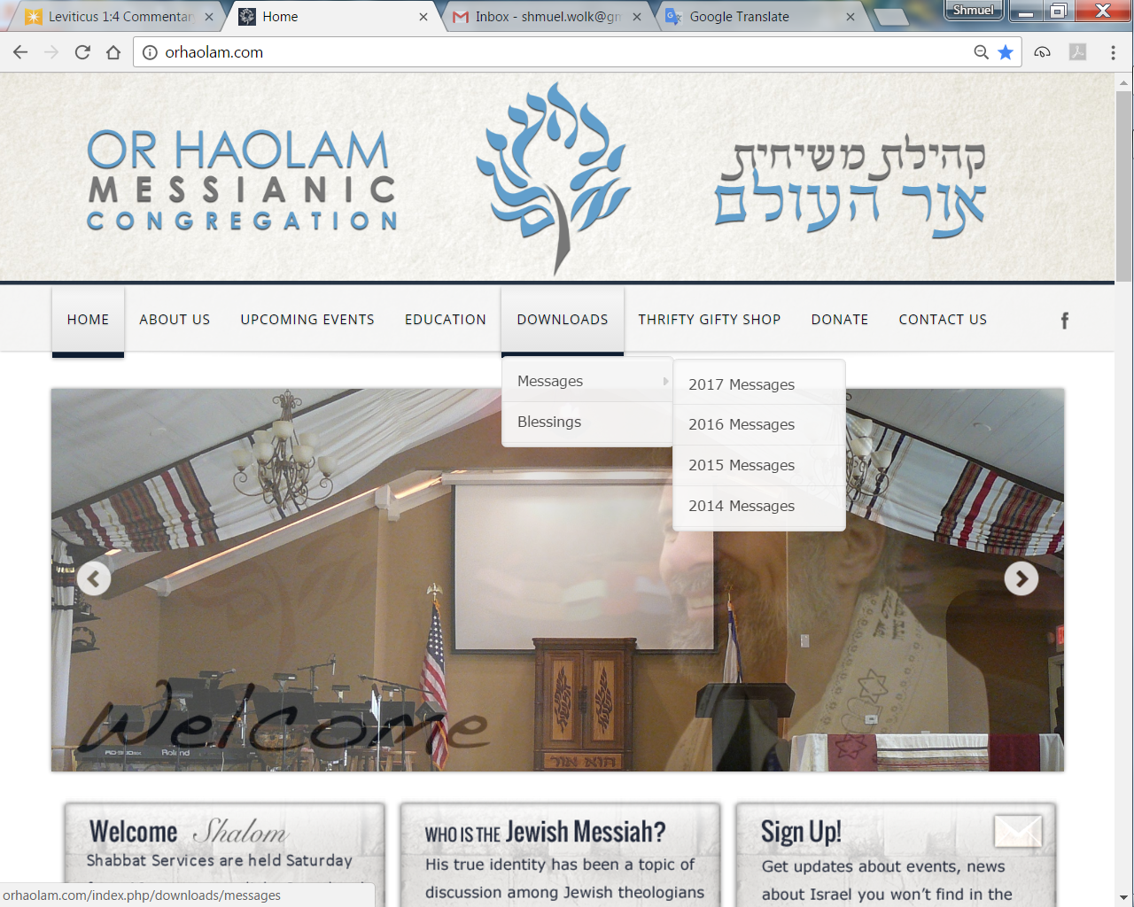
Downloads\messages\
2017 Messages
Notes:
While you are doing that, a special announcement.

Slide 4
^{Acts 6.1-2} Around this time, when the number of talmidim was growing, the Greek-speaking Jews began complaining against those who spoke Hebrew that their widows were being overlooked in the daily distribution. So the Twelve called a general meeting of the talmidim…
Notes:
So, it’s entirely scriptural, and reasonable, to gather opinions from the congregants about needs and insights. Ron Vine has been doing this professionally for many years.
Ron, come up…

Slide 5
2017 Or HaOlam Congregation Survey
Purpose: To gather feedback from Congregants (Members and Non-Members) regarding current and potential services of Or HaOlam Congregation to ensure Or HaOlam is addressing Congregants needs in bringing Jewish people, and those grafted in, to their covenantal identity in Messiah
Or HaOlam needs your feedback on:
Reasons for Your Involvement in Or HaOlam
Agreement with current Vision of Or HaOlam
Contents of Saturday morning worship services
Potential actions Or HaOlam can take to improve services at our new building
Your Vision for what Or HaOlam will look like in 10 years
Identify Priority Actions

Slide 6
2017 Or HaOlam Congregation Survey
Survey will be administered as an on-line web-survey.
Survey is very easy to complete-should take you about 10-12 minutes
Very confidential-your name will not be identified with answers
In the next few days, you will receive an e-mail from Or HaOlam with a link that will take you to the survey
If you need help in taking the survey, please contact Rachael Snider at racheelou@yahoo.com or myself at Ron@ronvineandassociates.com
Goal is 100% Participation
6

Slide 7
2017 Or HaOlam Congregation Survey
People need to take their surveys by no later than March 31
Rachael Snider and myself will analyze survey findings.
Results will be presented to the Congregation in June
Questions
Goal is 100% Participation
7
7
Notes:
We’ll send this out by email spam when Mordekhi back from vacation. You’ll find it really well formatted and pleasant and quick.

Slide 8
מַתִּתְיָהוּ Mattityahu
(Matthew) 16:24-27
Notes:
I became a believer in 1969. April 13 witness of the Spirit of new birth. About a month later I hitchhikeded home [180 miles, mostly NYS Thruway], and surprised my parents Friday night. Wisdom? shocks 1. I’m home. 2. Shaved off [hippy] beard. 3. I’ve found the answer to life’s problems. 4. Not in drugs or revolution. 5. Love of JC [no Messianic terminol then.] 6. Broke up with Jewish girlfriend. 7. Marrying Gentile. 8. Quitting college 9. going → Bible school. 9 shocks. No sleep. Next morning, “Sending you to best Dr., Jewish psych.” [Pause]
Yeshua sequence shocks, but with full wisdom:
Yeshua revealed the role of divine Messiah,
THEN [shock] His own horrible death, kingdom delay
and resurrection [double shock].
Kefa/Peter reaction: bad idea. Kefa corrected.
Now: their own horrible death [super shock]

Slide 9
Mattityahu (Matthew) 16:24
אָז אָמַר יֵשׁוּעַ לְתַלְמִידָיו: "מִי שֶׁרוֹצֶה לָבוֹא אַחֲרַי,
Then Yeshua told his talmidim, "If anyone wants to come after me,
Notes:
They thought they already were after Him.
Anyone: open invitation, but including them as insiders. That is, they already were literally following Him, probably expecting royal status in the Kingdom of Heaven that He spoke about. Sit on your left and your right. But now, shock…

Slide 10
Mattityahu (Matthew) 16:24
שֶׁיִּתְכַּחֵשׁ לְעַצְמוֹ וְיִקַּח אֶת צְלָבוֹ וְיֵלֵךְ אַחֲרַי;
let him say 'No' to himself, take up his execution-stake, and keep following me.
Notes:
Aparnēsasthō Say no: “deny, disown, repudiate (either another person or myself), disregard.” Heb: alienate from, deny
Misuse of term: does not mean practicing some form of asceticism [super fasting, no chocolate, flagellation, etc.] or developing low self-esteem [I’m worthless, useless, unimportant], or look ugly, tattered, disheveled. Rather placing the will of God above one’s own feelings, desires and urges (Stern 55).
Denying oneself means abandoning the relativism of determining one's own code of conduct, and conforming oneself to the will of God already expressed in the Torah Robison

Slide 11
What about??
^{Yn 10.10} I have come so that they may have life, life in its fullest measure.
^{TLV} I have come that they might have life, and have it abundantly!

Slide 12
^{1 Cor 7.24} Brothers and sisters, let each one—in whatever way he was called—remain that way with God.
Notes:
One famous TV preacher: “God wants us to prosper financially, to have plenty of money, to fulfill the destiny He has laid out for us.”
This is also true, paradox. Abundant LIFE, yet abundant death.

Slide 13
Mattityahu (Matthew) 16:24
שֶׁיִּתְכַּחֵשׁ לְעַצְמוֹ וְיִקַּח אֶת צְלָבוֹ וְיֵלֵךְ אַחֲרַי;
let him say 'No' to himself, take up his execution-stake, and keep following me.
Notes:
No to HIMSELF: Self on the throne.
Basic temptation in Gan Eden/Garden of Eden
You will be as gods. You will be in charge of moral decisions [knowing good and evil], reward good, punish evil.
You will be on throne, worshipped, admired.

Slide 14
Evaluating every situation: WWYD, for Him receiving glory.
We are tempted?
We are offended?
Notes:
My ego offended. Might be, but how to handle. His was offended repeatedly.

Slide 15
^{Yn 8.48-50} The Judean leaders responded, “Aren’t we right to say you are a Samaritan and have a demon?”
Yeshua answered, “I do not have a demon! I honor My Father, yet you dishonor Me. But I do not seek My own glory; there is One who is seeking and judging.
Notes:
Response, without invective. Information.

Slide 16
Mattityahu (Matthew) 16:24
שֶׁיִּתְכַּחֵשׁ לְעַצְמוֹ וְיִקַּח אֶת צְלָבוֹ וְיֵלֵךְ אַחֲרַי;
let him say 'No' to himself, take up his execution-stake, and keep following me.
Notes:
staurós – the crosspiece of a Roman cross; the cross-beam, placed at the top of the vertical member to form a capital "T." "This transverse beam was the one carried by the criminal" (Souter).

Slide 17
In order to understand what Yeshua meant by taking up a cross, we need to first consider what the cross meant to Yeshua. For him cross-bearing did not symbolize an irritation or martyrdom, but being an atoning sacrifice.
Notes:
http://www.blainerobison.com/bible2/marknotes08.htm

Slide 18
His followers obviously cannot make atonement by their own deaths, but disciples must be prepared to accept the reality of suffering and persecution just as Messiah suffered.
Notes:
http://www.blainerobison.com/bible2/marknotes08.htm

Slide 19
Paul expressed the desire, "My aim is to know Him and the power of His resurrection and the sharing of His sufferings, becoming like Him in His death" (Php 3:10 TLV).
Notes:
http://www.blainerobison.com/bible2/marknotes08.htm

Slide 20
Under ancient Roman penal practice, crucifixion was also a means of exhibiting the criminal's low social status. It was the most dishonorable death imaginable, originally reserved for slaves, hence still called "supplicium servile" by Seneca,
Notes:
https://en.wikipedia.org/wiki/Crucifixion

Slide 21
later extended to citizens of the lower classes. The citizen class of Roman society were almost never subject to capital punishments; instead, they were fined or exiled. Josephus mentions Jews of high rank who were crucified,
Notes:
https://en.wikipedia.org/wiki/Crucifixion

Slide 22
but this was to point out that their status had been taken away from them. The Romans often broke the prisoner's legs to hasten death and usually forbade burial.
Notes:
https://en.wikipedia.org/wiki/Crucifixion

Slide 23
Roman citizens were exempt from this form of execution, but would be beheaded for a capital crime. Crucifixion was common among Greeks, Romans, Egyptians, Persians and Babylonians, but never among Jews.

Slide 24
Jewish law specified four methods of execution—stoning, burning, beheading and strangling ^{(Sanh.7:1)}. Thus, many Jews had difficulty accepting a crucified Messiah, because the Torah identifies a man executed by hanging from a tree as accursed.
Notes:
http://www.blainerobison.com/bible2/marknotes08.htm

Slide 25
^{Dvarim 21.22-23} If someone has committed a capital crime and is put to death, then hung on a tree, his body is not to remain all night on the tree, but you must bury him the same day, because a person who has been hanged has been cursed by God.

Slide 26
Execution stake-bearing implies placing God's interests ahead of personal interests. This basic virtue can impact life in a variety of ways.
First, loyalty to Yeshua must come before family ^{(Luke 14:26).}
Notes:
http://www.blainerobison.com/bible2/marknotes08.htm

Slide 27
Second, being a disciple of Yeshua cannot be in secret. Discipleship must be publicly owned. [Although with wisdom.]
Third, the disciple must be willing to forgive his enemies. From the cross Yeshua prayed that his executioners would be
Notes:
http://www.blainerobison.com/bible2/marknotes08.htm

Slide 28
He had also taught them to petition God for forgiveness on the basis of how they forgave others ^{(Matt 6:12-15; Mark 11:25)}. Forgiveness is probably the single hardest virtue to develop.
Notes:
http://www.blainerobison.com/bible2/marknotes08.htm

Slide 29
^{Gal 2.20} When the Messiah was executed on the stake as a criminal, I was too; so that my proud ego no longer lives. But the Messiah lives in me, and the life I now live in my body I live by the same trusting faithfulness that the Son of God had, who loved me and gave himself up for me.

Slide 30
A really simple summary of death to self:
Say to someone, “I was wrong.”
“I was wrong in _______.” No “But….”
“I was wrong in _______. Will you forgive me?”
Notes:
Say to G-d, certainly.
Not always appropriate to ask for forgiveness. People not ready.
Try it. Inventory, and say to someone.

Slide 31
Mattityahu (Matthew) 16:25
כִּי הֶחָפֵץ לְהַצִּיל אֶת נַפְשׁוֹ יְאַבֵּד אוֹתָהּ, אֲבָל הַמְאַבֵּד אֶת נַפְשׁוֹ לְמַעֲנִי יִמְצָאֶנָּה.
For whoever wants to save his own life will destroy it, but whoever destroys his life for my sake will find it.
Notes:
Saves his pride.
Denies Y, reproach, persecution,

Slide 32
Mattityahu (Matthew) 16:26
מַה תּוֹעֶלֶת תִּצְמַח לְאָדָם אִם יַרְוִיחַ אֶת כָּל הָעוֹלָם וְיַפְסִיד אֶת נַפְשׁוֹ,
What good will it do someone if he gains the whole world but forfeits his life?

Slide 33
psuché: breath, the soul (a) the vital breath, breath of life, (b) the human soul, (c) the soul as the seat of affections and will, (d) the self, (e) a human person, an individual.
Notes:
http://biblehub.com/greek/5590.htm

Slide 34
psyxḗ (from psyxō, "to breathe, blow" which is the root of the English words "psyche," "psychology") – soul (psyche); a person's distinct identity (unique personhood), i.e. individual personality.
Notes:
http://biblehub.com/greek/5590.htm

Slide 35
The soul is the direct aftermath of God breathing (blowing) His gift of life into a person, making them an ensouled being.
Notes:
http://biblehub.com/greek/5590.htm

Slide 36
Mattityahu (Matthew) 16:26
אוֹ מַה יִּתֵּן אָדָם כִּתְמוּרָה בְּעַד נַפְשׁוֹ?
Or, what can a person give in exchange for his life?
Notes:
Lose life I think means lose eternal life. Next verse about eternal glory. Eternal perdition.

Slide 37
Mattityahu (Matthew) 16:27
הֵן עָתִיד בֶּן-הָאָדָם לָבוֹא בִּכְבוֹד אָבִיו עִם מַלְאָכָיו וְאָז יְשַׁלֵּם לְכָל אִישׁ כְּמַעֲשֵׂהוּ.
For the Son of Man will come in his Father's glory, with his angels; and then he will repay everyone according to his conduct.

Slide 38
Yes! I tell you that there are some people standing here who will not experience death until they see the Son of Man coming in his Kingdom!”
Mattityahu (Matthew) 16:28

Slide 39
This is why we are glad to surrender our sins and our selves…His glory revealed.

Slide 40
^{Eph. 3.14-21} I pray that from the treasures of his glory he will empower you with inner strength by his Spirit,

Slide 41
^{Eph. 3.14-21} so that the Messiah may live in your hearts through your trusting. Also I pray that you will be rooted and founded in love,
Notes:
Not just some mystical presence, but LOVE
Examine words:
Rooted: cause to take root; plant, fix firmly, establish

Slide 42
^{Gal 2.20} …the life I now live in my body I live by the same trusting faithfulness that the Son of God had, who loved me and gave himself up for me.
Notes:
This is why we surrender…to receive His glory in place of our selfishness, anger, ego, lust, materialism.
From Ravi Zaccharias…

Slide 43
One of Friedrich Nietzsche’s sustained critiques of Christianity was that it promoted weakness as a virtue. He argued in his book On the Genealogy of Morals that Christianity promoted a “slave morality.” Looking at the Beatitude sayings
Notes:
Just Thinking Mag Feb 2017 25.2

Slide 44
of Yeshua as the centerpiece of this morality, Nietzsche railed against this unique vision of the
moral life, particularly as it was embodied in Yeshua as the Suffering Servant.” For Nietzsche
Notes:
Just Thinking Mag Feb 2017 25.2

Slide 45
all of Western society, built as it was upon a foundation of Judeo-Christian morality—with its appeal to kindness, service, and caring for others—had to be torn down. The proper solution, for Nietzsche, was to
Notes:
Just Thinking Mag Feb 2017 25.2

Slide 46
argue for the exact opposite: the will to power by the ubermensch, serving no one and forging a moral vision rooted firmly in the powerful individual as the basis for virtue.
Notes:
Just Thinking Mag Feb 2017 25.2

Slide 47
Immediately, another question
comes to mind: Is the call of Yeshua to lose one’s life really a call to weakness, or is it about strength of will more powerful
than anything Nietzsche could fathom? While following Yeshua offers no
Notes:
Just Thinking Mag Feb 2017 25.2

Slide 48
security guarantee or promise of reward, it is a powerful choice to trust that as I lay my life down, someone will pick it up again. It is the potent surrender to God uttered by the psalmist —and reiterated by Yeshua on the cross—“Into your hands, I commit my spirit.”
Notes:
Just Thinking Mag Feb 2017 25.2

Slide 49
Mattityahu (Matthew) 16:24
אָז אָמַר יֵשׁוּעַ לְתַלְמִידָיו: "מִי שֶׁרוֹצֶה לָבוֹא אַחֲרַי,
Then Yeshua told his talmidim, "If anyone wants to come after me,
Notes:
They thought they already were after Him.
Anyone: open invitation, but including them as insiders. That is, they already were literally following Him, probably expecting royal status in the Kingdom of Heaven that He spoke about. Sit on your left and your right. But now, shock…

Slide 50
Mattityahu (Matthew) 16:24
שֶׁיִּתְכַּחֵשׁ לְעַצְמוֹ וְיִקַּח אֶת צְלָבוֹ וְיֵלֵךְ אַחֲרַי;
let him say 'No' to himself, take up his execution-stake, and keep following me.
Notes:
Aparnēsasthō Say no: “deny, disown, repudiate (either another person or myself), disregard.” Heb: alienate from, deny
Misuse of term: does not mean practicing some form of asceticism [super fasting, no chocolate, flagellation, etc.] or developing low self-esteem [I’m worthless, useless, unimportant], or look ugly, tattered, disheveled. Rather placing the will of God above one’s own feelings, desires and urges (Stern 55).
Denying oneself means abandoning the relativism of determining one's own code of conduct, and conforming oneself to the will of God already expressed in the Torah Robison

Slide 51
What about??
^{Yn 10.10} I have come so that they may have life, life in its fullest measure.
^{TLV} I have come that they might have life, and have it abundantly!

Slide 55
Notes:
$159 till Wed. $10 membership fee.

Slide 56
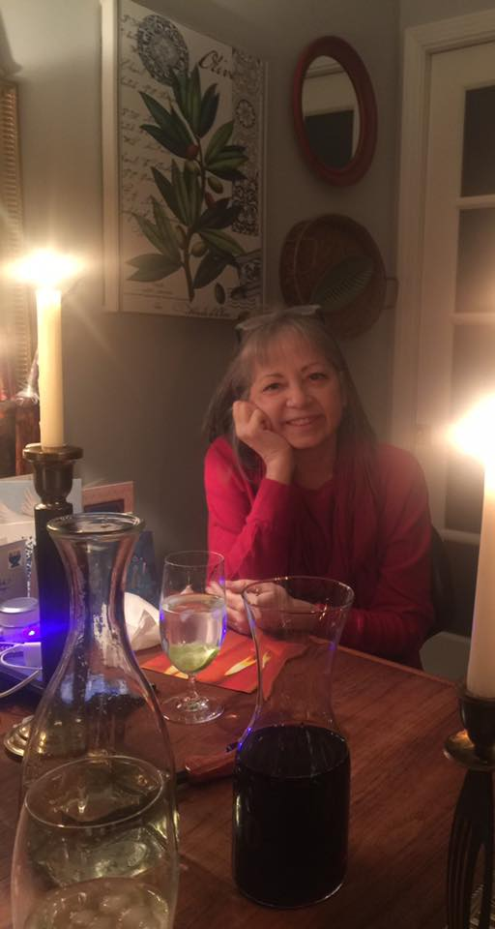
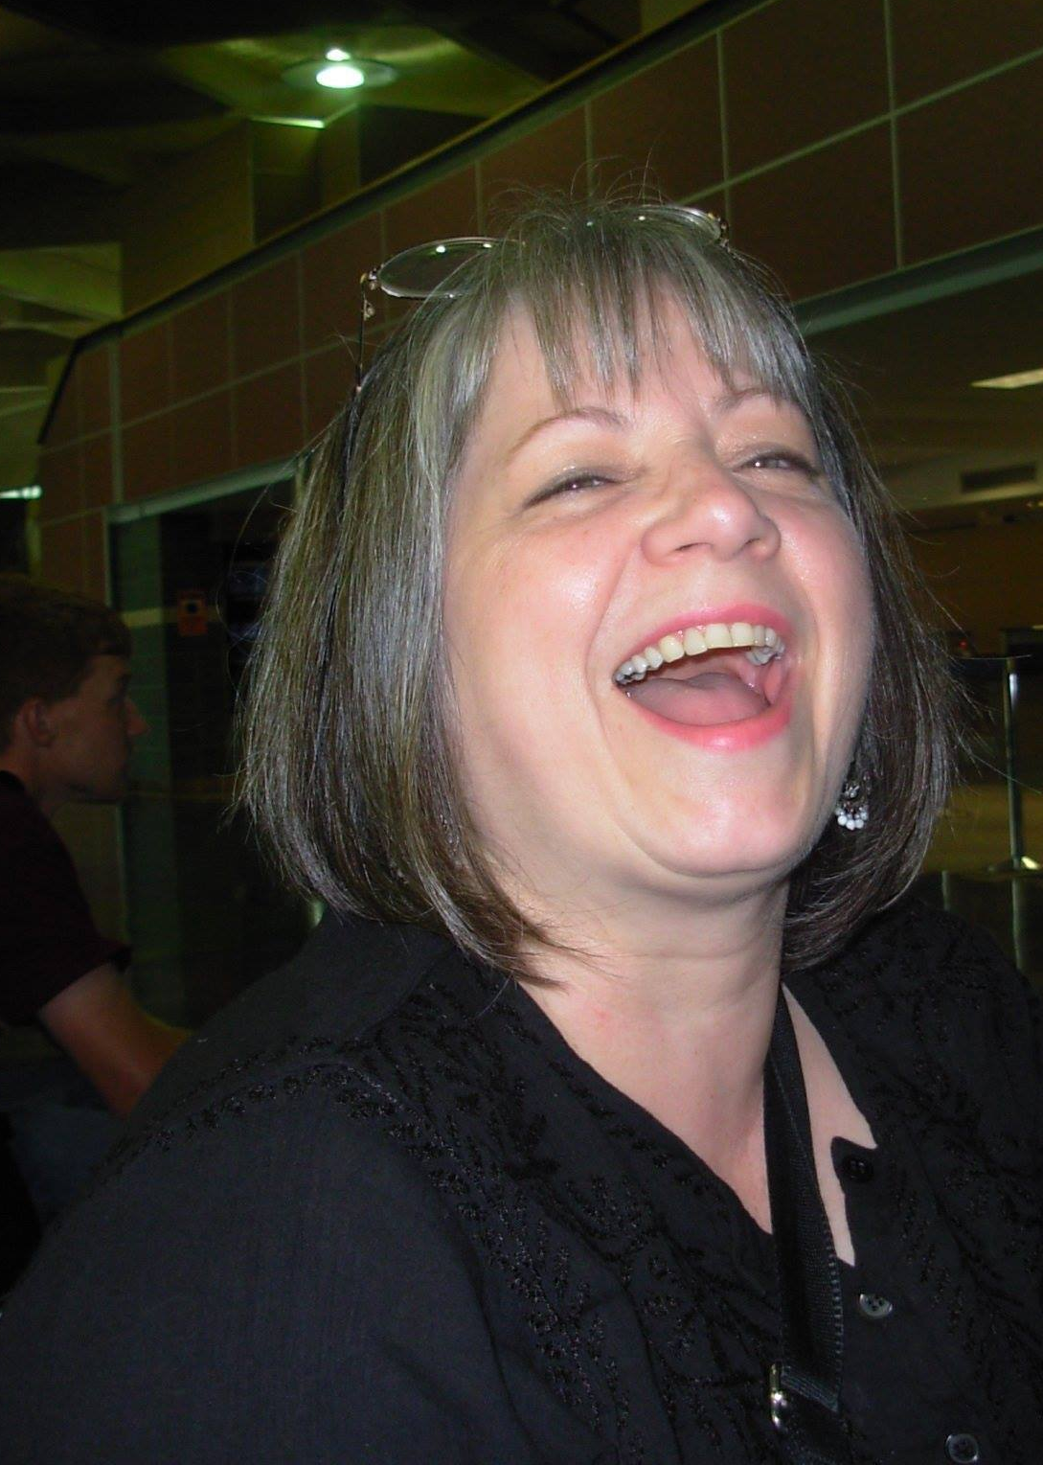

Slide 57
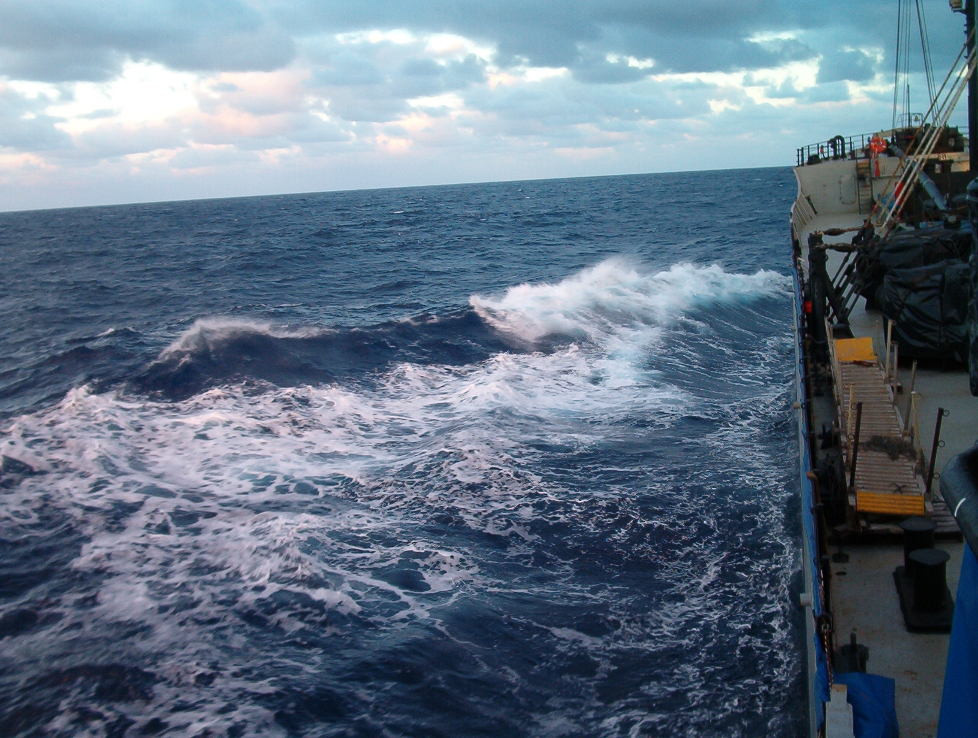

Slide 58
