Slide 1
To easily follow these notes, log on to our Wifi
Wifi: mycci01 p/w: ancientquail060
Go to OrHaOlam.com
Click on downloads, messages, 2017

Slide 2
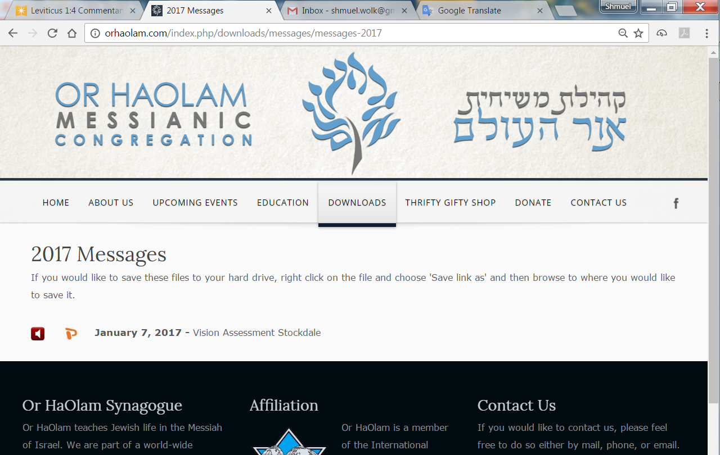

Slide 3
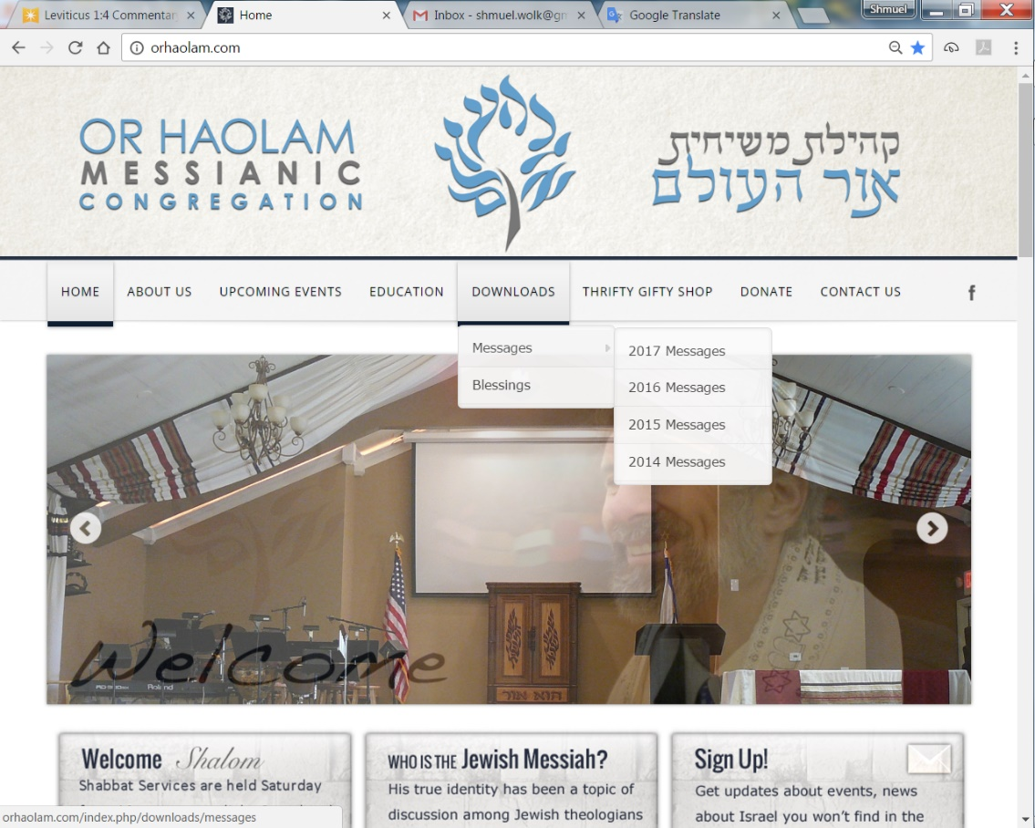
Downloads\messages\
2017 Messages
Notes:
In 2008 I was asked to speak in Nurenberg, Germany, by a pastor who is a great lover of Israel. I have said before that everything about the country to me was toxic and enemy: street signs, cars, sound of the language. I had a great transformation there. Want to play a clip of a German language rap inserted into the Hatikvah. Mordekhi brilliantly inserted “Come O Come, Immanuel” into the Hatikvah, great impact. This similarly redemptive. From the founder of the March of Remembrance. On line, or tomorrow at Purim Party, buy tickets!!
OH bought 59 last year. Need to double!

Slide 4
Play
https://www.youtube.com/watch?v=T885WA_PGJI
Buy March of Remembrance tickets manana!

Slide 5
Good construed as evil,
and its reversal
Notes:
By hidden reality underlying the reversal.

Slide 6
Ester (Esther) 3.8a

Slide 7
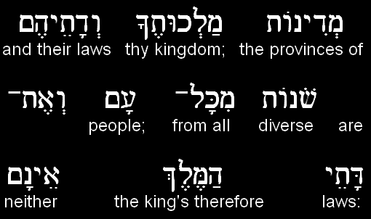
Ester (Esther) 3.8b

Slide 8
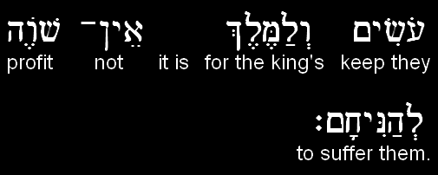
Ester (Esther) 3.8c

Slide 9
Jews were defined as a threat BECAUSE they kept Torah.
Reversal. They were a blessing because they did so.

Slide 10
^{Yermiyahu/Jer 29.4-7} “Here is what Adonai-Tzva’ot, the God of Isra’el, says to all those in exile, whom I have caused to be carried off captive from Yerushalayim to Bavel: ‘Build yourselves houses, and live in them. Plant gardens, and eat what they produce.

Slide 11
^{Yermiyahu/Jer 29.4-7} Choose women to marry, and have sons and daughters…Seek the welfare of the city to which I have caused you to go in exile, and pray to Adoni on its behalf; for your welfare is bound up in its welfare.’

Slide 12
^{Kohelet/Eccles 8.2-4} Keep the king’s command because of the oath before God. Don’t be quick to leave his presence, and don’t persist in doing what is wrong, for he does whatever he pleases. After all, his word is final; who can challenge him, “Why are you doing that?”

Slide 13
Jews were defined as a threat BECAUSE they kept Torah.
Reversal. They were a blessing because they did so.

Slide 14
^{Yeshayahu/Is 5.20-21} Oy to those who call evil good and good evil, who present darkness as light and light as darkness, who present bitter as sweet, and sweet as bitter! Oy to those who are wise in their own eyes, and clever in their own sight!

Slide 15
Benefits of following Tanakh
Literacy ^{Ro 3.1-2} Then what is the advantage of being Jewish? Or what is the benefit of circumcision? Much in every way. First of all, they were entrusted with very words of God.

Slide 16
Benefits of following Tanakh
Compassion [hospitals, educ.]
Hope >> visible distress “For everything written in the past was written to teach us, so that with the encouragement of the Tanakh we might patiently hold on to our hope.” ^{Ro 15.4}

Slide 17
In an 1808 letter, President John Adams expressed his respect for ancient Jewry. Adams wrote of Voltaire, "How is it possible [that he] should represent the Hebrews in such a contemptible light? They are the most glorious nation that ever inhabited this Earth.
Notes:
http://www.jewishvirtuallibrary.org/president-john-adams-embraces-a-jewish-homeland-1819-2
Learned today from David Barton that the Declaration of Independence was actually a collection of sermon topics! Preachers of the day would bring Bible truth to apply to the headlines.

Slide 18
The Romans and their Empire were but a Bauble in comparison of the Jews. They have given religion to three quarters of the Globe and have influenced the affairs of Mankind more, and more happily, than any other Nation ancient or modern."
Notes:
http://www.jewishvirtuallibrary.org/president-john-adams-embraces-a-jewish-homeland-1819-2

Slide 19
Jews were defined as a threat BECAUSE they kept Torah.
Reversal. They were a blessing because they did so.
Notes:
I’m going to make what may be controversial applications of this.

Slide 20
^{2 Cor.11.4-15} Satan masquerades as an angel of light. It is no great thing therefore if his servants also masquerade as servants of righteousness. Their end will be according to their deeds.
Notes:
Satanic light pretends to be Divine light.
Humanistic righteousness pretends to be G-d’s righteousness.
Purim time. Lots of masquerades.
I’m going to comment on the headlines of the day. Like our founding fathers, many preachers!

Slide 21
We have a world of moral terminology reversals.
Frequent media wording:
Pro-choice or anti-abortion
Really:
Pro-life or pro-abortion
Notes:
Makes anti-abortionists look like negativists. Against choice.

Slide 22
Notes:
https://www.pinterest.com/explore/good-slogans/
Seems reasonable

Slide 23
Notes:
Female body.
Really??

Slide 24
Notes:
G-d chose the unborn.

Slide 25
Frequent media wording:
Pro-choice or anti-abortion
Really:
Pro-life or pro-abortion
Notes:
The Women's March[ was a worldwide protest on January 21, 2017, to advocate legislation and policies regarding human rights and other issues. Huge media coverage. 500k https://en.wikipedia.org/wiki/2017_Women's_March
The March for Life is an annual rally protesting abortion, held in Washington, D.C., on or around the anniversary of the United States Supreme Court's decision legalizing abortion in the case Roe v. Wade… The March for Life has received relatively little media attention over the years. The typical coverage consists of a “story with a tiny little comment from one individual marcher”, Gray has said. https://en.wikipedia.org/wiki/March_for_Life_(Washington,_D.C.)

Slide 26
Jews were defined as a threat BECAUSE they kept Torah.
Reversal. They were a blessing because they did so.
Notes:
Good construed as evil. Whatever you may think of Pres. Trump’s immigration policies…

Slide 27
Frequent media wording:
Immigration ban from Muslim majority countries.
Really:
Immigration ban from failed or hostile states, vetting impossible
Notes:
Truth construed as a lie. Good construed as evil.

Slide 28
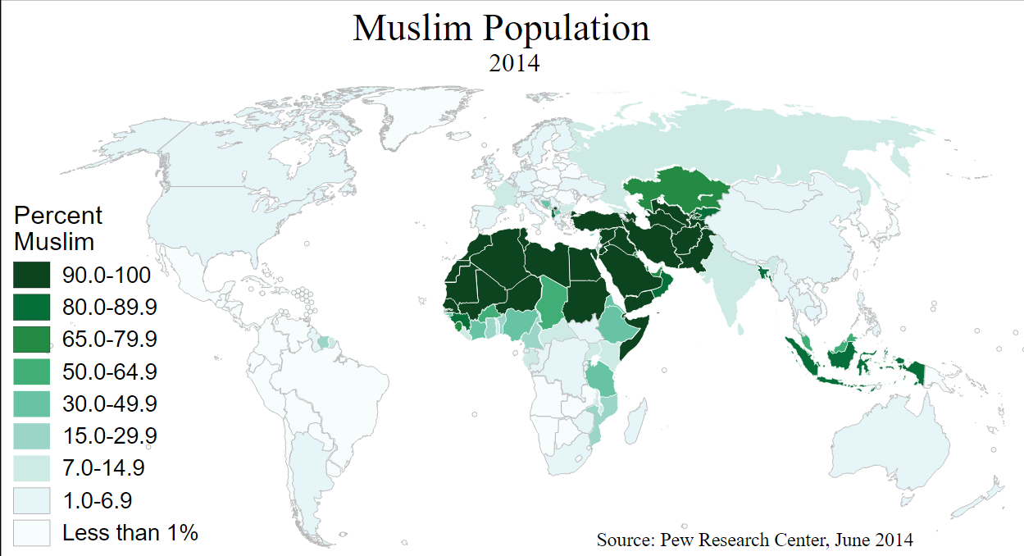
Notes:
https://en.wikipedia.org/wiki/Muslim_world#Islamic_states

Slide 29
29 nations
Notes:
https://en.wikipedia.org/wiki/Muslim_world#Islamic_states

Slide 30
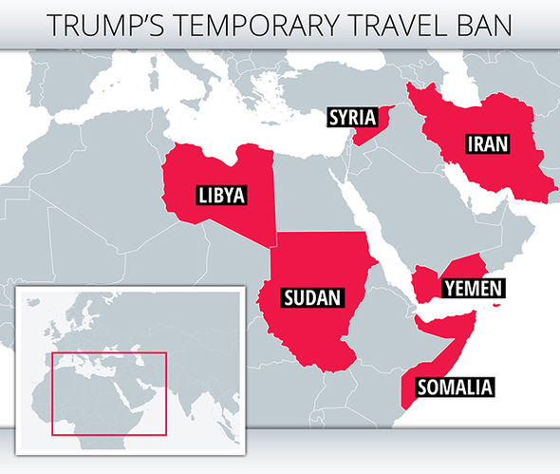
Six failed or hostile states

Slide 31
Frequent media wording:
Immigration ban from Muslim majority countries
Rather:
Immigration ban from failed or hostile states, vetting impossible
Notes:
Headlines IMPLY prejudice, unreasonable policy.

Slide 32
Frequent media wording:
Transgender rights
Really:
Gender privacy protection

Slide 33
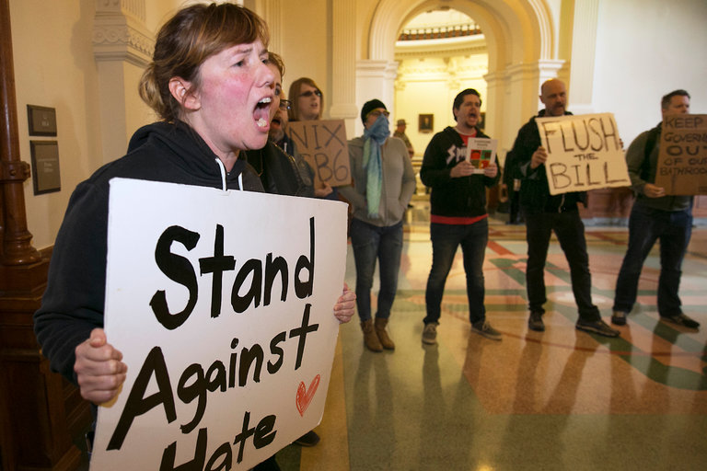
Notes:
“Protect transgender people”
Seems reasonable.

Slide 34
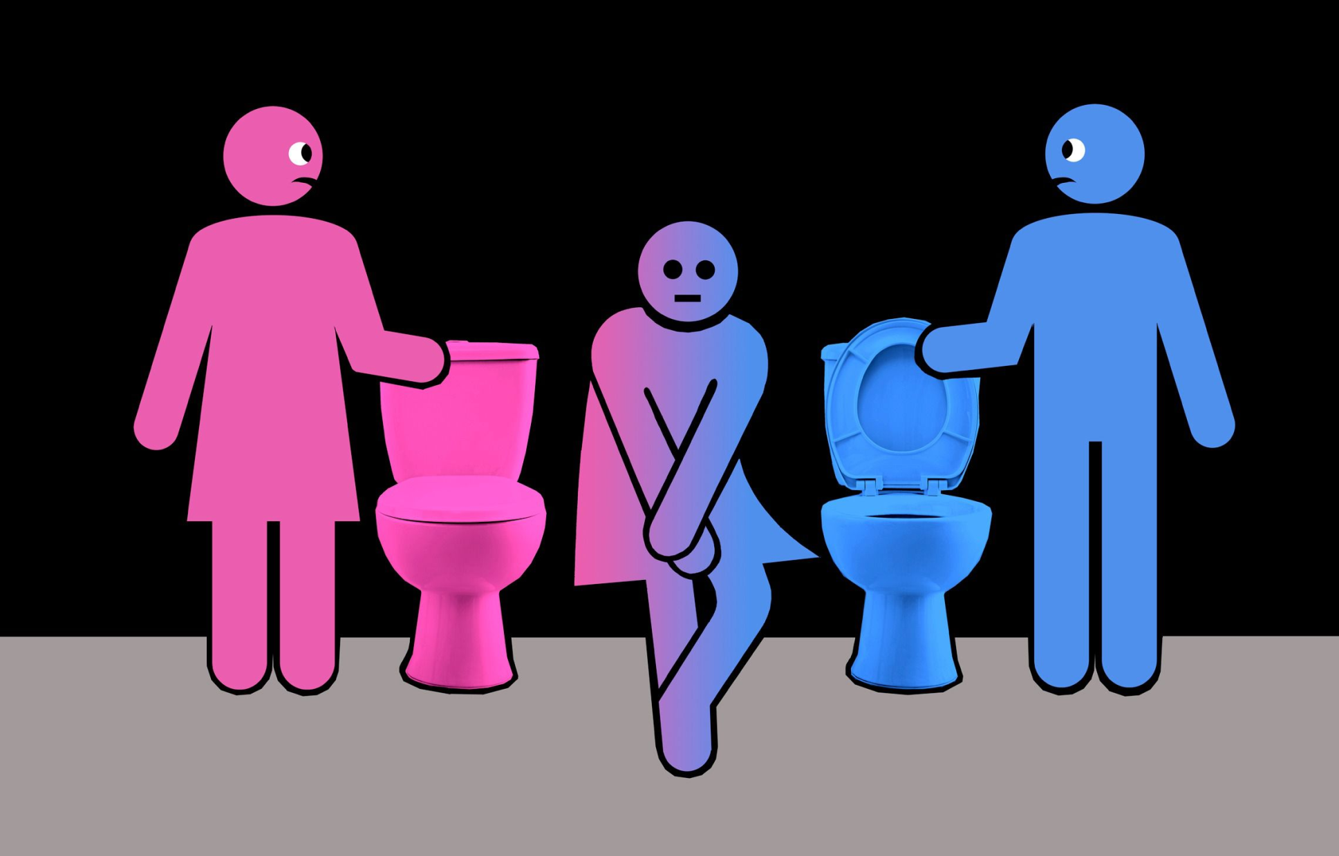
Notes:
Hard to find a good illustration that wasn’t obscene.
I am pretty regularly in a locker room at the J. The standard attire…Women in there who think they are guys!!
Note: Seat up or seat down.

Slide 35
Frequent media wording:
Transgender rights
Really:
Gender privacy
Notes:
Headline makes for a policy bias. Transgender rights? Safety.

Slide 36
Frequent media wording:
Israeli settlements causing terrorism, intifada
Rather:
Palestinian refusal, incitement causing terrorism, intifada

Slide 37
In December 2000, Israeli and Palestinian negotiators were brought to Washington. And on December 23, President Clinton presented a new plan to them. The Palestinians would get 97 percent of the West Bank, Arab neighborhoods in East Jerusalem
Notes:
http://www.weeklystandard.com/myths-of-the-intifada/article/2461

Slide 38
would become the capital of the new Palestinian state, refugees would be allowed to return to Palestine but not Israel, and a $30 billion fund would be established to compensate refugees. This was the final offer: The separated cantons were gone and a land link to Gaza was included.
Notes:
http://www.weeklystandard.com/myths-of-the-intifada/article/2461

Slide 39
After Clinton left the meeting, Dennis Ross stayed behind to make certain the Palestinian negotiators had gotten "every single word." They had. A footnote: Ross insists the Palestinian negotiators were ready to accept the offer.
Notes:
http://www.weeklystandard.com/myths-of-the-intifada/article/2461

Slide 40
They "understood this was the best they were ever going to get. They wanted [Arafat] to accept it." He refused. Why? Ross believes Arafat simply didn't want to end the conflict with Israel.
Notes:
http://www.weeklystandard.com/myths-of-the-intifada/article/2461

Slide 41
His career was governed by struggle and leaving his options open. "For him to end the conflict is to end himself," Ross said.
Notes:
http://www.weeklystandard.com/myths-of-the-intifada/article/2461

Slide 42
Frequent media wording:
Israeli settlements causing intifada
Rather:
Palestinian refusal, incitement causing terrorism, intifada
Notes:
One more…

Slide 43
Frequent media wording:
Anti-Islam
Really:
Anti-Islamist

Slide 44
In Western media usage the term tends to refer to groups who aim to establish a sharia-based Islamic state, often with implication of violent tactics and human rights violations, and has acquired connotations of political extremism.
Notes:
https://en.wikipedia.org/wiki/Islamism
Islamism is dangerous. Islam is not, per se. Can be poetic. Sufi mystics. Poem The Rubaiyat By Omar Khayyam
A Jug of Wine, a Loaf of Bread--and Thou Beside me singing in the Wilderness-- Oh, Wilderness were Paradise enow!
Similar truth reversal though not headlines, private:

Slide 45
End of life lies:
^{Thillim /Ps 116.15 NAS} Precious in the sight of Adoni Is the death of His godly ones.
^{2 Cor. 5.6-7} So we are always confident — we know that so long as we are at home in the body, we are away from

Slide 46
End of life lies of the enemy:
our home with the Lord; for we live by trust, not by what we see. We are confident, then, and would much prefer to leave our home in the body and come to our home with the Lord.

Slide 47
End of life lies of the enemy:
^{Ps 73.3-4} ^{NIV} For I envied the arrogant when I saw the prosperity of the wicked. They have no struggles at death; their bodies are healthy and strong.
Notes:
End of life Satanic attack: accusations, condemnation. Encourage resting in Yeshua, trusting in His Blood Atonement, mercy!!

Slide 48
So, how do we
discern truth
restore truth
live in truth?

Slide 49
Know that whenever truth is reversed, it’s NEVER 100% reversed. First, realize:
Resisting Transgender rights is NOT rejecting & rudeness to transgender people.
Resisting Islamism is NOT lack of love to Muslims.

Slide 50
The BEST of actions and principles can be tainted with bad attitudes: hostility, pride, anger.
The WORST behaviors and principles can have loving attitudes.
Notes:
Always a bit of mixture that seems to undermine clear thinking and differentiation.

Slide 51
^{Ro. 11.20} You stand by faith. Do not be arrogant, but fear.
People who are wrong are not usually 100% wrong. Listen and learn with humility.
When you are doing right, it’s usually not 100% right.
Notes:
Consider someone who irritates you. Try to respect and learn from them. Don’t cut people off. Don’t reject people!
When you are doing right, and being corrected, don’t resent it. Learn and do better!

Slide 52
^{T’hillim/Ps.139.1-4}Adoni, You searched me and know me. Whenever I sit down or stand up, You know it. You discern my thinking from afar. You observe my journeying and my resting and You are familiar with all my ways. Even before a word is on my tongue, behold, Adoni, You know all about it.

Slide 53
^{Mes. Jews/Heb.4.12-13} See, the Word of God is alive! It is at work and is sharper than any double-edged sword — it cuts right through to where soul meets spirit and joints meet marrow, and it is quick to judge

Slide 54
^{Mes. Jews/Heb.4.12-13} the inner reflections and attitudes of the heart. Before God, nothing created is hidden, but all things are naked and open to the eyes of him to whom we must render an account.

Slide 55
Use the Purim method
Supernatural Reversal
וְנַהֲפוֹךְ הוּא v’nahafokh hu
= On the contrary; the reverse is true

Slide 56
בַּיּוֹם אֲשֶׁר שִׂבְּרוּ אֹיְבֵי הַיְּהוּדִים לִשְׁלוֹט בָּהֶם, וְנַהֲפוֹךְ הוּא, אֲשֶׁר יִשְׁלְטוּ הַיְּהוּדִים הֵמָּה בְּשֹׂנְאֵיהֶם
On the day when the enemies of the Jews hoped to overpower them. But, as it turned out, the opposite took place — the Jews overpowered those who hated them.

Slide 57
The Scroll of Ester is about a Hidden miracle, a reversal based on hidden power.
The word Ester in Persian means star, in Hebrew is הֶסְתֵּר related to secret, hiding, concealing

Slide 58
וְנַהֲפוֹךְ הוּא v’nahafokh hu
The Book of Ester has NO mention of any of the names of G-d
Costumes are about hidden identity

Slide 59
^{(Devarim 31:18):} וְאָנֹכִי, הַסְתֵּר אַסְתִּיר פָּנַי בַּיּוֹם הַהוּא
"V'anokhi haster asteer...",
I am Adoni who will surely conceal my face... ”
”asteer” ” I will hide, is composed of the same letters as the name Ester.
Notes:
http://www.ulpanor.com/

Slide 60
So, the name Ester carries in it the meaning of: hiding/concealing - holding a secret
Notes:
http://www.ulpanor.com/

Slide 61
^{Mtt.6.6} When you pray, go into your inner room; and when you have shut your door, pray to your Father who is in secret. And your Father, who sees in secret, shall reward you.
Notes:
How is it that Akhashverosh couldn’t sleep that particular night, and the journal he had read was about the incident with Mordekhi?
Hidden power!
Some of us did a three day fast, or three day diminution of eating. I can fast fine until bedtime. Just get a feeding frenzy then.

Slide 62
^{Acts 26.18} I am sending you, to open their eyes—so they may turn from darkness to light and from the power of satan to God, that they may receive release from sins as well as a place among those who are made holy through trusting in Me.’
Notes:
Concerning the modern threat of Iran, the same nation as ancient Persia, developing N weapons, threatening Israel, sponsoring 80% of Israels terrorism threats, according to Benj Netanyahu. Some encouraging hidden possible huge breakthroughs…

Slide 63
Unpublicized, hidden impending disaster in Persia / Iran.
May soon fall as precipitously as did the evil empire, the Soviet Union.

Slide 64
The mullahs now ruling Iran were able to hijack the revolution that sacked the U.S.-backed Shah regime back in February 1979. However, the 38-year report card left by the mullahs has only raised extreme anger throughout the Iranian society.
Notes:
https://clarionproject.org/irans-regime-of-terror-by-the-numbers/

Slide 65
Numbers are very vivid in revealing the undeniable atrocities caused by the mullahs’ disastrous policies.
Notes:
https://clarionproject.org/irans-regime-of-terror-by-the-numbers/

Slide 66
The daily trend of continuous executions in Iran has raised anger amongst the international community for years. Iran is considered the number one executioner per capita.
Notes:
https://clarionproject.org/irans-regime-of-terror-by-the-numbers/

Slide 67
Suicides are also on the rise, especially amongst women, ranking Iran first in the Middle East and third in the world. There are also reports of a growing number of teenagers committing suicide.
Notes:
https://clarionproject.org/irans-regime-of-terror-by-the-numbers/

Slide 68
Drug addiction is yet another disastrous result of the mullahs’ rule in Iran. The amount of drugs spreading amongst women and teenagers is skyrocketing and state-run media are citing experts estimating at least 8 million Iranians are suffering from this dreadful phenomenon.
Notes:
https://clarionproject.org/irans-regime-of-terror-by-the-numbers/

Slide 69
Iran’s roads are even considered very dangerous, as the mullahs refuse to allocate the necessary budget to provide safe passages. 20,000 people die each year in Iran and 300,000 injured (150% more than the global average). Iran’s annual road accident casualty statistics are even compared to an all-out war.
Notes:
https://clarionproject.org/irans-regime-of-terror-by-the-numbers/

Slide 70
Poverty has increased to an extent that many Iranians have resorted to gathering recyclable products, food stuffs and other trash to make ends meet, and the homeless sleeping in pre-dug graves.
Notes:
https://clarionproject.org/irans-regime-of-terror-by-the-numbers/

Slide 71
All the while Iran is a country sitting on a vast sea of crude oil and natural gas, with new reports of 2 billion barrels of shell oil discovered in western Iran.
Notes:
https://clarionproject.org/irans-regime-of-terror-by-the-numbers/
2 billion x $50 = $100 billion

Slide 72
The country’s economy, however, has nosedived to such an extent that more than 50% of the industrial units have gone bankrupt or are on the verge of bankruptcy.
Notes:
https://clarionproject.org/irans-regime-of-terror-by-the-numbers/

Slide 73
Unemployment is now a critical and increasing crisis. Nearly 15 million people are unemployed in Iran, according to an Iranian economy expert.
Notes:
https://clarionproject.org/irans-regime-of-terror-by-the-numbers/

Slide 74
The mullahs’ policies have literally destroyed the entire “middle class” in Iran, leaving the population divided between a small percentage with massive riches, and a high percentage living in poverty.
“30% of the country’s population is hungry and have no bread to eat,” said Ali Akbar Sayari, Deputy Health Minister in the cabinet of Iranian President Hassan Rouhani.
Notes:
https://clarionproject.org/irans-regime-of-terror-by-the-numbers/

Slide 75
Financial corruption is spreading throughout society like cancer. The numbers have become massive and even unimaginable. Above all is the apparatus linked to Iranian Supreme Leader Ali Khamenei, whose riches value at $95 billion.
Notes:
https://clarionproject.org/irans-regime-of-terror-by-the-numbers/

Slide 76
Iran’s environment is also on the verge of complete annihilation. “If the water crisis in Iran continues, the country will soon become very similar to Somalia and 50 million Iranians will be forced to leave the country,” said Isa Kalantari, Rouhani’s advisor in water and agricultural matters
Notes:
https://clarionproject.org/irans-regime-of-terror-by-the-numbers/
Israelis used to maintain the water system in the days of the Shah.

Slide 77
Even the workplace is considered unsafe under the mullahs’ rule, as Iran ranks first in the world in workplace incidents. “Iran is the world record holder in construction accidents,” said Akbar Shokat, head of the Construction Workers’ Guild Center in an interview with the state-run ISNA news agency.
Notes:
https://clarionproject.org/irans-regime-of-terror-by-the-numbers/

Slide 78
Illiteracy is plaguing millions of Iranian children, depriving them of education due to their family’s economic and social problems. Iran has a population of 10 million illiterates and 10 million low-literates, according to Rouhani’s Deputy Education Minister.
Notes:
https://clarionproject.org/irans-regime-of-terror-by-the-numbers/

Slide 79
Yet another repulsive custom rendered from the mullahs’ regime has been child marriages. Poverty forces families to give off their young daughters, leaving them to face unthinkable spiritual and physical damages from arranged marriages. “43,000 girls between the ages of 10 to 15 are currently married in Iran,” according to regime officials.
Notes:
https://clarionproject.org/irans-regime-of-terror-by-the-numbers/

Slide 80
Heshmat Alavi is a political and rights activist. His writing focuses on Iran, ranging from human rights violations, social crackdown, the regime’s support for terrorism and meddling in foreign countries, and the controversial nuclear program.
He tweets at @HeshmatAlavi & blogs at IranCommentary
Notes:
https://clarionproject.org/irans-regime-of-terror-by-the-numbers/

Slide 81
Use the Purim method
Supernatural Reversal
וְנַהֲפוֹךְ הוּא v’nahafokh hu
= On the contrary; the reverse is true

Slide 82
So, the name Ester carries in it the meaning of: hiding/concealing - holding a secret
Notes:
http://www.ulpanor.com/

Slide 83
^{Mtt.6.6} When you pray, go into your inner room; and when you have shut your door, pray to your Father who is in secret. And your Father, who sees in secret, shall reward you.
Notes:
How is it that Akhashverosh couldn’t sleep that particular night, and the journal he had read was about the incident with Mordekhi?
Hidden power!

