Slide 1
To easily follow these notes, log on to our Wifi
Wifi: mycci01 p/w: ancientquail060
Go to OrHaOlam.com
Click on downloads, messages, 2017

Slide 2
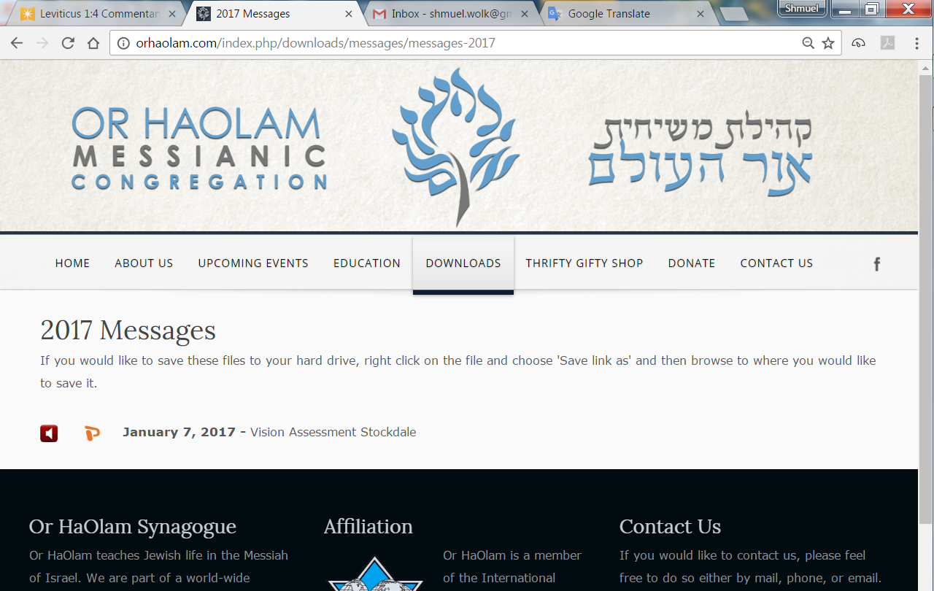

Slide 3
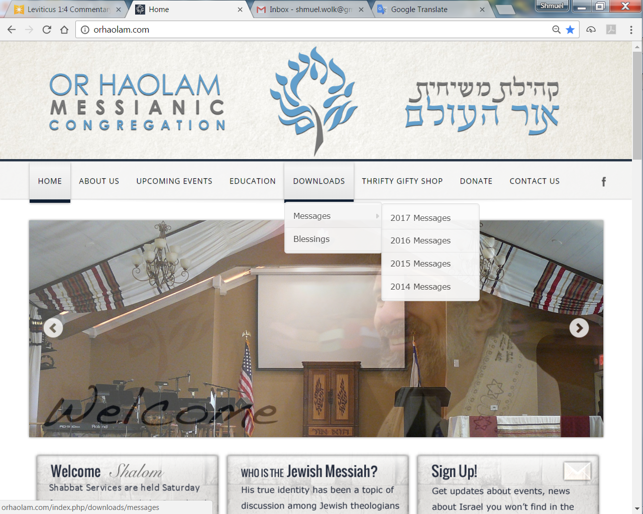
Downloads\messages\
2017 Messages

Slide 4
B’midbar בְּמִדְבַּר
(Numbers) 14:10-12
(from) Shelach l’kha (Send on your behalf) שְׁלַח-לְךָ
Notes:
Father’s day disclaimer: I know there are those who would like to be Dads, but single men, married men with no conception, Dads with estranged kids can hurt at these events. This is not meant to flaunt fatherhood, but rather encourage the older ones, and speak to the next gen.
Context: 12 spies just returned from Israel tour, but without the ac bus and 5 star hotels! With mostly negative report → great despair, anger, frustration by Israel. Except for Yehoshua and Calev. Brave, faith, joy, hope!

Slide 5
B’midbar (Numbers) 14:10a
יְיָ
ADONI
Notes:
רגם = stone [vb], so doubled, ‘with stones,’ intensified
Oo-k’vod That conjunction = BUT

Slide 6
B’midbar (Numbers) 14:10b
Notes:
In the tent of witness. It was above the tent, and in the Holy of Holies. Now close up and personal.
Torah doesn’t say the if, how, or why the commotion stopped. But then the dialogue went an entirely different direction. In verse 11 G is talking to Moshe about justice, vengeance, punishment. Why context change so entirely? Glory of G appeared. Timely. Maybe in response to repeated prayer.

Slide 7
T’hellim/Ps 90 [a prayer of Moshe]
יֵרָאֶה אֶל-עֲבָדֶיךָ פָעֳלֶךָ; וַהֲדָרְךָ, עַל-בְּנֵיהֶם.
Let Your work appear to Your servants, and Your glory on
their children.
הָדָר hadar glory, splendor, majesty
Notes:
We get consumed with the details, hopefully because we’re consumed with the vision.
פעל action, act, deed ; activity, operation
But, our children need to see the GLORY.

Slide 8
T’hellim/Ps 90
וִיהִי נֹעַם אֲדֹנָי אֱלֹהֵינוּ -- עָלֵינוּ:
Let the favor of the Adoni our
G-d be upon us.
נֹעַם Lovely, pleasant sweet, noam
Notes:
Do our children say that we are, in our spiritual walk: lovely, pleasant, sweet??
Or religious, strict, harsh, angry?
Pray that you can be accurately so viewed!
Pray daily! I do.

Slide 9
Establish the work of our hands for us—yes, establish the work of our hands.

Slide 10
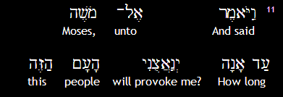
B’midbar (Numbers) 14:11a
יְיָ
ADONI

Slide 11
B’midbar (Numbers) 14:11b

Slide 12
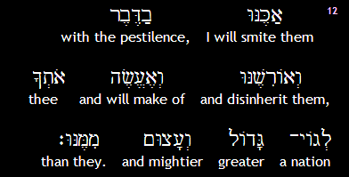
B’midbar (Numbers) 14:12
Notes:
Topic changes to prayer for mercy, and vindication of G-d’s Name and reputation.

Slide 13
מַתִּתְיָהוּ Mattityahu
(Matthew) 18:15-16
Notes:
Prev talking about not offending, then recovering the lost at great cost.
Continues about recovering the lost…

Slide 14
Mattityahu (Matthew) 18:15
אִם יֶחֱטָא לְךָ אָחִיךָ, לֵךְ וְהוֹכֵחַ אוֹתוֹ בֵּינְךָ וּבֵינוֹ לְבַד. אִם יִשְׁמַע לְךָ, קָנִיתָ לְךָ אֶת אָחִיךָ.
Moreover, if your brother commits a sin against you, go and show him his fault — but privately, just between the two of you. If he listens to you, you have won back your brother.

Slide 15
Mattityahu (Matthew) 18:16
וְאִם לֹא יִשְׁמַע, קַח אִתְּךָ עוֹד אֶחָד אוֹ שְׁנַיִם, כְּדֵי שֶׁ 'עַל-פִּי שְׁנַיִם אוֹ שְׁלוֹשָׁה עֵדִים יָקוּם כָּל דָּבָר'.
If he doesn't listen, take one or two others with you so that every accusation can be supported by the testimony of two or three witnesses.
Notes:
These are some of my favorite verses. Contained right in our Statement of Faith that many of you have signed on to. Membership class soon, for many more to enter into.
As on our website:

Slide 16
http://orhaolam.com/index.php/about/what-we-believe
8. I will practice the scriptural process, as needed, of conflict resolution. When a conflict arises, we will go to the individual in a loving, appreciative spirit, and try to get reconciliation.

Slide 17
If that fails, we will seek the help of the "one or two" intermediaries appointed by the elders. (Mattityahu 18:15–18)

Slide 18
How does this relate to Fathers, and to Father’s Day?

Slide 19
Role of a father is to build your kids up in G-dliness, by G-dly communication.

Slide 20
From Psychology Today [so grain of salt]
Most men have a hard time communicating anything that remotely resembles an emotion. Why? Because…men…think much more than they feel, and much of the time,
Notes:
https://www.psychologytoday.com/blog/emotional-fitness/201008/men-women-emotions-and-communication

Slide 21
many men don't even know what or how they are feeling.
It is interesting to note that women think and feel at the same time, while men can only think or feel.
Notes:
https://www.psychologytoday.com/blog/emotional-fitness/201008/men-women-emotions-and-communication
Take with a grain of salt, tentatively, not absolute. Point is, many men are much less communicative than their wives.
My marriage, role reversal most of the time.
“[Many] Guys figure that once they have said the fateful words, "I love you," and the relationship is in full swing there are only three reasons to have a real conversation: sex, money and breaking-up.”
However, our premier role model, Messiah:

Slide 22
^{Yn 1.1} In the beginning was the Word, and the Word was with God, and the Word was God.

Slide 23
From John Gill’s commentary:
God said, may Adoni the Son be called the word; also he was spoken of as the promised Messiah, throughout the whole Tanakh; and is the interpreter of his Father's mind,
Notes:
http://www.biblestudytools.com/commentaries/gills-exposition-of-the-bible/john-1-1.html

Slide 24
as he was in Eden's garden, as well as in the days of his flesh; and now speaks in heaven for the saints. The phrase memra, מימרא , "the word of the Lord", [is] so frequently used by the Targumists
Notes:
http://www.biblestudytools.com/commentaries/gills-exposition-of-the-bible/john-1-1.html

Slide 25
Vayikra/Lev 26:12 is paraphrased, by the Targum ascribed to Jonathan Ben Uzziel, thus;"I will cause the glory of my Shekinah to dwell among you, and my word shall "be your God", the Redeemer'
Notes:
http://www.biblestudytools.com/commentaries/gills-exposition-of-the-bible/john-1-1.html

Slide 26
Dvarim/Dt 26:17 is rendered by the Jerusalem Targum after this manner;``ye have made "the word of the Lord" king over you this day, that he may be your God:''
Notes:
http://www.biblestudytools.com/commentaries/gills-exposition-of-the-bible/john-1-1.html

Slide 27
Philo the Jew, who says, the name of God is his word, and calls him, my Lord, the divine word; and affirms, that the most ancient word is God .
Notes:
http://www.biblestudytools.com/commentaries/gills-exposition-of-the-bible/john-1-1.html

Slide 28
A primary identity of Messiah is Word, Davar, Memra, Logos
Communication
Radical statement:
A primary characteristic of a father is communication.
Notes:
English, Hebrew, Aramaic, Greek

Slide 29
Work to solve problems, bridge barriers, overcome difficulties.
Be there.
Notes:
Particularly important…

Slide 30
^{2 Tim 3.1-4} Understand this: in the akharit-hayamim [end of days] will come trying times. People will be self-loving, money-loving, proud, arrogant, insulting, disobedient to parents, ungrateful, unholy, heartless, unappeasable, slanderous, uncontrolled, brutal, hateful of good…loving pleasure
Notes:
Dangerous times

Slide 31
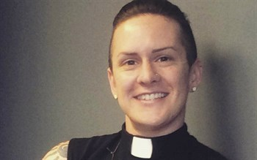
The Northern Illinois Conf.
of the UMC commissioned
the first UMC deacon
who openly identifies as neither
male nor female. The person,
who was born a woman, goes
by the name "M Barclay."
Notes:
https://www.onenewsnow.com/church/2017/06/15/umc-welcomes-a-non-gender-they-deacon?utm_source=OneNewsNow&utm_medium=email&utm_term=16787491&utm_content=323193037843968512&utm_campaign=29950
Can’t use the pronoun “he” or “she” nor “it” Must be “they” but with singular verb. My brother Glenn teaches at Berkeley HS, and uses this form of address regularly. This is the 21st century culture, in CA, at least. “As Calif. Goes, so goes the nation.”

Slide 32
non·bi·na·ry
not relating to, composed of, or involving just two things.
“Aristotelian ontology is nonbinary on the second level in that it allows for degrees of being”
A continuum of differences
Notes:
https://www.google.com/search?q=non+binary&rlz=1C1CHBF_enUS734US734&oq=non+binary&aqs=chrome..69i57.3197j0j7&sourceid=chrome&ie=UTF-8
This is the new term

Slide 33
non·bi·na·ry
denoting or relating to a gender or sexual identity that is not defined in terms of traditional binary oppositions such as male and female or homosexual and heterosexual.
Notes:
https://www.google.com/search?q=non+binary&rlz=1C1CHBF_enUS734US734&oq=non+binary&aqs=chrome..69i57.3197j0j7&sourceid=chrome&ie=UTF-8

Slide 34
Really not new. Greeks had hermaphrodite statues. Nudes with both male and female parts.
Many populations with alternative identities, such as hijras in South Asia, kathoeys in Thailand, and muxes in Mexico.
Notes:
Breasts and male parts. Not showing images, but you can google and see if you don’t believe it.
It’s all the Ro 1 culture… burn with passion. Some of us been there, and repented. BUT, DON’T despair…it’s to the Romans 1 culture context of the first great original Messianic awakening came.
https://www.google.com/search?q=hermaphrodite+statuary&safe=active&rlz=1C1CHBF_enUS734US734&tbm=isch&imgil=deBq5GHPSq41ZM%253A%253B2vMVREl01N1THM%253Bhttps%25253A%25252F%25252Fwww.pinterest.com%25252Fpin%25252F334321972314600057%25252F&source=iu&pf=m&fir=deBq5GHPSq41ZM%253A%252C2vMVREl01N1THM%252C_&usg=__uk_LamTjB1SjRNc8hda__mMQWFY%3D&biw=1164&bih=869&ved=0ahUKEwiG-Y_p0cLUAhWa2YMKHXPbDRcQyjcIPA&ei=sPNDWYbhDpqzjwTztre4AQ#q=hermaphrodite+statuary&safe=active&tbm=isch&tbs=rimg:CXXgauRhz0quIjg293T5iU7GY-HfdL1Oob0Kj3wd5oDbAfRHLpWqXm0ZxhG8jC4HsEfq8vPnx_1v2tizff1fkFQ2WQioSCTb3dPmJTsZjEeJts8SIqbFbKhIJ4d90vU6hvQoRHjpCQtL7UrQqEgmPfB3mgNsB9BGgdjq03VrmRioSCUculapebRnGETDd3CcB2oj8KhIJEbyMLgewR-oRK20Wdsrpq8IqEgny8-fH-_1a2LBGk8uV2pxLLWyoSCd9_1V-QVDZZCERwOLlghyxW7&imgrc=_yjLy3g5bgAj2M:
http://foreignpolicy.com/2014/06/30/third-gender-a-short-history/

Slide 35
What’s our answer? Relational love, joy, praise of King Messiah, worship, and proclamation.
Notes:
Father’s Day…you are a warrior of love and truth.

Slide 36
Notes:
http://www.drjamesdobson.org/blogs/the-fatherhood-challenge/the-fatherhood-challenge/2016/05/23/4-things-dads-should-do-every-day?sc=FEM&mc=FEM0617PAR&utm_source=SilverpopMailing&utm_campaign=20170614%20Parenting%20-%201%20Dads%20(FEM0617PAR)%20(3)&spMailingID=17446074&spUserID=MTk2NDM5NTE5MAS2&spJobID=1041000737&spReportId=MTA0MTAwMDczNwS2
Other dangers:

Slide 37
The D.C. shooter was a Facebook fan of the Southern Poverty Law Center (SPLC) which "had repeatedly implied that Scalise associated with white supremacists and other groups the organization had deemed 'hate groups'" and even linked Scalise with David Duke and the KKK in one of its publications.
Notes:
http://www.lc.org/newsroom/details/061517-dc-shooter-a-fan-of-the-southern-poverty-law-center-1
http://www.libertyaction.org/r.asp?U=779573&CID=201861&RID=49012226
So 66-year-old James. T. Hodgkinson was enraged by apparently bogus accusations. Could that happen to us?

Slide 38
Bernie Sanders said in a Congressional interview that a view that only certain people are going to heaven is racism and bigotry. Apparently, the government has mandated equal access to eternity.
Notes:
https://blogs.thegospelcoalition.org/justintaylor/2017/06/08/bernie-sanders-to-traditional-christians-your-beliefs-are-indefensibly-hateful-and-insulting-and-not-what-this-country-is-supposed-to-be-about/
I am not disrespecting the concept of equal access. We bought this building to give handicap access. But equal access to heaven is a Federal mandate according to Bernie!

Slide 39
This isn't the first time a connection can be drawn between a gunman who "liked" SPLC and the intentional targeting of conservatives. In 2012, a gunman attacked the Family Research Counsel after he "did a little research" on the SPLC website and found the Christian organization listed as a hate group.
Notes:
http://www.lc.org/newsroom/details/061517-dc-shooter-a-fan-of-the-southern-poverty-law-center-1
http://www.libertyaction.org/r.asp?U=779573&CID=201861&RID=49012226

Slide 40
What’s our answer? Love, joy, praise of King Messiah, worship, and proclamation.
Also a safety committee in formation.
Notes:
Also a safety committee in formation

Slide 41
This week, as several Maoz staff attended the FIRM's (Fellowship of Israel-Related Ministries) Jerusalem Encounter Conference, we witnessed some hatred as several young men "crashed" the place where the conference is being held through tonight. .
Notes:
MAOZ ISRAEL INTERCESSORS NETWORK LETTER No. 990 Thursday, June 15, 2017

Slide 42
With unimaginable anger in their eyes, they [Haredim/ultra-Orthodox] were shouting, "Yeshu [Yeshua] is dead!" and "We killed Yeshu!" They tried to disrupt the conference and they physically attacked a couple of people "accidentally" elbowed believers,
Notes:
MAOZ ISRAEL INTERCESSORS NETWORK LETTER No. 990 Thursday, June 15, 2017

Slide 43
"accidentally" took the table covers off the table, crashing everything that was on it, and spat on believers at the conference to name a few). The police had to be called and the havoc continued until
Notes:
MAOZ ISRAEL INTERCESSORS NETWORK LETTER No. 990 Thursday, June 15, 2017

Slide 44
one of the people brought out a loud speaker and blasted worship music, making all believers come together singing and dancing. It was a miracle to see how these boys, step by step, just left.
Notes:
MAOZ ISRAEL INTERCESSORS NETWORK LETTER No. 990 Thursday, June 15, 2017

Slide 45
Only when all believers there united in praise and worship did the conflict dissipate! What a power there is in unity!!!
Notes:
MAOZ ISRAEL INTERCESSORS NETWORK LETTER No. 990 Thursday, June 15, 2017

Slide 46
The same boys were back the next evening, but the conference organizers hired an outside security company and they were not allowed to come near.
Notes:
MAOZ ISRAEL INTERCESSORS NETWORK LETTER No. 990 Thursday, June 15, 2017

Slide 47
With worship music playing in the background for the entire duration of the second day, there was much less drama, and peace and joy were in abundance.
Notes:
MAOZ ISRAEL INTERCESSORS NETWORK LETTER No. 990 Thursday, June 15, 2017
Beth Yeshua in Philly did the same some decades ago when they first started in their current building. Worship music, dance, praise, food.

Slide 48
Derek Prince writes
Notes:
https://books.google.com/books?id=yP71BgAAQBAJ&pg=PT58&lpg=PT58&dq=derrick+prince+and+the+Scottish+doctor+and+the+tongue&source=bl&ots=7v7NUTCAt1&sig=fEoIPUBEQN--ypkvLuG-b8SG86g&hl=en&sa=X&ved=0ahUKEwjwkIHynMPUAhUM0IMKHVslAxcQ6AEIKzAA#v=onepage&q=derrick%20prince%20and%20the%20Scottish%20doctor%20and%20the%20tongue&f=false

Slide 49
Here the tongue showed the yellow, pasty coating, the yellow skin, full veins, and full ... Where the tongue presents a yellowish or bluish color, with a dirty, moist ..
Notes:
https://books.google.com/books?id=HglMAAAAMAAJ
Kinzer, Taming the Tongue p 1, 10

Slide 50
^{Mishlei/Prov 12.18} Idle talk can pierce like a sword, but the tongue of the wise can heal.
^{Mishlei/Prov 18.21} The tongue has power over life and death; those who indulge it must eat its fruit.
Notes:
Kinzer p 22

Slide 51
^{Vayikra/Lev 19.16-18}‘Do not go around spreading slander among your people, but also don’t stand idly by when your neighbor’s life is at stake; I am Adoni. “‘Do not hate your brother in your heart, but rebuke your neighbor frankly,
Notes:
Shalom Arush teaches that most of us are NOT worthy to rebuke our neighbor, since we can’t do it without anger, demeaning, negativity. [Let me repeat]
Shalom Arush teaches that most of us are NOT worthy to rebuke our neighbor, since we can’t do it without anger, demeaning, negativity.
Did I say this??
Most of us guys are NOT worthy to rebuke our neighbor, since we can’t do it without anger, demeaning, negativity.

Slide 52
^{Vayikra/Lev 19.16-18} so that you won’t carry sin because of him. Don’t take vengeance on or bear a grudge against any of your people; rather, love your neighbor as yourself; I am Adoni.

Slide 53
Men, what do we model?

Slide 54
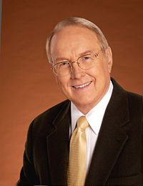
Dr. James
Dobson
reports

Slide 55
Among my favorites are recollections of my daughter, Danae, when she was five years old. We used to take bike trips together to a nearby park. We would play in a sandbox with shovels and buckets. I taught her to build sand castles, explained what a moat and a drawbridge were, and talked about anything else that seemed to interest her.

Slide 56
Then we would go to a nearby taco stand and have lunch before riding home. On the way back, we listened every week to a favorite recording of Rodgers and Hammerstein’s Cinderella on a small Craig recorder, and we sang the songs together. Danae loved those outings, and she can tell you in detail about them today. And guess what? I loved them too.

Slide 57
Our son, Ryan, and I had our fun adventures together too. When he was three years old, I would hide his stuffed bears, lions, deer, and giraffes around the house. Then when it was dark, we’d take my flashlights and his toy guns,

Slide 58
and we would creep around on a big game hunt. When he was twelve, we began hunting and fishing together for real. I will never forget those days in the great out-of-doors with my only son. We still hunt together today.

Slide 59
From where I sit today, I can say that nothing, and I mean nothing, from that era turned out to be more significant than the hours I spent with my little family. The relationships we enjoy today were nurtured during those years.

Slide 60
What’s our answer? Love, joy, praise of King Messiah, worship, and proclamation.
Also a safety committee in formation.
Notes:
Also a safety committee in formation

