Slide 1
e-handout
To have these notes
without taking notes
Go to OrHaOlam.com
Click on downloads,
messages, 2018
Notes:
.

Slide 3
Israeli Handheld Device Kills Head Lice With Ultrasonic Waves: Israeli start-up ParaSonic has developed a hand-held device that uses ultrasound technology to kill head lice and their eggs in a treatment that takes minutes.

Slide 4
Pesticide shampoos and fine-tooth combs are the only current treatments. The new device sends extremely low-intensity ultrasonic waves through the hair, said Michael Kardosh, ParaSonic VP for Technology. "We found a single frequency that applies to both the eggs [nits] and the lice."

Slide 5
The company says the ultrasound technology is safe for use with children and it has already been approved for use in the USA. Its trials show 95% efficiency and the product will launch in mid-2019. (Reuters)

Slide 6
wait for Lice killing by Ultrasound

Slide 7
Backup for lice killing
https://youtu.be/vJoCb1GyiwY

Slide 9
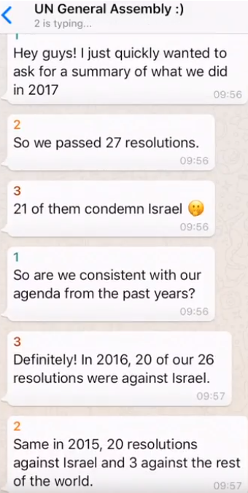
World’s view of
Israel [Summary
By Calev MYERS,
Jerusalem
Institute of
Justice]:
Notes:
In a YouTube, but it goes somewhat fast.

Slide 10
Calev Myers on the UN and Israel

Slide 11
Back up link on Israel and the UN:
https://www.youtube.com/watch?v=-o5Aweqc4Ns&feature=youtu.be

Slide 12
Nov 20, 2018 Pasco County, Fl [just north of Tampa] -- Pasco County Public School administrators have threatened a male P.E. teacher who had a conscience-based objection to supervising a gender-confused girl who has full access to disrobe and even shower in the boys’ locker room and open showers.
Notes:
https://www.lc.org/newsroom/details/112018-male-teacher-will-not-supervise-girl-in-shower

Slide 13
Administrators tried to force the male teacher to directly supervise and observe the girl while showering naked in the boys’ open shower. The girl remains free to enter the boys’ locker room and open showers at any time.
Notes:
https://www.lc.org/newsroom/details/112018-male-teacher-will-not-supervise-girl-in-shower

Slide 14
According to the male coach, the school district lawyer warned him, “you know this might cost you your job.” “Your teacher certificate might be taken from you, to where you can no longer teach.”
Notes:
https://www.lc.org/newsroom/details/112018-male-teacher-will-not-supervise-girl-in-shower
Other side says this is hype, since the showers aren’t used in any case. For how long?
The Massachusetts Gender Identity Anti-Discrimination Initiative is a state-wide referendum passed by Massachusetts voters in the November 2018 mid-term election that prohibits discrimination in public accommodations on the basis of gender identity

Slide 15
מַתִּתְיָהוּ Mattityahu
(Matthew) 25:19-21
Notes:
Previously: customized, specialized, HUGE gifts “You are wealthy, I am wealthy!”
How to use your vast gift for max reward??

Slide 16
Mattityahu (Matthew) 25:19
אַחֲרֵי זְמַן רַב בָּא הָאָדוֹן שֶׁל הָעֲבָדִים הָהֵם וְעָרַךְ עִמָּהֶם חֶשְׁבּוֹן.
“After a long time, the master of those servants returned to settle accounts with them.
Notes:
Long time. 2000 years! Early followers of Y thought imminent, then in 70,.
1969 thought imminent. Jews retook Jerusalem. Lk 21, Gentile age over…
Years went by. I still believe in Messiah’s Return, but…
Great scene from movie, Prince of Egypt that illustrates LOOOOOONG time.

Slide 17
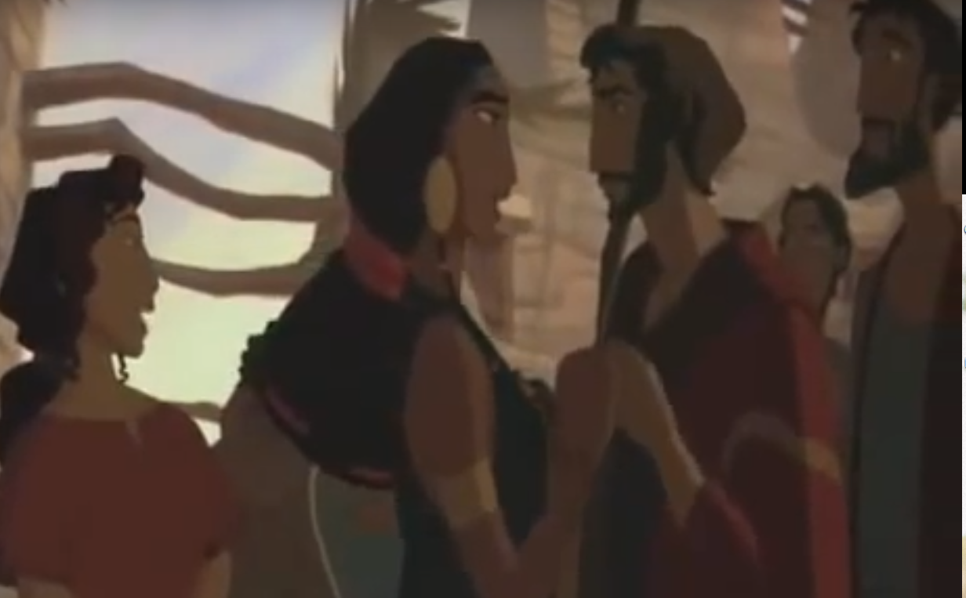
Prince of
Egypt movie
Miriam encouraging Moshe
Notes:
https://www.youtube.com/watch?v=smSY6P7QBLk

Slide 18
Many nights we've prayed With no proof anyone could hear In our hearts, a hopeful song We barely understood
400 years: good life → enslavement
Notes:
Ever feel that way? Praying…accomplishing anything??
They prayed, and things got worse. Our 40 days…

Slide 19
Now we are not afraid, Although we know there's much to fear. G-d was moving mountains long Before we knew He could…
Notes:
So, after a long time

Slide 20
Mattityahu (Matthew) 25:19
אַחֲרֵי זְמַן רַב בָּא הָאָדוֹן שֶׁל הָעֲבָדִים הָהֵם וְעָרַךְ עִמָּהֶם חֶשְׁבּוֹן.
“After a long time, the master of those servants returned to settle accounts with them.

Slide 21
Mattityahu (Matthew) 25:20
כַּאֲשֶׁר נִגַּשׁ זֶה שֶׁקִּבֵּל חָמֵשׁ כִּכָּרִים הֵבִיא חָמֵשׁ כִּכָּרִים נוֹסָפוֹת וְאָמַר, נוֹסָפוֹת‘.
“The one who had received five talents came forward bringing the other five and said,

Slide 22
Mattityahu (Matthew) 25:20
’אֲדוֹנִי, חָמֵשׁ כִּכָּרִים הִפְקַדְתָּ בְּיָדִי, הִנֵּה הִרְוַחְתִּי חָמֵשׁ כִּכָּרִים נוֹסָפוֹת‘.
‘Sir, you gave me five talents; here, I have made five more.’
Last week calculated: $5 million
MJ Literal Trans: 5 decades’ worth of wages.

Slide 23
Mattityahu (Matthew) 25:21
הֵשִׁיב לוֹ אֲדוֹנָיו, ’יָפֶה, עֶבֶד טוֹב וְנֶאֱמָן! הָיִיתָ נֶאֱמָן בִּמְעַט
“His master said to him, ‘Excellent! You are a good and trustworthy servant. You have been faithful with a small amount,
Notes:
Bit of an aside…

Slide 24
Yeshua used phraseology common for the evaluation of slaves in the Talmud….
Notes:
Yeshua thought in the language forms of His people. Thinking Hebraic even tho writing is Greek.

Slide 25
﻿^{Talmud - Mas. Berachoth 16b} For male and female slaves no funeral oration is said. R. Jose said: If he was a good slave, they can say over him, Alas for a good and faithful man, who worked for his living!
﻿ הוי איש טוב ונאמן ונהנה מיגיעו!

Slide 26
Mattityahu (Matthew) 25:21
אַפְקִיד אוֹתְךָ עַל הַרְבֵּה. בּוֹא אֶל שִׂמְחַת אֲדוֹנְךָ‘.
so I will put you in charge of a large amount. Come and join in your master’s happiness!”

Slide 27
^{Mattityahu (Matthew) 25:22-23} Also the one who had received two came forward and said, ‘Sir, you gave me two talents; here, I have made two more.’ His master said to him,

Slide 28
^{Mattityahu (Matthew) 25:22-23} ‘Excellent! you are a good and trustworthy servant. You have been faithful with a small amount, so I will put you in charge of a large amount. Come and join in your master’s happiness!’

Slide 29
Observations:
Same exact words of commendation for the $5,000,000 and the $2,000,000
Reward is for ‘a good and trustworthy servant עֶבֶד טוֹב וְנֶאֱמָן'
Notes:
Jealousy is pointless. You can get the same reward as Paul Wilbur, Jonathan Bernis, shakers and movers, Joseph Rabinowitz [who?]
What are you and I entrusted with?

Slide 30
Reward is twofold:
More responsibility
Enter into Master’s Happiness
Notes:
Unpack all that. Consider the words of the word. If any heritage of attendance at Or HaOlam, attendance = pay attention words of the Word. After all, Messiah Yeshua is the Word, Logos, Davar, Memra. Love the Word and the words. When the Torah is carried around the room, it is a representation of Messiah walking through the congregation.

Slide 31
עֶבֶד טוֹב וְנֶאֱמָן Eved tov v’ne-e-man
נֶאֱמָן adj
loyal, faithful, devoted ; reliable, trustworthy ; true to

Slide 33
πιστέ (piste) faithful, reliable, trustworthy, faithful, believing (loyalty to faith; literally, fullness of faith); typically, of believing the faith God imparts.
Parallel usages
Notes:
https://biblehub.com/greek/4103.htm

Slide 34
^{Rev. 2.10} Do not fear what you are about to suffer. Behold, the devil is about to throw some of you into prison, so that you may be tested, and you will have tribulation for ten days. Be faithful until death, and I will give you the crown of life.

Slide 35
^{Rev.14.9-12} Another angel, a third one, followed them and said in a loud voice, “If anyone worships the beast and its image and receives the mark on his forehead or on his hand, he will indeed drink the wine of God’s fury poured undiluted into the cup of his rage..

Slide 36
^{Rev.14.9-12} He will be tormented by fire and sulfur before the holy angels and before the Lamb, and the smoke from their tormenting goes up forever and ever…This is when perseverance is needed on the part of God’s people, those who observe his commands and exercise Yeshua’s faithfulness.
Notes:
Drinking in Yeshua’s faithfulness

Slide 37
^{ASV} Here, moreover, it is required in stewards, that a man be found faithful.
^{Holman} It is expected of managers that each one be found faithful.
^{Good News} The one thing required of such servants is that they be faithful to their master.

Slide 38
^{Mt 25.23} You have been faithful with a small amount, so I will put you in charge of a large amount.
Notes:
Getting the point: Hang in there. Attention to tasks. Do. Pray, love serve.

Slide 39
^{Lk 16.11} So if you haven’t been trustworthy in handling worldly wealth, who is going to trust you with the real thing?
Notes:
Further reasons for faithfulness…

Slide 40
^{Hag 2. 8} “The silver is mine, and the gold is mine,” says Adoni-Tzva’ot.
^{T’hillim / Ps 50 10-11} All forest creatures are mine already, as are the animals on a thousand hills; I know all the birds in the mountains; whatever moves in the fields is mine.
Notes:
Insights from BlaineRobison.com
G-d owns everything

Slide 41
^{T’hillim / Ps 24.1} The earth is Adoni’s, with all that is in it.
^{Dvarim 8.18} Remember Adoni your God, because it is he who is giving you the power to get wealth.

Slide 42
^{1 Tim 4.4} For everything created by God is good, and nothing received with thanksgiving needs to be rejected, because the word of God and prayer make it holy.

Slide 43
Nissan Chairman Carlos Ghosn gon, one of the auto industry's most high-profile executives, has been arrested, Monday, Nov. 19, 2018, in Japan for understating his income in financial reports and misusing company assets.
Net worth: $100 Million
Salary: $17 Million
Notes:
https://www.cnn.com/2018/11/19/business/carlos-ghosn-nissan-renault/index.html
Net worth: $100 Million Carlos Ghosn's Salary: $17 Million

Slide 44
"Nissan was something else entirely," Ghosn said, “Either we'd turn the business around or Nissan would cease to exist.” He was made CEO ALSO of Renault in 2005, becoming the first executive to run two Fortune Global 500 companies simultaneously.
Notes:
https://www.cnn.com/2018/11/19/business/carlos-ghosn-nissan-renault/index.html

Slide 45
Ultimately, he was responsible for production of one of every nine cars sold in the world.
Now he is being held at a detention center, where prisoners are typically fed basic rations of rice and miso soup.
Notes:
https://www.cnn.com/2018/11/22/business/carlos-ghosn-nissan-board/index.html
Net worth: $100 Million
Salary: $17 Million

Slide 46
^{Mattityahu (Matthew) 25:22-23} ‘Excellent! you are a good and trustworthy servant. You have been faithful with a small amount, so I will put you in charge of a large amount. Come and join in your master’s happiness!’
Notes:
Ghosn messed up with a relatively small amount…

Slide 47
Reward is twofold:
More responsibility
Enter into Master’s Happiness
Two criteria for reward:
Commitment to vision
Gratitude & Joy in the pursuit
Notes:
Master’s Happiness: banquet, eye contact 6x/sec exchange of dopamine rush.
Task joy, relational joy
How do these combine: 7 illustrations!
Thanksgiving weekend: good time to consider the value of gratitude.

Slide 48
Mat 2.9-10 After listening to the king, they went their way. And behold, the star they had seen in the east went on before them, until it came to rest over the place where the Child was. When they saw the star, they rejoiced exceedingly with great gladness.
Notes:
Apparently lost, or doubted their vision. Found it again.
Vision + Presence → GREAT JOY
On task, but with joy!

Slide 49
^{Dvarim/Dt 28.45-47} “All these curses will come upon you and pursue you and overtake you until you are destroyed — because you did not listen to the voice of Adoni your God, to keep His mitzvot and statutes that He commanded you…Instead of serving Adoni your God with joy and goodness of heart, out of the abundance of everything,

Slide 50
Two criteria for reward:
Commitment to vision
Gratitude & Joy in the pursuit
Task joy, relational joy
1. Thanksgiving holiday history
Notes:
Send me a testimony of praise, thanksgiving

Slide 51
The Pilgrims were a group of Separatists who broke away from the Church of England in an effort to return to a more biblically based way of life. They immigrated to Holland, where they enjoyed a greater degree of religious freedom but faced a host of other economic and social difficulties. After about a
Notes:
https://drjamesdobson.org/news/commentaries/archives/2018/november-newsletter-2018-em?sc=FEM&mc=FEM1118NL&utm_source=SilverpopMailing&utm_campaign=20181119%20-%20November%20Newsletter%20(FEM1118NL)%20(3)&spMailingID=20591000&spUserID=MTk2NDM5NTE5MAS2&spJobID=1381318796&spReportId=MTM4MTMxODc5NgS2

Slide 52
decade, they returned to England and resolved to set sail for the New World. On September 16, 1620, 102 passengers boarded the Mayflower with the hope of finding religious freedom and a better way of life.
Notes:
https://drjamesdobson.org/news/commentaries/archives/2018/november-newsletter-2018-em?sc=FEM&mc=FEM1118NL&utm_source=SilverpopMailing&utm_campaign=20181119%20-%20November%20Newsletter%20(FEM1118NL)%20(3)&spMailingID=20591000&spUserID=MTk2NDM5NTE5MAS2&spJobID=1381318796&spReportId=MTM4MTMxODc5NgS2

Slide 53
Hundreds of miles north of their original destination of Virginia, the Mayflower dropped anchor at what is now Provincetown, Massachusetts, on November 21. In December, they made their way across the bay to settle at Plymouth. As they looked out at the gray, windswept coast on that cold November day, many of the Pilgrims must have wondered if it really was God's will for them to relocate to this desolate land.
Notes:
https://drjamesdobson.org/news/commentaries/archives/2018/november-newsletter-2018-em?sc=FEM&mc=FEM1118NL&utm_source=SilverpopMailing&utm_campaign=20181119%20-%20November%20Newsletter%20(FEM1118NL)%20(3)&spMailingID=20591000&spUserID=MTk2NDM5NTE5MAS2&spJobID=1381318796&spReportId=MTM4MTMxODc5NgS2

Slide 54
That first harsh winter was devastating to the men, women, and children who had already traveled far and sacrificed so much. Poor nutrition, inadequate housing, and the unforgiving winter took their toll. Many died. The new year brought more of the same. Eight perished in January, and 17 in February. By the time spring descended on the North Atlantic coast, nearly half of the original group was gone.
Notes:
https://drjamesdobson.org/news/commentaries/archives/2018/november-newsletter-2018-em?sc=FEM&mc=FEM1118NL&utm_source=SilverpopMailing&utm_campaign=20181119%20-%20November%20Newsletter%20(FEM1118NL)%20(3)&spMailingID=20591000&spUserID=MTk2NDM5NTE5MAS2&spJobID=1381318796&spReportId=MTM4MTMxODc5NgS2

Slide 55
Christopher Jones, the captain of the Mayflower, anchored his ship in the harbor throughout the winter. He felt so sorry for the settlers that he allowed many from the colony to take refuge in the hull of his ship since shelter was scarce and the winter was so fierce.
Notes:
https://drjamesdobson.org/news/commentaries/archives/2018/november-newsletter-2018-em?sc=FEM&mc=FEM1118NL&utm_source=SilverpopMailing&utm_campaign=20181119%20-%20November%20Newsletter%20(FEM1118NL)%20(3)&spMailingID=20591000&spUserID=MTk2NDM5NTE5MAS2&spJobID=1381318796&spReportId=MTM4MTMxODc5NgS2

Slide 56
Finally, on April 5, 1621, he decided that he'd had enough, and resolved to return home. I can imagine him standing before his weary passengers imploring, "You must return to England with me. You are dying. Look at the graves up there on the sandy hill. More than half who came are now dead. It's time to go back."
Notes:
https://drjamesdobson.org/news/commentaries/archives/2018/november-newsletter-2018-em?sc=FEM&mc=FEM1118NL&utm_source=SilverpopMailing&utm_campaign=20181119%20-%20November%20Newsletter%20(FEM1118NL)%20(3)&spMailingID=20591000&spUserID=MTk2NDM5NTE5MAS2&spJobID=1381318796&spReportId=MTM4MTMxODc5NgS2

Slide 57
Not one of those remaining settlers left with Captain Jones when he set sail that day. Each one of them felt the call of God deep within his or her heart, and as a group, they refused to go back. Undoubtedly, they were afraid, and they probably didn't have a lot of optimism
Notes:
https://drjamesdobson.org/news/commentaries/archives/2018/november-newsletter-2018-em?sc=FEM&mc=FEM1118NL&utm_source=SilverpopMailing&utm_campaign=20181119%20-%20November%20Newsletter%20(FEM1118NL)%20(3)&spMailingID=20591000&spUserID=MTk2NDM5NTE5MAS2&spJobID=1381318796&spReportId=MTM4MTMxODc5NgS2

Slide 58
about the uncertain future lying before them. But, in essence, they said, "We would rather die here and remain true to what our Lord has called us to do than to turn our backs on Him and return to the warm hearth of England.“
Celebrate the next Fall: Thanksgiving: Task with joy!
Notes:
https://drjamesdobson.org/news/commentaries/archives/2018/november-newsletter-2018-em?sc=FEM&mc=FEM1118NL&utm_source=SilverpopMailing&utm_campaign=20181119%20-%20November%20Newsletter%20(FEM1118NL)%20(3)&spMailingID=20591000&spUserID=MTk2NDM5NTE5MAS2&spJobID=1381318796&spReportId=MTM4MTMxODc5NgS2
Great heritage of America! Task plus gratitude. If time, gratitude at close, or else email me, admin@OrHaOlam.com

Slide 59
Two criteria for reward:
Commitment to vision
Gratitude & Joy in the pursuit
Task joy, relational joy
2. Freedom from pornography.
Notes:
Send me a testimony of praise, thanksgiving

Slide 60
Dr. Kleponis said, "Often people who are enslaved by pornography addiction only see the problems with their lives. They are trapped in a cycle of negativity and pessimism. They live with bitterness, resentment and feel unworthy of receiving anything good in their lives, especially love."
Notes:
https://www.charismanews.com/opinion/74120-the-real-reason-you-can-t-quit-porn-has-nothing-to-do-with-sex?utm_source=Charisma%20News%20Daily&utm_medium=email&utm_content=subscriber_id:5160390&utm_campaign=CNO%20daily%20-%202018-11-20

Slide 61
He continued, "Overcoming this mindset is crucial for healthy recovery. To do this, people in recovery need to live their lives with gratitude. Every day, they need to take time to acknowledge all the ways they are blessed and be thankful for them. Keeping a gratitude list can help with this.
Notes:
https://www.charismanews.com/opinion/74120-the-real-reason-you-can-t-quit-porn-has-nothing-to-do-with-sex?utm_source=Charisma%20News%20Daily&utm_medium=email&utm_content=subscriber_id:5160390&utm_campaign=CNO%20daily%20-%202018-11-20

Slide 62
Try taking a few minutes every day to write down the people, things, events and situations in your life for which you are grateful. Then take a few minutes to read through your entire list and thank God for all your blessings."
Notes:
https://www.charismanews.com/opinion/74120-the-real-reason-you-can-t-quit-porn-has-nothing-to-do-with-sex?utm_source=Charisma%20News%20Daily&utm_medium=email&utm_content=subscriber_id:5160390&utm_campaign=CNO%20daily%20-%202018-11-20

Slide 63
Being aware of all the things you have to be thankful for will help keep you from relapsing. Focusing on all the good things God blesses you with will encourage you when temptations come your way.
Notes:
https://www.charismanews.com/opinion/74120-the-real-reason-you-can-t-quit-porn-has-nothing-to-do-with-sex?utm_source=Charisma%20News%20Daily&utm_medium=email&utm_content=subscriber_id:5160390&utm_campaign=CNO%20daily%20-%202018-11-20

Slide 64
Amy Morin wrote in Forbes that "Gratitude may be one of the most overlooked tools that we all have access to every day. Cultivating gratitude doesn't cost any money and it certainly doesn't take much time, but the benefits are enormous."
Notes:
https://www.charismanews.com/opinion/74120-the-real-reason-you-can-t-quit-porn-has-nothing-to-do-with-sex?utm_source=Charisma%20News%20Daily&utm_medium=email&utm_content=subscriber_id:5160390&utm_campaign=CNO%20daily%20-%202018-11-20

Slide 65
Two criteria for reward:
Commitment to vision
Gratitude & Joy in the pursuit
Task joy, relational joy
3. Family tensions
Notes:
Send me a testimony of praise, thanksgiving

Slide 66
Chris & Jen Coursey, coming Mar. 9
Notes:
https://thrivetoday.org/change-the-course-of-your-morning/
Mar. 9, Chris Coursey presents Thrive: True Identity https://thrivetoday.org/

Slide 67
Relational circuits are a specific part of our physical brain that, when functioning and working, help us feel connected with people. We have the desire to connect. When our relational circuits are dimmed or off, we lose our desire for connection and we no longer experience joy with the people around us.
Notes:
https://thrivetoday.org/the-brains-relational-real-estate/

Slide 68
Change the Course of Your Morning
Notes:
https://thrivetoday.org/change-the-course-of-your-morning/

Slide 69
It was a rough morning. My crew overslept. We woke up grumpy. From the moment our feet touched the floor we were running late. This is not how I planned to start my day. Can you relate?
Notes:
https://thrivetoday.org/change-the-course-of-your-morning/

Slide 70
When we finally made it out the door and climbed into the car, the boys began snapping at each other. I started barking at them to stop. It was clear our relational circuits were OFF. Once I recognized this, I announced that we needed to take a few moments of quiet to turn on our relational circuits. After some quiet and calm, I shared that it was time for a bit of appreciation.
Notes:
https://thrivetoday.org/change-the-course-of-your-morning/

Slide 71
However, when we are relationally sinking and we need appreciation to stay afloat, it is these moments that the boys do not feel like practicing the exercise. I must get a little creative and this morning required serious creativity.
Notes:
https://thrivetoday.org/change-the-course-of-your-morning/

Slide 72
At this stage of life my boys believe that going first on just about any activity is the most important thing in the whole world. They do not like going last. On this particular morning, I decided to use this information to my advantage. I announced we were going to share appreciation, however, this time it was my turn to go first.
Notes:
https://thrivetoday.org/change-the-course-of-your-morning/

Slide 73
Andrew jumped in and responded that I should go last because he wanted to go first. Next, Matthew quipped that he was not going to participate. I announced that I was glad Matthew wasn’t participating because it meant I could share next.
Notes:
https://thrivetoday.org/change-the-course-of-your-morning/

Slide 74
As you can imagine, this provoked a response from Matthew. He said, “No, you have to go last! I am sharing now!” then he launched into his own appreciation. When my turn finally arrived, the tone in the car was lighter. We were all laughing and giggling.
Notes:
https://thrivetoday.org/change-the-course-of-your-morning/

Slide 75
I dropped them off at school with a full bucket of joy instead of an empty bucket where they would feel depleted.
Notes:
https://thrivetoday.org/change-the-course-of-your-morning/

Slide 76
Two criteria for reward:
Commitment to vision
Gratitude & Joy in the pursuit
Task joy, relational joy
4. Counseling impossible transformation
Notes:
Send me a testimony of praise, thanksgiving

Slide 77
When I counsel those struggling with homosexual attraction, one of the first things I want them to do is trust God. It is not unusual for me to tell such a person, “It is time to gaze upon God’s faithfulness not your own.”
Notes:
Jeremy Lelek https://www.biblestudytools.com/blogs/association-of-biblical-counselors/3-powerful-gospel-truths-for-addressing-homosexuality.html

Slide 78
[Yeshua] knows the burden of sexual temptation, and He has profound sympathy for anyone whose hearts are captured by this issue (Heb. 2:17–18; 4:14–15). He is also committed to saving and transforming His own so that they reflect children of glory (Rom. 8:28-29; 1 Thess. 4:3).
Notes:
Jeremy Lelek https://www.biblestudytools.com/blogs/association-of-biblical-counselors/3-powerful-gospel-truths-for-addressing-homosexuality.html

Slide 79
Two criteria for reward:
Commitment to vision
Gratitude & Joy in the pursuit
Task joy, relational joy
5. Zionist pioneer

Slide 81
Born in Lithuania in 1858, Ben Yehuda, the youngest in his family, learned the Hebrew Scriptures on his father’s knee. He loved spending time with his father, and with a phenomenal mind, at the age of four he already knew significant portions of the Torah, the Talmud, and commentaries by heart.
Notes:
https://www.yeshuaisrael.com/father-of-the-modern-hebrew-language-part-1/
Age 4, his father died of TB. He was passed around to religious boarding schools.

Slide 82
At one academy, his favorite Rabbi slipped him a rare book that was not religious, but translated into Hebrew—“Robinson Crusoe.” It was that book that ignited his belief that Hebrew could be a living language once again.
Notes:
https://www.yeshuaisrael.com/father-of-the-modern-hebrew-language-part-1/

Slide 83
In his memoirs he wrote, “I fell in love with the Hebrew tongue as a living language. This love was a great and all-consuming fire that the torrent of life could not extinguish.” The next step came when he was slipped a short volume of Hebrew grammar by his favorite Rabbi who had dared to taste of non-religious books.
Notes:
https://www.yeshuaisrael.com/father-of-the-modern-hebrew-language-part-1/
His ultra-religious uncle with whom he lived was horrified that his nephew was straying into areas outside rabbinical literature, and in a rage, threw the 14-year-old boy out of his house, telling him never to return. He wandered and fell asleep in a synagogue. A Jewish businessman, Solomon Jonas—more secular than traditional—approached him and invited him to his home.

Slide 84
Jonas’ daughter, Devora, was enlisted to teach him Russian and French—required for the state school. He taught himself mathematics and biology by reading books in his newfound languages.

Slide 85
Among the important events that lit a fire in this visionary was a rising “nationalist” movement among different peoples who wanted their own country. He saw how the Bulgarians were rebelling against their rulers, the Turkish Ottoman Empire,
Notes:
https://www.yeshuaisrael.com/father-of-the-modern-hebrew-language-part-1/

Slide 86
“Suddenly, as if lightning struck, an incandescent light radiated before my eyes…and I heard a strange inner voice calling to me: ‘The revival of Israel and its language on the land of the forefathers!’ This was the dream.”
Notes:
https://www.yeshuaisrael.com/father-of-the-modern-hebrew-language-part-1/

Slide 87
He then read a unique and controversial book by the famous author George Eliot in 1876, calling for a homeland for the Jewish people. That was the deciding factor that crystalized his mission for life.
Notes:
https://www.yeshuaisrael.com/father-of-the-modern-hebrew-language-part-1/

Slide 88
Let us therefore, revive the language and plant it in the mouths of our youths and they will never betray it — but we shall not be able to revive the Hebrew language except in the land where the Hebrews form a majority of the inhabitants. Let us therefore, increase the number of Jews in our desolate land;
Notes:
https://www.yeshuaisrael.com/father-of-the-modern-hebrew-language-part-1/

Slide 89
let us return the remnant of our people to the land of their forefathers; let us bring back to life the nation—and the language will live, too! If we revive the nation and return it to its land—the Hebrew shall live, too! For in the end, this is the only path to final redemption—and without that redemption we are lost, lost forever.
Notes:
https://www.yeshuaisrael.com/father-of-the-modern-hebrew-language-part-1/

Slide 90
Sadly, Eliezer knew he must terminate his relationship with Devora Jonas, the love of his life. As a man with tuberculosis, he might die at any time, or worse, pass the disease onto a wife. Anyway, he would not be able to support a wife and family. He wrote a letter to Solomon Jonas, the father of Devora, and explained that though for years he had planned to marry Devora, he now released her because of his sickness.
Notes:
https://www.yeshuaisrael.com/father-of-the-modern-hebrew-language-part-1/

Slide 91
But when Solomon broke the news to Devora, she would not hear of it. She told her parents that she was going to marry Eliezer! She had waited for seven years to marry him and nothing was going to stop her now. Amazingly, her father finally acquiesced.
Notes:
https://www.yeshuaisrael.com/the-first-hebrew-family/

Slide 92
He saw the love she had for her man. They arranged for her to meet Eliezer who would be in Vienna a week before he left for Jerusalem, and in two days she was smuggled out of Russia without a passport.
Notes:
https://www.yeshuaisrael.com/the-first-hebrew-family/

Slide 93
He told his wife-to-be, “Devora, you are going to be the first Hebrew mother in nearly two thousand years. Our child will be the first infant in all these centuries who will come into the world hearing nothing but the beauty of our ancient language!”
Notes:
https://www.yeshuaisrael.com/the-first-hebrew-family/

Slide 94
And then came reality. He told her there were certain conditions to the success of his life’s mission. His words to Devora went something like this: “I must ask you, dear Devora, that from now on you shall speak only Hebrew.
Notes:
https://www.yeshuaisrael.com/the-first-hebrew-family/

Slide 95
We must set an example for our people, for those who would come after us. Hebrew must live again! It must become more than just a language of literary exercise! We must run our home in Hebrew, bring up our children in Hebrew, make love in Hebrew—and if we fight and argue, even that we must do in Hebrew.”
Notes:
https://www.yeshuaisrael.com/the-first-hebrew-family/

Slide 96
She answered, “But I really don’t know any Hebrew, dear!” He insisted, “Until you do—keep quiet in Hebrew.” On the spot, while still in Europe, he began teaching her words in Hebrew. This is a “tree,” a “window,” a “street,” a “lantern.”
Notes:
https://www.yeshuaisrael.com/the-first-hebrew-family/
They had a son, called Ben Zion, to whom they ONLY spoke Hebrew.

Slide 97
The boy was almost four—and completely mute! She thought back to her own childhood in Russia, and without thinking, began singing a lullaby to her child in Russian, tears running down her face.
Notes:
https://www.yeshuaisrael.com/the-first-hebrew-family/

Slide 98
As fate would have it, just at that moment, Eliezer entered the house and found his wife singing this Russian song to Ben Zion. Furious, he began shouting at her. Devora, not realizing she had been singing in Russian
Notes:
https://www.yeshuaisrael.com/the-first-hebrew-family/

Slide 99
was confused at his outburst and not able to answer. She cried in silence, and Ben Zion, wanting to come to his mother’s help, shouted, אבא אבא לא
“Abba, Abba, lo!” (Father, father, no!)
Notes:
https://www.yeshuaisrael.com/the-first-hebrew-family/

Slide 100
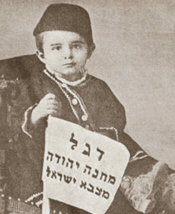
Ben Zion
Flag of the
camp of
Yehuda, of
the army of
Yisrael
Notes:
https://www.yeshuaisrael.com/the-first-hebrew-family/
I met his third sister, Dola, in 1971 in Jerusalem.

Slide 101
Two criteria for reward:
Commitment to vision
Gratitude & Joy in the pursuit
Task joy, relational joy
6. Difficult military situation, and the Word

Slide 102
^{1 Shmuel 13.5-6} The P’lishtim assembled themselves together to make war on Isra’el — 30,000 chariots, 6,000 horsemen and an army as large as the number of sand grains on the seashore. They came up and pitched camp at Mikhmas,

Slide 103
^{1 Shmuel 13.5-6} east of Beit-Aven. The men of Isra’el saw that their options were limited and that the people felt so hard pressed that they were hiding themselves in caves, thickets, crevices, watchtowers and cisterns;

Slide 104
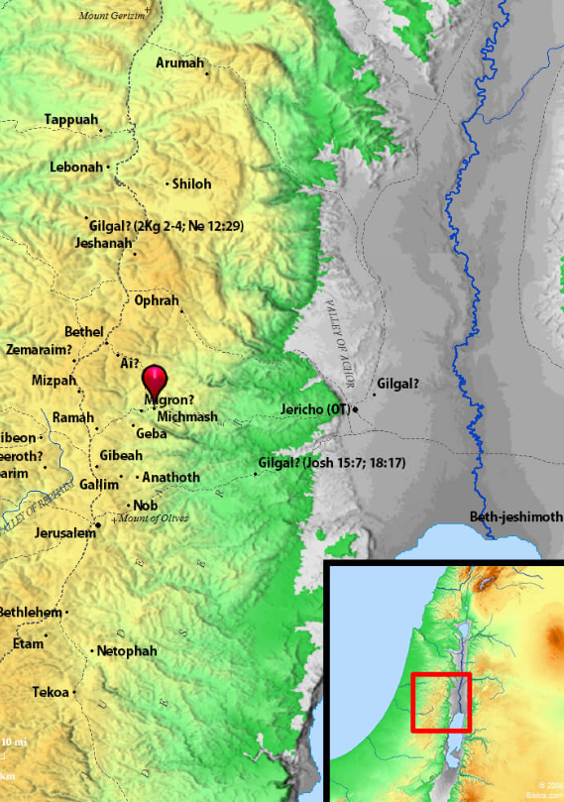
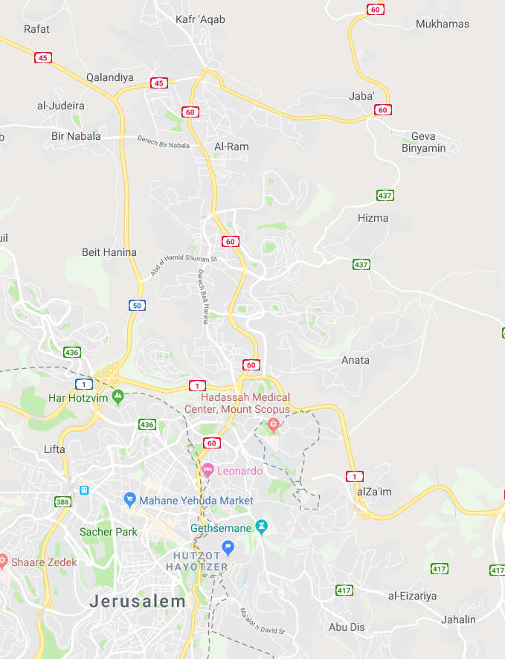

Slide 105
^{1 Samuel 14.4-6} Between the passes by which Y’honatan was trying to cross to the garrison of the P’lishtim, there was a rocky spur on one side and another rocky spur on the other side; the name of the one was Botzetz, and of the other, Seneh. The one spur rose up on the north, in front of Mikhmas,

Slide 106
^{1 Samuel 14.4-6} and the other on the south, in front of Geva. Y’honatan said to his armor-bearer, “Come on, let’s go across to the garrison of these uncircumcised people. Maybe Adoni will do something for us, since Adoni can rescue with a few people as easily as with many.”

Slide 107
During World War I, British forces under the command of General Allenby were to face the Turks at the same location. Major Vivian Gilbert of the British army relates the story of an unnamed brigade major who was reading his Bible while contemplating the situation
Notes:
https://en.wikipedia.org/wiki/Michmash

Slide 108
against the Ottoman forces. The brigade major remembered a town by the name of Michmash mentioned somewhere in the Bible. He found the verses, and woke the brigadier general.
Notes:
https://en.wikipedia.org/wiki/Michmash

Slide 109
The the general sent out scouts, who came back and reported finding the pass, thinly held by the Turks, with rocky crags on either side–obviously Bozez and Seneh; whilst in the distance, high up in Mickmash the moonlight was shining on a flat piece of ground.
Notes:
https://patternsofevidence.com/blog/2018/11/16/wwi-victory-gained-using-bible/?utm_source=Email&utm_medium=Thinker131Victory&utm_term=&utm_content=&utm_campaign=Thinker131Victory&inf_contact_key=9d777475af5abb8bf25ece8368f20b70b5b5447d07a92a41c23c4dca8701d61a

Slide 110
The general decided then and there to change the plan of attack, and instead of the whole brigade, one infantry company alone advanced at dead of night along the pass of Mickmash. A few Turks met were silently dealt with.
Notes:
https://patternsofevidence.com/blog/2018/11/16/wwi-victory-gained-using-bible/?utm_source=Email&utm_medium=Thinker131Victory&utm_term=&utm_content=&utm_campaign=Thinker131Victory&inf_contact_key=9d777475af5abb8bf25ece8368f20b70b5b5447d07a92a41c23c4dca8701d61a

Slide 111
We passed between Bozez and Seneh, climbed the hillside and, just before dawn, found ourselves on the flat piece of ground. The Turks who were sleeping awoke, thought they were surrounded by the armies of Allenby and fled in disorder.
Notes:
https://patternsofevidence.com/blog/2018/11/16/wwi-victory-gained-using-bible/?utm_source=Email&utm_medium=Thinker131Victory&utm_term=&utm_content=&utm_campaign=Thinker131Victory&inf_contact_key=9d777475af5abb8bf25ece8368f20b70b5b5447d07a92a41c23c4dca8701d61a

Slide 112
Two criteria for reward:
Commitment to vision
Gratitude & Joy in the pursuit
Task joy, relational joy
Send me a testimony of praise, thankfulness!
Notes:
Send me a testimony of praise, thanksgiving

