Slide 1
If you saw our livestream YouTube last week, it still wasn’t quite HD video and audio.
Still working on it! Adjusted more settings. Looking into different internet provider.

Slide 2
Notes:
4.64 mbps Should be ok, although minimal. Best possible with Cu wires, not fiber optic.

Slide 3
To easily follow these notes,
Go to OrHaOlam.com
WITHOUT WIFI
Click on downloads, messages, 2018 messages, the top one!

Slide 4
Notes:
https://youtu.be/Lb5EozgOs2g
Also
https://www.facebook.com/marchoflife/videos/1744828825812790/

Slide 5
Be a part of history and prophecy! 70 years after the founding of the State is the year of Release!
Except don’t register there, just go to OrHaOlam.com
Deadline Feb. 12 before price increase! If no enrollment by then tour dropped!

Slide 6
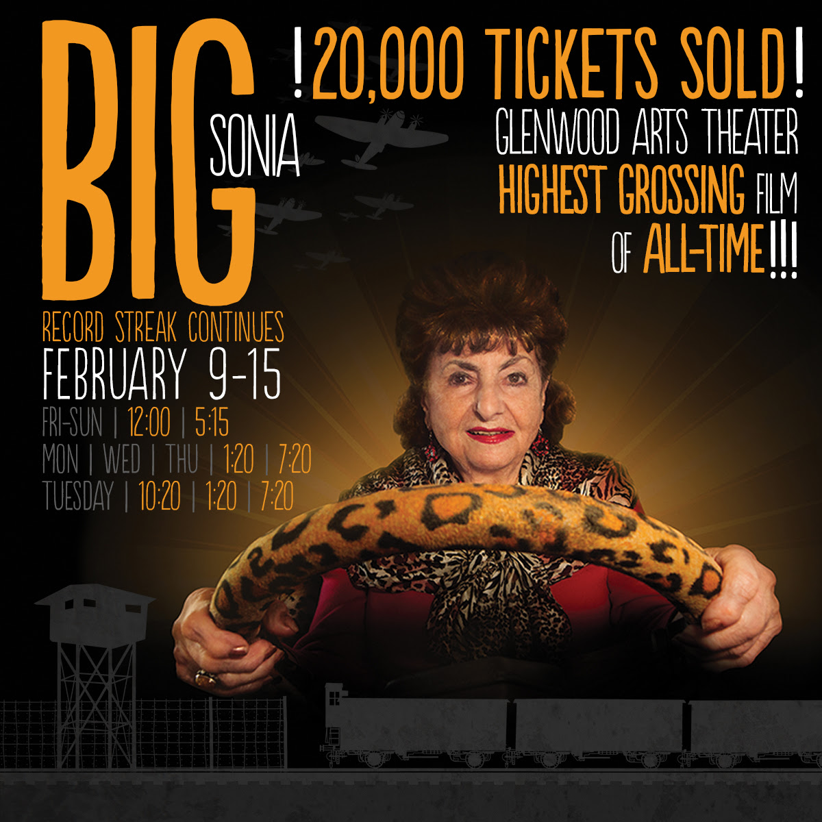
Week 11 & Still Going Strong at the
Glenwood Arts Theater in OP!

Slide 7
There are some great movie lines.
“Inigo Montoya” can best be understood, not as crass revenge, but as overcoming the failures of past generations.

Slide 8
Inigo
Mon-
toya
Notes:
https://youtu.be/6JGp7Meg42U

Slide 9
But I just received
an updated version…

Slide 10
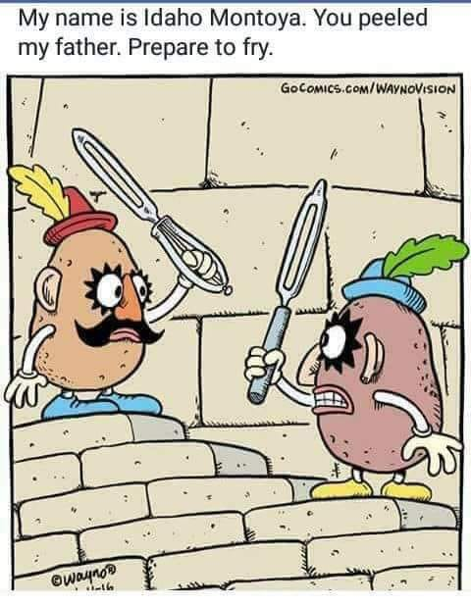
Notes:
Two sources: Rukhel Fields AND Lori Wilson!!

Slide 11
Should Messianics keep and observe Rabbinic law?
Notes:
When I was about to get married, my mother begged me to see a rabbi in Cincinnati before taking this step. He asked me, “Why don’t you, a Jewish follower of scripture, keep Orthodox Torah?”
Porque no?

Slide 12
מַתִּתְיָהוּ Mattityahu
(Matthew) 23:1-3

Slide 13
Mattityahu (Matthew) 23:1
אָז דִבֵּר יֵשׁוּעַ אֶל הֲמוֹן הָעָם וְאֶל תַּלְמִידָיו.
Then Yeshua addressed the crowds and his talmidim:
Notes:
Final discourse Ch 23-25 analogous to opening discourse Mt 5-7
There 7 blessings. Here 7 Woes.
Yeshua had been under siege/interrogation since Mt 19

Slide 14
^{Mt. 19.3} Some P’rushim came and tried to trap him by asking…
^{Mt. 21.15} But when the head cohanim and Torah-teachers saw the wonderful things…they were furious.

Slide 15
^{Mtt. 22.15} Then the P’rushim went away and put together a plan to trap Yeshua with his own words
^{Mtt. 22.35} and one of them who was a Torah expert asked a sh’eilah to trap him
Notes:
Four traps or fury, now response…

Slide 16
Mattityahu (Matthew) 23:2
אָמַר לָהֶם: "הַסּוֹפְרִים וְהַפְּרוּשִׁים יוֹשְׁבִים עַל כִּסֵּא מֺשֶׁה.
“The Torah-teachers [scribes] and the P'rushim,” he said, “sit in the seat of Moshe.
Notes:
Great statement of honor.

Slide 17
Scribes and Pharisees P’rushim have gotten a very negative press by Christianity. Sometimes equated them with the whole of the Jewish people. REALLY?
1. Shaul/Paul claimed his Pharisaic heritage in the present tense, late in his life.

Slide 18
1. ^{Acts 23.6} Sha’ul shouted, “Brothers, aI myself am a Parush and the son of P’rushim;nd it is concerning the hope of the resurrection of the dead that I am being tried!”…some…who were on the side of the P’rushim standing up and joining in — “We don’t find anything wrong with this man.
Notes:
So Shaul acknowledged his heritage past and current, and his peers acknowledged him.

Slide 19
2. ^{Mtt 23.34} Therefore I am sending you prophets and sages and Torah-teachers [scribes].
3. Yeshua still mourned for their return…“For I tell you, you will never see Me again until you say, ‘Barukh ha-ba b’shem Adoni. Blessed is He who comes in the name of the Lord!’”
Notes:
More like an in-house corrective, same as the prophets did!

Slide 20
4. There were only about 5000 P’rushim/Pharisees in Israel out of a population of ~500,000+.
5. Arguable that Yeshua was closest to the P’rushim, more than any other group.
6. Yeshua loves and respects leadership. Works with them.
Notes:
G-d didn’t have to convince Pharaoh to let Israel go. Couldn’t just killed him and out.
6 reasons why Yeshua loved the P’rushim, and the current rabbinic successors.

Slide 21
Mattityahu (Matthew) 23:2
אָמַר לָהֶם: "הַסּוֹפְרִים וְהַפְּרוּשִׁים יוֹשְׁבִים עַל כִּסֵּא מֺשֶׁה.
“The Torah-teachers [scribes] and the P'rushim,” he said, “sit in the seat of Moshe.
Seat of Moshe?
Notes:
Great statement of honor.

Slide 22
^{Shmot/Ex 18.13} The next day, Moses sat to judge the people, and they stood around Moses from morning till evening.

Slide 23
The seat of Moshe. The Midrash Rabbah says: "They made for him [Moses| a katedra like that of the advocates, in which one sits and yet seems to be standing." ^{(Exodus Rabbah 43:4)}
Pesiktu diRav Kahana ^{1:7} mentions the seat of Moses, and the editors of the English edition comment:
Notes:
^{Stern’s Commentary}

Slide 24
“The particular place in the synagogue where the leaders used to sit was known metaphorically as the seat of Moses or as the throne of Torah, symbolizing the succession of teachers of Torah down through the ages.”
Notes:
^{Stern’s Commentary} (William G. Braude and Israel J. Kapstein, Pesikta diRav Kahana, Philadelphia: Jewish Publication Society of America, 1975, p. 17)

Slide 25
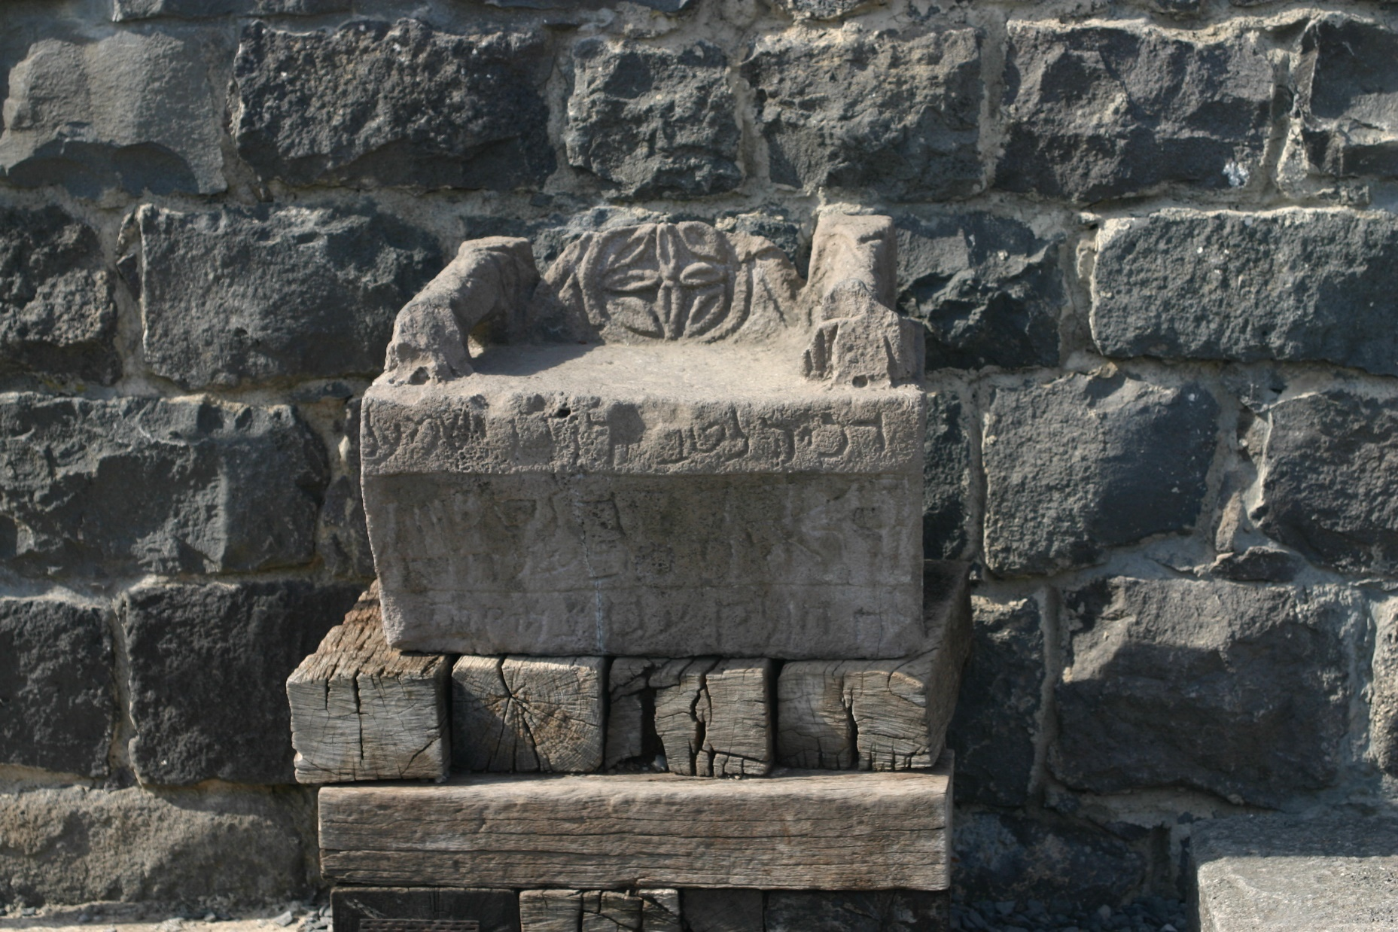
Moses’ Seat from Korazin
Notes:
https://www.google.com/search?safe=active&tbm=isch&q=moses+seat&chips=q:moses+seat+in+synagogue,online_chips:chair&sa=X&ved=0ahUKEwiYnMOPh5rZAhXIwFMKHaYtAysQ4lYILygH&biw=1282&bih=933&dpr=1#imgdii=tzzvVoEFxQgdZM:&imgrc=xPwCVanN2-K1hM:
A talmudic village (perhaps 400 years after Yeshua) the synagogue in the center of the community - not just a place of worship but the community center as well.

Slide 26
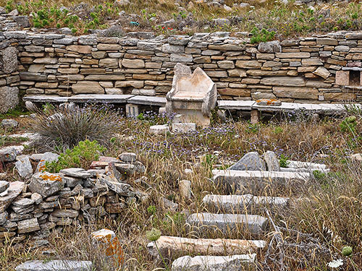
Notes:
https://ferrelljenkins.wordpress.com/tag/bible-atlas/
This large synagogue dates to the mid-second century B.C. Two inscriptions found in 1979-80 indicate that the worshipers here (Israelites) were likely Samaritans who revered Argarizein (Mount Gerizim). (See Kraabel, “New Evidence of the Samaritan Diaspora has been Found on Delos.” BA 47:1; 1984).
Close up view…

Slide 27
Notes:
http://www.bible.ca/synagogues/Moses-Seat-Metaphor-Pride-reader-leader-judge-Architectural-ancient-Synagogue-pre-70AD-standardized-typology-design-incorporated-adopted-similarities-into-church.htm

Slide 28
Mattityahu (Matthew) 23:3
לָכֵן כָּל אֲשֶׁר יֺאמְרוּ לָכֶם עֲשׂוּ וְשִׁמְרוּ,
So whatever they tell you, take care to do it.
Notes:
Reread that 3x. Combine with “sit and Moshe’s seat”

Slide 29
David H. Stern, born in Los Angeles in 1935, is the great-grandson of two of the city's first twenty Jews. Stern's background includes surfing, plus a Master of Divinity degree from Fuller Theological Seminary, graduate work at the University of Judaism
Notes:
Came to faith in Yeshua in the 1972. Ph.D in economics from Princeton.

Slide 30
and at UCLA he was a professor. In 1979 the Stern family made aliyah (immigrated to Israel).
David set out to write a Messianic Jewish commentary but quickly found that first, a new translation was needed of the New Testament

Slide 31
from the ancient Greek original text, to correct mistranslations resulting from anti-Jewish theological bias. Thus was born the Complete Jewish Bible.

Slide 32
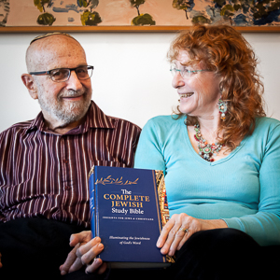
David &
Martha
Stern

Slide 33
^{Stern’s Commentary} There are some who understand this verse to mean that, according to Yeshua, the Oral Torah, as expounded in Orthodox Judaism, is binding on Messianic Jews today.

Slide 34
Mattityahu (Matthew) 23:3
לָכֵן כָּל אֲשֶׁר יֺאמְרוּ לָכֶם עֲשׂוּ וְשִׁמְרוּ,
So whatever they tell you, take care to do it.
So, what do the P’rushim and their successors tell us to do?
Notes:
Reread that 3x

Slide 35
A khumra חומרה; pl. חומרות, khumrot; is a prohibition or obligation in Jewish practice that exceeds the bare requirements of Halakha (Jewish laws). The rationale for a khumra comes from Dt 22:8, which states that when one builds a house,
Notes:
https://en.wikipedia.org/wiki/Khumra_(Judaism)

Slide 36
he must build a fence around the roof in order to avoid guilt should someone fall off the roof. This has been interpreted by many as a requirement to "build a fence around the Torah" in order to protect the mitzvot.
Notes:
https://en.wikipedia.org/wiki/Khumra_(Judaism)

Slide 37
^{Exodus 34:26} “You are not to boil a young goat in its mother’s milk.”
That commandment got expanded to not having milk and meat at the same meal.
Notes:
Might be milk from the mother of the goat meat you are eating.

Slide 38
Rabbenu Tam, in 12th-century France, ruled that it was sufficient merely to conclude the meat meal by reciting a blessing and removing the tablecloth, and then milk could be consumed immediately.
Notes:
https://en.wikipedia.org/wiki/Khumra_(Judaism)

Slide 39
Now it is universal halakhic practice today is to wait at least one hour (and even as much as six hours) after eating meat, before consuming milk.
Notes:
https://en.wikipedia.org/wiki/Khumra_(Judaism)

Slide 40
Thus, today's universal halakhic practice of waiting between meat and milk would be considered a khumra in comparison to Rabbenu Tam's ruling.
Notes:
https://en.wikipedia.org/wiki/Khumra_(Judaism)
Then further expanded to separate plates and tableware for meat and dairy.

Slide 41
Mattityahu (Matthew) 23:3
לָכֵן כָּל אֲשֶׁר יֺאמְרוּ לָכֶם עֲשׂוּ וְשִׁמְרוּ,
So whatever they tell you, take care to do it.
Nu?
Notes:
You could say, “I don’t care what rabbis and Talmud says.” Really.
Nu is defined as a Yiddish expression to ask a simple question instead of using words such as "well" or "so."
http://www.yourdictionary.com/nu#Fq0IlFU2L25dASYP.99

Slide 42
Mattityahu (Matthew) 23:2
אָמַר לָהֶם: "הַסּוֹפְרִים וְהַפְּרוּשִׁים יוֹשְׁבִים עַל כִּסֵּא מֺשֶׁה.
“The Torah-teachers [scribes] and the P'rushim,” he said, “sit in the seat of Moshe.

Slide 43
1. The P’rushim are sitting in the seat of Moshe. So, it can be inferred that only what they derive legitimately from Moshe is binding.
Notes:
John Gill: This must be restrained to things that were agreeable to the chair of Moses, in which they sat, to the law of Moses, which they read and explained, to other parts of Scripture and truth in general;

Slide 44
Another version of the text.
Bear with a bit of a rabbi-t rail.

Slide 45
Papias Παπίας was an Apostolic Father, Bishop of Hierapolis (modern Pamukkale, Turkey), and author who lived c. 60–130 AD.
Notes:
https://en.wikipedia.org/wiki/Papias_of_Hierapolis

Slide 46
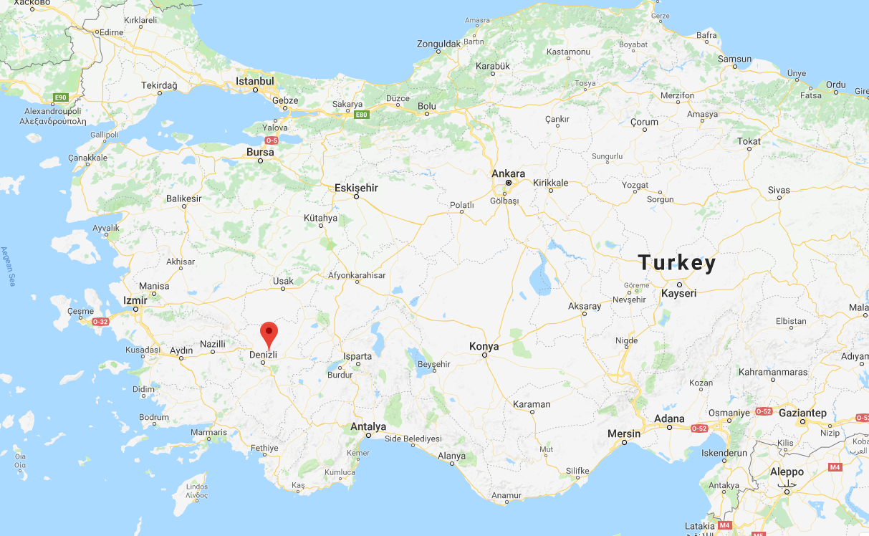
Hierapolis-Pamukkale
Notes:
60-130 CE

Slide 47
It was Papias who wrote the Exposition of the Sayings of the Lord, which is lost apart from brief excerpts of Irenaeus of Lyons (c. 180) and Eusebius of Caesarea (c. 320).
Notes:
https://en.wikipedia.org/wiki/Papias_of_Hierapolis

Slide 48
The excerpt [by Papias] regarding Matthew says only:
Therefore Matthew put the logia [the words, story] in an ordered arrangement in the Hebrew language, but each person interpreted them as best he could.
Notes:
https://en.wikipedia.org/wiki/Papias_of_Hierapolis
So, the original Matthew was in Hebrew!!
Do we have this Hebrew version original of Matthew. Maybe. Maybe not.

Slide 49
The Shem Tov Matthew consists of a complete text of Gospel of Matthew in the Hebrew language found interspersed among anti-Catholic commentary in the 12th volume of a polemical treatise The Touchstone (c.1380-85) by Shem Tov ben Isaac ben Shaprut (Ibn Shaprut),
Notes:
https://en.wikipedia.org/wiki/Rabbinical_translations_of_Matthew

Slide 50
a Jewish physician living in Aragon, after whom the version is named. Shem Tov debated Cardinal Pedro de Luna (later Antipope Benedict XIII) on original sin and redemption in Pamplona, December 26, 1375, in the presence of bishops and learned theologians.
Notes:
https://en.wikipedia.org/wiki/Rabbinical_translations_of_Matthew
Not universally accepted that this is the real original Matthew. Could be a translation from the Greek. Lots of disputes.

Slide 51
Nine manuscripts of The Touchstone survive.
The Hebrew version of Mtt. 23…
Notes:
https://en.wikipedia.org/wiki/Rabbinical_translations_of_Matthew

Slide 52
“The Pharisees and sages sit on Moshe’s seat. Therefore, all that he [i.e., Moshe] says to you, diligently do, ^{Hebrew Matt. 23:2-3}
Notes:
https://www.jesuswordsonly.com/books/212-matthew-232-3-in-hebrew-matthew.html
Huge difference!!

Slide 53
“but according to their reforms [i.e., additions] and their precedents [i.e., examples used to justify conduct], do not do because they talk but they do not do [Torah].” ^{Hebrew Matt. 23:2-3}
Notes:
https://www.jesuswordsonly.com/books/212-matthew-232-3-in-hebrew-matthew.html
Seat of Moshe could restrict their authority
Variant reading.

Slide 54
3. Yeshua has a form of khumra
^{Mtt. 5.20} For I tell you that unless your righteousness is far greater than that of the Torah-teachers and P’rushim, you will certainly not enter the Kingdom of Heaven!
For example?

Slide 55
^{Mt. 5.21-22}“You have heard it was said to those of old, ‘You shall not murder, and whoever commits murder shall be subject to judgment.’ But I tell you that everyone who is angry with his brother shall be subject to judgment.

Slide 56
^{Mt. 5.21-22} And whoever says to his brother, ‘Raca’ shall be subject to the council; and whoever says, ‘You fool!’ shall be subject to fiery Gehenna…First be reconciled to your brother, and then come and present your offering.
Notes:
Examine ourselves
Festering offense received…unforgiven. Choice, not emotion. G-d will work.
Lingering offense given…unapologized. Not ask forgiveness. Just apologize.

Slide 57
^{Mtt.5.27-28} “You have heard that it was said, ‘You shall not commit adultery.’ But I tell you that everyone who looks upon a woman to lust after her has already committed adultery with her in his heart.
Notes:
Really. But can’t I just admire beauty? Depends. You can admire the beauty of the Sierra Nevada mountains. But, you don’t usually spend cerebral energy imagining…What would they look like if the snow was off them, and they were bare? Look in her eyes. Smile. Ladies, make it easier for us to do so. Be elegantly feminine, not sensually.

Slide 58
3. Yeshua has a form of khumra ^{Mtt. 5.20} For I tell you that unless your righteousness is far greater than that of the Torah-teachers and P’rushim, you will certainly not enter the Kingdom of Heaven!

Slide 59
“Seat of Moshe” designation could restrict their authority
Variant reading
Yeshua has a different khumra, fence around the Torah.

Slide 60
Repeat conclusion from last week. May this be the trademark culture of Or HaOlam!
Yeshua’s “fence around the Torah” His khumra.

Slide 61
New first counseling questions:
Have you worshipped Messiah in this?
Have you seen the death to self and power of resurrection in this?

Slide 62
Then fix the situation.
We don’t fix it by fixing it. We fix it, as Yeshua followers, by first asking for Him: death to self and resurrection power.
Worship = warfare.

Slide 63
Many of you have heard me speak on Tikkun/soul correction.
This is Tikkun on steroids. Worship death of Messiah and yourself, and power of resurrection in EVERY situation first.

Slide 64
Everything we do, everything we face, every situation of finances, health, conflict with people is an expression of G-d’s redemptive love for us.
Must be understood in the context of spiritual warfare/worship!
Notes:
When we do Yeshua right…G-d will bless.

Slide 65
Report from Jerusalem: Our congregation is flourishing. It is hard to believe that it was almost 12 years ago that Asher and I along with fifteen others from Revive Israel started the work that now has a weekly attendance of about two hundred. And today, a team of young Israelis that we have helped
Notes:
http://zionsglory.activehosted.com/index.php?action=social&chash=41f1f19176d383480afa65d325c06ed0.561

Slide 66
raise up for this very moment are carrying the responsibility for the daily operation of the congregation. It is so gratifying to see them operate with such a high level of maturity, energy, vision and most importantly, love.
Notes:
http://zionsglory.activehosted.com/index.php?action=social&chash=41f1f19176d383480afa65d325c06ed0.561

Slide 67
“When the so-called 'progressive’ congregations question the historicity of Yeshua, deny the reality of sin, support abortion, ordain clergy in same-sex relationships and perform their marriages, people desiring real faith head elsewhere.
Notes:
http://www.frc.org/get.cfm?i=WA18A34&f=WU18A12

Slide 68
Stanton reminds people. "Fact: evangelical congregations gain five new congregants exiled from the liberal congregationhs for every one they lose for any reason. They also do a better job of retaining believers from childhood to adulthood than do mainline congs."
Notes:
http://www.frc.org/get.cfm?i=WA18A34&f=WU18A12

Slide 69
Mattityahu (Matthew) 23:3
אַךְ כְּמַעֲשֵׂיהֶם אַל תַּעֲשׂוּ, כִּי אוֹמְרִים הֵם וְאֵינָם עוֹשִׂים.
But don't do what they do, because they talk but don't act!”

Slide 70
Mattityahu (Matthew) 23:3
לָכֵן כָּל אֲשֶׁר יֺאמְרוּ לָכֶם עֲשׂוּ וְשִׁמְרוּ,
So whatever they tell you, take care to do it.
Notes:
Reread that 3x

Slide 71
3. Yeshua has a form of khumra ^{Mtt. 5.20} For I tell you that unless your righteousness is far greater than that of the Torah-teachers and P’rushim, you will certainly not enter the Kingdom of Heaven!

