Slide 1
Good news from Israel

Slide 2
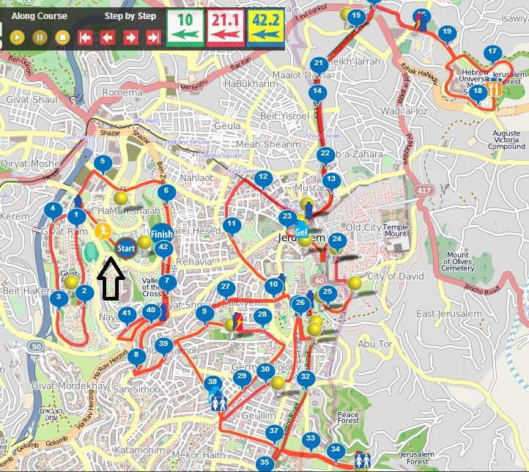
Jerusalem
Marathon
Map

Slide 3
More than 35,000 runners, including some 4,000 from 72 different countries, joined the Jerusalem Marathon on Friday morning, March 9, 2018, the largest-ever number to take part in the annual race.
Notes:
https://www.timesofisrael.com/30000-race-through-jerusalem-in-capitals-largest-ever-marathon/
People ask, is it safe there?

Slide 4
The winner, it was announced shortly after 9:30 a.m., was Kipkogey Shadrack, 27, of Kenya. Shadrack, the reigning champion, finished the race in 2:21.26. The second and third slots also went to African runners: Wendwesen Tilahun Damte of Ethiopia and Ronald Kimeli Kurgat, a Kenyan.
Notes:
https://www.timesofisrael.com/30000-race-through-jerusalem-in-capitals-largest-ever-marathon/
5 minutes 23 sec/mile for 26 miles!

Slide 5
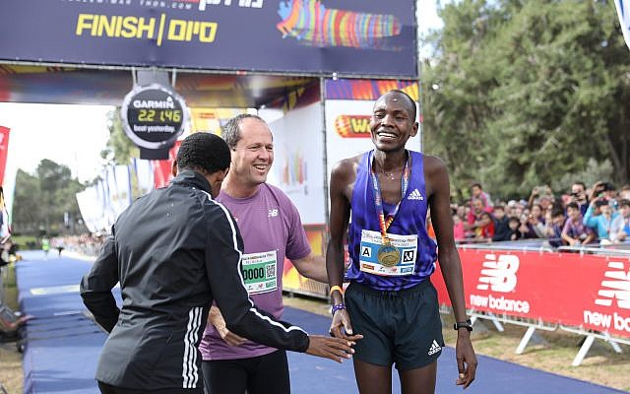
Mayor Nir Barkat (center), with Kenyan runner Kipkogey Shadrack, 27 (right), who won.

Slide 6
The average age of runners running the full course is 43, while the average age of those running the 10 km is 32. There are slightly more male runners than women, at 57% to 43%, the city said.

Slide 7
While no unexpected incidents were reported during the race, one runner decided to surprise his girlfriend after the 14-kilometer marker of the half-marathon by proposing to her. Motti Biton got down on one knee at the Armon HaNatziv boardwalk. His girlfriend, Daniel Mor, accepted the proposal.
Notes:
http://www.jerusalemonline.com/news/in-israel/local/over-35000-runners-participate-in-2018-jerusalem-race-34976?utm_source=ActiveCampaign&utm_medium=email&utm_content=The+Latest+News+From+Israel&utm_campaign=MiddayNewsletter+-+Recurring+-+Dec+17

Slide 8
Jerusalem
Marathon
Map
Armon
HaNatziv
#34
Notes:
Temporary US Embassy supposed to be here.
OUR TOUR will be there at Embassy opening!!
Mt. Zion rally.
Something interesting about Billy Graham…

Slide 9
Billy Graham's efforts on behalf of Jews weren't just about evangelism. When Syria and Egypt launched a surprise attack on Israel in October 1973, it soon became evident that Israel was in danger. The European powers refused to help.
Notes:
http://www.Christianitytoday.com/ct/2018/billy-graham/level-ground-at-execution stake.html

Slide 10
Richard Nixon hesitated to aid Israel for fear of escalating international tensions. But as the crisis grew graver, and Israel quietly threatened to use nuclear warheads, Nixon delivered weapons and supplies to save and stabilize Israel.
Notes:
http://www.Christianitytoday.com/ct/2018/billy-graham/level-ground-at-execution stake.html
Nixon remembered a prophetic statement his mother had said to him, that he would help the Jews.

Slide 11
Years later, Rabbi Tanenbaum's widow told The New York Times that it was only after Graham personally telephoned Nixon that the airlift began.
Notes:
http://www.Christianitytoday.com/ct/2018/billy-graham/level-ground-at-execution stake.html
Moving into the ministry of the word…

Slide 12
If you want to have notes without taking notes,
Go to OrHaOlam.com
WITHOUT WIFI
Click on downloads, messages, 2018 messages
Today’s should be on the top.

Slide 13
מַתִּתְיָהוּ Mattityahu
(Matthew) 23:16-17
Notes:
Yeshua continuing final discourse to Israel!

Slide 14
Mattityahu (Matthew) 23:16
אוֹי לָכֶם מוֹרֵי דֶרֶךְ עִוְרִים הָאוֹמְרִים: ’הַנִּשְׁבָּע בַּהֵיכָל אֵין בְּכָךְ כְּלוּם, אֲבָל הַנִּשְׁבָּע בִּזְהַב הַהֵיכָל חַיָּב‘.
“Woe to you, you blind guides! You say, ‘If someone swears by the Temple, he is not bound by his oath; but if he swears by the gold in the Temple, he is bound.
Notes:
Blind guides! Not very nice! Serious, if obscure issue here! Involves a theological term we don’t use much, but Yeshua considered important!
“You say” Who says? Some Talmudic statements similar. Quote one…

Slide 15
Says R. Jochanan ^{T. Bab. Kiddushin, fol. 71. 1} “‘by the temple’, it is in our hands; but what shall I do?”
Understood as:
“it is an oath by the temple of God, that it is in our power to reveal the illegitimacy of the families of the land of Israel.”
Notes:
https://www.ritmeyer.com/2015/12/14/the-gold-of-the-jerusalem-temple/
Talmudic writings are very terse and hard to understand. The sense is: the Temple building is our building, our control, our power. Now reread…

Slide 16
Mattityahu (Matthew) 23:16
אוֹי לָכֶם מוֹרֵי דֶרֶךְ עִוְרִים הָאוֹמְרִים: ’הַנִּשְׁבָּע בַּהֵיכָל אֵין בְּכָךְ כְּלוּם, אֲבָל הַנִּשְׁבָּע בִּזְהַב הַהֵיכָל חַיָּב‘.
“Woe to you, you blind guides! You say, ‘If someone swears by the Temple, he is not bound by his oath; but if he swears by the gold in the Temple, he is bound.
Notes:
That is, he can keep the oath or not…no punishment.

Slide 17
Human cultures developed oaths because people could not trust their neighbors without calling an avenging deity to witness.
Yeshua had already spoken about integrity.

Slide 18
^{Mattityahu (Matthew) 5.33-37} “Again, you have heard that our fathers were told, ‘Do not break your oath,’ and ‘Keep your vows to Adonai.’ But I tell you not to swear at all — not ‘by heaven,’ because it is God’s throne; not ‘by the earth,’ because it is his footstool; and
Notes:
https://www.ritmeyer.com/2015/12/14/the-gold-of-the-jerusalem-temple/

Slide 19
^{Mattityahu (Matthew) 5.33-37} “not ‘by Yerushalayim,’ because it is the city of the Great King. And don’t swear by your head, because you can’t make a single hair white or black. Just let your ‘Yes’ be a simple ‘Yes,’ and your ‘No’ a simple ‘No’; anything more than this has its origin in evil.
Notes:
https://www.ritmeyer.com/2015/12/14/the-gold-of-the-jerusalem-temple/
Just be people of integrity.
Ever tell a story, and in the flow of it, you have a detail that you’re not sure of, or overstate. Have to qualify, sometimes wrecks the flow of the joke. Truth tellers!!

Slide 20
But Yeshua knew that it was in the culture to base oaths on substitute phrases, and NOT deity, so they weren’t so binding.
Yeshua would have none of this use of clever but unsound reasoning, sophistry.
Notes:
https://www.ritmeyer.com/2015/12/14/the-gold-of-the-jerusalem-temple/
Here is where Yeshua introduces a theological term important to Him and the Father, but maybe esoteric, mysterious to us.

Slide 21
Mattityahu (Matthew) 23:17
‏ כְּסִילִים וְעִוְרִים! מַה גָּדוֹל יוֹתֵר, הַזָּהָב אוֹ הַהֵיכָל הַמְקַדֵּשׁ אֶת הַזָּהָב?
“You blind fools! Which is more important? the gold? or the Temple which makes the gold holy?
Notes:
Temple is the building, unchanging. Gold has commercial value.
HOLY, key word to this message.

Slide 22
That is, the Temple is permanent, not for sale. Gold is negotiable, marketable…
Notes:
https://www.ritmeyer.com/2015/12/14/the-gold-of-the-jerusalem-temple/

Slide 23
Context
Notes:
https://www.ritmeyer.com/2015/12/14/the-gold-of-the-jerusalem-temple/
Hope you like archeology. 3D effect to scripture.

Slide 24
Josephus describes the Temple façade as covered with “massive plates of gold” and writes that a large golden vine hung with golden fruit above the large door leading to the inner sanctum.
Notes:
https://www.ritmeyer.com/2015/12/14/the-gold-of-the-jerusalem-temple/

Slide 25
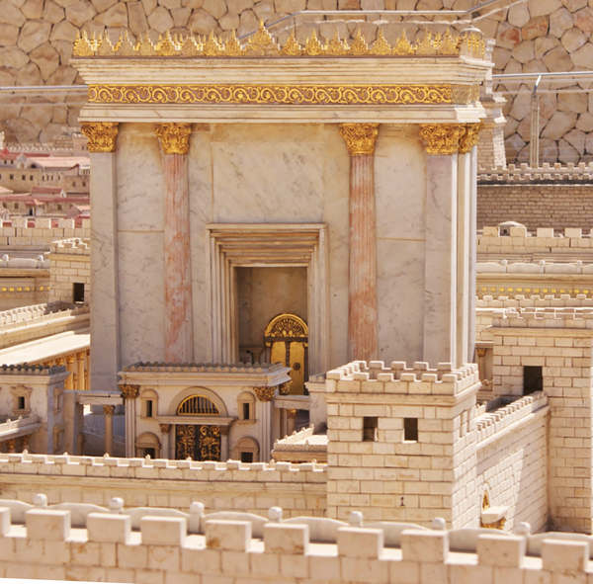
Temple
Model at the Israel
Museum.
Notes:
https://www.ritmeyer.com/2015/12/14/the-gold-of-the-jerusalem-temple/
For a bit of background from primary sources. Or almost primary…

Slide 26
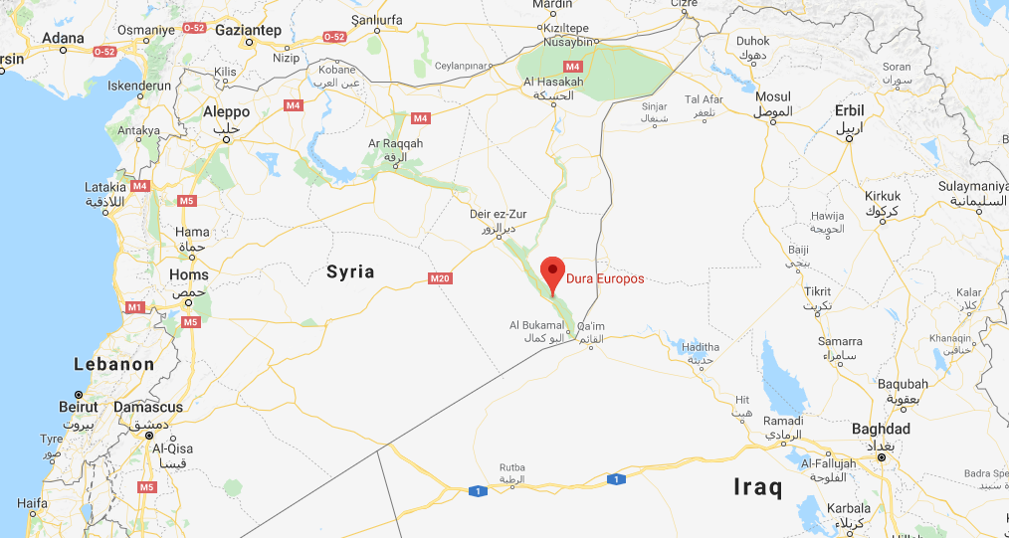
Dura Europas

Slide 27
Dura-Europos was a small garrison and trading city on the river Euphrates, and on the frontier between the Eastern Roman Empire and the Parthians of Persia. Before the final Persian destruction of the town in 256-257 CE, parts of the synagogue
Notes:
https://en.wikipedia.org/wiki/Dura-Europos_synagogue

Slide 28
which abutted the main city wall were apparently requisitioned and filled with sand as a defensive measure. The city was abandoned after its fall and never resettled, and the lower walls of the rooms remained buried and largely intact until excavated in 1932!
Notes:
https://en.wikipedia.org/wiki/Dura-Europos_synagogue

Slide 29
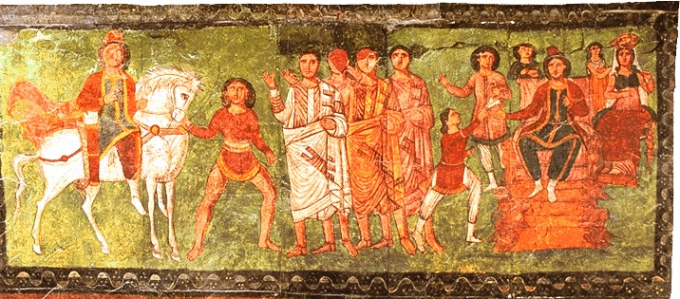
Scene from the Book of Esther
from the Dura-Europos synagogue murals, 244 CE
Notes:
https://en.wikipedia.org/wiki/Dura-Europos_synagogue
A few centuries of memory, much better than a few millennia!

Slide 30
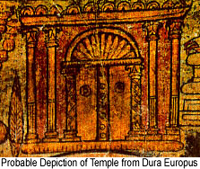
Notes:
https://www.google.com/search?q=golden+vine+of+the+Jerusalem+Temple&safe=active&source=lnms&tbm=isch&sa=X&ved=0ahUKEwj7ue3Kx9_ZAhWL0FMKHcLTC6kQ_AUIDCgD&biw=1282&bih=933#imgrc=quBFZtt6GvsvBM:
Note the vines on the inner pillars, whole purpose of this digression.

Slide 31
The Golden Vine was one of the most remarkable in all the Temple precincts. [Talmud] Middot records that “A golden vine stood over the entrance to the sanctuary, trained over posts; and whosoever gave a leaf, or a berry, or a cluster as a freewill-offering
Notes:
https://www.ritmeyer.com/2015/12/14/the-gold-of-the-jerusalem-temple/

Slide 32
he brought it and the cohenim hung it thereon.” This vine was so famous that even Tacitus (History 5.5) wrote about it. Messiah may also have alluded to this very feature of the Temple when he said in John 15.1: “I am the true vine.”
Notes:
https://www.ritmeyer.com/2015/12/14/the-gold-of-the-jerusalem-temple/
Tacitus was the Roman general who demolished the Temple. Some say unintentionally.

Slide 33
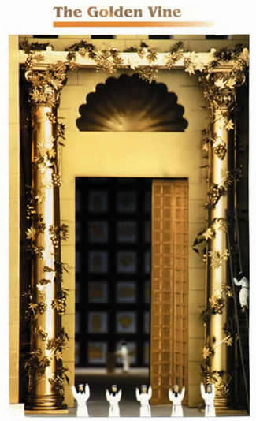
Notes:
https://www.google.com/search?q=golden+vine+of+the+Jerusalem+Temple&safe=active&source=lnms&tbm=isch&sa=X&ved=0ahUKEwj7ue3Kx9_ZAhWL0FMKHcLTC6kQ_AUIDCgD&biw=1282&bih=933#imgrc=AbD6B9jYL7UN2M:
Adding gold leaves: invested, sort of collateralized your word in the leaves.

Slide 34
Mattityahu (Matthew) 23:17
‏ כְּסִילִים וְעִוְרִים! מַה גָּדוֹל יוֹתֵר, הַזָּהָב אוֹ הַהֵיכָל הַמְקַדֵּשׁ אֶת הַזָּהָב?
“You blind fools! Which is more important? the gold? or the Temple which makes the gold holy?
Notes:
Temple is the building, unchanging. Gold has commercial value.
At that point in time, the GOLD much more breathtakingly impressive than the building!
So the going concept was, you can fib if you swear only about the Temple, but NOT if you swear by the gold.
Similarly…

Slide 35
^{Mattityahu (Matthew) 23:18} And you say, ‘If someone swears by the altar, he is not bound by his oath; but if he swears by the offering on the altar, he is bound.’ Blind men! Which is more important? the sacrifice? or the altar which makes the sacrifice holy?
Notes:
Sacrificial offerings were big business.

Slide 36
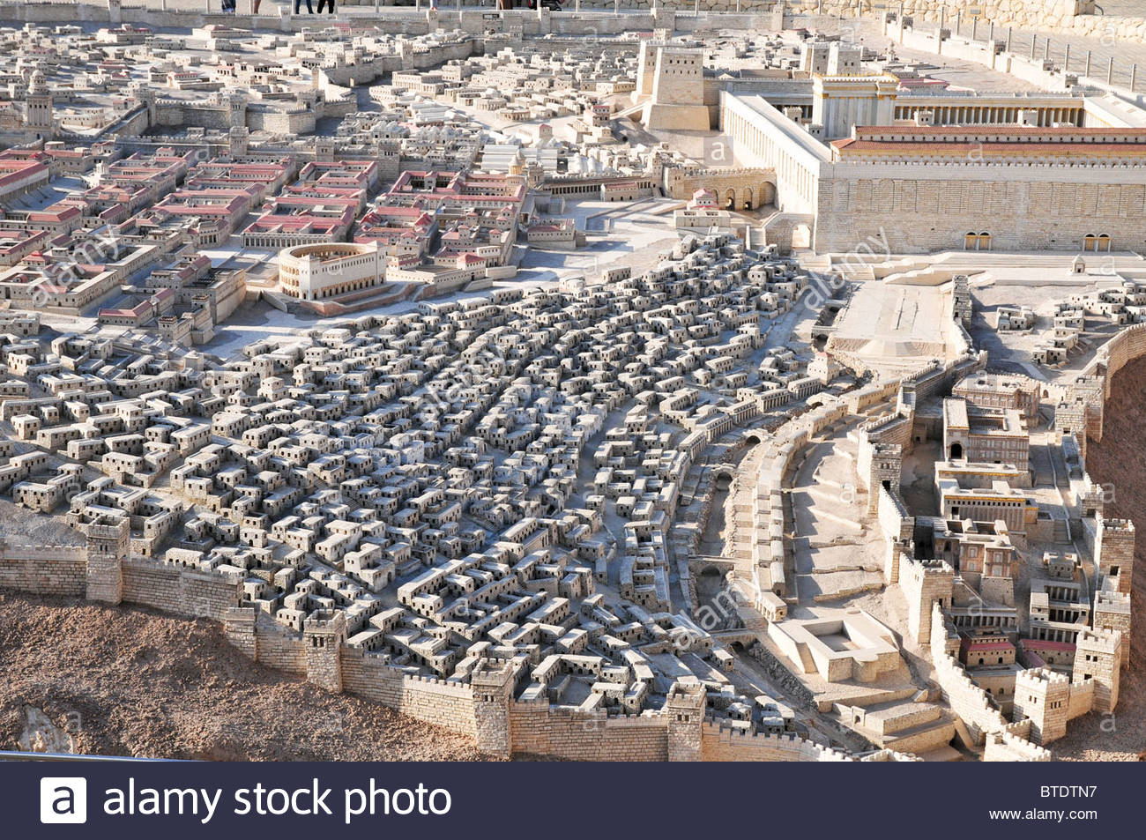
Commercial zone for selling
Temple sacrifices.
Notes:
israel-jerusalem-israel-museum-model-of-jerusalem-in-the-late-second-BTDTN7
https://www.google.com/search?q=Second+temple+models&safe=active&source=lnms&tbm=isch&sa=X&ved=0ahUKEwjM_7fZ5oDXAhUB0YMKHR7aCyYQ_AUICigB&biw=1282&bih=884#imgdii=gEU_yAUrHa-mCM:&imgrc=Dko-JRhpAtwr2M:
See Robinson’s Arch?

Slide 37
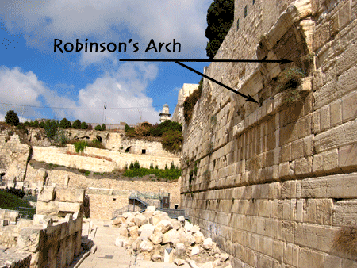
shops

Slide 38
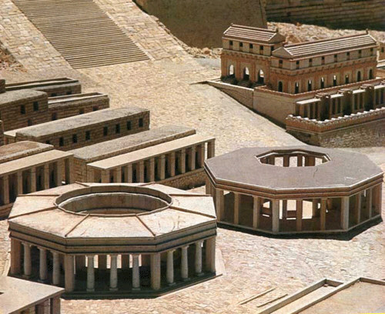
Market Pavilions in the Second
Temple Model of Jerusalem

Slide 39
^{Mattityahu (Matthew) 23:20-22} So someone who swears by the altar swears by it and everything on it. And someone who swears by the Temple swears by it and the One who lives in it. And someone who swears by heaven swears by God’s throne and the One who sits on it.

Slide 40
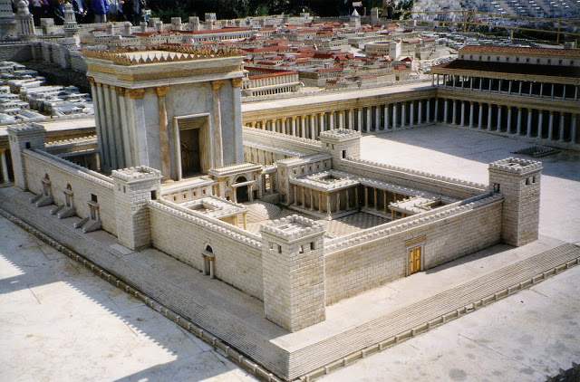
altar

Slide 41
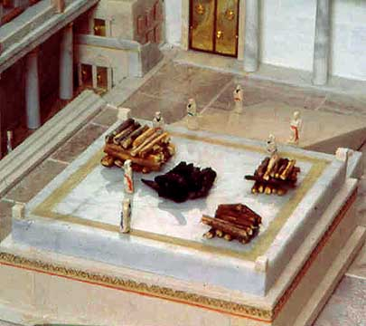

Slide 42
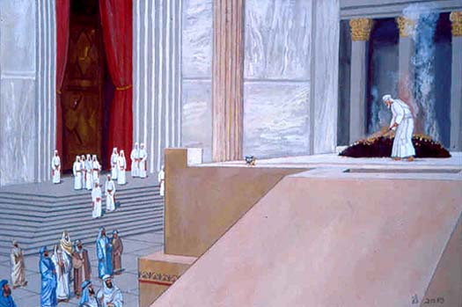
Notes:
Yeshua is building an analogy. Spiritual truth with concepts we don’t use much today. I feel these obscure to us, but not to scripture and Yeshua, are the theme for today.

Slide 43
Temple | Gold
Altar | Sacrifice
Heaven
G-d’s work | Our Work
Notes:
We tend to focus on OUR work. After all, it’s our sweat and hours.
Some rabbis were teaching that the gold, the sacrifices were the binding collateral.
Yeshua was contending that they had it backward.

Slide 44
the Temple which makes the gold holy
the altar which makes the sacrifice holy
It is contact with the Divine, the Eternal that transforms/sanctifies our lives.
Our gifts << our contact.
Notes:
Serious denunciation to the reversal of this. “You blind fools!”
We don’t talk much about sanctifiying, making holy. It’s by contact with the Holy One.
That’s why He came, make contact accessible.

Slide 45
Temple | Gold
Altar | Sacrifice
Heaven
G-d’s work | Our Work
Notes:
It is contact with the Divine, the Eternal that transforms/sanctifies our lives.

Slide 46
^{Shmot/Ex. 30.26-29} You are to anoint the Tent of Meeting with it, the Ark of the Testimony, as well as the table and all its articles, the menorah and its articles, the altar of incense, the altar of burnt offering with all its utensils,
Notes:
Ritual holiness in the Torah

Slide 47
^{Shmot/Ex.30.26-29} and the basin along with its stand. You are to consecrate them so that they will be most holy. Whatever touches them will become holy.
Notes:
.

Slide 48
^{Shmot/Ex. 29.36-37} “Each day, offer a young bull as a sin offering, besides the other offerings of atonement; offer the sin offering on the altar as your atonement for it; then anoint it to consecrate it. Seven days you will make atonement on the altar and consecrate it;

Slide 49
^{Shmot/Ex. 29.36-37} thus the altar will be especially holy, and whatever touches the altar will become holy.
Notes:
Following is the GREAT purpose of LIFE, according to Torah.

Slide 50
^{Vayikra/Ex 11.44} “For I am Adoni your God. Therefore, sanctify your-selves, and be holy, for I am holy. You are not to defile yourselves with any kind of creeping thing that moves on the earth. For I am Adoni who brought you up out of the land of Egypt, to be your God. Therefore, you shall be holy, for I am holy.
Notes:
Holiness, G-d likeness, in the symbolism, visualization of food.
Affirmed in the Messianic Scriptures…

Slide 51
^{1 Kefa/Peter 1.15-16} Just like the Holy One who called you, be holy yourselves also in everything you do. For it is written, “Holy, kedoshim קדושים you shall be, for I am kadosh.”
Notes:
We need to explore these terms: Holy, sanctify.

Slide 52
Temple | Gold
Altar | Sacrifice
Heaven
G-d’s work | Our Work
Notes:
We focus on our work.
Yeshua want us to focus on our contact. Not neglect our work or minimize it.

Slide 53
In English the noun, adjective, and verb seem unrelated.
Holiness, holy, sanctify.
In Biblical thinking in Hebrew, they are the same root.
Kedusha, Kadosh, Hekdish.
קדושה, קדוש, הקדיש
Notes:
I’d like to introduce a classical revivalist writer to really explore this term, deeply

Slide 54
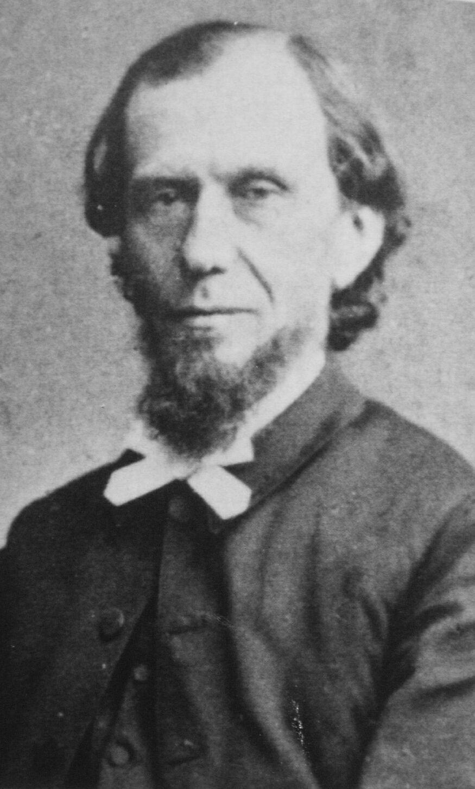
Andrew Murray
(1828 – 1917) was
A South African
writer, teacher,
and pastor.

Slide 55
There is not in Scripture a word more distinctly Divine in its origin and meaning than the word holy. There is not a word that leads us higher into the mystery of Deity, nor deeper into the privilege and the blessedness of God’s children. And yet it is a word that many a believer has never studied or understood
Notes:
Andrew Murray Holy in the Messiah

Slide 56
^{Yeshayahu/Is 6.1-5} They were crying out to each other, “Holy, holy, holy [more holy than the holiest holiness] is Adonai-Tzva’ot! The whole earth is filled with his glory!”
Notes:
Mtt. 16.24-28 Yeshua's Followers Execution stake
Feb. 25, 2017 5777
56

Slide 57
וְקָרָא זֶה אֶל-זֶה וְאָמַר,
V’kara zeh el zeh v’amar
קָדוֹשׁ קָדוֹשׁ קָדוֹשׁ יְיָ צְבָאוֹת;
Kadosh, Kadosh, Kadosh ADONI Ts’vaot,
מְלֹא כָל-הָאָרֶץ, כְּבוֹדוֹ.
M’lo khawl ha arets c’vodo
Notes:
Mtt. 16.24-28 Yeshua's Followers Execution stake
Feb. 25, 2017 5777
57

Slide 58
^{More from Andrew Murray:} You may have heard that God calls you to salvation or to happiness, to receive pardon or to obtain heaven, and never noticed that all these were subordinate. It was to ‘salvation in sanctification,’
Notes:
Andrew Murray Holy in the Messiah

Slide 59
it was to Holiness in the first place, as the element in which salvation and heaven are to be found. The complaints of many believers as to lack of joy and strength, as to failure and want of growth, are simply owing to this—the place God gave Holiness in His call they have not given it in their response.
Notes:
Andrew Murray Holy in the Messiah

Slide 60
‘Like as He which called you is holy, be ye yourselves also holy’. How this call of God shows us the true motive to Holiness. ‘Be ye holy, for I am holy.’ It is as if God said, Holiness is my blessedness and my glory: without this you cannot, in the very nature of things, see me or enjoy me.
Notes:
Andrew Murray Holy in the Messiah

Slide 61
Holiness is my blessedness and my glory: there is nothing higher to be conceived; I invite you to share with me in it, I invite you to likeness to myself: ‘Be ye holy, for I am holy.’
Notes:
Andrew Murray Holy in the Messiah
G-d never invites us to His other attributes: enter my omnipotence, my omniscience, my omnipresence.
The quick reaction is that Holiness is some kind of religious rigidity. That is a false stereotype. Holiness is partaking of the divine nature by the Ruakh through the Messiah. It means joy!

Slide 62
^{Ephesians 1.4-5} In the Messiah he chose us in love before the creation of the universe to be holy and without defect in his presence. He determined in advance that through Yeshua the Messiah we would be his sons — in keeping with his pleasure and purpose,

Slide 63
^{Yeshayahu/Is 6.6-7} One of the seraphim flew to me with a glowing coal in his hand, which he had taken with tongs from the altar. He touched my mouth with it and said, “Here! This has touched your lips. Your iniquity is gone, your sin is atoned for.”
Notes:
https://www.ritmeyer.com/2015/12/14/the-gold-of-the-jerusalem-temple/

Slide 64
Andrew Murray: Holiness is not something we do or attain: it is the communication of the Divine life, the inbreathing of the Divine nature, the power of the Divine Presence resting on us. And our power to become holy is to be found in the call of God: the Holy One calls us to Himself, that He may make us holy in possessing Himself.
Notes:
Andrew Murray Holy in the Messiah

Slide 65
Yes, be very silent and listen. When God called Abraham, he answered, Here am I. When God called Moses from the bush, he answered, Here am I, and he hid his face, for he was afraid to look upon God. God is calling you to Holiness, to Himself the Holy One, that He may make you holy
Notes:
Andrew Murray Holy in the Messiah

Slide 66
Let your whole soul answer, Here am I, Lord! Speak, Lord! Show Yourself, Lord! Here am I. As you listen, the voice will sound ever deeper and ever stiller: Be holy, as I am holy. Be holy, for I am holy. You will hear a voice coming out of the great eternity, from the council-chamber of redemption,
Notes:
Andrew Murray Holy in the Messiah

Slide 67
and as you catch its distant whisper, it will be, Be holy, I am holy. You will hear a voice from Paradise, the Creator making the seventh day holy for man whom He had created, and saying, Be holy.
Notes:
Andrew Murray Holy in the Messiah

Slide 68
You will hear the voice from Sinai, amid thunderings and lightnings, and still it is, Be holy, as I am holy. You will hear a voice from Calvary, and there above all it is, Be holy, for I am holy.
Notes:
Andrew Murray Holy in the Messiah

Slide 69
^{1 Thes 3.12-13} May the Lord also cause you to increase and overflow in love for one another and for all people, just as we also do for you, in order to strengthen your hearts as blameless in holiness before our God and Father at the coming of our Lord Yeshua with all His kedoshim. Amen.

Slide 70
^{1 Thes 5.12-23} Now we ask you, brothers and sisters, to recognize those who work hard among you and are over you in the Lord and correct you, and to esteem them beyond all measure in love because of their work. Keep shalom among yourselves.

Slide 71
^{1 Thes 5.12-23} We urge you, brothers and sisters, correct the unruly, comfort the fainthearted, help the weak, be patient with everyone. See that no one repays evil for evil to anyone, but always pursue what is good for one another and for all.

Slide 72
^{1 Thes 5.12-23} Rejoice always, pray constantly, in everything give thanks; for this is God’s will for you in Messiah Yeshua. Do not quench the Spirit, do not despise prophetic messages, but test all things, hold fast to what is good, keep away from every kind of evil.

Slide 73
^{1 Thes 5.12-23} Now may the God of shalom Himself make you completely holy; and may your whole spirit and soul and body be kept complete, blameless at the coming of our Lord Yeshua the Messiah. Faithful is the One who calls you—and He will make it happen!

Slide 74
Holy! the word of unfathomable meaning, which the Seraphs utter with veiled faces. Holy! the word in which all God’s perfections centre, and of which His glory is but the streaming forth. Holy! the word which reveals the purpose with which God from eternity thought of man, and tells what
Notes:
Andrew Murray Holy in the Messiah

Slide 75
man’s highest glory in the coming eternity is to be; to be partaker of His Holiness!
In the Messiah! the word in which all the wisdom and love of God are unveiled! The Father giving His Son to be one with us! the Son dying on
Notes:
Andrew Murray Holy in the Messiah

Slide 76
the execution stake to make us one with Himself! the Holy Spirit of the Father dwelling in us to establish and maintain that union! In the Messiah! what a summary of what redemption has done, and of the inconceivably blessed life in which the child of God is permitted to dwell
Notes:
Andrew Murray Holy in the Messiah

Slide 77
In the Messiah! the one lesson we have to study on earth. God’s one answer to all our needs and prayers. In the Messiah! the guarantee and the foretaste of eternal glory.
What wealth of meaning and blessing in the two words combined: Holy in the Messiah!
Notes:
Andrew Murray Holy in the Messiah

Slide 78
the Temple which makes the gold holy
the altar which makes the sacrifice holy
It is contact with the Divine, the Eternal that transforms/sanctifies our lives.
Our gifts << our contact.
Notes:
Serious denunciation to the reversal of this. “You blind fools!”
That’s why He came, make contact accessible.
Receiving the Holy Spirit, Ruakh HaKodeh, is to receive His holiness. Spirit is no more holy than the Father and the Son, but He MAKES us holy.
Receive the Ruakh today! Renounce any sin and self, and receive!!

