Slide 1
If you want to have notes without taking notes,
Go to OrHaOlam.com
WITHOUT WIFI
Click on downloads, messages, 2018 messages
Today’s should be on the top.
Notes:
Knew about much Israeli innovation and excellence. Friend asked me what I wanted for supper Tuesday.
Anything Israeli.
Hamburger?
What?

Slide 2
Notes:
Israeli hamburger, grilled and spiced to perfection. 320 g = ¾ lb patty, fried egg, spices.
How do you bite it?
Practice!
Too big to bite without work!

Slide 3
מַתִּתְיָהוּ Mattityahu
(Matthew) 24:3-5
Notes:
Continuing in our Matityahu series. Surprising connection to Shavuot.

Slide 4
Mattityahu (Matthew) 24:3
ככַּאֲשֶׁר יָשַׁב עַל הַר הַזֵּיתִים נִגְּשׁוּ אֵלָיו הַתַּלְמִידִים לְבַדָּם וְאָמְרוּ:
When he was sitting on the Mount of Olives, the talmidim came to him privately. “Tell us,” they said,

Slide 5
Mattityahu (Matthew) 24:3
”הַגֵּד נָא לָנוּ מָתַי יִהְיֶה הַדָּבָר הַזֶּה וּמַה הוּא אוֹת בּוֹאֲךָ וְקֵץ הָעוֹלָם?“
“when will these things happen? And what will be the sign that you are coming, and that the ‘olam hazeh is ending?”

Slide 6
Mattityahu (Matthew) 24:4
הֵשִׁיב יֵשׁוּעַ וְאָמַר לָהֶם: ”הִזָּהֲרוּ שֶׁלֹּא יַתְעֶה אֶתְכֶם אִישׁ,
Yeshua replied: “Watch out! Don’t let anyone fool you!
πλανάω planaó
lead astray, deceive, cause to wander
Notes:
Significant problem in the Kingdom, from beginning until now. Especially now.

Slide 7
^{Acts 20.29-30} I know that after my departure, savage wolves will come in among you, not sparing the flock. Even from among yourselves will arise men speaking perversions, to draw the disciples away after themselves.

Slide 8
^{1 Tim. 3.13} Evil people and impostors will go from bad to worse, deceiving others and being deceived themselves.
Notes:
Worst deception is when people really buy into falsehood.

Slide 9
^{1 Tim. 4.1} The Spirit expressly states that in the akharit hayamim, end of days, some people will apostatize from the faith by paying attention to deceiving spirits and things taught by demons.
Notes:
Deceit and false religion endemic in last days!

Slide 10
Mattityahu (Matthew) 24:5
כִּי רַבִּים יָבוֹאוּ בִּשְׁמִי וְיֹאמְרוּ ’אֲנִי הַמָּשִׁיחַ‘ וְיַתְעוּ רַבִּים.
For many will come in my name, saying, ‘I am the Messiah!’ and they will lead many astray.
Notes:
What does this have to do with Shavuot/Pentecost?

Slide 11
History of Shavuot: 3 fold

Slide 12
First Shavuot [no farms yet]
Wheat Bread Celebration
^{Vayikra/Lev 23. 16-17} The morrow after the seventh Shabbat you are to count fifty days, and then present a new grain offering to Adoni. You are to bring out of your houses

Slide 13
First Shavuot
^{Vayikra/Lev 23. 16-17} two loaves of bread for a wave offering, made of two tenths of an ephah of fine flour. They are to be baked with hametz.

Slide 14
First Shavuot
2/10 ephah = .2x 23 liters = 4.6 liters = 1.2 gallons flour = 19 cups. 4 cups normal loaf
5 x normal loaf.

Slide 15
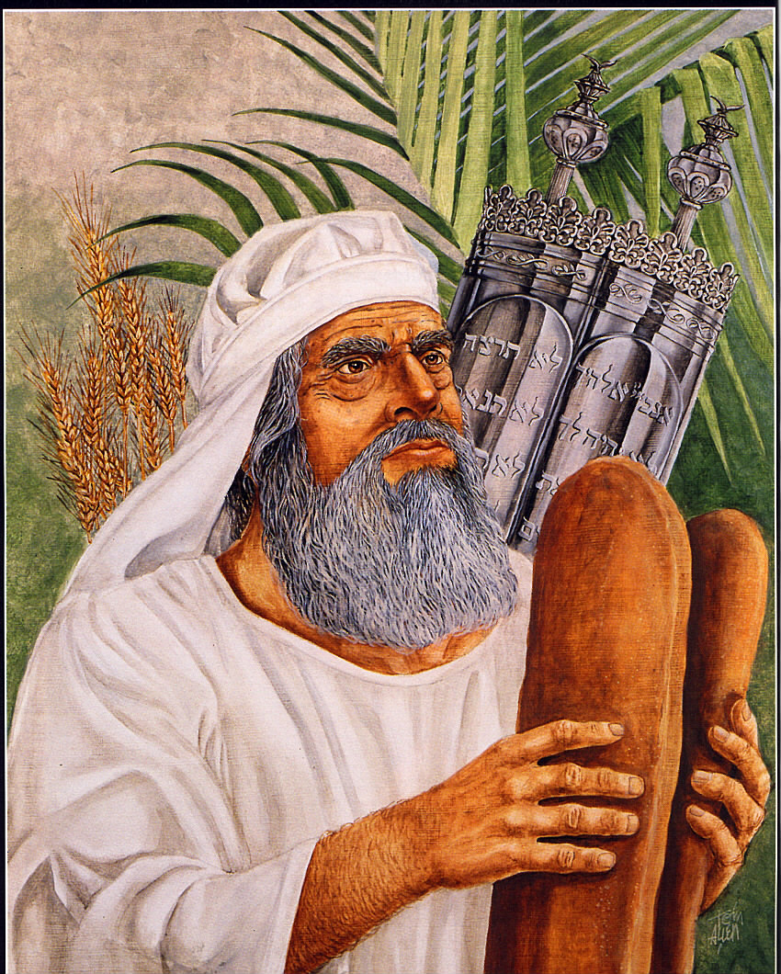

Slide 16
First Shavuot
2. Torah given: main identity of Jewish people → national mission task of literacy in divine literature.
^{Ro 3.1-2} Then what is the advantage of being Jewish? Much in every way. First of all, they were entrusted with the sayings of God.
Notes:
This is why stereotypical successful Jews, rich Jews, Nobel prizes plethora.

Slide 17
Side note: corrupted ‘literacy’ divergence today:
…these sites, the same ones teaching kids a distorted and twisted version of sex, get more visitors each month than Netflix, Amazon, and Twitter combined.
Notes:
https://www.frc.org/get.cfm?i=WA18E33&f=WU18E11

Slide 18
These are the actors who are being exploited for an industry that's tied to the dark world of trafficking, domestic violence, child abuse, and abortion.
Accountability of self and children. Epidemic!
Notes:
https://www.frc.org/get.cfm?i=WA18E33&f=WU18E11

Slide 19
First Shavuot
2. Torah given: main identity of Jewish people → national mission task of literacy in divine literature.
^{Ro 3.1-2} Then what is the advantage of being Jewish? Much in every way. First of all, they were entrusted with the sayings of God.

Slide 20
Immediate Israeli reaction:
^{Shmot/Ex 20.18-19} All the people witnessed the thundering and the lightning, and the sound of the shofar, and the mountain smoking.

Slide 21
Immediate Israeli reaction:
^{Shmot/Ex 20.18-19} When the people saw it, they trembled and stood far off. So they said to Moses, “You, speak to us, and we will listen, but do not let God speak to us, or we will die.”
Notes:
Dread, not joy to hear! Shma. Some say that this is the beginning of the Oral Law, not to hear from G-d, but from man.

Slide 22
Long term Israeli reaction
Rejected Torah → sensual idolatry → exiled from Land
Repented, returned under Ezra rebuilt the Temple, cleansed the land, but many later seduced by Greek ways that they had defeated.

Slide 23
Long term Israeli reaction
The very descendants of the liberators from Greek oppression invited Romans to settle a dynastic dispute. Romans settled it, took over.
Sages, scholars, and spoilers.
Notes:
Great men, not so great. Men of the Great Assembly.

Slide 24
Second Shavuot
^{Gal 4.4-6} When the fullness of time came, God sent out His Son, born of a woman and born under law—to free those under law, so we might receive adoption as sons. Now because you are sons, God sent the Ruakh of His Son into our hearts, who cries out, “Abba! Father!”
Notes:
Not just sensitivity to Christian vitriolic use of the term.

Slide 25
Second Shavuot
“Executed on a stake”
Garden tomb version
Only horizontal bar carried
Hung at eye level
Title was crime summary so mocked by crowd

Slide 26
Second Shavuot
Totally naked
Emotional, mental, physical anguish
Bore all our sins
G-d gave the Ruakh: forgiveness, transformation

Slide 27
Immediate Israeli reaction:
Many received Him and the Ruakh
Most leaders and majority rejected.
We failed as lights to the world.
Yet, G-d keeps covenant!

Slide 28
Yet ^{Ro. 11.25 -27} For I do not want you, brothers and sisters, to be ignorant of this mystery—lest you be wise in your own eyes—that a partial hardening has come upon Israel until the fullness of the Gentiles has come in; and in this way all Israel will be saved, as it is written,

Slide 29
^{Ro. 11.25 -27} “The Deliverer shall come out of Zion. He shall turn away ungodliness from Jacob. And this is My covenant with them, when I take away their sins.”
Martin Luther: “these verses remain dark to me. Who can believe it?”

Slide 30
Third Shavuot
Return to the Land after the Holocaust, but without Jerusalem
May 1967 general panic, assuaged by Rabbi Schneerson
Mivtva Moked [Operation Focus] 7% success likelihood!!
Notes:
Read from FFOZ Messiah Mag Vol 2 issue 18 Fall 2017 p 9-12

Slide 31
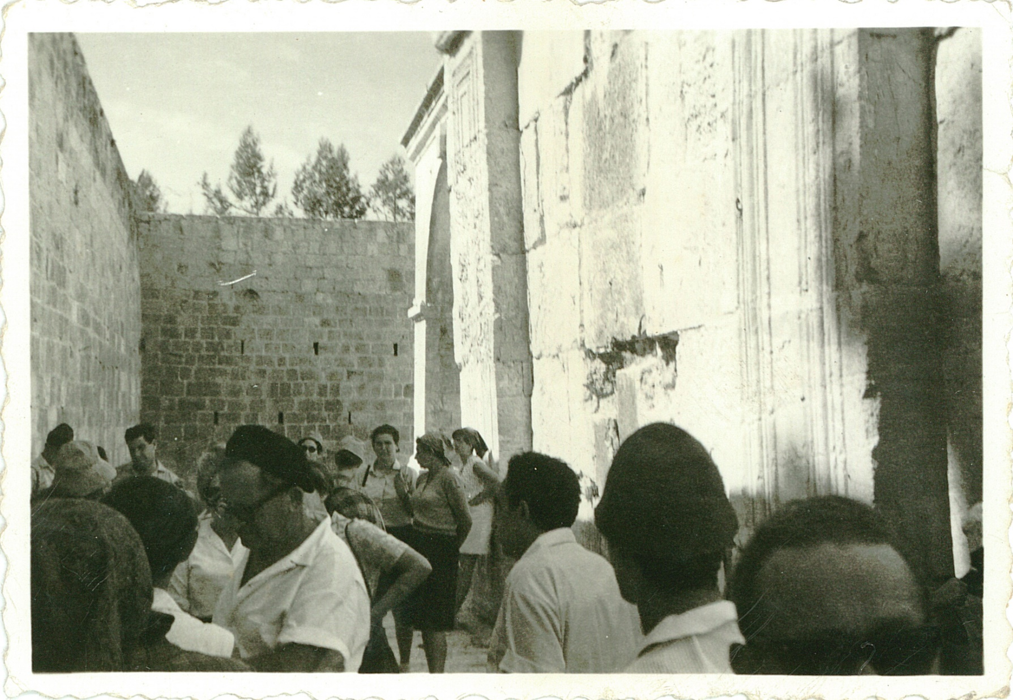
Notes:
https://www.google.com/search?q=shavuot+1967+Jerusalem&safe=active&tbm=isch&tbs=rimg:Cb_1e6NwSZf-iIjh9NpxvH3ebds7R6KfQtluiOQha2O2-T8IEhJIy6oc6XVLA3pXQ7qb43ktNfunB_1rtN1gioqrzQzyoSCX02nG8fd5t2EWBZdI6PJ0rzKhIJztHop9C2W6IRfVxiaTprSXoqEgk5CFrY7b5PwhHR7HbzxwXuqyoSCQSEkjLqhzpdEf-9gONIUcKSKhIJUsDeldDupvgRidvXeFXGA0AqEgneS01-6cH-uxGyz9A3zTEoHSoSCU3WCKiqvNDPEYxWoEB0fDy0&tbo=u&sa=X&ved=2ahUKEwiQ1KKG8pHbAhVthq0KHayjCJIQ9C96BAgBEBs&biw=1165&bih=848&dpr=1.1#imgdii=RU8ANKUxkK9x5M:&imgrc=YDj2NFWZlotUHM:

Slide 32
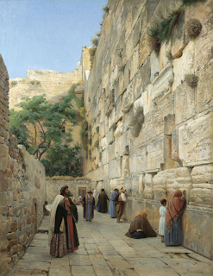
Notes:
http://jewishbubba.blogspot.com/2016/10/western-wall-in-jerusalem-and-denial.html

Slide 33
^{Yekhezkel/Ezk 36.26-28} Moreover I will give you a new heart. I will put a new spirit within you. I will remove the stony heart from your flesh and give you a heart of flesh. I will put My Ruach within you.

Slide 34
^{Yekhezkel/Ezk 36.26-28} Then I will cause you to walk in My laws, so you will keep My rulings and do them. Then you will live in the land that I gave to your fathers. You will be My people and I will be your God.

Slide 35
Before 1967, for the most part, Jewish people following Messiah = deny Judaism and assimilate.
224,000 Jewish immersions in the 1800’s. Where are the descendants?
Some: David Brickner, Steve Galilee

Slide 36
Return to our original issue of deception:

Slide 37
Daniel Steele (1824 -1914) In 1886, Professor of Doctrinal Theology at Boston University.
Notes:
http://www.craigladams.com/Steele/

Slide 38
The fulness of the Holy Spirit in rabbi and people will always insure a correct theology. St. John in his First Epistle, ii. 20-27, regards the anointing or full immersin of the Spirit as the great safeguard against being drawn away by the falsity of anti-Messiah. Says Dr. Whedon:
Notes:
http://www.craigladams.com/Steele/page215/page254/

Slide 39
The word ‘Messiah' signified anointed, as ‘mashiakh’ signifies oil, or the anointment. Here the anointing is used in contrast to the anti-Messiahs who became such because they had no such sanctifying anointing. As long as we possess the holy anointing, we will adhere to the holy Messiah.
Notes:
http://www.craigladams.com/Steele/page215/page254/

Slide 40
A major deception
Palestinian refugees worldwide number only some 30,000, and not the millions claimed by the Palestinians, according to a classified Obama-era report on the issue.
Notes:
https://unitedwithisrael.org/classified-us-report-palestinian-refugees-number-only-30000/?utm_source=MadMimi&utm_medium=email&utm_content=Netanyahu+Welcomes+Smiling+US+Secretary+of+State+Pompeo+to+Israel%3B+Arab+Voices+Urge+Mideast+Countries+to+be+Like+Israel&utm_campaign=20180429_m145178019_Netanyahu+Welcomes+Smiling+US+Secretary+of+State+Pompeo+to+Israel%3B+Arab+Voices+Urge+Mideast+Countries+to+be+Like+Israel&utm_term=more_btn_dark_jpg

Slide 41
The Free Beacon on Friday reported that the US government continues to keep this explosive report classified. Congressional officials view the document as a potential game changer in how the US
Notes:
https://unitedwithisrael.org/classified-us-report-palestinian-refugees-number-only-30000/?utm_source=MadMimi&utm_medium=email&utm_content=Netanyahu+Welcomes+Smiling+US+Secretary+of+State+Pompeo+to+Israel%3B+Arab+Voices+Urge+Mideast+Countries+to+be+Like+Israel&utm_campaign=20180429_m145178019_Netanyahu+Welcomes+Smiling+US+Secretary+of+State+Pompeo+to+Israel%3B+Arab+Voices+Urge+Mideast+Countries+to+be+Like+Israel&utm_term=more_btn_dark_jpg

Slide 42
approaches its regional policies and allocates billions in taxpayer funds, including information that could deeply impact the diplomatic process.
Notes:
https://unitedwithisrael.org/classified-us-report-palestinian-refugees-number-only-30000/?utm_source=MadMimi&utm_medium=email&utm_content=Netanyahu+Welcomes+Smiling+US+Secretary+of+State+Pompeo+to+Israel%3B+Arab+Voices+Urge+Mideast+Countries+to+be+Like+Israel&utm_campaign=20180429_m145178019_Netanyahu+Welcomes+Smiling+US+Secretary+of+State+Pompeo+to+Israel%3B+Arab+Voices+Urge+Mideast+Countries+to+be+Like+Israel&utm_term=more_btn_dark_jpg

Slide 43
Golda Meir said it right: "We can forgive [the Arabs] for killing our children. We cannot forgive them for forcing us to kill their children. We will only have peace with [the Arabs] when they love their children more than they hate us..."

Slide 44
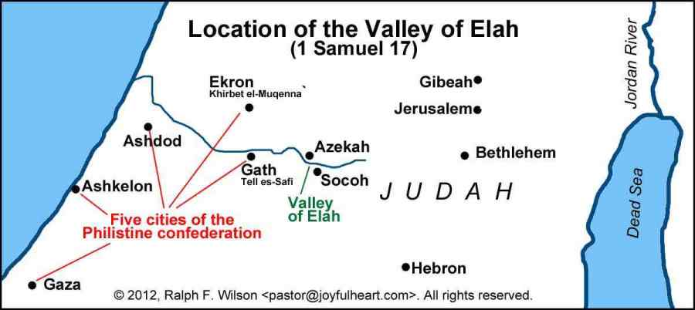
Notes:
http://www.gilberthouse.org/valley-of-elah-location/

Slide 45
View from the south. West is to the right. We were on the
road just behind the Elah pointer.

Slide 46
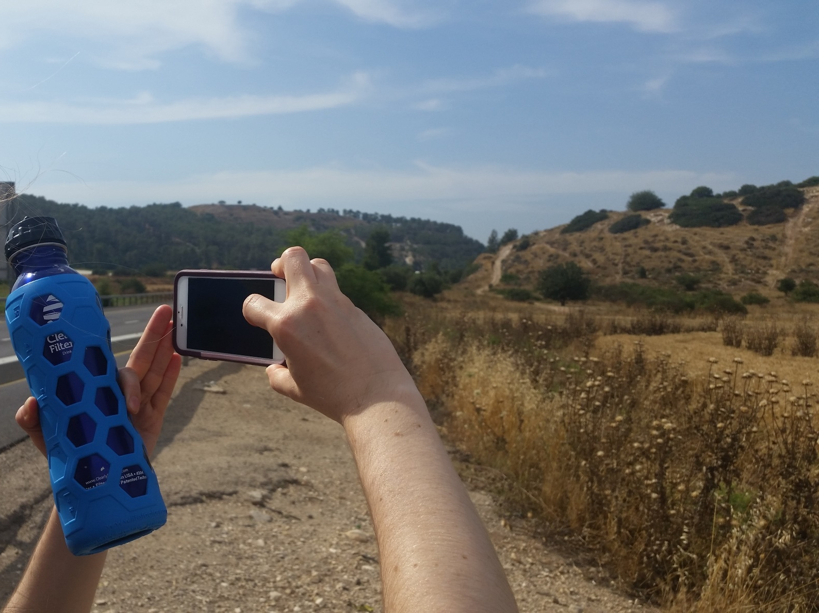
Tel Azekah

Slide 47
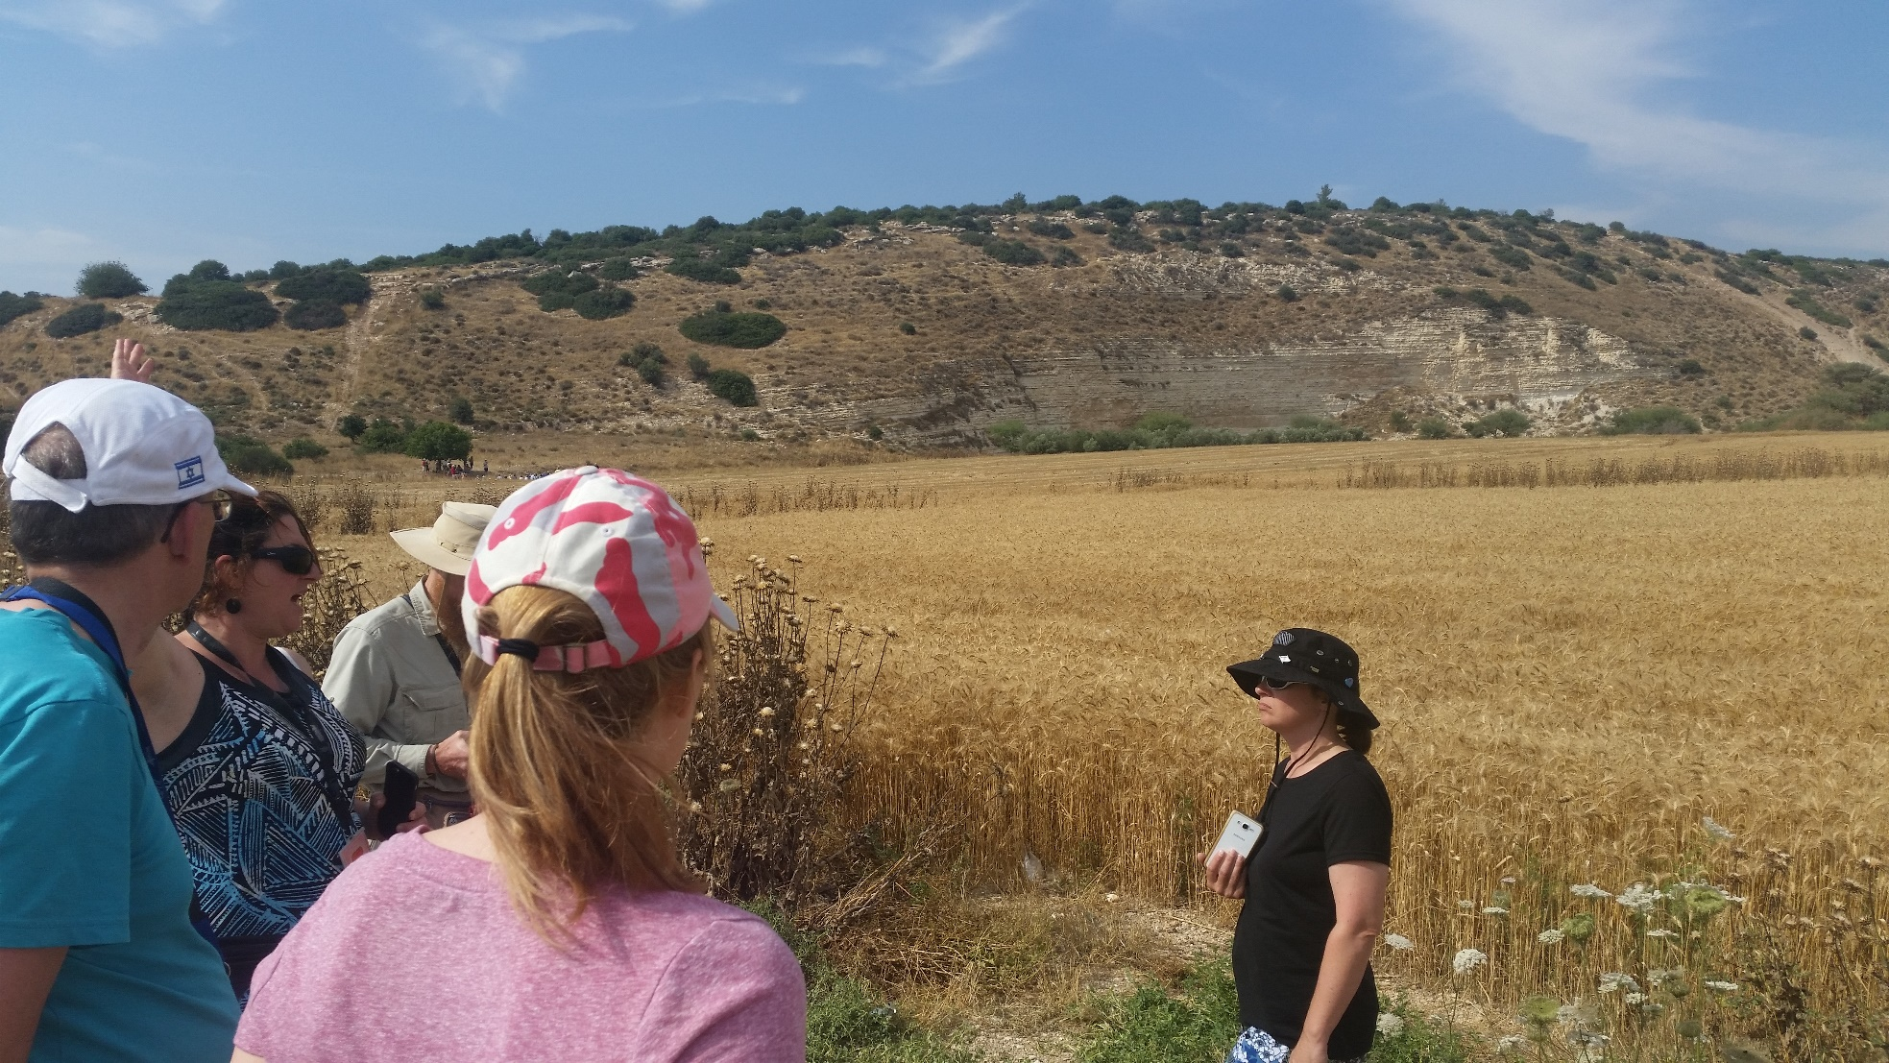
Israeli camp

Slide 48
Just as the physical liberation of Jerusalem in 1967 seemed to release an outpouring of the Ruakh through the Jewish and Gentile world, this week:
Notes:
https://www.frc.org/get.cfm?i=WA18E33&f=WU18E11

Slide 49
The Iranian Qods Force fired a barrage of 20 rockets at IDF forward posts on the Golan Heights around midnight on Wednesday night. [We heard one.]
Four of rockets were intercepted by the IDF's Iron Dome aerial defense system. No injuries were reported. Others landed in Syria.
Notes:
https://www.israelnationalnews.com/News/News.aspx/245717

Slide 50
In retaliation, Israel struck the rocket launching site. In addition, Israel destroyed weapons depots, intelligence centers, anti-aircraft weaponry, storage facilities, observation posts and operations headquarters.
Notes:
http://www.sun-sentinel.com/florida-jewish-journal/fl-jjps-airstrike-0516-20180510-story.html

Slide 51
The Israel Defense Forces reported that it had set back Iranian military capabilities in Syria by "many months," smashing more than 50 targets in what IDF Spokesperson Brig.-Gen. Ronen Manelis called "one of the greatest operations of the Israel Air Force in the past decade."
Notes:
http://www.sun-sentinel.com/florida-jewish-journal/fl-jjps-airstrike-0516-20180510-story.html

Slide 52
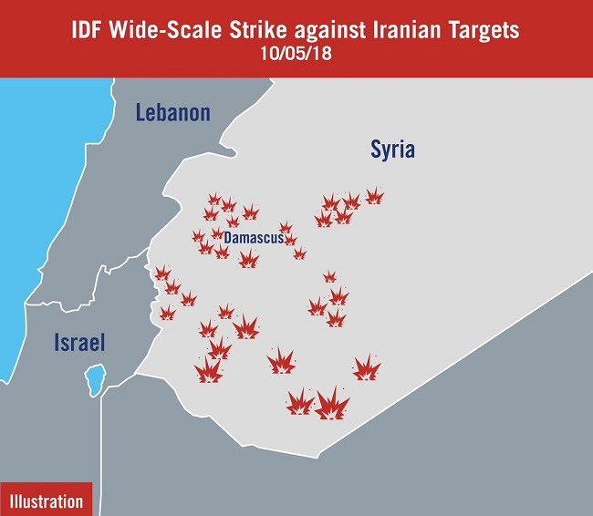
Notes:
http://osnetdaily.com/2018/05/israel-attacks-50-targets-in-opening-strike-of-war-with-iran-in-syria/

Slide 53
Also this week
US Embassy opened in Jerusalem May 15, 2018
~3000 people from the Nations march through Jerusalem to recognize the Holocaust and Israel. 7 member of the Knesset.
Notes:
Guatemala followed. Paraguay next.

Slide 54
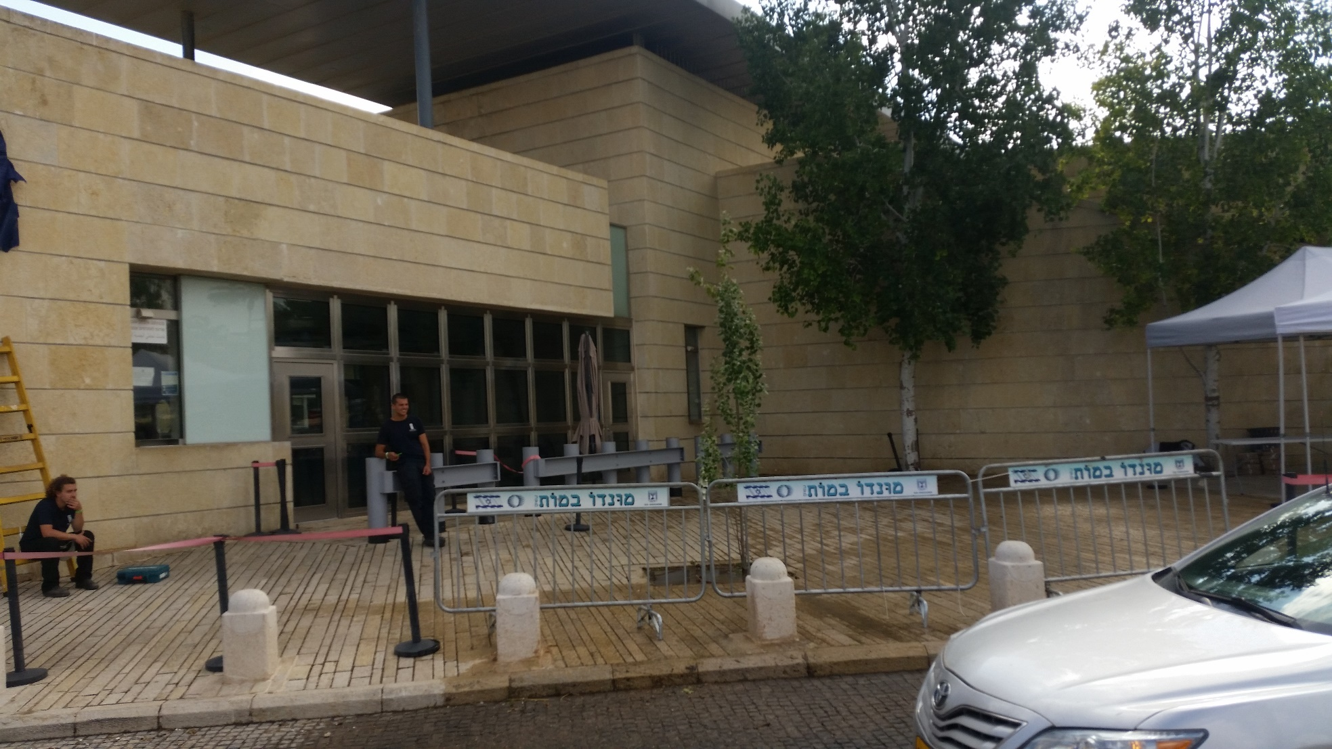

Slide 55
The JCPoA Iranian Deal negated by Pres. Trump
7 members of the Knesset came to greet and thank the MoN leaders.

Slide 56
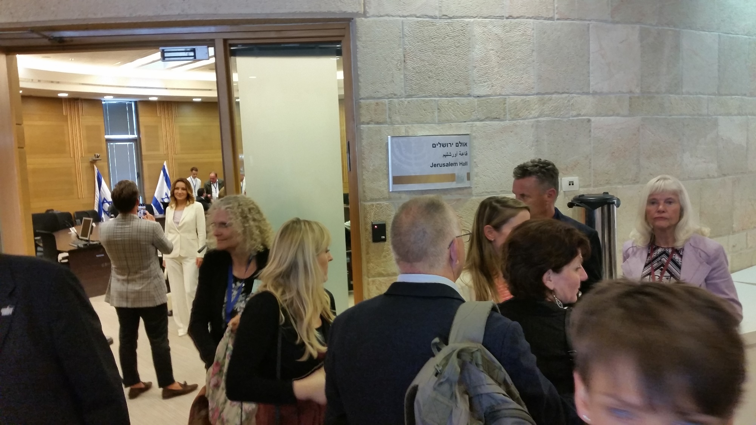

Slide 57
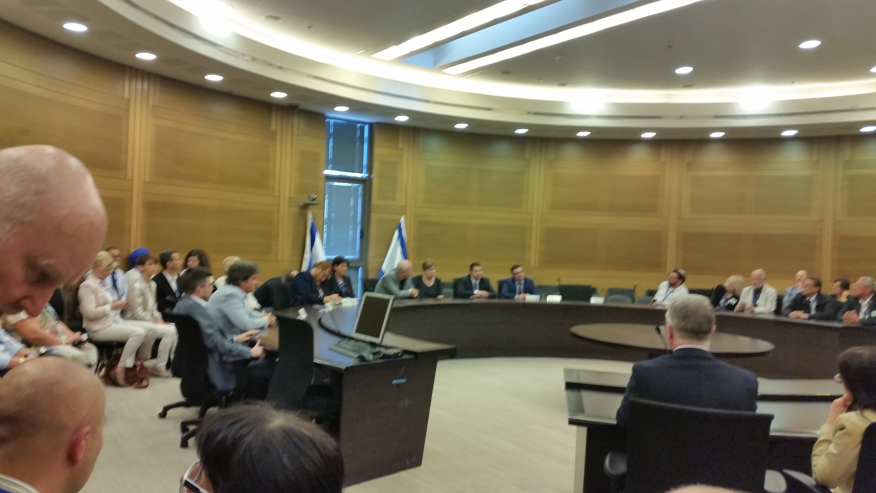

Slide 58
^{Luke 17:5-6} And the apostles said to the Lord, “Increase our faith.” So the Lord said, “If you have faith as a mustard seed, you can say to this mulberry tree, ‘Be pulled up by the roots and be planted in the sea,’ and it would obey you.
Notes:
https://unitedwithisrael.org/classified-us-report-palestinian-refugees-number-only-30000/?utm_source=MadMimi&utm_medium=email&utm_content=Netanyahu+Welcomes+Smiling+US+Secretary+of+State+Pompeo+to+Israel%3B+Arab+Voices+Urge+Mideast+Countries+to+be+Like+Israel&utm_campaign=20180429_m145178019_Netanyahu+Welcomes+Smiling+US+Secretary+of+State+Pompeo+to+Israel%3B+Arab+Voices+Urge+Mideast+Countries+to+be+Like+Israel&utm_term=more_btn_dark_jpg

Slide 59
The African Impala (an African antelope) are amazing creatures that can jump to a height of over 10 feet and cover a distance greater than 30 feet. Yet Impalas can be kept in a zoo inside an enclosure with a simple 3 foot wall. Why?
Notes:
https://unitedwithisrael.org/classified-us-report-palestinian-refugees-number-only-30000/?utm_source=MadMimi&utm_medium=email&utm_content=Netanyahu+Welcomes+Smiling+US+Secretary+of+State+Pompeo+to+Israel%3B+Arab+Voices+Urge+Mideast+Countries+to+be+Like+Israel&utm_campaign=20180429_m145178019_Netanyahu+Welcomes+Smiling+US+Secretary+of+State+Pompeo+to+Israel%3B+Arab+Voices+Urge+Mideast+Countries+to+be+Like+Israel&utm_term=more_btn_dark_jpg

Slide 60
Impalas will not jump if they can't see where their feet will land. Do we have something in common with these antelopes? Able to take great leaps of faith, but refusing to do it unless we can see where we'll land?
Notes:
https://unitedwithisrael.org/classified-us-report-palestinian-refugees-number-only-30000/?utm_source=MadMimi&utm_medium=email&utm_content=Netanyahu+Welcomes+Smiling+US+Secretary+of+State+Pompeo+to+Israel%3B+Arab+Voices+Urge+Mideast+Countries+to+be+Like+Israel&utm_campaign=20180429_m145178019_Netanyahu+Welcomes+Smiling+US+Secretary+of+State+Pompeo+to+Israel%3B+Arab+Voices+Urge+Mideast+Countries+to+be+Like+Israel&utm_term=more_btn_dark_jpg

Slide 61
George Mueller said of faith, "Faith does not operate in the realm of the possible. There is no glory for God in that which is humanly possible. Faith begins where man's power ends.“ In Biblical terms: "Now faith is the substance of things hoped for, the evidence of things not seen."
Notes:
https://unitedwithisrael.org/classified-us-report-palestinian-refugees-number-only-30000/?utm_source=MadMimi&utm_medium=email&utm_content=Netanyahu+Welcomes+Smiling+US+Secretary+of+State+Pompeo+to+Israel%3B+Arab+Voices+Urge+Mideast+Countries+to+be+Like+Israel&utm_campaign=20180429_m145178019_Netanyahu+Welcomes+Smiling+US+Secretary+of+State+Pompeo+to+Israel%3B+Arab+Voices+Urge+Mideast+Countries+to+be+Like+Israel&utm_term=more_btn_dark_jpg

Slide 62
Just as the physical liberation of Jerusalem seemed to release an outpouring of the Ruakh through the Jewish and Gentile world, this week. Overcome deceptions, serve Messiah, fruitfulness and victory!
Notes:
https://www.frc.org/get.cfm?i=WA18E33&f=WU18E11

