Slide 1
If you want to have notes without taking notes,
Go to OrHaOlam.com
WITHOUT WIFI
Click on downloads, messages, 2018 messages
Today’s should be on the top.

Slide 2
News from Israel

Slide 3
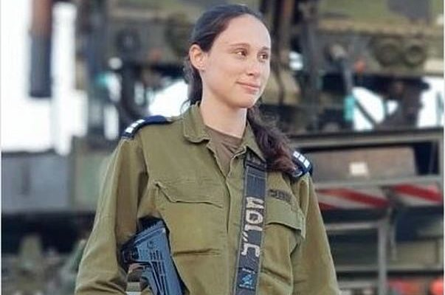
IDF Captain Or Na’aman
Notes:
https://worldisraelnews.com/female-idf-officer-responsible-for-felling-syrian-sukhoi-fighter-jet/?utm_source=MadMimi&utm_medium=email&utm_content=Haley+is+%27More+Israeli+than+Israelis%27%3B+ISIS+Video+of+Syrian+Jet+Downed+by+Israel+Goes+Viral%3B+Assad+Not+Expected+to+Retaliate&utm_campaign=20180725_m146401246_Haley+is+%27More+Israeli+than+Israelis%27%3B+ISIS+Video+of+Syrian+Jet+Downed+by+Israel+Goes+Viral%3B+Assad+Not+Expected+to+Retaliate&utm_term=_0D_0A_09_09_09_09_09_09_09_09_09_09Read+Now_0D_0A_09_09_09_09_09_09_09_09_09
IDF Captain Or Na’aman commanded the Patriot battery stationed in northern Israel which shot down a Syrian fighter jet Tuesday. As the commander of the Patriot Battery of the 138th Battalion, Na’aman was also in charge of downing a Syrian drone over the Lake of the Galilee earlier this month.
Some sad news…

Slide 4
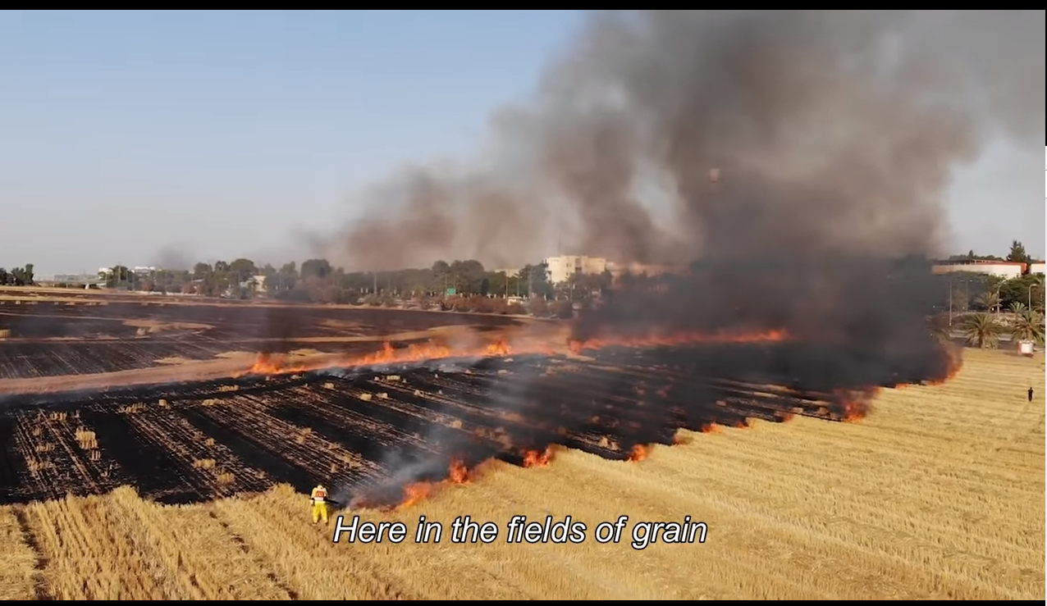
Notes:
https://unitedwithisrael.org/watch-a-tribute-to-southern-israels-farmers-and-firefighters/?utm_source=MadMimi&utm_medium=email&utm_content=US+Says+IDF+Deserves+Medal+for+Syrian+Rescue%3B+Netanyahu%3A+Christians+Thriving+in+Israel%2C+Persecuted+in+Iran%3B+Over+2+Million+Aided+by+Israel%21&utm_campaign=20180723_m146376854_US+Says+IDF+Deserves+Medal+for+Syrian+Rescue%3B+Netanyahu%3A+Christians+Thriving+in+Israel%2C+Persecuted+in+Iran%3B+Over+2+Million+Aided+by+Israel%21&utm_term=watch_btn_light_png

Slide 5
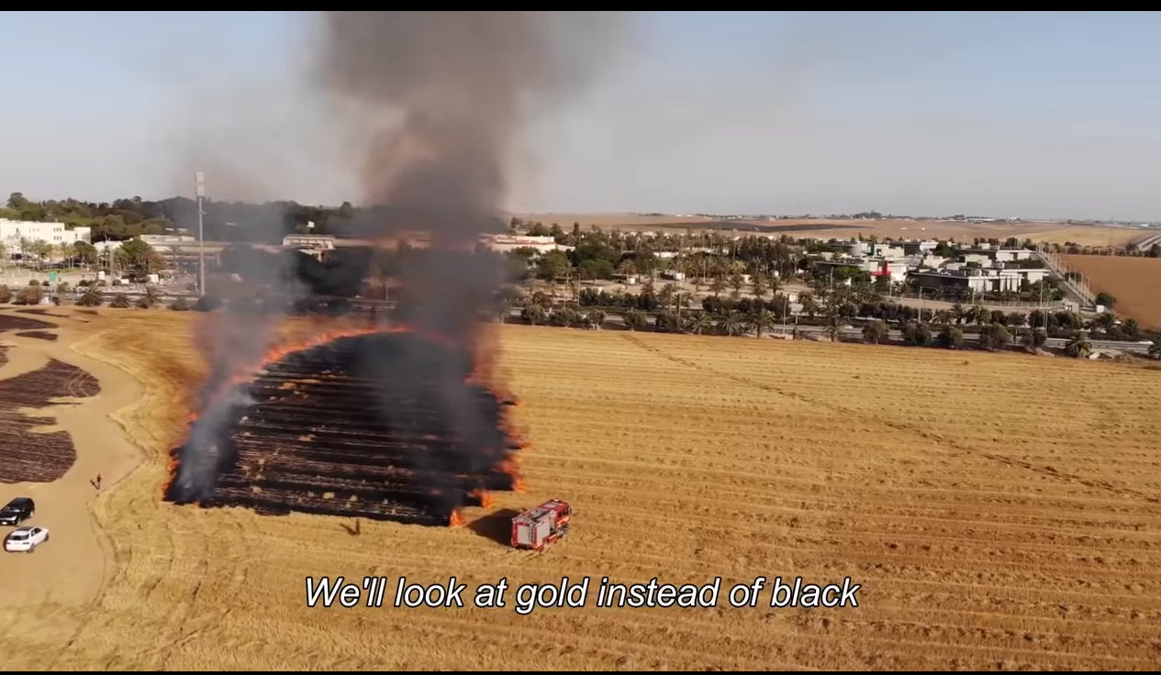
Notes:
https://unitedwithisrael.org/watch-a-tribute-to-southern-israels-farmers-and-firefighters/?utm_source=MadMimi&utm_medium=email&utm_content=US+Says+IDF+Deserves+Medal+for+Syrian+Rescue%3B+Netanyahu%3A+Christians+Thriving+in+Israel%2C+Persecuted+in+Iran%3B+Over+2+Million+Aided+by+Israel%21&utm_campaign=20180723_m146376854_US+Says+IDF+Deserves+Medal+for+Syrian+Rescue%3B+Netanyahu%3A+Christians+Thriving+in+Israel%2C+Persecuted+in+Iran%3B+Over+2+Million+Aided+by+Israel%21&utm_term=watch_btn_light_png
Has anyone seen this in the KC Star, heard on radio, TV?
Continuing the series in Matityahu/Matthew

Slide 6
מַתִּתְיָהוּ Mattityahu
(Matthew) 24:15-16
Notes:
Previous verse very upbeat. In the midst of endtime difficulties:
^{Mt 34.14} This Good News of the kingdom shall be proclaimed in the whole world as a testimony to all the nations, and then the end will come.
And I don’t think the testimony will be ineffective. That’s why we’re in the 40 day fast. Outreach to Jewish world, then the Nations. Scripture isn’t passive, it’s a play book for us. Destined for the Throne. G-d is sovereign, but He wants our involvement in the Kingdom. I’m believing G-d for a GREAT harvest. However, in the context of that warning from Messiah…

Slide 7
Mattityahu (Matthew) 24:15
‏ ”לָכֵן כַּאֲשֶׁר תִּרְאוּ אֶת הַשִּׁקּוּץ הַמְּשֹׁמֵם, כַּנֶּאֱמַר בְּפִי דָּנִיאֵל הַנָּבִיא,
“So when you see the abomination that causes devastation spoken about through the prophet Dani’el

Slide 8
Mattityahu (Matthew) 24:15
‏ ”עוֹמֵד בְּמָקוֹם קָדוֹשׁ — עַל הַקּוֹרֵא לְהָבִין -
”standing in the Holy Place” (let the reader understand the allusion),
Notes:
Mt 21.42 Yeshua said to them, “Haven’t you ever read in the Tanakh,”

Slide 9
Mattityahu (Matthew) 24:16
‏ אֲזַי הַנִּמְצָאִים בִּיהוּדָה, שֶׁיָּנוּסוּ אֶל הֶהָרִים:
“that will be the time for those in Y’hudah to escape to the hills.”

Slide 10
Mattityahu (Matthew) 24:17-22
‏ If someone is on the roof, he must not go down to gather his belongings from his house; if someone is in the field, he must not turn back to get his coat. What a terrible time it will be for pregnant women and nursing mothers!

Slide 11
Mattityahu (Matthew) 24:17-22
‏Pray that you will not have to escape in winter or on Shabbat. For there will be trouble then worse than there has ever been from the beginning of the world until now, and there will be nothing like it again!
Notes:
There have been a lot of times of trouble. We can’t imagine worse than WW II. Up to 85 million deaths 2.3 billion world population. About 3% of the 1940 world population . Look around and imagine 3%. Much more among certain populations: Jews, Belarussians, Germans, Russians. Nazi death camps.
Also Stalin, Mao, PolPot.
Never been like this one.

Slide 12
Mattityahu (Matthew) 24:17-22
‏Indeed, if the length of this time had not been limited, no one would survive; but for the sake of those who have been chosen, its length will be limited.

Slide 13
Great trouble coming
How to understand it.
How to walk in it.
Notes:
Key is this man and event…

Slide 14
Mattityahu (Matthew) 24:15
‏ ”לָכֵן כַּאֲשֶׁר תִּרְאוּ אֶת הַשִּׁקּוּץ הַמְּשֹׁמֵם, כַּנֶּאֱמַר בְּפִי דָּנִיאֵל הַנָּבִיא,
“So when you see the abomination that causes devastation spoken about through the prophet Dani’el

Slide 15
Mattityahu (Matthew) 24:15
‏ ”עוֹמֵד בְּמָקוֹם קָדוֹשׁ — עַל הַקּוֹרֵא לְהָבִין -
”standing in the Holy Place” (let the reader understand the allusion),
Notes:
Note ‘reader’
Parallel passage Mark…

Slide 16
^{Mark 13.14} “Now when you see the abomination that causes devastation standing where it ought not to be” (let the reader understand the allusion), “that will be the time for those in Y’hudah to escape to the hills.
Notes:
Apparently Yeshua made a big deal of reading the Scriptures, even when they weren’t printed en masse on paper, never mind digitally.
Mt 21.42 Yeshua said to them, “Haven’t you ever read in the Tanakh,
‘The very rock which the builders rejected has become the cornerstone! This has come from Adonai, and in our eyes it is amazing’?
So, let’s read what Yeshua was talking about. [We need to read the Hebrew scriptures, according to the Messiah, despite what some have recently said to “detach”] Three references to this Abomination of desolation.
So word study first, then let’s read

Slide 17
שִׁקּוּץ מְשֹׁמֵם shikoots m’shomem
שִׁקּוּץ abomination, detestable thing; idol, fetish
מְשֹׁמֵםdesolate deserted, waste, solitary depopulated, to be stupefied, stunned, astonished, appalled, alarmed, shocked
Notes:
This guy and action are bad. The worst imaginable. Unimaginable.

Slide 18
The word שִׁקּוּץ "abomination" is described as a "detestable act" or "detestable thing" and in both biblical and rabbinic Hebrew, is a familiar term for an idol, suggest that as a designation for Jupiter it is simply an intentional
Notes:
https://en.wikipedia.org/wiki/Abomination_of_desolation

Slide 19
perversion of his usual appellation "Baal Shamem" ("lord of heaven")
שִׁקּוּצִים מְשֹׁמֵם
shikootsim m’shomem
So, let’s read the Tanakh that Yeshua is referring to. Three verses…
Notes:
https://en.wikipedia.org/wiki/Abomination_of_desolation
About this very bad guy and action

Slide 20
^{Daniel 9.27}וְהִגְבִּיר בְּרִית לָרַבִּים, שָׁבוּעַ אֶחָד; וַחֲצִי הַשָּׁבוּעַ יַשְׁבִּית זֶבַח וּמִנְחָה, וְעַל כְּנַף שִׁקּוּצִים מְשֹׁמֵם, וְעַד-כָּלָה וְנֶחֱרָצָה, תִּתַּךְ עַל-שֹׁמֵם.
He will make a strong covenant with leaders for one week [of years]. For half of the week he will put a stop to the sacrifice and the grain offering.

Slide 21
^{Daniel 9.27}וְהִגְבִּיר בְּרִית לָרַבִּים, שָׁבוּעַ אֶחָד; וַחֲצִי הַשָּׁבוּעַ יַשְׁבִּית זֶבַח וּמִנְחָה, וְעַל כְּנַף שִׁקּוּצִים מְשֹׁמֵם, וְעַד-כָּלָה וְנֶחֱרָצָה, תִּתַּךְ עַל-שֹׁמֵם.
On the wing of detestable things the desolator will come and continue until the already decreed destruction is poured out on the desolator.”

Slide 25
This is in the chapter and section of the 70 weeks, understood to be weeks of years. How? Example of Nebuchadnetser:
Let his mind be altered from that of a man and let an animal’s mind be given to him and let seven periods of time
Time, period, era, epoch עִדָּנִין
Notes:
Context:

Slide 26
^{Dan. 9.24-26} “Seventy weeks have been decreed for your people and for your holy city for putting an end to the transgression, for making an end of sin, for forgiving iniquity, for bringing in everlasting justice, for setting the seal on vision and prophet, and for anointing the Especially Holy Place.

Slide 27
^{Dan. 9.24-26} So know and understand: From the issuing of the decree to restore and to build Jerusalem until the time Mashiakh, the Prince, there shall be 7 weeks and 62 weeks. It will be rebuilt, with plaza and moat, but it will be in times of distress.
Notes:
Typical chart of these weeks of years:

Slide 28
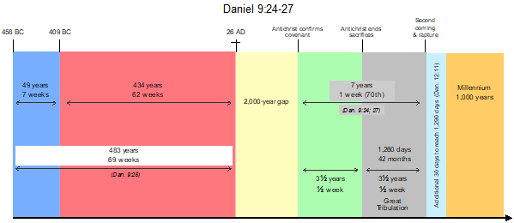
Notes:
MikeBickle.org
7 weeks, 49 years are the years of Ezra and Nekhemyah restoring the city walls and the Temple, starting with the decree the dedication of the new city, in the twenty third year of Artaxerxes . ( Nehemiah 12:27 )

Slide 29
^{Dan. 9.24-26} but these will be troubled times. Then, after the sixty-two weeks, Mashiach will be cut off and have nothing. The people of a prince yet to come will destroy the city and the sanctuary, but his end will come with a flood, and desolations are decreed until the war is over.
Notes:
The people of Israel themselves are said to have destroyed it, by obstinance.
Syrian auxiliaries hired by the Romans. ^{Josephus Wars 5.550-552} Joel Richardson teaches that the soldiers under Titus were Arabs, and that the prince yet to come will be an Arab.

Slide 30
This is the typical Christian interpretation. However, the expression appears twice more.

Slide 31
^{Dan. 11.31}Armed forces will come at his order and profane the sanctuary and fortress. They will abolish the daily burnt offering and set up the abomination that causes desolation.
Shikutz m’ shomam הַשִּׁקּוּץ מְשֹׁמֵם
Notes:
Daniel 11, above. is a detailed description-in-advance of the Maccabean wars. So, not an end times “abomination that makes desolation.”

Slide 32
There is a rabbinical consensus that the expression refers to the 168 BCE desecration of the Second Temple by the erection of a Zeus statue in its sacred precincts by Antiochus IV Epiphanes (the flashpoint of the Maccabean Revolt).
Notes:
https://en.wikipedia.org/wiki/Abomination_of_desolation

Slide 33
Some rabbis, however, see in it an allusion to Manasseh, who was reported to have set up "a carved image ... in the house of God"
Notes:
https://en.wikipedia.org/wiki/Abomination_of_desolation

Slide 34
Another possibility
One commentator relates the prophecy to the actions of Caligula c. 40 AD when he ordered that a golden statue depicting himself as Zeus incarnate be set up in the Temple in Jerusalem.
Notes:
https://en.wikipedia.org/wiki/Abomination_of_desolation

Slide 35
[Spring to Summer of 40 C.E.]
Towards the end of the reign of Gaius Caligula, a proclamation was sent out for a statue of the Roman Emperor to be built within the Temple walls in Jerusalem.
Notes:
https://nvdatabase.swarthmore.edu/content/jewish-peasants-block-construction-statue-gaius-caligula-galilee-40-ce

Slide 36
The President of Syria Petronius was sent along with two legions of soldiers to complete the task. A time after Petronius’ arrival in the port city of Ptolemais he was met by tens of thousands of Jews who travelled from the countryside to petition him not to violate the laws of their forefathers.
Notes:
https://nvdatabase.swarthmore.edu/content/jewish-peasants-block-construction-statue-gaius-caligula-galilee-40-ce

Slide 37
Farmers completely abandoned planting fresh crops in spring creating both economic and social strain and a dilemma situation for Petronius. Petronius eventually wrote to Gaius Caligula of his inability to erect the statue and his willingness to face the consequences.
Notes:
https://nvdatabase.swarthmore.edu/content/jewish-peasants-block-construction-statue-gaius-caligula-galilee-40-ce

Slide 38
John Wesley (1754) also rejects the rabbinical view and wrote, "When ye shall see the abomination of desolation - Daniel's term is, 'The abomination that maketh desolate' (xi. 31); that is, the standards of the desolating legions, on which they bear the abominable images of their idols.
Notes:
https://en.wikipedia.org/wiki/Abomination_of_desolation

Slide 39
John Wesley (1754) Standing in the holy place - Not only the temple, and the mountain on which it stood, but the whole city of Jerusalem, and several furlongs of land round about it, were accounted holy; particularly the mountain on which our Lord now sat, and on which the Romans afterward planted their ensigns."
Notes:
https://en.wikipedia.org/wiki/Abomination_of_desolation

Slide 40
AND now the Romans, upon the flight of the seditious into the city, and upon the burning of the holy house itself, and of all the buildings round about it, brought their ensigns to the temple and set them over against its eastern gate; and there did they offer sacrifices to them, and there did they make Titus imperator
Notes:
http://sacred-texts.com/jud/josephus/war-6.htm

Slide 41
Some scholars see these verses about Emperor Hadrian's attempt to install the statue of Jupiter Capitolinus on the site of the ruined Jewish Temple in Jerusalem leading to the Bar Kokhba revolt of 132-135 AD.
Notes:
https://en.wikipedia.org/wiki/Abomination_of_desolation

Slide 42
Some claim that the abomination of desolation refers to the crucifixion of the Son of God…He is the "desolating sacrilege" and Golgotha is "the holy place".
Notes:
https://en.wikipedia.org/wiki/Abomination_of_desolation

Slide 43
Some see the building of the Dome of the Rock by the Umayyad Caliph Abd al-Malik ibn Marwan in 691 AD.
A practical application to the concept of defiling the Temple:
Notes:
https://en.wikipedia.org/wiki/Abomination_of_desolation

Slide 44
^{1 Cor. 6.19-20} Or don’t you know that your body is a temple for the Ruakh HaKodesh who lives inside you, whom you received from God? The fact is, you don’t belong to yourselves; for you were bought at a price. So use your bodies to glorify God.

Slide 45
^{1 Cor. 6.18} Run from sexual immorality! Every other sin a person commits is outside the body, but the fornicator sins against his own body.

Slide 46
In a study of 5,000 people who identify as transgender, men trying to become women were 80 to 90 percent more likely to have a stroke or heart attack. They also had a higher risk of blood clots from the estrogen. That's an astounding level of risk for anyone, let alone these patients,
Notes:
https://www.frc.org/updatearticle/20180724/killer-effects

Slide 47
who are choosing to create an imbalance in their system. "This is the largest study of the health of transgender individuals on hormone therapy ever done," one of the authors, Dr. Darios Getahun, told NBC News. "Doctors and patients need to be aware of the possibility for increased health risks for transgender women."
Notes:
https://www.frc.org/updatearticle/20180724/killer-effects
They had thought the the abundant estrogen would have no more deleterious effect on men than on post menopausal women. Not so. A man’s body can’t receive estrogen in such quantities without harm.
Back to our text, third use of the term in Daniel:

Slide 48
^{Daniel 12.11} From the time the regular burnt offering is taken away and the abomination that causes desolation is set up, there will be 1,290 days.
Shikutz shomam שִׁקּוּץ שֹׁמֵם
Context:

Slide 49
^{Dan. 12.1-4} “At that time Michael, the great prince who protects your people, will arise. There will be a time of distress such as has not happened from the beginning of nations until then. But at that time your people—everyone whose name is found written in the book—will be delivered.

Slide 50
^{Dan. 12.1-4} Multitudes who sleep in the dust of the earth will awake: some to everlasting life, others to shame and everlasting contempt. Those who impart wisdom will shine like the brightness of the heavens,

Slide 51
^{Dan. 12.1-4} and those who lead many to righteousness, like the stars for ever and ever. But you, Daniel, roll up and seal the words of the scroll until the time of the end. Many will go here and there to increase knowledge.”

Slide 52
^{Daniel 12.11} From the time the regular burnt offering is taken away and the abomination that causes desolation is set up, there will be 1,290 days.
Shikutz shomam שִׁקּוּץ שֹׁמֵם
This is indeed a last days scenario, similar to:

Slide 53
^{2 Thes 2.3-4} Let no one deceive you in any way, for the Day will not come unless the rebellion comes first and the man of lawlessness is revealed, the one destined to be destroyed. He opposes and exalts himself above every so-called god or object of worship, so that he sits in the Temple of God, proclaiming himself that he is God.

Slide 54
Apparently, there is a future figure that will rise to global prominence politically, economically and militarily by setting up a governmental structure possessing sweeping powers over worship and the affairs of humanity.
Notes:
https://en.wikipedia.org/wiki/Abomination_of_desolation

Slide 55
Most current believers see the "Abomination of Desolation" prophecy of Daniel mentioned by Yeshua in Matthew 24:15 and Mark 13:14 as referring to an event in the end time future, when a 7-year peace treaty will be signed between Israel and a world ruler called "the man of lawlessness", or the "AntiMessiah."
Notes:
https://en.wikipedia.org/wiki/Abomination_of_desolation

Slide 56
Notes:
MikeBickle.org
7 weeks, 49 years are the years of Ezra and Nekhemyah restoring the city walls and the Temple, starting with the decree the dedication of the new city, in the twenty third year of Artaxerxes . ( Nehemiah 12:27 )

Slide 57
Summary of possible interpretations of the Abomination that makes desolate
Manesseh
Antiochus
Titus on the destroyed Temple
Caligula 40
Hadrian
End Time Anti-Messiah
Notes:
Which one? All are interpretations. Final one is the strongest.

Slide 58
Mattityahu (Matthew) 24:15
‏ ”לָכֵן כַּאֲשֶׁר תִּרְאוּ אֶת הַשִּׁקּוּץ הַמְּשֹׁמֵם, כַּנֶּאֱמַר בְּפִי דָּנִיאֵל הַנָּבִיא,
“So when you see the abomination that causes devastation spoken about through the prophet Dani’el

Slide 59
Mattityahu (Matthew) 24:15
‏ ”עוֹמֵד בְּמָקוֹם קָדוֹשׁ — עַל הַקּוֹרֵא לְהָבִין -
”standing in the Holy Place” (let the reader understand the allusion),

Slide 60
Mattityahu (Matthew) 24:16
‏ אֲזַי הַנִּמְצָאִים בִּיהוּדָה, שֶׁיָּנוּסוּ אֶל הֶהָרִים:
“that will be the time for those in Y’hudah to escape to the hills.”
Notes:
Warning was needed. People could leave Jerusalem safely until 68 CE. Jos Wars 4.377-80. After that Romans suspected deserters to have swallowed jewels to escape with them, and were cut open by the Syrian auxiliaries.
Pella

Slide 61
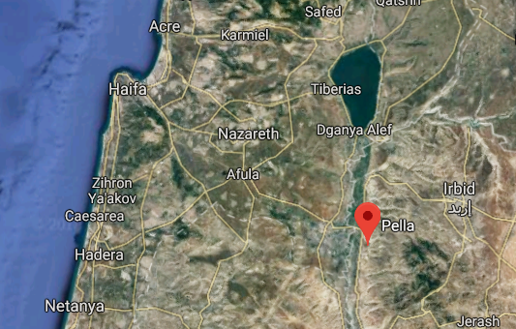

Slide 62
Mattityahu (Matthew) 24:17-22
‏ If someone is on the roof, he must not go down to gather his belongings from his house; if someone is in the field, he must not turn back to get his coat. What a terrible time it will be for pregnant women and nursing mothers!
Notes:
Houses had external stairways to the roof, so one could leave the roof without going into the house.

Slide 63
Mattityahu (Matthew) 24:17-22
‏Pray that you will not have to escape in winter or on Shabbat. For there will be trouble then worse than there has ever been from the beginning of the world until now, and there will be nothing like it again!

Slide 64
Mattityahu (Matthew) 24:17-22
‏Indeed, if the length of this time had not been limited, no one would survive; but for the sake of those who have been chosen, its length will be limited.

Slide 65
Great trouble coming
How to understand it.
How to walk in it.
Notes:
Key is this man and event…

Slide 66
^{Joel 2.1-2} “Blow the shofar in Tziyon! Sound an alarm on my holy mountain!” Let all living in the land tremble, for the Day of Adonai is coming! It’s upon us! — a day of darkness and gloom, a day of clouds

Slide 67
^{Joel 2.1-2} and thick fog; a great and mighty horde is spreading like blackness over the mountains. There has never been anything like it, nor will there ever be again, not even after the years of many generations

Slide 68
^{Yermiyah 30.4-7} These are the words the Lord spoke concerning Israel and Judah: “This is what the Lord says: “‘Cries of fear are heard— terror, not peace. Ask and see: Can a man bear children? Then why do I see every strong man with his hands on his stomach

Slide 69
^{Yermiyah 30.4-7} like a woman in labor, every face turned deathly pale? It will be a time of troublHow awful that day will be! No other will be like it. e for Jacob, but he will be saved out of it.

Slide 70
^{Zekh. 13 8-9} In time, throughout that land,” says Adoni, “two-thirds of those in it will be destroyed — they will die, but one-third will remain. That third part I will bring through the fire; I will refine them as silver is refined, I will test them as gold is tested. They will call on my name, and I will answer them. I will say, ‘This is my people’ and they will say, ‘Adoni is my God.’”
Notes:
Key is this man and event…

Slide 71
Great trouble coming
How to understand it.
How to walk in it.
Notes:
Key is this man and event…

Slide 72
Applications:
Horrific times are coming for Israel and believers in Messiah. Fight to reform the culture politically, but ultimately there will be an Anti-Messiah ruling. Will we be raptured beforehand? Engage in the fight, prepare to suffer.
Notes:
We are currently blessed to be in a time of reprieve. Many say that.
Make sure your salvation is real, and deep.

Slide 73
For the sake of those who have been chosen, its length will be limited. G-d controls the chaos.
It will be a time of trouble for Jacob, but he will be saved out of it. Salvation comes in distress if we look to G-d in it.
Notes:
Praise Him in the Chaos. Most massive praises in scripture are in the midst of chaos.

Slide 74
4. Those who impart wisdom will shine like the brightness of the heavens, and those who lead many to righteousness, like the stars for ever and ever. Pray for outreach and talmidut /discipleship

Slide 75
Pray that you will not have to escape in winter or on Shabbat. Have an escape plan. Implies difficulties of Shabbat travel: gates closed, implies honoring Shabbat.
Don’t hold too tightly to possession. G-d is our possession.

Slide 76
​
https://drive.google.com/file/d/0B9wqjBTYQZt-Y3M0OXV0VE9xNEU/view

