Slide 1
e-handout
To have these notes
without taking notes
Go to OrHaOlam.com
Click on downloads,
messages, 2020

Slide 2
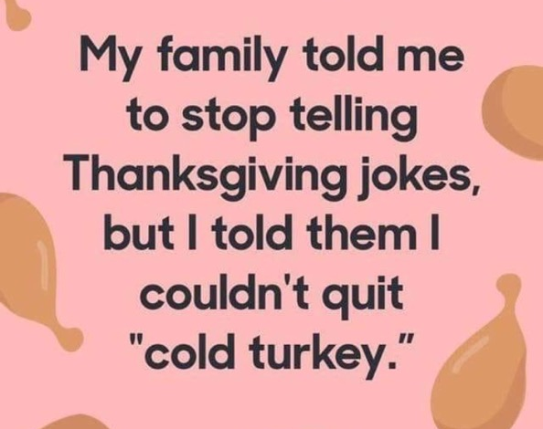
Notes:
Jai Cohen

Slide 3
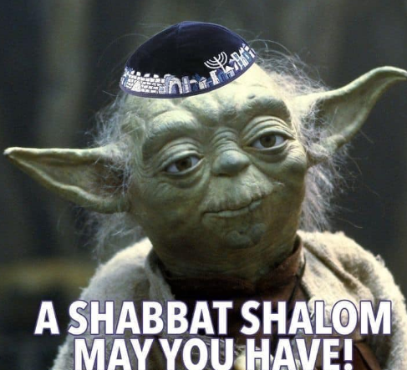
Notes:
From JB Bernstein

Slide 5
Important news from Israel

Slide 6
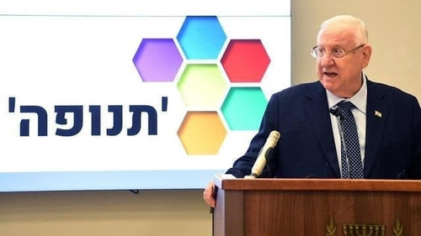
The תְּנוּפָה Tnufa (Momentum) logo behind Israel's President Reuven Rivlin. Victory policy.

Slide 7
In August 2018, then-Defense Minister Avigdor Liberman announced that the IDF's next chief of staff will be someone who talks "in terms of decisiveness and victory." That turned out to be Aviv Kochavi. He, indeed, affirmed at his January 2019 swearing-in ceremony that the army "is all about victory."

Slide 8
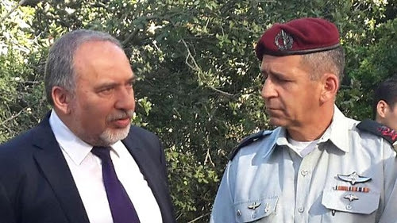
Avigdor Liberman (L) appointed Aviv Kochavi as IDF chief of staff.
Notes:
From Daniel Pipes

Slide 9
The new definition of victory involves "the rapid destruction of enemy capabilities" such as command posts, rocket launchers, weapons storehouses, enemy command levels, and combat personnel.
Notes:
That’s why you haven’t read much or anything about kite and balloon bombs from Gaza. There will only be peace with the Palestinian Arabs when they understand that they lost the war to destroy Israel. This is what the Gulf states realized in the Abraham Accords. No sense maintaining forever war.
From Daniel Pipes

Slide 10
Today’s theme…

Slide 12
Hardships this year 2020
COVID-19
Shutdown, social isolation
Economic loss *
Riots, defunding police.
Forest Fires
Election uncertainty
Persecution of believers. 260 meg
Notes:
*Big companies are going bankrupt at a record pace, but that’s only part of the carnage. By some accounts, small businesses are disappearing by the thousands amid the Covid-19 pandemic, and the drag on the economy from these failures could be huge.
This wave of silent failures goes uncounted in part because real-time data on small business is notoriously scarce, and because owners of small firms often have no debt, and thus no need for bankruptcy court. https://www.bloomberg.com/news/articles/2020-08-11/small-firms-die-quietly-leaving-thousands-of-failures-uncounted

Slide 13
Notes:
https://www.google.com/url?sa=i&url=https%3A%2F%2Fsma.ie%2Fred-wednesday-in-defence-of-people-of-faith-throughout-the-world%2F&psig=AOvVaw0pyAigMX6m04Se_xULZu9Q&ust=1606586705202000&source=images&cd=vfe&ved=0CAIQjRxqFwoTCKCavIqoo-0CFQAAAAAdAAAAABAD
Actually Nov 18,2020
Hungary's government says landmarks in Budapest lit up in red to remember persecuted Christians who it claims to form the world's most suffering faith community. "The initiative "Red Wednesday"

Slide 14
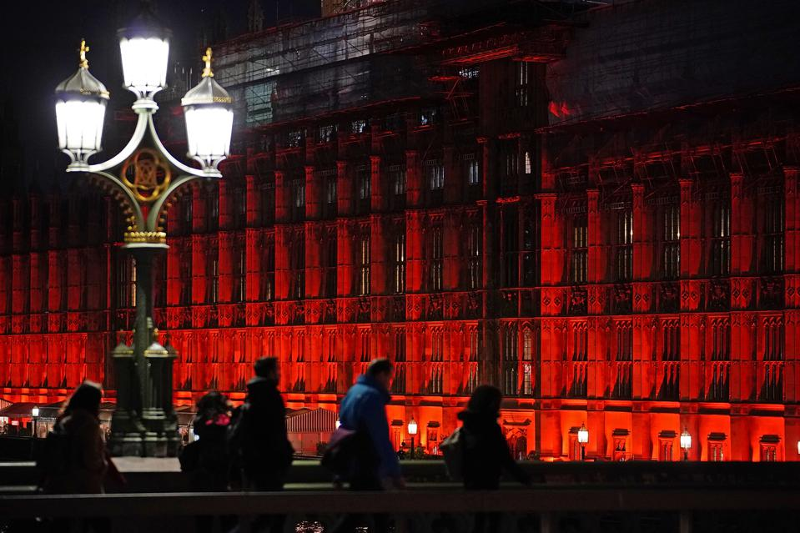
The Houses of Parliament in Westminster are floodlit in red light to mark #RedWednesday
Nov 18, 2020
Notes:
https://specials-images.forbesimg.com/imageserve/5fbed020b81295b0df73ab8f/960x0.jpg?fit=scale

Slide 15
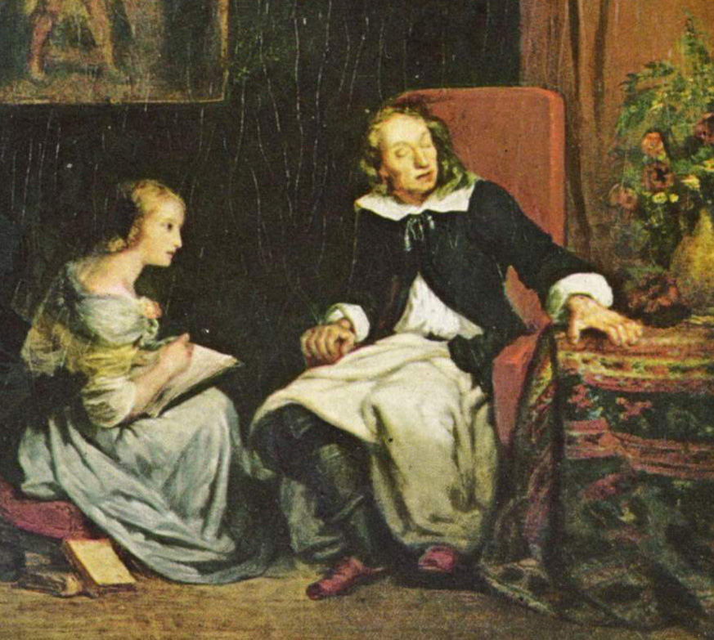
John Milton author of Paradise Lost (1667) widely considered to be one of the greatest works of literature ever written.
Notes:
https://www.google.com/url?sa=i&url=https%3A%2F%2Fadvopps.org%2Faccess-to-printed-word-blind-with-victor-reader%2Fjohn-milton-dictates-to-his-daughters-eugene-delacroix-cropped%2F&psig=AOvVaw3ZJ8FQqTubldjxpJOLfsB_&ust=1606614894589000&source=images&cd=vfe&ved=0CAIQjRxqFwoTCKDenoORpO0CFQAAAAAdAAAAABBe
By 1652, blind, and dictating the work

Slide 16
The poet Milton, a blind poet, he said that a person with an ungrateful spirit only has one vice.
Notes:
Adrian Rogers on Dobson’s Family Talk, Nov 2020

Slide 17
He said because all of the rest of his vices are virtues compared to ingratitude.
Notes:
Adrian Rogers on Dobson’s Family Talk, Nov 2020
A blind man said that.

Slide 18
Shakespeare said, "How sharper than a serpent's tooth it is to have a thankless child."
Notes:
The title comes from Act 1, Scene 4 of William Shakespeare's King Lear

Slide 19
^{T’hillim/Ps 107.1-2} Give thanks to Adoni; for he is good, for his grace continues forever. Let those redeemed by Adoni say it, those he redeemed from the power of the foe.
הֹדוּ לַיְיָ כִּי-טוֹב, כִּי לְעוֹלָם חַסְדּוֹ.
יֹאמְרוּ, גְּאוּלֵי יְיָ--אֲשֶׁר גְּאָלָם מִיַּד-צָר

Slide 20
חֶסֶד khesed
kindness, benevolence; goodness, charity, grace; favor, lovingkindness
Notes:
Khesed חֶסֶדOne of those intoxicating words Hebrew equiv of agape

Slide 21
זָכַרְתִּי לָךְ חֶסֶד נְעוּרַיִךְ, אַהֲבַת כְּלוּלֹתָיִךְ Jer 2.2.
I remember your devotion when you were young; how, as a bride, you loved me.
The root hasad has a primary meaning of “eager and ardent desire.”

Slide 22
^{T’hillim/Ps 107.1-2} Give thanks to Adoni for his grace, for his wonders bestowed on humanity! Let them offer sacrifices of thanksgiving and proclaim his great deeds with songs of joy.
יוֹדוּ לַיְיָ חַסְדּוֹ; וְנִפְלְאוֹתָיו לִבְנֵי אָדָם. וְיִזְבְּחוּ, זִבְחֵי תוֹדָה; וִיסַפְּרוּ מַעֲשָׂיו בְּרִנָּה.

Slide 23
Lev 1 Burnt offering. Olah
Lev 2 Grain offering. Minkha
Lev 3 Peace offering. Shalem
Lev 4 Sin offering. Khatat
Lev 5 Trespass offering. Asham
There is no thanks offering.

Slide 24
^{1 Kefa/Pet 2.5} You yourselves, as living stones, are being built into a spiritual house to be Cohanim [priests] set apart for God to offer spiritual sacrifices acceptable to him through Yeshua the Messiah.

Slide 25
^{Ro 12.1} I urge you therefore, brothers and sisters, by the mercies of God, to present your bodies as a living sacrifice—holy, acceptable to God—which is your spiritual service.
Notes:
G-d’s prayer to man! Why should I give my body to Him? Because He gave His body for me. He suffered, bled and died upon that execution stake.
That you must do it voluntarily. Nobody can make you do it. You see the word "present". That's the word for a man joining an army voluntarily. Now two ways to get in the army: you can go down and present yourself or they can draft you.
secondly, not only must you do it willingly, but you must do it completely. Now that you present your bodies a living sacrifice holy. Now that word H O L Y is akin to our word W H O L E
"bind the sacrifice to the altar” devotion and discipline. Marriage, membership = commitment

Slide 26
^{MJ 13.15} Through Yeshua then, let us continually offer up to God a sacrifice of praise — the fruit of lips giving thanks to His name.

Slide 27
Testimonies
First Roxie Lyle

Slide 28
From Roxie Lyle:
“The praise list gets longer all the time!
I’m so very thankful that He IS.
...That His real love has provided for my forgiveness & sin debt, by Yeshua’s own blood...a freeing & life-giving fact!
...& that Yeshua continues to intercede for me.

Slide 29
I am thankful that He speaks through His steadfast Word that is available & vital to me
& that I have instant access to the Only God!
I praise Him for the substance & certainty of faith, trust, hope & love
And for the Ruach HaKodesh who leads & guides, corrects & comforts...
I am blessed with precious biological & spiritual families - to enjoy, fellowship with, & intercede for.

Slide 30
And I marvel at Adonai’s plan that praise is a weapon of warfare in every circumstance & issue of our life.
He is so very merciful & full of grace to me!
Thank You for Your plan of praise Abba! 🎶
HalleluYah!”

Slide 31
Testimonies

Slide 32
Ingratitude was the source of failure in Gan Eden, Garden of Eden.
^{Ber/Gen 3.6} When the woman saw that the tree was good for food, that it had a pleasing appearance and that the tree was desirable for making one wise, she took some of its fruit and ate.
Notes:
They were in the ideal environment. Perfect. Why not grateful? Didn’t trust what G-d said. Suspicion cf celebration.
Your life? My life? Could be better, but ingratitude will kill every thing we have.

Slide 33
^{1 Yn 2.16} All the things of the world — the desires of the flesh, the desires of the eyes, and the pride of life — are not from the Father but from the world.
Three root sins in the universe: sexual sin, materialism, pride.

Slide 34
Sexual sin, materialism, pride are all derived from ingratitude.
Sexual sin is choosing to NOT be grateful for life as it is. Demanding more.
Be grateful you have working hormones! For beauty.
Notes:
“I’m sooooo frustrated.” All these desires. Stop! Be grateful you have working hormones! Praise G-d that “the blood of Yeshua the Messiah G-d’s son cleanses us from all sin.”
Porn is not because men are strong and rapacious, it’s because men, some men are weak, and it’s easier to fantasize with an image on screen than relate with joy and gratefulness and a servant spirit to a real female.

Slide 35
Sexual sin, materialism, pride are all derived from ingratitude.
Materialism is choosing to NOT be grateful with what we have.

Slide 36
Notes:
We’re big fans of Dave Ramsey here, at least my wife and I are. Rachel, Dave’s daughter, said on the presentation here last year, that as soon as you start to compare your stuff, you lose. You sin.
Either your stuff is worse than the other person, and you pout and fuss and get mad at G-d and at life.
Or, you note that your stuff is better than the other person, and you admire yourself in pride.
She offers that the only way to avoid both is GRATITUDE.

Slide 37
Sexual sin, materialism, pride are all derived from ingratitude.
Pride is praising yourself, and not remembering…

Slide 38
^{Dvarim/Dt 8.17-18} You may say in your heart, ‘My power and the might of my hand has made me this wealth.’ Rather you are to remember Adoni your God, for it is He who gives you power to make wealth.

Slide 39
Pride is ungratefulness at your place in life.
^{1 Cor 7.20-24} Let each one remain in the calling in which he was called. Were you called as a slave? Don’t let that bother you—but if indeed you can become free, make the most of the opportunity. For the one who was called in the Lord as a slave is the Lord’s freedman.

Slide 40
Pride is ungratefulness at your place in life.
^{1 Cor 7.20-24} Likewise the one who was called while free is Messiah’s slave. You were bought with a price; do not become slaves of men. Brothers and sisters, let each one—in whatever way he was called—remain that way with God.

Slide 41
Sexual sin, materialism, pride are all derived from ingratitude.
Anger is violation of my rights. Our rights belong to G-d. Tikkun.
Depression [can be clinical] is often from looking at the glass half empty.

Slide 42
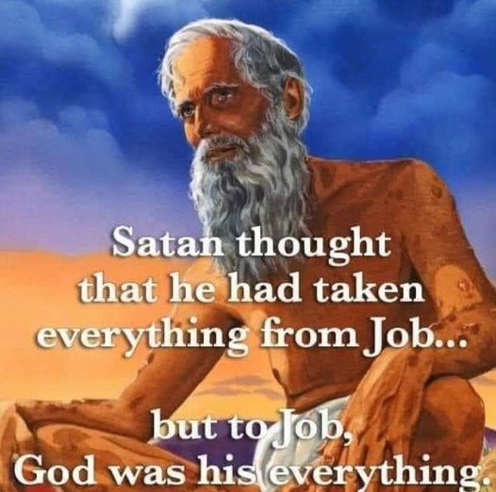
Notes:
From Dr. Michael Brown from a friend: it has reached more than 580,000 people, received 67,000 engagements, including more than 13,000 likes, and it has been shared more than 7,800 times.

Slide 43
testimonies

Slide 44
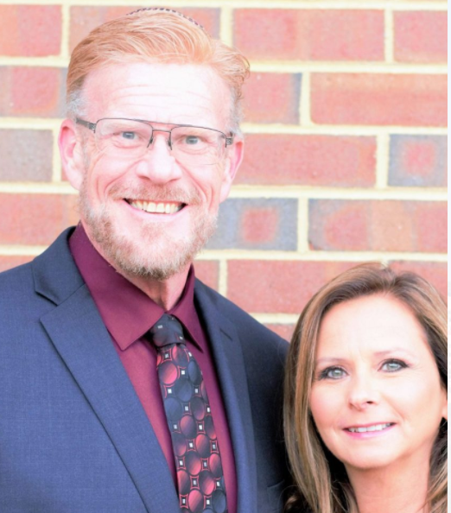
Rabbi Eric Carlson is the founder and shepherd of Congregation Zion’s Sake, a Messianic Congregation, located in Newport News
Notes:
Was a submariner 20 years. Wife Barbara. About 3x our size. Hired Micah Mahoney away from us, but called first to ask my permission.

Slide 45
Cong Zion’s Sake
1233 Shields Rd
Newport News, VA,
Notes:
Eric is a GREAT history buff. Much more than me, and some say I have too much. Jews remember…

Slide 46
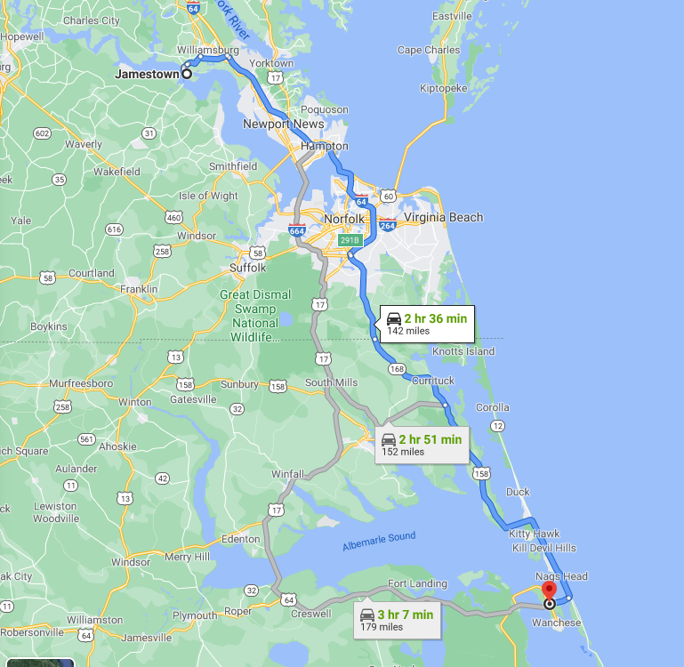
2. Jamestown, VA 1607
1. Roanoke Island, NC
1587 all died
Notes:
August 1587, when a group of about 115 English settlers arrived on Roanoke Island, off the coast of what is now North Carolina. Later that year, it was decided that John White, governor of the new colony, would sail back to England in order to gather a fresh load of supplies. But just as he arrived, a major naval war broke out between England and Spain, and Queen Elizabeth I called on every available ship to confront the mighty Spanish Armada. In August 1590, White finally returned to Roanoke, where he had left his wife and daughter, his infant granddaughter (Virginia Dare, the first English child born in the Americas) and the other settlers three long years before. He found no trace of the colony or its inhabitants.

Slide 47
On May 13th, 1607, twenty yers after Roanoke Is. Disater, three very small English ships (Susan Constance, Discovery, and Godspeed) landed on Jamestown Island, and established the first permanent settlement in what would come to be known as America: Jamestown, Virginia.
Notes:
Copyright © 2020 The Road to Jerusalem, All rights reserved.

Slide 48
The English settlers discovered a complex indigenous native culture here, the Powhattan Nation, a 32 tribe confederation ruled by Grand Chief Powhatan! The English were inadequately prepared to survive and sustain themselves in the harsh wilderness! By December of 1608, the English supplies were running short.

Slide 49
In desperate need of food to survive the coming winter, John Smith approached Chief Powhatan in Werowocomoco for corn. Powhatan agreed to provide the English with food in exchange for a grindstone, fifty swords, guns, beads, chickens, and an English-style house. Without these provisions, the settlement of Virginia would have ceased to exist, like Roanoke!
Notes:
Copyright © 2020 The Road to Jerusalem, All rights reserved.

Slide 50
Later, another settler ship arrived. On December 4, 1619, after ten weeks at sea, thirty-eight English settlers arrived at Berkeley Hundred, about 20 miles upstream from Jamestowne. Upon arrival Captain John Woodleaf held the first service of Thanksgiving.
Notes:
Copyright © 2020 The Road to Jerusalem, All rights reserved.

Slide 51
as the newly-landed settlers fell to their knees to thank God for their safe arrival. The Charter of Berkeley Hundred stated, “We ordaine that the day of our ships arrival at the place assigned for plantacon in the land of Virginia shall be yearly and perpetually kept holy as a day of thanksgiving to Almighty God.”
Notes:
Copyright © 2020 The Road to Jerusalem, All rights reserved.

Slide 52
While four states continue to debate the rightful claim to the first American Thanksgiving Day (the Pilgrims of Massachusetts [1621], the Anglican settlers in Virginia, the Huguenots in Florida, and the Spanish Catholics in El Paso, Texas), Thanksgiving is a uniquely American holiday.
Notes:
Tony Perkins. Many countries have harvest festivals, but none with the unique theme of thanksgiving!

Slide 53
Despite Powhatan’s assistance to Jamestown, even the marriage of his daughter Pocahontas to English Explorer John Rolfe in April of 1614 the relationship between the colonists and the Indigenous peoples (American Indians) became increasingly distrustful.
Notes:
Copyright © 2020 The Road to Jerusalem, All rights reserved.

Slide 54
More settlers poured into America while the natives were pushed off their tribal lands even though thousands of them had come to faith in Messiah.
Notes:
Copyright © 2020 The Road to Jerusalem, All rights reserved.

Slide 55
Ultimately the Natives would be forcibly removed from their land and placed upon reservations. Every treaty (over 400) that the United States of America made with the Natives was broken.
Notes:
Copyright © 2020 The Road to Jerusalem, All rights reserved.
By Rabbi Eric Carlson

Slide 56
For the last 100 years, the natives were mostly a forgotten people even though the first settlers couldn’t have survived without the Natives' help and guidance. Yet there is a powerful Kingdom mystery revealed through the Indigenous people of this Land.
Notes:
Copyright © 2020 The Road to Jerusalem, All rights reserved.
By Rabbi Eric Carlson

Slide 57
The Indigenous people, the native tribes are the physical and spiritual stewards of this land as ordained by God. They are the prophetic voice and true spiritual authority of this land and nation! Over the centuries Ha Satan has sought to oppress and remove their identity and spiritual authority. Here’s why:
Notes:
Copyright © 2020 The Road to Jerusalem, All rights reserved.
By Rabbi Eric Carlson

Slide 58
The late Billy Graham predicted in 1975 that the Native Americans would become a “spiritual superpower” to change the world! This is coupled with an 1877 prophecy from Crazy Horse, leader of the Oglala Lakota Sioux from 1840-1877,
Notes:
Copyright © 2020 The Road to Jerusalem, All rights reserved.
Crazy Horse teamed up with Sitting Bull to decimate Lt. Col. George Armstrong Custer and his esteemed Seventh Cavalry in the Battle of the Little Bighorn, perhaps the greatest victory ever by Native Americans over U.S. troops.
Song: “Please Mr. Custer”
Bio of Crazy Horse Battle of Little Big Horn
https://www.biography.com/video/crazy-horse-battle-at-little-big-horn-24512579907

Slide 59
Native Chief, fierce warrior, Crazy Horse said: “The Red Nation shall rise again and it shall be a blessing for a sick world, a world filled with broken promises, selfishness and separations, a world longing for light again.
Notes:
Copyright © 2020 The Road to Jerusalem, All rights reserved.
By Rabbi Eric Carlson

Slide 60
Today there is an awakening among the Indigenous people, the American Indians! Revival is breaking out across their reservations, throughout all the tribes! After years of oppression and persecution, they are humbly repenting, seeking God with great fervency,
Notes:
Copyright © 2020 The Road to Jerusalem, All rights reserved.
By Rabbi Eric Carlson

Slide 61
and walking into their destiny and mandate as this land’s spiritual authority to bring this nation to revival through Yeshua the Messiah! This Thanksgiving let us pause to remember our Native brothers and sisters!
Notes:
Copyright © 2020 The Road to Jerusalem, All rights reserved.
By Rabbi Eric Carlson

Slide 62
Let us remember, with thanks, their help and assistance in the birth of this nation! Let us stand with them, pray with them, and join with them as America’s Spiritual Authority to intercede and seek an American awakening!
Notes:
Copyright © 2020 The Road to Jerusalem, All rights reserved.
By Rabbi Eric Carlson

Slide 63
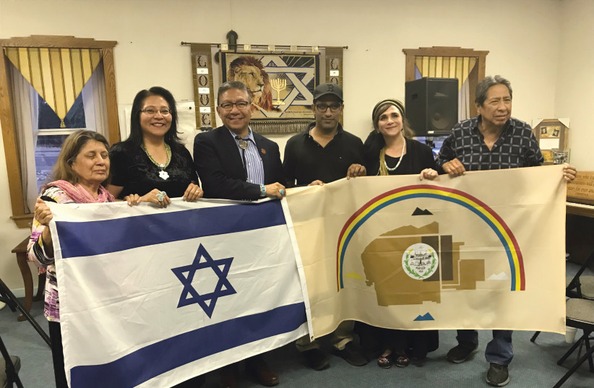
Notes:
NAVAJO NATION vice president Myron Lizer (third from left), Dine Navajo Nation members and Indigenous Bridges activists including Ateret Violet Shmuel (second from right) hold the Navajo Nation and Israeli flags to demonstrate the desire to collaborate.
(photo credit: Courtesy)
https://www.jpost.com/diaspora/jews-and-native-americans-brothers-in-the-great-spirit-627955

Slide 64
testimonies

Slide 65
Thank YOU for your giving:
Orphan Shabbat total $1000,
Oxana total $1000,
Chernack total $700, total
Beirut $1000 through a congregation there.
Notes:
Orphan $875, Oxana $377, Chernack $401

Slide 66
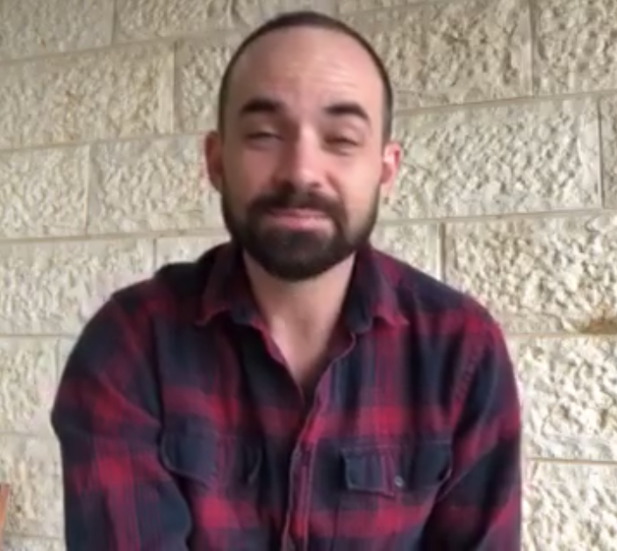
Evan Levine thanking us for the Orphan Shabbat offering
Notes:
https://www.facebook.com/messenger_media/?thread_id=1425198759&attachment_id=816270629161504&message_id=mid.%24cAAAAAH8tnEN8D228rV13ihxsxJYI

Slide 67
testimonies

Slide 68
In August 1619, a pirate ship, the White Lion, stopped at Jamestown and traded 20-some captive Africans for food. The Africans were treated as indentured servants and soon released.
Notes:
While many more such ships came, and the African captives were NOT released, nevertheless this is not our ideal, it’s our aberration.
The New York Times has declared that America was built on slavery with its “1619 Project.”

Slide 69
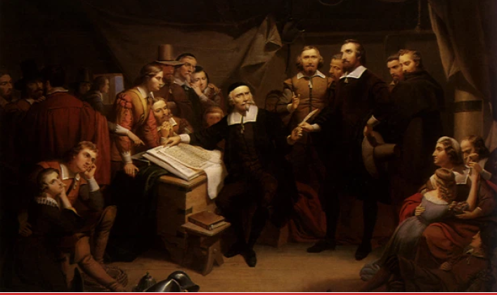
Pilgrims signing the Mayflower Compact in 1620.

Slide 70
"In ye name of God, Amen. We whose names are underwriten, the loyall subjects of our dread soveraigne Lord, King James, by ye grace of God, of Great Britaine, France, & Ireland king, defender of ye faith, etc., having undertaken, for ye glorie of God,

Slide 71
and advancemente of ye Christian faith, and honour of our king & countrie, a voyage to plant ye first colonie in ye Northerne parts of Virginia, doe by these presents solemnly & mutually in ye presence of God, and one of another, covenant & combine our selves togeather into a civill body politick,
Notes:
Make laws and obey them. Loyalty to the King, but not dependent on the king for every decision.

Slide 72
for our better ordering & preservation & furtherance of ye ends aforesaid; and by vertue hearof to enacte, constitute, and frame such just & equall lawes, ordinances, acts, constitutions & offices, from time to time, as shall be thought most meete & convenient for ye generall good of ye Colonie, unto which we promise all due submission and obedience. at Cap-Codd ye 11. of November, Ano:Dom. 1620."*
Notes:
Make laws and obey them. Loyalty to the King, but not dependent on the king for every decision.
Free and independent people, trusting G-d for wisdom, is the foundation of our republic. Slavery is an aberration.

Slide 73
testimonies

Slide 74
We need to turn thanksgiving into thanks-living.
And yet in America all around we can find those who are grumbly hateful rather than humbly grateful.
Notes:
Adrian Rogers

Slide 75
You do not come to service to praise the Lord. You are to bring your praise with you to service. You don't commence your praise here, you continue.

Slide 76
^{T’hillim/Ps 34.2} I will bless Adoni at all times. His praise is continually in my mouth.

Slide 77
אָבוֹא אֶל מִזְבֵּחַ אֱלֹהִים אֶל אֵל שִׂמְחַת גִּילִי
Avo el mizbakh Elohim
el El simkhat gili
אַקְרִיב פְּרִי שְׂפָתַי לְפָנֶיךָ
Akriv pri sfati lefaneikha
[I will come to the altar of God, to G-d my exceeding joy,
I will bring the fruit of my lips]
Notes:
Sarah Liberman

Slide 78
הִנֵּה מִשְׁכָּן אֱלֹהִים עִם בְּנֵי אָדָם
Hineh mishkan Elohim im b’nei adam
הֵמָּה יִהְיוּ לוֹ לָעָם
Hema yihyu lo le’am
[Behold, the tabernacle of G-d
is with men
They shall be His people.]

Slide 79
הוּא יִמְחֶה כָּל דִּמְעָה מֵעֵינָם
Hu yimkheh kol dimah me’einam
וּמָוֶת, כְּאֵב וּזְעָקָה לֹא יִהְיוּ עוֹד
Umavet, ke’ev veze’akah lo yihu od
He will wipe away every tear
from their eyes
There shall be no more death,
pain, nor crying.

Slide 80
נָגִילָה וְנִשְׂמְּחָה וְנִתַּן לוֹ כָּבוֹד
Nagila v’nis’mekha V’nitan lo kavod
[Come and rejoice and give Him glory]
Notes:
But there are some people…that always hurt. This is a powerful formula, although you may need help to invoke. “The Blood of Yeshua the Messish

Slide 81
Let him smother me with kisses from his mouth, for your love is better than wine.
יִשָּׁקֵנִי מִנְּשִׁיקוֹת פִּיהוּ, כִּי-טוֹבִים דֹּדֶיךָ מִיָּיִן.
“Loves” in plural
Notes:
Adjective agrees with noun in number and gender: love and good both in plural. Jon Cahn

Slide 82
^{T’hillim/Ps 69.31-32} I will praise God’s Name with a song, and magnify Him with praise. It will please Adonai better than an ox
or a bull with horns and hoofs.

Slide 83
^{Luke 17:11-17} Now one of them, when he saw that he was healed, came back, glorifying God with a loud voice. And he fell at Yeshua’s feet, facedown, giving Him thanks. And he was a Samaritan

Slide 84
^{T’hillim/Ps 141.2} May my prayer be set before You like incense. May the lifting up of my hands be like the evening sacrifice.

Slide 85
testimonies

Slide 86
