Slide 1
e-handout
To have these notes
without taking notes
Go to OrHaOlam.com
Click on downloads,
messages, 2020

Slide 2
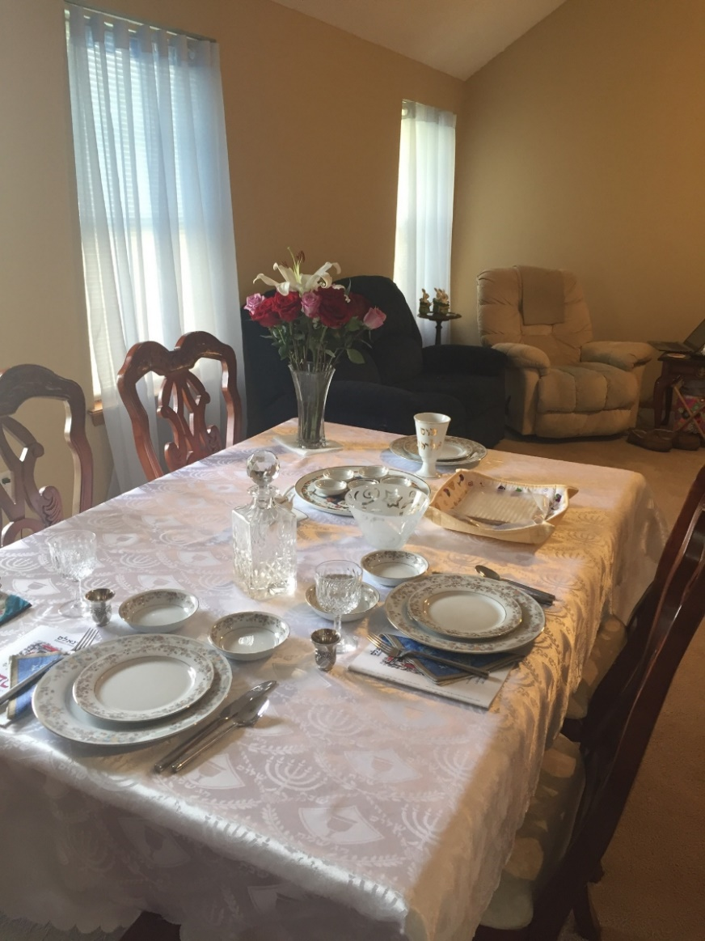
Note place setting for Eliyahu HaNavi/
Elijah the prophet
Social distance of six feet

Slide 3
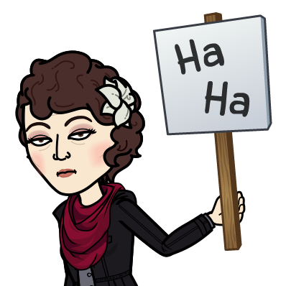
Notes:
Continuing our series in Messiah the Divine Cohen/Priest
Why do I care what type of Cohen/priest I have?
It’s the cohen that gets you in…to the holy place!!

Slide 4
Anther joke, sort of

Slide 5
Iran’s Ayatollah Nasir Makarim Shirazi released a rather surprising statement. He stated that there is no prohibition in Islamic law against purchasing medicine or a vaccine from Israel, provided there is no other country from which to acquire it. In other words, doing business with the Zionist entity has its exceptions.
Notes:
https://www.israeltoday.co.il/read/coronavirus-in-the-eyes-of-muslim-clerics/?utm_source=acfs&utm_medium=email&utm_term=all&utm_campaign=newsletter-2020-03-18

Slide 6
BDS Leader Admits He Would Not Boycott Israeli Corona-virus Cure
Notes:
https://unitedwithisrael.org/bds-leader-admits-he-would-not-boycott-israeli-coronavirus-cure/?utm_source=MadMimi&utm_medium=email&utm_content=%E2%80%98No+Modern-Day+Plague+Can+Break+Jewish+Tradition%E2%80%99%3B+Israel+Sends+Passover+Supplies+to+Jews+in+Egypt%3B+Palestinians+Blame+%27Israel%E2%80%99s+Greed%27+for+Coronavirus&utm_campaign=20200406_m157755108_%E2%80%98No+Modern-Day+Plague+Can+Break+Jewish+Tradition%E2%80%99%3B+Israel+Sends+Passover+Supplies+to+Jews+in+Egypt%3B+Palestinians+Blame+%27Israel%E2%80%99s+Greed%27+for+Coronavirus&utm_term=BDS+Leader+Admits+He+Would+Not+Boycott+Israeli+Coronavirus+Cure

Slide 7
Omar Barghouti, co-founder of the BDS movement, said in a video on Sunday on Facebook that if Israel discovers a cure for coronavirus (COVID-19), then cooperation with the Jewish state is acceptable.
Notes:
https://unitedwithisrael.org/bds-leader-admits-he-would-not-boycott-israeli-coronavirus-cure/?utm_source=MadMimi&utm_medium=email&utm_content=%E2%80%98No+Modern-Day+Plague+Can+Break+Jewish+Tradition%E2%80%99%3B+Israel+Sends+Passover+Supplies+to+Jews+in+Egypt%3B+Palestinians+Blame+%27Israel%E2%80%99s+Greed%27+for+Coronavirus&utm_campaign=20200406_m157755108_%E2%80%98No+Modern-Day+Plague+Can+Break+Jewish+Tradition%E2%80%99%3B+Israel+Sends+Passover+Supplies+to+Jews+in+Egypt%3B+Palestinians+Blame+%27Israel%E2%80%99s+Greed%27+for+Coronavirus&utm_term=BDS+Leader+Admits+He+Would+Not+Boycott+Israeli+Coronavirus+Cure

Slide 8
Notes:
Continuing our series in Messiah the Divine Cohen/Priest
Why do I care what type of Cohen/priest I have?
It’s the cohen that gets you in…to the holy place!!

Slide 9
Good news from Israel

Slide 10
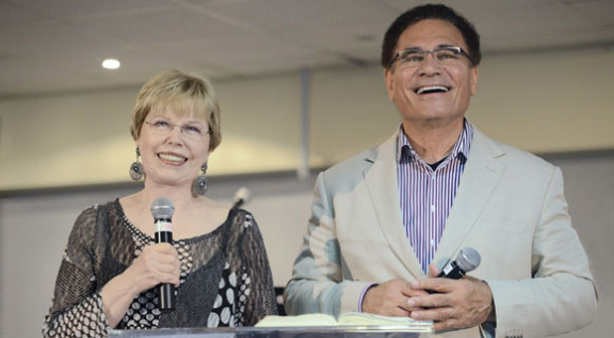
Ari and Shira Sorko-Ram, founders of Tiferet Yeshua Cong., Tel Aviv
Notes:
https://www.charismanews.com/opinion/standing-with-israel/47118-end-of-an-era-sorko-rams-pass-the-leadership-baton

Slide 11
Ari and Shira’s son, Ayal, started a nano-biotechnology company that develops incredibly sensitive sensors. With the outbreak of COVID-19, they have been working around the clock to develop and mass-produce a test that would give results in less than 2 minutes. It is different than the standard tests as it doesn’t require labs and chemicals.
Notes:
https://myemail.constantcontact.com/Prayer-for-Medical-Breakthroughs-and-Passover.html?soid=1130986288219&aid=T9JqERankhE

Slide 12
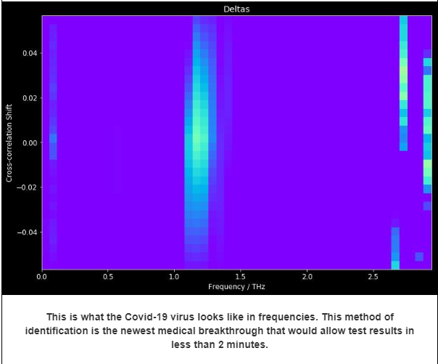
Notes:
https://vfinews.com/en/news/april-10-2020/israel-develops-coronavirus-symptom-detector
Measures the vital signs of patients, including pulse, respiratory rate, and temperature, and pick out patterns that indicate a likely coronavirus infection.
https://myemail.constantcontact.com/Prayer-for-Medical-Breakthroughs-and-Passover.html?soid=1130986288219&aid=T9JqERankhE

Slide 13
Rather, it identifies the frequency COVID-19 as well as the antibodies give off when they are present and is entirely digital. They have been working with the German and now Israeli government to prove its accuracy in hospitals with live patients!
Notes:
Frequency as in MRI or mass spectrogram. Not a musical frequency.
https://myemail.constantcontact.com/Prayer-for-Medical-Breakthroughs-and-Passover.html?soid=1130986288219&aid=T9JqERankhE

Slide 14
Within a week or two, we are praying that Ayal's company, Ram Group, will complete trials and be able to provide the solution to the testing shortage.
Notes:
https://myemail.constantcontact.com/Prayer-for-Medical-Breakthroughs-and-Passover.html?soid=1130986288219&aid=T9JqERankhE

Slide 15
Finding Shalom in Chaos

Slide 16
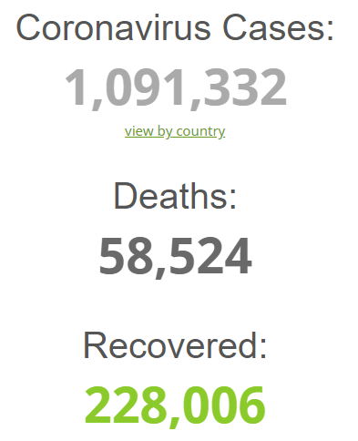
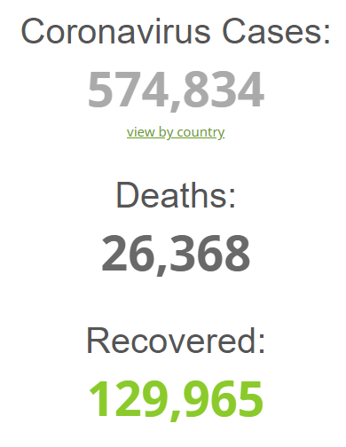
Friday, April 3, 2020 4 p.m.
Friday, March 27,
2020 noon
90%
Weekly
increase
Notes:
https://www.worldometers.info/coronavirus/

Slide 17
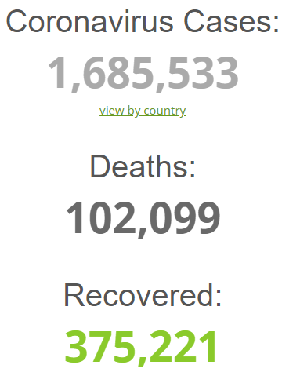
Friday, April 10,
2020 4 p.m.
54%
Weekly
increase
Notes:
https://www.worldometers.info/coronavirus/

Slide 18
Johnson County COVID-19 Statistics
Sun., Mar 29, 108 cases, 2 deaths
Sun., Apr 5, 192 cases, 8 deaths
Fri., Apr 10, 263 cases, 12 deaths
A bit of perspective…

Slide 19
COVID-19: Approximately 1,359,398 cases worldwide; 368,449 cases in the U.S. as of Apr. 7, 2020.*
Flu: Estimated 1 billion cases worldwide; 9.3 million to 45 million cases in the U.S. per year.
Notes:
https://www.hopkinsmedicine.org/health/conditions-and-diseases/coronavirus/coronavirus-disease-2019-vs-the-flu

Slide 20
Deaths
COVID-19: Approximately 75,945 deaths reported worldwide; 10,993 deaths in the U.S., as of Apr. 7, 2020.*
Flu: 291,000 to 646,000 deaths worldwide; 12,000 to 61,000 deaths in the U.S. per year.
Notes:
But here is the key issue: the rate of increase:
https://www.hopkinsmedicine.org/health/conditions-and-diseases/coronavirus/coronavirus-disease-2019-vs-the-flu

Slide 21
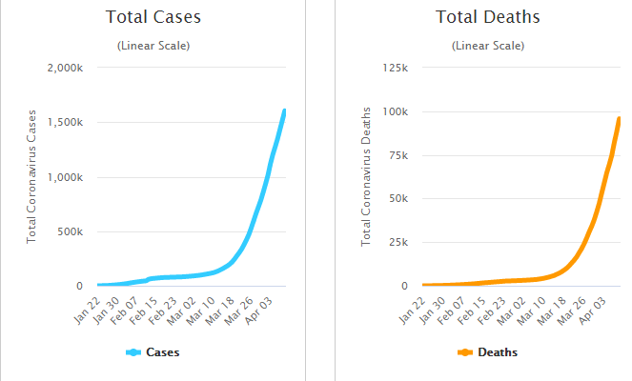
Notes:
Another dimension to the COVID-19 crises, that makes it worse yet for Jewish people...
https://www.worldometers.info/coronavirus/

Slide 22
In the 14th century, Jews were massacred in France during the Black Death epidemic after they were blamed for spreading the disease by poisoning water wells. In the city of Strasbourg alone, 2,000 Jews were burned alive by orders of the local council, according to the historian Robert Gottfried’s book “Black Death.”
Notes:
https://www.timesofisrael.com/anti-semitic-conspiracy-theories-an-odious-symptom-of-frances-virus-crisis/

Slide 23
In recent weeks, a caricature of Agnes Buzyn, France’s previous health minister who is Jewish, pouring poison into a well — a depiction of one of the most prevalent theories that led to pogroms during the Black Death plague — has made the rounds on French social media. It’s been shared tens of thousands of times.
Notes:
https://www.timesofisrael.com/anti-semitic-conspiracy-theories-an-odious-symptom-of-frances-virus-crisis/

Slide 24
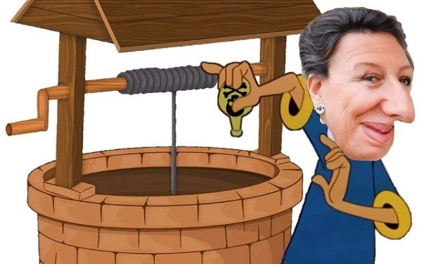
The former Minister of Health and LREM candidate for mayor of Paris, Agnès Buzyn, is the victim of obnoxious anti-Semitic cartoons on social networks.
Notes:
The former Minister of Health and LREM candidate for mayor of Paris, Agnès Buzyn, is the victim of obnoxious anti-Semitic cartoons on social networks.
https://www.lemondejuif.info/2020/03/haine-du-juif-sur-internet-agnes-buzyn-victime-dodieuses-caricatures-antisemites/

Slide 25
Then there’s a widely shared video accusing Buzyn and her husband, Yves Levy, also Jewish, of withholding chloroquine — an anti-malarial drug being touted as a possible coronavirus antidote — withholding it from the French public for financial gain. It garnered 170,000 views on YouTube before being deleted.
Notes:
https://www.timesofisrael.com/anti-semitic-conspiracy-theories-an-odious-symptom-of-frances-virus-crisis/

Slide 26
Finding Shalom in Chaos

Slide 27
לוּקַס Lukas
(Luke) 24.25-27
Notes:
Most of us just celebrated Passover, a magnificent celebration of the atonement of the Lamb of G-d, Who took away our sins!

Slide 28
^{Luke 22.1} But the festival of Matzah, known as Pesakh, was approaching.
By the time of Yeshua,
Festival of Matzah [unleavened bread]
= Pesakh/Passover

Slide 29
Yeshua’s year, Seder was Thursday.
No work
Res. Day?
1st Seder
2nd Seder
Res. Day?
No work
Special Teerosh
Notes:
Analyze this calendar. Seder, second Seder. Barley waving/Resurrection Day? Omer count.
https://www.hebcal.com/hebcal/?v=1&maj=on&o=on&i=off&year=2020&month=x&yt=G&lg=s&d=on&c=off&geo=geoname&zip=&city=&geonameid=&b=18&m=50&.s=Create+Calendar

Slide 30
Analyze this calendar.
Seder, second Seder.
Barley waving/Resurrection Day?
Omer count.
Last day of Pesakh celebration.

Slide 31
^{Lev 23.10-11} You are to bring a sheaf of the firstfruits of your harvest to the cohen. He is to wave the sheaf before Adoni, so that you will be accepted; the cohen is to wave it on the day after the Shabbat.
Is Pesakh/Passover a Shabbat, or the Shabbat after Pesakh?

Slide 32
^{1 Cor 15.20} Messiah has been raised from the dead, the firstfruits of those who have died.
Scriptural symbol of Resurrection is not lilies, bunnies, eggs [chocolate always good], ham
BARLEY is the first of the firstfruits

Slide 33
In Temple times, Yeshua’s time, the barley waving was done shortly after Pesakh.

Slide 34
harvest its ripe crops

Slide 35
Ashes Valley where the
firstfruits barley was grown.
Notes:
Called Ashes Valley

Slide 36
^{Lev 23.8-10} On the seventh day is a holy convocation; do not do any kind of ordinary work.’ Adoni said to Moshe, “Tell the people of Isra’el, ‘After you enter the land I am giving you and harvest its ripe crops,

Slide 37
^{Lev 23.15-16} From the day after the day of rest — that is, from the day you bring the sheaf for waving — you are to count seven full weeks, until the day after the seventh week; you are to count fifty days; and then you are to present a new grain offering to Adoni .’
Count weeks, count days
Notes:
G-d seems to have a premium on counting. Bk Numbers, counts Israel. Recorded the number of fish caught: 153. We count attendance and offering. We all count corona victims.

Slide 38
^{Acts 2.1} The festival of Shavu'ot arrived [7 weeks, 50 Days], and the believers all gathered together in one place.

Slide 39
All this happening
Pesakh lamb slaughtered and eaten with family.
Messiah [they believed] executed!
Firstfruits Barley harvested and waved in the Temple.
Counting the omer barley days to Shavuot.
Seven days of matzah.

Slide 40
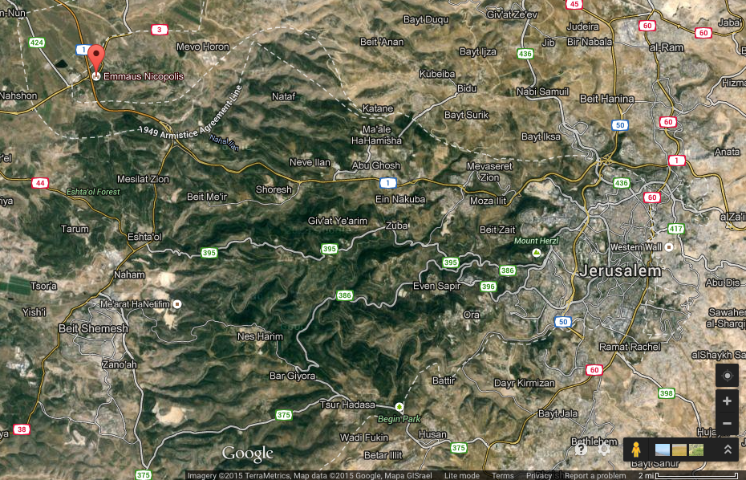
^{Lk 24.13} That same day, two of them were going toward a village about seven miles from Yerushalayim called Amma'us,
Notes:
What same day? Reports from women and Kefa/Peter that tomb empty!!??
Emaus edge of coastal plain.
Place of a decisive battle in 166 BC between the Hasmonean forces of Judea, led by Judas Maccabeus, and the Greek forces. The generals for the Greeeks were Gorgias, Ptolemy the son of Dorymenes and Nicanor. Decisive victory. 5000 Greek Syrians, 3000 killed. 3000 Jews. Maybe thinking of this history.
So Yeshua ישוע entered their conversation,

Slide 41
^{Lk 24.14-21} And they were talking with each other about all the things that had happened. As they talked and discussed, Yeshua himself came up and walked along with them, but something kept them from recognizing him. He asked them,
"What are you talking about with each other as you walk along?"

Slide 42
^{Lk 24.14-21} They stopped short, their faces downcast; and one of them, named Cleopas, answered him, "Are you the only person staying in Yerushalayim that doesn't know the things that have been going on there the last few days?"
Notes:
Answer a question with a question.

Slide 43
^{Lk 24.14-21} “What things?” he asked them. They said to him, “The things about Yeshua from Natzeret. He was a prophet and proved it by the things he did and said before God and all the people.
Notes:
Answer a question with a question. Jewish dialogue common.

Slide 44
^{Lk 24.14-21} Our head cohanim and our leaders handed him over, so that he could be sentenced to death and executed on a stake as a criminal. And we had hoped that he would be the one to liberate Isra'el! Besides all that, today is the third day since these things happened;”
Notes:
Third day. Why is that a big deal??
Trepp 335.
Keep third day in mind

Slide 45
Lk 24.21 Besides all that, today is the third day since these things happened.”
Third day expectation
Notes:
Then described astonishing report of their women and men!

Slide 46
^{Luke 24.25-32} He said to them, “Foolish people! So unwilling to put your trust in everything the prophets spoke! Didn’t the Messiah have to die like this before entering his glory?” Then, starting with Moshe and all the prophets, he explained to them

Slide 47
^{Luke 24.25-32} the things that can be found throughout the Tanakh concerning himself. They approached the village where they were going. He made as if he were going on farther; but they held him back, saying, “Stay with us, for it’s almost evening, and it’s getting dark.”

Slide 48
^{Luke 24.25-32} So he went in to stay with them. As he was reclining with them at the table, he took the matzah, made the b’rakhah, broke it and handed it to them. Then their eyes were opened,

Slide 49
^{Luke 24.25-32} and they recognized him. But he became invisible to them. They said to each other, “Didn’t our hearts burn inside us as he spoke to us on the road, opening up the Tanakh to us?”

Slide 50
^{Lk 24.33-47} They got up at once, returned to Yerushalayim and found the Eleven and others with them gathered together, saying, “The Lord is risen indeed! He has appeared to Simon!” Then they began telling about the events on the road and how He became recognized by them in the breaking of the matzah.

Slide 51
Notes:
Ran to bless their buddies! No phone or email or Facetime or Zoom. Just hoof it!
7 miles over mountainous roads, in the dark. Passover, so full moon. Back to Jerusalem
[Wikipedia: the average human walking speed is about 5.0 kilometres per hour (km/h), or about 3.1 miles per hour (mph).
7 mi ÷ 4 mph =] 1.75 hours!

Slide 52
All this happening
Pesakh lamb slaughtered and eaten with family.
Messiah [they believed] executed!
Firstfruits Barley harvested and waved in the Temple.
Counting the omer barley days to Shavuot.
Seven days of matzah.

Slide 53
Death of the Messiah King. Astonishing report.
Took in a stranger.
Fed the stranger.
Listened to Tanakh teaching.

Slide 54
Why did they recognize Him then??
How He said the blessing: joy to His Father?
How he shared it? Servant spirit of LOVE?
Saw His hands with wounds? Still serving? Do we serve even when it hurts.

Slide 55
Maybe they remember those hands, that brakhah / blessing…
^{Mk 6.39-41} Then Yeshua made them all sit down in groups on the green grass. So they reclined in groups of hundreds and fifties. And He took the five loaves and the two fish; and looking up to heaven,

Slide 56
He offered the brakha. He broke the loaves and kept giving them to the disciples to serve to the people. 5000 men + families!!
Maybe same spirit of brakha, same manner of breaking…
Remembered, He provided 5000+. We’ll be OK with Roman wrath.

Slide 57
He provided.
We’ll be OK with COVID wrath. Financially… personally, families, synagogue.
Maybe they remembered about bread…

Slide 58
^{Yn 6.32-36} Yeshua said to them, “Yes, indeed! I tell you it wasn’t Moshe who gave you the bread from heaven. But my Father is giving you the genuine bread from heaven; for God’s bread is the one who comes down out of heaven and gives life to the world.”

Slide 59
^{Yn 6.32-36} They said to him, “Sir, give us this bread from now on.” Yeshua answered, “I am the bread which is life! Whoever comes to me will never go hungry, and whoever trusts in me will never be thirsty. I told you that you have seen but still don’t trust. [So they entered into a spirit of more trust, the Bread of Life!]

Slide 60
^{Proverbs 3:5-6, 25-26} Trust in Adoni with all your heart, and do not lean on your own understanding. In all your ways acknowledge him, and he will make straight your paths… “Do not be afraid of sudden terror or of the ruin of the wicked, when it comes, for Adoni will be your confidence and will keep your foot from being caught.”.

Slide 61
It has been said that you can get good at whatever you practice—and so we all practice those things we desire to excel in. In Proverbs 3, Solomon desired for his son to get good at trusting in Adoni. To get better day by day in trusting in Adoni. He wanted his son to experience the abundant rewards of rightly-placed confidence.

Slide 62
Rightly-placed confidence is placed in God, not in ourselves. That confidence can be nurtured and developed through disciplined practice—looking to and placing our hope and trust in God in whatever we may face day by day. As we trust in Adoni, our confidence in Him strengthens.
Notes:
Avner Boskey

Slide 63
Our hearts practice the melodies of trusting in God, and our ability to express that melody continues to become more beautiful and strong.
However, the opposite can also happen..
Notes:
Avner Boskey

Slide 64
Interestingly, in Proverbs 3:26, the Hebrew word for confidence can also be translated as folly. Context is what determines which meaning is appropriate. From this context, we know the proper translation in this verse is “confidence”.

Slide 65
Why? Adoni Yeshua is where we set our trust, and as we trust Him—in the midst of quite troubling circumstances— we experience security in Him (“will keep your foot from being caught”).

Slide 66
Being ensnared, or having one’s foot “caught”, is a way to describe unexpected calamity or hindrances that thwart God’s purposes in our lives. This verse isn’t stating that those who trust in God won’t suffer or face the troubles of this life. Rather, this verse is a reminder that there is no trouble, no calamity, no terror, that can thwart God’s purposes for us. With our confidence in God, our hearts can be at rest in Him in the midst of turmoil.
Notes:
Avner Boskey

Slide 67
But trusting in ourselves is folly and can’t and won’t provide us that same peace. In fact, self-trust brings its own troubles. As trusting in Adoni deepens our confidence in Him, conversely, trusting in ourselves grows our folly and multiplies our troubles.
Notes:
Avner Boskey

Slide 68
COVID-19 is providing a kind of recital, where we and others are able to see and hear the melodies of what our hearts have been practicing. The notes will faithfully ring true to the reality of our confidence—whether rightly placed in God or foolishly placed in ourselves.
Notes:
Avner Boskey

Slide 69
If your melody has faltered, lift your eyes and heart to Yeshua the Messiah once more. Place your confidence not in what you can do, but in what He has already done. Listen for the melody He’s been singing. And join that.
Notes:
Avner Boskey

Slide 70
This is how we can find
Shalom in Chaos
Who can you bless with an encouraging word?
To whom can we extend blessing, forgiveness?
How can we keep ourselves pure?
Study and BELIEVE His Word.
Pray!!

Slide 71
Do we serve even when it hurts? People hurting us? These guys had abandoned Him and fled. Now depressed without Him.
Notes:
Not sure if drive in prayer will work, mentioned last week. Experiment in parking lot logistics.
You can’t do much, but you can phone and bless. Zoom and smile. Restore relations. Get the hametz of anger, lust out of your life.

Slide 73
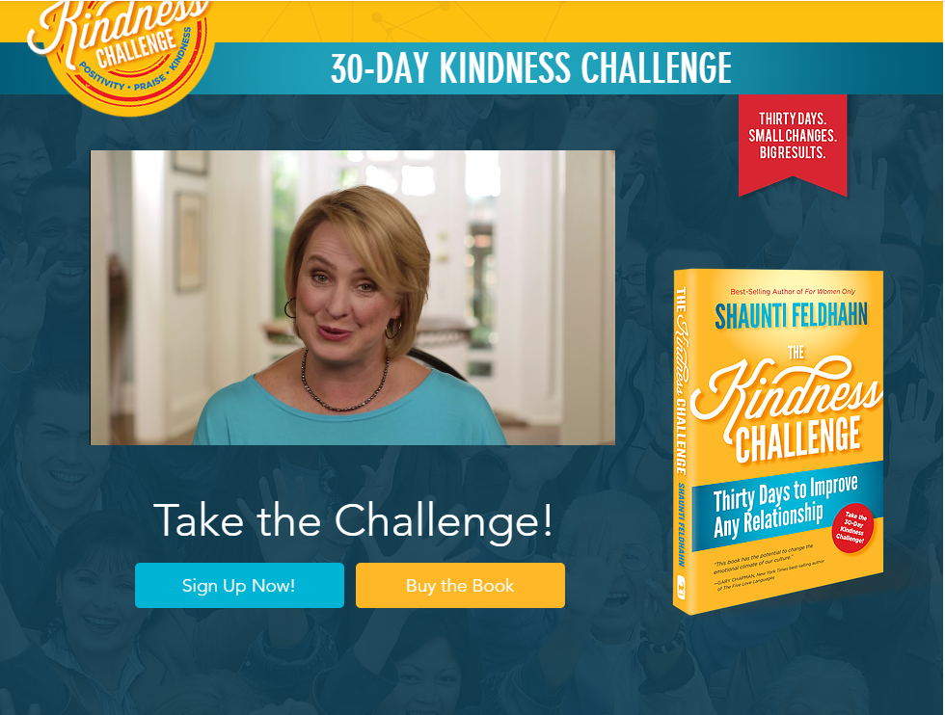
jointhekindnesschallenge.com/
Notes:
http://www.jointhekindnesschallenge.com/
Here is the summary. Pick a target person. Maybe a spouse, congregant, neighbor, co-worker, son/daughter, parent, etc.

Slide 74
For 30 days, you will:
Say nothing negative about your person—either to them or about them to someone else. If you must provide negative feedback (for example, to discipline a child or correct a subordinate’s mistake), be constructive and encouraging without a negative tone.

Slide 75
For 30 days, you will:
Every day, find one thing that you can sincerely praise or affirm about your person and tell them—and tell someone else.
Every day, do one small act of kindness or generosity for them.

Slide 76
A great forgiveness story…

Slide 77
I was greatly encouraged to hear a report of how over 300 Christians had come together for a service of repentance in High Wycombe, where confession was made for the crime of having expelled Jews from the town in 1234, nearly 800 years ago.

Slide 78
Britain subsequently expelled all Jews in 1290, and it was nearly 400 years before they were allowed back. Jews have suffered much wicked persecution over the centuries at the hands of so-called Christians.

Slide 79
It’s time we turned that around and instead acknowledged our great debt to them – for the patriarchs, the prophets, the Scriptures almost in their entirety and, of course, for Messiah himself!

Slide 80
As for the confessional service, I am told that even the Buckinghamshire town’s Muslim mayor took part, along with a Rabbi who spoke of how very dignified it was on the one hand “and hugely transforming and therapeutic on the other”, adding: “There was a moment when tears welled up in response to all the compassion being expressed.

Slide 81
“To feel that the historic pain of Jews was being addressed and that the fear lying deep within our collective Jewish consciousness was being responded to was emotional and cathartic. Memories of tonight will stay with me for a long while. I will share them with colleagues, family and friends.” (See: Christians Confess Antisemitism)

Slide 82
This is how we can find
Shalom in Chaos
Who can you bless with an encouraging word?
To whom can we extend blessing, forgiveness?
How can we keep ourselves pure?
Study and BELIEVE His Word.
Pray!!

Slide 83
Do we serve even when it hurts? People hurting us? These guys had abandoned Him and fled. Now depressed without Him.

Slide 84
I have only had one vision in my live. I saw the face of Yeshua, evident that He was fully human, facial hair, all hormones and sensations that I had. The vision helped me with a certain fleshly temptation of my 20’s.
Maybe they saw His hands…

Slide 85
On the dark side, with isolation being such a trigger for porn addicts, internet porn use has increased by 18%
Notes:
American Family Assoc. of KS & MO, MAILING: 11936 W. 119th St. # 193, Overland Park, KS 66213
Also Dobson Newsletter on Superbowl show.

Slide 86
A surprising good note..

Slide 87
All Porn Shops and Strip Clubs are closed across Kansas and Missouri as non-essential.
The Small Business Administrations guidance on the few businesses that DO NOT qualify for forgivable loans... Strip Clubs and Porn Shops don't qualify!
Notes:
American Family Assoc. of KS & MO, MAILING: 11936 W. 119th St. # 193, Overland Park, KS 66213

Slide 88
“Applicant does not present live performances of a prurient sexual nature or derive directly or indirectly more than de minimis gross revenue through the sale of products or services, or the presentation of any depictions or displays, of a prurient sexual nature.”
Notes:
American Family Assoc. of KS & MO, MAILING: 11936 W. 119th St. # 193, Overland Park, KS 66213

Slide 89
Across Africa and Asia, millions of people in historically unengaged people groups are now in rapidly growing Disciple Making Movements. In 2000 there were 6 such movements, today there are now 1,035!
Notes:
https://www.christianpost.com/voices/christianity-is-growing-faster-than-any-time-in-history-why-is-the-church-in-europe-america-declining.html

Slide 90
Across Africa and Asia many thousands of former Muslim clerics have left Islam to become fearless disciples of Messiah. Not surprisingly, Christianity’s growth in Africa and Asia is explosive. On average, using data from The Status of Global Christianity, between 2000 to 2020, (7,300 days):
Notes:
https://www.christianpost.com/voices/christianity-is-growing-faster-than-any-time-in-history-why-is-the-church-in-europe-america-declining.html

Slide 91
Africa had 37,825 new Messiah Followers every day over the last 20 years
Latin America had 16,988
Asia had 13,443
North America had 1,999
Oceania had 473
Europe had 8
[ Source: Christian Post]
Notes:
https://www.christianpost.com/voices/christianity-is-growing-faster-than-any-time-in-history-why-is-the-church-in-europe-america-declining.html

Slide 92
What is it that the churches of the Global South are doing that makes so much difference?
1. Abundant, and Bold Prayer
2. Discipling to Conversion
3. Obedience-Based Discipleship
4. Empowering Ordinary People for Ministry
Notes:
https://www.christianpost.com/voices/christianity-is-growing-faster-than-any-time-in-history-why-is-the-church-in-europe-america-declining.html

Slide 93
5. Make Replicating Disciples, not Converts
6. Never Ending Leadership Training for All
Notes:
https://www.christianpost.com/voices/christianity-is-growing-faster-than-any-time-in-history-why-is-the-church-in-europe-america-declining.html

Slide 94
^{Lk 24.33-47} They were still talking about it [with the group in Yerushaliyim] when -- there he was, standing among them!
Yeshua said to them, "This is what I meant when I was still with you and told you that everything written about me in the Torah of Moshe, the Prophets and the Psalms had to be fulfilled." Then he opened their minds, so that they could understand the Tanakh, telling them,

Slide 95
^{Lk 24.33-47} "Here is what it says: the Messiah is to suffer and to rise from the dead on the third day; and in his name repentance leading to forgiveness of sins is to be proclaimed to people from all nations, starting with Yerushalayim.

Slide 96
^{Luke 24.48-49} You are witnesses of these things. Now I am sending forth upon you what my Father promised, so stay here in the city until you have been equipped with power from above.”

Slide 97
This is how we can find
Shalom in Chaos
Who can you bless with an encouraging word?
To whom can we extend forgiveness?
How can we keep ourselves pure?
Study and BELIEVE His Word.
Pray!!

Slide 98
Notes:
https://www.google.com/search?q=coronavirus+tips&fbx=dothefive

