Slide 1
e-handout
To have these notes
without taking notes
Go to OrHaOlam.com
Click on downloads,
messages, 2020

Slide 2
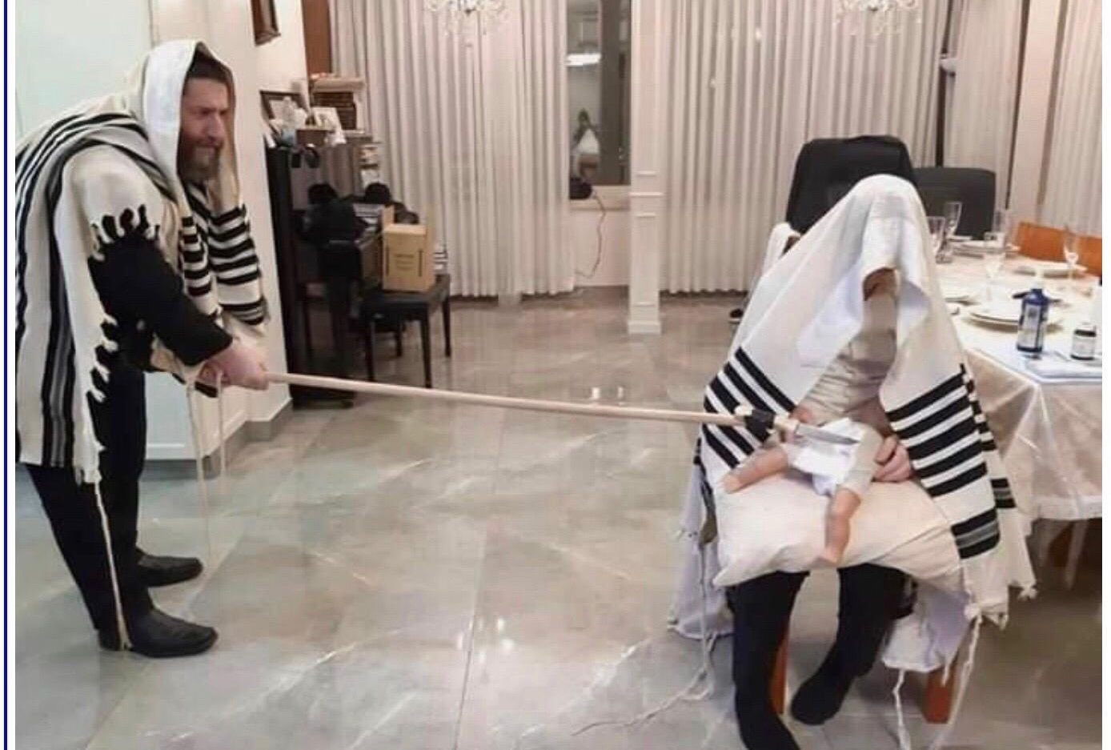
Social distancing circumcision
Notes:
Jim Adler

Slide 3
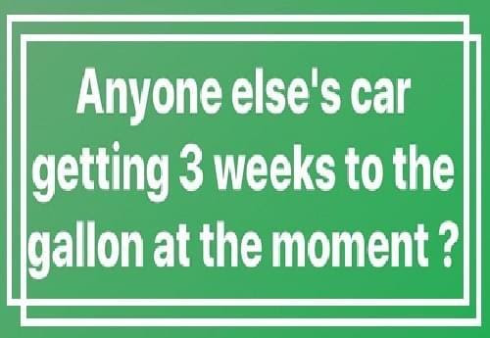
Notes:
Greg McIntire

Slide 4
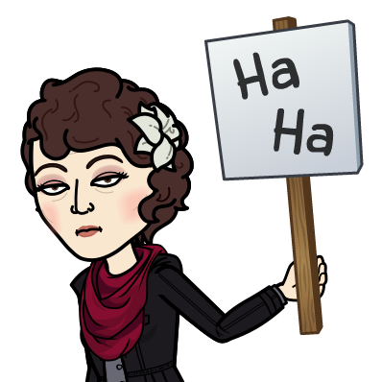

Slide 5
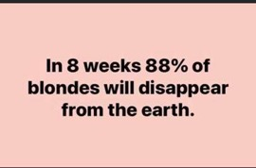
Notes:
Greg McIntire

Slide 6
Notes:
Greg McIntire

Slide 8
We are in the
Omer counting time, the Sephiraסְפִירַה

Slide 9
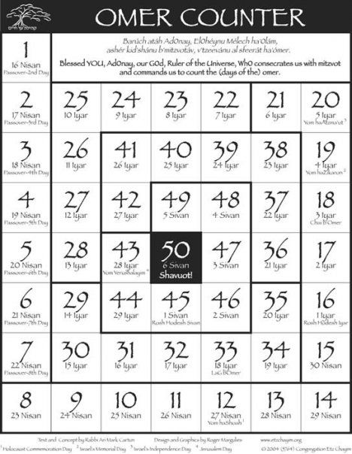
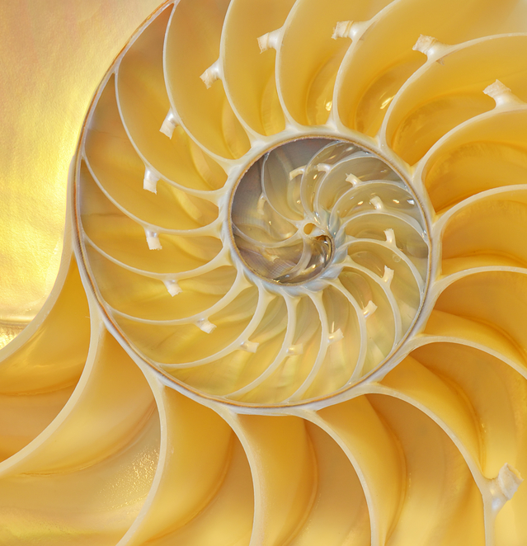
Notes:
https://www.google.com/search?q=omer+calendar+2020&safe=active&sxsrf=ALeKk009ZPK6pqy4kdhGdYd1A9w5aCTOCA:1587174732777&tbm=isch&source=iu&ictx=1&fir=WyelTA52yA05EM%253A%252ChJhcP_EM9kze5M%252C_&vet=1&usg=AI4_-kTV0SoIDGZqmHYI7InJEq6Zx3zlUQ&sa=X&ved=2ahUKEwiLyJLR7vDoAhUIRKwKHYpODaQQ9QEwBHoECAoQCQ#imgrc=2WJu47rjTGlACM&imgdii=-NjPR12wGK9zgM
https://his-israel.com/2020/03/25/5780-2020-counting-the-omer-calendar/
Calev’s favorite.

Slide 10
What is the significance of the Omer counting =
Sephirat HaOmer סְפִירַת הָעוֹמֶר
Spiraling Up to Holiness--
Passover → Shavuot
Sephira
Notes:
Sometimes just called Sephira

Slide 11
Lev 23.15-16 From the day after the day of rest — that is, from the day you bring the sheaf for waving — you are to count seven full weeks, until the day after the seventh week; you are to count fifty days; and then you are to present a new grain offering to Adoni .' "
Notes:
Scripture doesn’t actually give us any explanation, but the meaning is found in the doing.

Slide 12
“The number seven is code for two things in the Torah – wholeness and holiness – and it’s the base unit for the way sacred time is arranged in the biblical view. The seventh day is the day of rest. When the Cohanim/ priests got the tabernacle ready to be
Notes:
https://his-israel.com/2020/03/25/5780-2020-counting-the-omer-calendar/

Slide 13
G-d’s house, they did a seven day ritual to prepare. Harvest festivals last seven days, and a baby boy gets seven days in the world before undergoing circumcision. When we count the Omer, we count seven sets of seven, each week building on the one before,
Notes:
https://his-israel.com/2020/03/25/5780-2020-counting-the-omer-calendar/

Slide 14
like a spiral staircase, helping us to make the climb up to wherever it is that revelation happens for us.”
Notes:
https://his-israel.com/2020/03/25/5780-2020-counting-the-omer-calendar/

Slide 15
SPIRALING UP TO HOLINESS – KEEP CLIMBING!

Slide 16
Notes:
https://www.google.com/search?q=omer+calendar+2020&safe=active&sxsrf=ALeKk009ZPK6pqy4kdhGdYd1A9w5aCTOCA:1587174732777&tbm=isch&source=iu&ictx=1&fir=WyelTA52yA05EM%253A%252ChJhcP_EM9kze5M%252C_&vet=1&usg=AI4_-kTV0SoIDGZqmHYI7InJEq6Zx3zlUQ&sa=X&ved=2ahUKEwiLyJLR7vDoAhUIRKwKHYpODaQQ9QEwBHoECAoQCQ#imgrc=2WJu47rjTGlACM&imgdii=-NjPR12wGK9zgM
https://his-israel.com/2020/03/25/5780-2020-counting-the-omer-calendar/
Calev’s favorite.

Slide 17
How do we understand and DO this spiraling up?
Barley and flax are the first of the grains, sprouted at Passover time. Wheat comes up later in the Spring.
So the wheat crop is at risk during the time after Pesakh.

Slide 18
During the plagues on Egypt:
^{Shmot/Ex 9.31-32} The flax and the barley were destroyed, because the barley was in the ear, and the flax was in bloom. But the wheat and the spelt were not destroyed, because they ripen later.

Slide 19
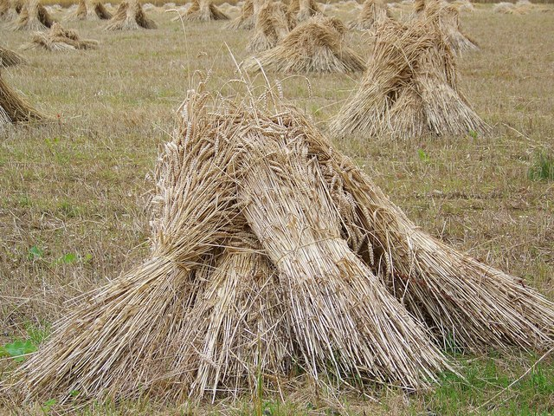
Sheaves of wheat

Slide 20
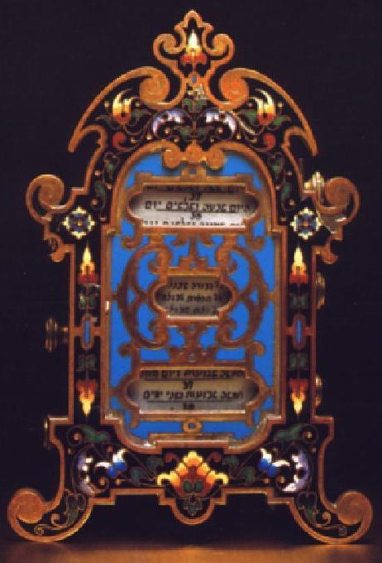

Slide 21
Therefore, the Sephira is a period of uncertainty -- of hope and prayer that our physical sustenance will be continued in. This uncertainty was due, in particular, to the fact that in Israel, the hot winds that are so harmful to the crops blow between Pesakh and Shavu'ot

Slide 22
Khamsin, Arabic for 50, hot, dry, dusty wind in North Africa and the Arabian Peninsula that blows from the south or southeast in from March to June. It often reaches temperatures above 104°, and it may blow continuously for three or four days at a time.
Notes:
https://www.britannica.com/science/khamsin

Slide 23
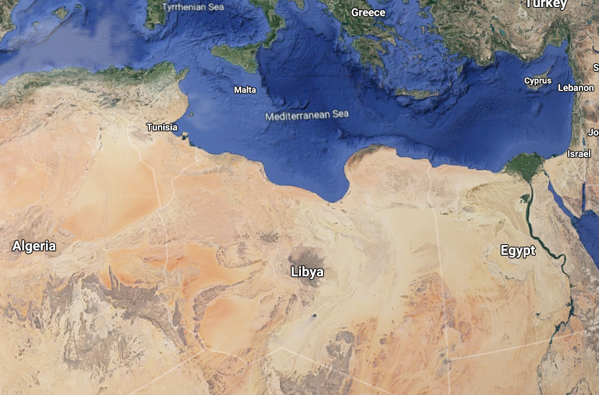
Notes:
(Hebrew: חמסין‎) is known more formally as sharav (שרב), and the Biblical term for khamsin is ruaḥ qadīm (רוח קדים) or "east wind"

Slide 24
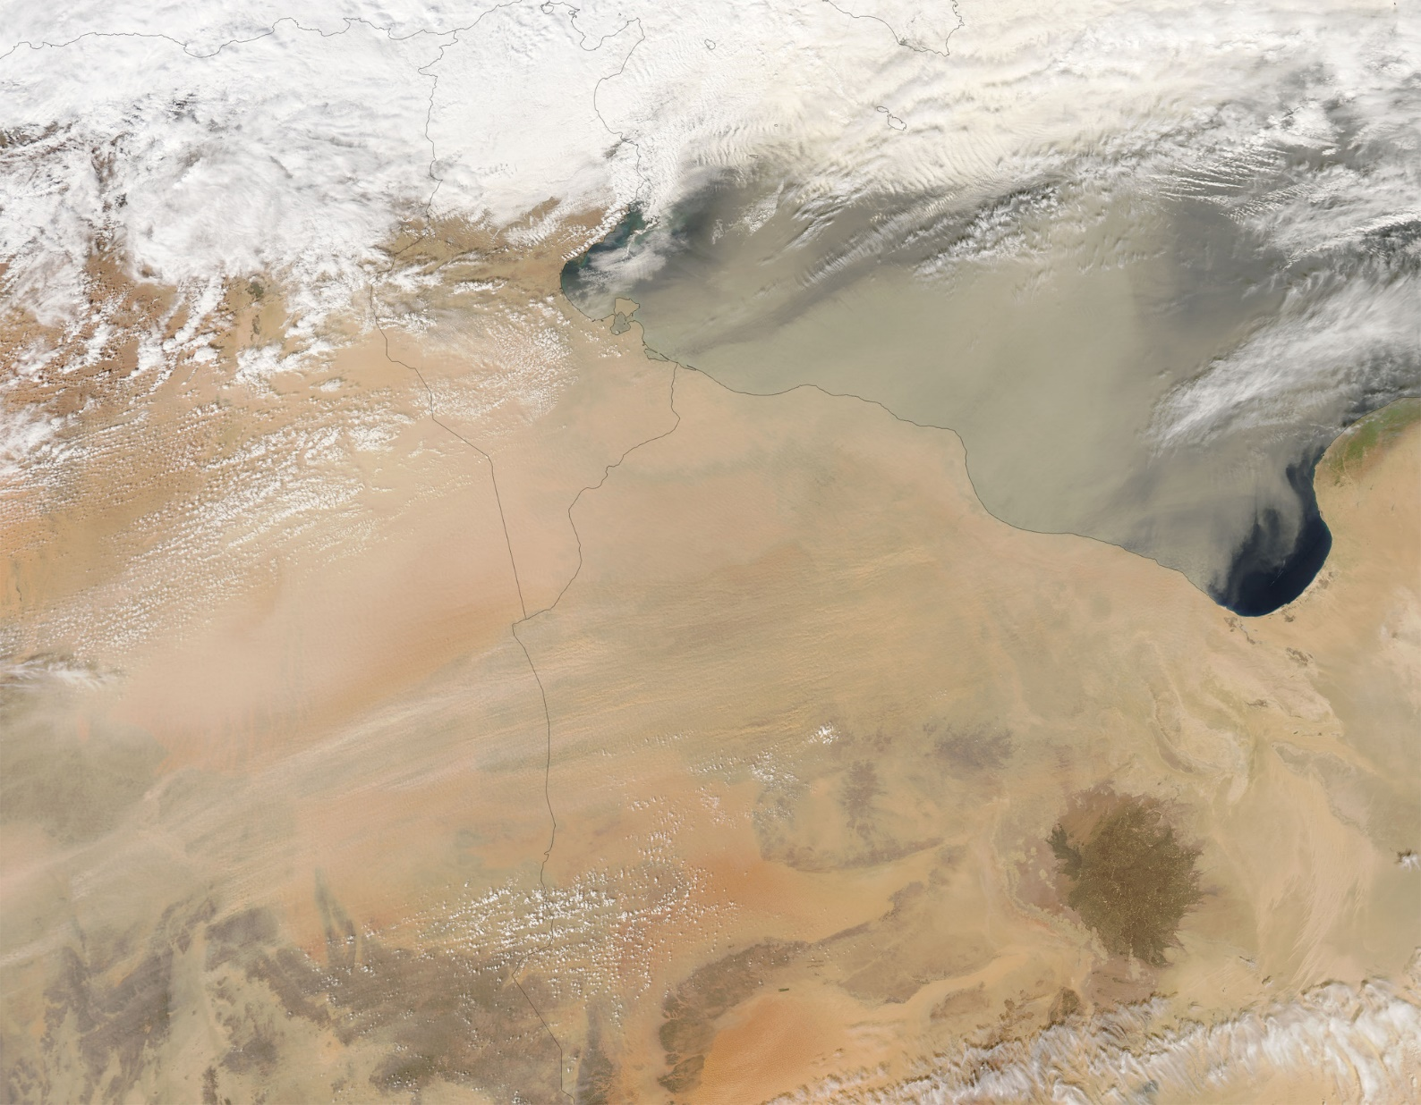
Dust Storm over Libya and Egypt
A thin sheet of dust blew north-
eastward from deserts March 1, 2005
Notes:
http://www.time.com/time/magazine/article/0,9171,862302,00.html#ixzz1z2dizbSq

Slide 25
During Napoleon's Egyptian Campaign, the French soldiers had a hard time with khamsin: when the storm appeared "as a blood-stain in the distant sky", the natives went to take cover, while the French "did not react until it was too late,

Slide 26
then choked and fainted in the blinding, suffocating walls of dust.“
During the North African Campaign of the World War II "allied and German troops were several times forced to halt in mid-battle because of sandstorms caused by khamsin...

Slide 27
Grains of sand whirled by the wind blinded the soldiers and created electrical disturbances that rendered compasses useless." Under Ottoman Empire law, murder was held more pardonable if committed while the khamsin was blowing.

Slide 28
Therefore, this counting time is somewhat solemn, for the wheat harvest is at risk.
Also, untimely rains can damage or destroy the wheat crop.
Shmuel the prophet rebuking Israel for wanting royalty:

Slide 29
^{1 Shmuel 12.17-19} Is it not wheat harvest season today? I will call to Adoni, that He may send thunder and rain. Then you will know and see that your wickedness is great which you have done in the sight of Adoni by asking for yourselves a king.” So Samuel prayed to Adoni,

Slide 30
^{1 Shmuel 12.17-19} and Adoni sent thunder and rain that day. Then all the people greatly feared Adoni and Samuel, and all the people said to Samuel, “Pray for your servants to Adoni your God, that we would not die, for we have added to all our sins this evil by asking for ourselves a king.”

Slide 31
Therefore, this counting time is somewhat solemn, for the harvest is at risk. Historically, the omer period has been marked by several tragedies occurring to our people.
Notes:
Weddings and concerts are forbidden among the Orthodox.

Slide 32
Lag BaOmer לַ״ג בָּעוֹמֶר also Lag B'Omer, is a Jewish holiday celebrated on the 33rd day of the Counting of the Omer, the Sephira.
It marks the day that the plague that killed Rabbi Akiva's 24,000 disciples came to an end, and for this reason the mourning period of Sefirat HaOmer concludes on Lag BaOmer for some people.
Notes:
https://en.wikipedia.org/wiki/Lag_BaOmer
The Talmud goes on to say that this was because they did not show proper respect to one another.
The origins of Lag BaOmer as a minor festival are unclear. Also this day marks the anniversary of death of Rabbi Shimon bar Yochai, a Mishnaic sage and leading disciple of Rabbi Akiva, who survived the plague, and is the likely author of the Zohar, the book of Jewish mysticism and occult.

Slide 33
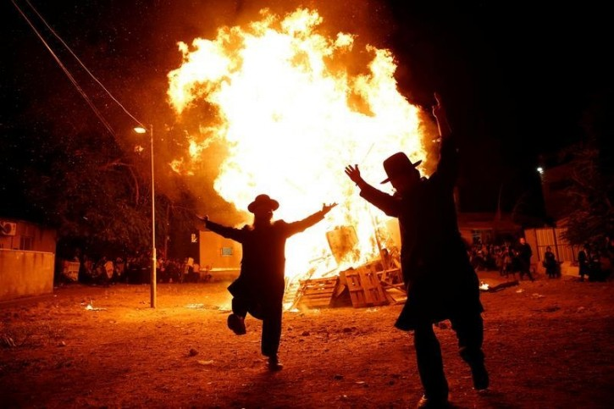
Lag B’Omer bonfire, celebrating the end of the
plague.
Notes:
First 33 days no weddings. My parents wedding was postponed because of this until Lag B’Omer.

Slide 34
So there was a mysterious plague in ancient times, during the Sephira, Omer counting time.

Slide 35
The last great deportation to the gas chambers, that of the Jews of Hungary, took place during the Sefirah period.

Slide 36
Although the crematoria and gas chambers of the Nazis operated all year round, the Knesset of Israel decided to fix the twenty-seventh of Nisan as Memorial Day for those slaughtered by the Nazis during World War II. This day is called יוֹם הַשּׁוֹאָה Yom HaShoah, Holocaust Memorial Day, and will be observed April 21. https://www.facebook.com/MidwestCenterforHolocaustEducation/

Slide 37
^{T’hillim/Ps 90.12} So, teach us to number our days, so that we may get a heart of wisdom.
So we count, we examine ourselves, we seek mercy and LIFE. This is a great time for fasting and prayer!
Notes:
Many believers in the body of Messiah fast before Passover. There is no scriptural basis to that, even a pagan affiliation. These 50 days are the time to pick a fast period. Three days, 10 days, etc.

Slide 38
The counting reminds us of the link between פֶּסַח Passover, which commemorates the Exodus, and שָׁבוּעוֹת Shavuot (Pentecost). which is the Firstfruits of the wheat harvest, and also commemorates the giving of the Torah, and to Messianics, the Ruakh/Spirit!

Slide 39
Shavuot is linked to the giving of the Torah because the Ten Commandment were given on the day of Shavu’ot at Mt. Sinai. Redemption from slavery at Pesakh was not complete until we received the Torah on Shavu’ot. Liberation is useless unless we know how to live as free men and women.

Slide 40
As Messianics, we want to have not only the Torah, but the power of the Ruakh to keep the Torah, which also came on Shavuot/Pentecost.
The followers of Messiah were told to wait in Jerusalem. Count, seek His power!

Slide 41
Passover is a symbolic expression of the atonement of Messiah.
Firstfruits typifies the Resurrection.
Omer counting prepares us for
Shavuot, giving of the Word and the Ruakh/Spirit!

Slide 43
In fact, during this period, the prayer in the Amidah = Shmoneh Esray, the central prayer in the Jewish prayer book, changes. The rainy season is over.
No more prayer for rain, only for dew.

Slide 44
בחורף: (From the 1st day of Pesakh to the 8th day of Sukkot, omit)
מַשִּׁיב הָרֽוּחַ וּמוֹרִיד הַגָּֽשֶׁם:
Ma-sheev ha-roo-akh oo-mo-reed ha-ga-shem
He who turns the wind, and causes the rain to fall.
Notes:
Right after the Melekh Ozair

Slide 45
A physical manifestation of this praying for harvest, for the right kind of rain at the right time, is the current history of Yam Kinneret = the Sea of Galilee.

Slide 46
Apr., 2020
Nov., 2001
Notes:
the lowest level recorded since then was November 2001, which today constitutes the "black line" of 214.87 meters 704.95 feet below sea level

Slide 47
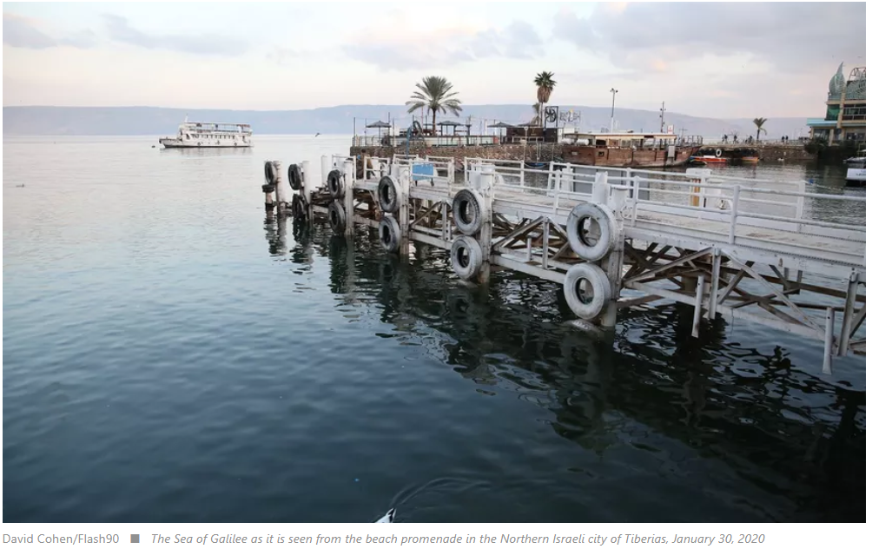
Notes:
Note the support poles. The pier is at the top.

Slide 48
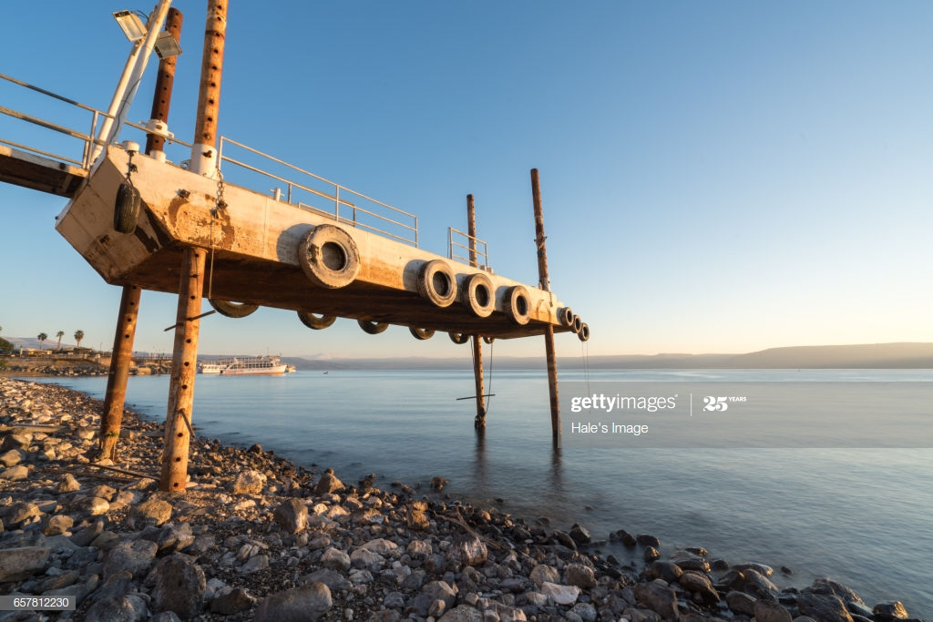
Notes:
https://www.google.com/search?q=sea+of+galilee+pier&safe=active&sxsrf=ALeKk02i6OR1nYFvFPTFUdzvZTKVUhATYw:1587165492015&source=lnms&tbm=isch&sa=X&ved=2ahUKEwjCtOeazPDoAhUPlawKHd0cB7wQ_AUoA3oECBMQBQ&biw=1280&bih=951#imgrc=uE5YyGD0dXr0CM

Slide 49
So, Israel HAS received good rain this year. Nevertheless, we are in a time in the Sephira [Counting] of risk.
We are also in the midst of a great plague!

Slide 50
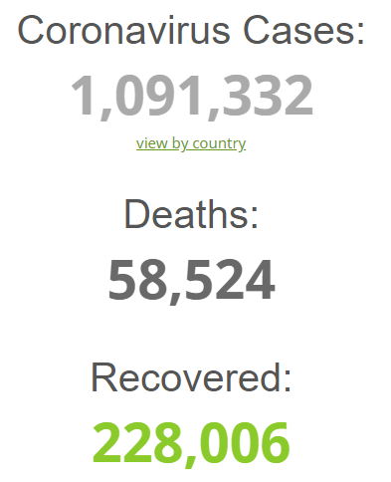
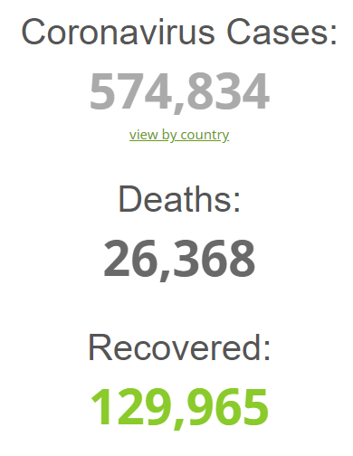
Friday, April 3, 2020 4 p.m.
Friday, March 27,
2020 noon
90%
Weekly
increase
Notes:
https://www.worldometers.info/coronavirus/

Slide 51
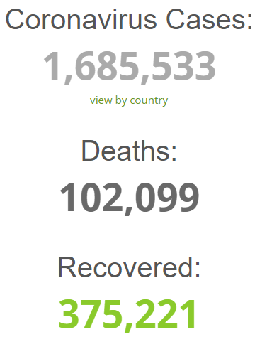
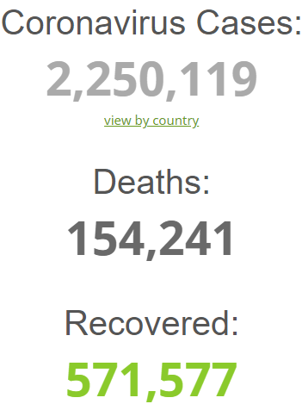
Friday, Apr. 17,
2020 8:30 p.m.
Friday, April 10,
2020 4 p.m.
+54%
Weekly
+33%
weekly
Notes:
https://www.worldometers.info/coronavirus/

Slide 52
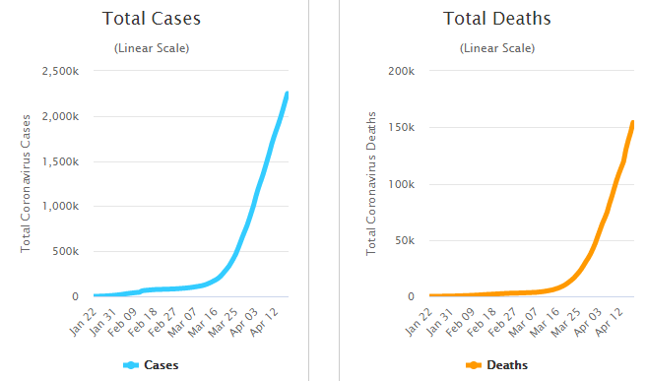

Slide 53
Johnson County COVID-19 Statistics
Sun., Mar 29, 108 cases, 2 deaths
Sun., Apr 5, 192 cases, 8 deaths
Fri., Apr 10, 263 cases, 12 deaths
Fri., Apr 17, 355 cases 23 deaths

Slide 54
Notes:
https://unitedwithisrael.org/delete-viral-anti-semitic-corona-content-demands-hate-crime-watchdog/?utm_source=MadMimi&utm_medium=email&utm_content=Israeli+Patriotism+Strong+as+Ever+Despite+Pandemic%3B+Mission+Impossible%3A+Mossad+Brings+Ventilators%2C+Masks+to+Israel%3B+%E2%80%98Delete+Viral+Anti-Semitic+Corona+Content%E2%80%99&utm_campaign=20200417_m157918948_Israeli+Patriotism+Strong+as+Ever+Despite+Pandemic%3B+Mission+Impossible%3A+Mossad+Brings+Ventilators%2C+Masks+to+Israel%3B+%E2%80%98Delete+Viral+Anti-Semitic+Corona+Content%E2%80%99&utm_term=more_btn_dark_jpg

Slide 55
The spirit of fear is rampant among people all over the globe. “Men’s hearts will be failing them for fear of the things coming on them.” ^{(Luke 21:26)} There is a spirit in the secular media that exaggerates this virus so badly that you will need to insulate your mind in order to keep yourself free from paranoia.
Notes:
https://tikkun.tv/the-corona-virus/ Eric Morey

Slide 56
“…there will be famines, pestilences, and earthquakes in various places. All these are the beginning of sorrows.” ^{(Mtt 24: 7b-8)}
We are living in a time when the world is in crisis.
Notes:
https://tikkun.tv/the-corona-virus/ Eric Morey

Slide 57
This can be our finest moment. We have hope.
“God has not given us a spirit of fear, but of love and power and a sound mind.” ^{(II Timothy 1:7)}
The word “fear” appears 365 times in the Bible, one for each day of the year – for example, “Fear not” and “Be not afraid.”
Notes:
https://tikkun.tv/the-corona-virus/ Eric Morey

Slide 58
F.E.A.R. can be made into an acronym for “False Evidence Appearing Real.” The definition of fear in the Merriam-Webster dictionary is, “Dread, fright, alarm, trepidation, panic, terror.”
Notes:
https://tikkun.tv/the-corona-virus/ Eric Morey

Slide 59
We have assurance, even while the world around us is in darkness. We can use this time to reach those who have not yet given their hearts to the Lord.
Notes:
https://tikkun.tv/the-corona-virus/ Eric Morey

Slide 60
“Arise, shine; For your light has come! And the glory of Adoni is risen upon you. For behold, the darkness shall cover the earth, And deep darkness the people; But Adoni will arise over you, And His glory will be seen upon you.” ^{(Isaiah 60:1-2)}
Notes:
https://tikkun.tv/the-corona-virus/ Eric Morey

Slide 61
Some recourse
in this time of fear.
Spiraling Up to Holiness--
Passover → Shavuot
Sephira

Slide 62
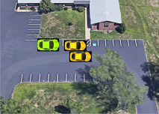
Drive
In prayer
Starting Sunday 1 p.m.
Tomorrow!!
Notes:
I left out a table between the pray-er and pray-ee.
If you are interested in being a prayer minister, or and intercessor, let me know, or email admin@OrHaOlam.com
We will maintain social distancing, masks, gloves, etc. But will there be difficulties and even opposition?

Slide 63
“The City of Greenville fined congregants $500 per person for attending these parking lot services. [This happened] while permitting citizens to attend nearby drive-in restaurants, even with their windows open," Barr complained.
Notes:
https://www.worthynews.com/48544-u-s-attorney-general-condemns-ban-on-drive-in-churches?utm_source=Worthy+Brief&utm_campaign=98edb00162-EMAIL_CAMPAIGN_2020_04_16_12_42&utm_medium=email&utm_term=0_d1151ee7ea-98edb00162-104018657

Slide 64
"The City appears to have thereby singled congregations out as the only essential service [as designated by the state of Mississippi] that may not operate. [This] despite following all [Centers for Disease Control and Prevention] (CDC) and state recommendations regarding social distancing," he argued.
Notes:
https://www.worthynews.com/48544-u-s-attorney-general-condemns-ban-on-drive-in-churches?utm_source=Worthy+Brief&utm_campaign=98edb00162-EMAIL_CAMPAIGN_2020_04_16_12_42&utm_medium=email&utm_term=0_d1151ee7ea-98edb00162-104018657

Slide 65
Mayors in Tennessee and Kentucky have also banned drive-in church services for allegedly violating social distancing standards while maintaining that drive-through restaurants do not.
Notes:
https://www.worthynews.com/48544-u-s-attorney-general-condemns-ban-on-drive-in-churches?utm_source=Worthy+Brief&utm_campaign=98edb00162-EMAIL_CAMPAIGN_2020_04_16_12_42&utm_medium=email&utm_term=0_d1151ee7ea-98edb00162-104018657

Slide 66
However, Barr suggested that authorities should not ban worship services observing social distance guidelines to avoid spreading the coronavirus, COVID-19.
Notes:
https://www.worthynews.com/48544-u-s-attorney-general-condemns-ban-on-drive-in-churches?utm_source=Worthy+Brief&utm_campaign=98edb00162-EMAIL_CAMPAIGN_2020_04_16_12_42&utm_medium=email&utm_term=0_d1151ee7ea-98edb00162-104018657

Slide 67
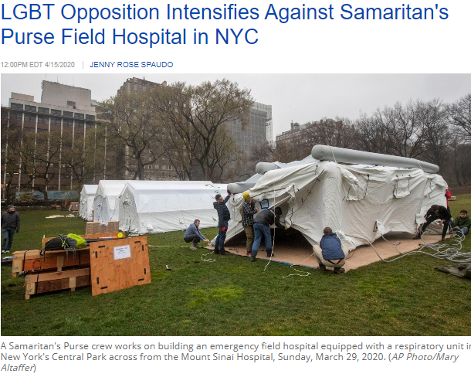

Slide 68
James Sarah Rebba-varapu family

Slide 69
30% Indian population Dalits = Untouchables. Poorest laborers. If don’t work then don’t eat; no reserves. Indian Prime Minister Narendra Modi govt is radical Hindu did lock down with 4 hours notice, and doesn’t care about Dalits. Moreover, many Dalits became Christians, so government really about doesn’t care them.

Slide 70
Notes:
http://icmin.org/ Here a woman has just received a large bag, and walks past a "socially-distanced" waiting line of other villages, grateful for the supplies.

Slide 71
Or HaOlam has decided to donate $1000 to ICM, India Christian Ministries. Sixty five families will have rice for a month with Or HaOlam’s $1000 donation. Associated with evangelism and congregation building.

Slide 74
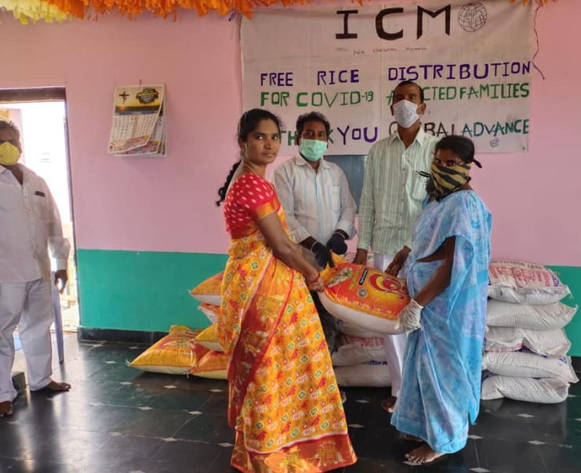
Operation Saturation
http://icmin.org/
Notes:
https://icm.kindful.com/opsat-2020/help-local-churches-feed-villages-in-asia-covid-19

Slide 75
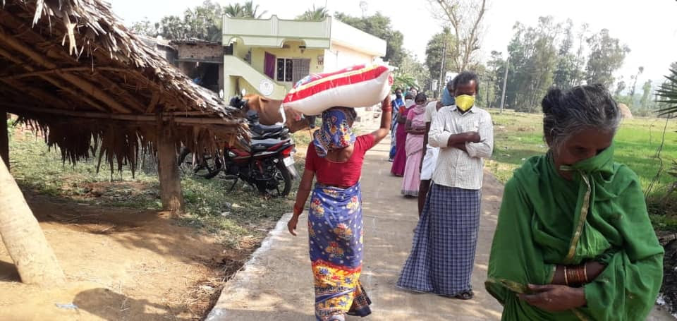

Slide 77
If you listen to the pundits, the conventional wisdom is that this quarantine is fracturing marriages in an unprecedented way. We hear about China’s divorce filings spiking as soon as their lockdown let up, and divorce requests breaking a city’s single-day record. We hear that we too will soon see a wave of divorces
Notes:
Copyright © 2020 Veritas Enterprises, All rights reserved.

Slide 78
One of the most sneakily simple actions that makes marriages better is to simply hang out more often.
Well, we’re all hanging out a lot more than we used to, aren’t we?! So why does it matter, and how do we use it to strengthen our marriage?
Notes:
Copyright © 2020 Veritas Enterprises, All rights reserved.

Slide 79
Why it matters: It turns out, the happiest couples treat each other first and foremost as best friends. Think about it: When you are very, very close friends with someone, you don’t just love each other—you like each other. And you like and care for one other so much that you can and will work through very difficult things in order to keep the friendship intact.
Notes:
Copyright © 2020 Veritas Enterprises, All rights reserved.

Slide 80
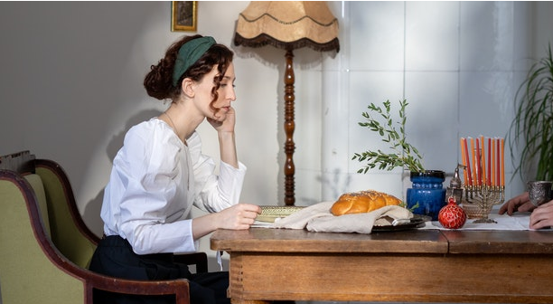

Slide 81
The Jewish thinker Abraham Joshua Heschel classically described the Sabbath as “sanctuary in time,” noting that, “The Sabbaths are our great cathedrals, the Jewish equivalent of sacred architecture.”
What exactly did he mean?
Notes:
https://www.charismanews.com/opinion/in-the-line-of-fire/80788-the-shutdown-the-sabbath-and-a-weekly-divine-reset

Slide 82
He noted that, “One of the most distinguished words in the Bible is the word kadosh, “holy,” a word which more than any other is representative of the mystery and majesty of the divine. Now what was the first holy object in the history of the world? Was it a mountain? Was it an altar?”
Notes:
https://www.charismanews.com/opinion/in-the-line-of-fire/80788-the-shutdown-the-sabbath-and-a-weekly-divine-reset

Slide 83
Heschel answers, “It is, indeed, a unique occasion at which the distinguished word kadosh is used for the first time: in the book of Genesis at the end of the story of creation. How extremely significant is the fact that it is applied to time:
Notes:
https://www.charismanews.com/opinion/in-the-line-of-fire/80788-the-shutdown-the-sabbath-and-a-weekly-divine-reset

Slide 84
‘And God blessed the seventh day and made it holy.’ There is no reference in the record of creation to any object in space that would be endowed with the quality of holiness.”
So, it is a day, a period of time, which is called holy. Those who enter into Sabbath rest enter into its holiness. It is, in that sense, a “sanctuary in time.” What does this mean for us today?
Notes:
https://www.charismanews.com/opinion/in-the-line-of-fire/80788-the-shutdown-the-sabbath-and-a-weekly-divine-reset

Slide 85
Holocaust Survivor Thanks You!
Notes:
https://reachii.org/holocaust-survivor-thank-you/

Slide 86
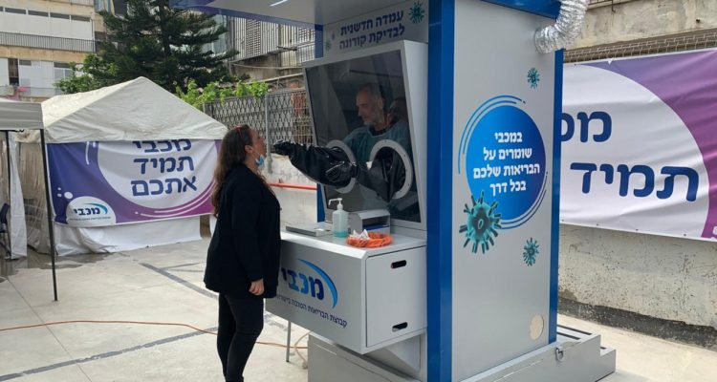
A coronavirus test station that keeps the tester
isolated from those being tested. (Maccabi Health Services

Slide 87
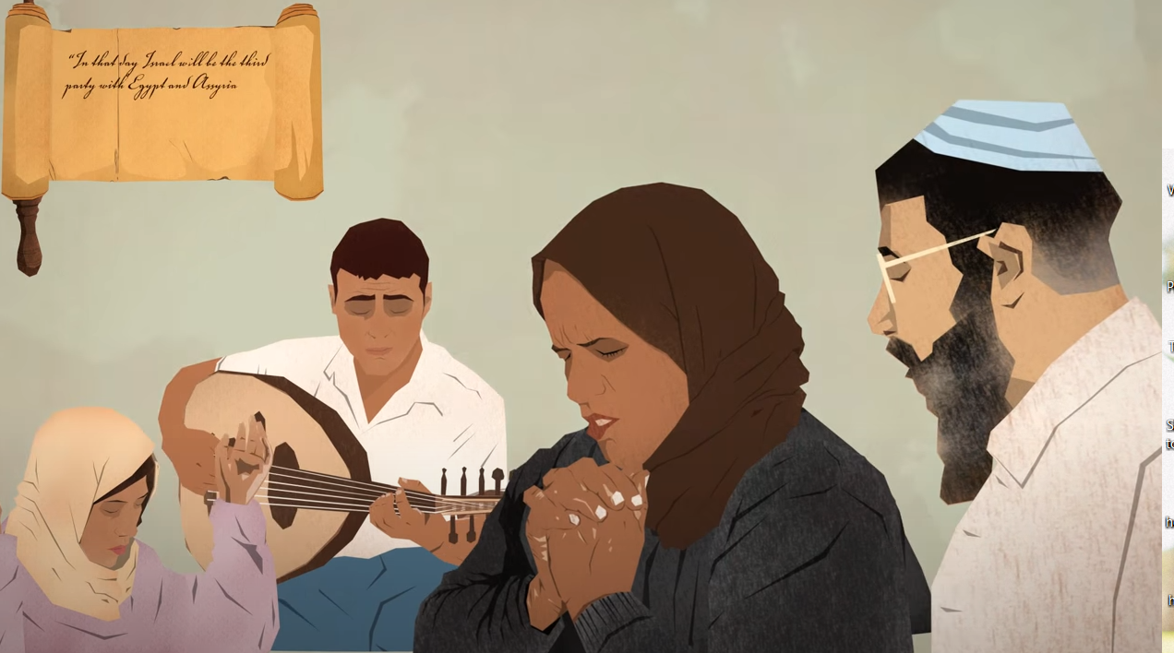
https://youtu.be/P69lF3Rao5w Isaiah 19 Hwy

Slide 88
Let’s DO the significance of the Omer counting =
Sephirat HaOmer סְפִירַת הָעוֹמֶר
Spiraling Up to Holiness--
Passover → Shavuot
Sephira
Notes:
Sometimes just called Sephira

Slide 89
Prayer and intercession.
Pick a private prayer time.
Join in many Zoom prayer meeings.
Join ours after 15 minute break, and again Tuesday at 7. If you don’t have the link, email admin@orhaOlam.com

Slide 90
Reach out and bless someone. Or HaOlam care phone tree.
Bless your family. Spend time!
Give to G-dly causes.
Join us for drive in prayer.

Slide 91
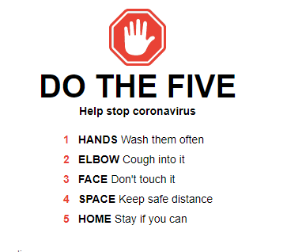
Notes:
https://www.google.com/search?q=coronavirus+tips&fbx=dothefive

