Slide 2
e-handout
To have these notes
without taking notes
Go to OrHaOlam.com
Click on downloads,
messages, 2020

Slide 3
Hanan Naftali on IDF ethics
Notes:
https://youtu.be/Tma1OnF4Dcg
3.05 minutes

Slide 4
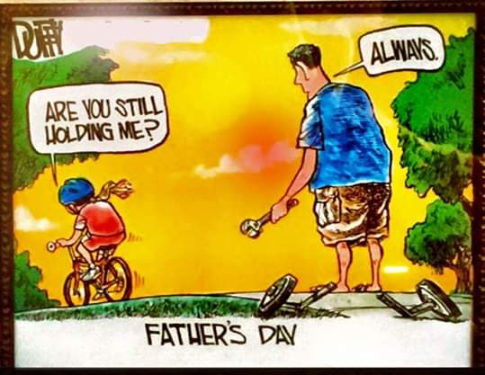
Notes:
From Robert and Linda Panther

Slide 6
On November 8, 1895 Wilhelm Röntgen was investigating radiation. The rays came from an electrified tube which he had wrapped in black cardboard so that the visible light from the tube would not come out. Nevertheless, he noticed a faint green glow from his fluorescent screen.
Notes:
https://en.wikipedia.org/wiki/X-ray

Slide 7
Some invisible rays coming from the tube were passing through the cardboard to make the screen glow. He found they could also pass through books and papers on his desk, but not metal. He called these mysterious rays “X-rays.”
Notes:
https://en.wikipedia.org/wiki/X-ray
About a month later, he set up photographic film, and x-rayed his wife’s hand.

Slide 8
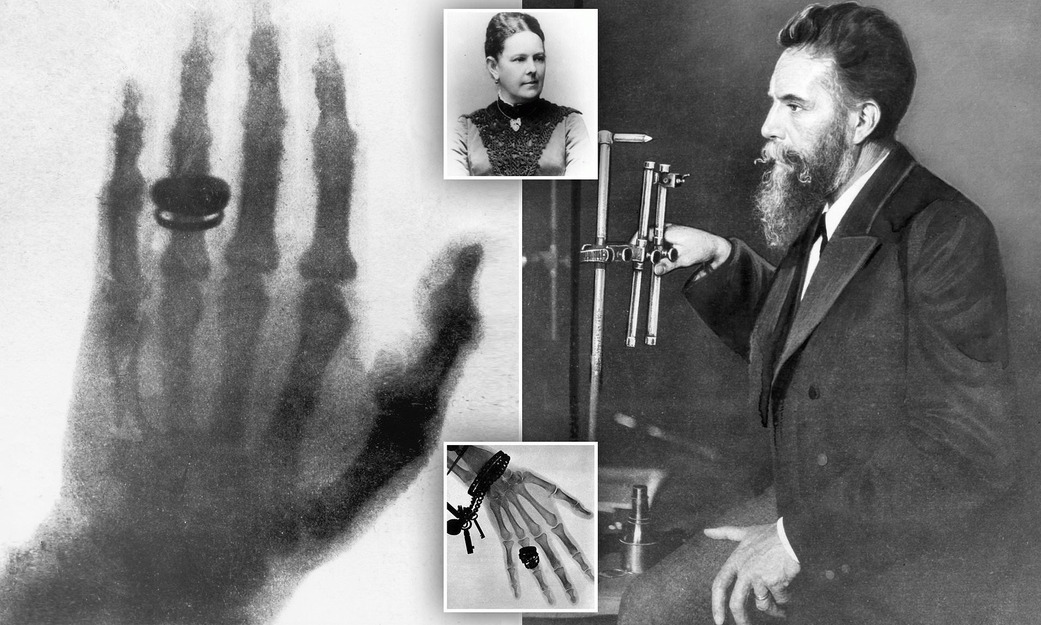

Slide 9
The photograph of his wife's hand was the first photograph of a human body part using X-rays. When she saw the picture, she said "I have seen my death."
Notes:
https://en.wikipedia.org/wiki/X-ray

Slide 10
How does G-d see us

Slide 11
^{MJ 4.12-16} Before God, nothing created is hidden, but all things are naked and open to the eyes of him to whom we must render an account.
Notes:
You would think “all things are naked” means that all is exposed. But it says naked and open. Seeing what is under wraps, under the skin, hidden in darkness, in memory, maybe faded, suppressed memory.
First done by Wilhelm Roentgen 1895 with X rays. Now, many methods, sort of models how G-d sees us.

Slide 12
Accountability
Notes:
What helps me when I get up in the morning, and live my life, is the thought that all my actions have a cosmic effect. They are all seen and recorded. My little miniscule contribution to the Ruakh access to the world. ~Strength of the Force? Where did I get this idea? Patriarchs story. Iyov/Job’s story. Ruth, Ester. All are under scrutiny and impact.

Slide 13
Positive aspects to G-d seeing us
Compassion
Steps for recovery
Camaraderie
Negative aspects to G-d seeing us
No excuses
No blame
No hiding wrongdoing
Notes:
Illustrate with a story from scripture…

Slide 14
When Hagar became aware that she was pregnant, she looked on her mistress with contempt. Sarai said to Avram, “This outrage being done to me is your fault! …May Adoni decide who is right — I or you!” However, Avram answered Sarai, “Look, she’s your slave-girl. Deal with her as you think fit.” Then Sarai treated her so harshly that she ran away from her.

Slide 15
The angel of Adoni found her by a spring in the desert. He said, “Hagar, Sarai’s slave-girl, where have you come from and where are you going?” She said, “I am fleeing from the presence of my mistress Sarai.”

Slide 16
The angel of Adoni said, “Return to your mistress and humble yourself under her hand.” Then the angel of Adoni said to her, “I will bountifully multiply your seed, and they will be too many to count.
Notes:
The Angel then made some other prophetic statements. Hagar responded…

Slide 17
^{Beresheet/Gen 16.13-14} So she named Adoni who had spoken with her אֵל רֳאִי El Ro’i [God of seeing], because she said, “Have I really seen the One who sees me [and stayed alive]?” This is why the well has been called באר לחי רואי Be’er-Lakhai-Ro’i [well of the one who lives and sees]; it lies between Kadesh and Bered.
Notes:
Hagar’s comfort was that G-d saw her.

Slide 18
All things are naked and open to the eyes of him to whom we must render an account.
G-d sees us, through and through. A bit of a lesson from Roentgen X rays plus…

Slide 19
Today’s medicine has
X-rays
CT scans
MRI
PET scans
Notes:
All these are a bit of a lesson in the all-seeing nature of Adoni.

Slide 20
X-rays, sees the bones and some tissue: tells doctors how some places are broken. Need to be reset.
IF you come from a home with a lot of criticism, arguing, you may think it’s normal. Put downs are not normal. Criticism is NOT normal. Affirming love is normal.
Notes:
You may have a bent that needs to be reset. Scripture is the standard, not your family of origin. Why small groups, home groups, new social normal is so important. People who see you charitably.

Slide 21
X rays show major breaks and deformities. The word of G-d is like an X-ray.
2. CT scans: X-ray by cross sections. Layers.

Slide 22
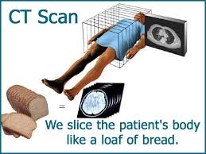
Notes:
https://www.google.com/url?sa=i&url=http%3A%2F%2Fwww.dielp.com%2Fdielp-ctvsmri.html&psig=AOvVaw2unQ2SHrILJe4byr1VLYui&ust=1593294690666000&source=images&cd=vfe&ved=0CAIQjRxqFwoTCIiOt7O7oOoCFQAAAAAdAAAAABAD

Slide 23
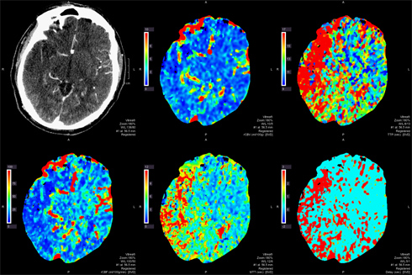
CT scans: sees layers of tissue
Notes:
Layers of this person’s brain.

Slide 24
People have layers too.
Heard of the Shrek doctrine?

Slide 25
Ogres have Layers
Notes:
https://youtu.be/aJQmVZSAqlc
Or
https://www.youtube.com/watch?v=aJQmVZSAqlc&feature=youtu.be

Slide 26
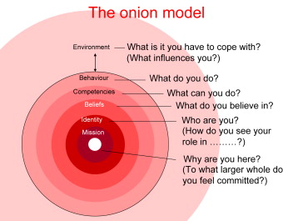
Notes:
https://www.google.com/url?sa=i&url=https%3A%2F%2Fwww.sciencedirect.com%2Fscience%2Farticle%2Fpii%2FS0742051X08001601&psig=AOvVaw3_CwNJhgqns4lY4H6tMyoz&ust=1593293709109000&source=images&cd=vfe&ved=0CAIQjRxqFwoTCMDR8t63oOoCFQAAAAAdAAAAABBB

Slide 27
LAYERS
Sozo one of many methods of unpackaging.
Wounds → lies believed → reactions.
Forgive → renounce lies → new TRUTH, new normal.
Home groups
Notes:
[Sozo confidential? Sozo ministers tell nothing, you should be transparent with those you are intimate with]
G-d wants you perfect, holy, pure.
Wounds: insecurities, depression and anger and offense and fear, poverty mentality.
Forgive wounders, ישוע present
Renounce, close doors, dear down walls. Receive revelation of REALITY
Home groups: ultimately, know your struggles, inner wounds

Slide 28
^{1 Yn 1.7-9} But if we walk in the light as He Himself is in the light, we have fellowship with one another and the blood of His Son Yeshua purifies us from all sin. If we say we have no sin, we are deceiving ourselves and the truth is not in us. If we confess our sins, He is faithful and righteous to forgive our sins and purify us from all unrighteousness.

Slide 29
^{Yokhanan 151-7} "I am the real vine, and my Father is the gardener. Every branch which is part of me but fails to bear fruit, he cuts off; and every branch that does bear fruit, he prunes, so that it may bear more fruit. Stay united with me, as I will with you -- for just as the branch can't put forth fruit by itself apart from the vine, so you can't bear fruit apart from me.
Notes:
Are we letting the heavenly vinedresser, gardener, prune us? Are we changing, usually in community: more joy, patience, gentleness?

Slide 30
Recently there was a story written in the San Francisco Chronicle about a female Humpback that had become entangled in a spider web of crab traps and lines. Weighted down by hundreds of pounds of traps that caused her to struggle to stay afloat,
Notes:
George Whitten Engaging with people.

Slide 31
with hundreds of yards of line rope wrapped around her body, tail, and torso, and a line tugging in her mouth, she was a miserable victim indeed.
Thankfully, a fisherman spotted her just east of the Farralone Islands (outside the Golden Gate)
Notes:
George Whitten Engaging with people.

Slide 32
and radioed an environmental group for help. Within a few hours, the rescue team arrived and determined that she was in such bad condition the only way to save her was to dive in and untangle her, a very dangerous proposition.
Notes:
George Whitten Engaging with people.

Slide 33
One slap of her enormous tail could kill a rescuer. Undaunted, these brave souls worked for hours cutting her free. One guy who was cutting the rope out of her mouth says he saw her eye following him the entire time. Finally, they were able to free her.
Notes:
George Whitten Engaging with people.

Slide 34
The moment she was freed, the divers say she began to swim in joyous circles! She then came back to each and every diver, one at a time, and nudged them, gently --she thanked them all. Some said it was the most incredibly beautiful experience of their lives.
Notes:
George Whitten Engaging with people.

Slide 35
Now here is a powerful lesson from a beautiful story. There are deeply wounded and entangled souls in our congregations and communities who are desperate and near to sinking, never to be seen again. Where are the brave souls ready to risk the danger and gather a team of rescuers to cut them loose and bring them to joyous freedom?
Notes:
George Whitten Engaging with people.

Slide 36
Isn't this exactly what our Lord has done for us? We can afford to do the same, and I believe we have this mandate from Him. These are difficult cases, perhaps there is even some danger in approaching them; but a brave and resolute team, led and empowered by our Captain, can accomplish the rescue and share in the amazing joy of the deliverance.
Notes:
George Whitten Engaging with people.

Slide 37
^{Yokhanan 151-7} "If you remain united with me, and my words with you, then ask whatever you want, and it will happen for you.”
All things are naked and open to the eyes of him to whom we must render an account.
Third analogy; MRI…

Slide 38
3. MRI: sees the soft tissue, tender from beatings.
^{Rev. 12.10-12} The accuser of our brothers and sisters—the one who accuses them before our God day and night—has been thrown out…the devil has come down to you with great rage, knowing that his time is short.
Notes:
Soft: some things soft, tender hard to define, hard to defend, so brutalized that it’s hard to make a case.

Slide 39
^{Ps 43.1} Judge me, God, and plead my cause against a faithless nation.
שָׁפְטֵנִי אֱלֹהִים, וְרִיבָה רִיבִי--מִגּוֹי לֹא-חָסִידrighteous, pious, kind khasid
חֶסֶד khesed grace, goodness, love mercy, kindness, benevolence
Notes:
A khasid could be considered “one with khesed” My interpretation. Not all Hasidim are so necessarily.
Warm, loving, community, people who read your BEST motives and heart. 6x/sec exchange. Somewhat equivalent to the Greek work Agape.
Key attribute of the nature of G-d as self defined to Moshe at Sinai:

Slide 40
יְיָ יְיָ אֵל רַחוּם וְחַנּוּן
Adoni, Adoni, El ra-khoom v'kha-noon
אֶֽרֶךְ אַפַּֽיִם, וְרַב חֶֽסֶד
Eh-rekh a-pi-yeem, v'rav khe-sed
ADONI, ADONI is G-d, merciful and compassionate, slow to anger and rich in grace
Notes:
Hence, G-d is love. Special love. Redeeming love. Uplifting love. Re-enforcing empowering, convicting, transforming. Love through and in Yeshua to make us whole, forgiven, blessed, joyful in difficulties!
Psalmist is saying that I’m in a world without Khesed חסד

Slide 41
^{Ps 43.1} Rescue me from those who deceive and from those who are unjust.
מֵאִישׁ מִרְמָה וְעַוְלָה תְפַלְּטֵנִי.
מִרְמָהmirma deceit, fraud, falsehood
עַוְלָה injustice, wrong, crook avlah
Notes:
Shaul, Philistines,or Avshalom Implacable
Keep in mind if you are in such a situation, that G-d is seeing it all. Right through to the bottom, the beginning.

Slide 42
^{Ps 43.2} For you are the God of my strength; why have you thrust me aside? Why must I go about mourning, under pressure by the enemy?
כִּי-אַתָּה, אֱלֹהֵי מָעוּזִּי--לָמָה זְנַחְתָּנִי: לָמָּה-קֹדֵר אֶתְהַלֵּךְ, בְּלַחַץ אוֹיֵב. קֹדֵר mournful, gloomy, sad koder
Notes:
לַחַץ lakhatz pressure, stress
Ever feel stressed?
Are we stressed now? Danger, death?, job loss, financial loss. Stock market back to value before current bull market.

Slide 43
Iyov/Job for 27 chapters of scripture endured the raging, “spiritual,” religiously astute accusations of his friends.
His comfort was this concept: ^{Iyov/Job 23.10} Yet he knows the way I take; when he has [finished] testing me, I will come out like gold.
Notes:
He KNOWS you.
His comfort in GREAT pain.

Slide 44
^{1 Cor 13.6-9} Love does not delight in evil but rejoices with the truth. It always protects, always trusts, always hopes, always perseveres. Love never fails. But where there are prophecies, they will cease; where there are tongues, they will be stilled; where there is knowledge, it will pass away. For we know in part and we prophesy in part,

Slide 45
4. PET scans: sees the activity, the processes. Some things are fluid, always changing.

Slide 46
^{T’hillim / Ps 23} He guides me in right paths for the sake of his own name. Even if I pass through death-dark ravines, I will fear no disaster; for you are with me; your rod and staff reassure me.
Notes:
No matter how we messed up, He’ll guide us aright for His Name’s sake. His righteousness. We don’t earn his favor.
His correcting rod is there with all insight.

Slide 48
Positive aspects to G-d seeing us
Compassion
Steps for recovery
Camaraderie
Negative aspects to G-d seeing us
No excuses
No blame
No hiding wrongdoing

Slide 49
^{T’hillim/Ps 66.18-20} If I had cherished sin in my heart, Adoni would not have listened. But surely God has heard. He has listened to my voice in prayer. Blessed be God, who has not turned away my prayer, nor His lovingkindness from me.
Notes:
One traditional Jewish interp. G-d would not have heard the iniquity.

Slide 50
^{Mt. 10.26-28} There is nothing concealed that will not be revealed and nothing hidden that will not be made known. What I tell you in the darkness, speak in the light; and what you hear in your ear, proclaim from the housetops!

Slide 51
^{Mt. 10.26-28} And do not fear those who kill the body but cannot kill the soul. Instead, fear the One who is able to destroy both soul and body in Gehenna.

Slide 52
^{Mtt.5.28} But I tell you that a man who even looks at a woman with the purpose of lusting after her has already committed adultery with her in his heart.
What is your thought life? Do you click on those ever present buttons?
Notes:
What really happened at Woodstock?
How does G-d know how we are looking?
Just admiring beauty. Like majestic scenery. True, but with scenery, you don’t usually speculate: What would those mountains look like without the forests covering?
In some sense, we are doing growth all wrong. Minimizing accountability, service, discipleship. We have more of a consumer faith. G-d sees, and expects…

Slide 53
Across Africa and Asia, millions of people in historically unengaged people groups are now in rapidly growing Disciple Making Movements. In 2000 there were 6 such movements, today there are now 1,035!
Notes:
https://www.christianpost.com/voices/christianity-is-growing-faster-than-any-time-in-history-why-is-the-church-in-europe-america-declining.html

Slide 54
Across Africa and Asia many thousands of former Muslim clerics have left Islam to become fearless disciples of Messiah. Not surprisingly, Christianity’s growth in Africa and Asia is explosive. On average, using data from The Status of Global Christianity, between 2000 to 2020, (7,300 days):
Notes:
https://www.christianpost.com/voices/christianity-is-growing-faster-than-any-time-in-history-why-is-the-church-in-europe-america-declining.html

Slide 55
Africa had 37,825 new Messiah Followers every day over the last 20 years
Latin America had 16,988
Asia had 13,443
North America had 1,999
Oceania had 473
Europe had 8
Notes:
https://www.christianpost.com/voices/christianity-is-growing-faster-than-any-time-in-history-why-is-the-church-in-europe-america-declining.html

Slide 56
What is it that the churches of the Global South are doing that makes so much difference?
1. Abundant, and Bold Prayer
2. Discipling to Conversion
3. Obedience-Based Discipleship
4. Empowering Ordinary People for Ministry
Notes:
https://www.christianpost.com/voices/christianity-is-growing-faster-than-any-time-in-history-why-is-the-church-in-europe-america-declining.html

Slide 57
5. Make Replicating Disciples, not Converts
6. Never Ending Leadership Training for All
G-d sees us…to be servants, not consumers!
Notes:
https://www.christianpost.com/voices/christianity-is-growing-faster-than-any-time-in-history-why-is-the-church-in-europe-america-declining.html

Slide 58
^{Rev. 20.11-15} Then I saw a great white throne, and the One seated on it. The earth and heaven fled from His presence, but no place was found for them. And I saw the dead—the great and the small—standing before the throne. The books were opened, and another book was opened—the Book of Life.
Notes:
The book of works. G-d has been seeing and recording. All things are naked and open. We all have things against us in that book. BUT if you’re in the book of LIFE…works cancelled.

Slide 59
^{Rev. 20.11-15} And the dead were judged according to what was written in the books, according to their deeds. The sea gave up the dead that were in it, and death and Sheol gave up the dead in them. Then they were each judged, each one of them, according to their deeds.

Slide 60
^{Rev. 20.11-15} Then death and Sheol were thrown into the lake of fire. This is the second death — the lake of fire. And if anyone was not found written in the Book of Life, he was thrown into the lake of fire.
Notes:
So, if we are in the book of life, but deficits in our walk?

Slide 61
So, how do we deal
with all that is recorded?

Slide 62
^{MJ 4.12-16} Therefore, since we have a great cohen gadol who has passed through to the highest heaven, Yeshua, the Son of God,

Slide 63
^{MJ 4.12-16} let us hold firmly to what we acknowledge as true. For we do not have a cohen gadol unable to empathize with our weaknesses; since in every respect he was tempted just as we are, the only difference being that he did not sin.
Notes:
Could Yeshua sin?
Yes as a man
No as eternal G-d.

Slide 64
^{MJ 4.12-16} Therefore, let us confidently approach the throne from which God gives grace, so that we may receive mercy and find grace in our time of need.
All things are naked and open to the eyes of him to whom we must render an account.

Slide 66
