Slide 1
e-handout
To have these notes
without taking notes
Go to OrHaOlam.com
Click on downloads,
messages, 2020

Slide 2
Las Vegas, Nevada
Notes:
https://www.frc.org/get.cfm?i=WA20G46&f=WU20G14

Slide 3
When Nevada's governor, Steve Sisolak (D) decided to open casinos to thousands of people -- but cap church attendance at 50 -- the lawsuit almost wrote itself. To the absolute astonishment of everyone, Roberts and the other liberal justices decided
Notes:
https://www.frc.org/get.cfm?i=WA20G46&f=WU20G14

Slide 4
that casinos should have more freedom to operate than the houses of worship legally protected by the Constitution.
Notes:
https://www.frc.org/get.cfm?i=WA20G46&f=WU20G14

Slide 5
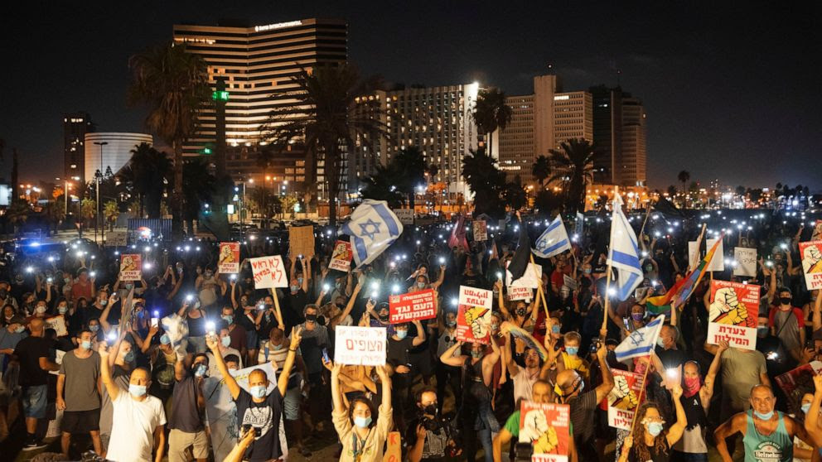
Tel Aviv, Israel

Slide 6
There have been ongoing protests and demonstrations against the restrictions and also against the Prime Minister, calling for him to step down, with some of these protests described as "violent". This is not business as usual in Israel where the citizens pride themselves on having only "peaceful" demonstrations and with great respect for law and order.
Notes:
With permission from Jackie Santoro

Slide 7
As the demonstrations continue and increase each evening, there is a growing tension between the protestors and the police. In addition, some citizens who disagree with the protests have attacked some of the demonstrators and caused injury. It is a very volatile situation.
Notes:
With permission from Jackie Santoro

Slide 8
Please pray that these demonstrations and protests will stay peaceful and the spirit of violence seen in the US would not manifest in the demonstrations here.
Notes:
With permission from Jackie Santoro

Slide 9
According the Wall St. Journal and Forbes
40% of homeowners are in danger of mortgage default
30% of renters are 90 days behind
GDP dropped 32.9%
Notes:
Mike Boatright, quoted with permission

Slide 10
We are in perilous times in many dimensions!
What can we do?
What can we offer?
^{Ro 15.4} For whatever was written before was written for our instruction, so that through patience and the encouragement of the Scriptures we might have hope.
Notes:
Mike Boatright, quoted with permission

Slide 11
Make excuses or progress not both.
A man was stopped for drunk driving.
Officer, I’m asthmatic so I can’t do the breathalyzer.
Sir, neither can I take the blood test כי I’m hemophiliac.
[כי = because]

Slide 12
Can’t walk line כי I’m drunk.

Slide 13
^{Proverbs 29:18 MSG)} If people can’t see what God is doing, they stumble all over themselves; but when they attend to what he reveals, they are most blessed.

Slide 14
Matthew Emmons is a trained accountant but he got his numbers terribly wrong. The American sharpshooter was just one shot away from a second Olympic gold medal when he fired at the wrong target in the final round. Gone was the chance of gold - or even silver or bronze.
Notes:
https://www.independent.co.uk/sport/olympics/shot-at-wrong-target-costs-rifleman-gold-587595.html

Slide 15
Emmons, who had dominated the 50-metre rifle three-position target event and is considered the best in the world in his discipline, got a big zero and plunged to eighth. “[Stuff] happens," said the 23-year-old. "I'll live to shoot another day."

Slide 16
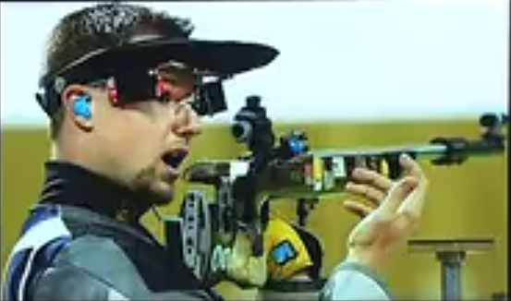
Matthew Emmons 2004 Athens Olympics gasping over mistaken target.
Notes:
https://www.independent.co.uk/sport/olympics/shot-at-wrong-target-costs-rifleman-gold-587595.html
https://en.wikipedia.org/wiki/Shooting_at_the_2004_Summer_Olympics

Slide 17
^{1 Cor 9.25-27} Everyone who competes in the games goes into strict training. They do it to get a crown that will not last, but we do it to get a crown that will last forever. Therefore I do not run like someone running aimlessly; I do not fight like a boxer beating the air.

Slide 18
^{1 Cor 9.25-27} No, I strike a blow to my body and make it my slave so that after I have preached to others, I myself will not be disqualified for the prize.

Slide 20
^{MJ 5.7-10} In the days of His life on earth [sarx: flesh σάρξ], Yeshua offered up both prayers and pleas, with loud crying and tears, to the One able to save Him from death;
Where did that happen?

Slide 21
^{Lk 22.41-46} He went about a stone’s throw away from them, kneeled down and prayed, “Father, if you are willing, take this cup away from me; still, let not my will but yours be done.” There appeared to him an angel from heaven giving him strength,

Slide 22
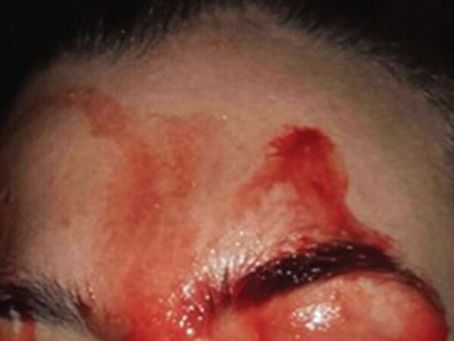
^{Lk 22.41-46} and in great anguish he prayed more intensely, so that his sweat became like drops of blood falling to the ground.
Hematadrosis
Woman sweating
Blood.
Notes:
https://nationalpostcom.files.wordpress.com/2017/10/sweating-blood1.jpg?quality=100&strip=all&w=642

Slide 23
^{MJ 5.7-10} and He was heard because of His reverence.
Though He was a Son, He learned
[he had an experience of it, and effected it; and which was voluntary, and done in our room and stead]
obedience, [submissiveness, compliance] from what He suffered.
Notes:
You might think that he was not heard, since He was apparently praying for deliverance from the execution stake. When we pray in trial, for deliverance, the answer from the Father may not be deliverance FROM the trial, but deliverance IN the trail. He was praying for G-d’s will to be done. RW Dunn, in Bible school in 1970 [Dawn with me in that class] said He was praying for strength to make it to the execution.
He did not do the path of obedience for all who obey him by using divine power from heaven, even though he was the Son of God. Instead, he emptied himself of that power and instead learned obedience through his sufferings (the Greek word for "sufferings" implies specifically the sufferings of death;

Slide 24
^{MJ 5.7-10} And once made perfect, He became the source of eternal salvation to all who obey Him — called by God Kohen Gadol “according to the order of Melkhizedek.”
Notes:
~MJ 2.10

Slide 25
^{MJ 2.10} For in bringing many sons to glory, it was only fitting that God, the Creator and Preserver of everything, should bring the Initiator of their deliverance to the goal through sufferings.
Notes:
it was God's goal to have Yeshua made our perfect cohen gadol, fully representative of and empathetic with the human condition (4:15). Through his heavenly priesthood he became the source of eternal deliverance to all who obey him
We may learn from this not to expect to be exempted from sufferings on account of sonship; nor to conclude we are not sons, because we suffer; and that afflictions are instructive, and by them experience is learned.

Slide 26
Yeshua became the perfect cohen / priest by His sufferings, so we can receive forgiveness and LIFE.
If you haven’t received His life, it’s available today, now.
But when we receive His life, what then?

Slide 27
^{Col 1.24} I rejoice in my present sufferings on your behalf! Yes, I am completing in my own flesh what has been lacking of the Messiah’s afflictions, on behalf of his Body, the Messianic Community.

Slide 28
^{Yn 3.16} For God so loved the world that He gave His one and only Son, that whoever believes in Him shall not perish but have eternal life.

Slide 29
^{1 Yn 3.16} We have come to know love by this—Yeshua laid down His life for us, and we also ought to lay down our lives for our brothers and sisters.
Receiving the Messiah and the Ruakh is not the center of our LIFE in Him, just the beginning.

Slide 30
This week, about two dozen Or HaOlamniks spent 8 hours at the Grow Conference by livestream from Birmingham, AL, Tuesday and Wednesday.
Stewart Winograd and his people Minsk, Belarus were also at the Conference.

Slide 32
Grow Conference Chris Hodges
Notes:
https://www.google.com/search?q=grow20+growleader.com&oq=grow&aqs=chrome.3.69i60j69i57j35i39l2j46j0j69i60j69i61.8260j1j7&sourceid=chrome&ie=UTF-8
Previous attendees who followed his teaching: Ev saw 30% growth. We love transfer growth, but not only have transfer, not primarily.
2872 congs 617 outside US 18027 attendees 42 new launches this year.
Winograd himself and all his leaders in Minsk who could understand English on this.
Next statement I’ve heard before. It may make you uncomfortable.

Slide 33
Hindrances to growth are usually structural >> spiritual.
^{Acts 16.5} Messiah’s communities were strengthened in the faith and kept increasing daily in number.
Healthy things grow.
^{Yn 15.8} This is how my Father is glorified — in your bearing much fruit; this is how you will prove to be my talmidim.
Notes:
If only we prayed deeper, preached with more anointing. That’s always true, but not the whole story.
We were there כי hungry to grow.
Entrepreneurial myth: great product = great success. McDonalds best hamburgers?
What about the Ruakh and the Word? Not enough? This is a channel to communicate that.
^{Ro 10.15} how can people proclaim him unless God sends them? — as the Tanakh puts it, “How beautiful are the feet of those announcing good news about good things!” Isaiah 52:7 →

Slide 34
^{Yeshayahu 52.7} How beautiful on the mountains are the feet of him who brings good news, proclaiming shalom, bringing good news of good things, announcing salvation and saying to Tziyon, “Your God is King!”
Notes:
Here is a summary of Chris Hodges system. 8 hours lecture plus reactions next few minutes!

Slide 35
Lost people reborn | Cup of Sanctifica-tion | Know G-d | Yokhanan/ John Lion | Main service
Reborn people healed | Cup of judgment | Find Freedom Emotionally Jewishly | Luke Man | Home groups
Healed people trained | Cup of Redemption | Discover Develop your calling | Matthew Eagle | Training
Trained people mobilized | Cup of fulfilment | Make a Difference | Mark Ox: plow or sacrifice | Dream team
Notes:
Cups:
out of Egypt,
Egypt out of you / deliverance,
back to original intention/after supper,
Praise
10 other scriptures where this pattern appears.
• Know G-d: the main weekend service
• Find freedom: intimacy and community of the small groups
• Discover purpose: discipleship and training
• Make a difference: Dream team

Slide 36
Pipeline Concept David Levine
Pipeline Concept David Levine
Notes:
Prep for what some of you may remember the Alef outreach. Alla Landa, for whom we just said kaddish, was a fruit of that outreach.
2007
So, none of these considerations are new, but maybe we can make them work now build them into our culture better?

Slide 37
When I greet newcomers, I often say that I am the rabbi, and what that really means is that whatever goes wrong is my doing. Whatever goes right is the doing of my wife and the staff.
It's the Truman line of "the buck stops here."
Notes:
Usually gets a laugh.

Slide 38
I'm well aware that the lack of growth, loss of people, is ultimately my responsibility. I'm not taking it with toxic guilt, because I tried . I take responsibility to initiate change. We can't let the Jewish population be eternally lost. We’ll win them, if we work together. "I get by with a little help from my friends."
Notes:
https://www.youtube.com/watch?v=75Oct1Qv8x0
I need to change.

Slide 39
Michael Jackson
Man in the Mirror
Notes:
https://www.youtube.com/watch?v=PivWY9wn5ps 1.08 to 1.32
I came to faith in Messiah in 1969 in a very conservative Holiness church. Was a drop out from popular culture till about 1995. I don’t think I could sing one Michael Jackson song. I can sing almost any Beatles song. But, this on seemed relevant for the message, and was suggested by Gary Cohen. So, I get by with a little help from my friend. NO endorsement of Michael Jackson.

Slide 40
Michael Jackson’s song Man in the Mirror –
I'm gonna make a change
For once in my life
It's gonna feel real good
Gonna make a difference
Gonna make it right
As I turn up the collar on
My favorite winter coat

Slide 41
This wind is blowing my mind
I see the kids in the street
With not enough to eat
Who am I to be blind
Pretending not to see their needs?
I'm starting with the man in the mirror

Slide 42
I'm asking him to change his ways
And no message could have been any clearer
If you wanna make the world a better place
Take a look at yourself and then make a change

Slide 43
I come from a toxic Jewish secular family. Grew up in the first bit of American chaos
1960’s: Woodstock, Kent State, Yippies at the Democratic National Convention 1968, Watts riots…

Slide 44
We’re again having now. I was a revolutionary without a cause. Marxism, Eastern religion, drugs. I got saved my sophomore year. G-d told, “You’ve been out to change the world – now you’re a revolutionary for Yeshua.”

Slide 45
^{1 Cor 7.20-24} Let each one remain in the calling in which he was called…You were bought with a price; do not become slaves of men. Brothers and sisters, let each one—in whatever way he was called—remain that way with God.

Slide 46
Change: ~2000 Blockbuster had opportunity to buy Netflix idea. ~$5.5 million. Now 2.2 billion. Blockbuster? Blackberry?
Message is holy. Method is helpful.
Don’t build a culture. Be a culture.
Notes:
Our system is designed to get exactly the results that we are getting.

Slide 47
Henry Ford: If I’d asked people what they wanted, they’d have said a faster horse.
Pipeline that continually develops leaders.
What one thing, if it got better, would make the biggest difference?

Slide 48
So, I’m willing to make whatever changes necessary to see Jewish people and others
• Know G-d: the main weekend service
• Find freedom: intimacy and community of the small groups
• Discover purpose: discipleship and training
• Make a difference: Dream team
Notes:
Are you willing? I’m doing all I can! Yes, but maybe differently.

Slide 49
Lost people reborn | Cup of Sanctifica-tion | Know G-d | Yokhanan/ John Lion | Main service
Reborn people healed | Cup of judgment | Find Freedom Emotionally Jewishly | Luke Man | Home groups
Healed people trained | Cup of Redemption | Discover Develop your calling | Matthew Eagle | Training
Trained people mobilized | Cup of fulfilment | Make a Difference | Mark Ox: plow or sacrifice | Dream team
Notes:
Our system is designed to get exactly the results that we are getting.
Services that pre-believing people LOVE to come to. Paul says presenting “Kindness and love” on his trips.
Acts 15 Jerusalem Council, not put a yoke on new believers that we didn’t bear well.
He paid 5 to 10 prebelievers to attend service and tell him how it was communicating, it was attractive.

Slide 50
Make weekend service memorable. Fun. If Shabbat broke, nothing else works.
CF boring, unfriendly, ask for money.
Lost saved, saved healed, healed empowered, empowered mobilized.
Notes:
Services that pre-believing people LOVE to come to. Paul says presenting “Kindness and love” on his trips. Acts 15 Jerusalem Council, not put a yoke on new believers that we didn’t bear well.
He paid 5 to 10 prebelievers to attend service and tell him how it was communicating, it was attractive. I have a financier pay $199 for ~7 Jewish secular millianniels to evaluate our service: clarity of communication, Jewishness of expression, warmth and friendliness. We’ll make a questionnaire.
Style of music. Messianic message, but older younger. New generation in Israel and US. Josh Aaron, Miqedem, Sarah Liberman. Nashville group.

Slide 51
We had a review meeting 6 p.m. here plus Zoom, and many acknowledged need for more community. Lonely?
More home groups. Neighborhood plus Zoom.
Discipleship: Adult Ed. Enough? One on one needed.
Notes:
Instagram. Josie mentioned.

Slide 52
John Maxwell: 2020 is a wilderness year, NOT a wasted year. My book 21 Irrefutable laws of Leadership works because each came from difficulties.
Everything you want but don’t have is outside your comfort zone.
Everyone has been moved last few months. Are we moved positively or negatively?

Slide 53
Growth Track Create an experience where people can connect with their campus and their spiritual gifts.
Step 1: become a member of the congregation.
Step 2: Discover your God-given gifting and calling.

Slide 54
Step 3: Connect to a team
Monthly: Team Nights and Community Nights
Dream Team 29 serving areas Measure success by this one. This is the touchdown line. This is where they are the happiest.

Slide 55
The number of American adults the American Bible Society considers "Scripture engaged" based on how frequently they read Scripture and its impact on their relationships and choices dropped significantly from 28% to 22.7% between January and June, according to additional data collected by the organization in June.
Notes:
https://www.charismanews.com/culture/81977-national-survey-reveals-drop-off-in-bible-reading-during-pandemic?utm_source=Charisma%20News%20Daily&utm_medium=email&utm_content=subscriber_id:5160390&utm_campaign=CNO%20daily%20-%202020-07-23

Slide 56
"What we saw between January and June was that 13 million people in America, who were previously really engaging meaningfully with Scripture, no longer were, and that was a serious drop-off," said Plake.
Notes:
https://www.charismanews.com/culture/81977-national-survey-reveals-drop-off-in-bible-reading-during-pandemic?utm_source=Charisma%20News%20Daily&utm_medium=email&utm_content=subscriber_id:5160390&utm_campaign=CNO%20daily%20-%202020-07-23

Slide 57
Frequency of Scripture reading also dropped over the last year, with daily readers dropping from 14% to 9% and those who read the Bible several times a week, from 14% to 12%, the lowest number on record, according to the survey, conducted in January with Barna Group, a Christian research firm.
Notes:
https://www.charismanews.com/culture/81977-national-survey-reveals-drop-off-in-bible-reading-during-pandemic?utm_source=Charisma%20News%20Daily&utm_medium=email&utm_content=subscriber_id:5160390&utm_campaign=CNO%20daily%20-%202020-07-23

Slide 58
Ultimately, it’s NOT about us, our systems, our efforts.

Slide 59
^{(Mark 4:26-29)} He also said, “This is what the kingdom of God is like. A man scatters seed on the ground. [services, small groups] Night and day, whether he sleeps or gets up, the seed sprouts and grows, though he does not know how.

Slide 60
^{(Mark 4:26-29)} All by itself the soil [condition of the soil] produces grain—first the stalk, then the head, then the full kernel in the head. As soon as the grain is ripe, he puts the sickle to it, because the harvest has come.”

Slide 61
^{(Ephesians 6:12 NIV)} For our struggle is not against flesh and blood, but against the rulers, against the authorities, against the powers of this dark world and against the spiritual forces of evil in the heavenly realms.
Die daily. Crucify the flesh. Dead people don’t get mad or jealous or upset.

Slide 62
Humility wins.
A person on their face cannot fall from that position. ^{-Roy Stockstill}

Slide 63
^{(Matthew 11:28-30 NIV)} “Come to me, all you who are weary and burdened, and I will give you rest. Take my yoke [Gk custom made yoke] upon you and learn from me, for I am gentle and humble in heart, and you will find rest for your souls. For my yoke is easy and my burden is light.”

Slide 64
^{Ephesians 4:16 NIV} From him the whole body, joined and held together by every supporting ligament, grows and builds itself up in love, as each part does its work.

Slide 65
Yom Kippur is Sept. 28. Unsubmitted thought:
Consider 21 day fast. After Labor Day barbecue, till YK?

Slide 68
