Slide 1
e-handout
To have these notes
without taking notes
Go to OrHaOlam.com
Click on downloads,
messages, 2020

Slide 6
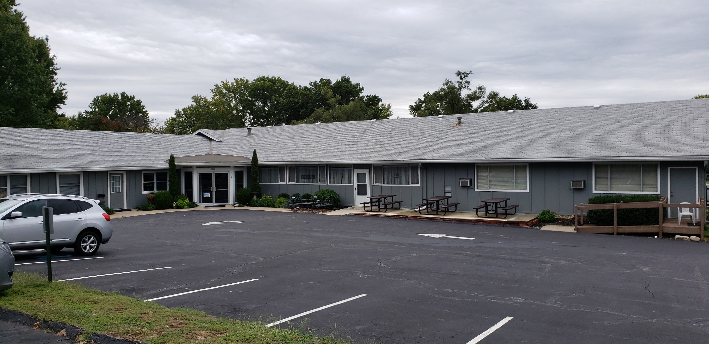
Notes:
Thanks to Ted and Suzanne for precipitating this and color choices, etc.

Slide 7
GREATEST appreciation to Greg McIntire for wonderful organizational skills to make our trip possible.
Relayed from Greg McInitre: Thanks to all.
Brett is the technical coordination. He will be responsible for the simulcast, sound etc.
Lori - printed schedule for the Return.
Notes:
I usually have a “Duties away” list that I sent to the Shamshim servant leaders. This trip I did nada, nothing, אפס efes

Slide 8
Kent MC to welcome people at 7:55, and conduct the announcements and Kaddish, announce the offering at 11 am, interact with us in DC on Zoom during the offering, and end the service at 4:00.
Ulises share the MC duties
Amy - music for Kaddish.
Mike Boatright - ushers, collection, security

Slide 9
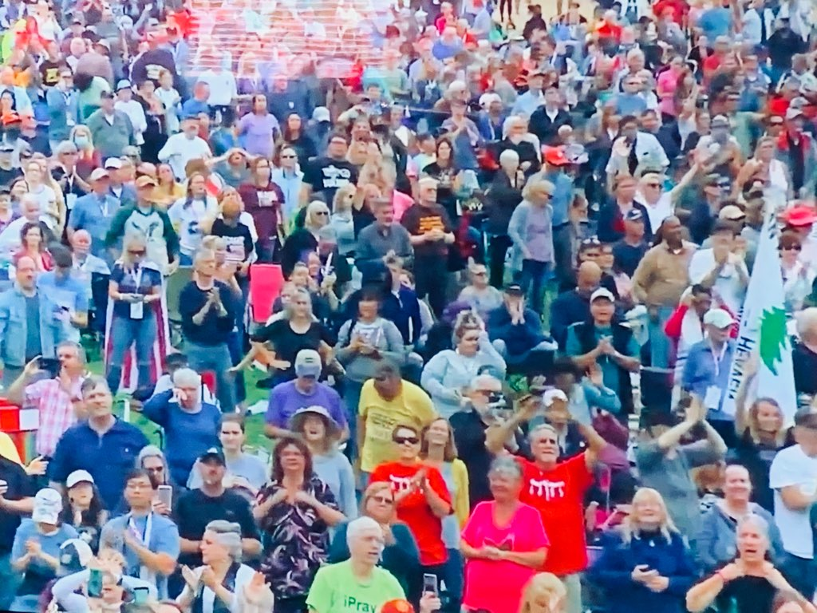
The Return, 2020, Capital Mall

Slide 11
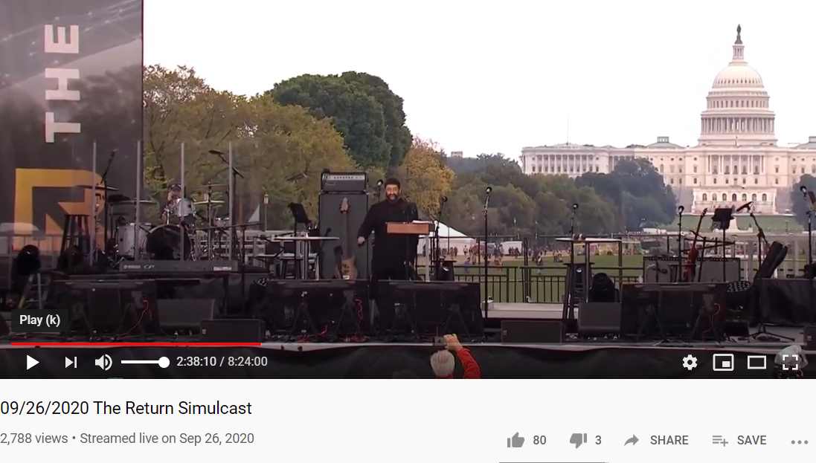
2,788 views of OUR simulcast!
Notes:
As of 9:32 am EDT 2,788 views of OUR simulcast. Crisp clear video and audio. What I watched if I had to take a bathroom break. Terrible lines!!

Slide 12
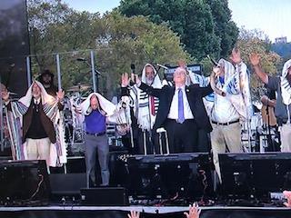
The Return, 2020, Capital Mall
Notes:
Messianic Rabbis Jim Appel and me saying the Aaronic Blessing with Jonathan.

Slide 13
The Return2020, Capital Mall, nasal view

Slide 14
Erev Yom Kippur message
Notes:
Original message was going to be on the Kol Nidre, history, meaning, application. But last night my heart was really full, and I feel the Ruakh gave me this.

Slide 15
^{Vayikra/Lev 23.26-27} Adoni spoke to Moses, saying: “However, the tenth day of this seventh month is Yom Kippur, a holy gathering to you, so you are to afflict yourselves.

Slide 16
^{Vayikra/Lev 16.29-31} [Yom Kippur] It is to be a permanent regulation for you that on the tenth day of the seventh month you are to deny yourselves and not do any kind of work, both the citizen and the foreigner living with you. For on this day,

Slide 17
^{Vayikra/Lev 16.29-31} atonement will be made for you to purify you; you will be clean before Adoni from all your sins. It is a Shabbat of complete rest for you, and you are to deny yourselves.
Notes:
Kol Nidre is a reflection of this. Renunciation of wrong vows, many said in bitterness and fear.

Slide 18
^{Yoel 2.1-16} “Yet even now,” says Adoni, “turn to me with all your heart, with fasting, weeping and lamenting.” Tear your heart, not your garments; and turn to Adoni your God. For he is merciful and compassionate, slow to anger, rich in grace, and willing to change his mind about disaster.

Slide 19
^{Yoel 2.1-16} “Blow the shofar in Tziyon! Proclaim a holy fast, call for a solemn assembly.” Gather the people.

Slide 20
Capital Mall, Washington, DC

Slide 21
We repented for the 62 million aborted babies we have allowed, as decided in the Supreme Court a few blocks away.
^{Vayikra/Lev 18.21} “‘You are not to let any of your children be sacrificed to Molekh, thereby profaning the name of your God; I am Adoni.

Slide 22
Roe v. Wade was a landmark decision of the U.S. Supreme Court in which the Court ruled that the Constitution of the United States protects a pregnant woman's liberty to choose to have an abortion without excessive government restriction. [Pending determination of the beginning of life.] Jan. 22,1973
Notes:
https://en.wikipedia.org/wiki/Roe_v._Wade#:~:text=Roe%20v.%20Wade%2C%20410%20U.S.,abortion%20without%20excessive%20government%20restriction.

Slide 23
^{Vayikra/Lev 18.25} The land has become defiled, so I will punish its iniquity, and the land will vomit out its inhabitants.

Slide 24
We repented for rampant unbiblical sexuality.
^{Vayikra/Lev 18.20} “‘You are not to go to bed with a man as with a woman; it is an abomination.

Slide 25
Obergefell v. Hodges the Supreme Court of the United States ruled that the fundamental right to marry is guaranteed to same-sex couples by both the Due Process Clause and the Equal Protection Clause of the Fourteenth Amendment to the United States Constitution. June 26, 2015

Slide 26
Capital Mall, Washington, DC

Slide 27
We examined our hearts, repented of pride, materialism, bitterness, unforgiveness…
Also…

Slide 28
We repented of anti-Semitism
and replacement theology!

Slide 29
We repented of broken covenants, mistreatment, horrid history with the First Nations.

Slide 30
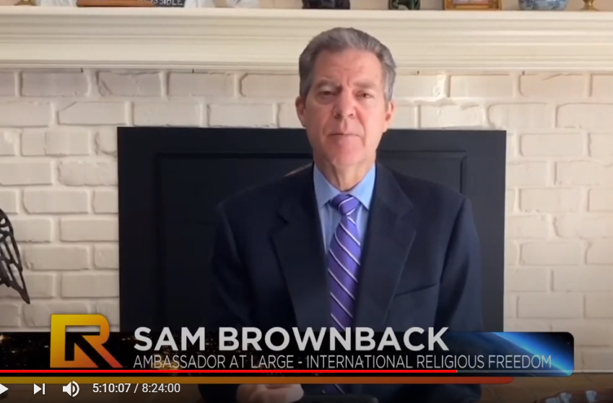
Notes:
United States Ambassador-at-Large for International Religious Freedom since 2018
Read and led in a prayer of apology for the mistreatment of the Native Americans.

Slide 32
We repented of slavery
and racial bias.

Slide 33
Apology to African Americans.
Israel was exiled and the Temple was destroy, because of unjust slavery.
Notes:
. I can’t remember who

Slide 34
^{Yirmeyahu / Jeremiah 34.8-18} This word came to Yirmeyahu from Adoni after King Tzidkiyahu had made a covenant with all the people in Yerushalayim to emancipate them. Everyone who had a male or female slave who was Hebrew was to let him go free; none was to keep as his slave a fellow Jew…They let them go.

Slide 35
^{Yirmeyahu / Jeremiah 34.8-18} But afterwards, they changed their minds; they made the male and female slaves, whom they had freed, return; and they brought them back into subjection as slaves. Therefore this word of Adoni came to Yirmeyahu from Adoni: “Here is what Adoni the God of Isra’el says: ‘When I brought your ancestors out of the land of Egypt, where they lived as slaves, I made this covenant with them:

Slide 36
^{Yirmeyahu / Jeremiah 34.8-18} “At the end of seven years every one of you is to set free his brother Hebrew who has been sold to you and has served you six years. You are to let him go free from you.” But your ancestors did not listen to me or pay any attention. Now you repented, you did what is right from my viewpoint when each of you proclaimed freedom to his fellow…

Slide 37
^{Yirmeyahu / Jeremiah 34.8-18} But then you changed your minds. You profaned my name when each of you took back his male and female slaves, whom you had set free to live as they wished, and brought them back into subjection as your slaves.’ Therefore here is what Adoni says:

Slide 38
^{Yirmeyahu / Jeremiah 34.8-18} ‘You did not heed me and proclaim freedom, each to his brother and each to his neighbor; so now I proclaim for you a freedom,’ says Adoni, ‘for sword, plague and famine. I will make you an object of horror to all the kingdoms on earth.

Slide 39
In that culture, it was possible to have just slavery, without regard to ethnicity. Debtors, war conquest. But they violated it.
In our history, there was no just slavery.
Do we have biased attitudes?

Slide 40
Jonathan shared the
19 year warning

Slide 41
^{Yeshevyahu/Is 9.8-9} Adoni sent a word to Ya‘akov, and it has fallen on Isra’el. All the people know it, Efrayim and the inhabitants of Shomron. But they say in pride, in the arrogance of their hearts, “The bricks have fallen, but we will rebuild with cut stone; the sycamore-fig trees have been chopped down, but we will replace them with cedars.” 738 BCE

Slide 42
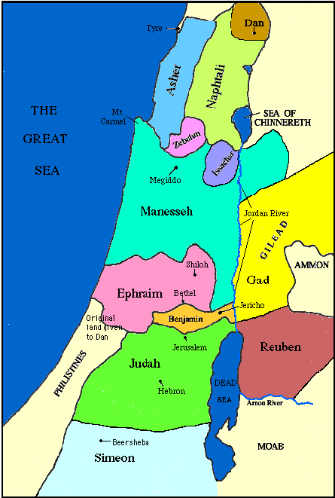
Map of the tribes of Israel
Assyria invaded Gil‘ad, and the Galil Naftali but did not destroy the Northern Kingdom.
Notes:
https://www.jewishvirtuallibrary.org/the-twelve-tribes-of-israel

Slide 43
^{2 K 15.29} During the time of Pekach king of Isra’el, Tiglat-Pil’eser king of Ashur came and conquered ‘Iyon, Avel-Beit-Ma‘akhah, Yanoach, Kedesh, Hatzor, Gil‘ad, and the Galil — all the land of Naftali — and took them captive to Ashur.

Slide 44
^{2 K 15.29} Hoshea the son of Elah conspired against Pekach the son of Remalyah, struck him, killed him and took his place as king in the twentieth year of Yotam the son of ‘Uziyah. 738 BCE
But at this point, the Assyrians did NOT conquer Northern Israel.

Slide 45
^{Yeshevyahu/Is 9.8-9} But they say in pride, in the arrogance of their hearts, “The bricks have fallen, but we will rebuild with cut stone; the sycamore-fig trees have been chopped down, but we will replace them with cedars.” 738 BCE

Slide 46
^{2 K 17.22-23} The people of Isra’el followed the example of all the sins that Yarov‘am had committed and did not turn away from them, until Adoni removed Isra’el out of his sight, as he had said he would through all his servants the prophets.

Slide 47
^{2 K 17.22-23} Thus Isra’el was carried away captive from their own land to Ashur, and it remains so to this day. 721 BCE
738 -721 = 17 years [Adam Clarke chronology 1837] Jonathan Cahn says 19 years. 2001 + 19 = 2020

Slide 48
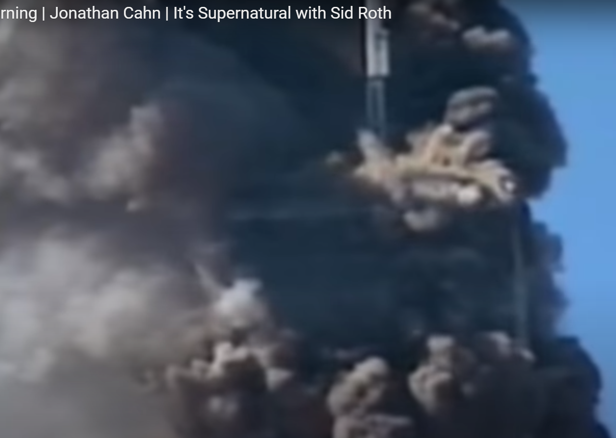

Slide 49
https://www.pinterest.com/pin/571323902703954086/ 10.23 to 13.59

Slide 50
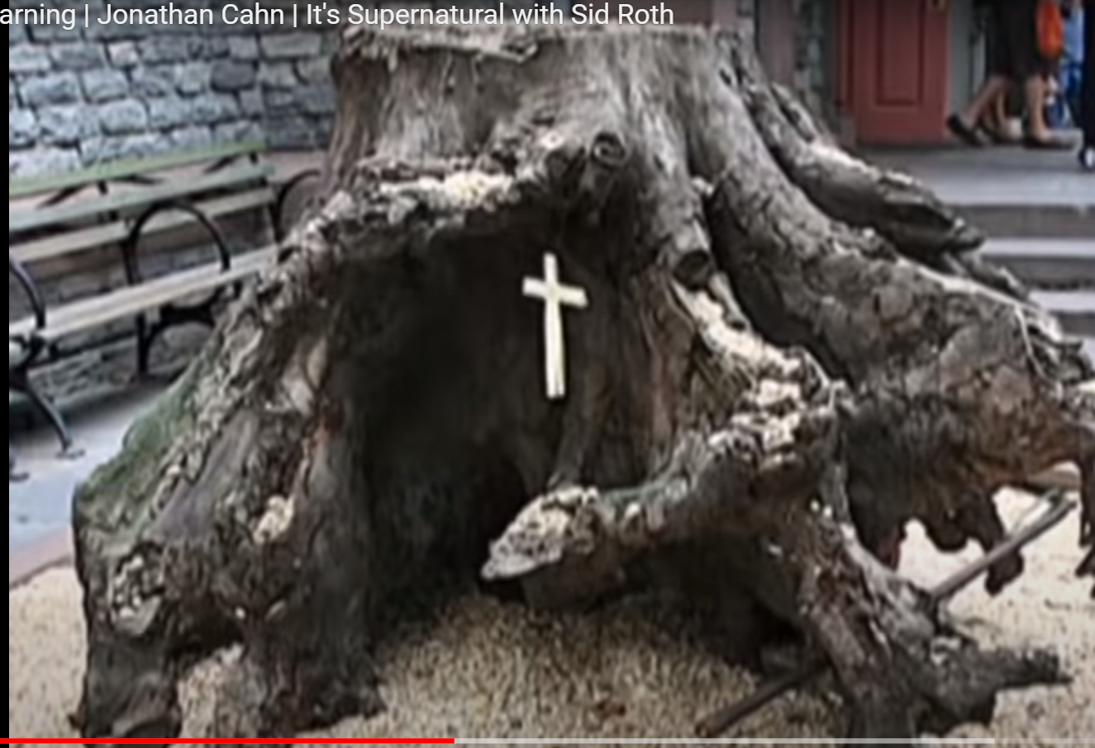
Sycamore tree at the base
Of the Twin Towers

Slide 51
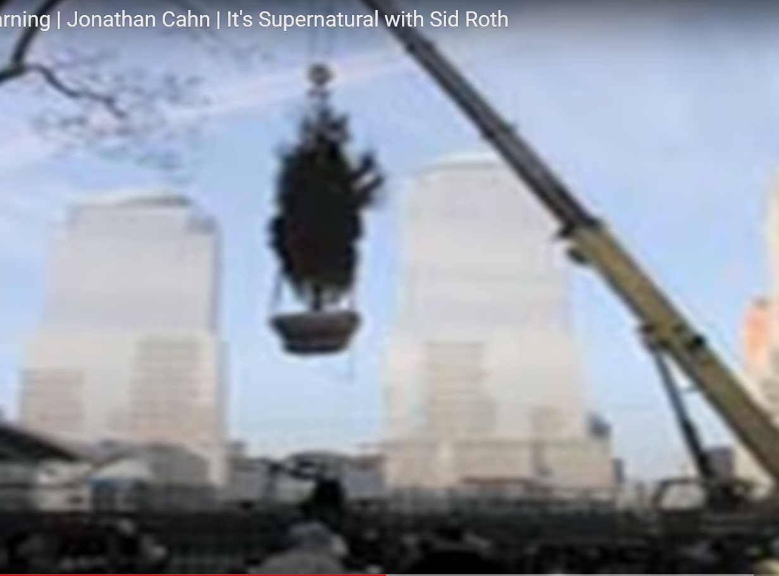

Slide 52
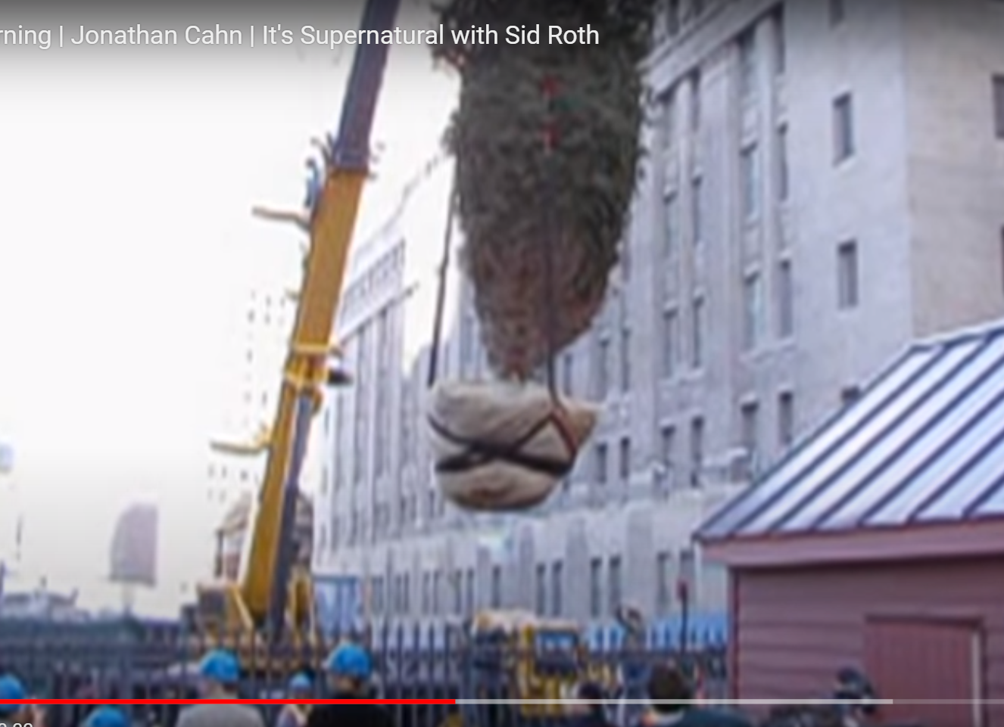
Cedar tree being lowered
To replace it.

Slide 53
https://www.pinterest.com/pin/571323902703954086/ 18.28 to 20.05

Slide 54
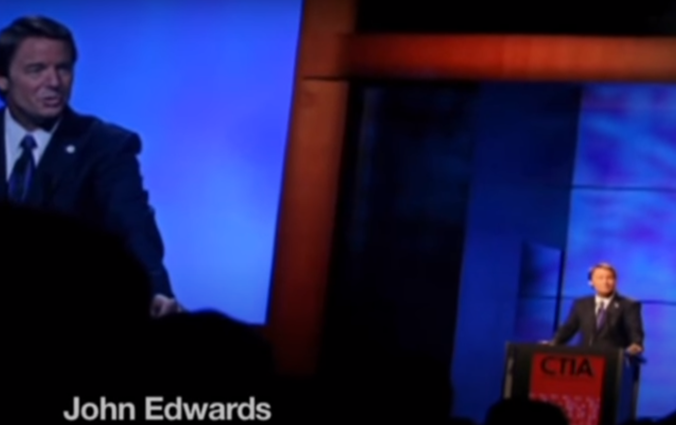
Sept. 11, 2004

Slide 55
Notes:
Said Sept. 11, 2004

Slide 56
^{2 K 17.22-23} Thus Isra’el was carried away captive from their own land to Ashur, and it remains so to this day. 721 BCE
738 -721 = 17 years [Adam Clarke chronology 1837] Jonathan Cahn says 19 years. 2001 + 19 = 2020

Slide 58
We have been fasting, some of us 21 days, and meeting morning and night. Plus all day Shabbat Shuvah.
We are not done yet, but I feel we’ve moved a significant step closer.
Time for continued seeking, also claiming…

Slide 59
^{Yoel 2. 18-19} Then Adoni will become jealous for his land and have pity on his people. Here is how Adoni will answer his people: “I will send you grain, wine and olive oil, enough to satisfy you; and no longer will I make you a mockery among the Goyim.

Slide 60
Notes:
READING FROM THE TORAH
Once this news has been received, the High Priest descends to the Women's Court and reads aloud from the book of Leviticus (chapter 16, the reading for Yom Kippur) before the congregation. This is done with great ceremony. In the words of the Mishna (Yoma 7, 1): "The synagogue assistant takes the Torah scroll from the synagogue, and gives it to the synagogue head. He, in turn, hands the Torah to the assistant priest. The latter delivers it into the hands of the High Priest." All of this was done out of honor for the High Priest, who is served by such a large staff.

Slide 61
Notes:
A CELEBRATION OF THANKS
At the conclusion of this awesome day, after all the service was completed and the day had waned, the High Priest was accompanied by the entire multitude of worshippers back to his own home. "When the High Priest exited from the holy place unharmed, he made a celebration for his loved ones" (ibid., 4) at the conclusion of Yom Kippur - to give thanks to God that he successfully guided the service, and was neither rendered unfit nor adversely affected.
As we read in the High Holiday Prayer Book for the Day of Atonement,
"How radiant was the appearance of the High Priest, when he exited in peace from the holy place! Like flashes of light that emanate from the splendor of the angels - such was the appearance of the High Priest."

Slide 62
^{Yoel 3.1-5} “After this, [rending of hearts] I will pour out my Spirit on all humanity. Your sons and daughters will prophesy, your old men will dream dreams, your young men will see visions; and also on male and female slaves in those days I will pour out my Spirit.

Slide 63
^{Yoel 3.1-5} “I will show wonders in the sky and on earth — blood, fire and columns of smoke. The sun will be turned into darkness and the moon into blood before the coming of the great and terrible Day of Adoni.”

Slide 64
^{Yoel 3.1-5} At that time, whoever calls on the name of Adoni will be saved. For in Mount Tziyon and Yerushalayim there will be those who escape, as Adoni has promised; among the survivors will be those whom Adoni has called.

Slide 65
^{Acts 2.36-37} Therefore, let the whole house of Isra’el know beyond doubt that God has made him both Lord and Messiah — this Yeshua, whom you executed on a stake!” On hearing this, they were stung in their hearts; and they said to Kefa and the other emissaries, “Brothers, what should we do?”

Slide 66
^{Acts 2.36-37} Kefa answered them, “Turn from sin, return to God, and each of you be immersed on the authority of Yeshua the Messiah into forgiveness of your sins, and you will receive the gift of the Ruakh HaKodesh! For the promise is for you, for your children, and for those far away — as many as Adoni our God may call!”

Slide 67
^{Acts 13.38-39} “Therefore, brothers, let it be known to you that through this man is proclaimed forgiveness of sins! That is, God clears everyone who puts his trust in this man, even in regard to all the things concerning which you could not be cleared by the Torah of Moshe.

