Slide 1
e-handout
To have these notes
without taking notes
Go to OrHaOlam.com
Click on downloads,
messages, 2021

Slide 2
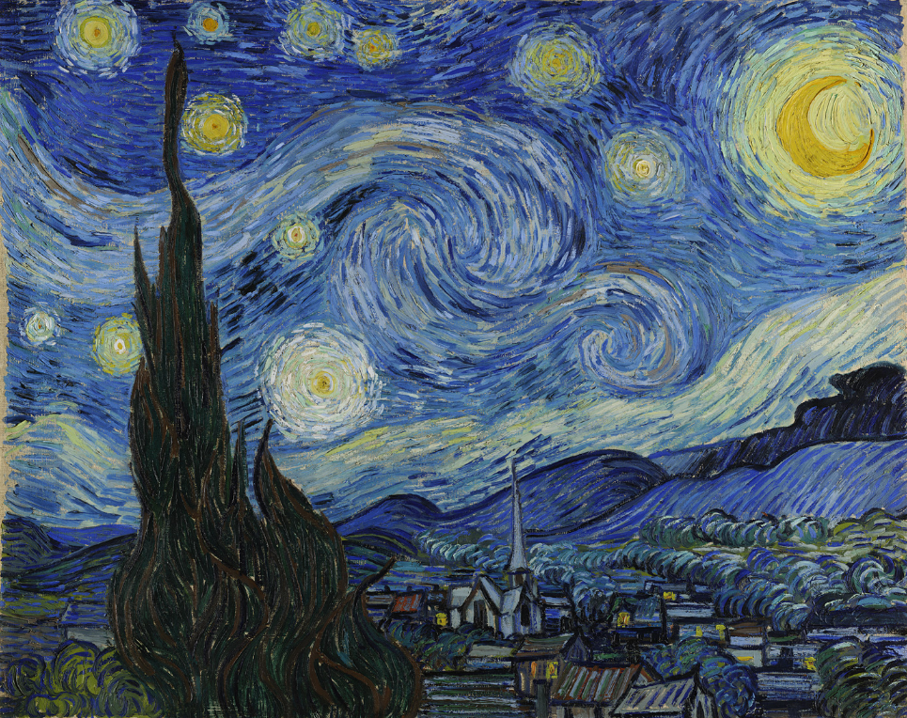
The Starry Night
Vincent van Gogh 1889
Notes:
Van Gogh's night sky is a field of roiling energy. Below the exploding stars, the village is a place of quiet order. Connecting earth and sky is the flamelike cypress, a tree traditionally associated with graveyards and mourning.
Consider Vincent van Gogh’s relatives…

Slide 3
His dizzy aunt --- Verti Gogh
The brother who ate prunes---Gotta Gogh
The brother who worked at a convenience store ---- Stop N Gogh
Notes:
Suzanne Alongi

Slide 4
His magician uncle--- Where-diddy Gogh
His Mexican cousin--- A MeeGogh
The Mexican cousin's American half-brother --- Gring Gogh
The nephew who drove a stage coach ---- Wells-far Gogh
Notes:
Suzanne Alongi credit

Slide 5
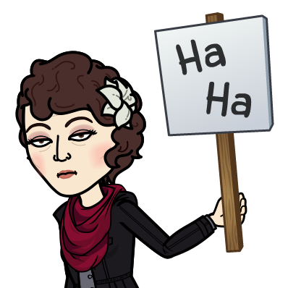

Slide 6
We have described Yeshua
The cohen/priest ~ Melkitsedek
His offering / our offering: ourselves
His Temple: The Heavenly Original
His covenant?? Does He need one?
Notes:
Who cares?

Slide 7
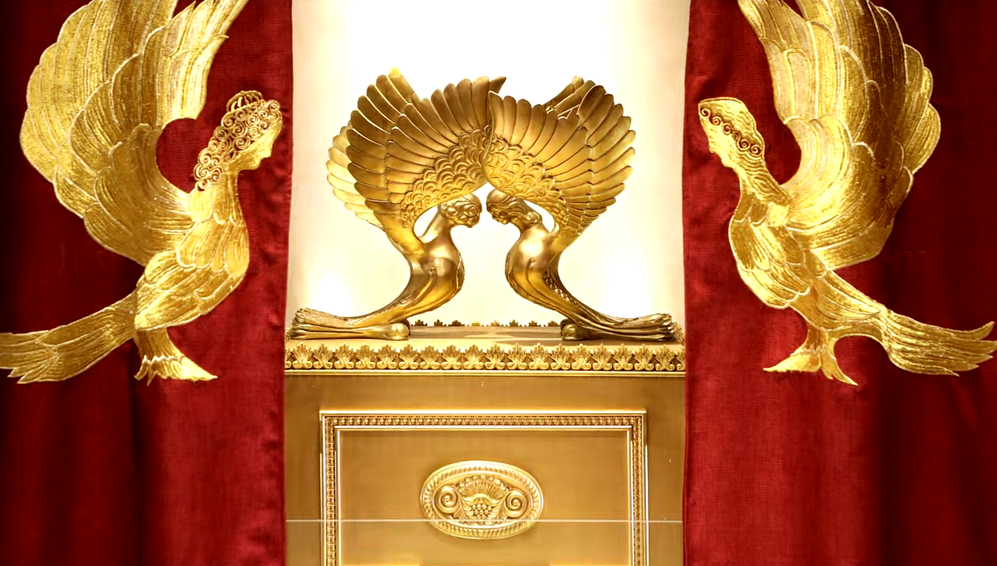
Letter to the Messianic Jews
MJ.8.6-13 The Covenantal Cohen
Notes:
https://www.templeinstitute.org/new-location.htm

Slide 8
Outline
What is a covenant?
What are the covenants in scripture?
What is Yeshua’s covenant?
How does this apply to us.

Slide 9
^{Mes Jews 8.6-13} But now the work Yeshua has been given to do is far superior to theirs, just as the covenant he mediates is better.
Did Yeshua need a covenant to do His work?
Notes:
Consider similarly…

Slide 10
Is Trump's post-presidency impeachment trial constitutional?
Notes:
This is the question of the day. Some say no, such as Alan Dershowitz, Rick Green, 45 Senators
Then 56 Senators said “Yes.” So, it’s proceeding.
As it is written.
When we consider doing or believing something, the key question we ask, “Is it scriptural?”
A king or a dictator rules by decree.
America was founded on ruling by law.

Slide 11
In 1780 John Adams wrote “For as in absolute governments the King is law, so in free countries the law ought to be king; and there ought to be no other.” It was in the Massachusetts Constitution that he was trying to enshrine the idea that the new U.S. would be "a nation of laws not men."
Notes:
https://shows.acast.com/deepstateradio/episodes/rip-a-nation-of-laws-not-men-1780-2019

Slide 12
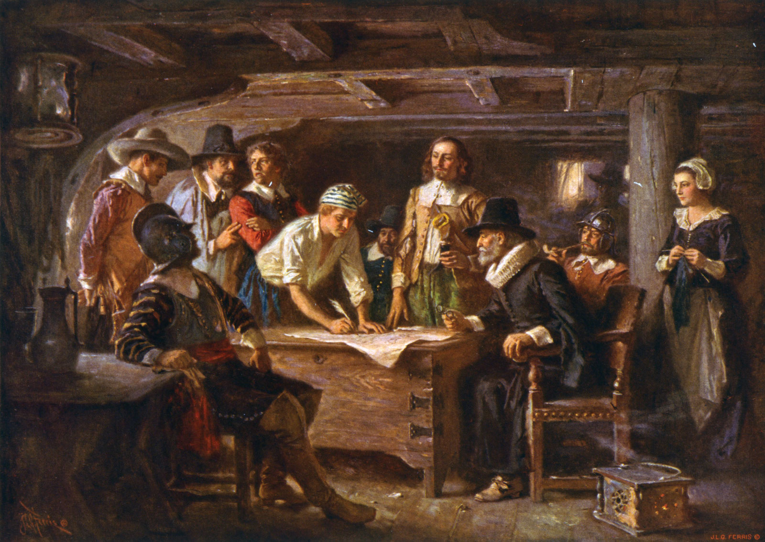
Signing the Mayflower Compact, aboard ship on November 21, 1620.
Notes:
the Pilgrims determined to establish their own government, while still affirming their allegiance to the Crown of England. It was in essence a social contract in which the settlers consented to follow the community's rules and regulations for the sake of order and survival

Slide 13
We, whose names are underwritten, the Loyal Subjects of our dread Sovereign Lord King James…Having undertaken for the Glory of God…and the Honour of our King and Country…Do by these Presents, solemnly and mutually, in the Presence of God and one another,
Notes:
https://en.wikipedia.org/wiki/Mayflower_Compact

Slide 14
covenant and combine ourselves together into a civil Body Politick: And by Virtue hereof do enact, constitute, and frame, such just and equal Laws, Ordinances, Acts, Constitutions, and Offices,
Notes:
https://en.wikipedia.org/wiki/Mayflower_Compact

Slide 15
from time to time, as shall be thought most meet and convenient for the general Good of the Colony; unto which we promise all due Submission and Obedience.
Notes:
https://en.wikipedia.org/wiki/Mayflower_Compact

Slide 16
The Mayflower Compact was based simultaneously upon a majority rule model and the settlers' allegiance to the king.
Notes:
https://en.wikipedia.org/wiki/Mayflower_Compact
https://shows.acast.com/deepstateradio/episodes/rip-a-nation-of-laws-not-men-1780-2019

Slide 17
In 1780 John Adams wrote, “The new U.S. would be "a nation of laws not men."
Notes:
https://shows.acast.com/deepstateradio/episodes/rip-a-nation-of-laws-not-men-1780-2019

Slide 18
Outline
What is a covenant?
What are the covenants in scripture?
What is Yeshua’s covenant?
How does this apply to us.

Slide 19
בְּרִית brit כָּרַת בְּרִית carat brit
to cut a covenat
Covenant, treaty pact, alliance, constitution, ordinance, between monarch and subjects
Notes:
Modern Hebrew usage, flows out of ancient understanding…

Slide 20
Notes:
Reuben Alcalay Complete Hebrew English Dictionary

Slide 21
Notes:
Reuben Alcalay Complete Hebrew English Dictionary

Slide 22
^{MJ 8.6} But now the work Yeshua has been given to do is far superior to theirs, just as the covenant he mediates is better. For this covenant has been given as Torah on the basis of better promises.
Notes:
Does He need a covenant?

Slide 23
^{MJ 8.7} Indeed, if the first covenant had not given ground for faultfinding, there would have been no need for a second one.

Slide 24
First and second covenants are summaries of a huge amount of scripture history.
EIGHT covenants between G-d and humanity.
First and second are really fifth and eighth!
Notes:
Eight sermons here.

Slide 25
Outline
What is a covenant?
What are the covenants in scripture?
What is Yeshua’s covenant?
How does this apply to us.
Notes:
1. A covenant is a binding agreement / relationship.

Slide 26
Name: | Edenic, before the Fall
Verses | Ber / Gen Ch 1-3
Provisions | Garden eternally
Type | Conditional
Response | Works / obedience
Sign | Tree of Life?
Participants | all humanity potentially
Notes:
Salvation by works, eternal life there in the Garden.

Slide 27
Name: | Adamic, after the Fall
Verses | Ber / Gen 3.1-9
Provisions | Salvation
Type | Conditional
Response | Faith in future Descendent
Sign | Skins, childbirth issues
Participants | all humanity potentially
Notes:
Promise of eternal salvation
Blood of the animals slaughtered to make the skins

Slide 28
Name: | Noakhic [Noah]
Verses | Ber / Gen 8.20-9.13
Provisions | Seasons, no flood
Type | Unconditional
Response | Capital punishment
Sign | rainbow
Participants | all humanity
Notes:
Physical salvation
^{Ber/Gen 8.20-21}Noakh built an altar…sacrifice. Noach built an altar to Adoni. Then he took from every clean animal and every clean bird, and he offered burnt offerings on the altar. Adoni smelled the sweet aroma.

Slide 29
Name: | Avrahamic
Verses | Ber / Gen 12, 15, 17
Provisions | Blessings and curses, Land
Type | Unconditional
Response | Avraham’s obedience
Sign | Circumcision
Participants | Avraham’s descendants
Notes:
This gave Israel title to the land.
Abrahamic covenant is NOT salvation. It’s blessings and the LAND.
Abe saved by faith in Gen 15
Abe covenant in Gen 12
^{Ber/Gen 15.9-10} Adoni God…answered him, “Bring me a three-year-old cow, a three-year-old female goat, a three-year-old ram, a dove and a young pigeon.” He brought him all these, cut the animals in two and placed the pieces opposite each other; but he didn’t cut the birds in half.

Slide 30
Name: | Mosaic
Verses | Shmot/Ex 19-Dvarim/Dt
Provisions | Blessings, head of nations
Type | Conditional
Response | obedience
Sign | Shabbat Shmot/Ex 31.13
Participants | People of Israel
Notes:
This gave Israel possession of the land.
This has a means of salvation, but we Jews failed it.
Actually two means of salvation: faith Dt. 30.11 quoted by Paul
Works in Lev 18.5 quoted by Paul.

Slide 31
Name: | Moavi / Moabite
Verses | Dvarim/Dt 29-30
Provisions | Regathering to Land
Type | conditional
Response | repentance
Sign | May 14, 1948 Hatikvah
Participants | People of Israel
Notes:
This one often gets overlooked. Marilyn Griffin’s insight. Dt 28.69-29.1 These are the words of the covenant which ADONAI ordered Moshe to make with the people of Isra'el in the land of Mo'av, in addition to the covenant which he made with them in Horev 30.3 [after exile] At that point, ADONAI your God will reverse your exile and show you mercy; he will return and gather you from all the peoples to which ADONAI your God scattered you

Slide 32
Name: | Davidic
Verses | 2 Shmuel 7.8-17
Provisions | Everlasting Kingdom
Type | Conditional
Response | Kings keep Torah
Sign | Two comings of Messiah
Participants | Israel, and all nations
Notes:
The covenant G-d made with David was for an everlasting dynasty. But David got saved by faith in G-d's redemption, as described at length in Ro 4.6-8 quoting Ps 32. The kingly covenant did not save David eternally.

Slide 33
Name: | Renewed
Verses | Yermiyahu/Jer 31.31-34
Provisions | Torah in our hearts
Type | Conditional
Response | Faith
Sign | Seder of Messiah
Participants | Israel & Judah, grafted
Notes:
God made two UNCONDITIONAL choices: salvation information through Jews, salvation fact through Yeshua.

Slide 34
Five of eight: Abrahamic, Mosaic, Moabite, Davidic, Renewed covenants were made with Israel, the Jewish people.
Seven of eight are still in force!
Seven of eight are enacted with sacrifice.
Notes:
Eden is gone. No sacrifice in Gan Eden. No death.

Slide 35
Outline
What is a covenant?
What are the covenants in scripture?
What is Yeshua’s covenant?
How does this apply to us.

Slide 36
^{Mes Jews 8.6-13} “‘For this is the covenant which I will make with the house of Isra’el after those days,’ says Adoni:

Slide 37
^{MJ 8.6-13}‘I will put my Torah in their minds and write it on their hearts; I will be their God, and they will be my people. “‘None of them will teach his fellow-citizen or his brother, saying, “Know Adoni!” For all will know me, from the least of them to the greatest,

Slide 38
^{MJ 8.6-13} because I will be merciful toward their wickednesses and remember their sins no more.’”

Slide 39
Yeshua gave Israel the New Covenant, and invites the Nations to be grafted in!
Does not abrogate other covenants with Israel.
Covenants are enacted with sacrifice.

Slide 40
It is a covenant of power!
Inward Ruakh /Spirit guidance, empowerment to obey holiness.
Experience of G-d and Messiah!
Experiential forgiveness: received and given.
Notes:
Do you know G-d’s forgiveness → joy? Do you know G-d’s power to change? Filling with the Spirit?
There is much to say on G-d’s power!
But today, I feel like we should consider the issue of COVENANTS we make.

Slide 41
Covenant power of words.
^{Yeshayahu/Is 40.8} But the word of our God stands forever.
וּדְבַר-אֱלֹהֵינוּ, יָקוּם לְעוֹלָם.
D’var Elohim yakum l’olam

Slide 42
Outline
What is a covenant?
What are the covenants in scripture?
What is Yeshua’s covenant?
How does this apply to us.
Notes:
Do we make covenants?

Slide 43
^{Mtt. 12.36-37} Moreover, I tell you this: on the Day of Judgment people will have to give account for every careless word they have spoken; for by your own words you will be acquitted, and by your own words you will be condemned.”

Slide 44
Asher Intrater: Covenant Relationships “Every spoken word [is] backed by a man’s integrity [and] is a step of covenant.”

Slide 45
Some covenants we are in.
Hebrew for United States:
Artsot HaBrit ארצות הברית
Lands of the Covenant
We are a covenantal nation. Power of words, not whim.

Slide 46
In 1780 John Adams wrote, “The new U.S. would be ‘a nation of laws not men.’”
Notes:
https://shows.acast.com/deepstateradio/episodes/rip-a-nation-of-laws-not-men-1780-2019

Slide 47
We hold these truths to be self-evident, that all men are created equal, that they are endowed by their Creator with certain unalienable Rights, that among these are Life, Liberty and the pursuit of Happiness
Notes:
https://www.archives.gov/founding-docs/declaration-transcript
How has our covenantal identity played out?

Slide 48
The 1619 Project, named for the date of the first arrival of Africans on American soil, sought to place “the consequences of slavery and the contributions of black Americans at the very center of our national narrative.”
Notes:
https://www.theatlantic.com/ideas/archive/2019/12/historians-clash-1619-project/604093/

Slide 49
Was America founded as a slavocracy, and are current racial inequities the natural outgrowth of that? Or was America conceived in liberty, a nation haltingly redeeming itself through its founding principles?
Notes:
https://www.theatlantic.com/ideas/archive/2019/12/historians-clash-1619-project/604093/
Which reflects our covenantal identity?

Slide 51
Black History Month is an annual observance originating in the United States. It is celebrated in February, remembering important people and events in the history of the African diaspora.
Notes:
https://en.wikipedia.org/wiki/Black_History_Month#United_States:_Black_History_Month_(1970)

Slide 52
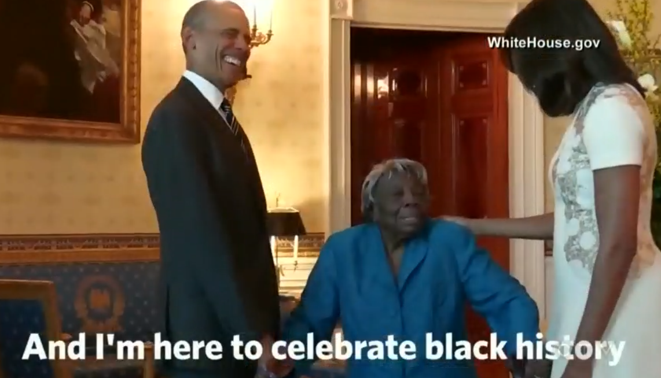
Notes:
On February 21, 2016, 106-year Washington D.C. resident and school volunteer Virginia McLaurin visited the White House as part of Black History Month. When asked by the president why she was there, McLaurin said, "A Black president. A Black wife. And I’m here to celebrate Black history. That's what I'm here for."

Slide 53
I almost chose the illustration:
Dionne Warwick sings “What The World Needs Now Is Love”
https://www.youtube.com/watch?v=FfHAs9cdTqg

Slide 54
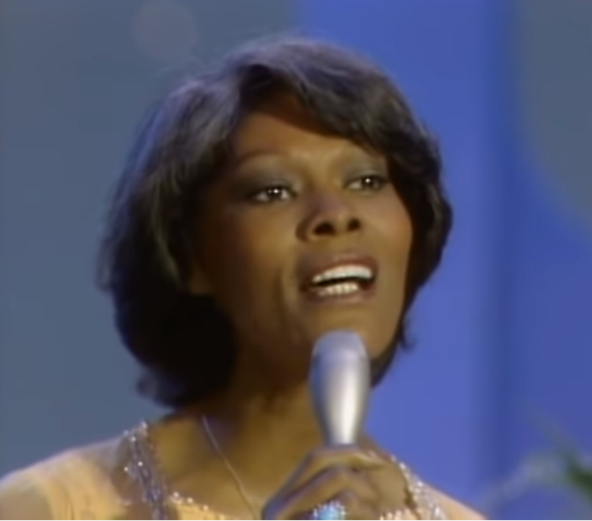
Notes:
The song was originally offered to Dionne Warwick, who turned it down at the time, saying she felt it was "too country" for her tastes and "too preachy" though she later recorded it for her album Here Where There Is Love.

Slide 55
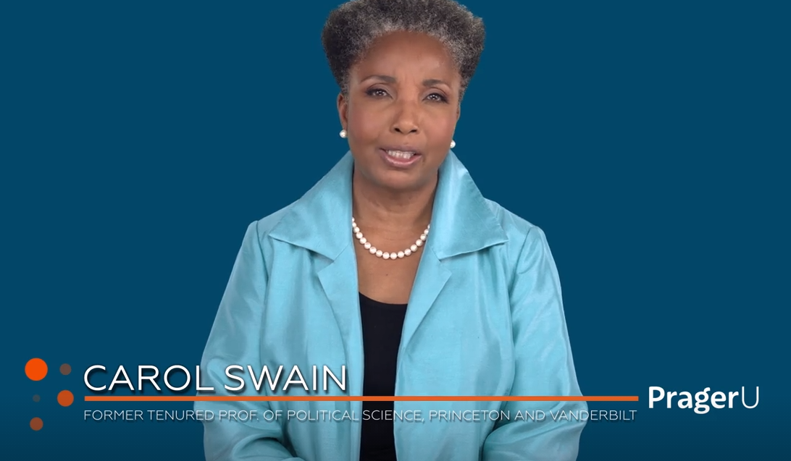
Notes:
https://www.prageru.com/video/what-i-can-teach-you-about-racism/?utm_source=Main+Mailing+List&utm_campaign=b4ec684d11-EMAIL_CAMPAIGN_2020_04_09_06_29_COPY_01&utm_medium=email&utm_term=0_f90832343d-b4ec684d11-164356353

Slide 56
As as covenant nation and people
Application:
Examine our hearts and attitudes
Superiority
Resentment

Slide 58
This is a land of covenant, of words and laws and principles.
Are we a people of our words? Of principle?

Slide 59
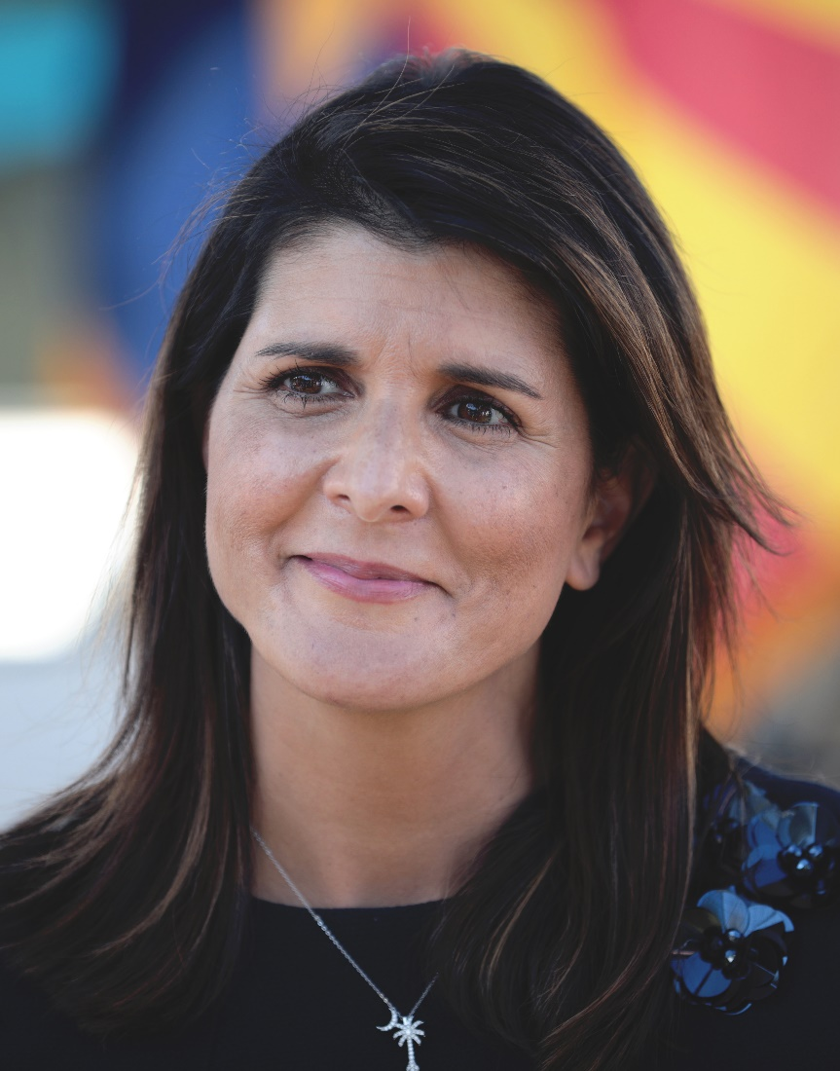
Nimrata Nikki (née Randhawa) Haley; born 1972
Gov S. Carolina
UN Ambassador
Notes:
You may be aware that New Yorkers love ethnic issues. I love Thai food, Mexican, Indian, Chinese, Japanese.
So here’s a story.
Her father, Ajit Singh Randhawa, and her mother, Raj Kaur Randhawa, immigrated to the United States from Amritsar District, Punjab, India. Her father was formerly a professor at Punjab Agricultural University, and her mother received her law degree from the University of Delhi.

Slide 60
Age 5-year-old she and her older sister werer entered into a pageant in which they historically crowned one white winner and one black winner.
Notes:
https://www.nytimes.com/2011/03/06/magazine/06talk-t.html

Slide 61
Right after I got through singing “This Land Is Your Land,” the judges called my parents to the back and said, “If we put them in one category, then one group will be mad, and if we put them in the other category, the other group will be mad.” They basically disqualified me and gave me a beach ball and sent me on my way.
Notes:
https://www.nytimes.com/2011/03/06/magazine/06talk-t.html

Slide 62
I know that to people outside the state, it sounds like something that’s really terrible. But what I want people to understand is that Bamberg, SC, is the same small town that stopped segregating the princesses after that,
Notes:
https://www.nytimes.com/2011/03/06/magazine/06talk-t.html

Slide 63
that took black girls and white girls in the Girl Scouts and that allowed me on the tennis team. I wanted the takeaway not to be that I was disqualified from the pageant but what the town did after the pageant.
Notes:
https://www.nytimes.com/2011/03/06/magazine/06talk-t.html

Slide 64
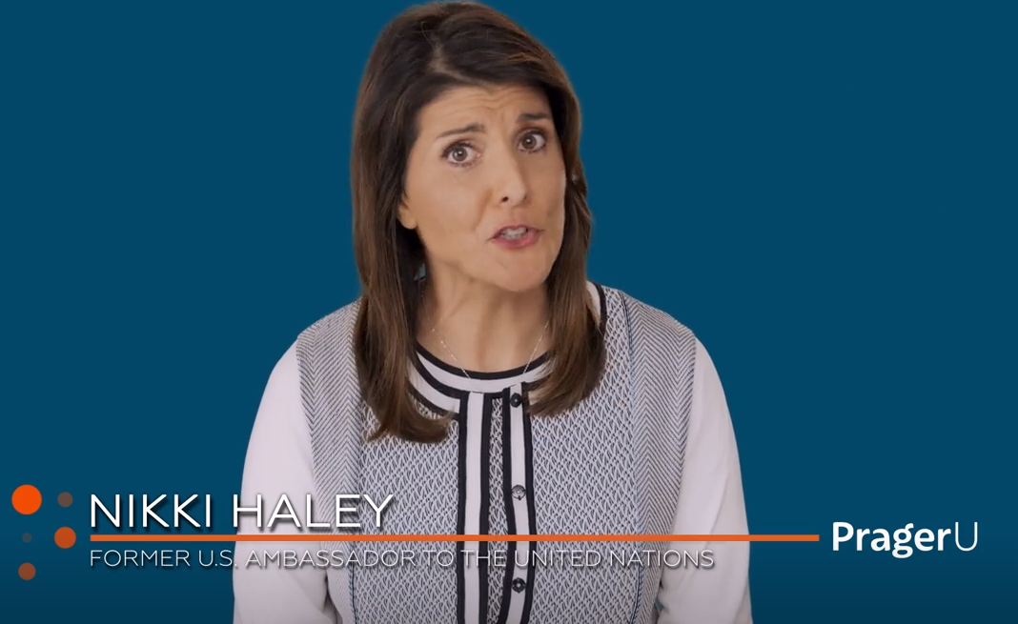
Notes:
https://www.prageru.com/video/capitalism-wins/?utm_source=Main+Mailing+List&utm_campaign=e987838263-EMAIL_CAMPAIGN_2020_04_09_06_29_COPY_01&utm_medium=email&utm_term=0_f90832343d-e987838263-164356353

Slide 65
This is not a land of ethnic rulership, nor dictatorship, but a land of covenant.
My father saved up $600 after serving in Saipan in WW II, an started the jewelry making tool business that I refer to at times.

Slide 66
Another major covenantal commitment that we make…

Slide 67
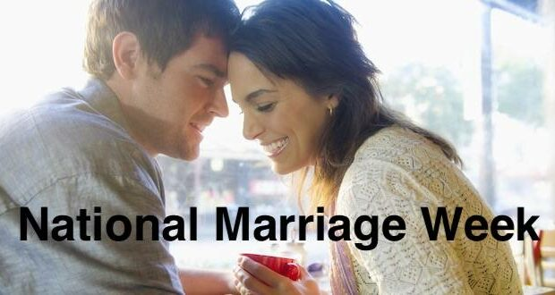
Notes:
https://metrovoicenews.com/organization-shares-tips-for-celebrating-national-marriage-week/
We DON’T practice Valentines Day. But we do affirm covenantal marriage!!

Slide 68
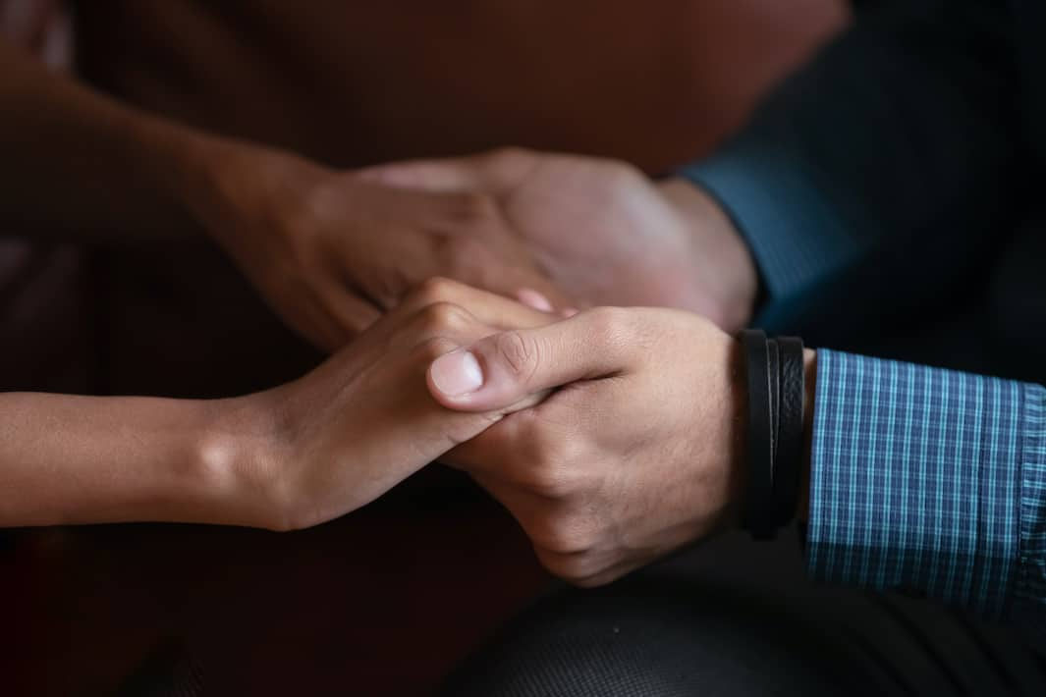
Blessing…

Slide 69
Affirm the covenant: Meaningful, appropriate touch. Spoken words of affirmation. Words that attach high value to her. Picturing for her a special future in Messiah, and for the two of you as a couple.

Slide 70
Blessing your wife involves an attitude that says, “You are incredibly valuable to me.” The very word, “Bless” in Hebrew means, “to bow the knee.”

Slide 71
Notes:
https://www.facebook.com/DrJamesDobsonsFamilyTalk/videos/565861480585115/

Slide 72
You don’t have to be married to honor covenantal marriage.
Live in sexual purity
Honor the concept of marriage.
Honor gender identity.
Marriage: fight for it, may have to face world, flesh, devil

Slide 73
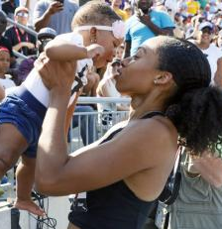
The fastest female sprinter in the world, American runner Allyson Felix, has more Olympic gold medals than Usain Bolt. "Her lifetime best for the 400-meter run is 49.26 seconds. Based on 2018 data, nearly 300 high school boys in the U.S. alone could beat it."
Notes:
https://qz.com/work/1679505/allyson-felix-an-olympic-medalist-who-split-with-nike-over-maternity-rights-signs-with-athleta/
https://www.frc.org/get.cfm?i=WA21B25&f=WU21B08
Usain St Leo Bolt, born 1986) is a Jamaican former sprinter, widely considered to be the greatest sprinter of all time. He is a world record holder in the 100 metres, 200 metres and 4 × 100 metres relay.
An eight-time Olympic gold medallist, Bolt is the only sprinter to win Olympic 100 m and 200 m titles at three consecutive Olympics (2008, 2012 and 2016).

Slide 74
Another application:
Covenant love in community.
^{John 13:34} – A new commandment I give to you, that you love one another; as I have loved you, that you also love one another.
^{John 15:12} – This is My commandment, that you love one another as I have loved you.

Slide 75
^{John 15:17} – These things I command you, that you love one another.
^{I John 3:11} – This is the message that you have heard from the beginning, that we should love one another.
^{I John 3:23} – Believe on the name of His Son Messiah Yeshua and love one another, as He gave us commandment.

Slide 76
^{I John 4:7} – Beloved, let us love one another, for love is of God; and everyone who loves is born of God and knows God.
^{I John 4:11} – Beloved, if God so loved us, we also ought to love one another.

Slide 77
^{II John 5} – Not as though I wrote you a new commandment, but that which we have had from the beginning: that we love one another.
Congregational covenant and discipleship.

Slide 78
Outline
What is a covenant?
What are the covenants in scripture?
What is Yeshua’s covenant?
How does this apply to us.

Slide 79
But when I am tempted to despair, I recall the comforting words of the Prophet Habakkuk in Ancient Israel. He wrote, "Lord, I have heard of your fame. I stand in awe of your deeds. Lord, repeat them in our day. In our time, make them known. In wrath, remember mercy." (Habakkuk 3:2)

Slide 80
Jonathan Cahn as quoted by James Dobson: 232 years ago, in the first ever presidential inauguration, the nation's first president addressed a jubilant multitude, and a nation that was united in shared values and a common hope in America's future.
Notes:
https://www.drjamesdobson.org/newsletters/february-newsletter-2021-0?utm_campaign=2021%20February%20NL&utm_medium=email&_hsenc=p2ANqtz--304MuHgYwUvxJjqvUU7H5S5DRTUROJ128s0mT-HKeE2BSA0nl_IzR9GwpWt7Gi9vZW2suQDXtJUgiQRd4bsEIzBv97Q&_hsmi=110349453&utm_content=110349453&utm_source=hs_email&hsCtaTracking=fc50e458-601a-4329-ba48-833cc28e340f%7C2fc0c051-1aa7-4cf8-b2f5-de4b6f422449

Slide 81
In that first ever presidential address, George Washington gave the newborn nation a prophetic warning. He said this: "The propitious smiles of heaven cannot be expected on a nation that disregards the eternal rules of order and right that heaven itself has ordained."
Notes:
https://www.drjamesdobson.org/newsletters/february-newsletter-2021-0?utm_campaign=2021%20February%20NL&utm_medium=email&_hsenc=p2ANqtz--304MuHgYwUvxJjqvUU7H5S5DRTUROJ128s0mT-HKeE2BSA0nl_IzR9GwpWt7Gi9vZW2suQDXtJUgiQRd4bsEIzBv97Q&_hsmi=110349453&utm_content=110349453&utm_source=hs_email&hsCtaTracking=fc50e458-601a-4329-ba48-833cc28e340f%7C2fc0c051-1aa7-4cf8-b2f5-de4b6f422449

Slide 82
In other words, if America followed the ways of God, His eternal rules of order and right, the blessings of God would remain upon it, but if America should ever depart from the ways of God, that His blessings would be removed from the land.
Notes:
https://www.drjamesdobson.org/newsletters/february-newsletter-2021-0?utm_campaign=2021%20February%20NL&utm_medium=email&_hsenc=p2ANqtz--304MuHgYwUvxJjqvUU7H5S5DRTUROJ128s0mT-HKeE2BSA0nl_IzR9GwpWt7Gi9vZW2suQDXtJUgiQRd4bsEIzBv97Q&_hsmi=110349453&utm_content=110349453&utm_source=hs_email&hsCtaTracking=fc50e458-601a-4329-ba48-833cc28e340f%7C2fc0c051-1aa7-4cf8-b2f5-de4b6f422449

Slide 83
Conclusion
Are we walking in Yeshua’s covenant of forgiveness and change?
Are we keeping the covenants we are in?

Slide 86
