Slide 1
Don't be worried about your smartphone or TV spying on you.
Notes:
Mary Ann Dixon

Slide 2
Don't be worried about your smartphone or TV spying on you. Your vacuum cleaner has been collecting dirt on you for years.
Notes:
Mary Ann Dixon

Slide 3
If you can't think of a word say,
“I forgot the English word for it.”.
Notes:
Mary Ann Dixon

Slide 4
If you can't think of a word say,
“I forgot the English word for it.” That way people will think you're bilingual instead of an idiot.
Notes:
Mary Ann Dixon

Slide 5
I don't always go the extra mile,
Notes:
Mary Ann Dixon

Slide 6
I don't always go the extra mile, but when I do it's because I missed my exit.
Notes:
Mary Ann Dixon

Slide 7
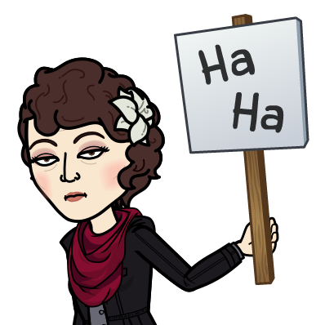

Slide 8
Last message in this series in the Letter to the Messianic Jews / Hebrews / MJ
was about Messiah the covenantal cohen.
Today we’ll consider His equipment.

Slide 9
Notes:
https://www.templeinstitute.org/new-location.htm
But first, as Ben Shapiro says….

Slide 10
^{Sanh. 99 a} ‘All the prophets prophesied not but of the days of the Messiah.’
^{Sanh. 98 b} ‘The world was not created but only for the Messiah.’
Notes:
This is not to minimize the importance of the Mishkan/Tabernacle, rather eternally validate it all. In fact, EVERYTHING that we do at Or HaOlam should be focused, motivated by the worship and glorify of King Messiah Yeshua!

Slide 11
^{MJ 9.1-5} Now even the first one [Mishkan/Tabernacle] had regulations for worship and the earthly sanctuary. For a tent was prepared: in the outer part were the menorah, the table, and the presentation of the bread —

Slide 12
^{MJ 9.1-5} this is called the Holy Place. Beyond the second curtain was a dwelling called the Holy of Holies. It held a golden altar of incense and the ark of the covenant, completely covered with gold. In the ark was a golden jar holding the manna,

Slide 13
^{MJ 9.1-5} Aaron’s rod that budded, and the tablets of the covenant and above it, cherubim of glory overshadowing the mercy seat. But it is not now possible to speak in detail about these things.
Notes:
Not for the writer of Mes Jews, but for us, consider the scripture and the history…

Slide 14
There are five historical formulations of this building.
The Mishkan/Tab of Moshe.
The Mishkan/Tab at Shiloh.
The Temple of Solomon.
The Temple of Zerubavel.
The Temple of Herod.
Notes:
Coming, two more…
the Tribulation Temple that the Orthodox Jews will be empowered to build, and the anti-Messiah will take over
The Millennial Temple that Yeshua will reign in, which will STILL have sacrifice…commemorative.

Slide 15
There are five historical formulations of this building.
The Mishkan/Tab of Moshe.
The Mishkan/Tab at Shiloh.
The Temple of Solomon.
The Temple of Zerubavel.
The Temple of Herod.
Notes:
Temple Institute graphics are basically about #5
Reference to “first one”

Slide 16
^{MJ 9.1.5} Now even the first one had regulations for worship and the earthly sanctuary.
Notes:
Interesting phrase

Slide 17
kosmikos: κοσμικός pertaining to the world earthly, worldly (belonging to the present earthly world as opposed to the heavenly and future).

Slide 18
Philo of Alexandria
יְדִידְיָה הַכֹּהֵן‎‎ Yedidia HaCohen;
20 BCE – c. 50 CE)
also called Philo Judaeus, was a Hellenistic Jewish philosopher who lived in Alexandria, in the Roman province of Egypt.
Notes:
He acknowledged the symbolic representations of the Mishkan furniture, long before Yeshua. Furthermore, rabbinical writings...

Slide 19
M
below
Mikdash sheh-l’malah
Mikdash sheh-l’matah
Mishkana d’layla,
Mishkana d’latata
Notes:
From John Gill’s commentary
Jarchi in Gen. xxviii. 17. Zohar in Exod. fol. 65. 4. & 94. 4. & 96. 2. & in Lev. fol. 1. 3.
So, it’s not out of Judaic context to see something greater than these items in them. Not allegorizing, trivializing.

Slide 20
^{MJ 9.2} For a tent was prepared: in the outer part were the menorah…

Slide 21
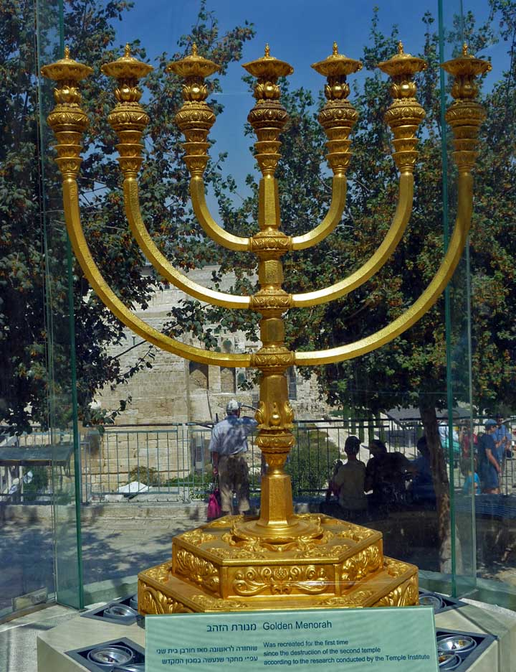
Temple Institute menorah in Jerusalem,full size, awaiting the rebuilding of the Temple.
Notes:
https://external-content.duckduckgo.com/iu/?u=https%3A%2F%2Ftempleinstitute.org%2Fwp-content%2Fuploads%2F2020%2F01%2Fmenora-classic-720.jpg&f=1&nofb=1
May not be exactly like the one in Moshe’s Mishkan/Tent, but close. Prepared to be pressed into service immediately should the need arise. The menorah is made of one talent (interpreted as 45 kg, 1447 troy oz = $2.5 M) of 24 karat pure gold, hammered out of a single block of solid gold, with decorations based on the depiction of the original in the Arch of Titus and the Temple Institute's interpretation of the relevant religious texts.

Slide 22
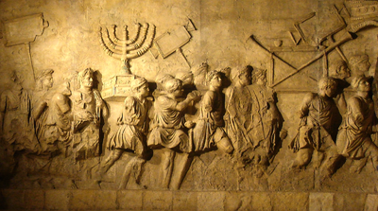
The menorah on
the Arch of Titus in Rome
Notes:
Rabbi Herb Mandl, retired rabbi of Kehilath Israel Synagogue here in OP, whom some of us know, has his Ph.D. in Jewish Catholic relations, and believes the Menorah is in the sealed vaults of the Vatican.

Slide 23
The menorah on
the Arch of Titus in Rome
Notes:
Rabbi Herb Mandl, retired rabbi of Kehilath Israel Synagogue here in OP, whom some of us know, has his Ph.D. in Jewish Catholic relations, and believes the Menorah is in the sealed vaults of the Vatican.

Slide 24
found among the remains of an ancient Beit Knesset in the Golan. Also depicted are an incense shovel and a shofar.
Notes:
https://templeinstitute.org/menorah-archeological-evidence/

Slide 25
^{Shmot/Ex 25.31} You are to make a menorah of pure gold, by hammered work. Its base, stem, cups, bulbs and flowers are to be one piece.
Pure gold = 24 karat
Uncompromised, unmixed light.
Notes:
Karats, spelled "carats" outside of North America

Slide 26
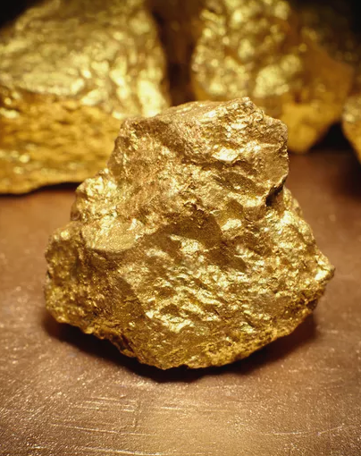
Gold properties:
Non reactive
Very dense 2x Pb
Great conductor of heat and electricity
Malleabe

Slide 27
Shaped exactly as the craftsman wanted.
Heavy, not easily moved.
One piece: impossible task
Conducted the olive oil for the light without taint. Ions taint.
Notes:
Rashi reports that G-d instructed Moshe to throw the 2400 oz ingot into a fire, G-d formed it. Current Menorah made one piece by casting. Parts hammered out.

Slide 28
^{Yn 1.5,9} The light shines in the darkness, and the darkness has not overpowered it. This was the true light, which gives light to everyone entering the world.
Notes:
I remember when I didn’t know if gay was wrong or just an biological tendency. Didn’t know what TRUTH was. Sitting in a bus in Albany NY and trying to decide why I wasn’t in Port Authority, NYC.
Pause and worship.

Slide 29
^{Ro 7.7} For I would not have known about coveting if the Torah had not said, “You shall not covet.”
^{Ro 7.9-10} I was once alive outside the framework of Torah. But when the commandment really encountered me, sin sprang to life, and I died.
Notes:
John Gill: When the light of reason in the mind is so far extinguished by any prevailing iniquity, particularly the sin of covetousness, so that it is wholly influenced and governed by it, what irregular actions is it led into! What deeds of darkness does it perform! and what will be the consequence of it, but utter and eternal darkness, if grace prevent not!

Slide 30
^{Yn 3.19-21} “Now this is the judgment, that the light has come into the world and men loved the darkness instead of the light, because their deeds were evil. For everyone who does evil hates the light and does not come to the light, so that their deeds will not be exposed. But whoever practices the truth comes to the light.

Slide 31
^{Yn 8.12} Yeshua spoke to them again, saying, “I am the light of the world. The one who follows Me will no longer walk in darkness, but will have the light of life.”
^{Mt.5.14} “You are the light of the world. A city set on a hill cannot be hidden.

Slide 32
(Worthy News) – A new survey has found that just six percent of American adults hold to a Biblical worldview, while nearly nine out of 10 holds to syncretism, a mixture of worldviews, Christian Headlines reports.

Slide 33
The study was carried out by the Cultural Research Center (CRC) at Arizona Christian University on a nationally representative sample of 2,000 people in February 2021.

Slide 34
However, the study found, 88 percent of US adults hold to a mixture of world views. “Rather than developing an internally consistent and philosophically coherent perspective, Americans embrace points of view or actions that feel comfortable or most convenient,”
Notes:
George Whitten

Slide 35
researcher Dr. George Bana said in a statement. “Those beliefs and behaviors are often inconsistent, or even contradictory, but few Americans seemed troubled by that.”
Notes:
George Whitten

Slide 36
Let’s examine ourselves for purity consistency of truth.

Slide 37
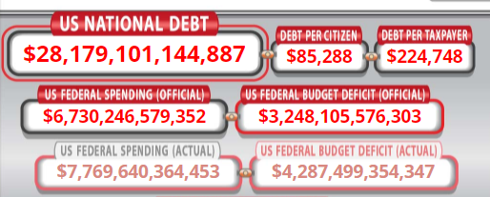
Let’s examine ourselves for purity consistency of truth.
Debt:
Notes:
https://www.usdebtclock.org/
as of April 16, 2021 10 p.m.
Why start with that? כי “small sin” can be example of inconsistency in world view of otherwise sound believer, but may be the ruin of our nation, civilization.
That’s why babies cry.

Slide 38
Don’t owe anyone anything — except to love one another; for whoever loves his fellow human being has fulfilled Torah.
For those who contemplate the great impending Reset, this is what I understand will be the bait. Debt relief in exchange for control.
Notes:
Trip, garment, restaurant meal: MUST have? Not so. Won’t die.
Scriptural consistency?
Pure light from the golden menorah?

Slide 39
Don’t owe anyone anything — except to love one another; for whoever loves his fellow human being has fulfilled Torah.
This is the great test of spiritual truth: Satan is transformed into an angel of light. ^{2 Cor 11.14}
Notes:
Another small inconsistency.

Slide 40
Satan can counterfeit the light of
G-d’s truth.
Satan cannot counterfeit the heat of G-d’s love.
^{Eph 4.15} speaking the truth in love
Pure gold truth is saturated by love.
Pure gold love is wrought in truth.

Slide 41
A New Yorker who wants to marry their own adult offspring is suing to overturn laws barring the incestuous practice, calling it a matter of “individual autonomy.”
Notes:
https://nypost.com/2021/04/10/new-york-parent-seeks-ok-to-marry-their-own-adult-child/

Slide 42
^{Eph 4.14-16} We will then no longer be infants tossed about by the waves and blown along by every wind of teaching, at the mercy of people clever in devising ways to deceive. Instead, speaking the truth in love, we will in every respect grow up into him who is the head,

Slide 43
^{Eph 4.14-16} the Messiah. Under his control, the whole body is being fitted and held together by the support of every joint, with each part working to fulfill its function; this is how the body grows and builds itself up in love.
Notes:
Held together by every joint: six branches plus central shaft, Cups, knobs, flowers.

Slide 44
^{Shmot/Ex 25. 32} There are to be six branches coming out of the sides, three branches of the menorah out of one side, and three branches out of the other.

Slide 45
^{Shmot/Ex 25.33} There are to be three cups shaped like almond blossoms in one branch, each with a bulb and flower, then three cups made like almond blossoms in the next branch, each with a bulb and flower, and so forth for the six branches coming out of the menorah.
Notes:
My own experience in 1970. R W Dunn’s class. Draw a picture of this thing…!

Slide 46
Six branches ~ complexity of the light bearers, of the congregational community.
All with oil: gifts and graces.
All different gifts and graces.
^{Eph 4.32} Be kind to one another, compassionate, forgiving each other just as God in Messiah also forgave you.

Slide 47
No person is greater than his/her prayer life.
The rabbi / leader who is not praying is playing.
People who are not praying are straying.
Failing in prayer, we fail everywhere.
Notes:
Daniel and Carol Ketchum
There is a certain extent to which all people receive G-d’s light. But not like after we pray!!

Slide 48
^{Ro 1.18-20} What is revealed is God’s anger from heaven against all the godlessness and wickedness of people who in their wickedness keep suppressing the truth; because what is known about God is plain to them,

Slide 49
^{Ro 1.18-20} since God has made it plain to them. For ever since the creation of the universe his invisible qualities — both his eternal power and his divine nature — have been clearly seen, because they can be understood from what he has made.

Slide 50
^{Mt 6.24} If, then, the light in you is darkness, how great is that darkness!

Slide 51
In an effort to create experimental models that more closely mirror human biology, scientists are building chimeras, organisms that contain cells from multiple species. And in research published yesterday,
Notes:
https://mailchi.mp/statnews/tk-tncyc6de8v-607874?e=270d53feb3

Slide 52
a group of international researchers have now created the first embryos that are part human, part monkey. It’s controversial, though early-stage, work: The embryos were grown outside the womb, and so could only survive up to 20 days.
Notes:
https://mailchi.mp/statnews/tk-tncyc6de8v-607874?e=270d53feb3

Slide 53
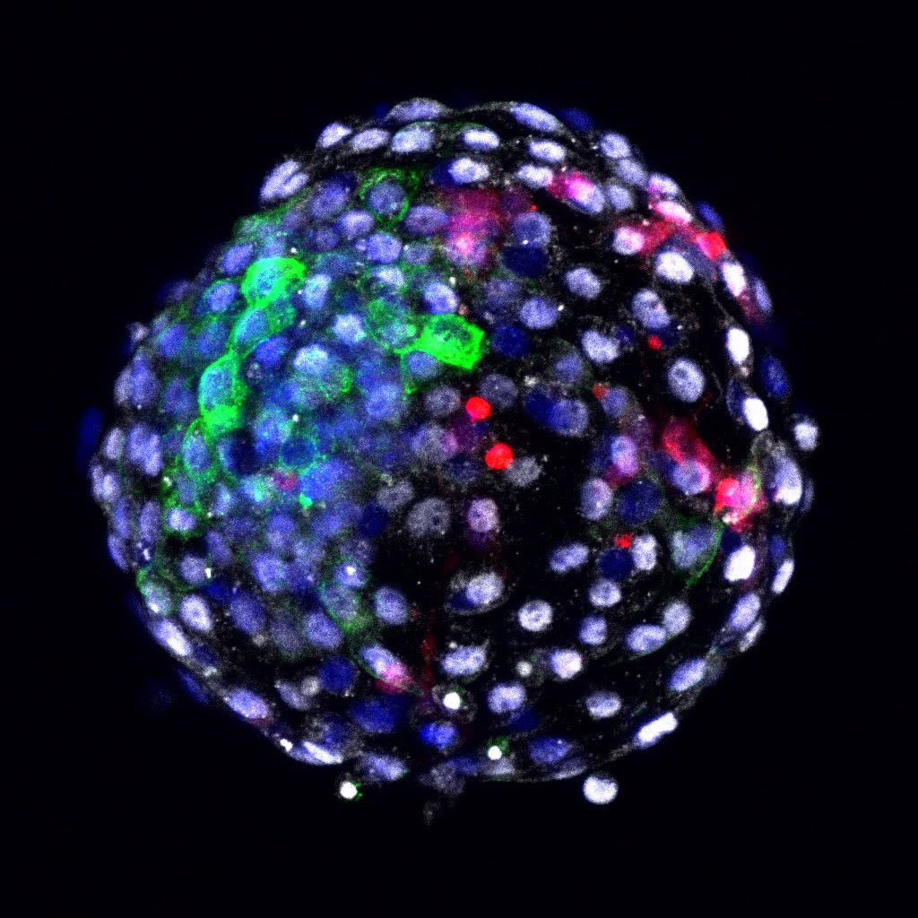
One of the chimeric human-monkey embryos. (Salk institute for biological studies)
Notes:
https://mailchi.mp/statnews/tk-tncyc6de8v-607874?e=270d53feb3

Slide 54
^{Mt 6.24} If, then, the light in you is darkness, how great is that darkness!

Slide 56
^{MJ 9.2b} For a tent was prepared: in the outer part were…the presentation of the bread —this is called the Holy Place

Slide 57
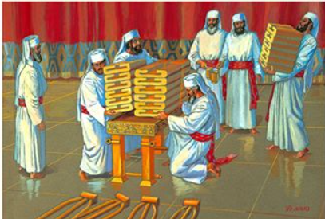

Slide 58
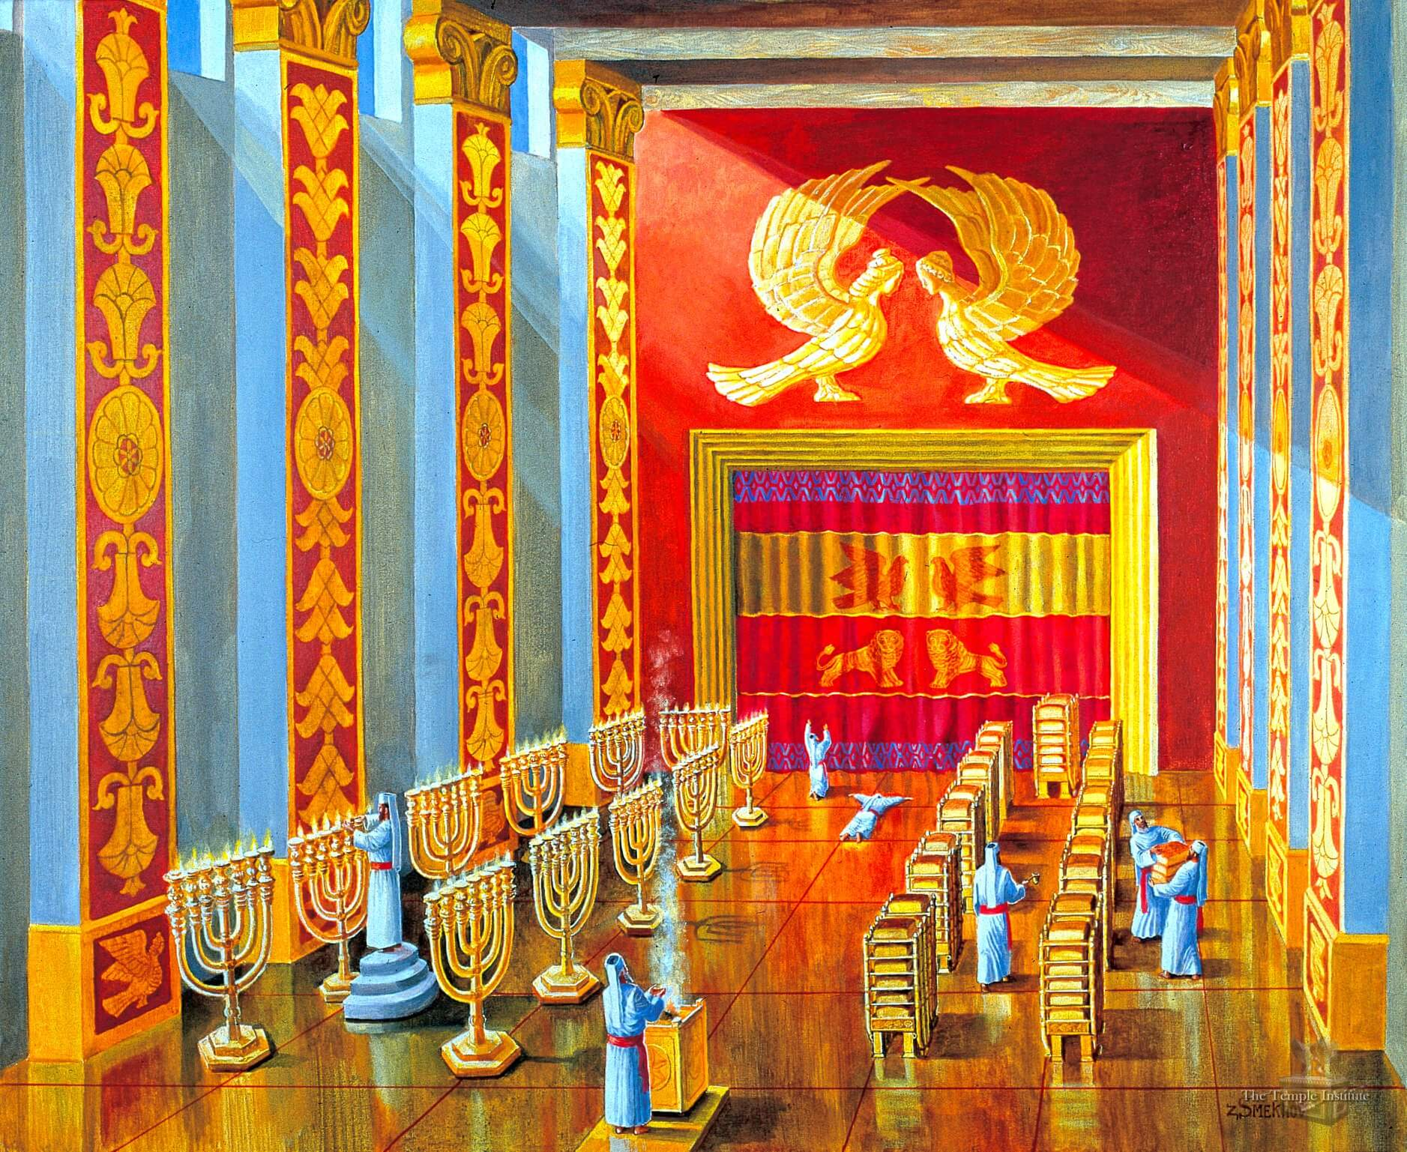
Solomon’s Temple had 10 additional
bread tables and menorot
Notes:
https://templeinstitute.org/illustrated-tour-the-mikdash-sanctuary/
In addition to the original Menorah and Showbread Table from the time of the Tabernacle, King Solomon added another ten Menorot and ten Showbread Tables.

Slide 59
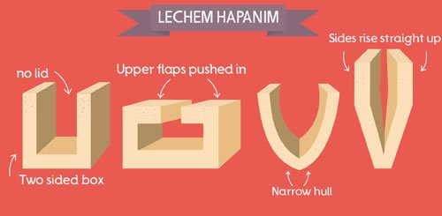
Notes:
https://w3.chabad.org/media/images/894/RxVK8943560.jpg

Slide 60
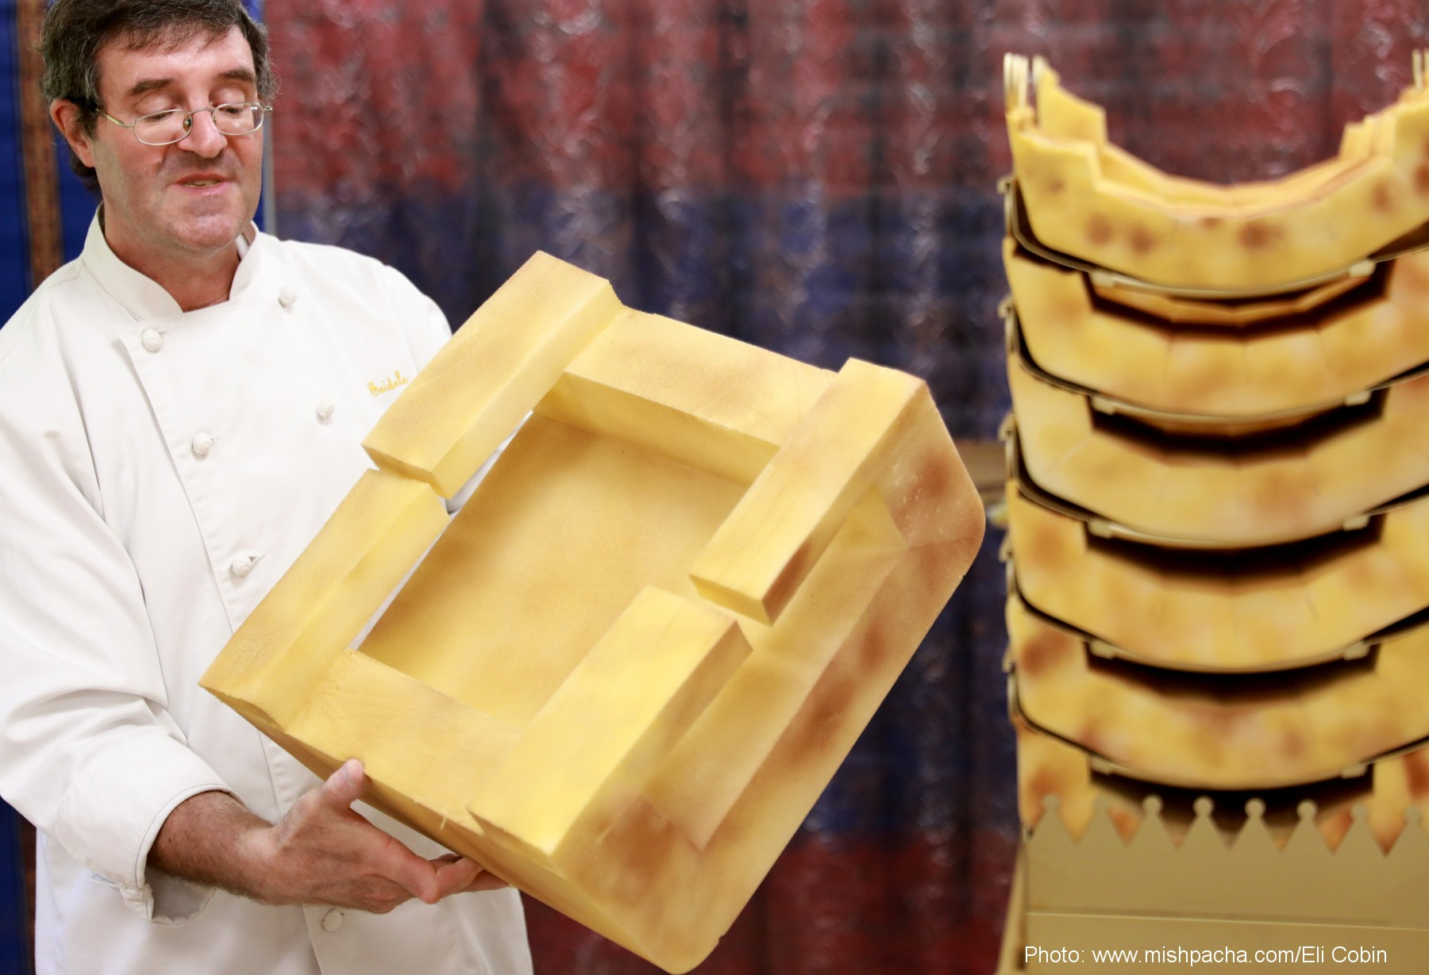
Notes:
https://external-content.duckduckgo.com/iu/?u=https%3A%2F%2Fwww.showbreadinstitute.org%2Fimages%2Ful240756%2Fda7fbd8ac1d6a5273f8474c42c5d2acd.jpg&f=1&nofb=1

Slide 61
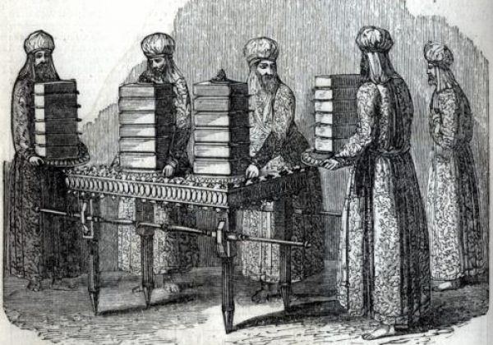
Notes:
Baked on Friday and replaced for Shabbat. Eaten by Cohanim.
David and his men, pursued by murderous King Saul, had some of this.

Slide 62
^{Yn 6.32-40} But my Father is giving you the genuine bread from heaven; for God’s bread is the one who comes down out of heaven and gives life to the world.” They said to him, “Sir, give us this bread from now on.” Yeshua answered, “I am the bread which is life! Whoever comes to me will never go hungry,

Slide 63
^{Yn 6.32-40} and whoever trusts in me will never be thirsty. I told you that you have seen but still don’t trust. Everyone the Father gives me will come to me, and whoever comes to me I will certainly not turn away. For I have come down from heaven to do not my own will but the will of the One who sent me.

Slide 64
^{Yn 6.32-40} And this is the will of the One who sent me: that I should not lose any of all those he has given me but should raise them up on the Last Day. Yes, this is the will of my Father: that all who see the Son and trust in him should have eternal life, and that I should raise them up on the Last Day.”

Slide 66
Are we getting filled with His bread, His presence, daily?
Are we sharing His bread?

Slide 67
Do you KNOW Him and the assurance of sins forgiven?
Are you surrendered to Him, His light?
Are you filled with His Spirit, transforming your life?
Are you seeking to win others?

