Slide 1
e-handout
To have these notes
without taking notes
Go to OrHaOlam.com
Click on Messages tab,
2022 Messages
Notes:
You may notice that I’m slowing down in my rate of speech. This is because we may be getting language translation equipment for simultaneous translation.

Slide 3
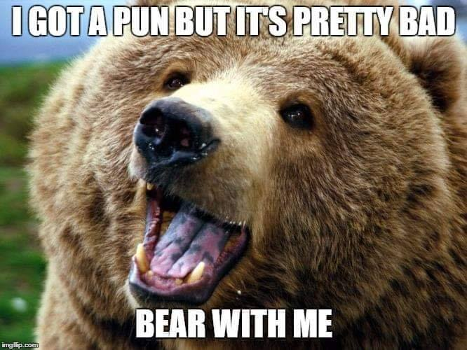

Slide 4
The guy who fell onto an upholstery machine
Notes:
Peter vd S

Slide 5
The guy who fell onto an upholstery machine is now fully recovered.
Notes:
Peter vd S

Slide 6
Police were summoned to a daycare center
Notes:
Peter vd S

Slide 7
Police were summoned to a daycare center where a three-year-old was resisting a rest.
Notes:
Peter vd S

Slide 9
So, why are we here today?

Slide 11
^{Vayikra/Lev 23.33-36} Adoni spoke to Moshe saying: “Speak to Bnei-Yisrael, and say, On the fifteenth day of this seventh month is the Feast of Sukkot, for seven days to Adoni. On the first day there is to be a holy convocation [?]
מִקְרָא-קֹדֶשׁ mikra kodesh

Slide 12
^{Vayikra/Lev 23.33-36}
מִקְרָא-קֹדֶשׁ mikra kodesh
a holy convocation from
קָרָא kara
to read; to call out to, to summon
A holy calling out

Slide 13
^{Vayikra/Lev 23.33-36} On the first day there is to be a holy convocation מִקְרָא-קֹדֶשׁ mikra kodesh you are to do no laborious work. For seven days you are to bring an offering by fire to Adoni. The eighth day will be a holy convocation to you, and you are to bring an offering by fire to Adoni. It is a solemn assembly

Slide 14
^{Vayikra/Lev 23.33-36} a solemn assembly
עֲצֶרֶת atseret
assembly, rally; (talmudic) Shavuot, Feast of Weeks; (mathematics) factorial
עָצַר atsar
to stop, to halt; to imprison, to detain; to prevent
Notes:
Even if you don’t know Hebrew, note the three letters
ע
צ
ר

Slide 15
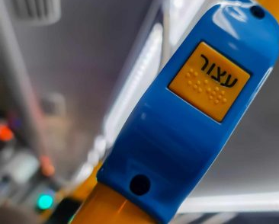
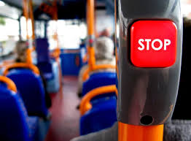
On a bus in Israel.
Notes:
Pull the string or push the button and the stop light comes on. The bus will stop at the next bus stop.
https://hamechadesh.b-cdn.net/wp-content/uploads/elementor/thumbs/PSX_20210216_175917-scaled-p2yexmf3rvb1gql3etw3qvxb5qdlk7beskfe2ysb08.jpg

Slide 16
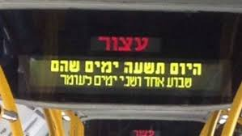
On a bus in Israel.
Notes:
https://encrypted-tbn0.gstatic.com/images?q=tbn:ANd9GcQWwwUl1UdC3Oom6swp1ohLbTLh-7uxEFgx3g&usqp=CAU
"Today is the ninth day, that is, one week and two days of the Omer count."
So, re-reading with these insights…

Slide 17
^{Vayikra/Lev 23.33-36} Adoni spoke to Moshe saying: “Speak to Bnei-Yisrael, and say, On the fifteenth day of this seventh month is the Feast of Sukkot, for seven days to Adoni. On the first day there is to be a holy convocation—you are to do no laborious work.
Notes:
A holy calling out from the world.

Slide 18
^{Vayikra/Lev 23.33-36} For seven days you are to bring an offering by fire to Adoni. The eighth day will be a holy convocation to you, and you are to bring an offering by fire to Adoni. It is a solemn assembly—you should do no laborious work.
Notes:
A stop day.

Slide 19
1st Day | Sukkot | holy convocation מִקְרָא-קֹדֶשׁ mikra kodesh
7th Day
8th Day | Shemini Atseret | Mikra kodesh PLUS a solemn assembly עֲצֶרֶת atseret The stop day
9th Day
Notes:
But it doesn’t stop there. Our people added some ornamentation, that Yeshua subscribed to.

Slide 20
The seventh day:
^{Yn 7.33-39} Now on the last day of the festival, Hoshana Rabbah, Yeshua stood and cried out, “If anyone is thirsty, let him keep coming to me and drinking! Whoever puts his trust in me, as the Scripture says,

Slide 21
The seventh day:
^{Yn 7.33-39} rivers of living water will flow from his inmost being!” (Now he said this about the Spirit, whom those who trusted in him were to receive later — the Spirit had not yet been given, because Yeshua had not yet been glorified.)

Slide 22
So, the eighth day is the
עֲצֶרֶת atseret
The stop day
The seventh day is Hoshanna Rabbah
Then a ninth day, Simkhat Torah, was added.

Slide 23
In Orthodox and Conservative communities outside Israel, Shemini Atzeret is a two-day holiday and the Simkhat Torah festivities are observed on the second day. The first day is referred to as "Shemini Atzeret" and the second day as "Simchat Torah"
Notes:
https://en.wikipedia.org/wiki/Simchat_Torah

Slide 24
In Israel, Shemini Atzeret and Simkhat Torah are celebrated on the same day.
Notes:
https://en.wikipedia.org/wiki/Simchat_Torah

Slide 25
1st Day | Sukkot | holy convo-cation מִקְרָא-קֹדֶשׁ mikra kodesh 4 species
7th Day | Hoshannah Rabba Water drawing
8th Day | Shemini Atseret | Mikra kodesh PLUS a solemn assembly= עֲצֶרֶת atseret The stop day | Combined in Israel, and by others in the diaspora, us.
9th Day | Simkhat Torah = Rejoicing in the Torah | Rewinding the scroll, dancing
Notes:
We are combining 7, 8 and 9th days. We are emphasizing the one of these three that is specifically in the Bible, but observing, at least in a measure, the other two.

Slide 26
There is some evidence that dancing with the Torah scrolls goes back to the first century, the century of Yeshua.
Why such a fervent and additional festivity?
Notes:
https://en.wikipedia.org/wiki/Simchat_Torah#History

Slide 28
^{T’hillim/Ps 1.1-2} How blessed are those who reject the advice of the wicked, don’t stand on the way of sinners or sit where scoffers sit! Their delight is in Adoni’s Torah; on his Torah they meditate day and night.

Slide 29
^{T’hillim/Ps 1.3,6} They are like trees planted by streams — they bear their fruit in season, their leaves never wither, everything they do succeeds. For Adoni watches over the way of the righteous, but the way of the wicked is doomed.

Slide 30
^{T’hillim/Ps 19.8-12} The Torah of Adoni is perfect, restoring the inner person. The instruction of Adoni is sure, making wise the thoughtless. The precepts of Adoni are right, rejoicing the heart. The mitzvah of Adoni is pure, enlightening the eyes.
Notes:
Personal illustration: there is a certain inner weakness and fear, that two of my accountability partners are aware of, for which I got a word insight from the Ruakh, which breaks it’s power. Almost like an “off switch.” And…it works best when I quote it in Hebrew.

Slide 31
^{T’hillim/Ps 19.8-12} The fear of Adoni is clean, enduring forever. The rulings of Adoni are true, they are righteous altogether, more desirable than gold, than much fine gold, also sweeter than honey or drippings from the honeycomb. Through them your servant is warned; in obeying them there is great reward.

Slide 32
^{T’hillim/Ps 119.1-3} How happy are those whose way of life is blameless, who live by the Torah of Adoni! How happy are those who observe his instruction, who seek him wholeheartedly! They do nothing wrong but live by his ways.

Slide 33
^{T’hillim/Ps 119.9} How can a young man keep his way pure? By guarding it according to your word.
Notes:
Temptations of youth…hormones raging, sex, anger, ego and identity.

Slide 34
^{T’hiIlim/Ps 119.11-16} I will meditate on your precepts and keep my eyes on your ways. I will find my delight in your regulations. I will not forget your word.

Slide 35
^{T’hiIlim/Ps 119.11-16} I treasure your word in my heart, so that I won’t sin against you. Blessed are you, Adoni! Teach me your laws. I proclaim with my mouth all the rulings you have spoken. I rejoice in the way of your instruction more than in any kind of wealth.

Slide 36
^{T’hillim/Ps 119.18,38-40} Open my eyes, so that I will see wonders from your Torah. Fulfill your promise, which you made to your servant, which you made to those who fear you. Avert the disgrace which I dread, for your rulings are good. See how I long for your precepts; in your righteousness, give me life!

Slide 37
^{T’hillim/Ps 119.65-37} You have treated your servant well, Adoni, in keeping with your word. Teach me good judgment and knowledge, because I trust in your mitzvot. Before I was humbled, I used to go astray; but now I observe your word.
Notes:
There is something in my life that is irritating, regularly. Temptation to anger. But to that, I quote,
^{2 Corinthians 4:17 KJV} For our light affliction, which is but for a moment, works for us a far more exceeding and eternal weight of glory.

Slide 38
For wayward children, many scriptures. One of the strongest…

Slide 39
^{Yeshayahu / Is 60.4-5} Lift up your eyes and look all around: they all gather—they come to you— your sons will come from far away, your daughters carried on the hip. Then you will see and be radiant, and your heart will throb and swell with joy.
Notes:
Lift up your eyes? Praise and dwelling in the Word! Passive verbs…נקבצו = they will be gathered. Our work at this point, primarily to lift our eyes…to Him in praise and faith.

Slide 40
A cosmic dimension of the Word. Far out!

Slide 41
^{T’hillim/Ps 33.6} By the word of Adoni the heavens were made, and their whole hostצָבָא tsava [the military; army; multitude] by a breath from his mouth.

Slide 42
^{Yn 1.1-3} In the beginning was the Word. The Word was with God, and the Word was God. He was with God in the beginning. All things were made through Him, and apart from Him nothing was made that has come into being.
The Word = Logos = Davar דבר

Slide 43
^{Ber/Gen 1.1-2} In the beginning God created the heavens and the earth. Now the earth was chaos and waste, darkness was on the surface of the deep, and the Ruach Elohim was hovering upon the surface of the water. Then God said, “Let there be light!” and there was light.

Slide 44
G-d existed before space-time. Then He caused the pulse of space time and light by the Word = Logos = Davar.
The Logos = the logic
But the logic is the math!
So G-d paused to get the equations of creation formulated.

Slide 45
.
General relativity
E = mc²
Gravitational field equation, bending of space time.
Notes:
Einstein (gravitational) field equations including the cosmological constant Lambda
https://commons.wikimedia.org/wiki/File:EinsteinLeiden4.jpg
https://www.physlink.com/education/askexperts/Images/ae329a.jpg

Slide 46
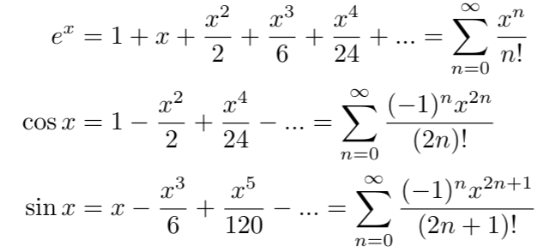
The Essence of Quantum Mechanics Part 2
Notes:
https://medium.com/@notaredpanda/the-essence-of-quantum-mechanics-part-2-complex-numbers-1b051478fc2d
I used to get intoxicated on this as divine, of sorts. Beauty, symmetry. That’s what the people at the Cern are doing. But it’s just an expression of the Logos, the Davar, the Memra!

Slide 47
^{Mishlei/ Prov 8.30-32} I was the craftsman beside Him, I was His daily delight, always rejoicing before Him, rejoicing in His whole world, and delighting in mankind. “So now, children, listen to me! Blessed are those who keep my ways.
Notes:
Keep the ways as foundational as relativity and quantum mechanics!

Slide 48
Applying the Word

Slide 49
^{Yn 15.3-4} You are already clean because of the word I have spoken to you. Abide in Me, and I will abide in you. The branch cannot itself produce fruit, unless it abides on the vine. Likewise, you cannot produce fruit unless you abide in Me.

Slide 50
^{Yn 15.7-8} “If you abide in Me and My words abide in you, ask whatever you wish, and it shall be done for you. In this My Father is glorified, that you bear much fruit and so prove to be My disciples.”

Slide 51
^{Yn 15.10-12} If you keep My commandments, you will abide in My love, just as I have kept My Father’s commandments and abide in His love. These things I have spoken to you so that My joy may be in you, and your joy may be full. “This is My commandment, that you love one another just as I have loved you.

Slide 52
^{Yn 14.13-14} And whatever you ask in My name, that I will do, so that the Father may be glorified in the Son. If you ask Me anything in My name, I will do it.
Notes:
There are those who say you should only pray to the Father, albeit in Yeshua’s Name, and to pray to Him is idolatry. I was told by a Hasidic rabbi in Jerusalem that if I would commit to that, he would get me citizenship in Israel. However, here and other places, not so.

Slide 53
^{Dvarim 6.4-6} “Sh’ma, Yisra’el! Adoni Eloheinu, Adoni ekhad [Hear, Isra’el! Adoni our God, Adoni is one]; and you are to love Adoni your God with all your heart, all your being and all your resources. These words, which I am ordering you today, are to be on your heart

Slide 55
A success story

Slide 56
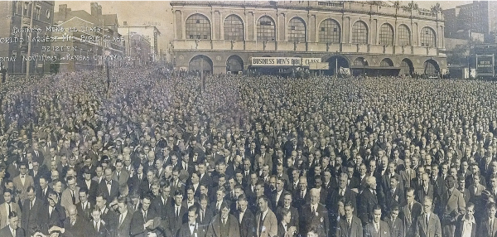
Notes:
https://thesignatry.com/kcroots/
Spiritual Roots p 92-93

Slide 57
The historic photo above shows 52,121 Bible believers from the marketplace who gathered in downtown Kansas City in 1923 to honor Messiah.
Notes:
https://kcpray.com/what?ct=t(EMAIL_CAMPAIGN_1_3_2021_20_50_COPY_01)

Slide 58
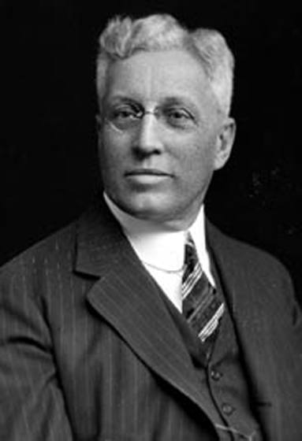
Napoleon W Dible, 1842–1916, was well known in Kansas City as an architect, and his Tudor style houses still fill Ward Parkway and the Brookside and Waldo areas.
Notes:
https://metrovoicenews.com/wp-content/uploads/2019/11/Dible.jpg

Slide 59
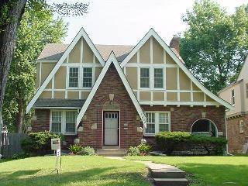
He had four basic floor plans, and his goal was to build affordable, well-built homes.
Notes:
https://metrovoicenews.com/wp-content/uploads/2019/11/tudor.jpeg

Slide 60
His company made their profit by selling homes at a low price but selling lots of them. Dible kept a tight rein on his business: “He called his salesmen after dinner each night for a daily report, asking each one, ‘What’s it going to be, steak or hot dogs?’” writes historian Susan Jezak Ford.
Notes:
https://metrovoicenews.com/the-believer-behind-the-charm-of-brookside-and-kansas-citys-largest-bible-study/

Slide 61
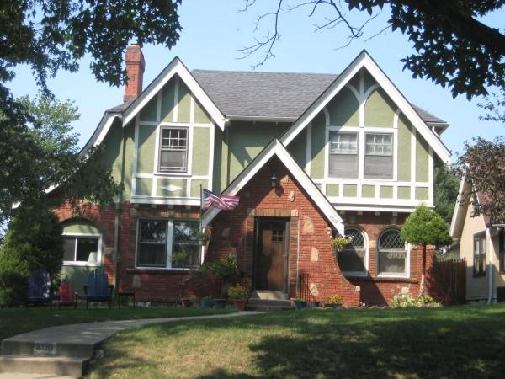
When the president of William Jewell College, Dr. David Jones Evans, stepped down from his presidency to pastor First Baptist Church of Kansas City, he recruited Dible to lead the Business Men’s Bible Class. Starting at just 35 members, Dible brought the class membership into the thousands.
Notes:
https://external-content.duckduckgo.com/iu/?u=https%3A%2F%2Fcontent.mediastg.net%2Fdyna_images%2Fmls%2F313%2F2219528.jpgx%3Fd%3D2021-01-17T20-08-50&f=1&nofb=1

Slide 62
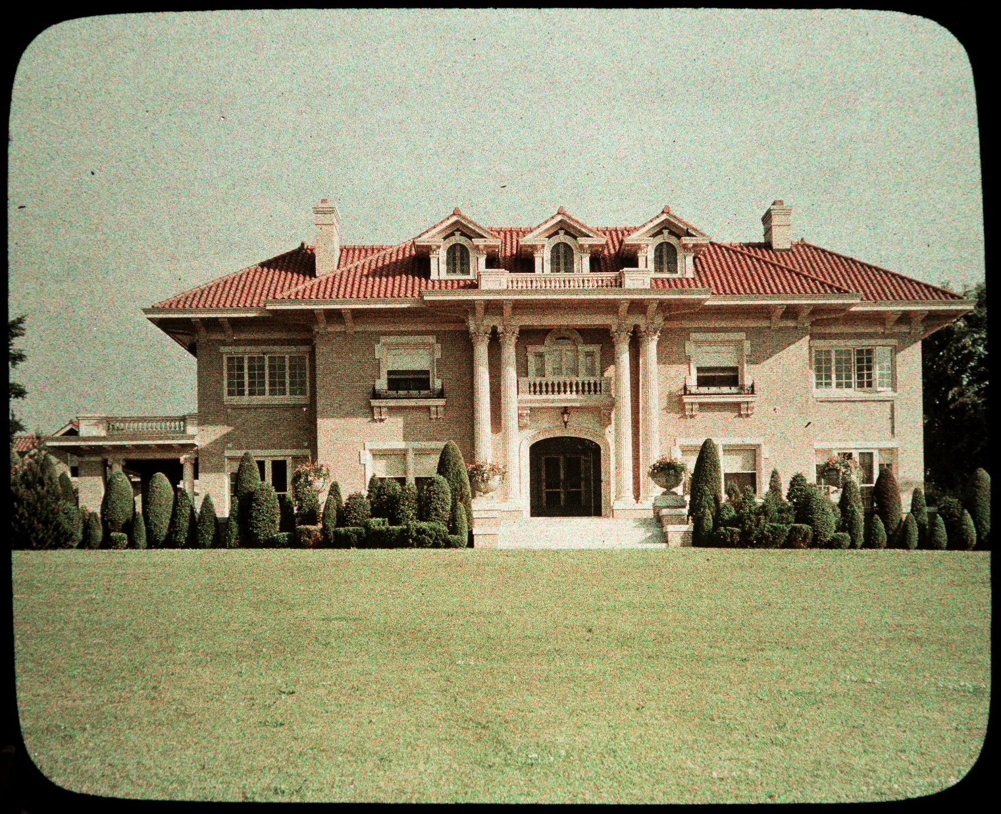
Notes:
https://external-content.duckduckgo.com/iu/?u=https%3A%2F%2Fpendergastkc.org%2Fsites%2Fdefault%2Ffiles%2Fcollections%2F1Autochromes%2F20003627-001.jpg&f=1&nofb=1

Slide 63
Dible carried this same dedication and ambition from his housing business into his service at his congregation.
Notes:
https://metrovoicenews.com/wp-content/uploads/2019/11/dible-bible-meeting.jpg

Slide 64
Dible organized the study into a military model, with captains and lieutenants over groups of 50 and 100. He rallied men together to become the largest Bible study. One Sunday morning in 1923, over 52,000 men in suits
Notes:
https://metrovoicenews.com/the-believer-behind-the-charm-of-brookside-and-kansas-citys-largest-bible-study/

Slide 65
flooded the streets of Kansas City with a banner over their heads that read, “Business Men’s Bible Class.” On the day of the event, seventy-five buglers rode through the city, sounding the call. The mayor of Independence came, as well as Missouri Governor Arthur Hyde.
Notes:
https://metrovoicenews.com/the-believer-behind-the-charm-of-brookside-and-kansas-citys-largest-bible-study/

Slide 66
Notes:
https://thesignatry.com/kcroots/
Spiritual Roots p 92-93

Slide 68
The power of the Word in Hebrew

Slide 69
William Bradford, Governor of the Plymouth Colony, was fanatical about the Hebrew language. He taught himself Hebrew because he wanted to read the Scriptures in their original language. He believed that after his death, he would speak Hebrew with God and the angels. Bradford was also in favor of Hebrew being the language of their new country.
Notes:
https://www.jewishjewels.org/news-letters/hebrew/

Slide 70
This would be another way to separate from all things “English.” They would speak the language of the Bible. A vote was taken on the Mayflower to determine which language the settlers would speak in the New World.
Notes:
https://www.jewishjewels.org/news-letters/hebrew/

Slide 71
According to an article by Tsivya Fox in Breaking Israel News, “How Hebrew Almost Became the Official Language of America,” Hebrew lost by only one vote. Imagine: if Hebrew had won, we would all be speaking the Holy Tongue today!
Notes:
https://www.jewishjewels.org/news-letters/hebrew/

Slide 72
During the time of the American Revolution, the topic resurfaced, since a linguistic separation was deemed appropriate to follow a political separation. In 1780, Hebrew was once again proposed as the official American language.
Notes:
https://www.jewishjewels.org/news-letters/hebrew/

Slide 73
Marquis de Chastellux, a companion of George Washington, wrote that, “certain members of Congress proposed that the use of English be formally prohibited in the United States, and Hebrew substituted for it.”
Notes:
https://www.jewishjewels.org/news-letters/hebrew/

Slide 74
Don’t think everyone will love you, just because you are filled with love, and the Word, and love of the Israel of the Word.

Slide 75
Notes:
https://youtu.be/1fUv0BXZY70

Slide 76
The High Holidays have been about
Repetance
Atonement
His presence among us
Now: keeping it by His Word!!

Slide 77
Do you KNOW Yeshua and the assurance of sins forgiven?
Are you hearing daily from His Word?
How are you applying what you heard?
Are you asking this of another?
Notes:
Who are you discipling, building up?4

