Slide 1
e-handout
To have these notes
without taking notes
Go to OrHaOlam.com
Click on Messages tab,
2022 Messages
Notes:
You may notice that I’m slowing down in my rate of speech. This is because we may be getting language translation equipment for simultaneous translation.

Slide 2
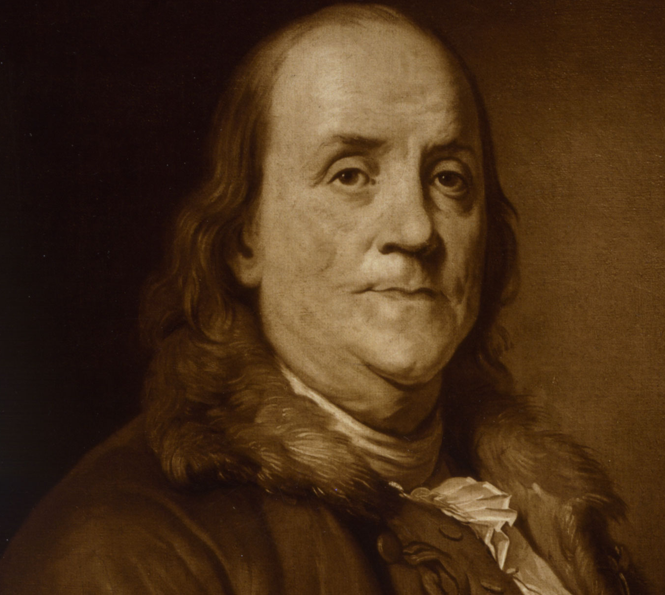
Benjamin Franklin's Famous Quotes
Notes:
https://www.washingtonpost.com/history/2019/12/18/republic-if-you-can-keep-it-did-ben-franklin-really-say-impeachment-days-favorite-quote/

Slide 3
“He that lies down with Dogs,
Notes:
https://www.fi.edu/benjamin-franklin/famous-quotes

Slide 4
“He that lies down with Dogs, shall rise up with fleas.” - Poor Richard’s Almanack, 1733
Notes:
https://www.fi.edu/benjamin-franklin/famous-quotes

Slide 5
“Better slip with foot
Notes:
https://www.fi.edu/benjamin-franklin/famous-quotes

Slide 6
“Better slip with foot
than tongue.” - Poor Richard’s Almanack, 1734
Notes:
https://www.fi.edu/benjamin-franklin/famous-quotes

Slide 7
“Dost thou love life?
Notes:
https://www.fi.edu/benjamin-franklin/famous-quotes

Slide 8
“Dost thou love life?
Then do not squander Time; for that’s the Stuff Life is made of.” - Poor Richard’s Almanack, 1746
Notes:
https://www.fi.edu/benjamin-franklin/famous-quotes

Slide 9
In 1906 in the American Historical Review… was publishing for the first time the notes of James McHenry, a Maryland delegate to the Constitutional Convention. He describes Elizabeth Powel, a prominent society figure…known for her wit and knowledge.
Notes:
https://www.washingtonpost.com/history/2019/12/18/republic-if-you-can-keep-it-did-ben-franklin-really-say-impeachment-days-favorite-quote/

Slide 10
Powel: Well, Doctor what have we got—a republic or a monarchy?
Notes:
https://boston1775.blogspot.com/2017/03/how-dr-mchenry-operated-on-his-anecdote.html
https://www.washingtonpost.com/history/2019/12/18/republic-if-you-can-keep-it-did-ben-franklin-really-say-impeachment-days-favorite-quote/

Slide 11
Powel: Well, Doctor what have we got—a republic or a monarchy? Franklin: A republic, if you can keep it.
Notes:
https://boston1775.blogspot.com/2017/03/how-dr-mchenry-operated-on-his-anecdote.html
https://www.washingtonpost.com/history/2019/12/18/republic-if-you-can-keep-it-did-ben-franklin-really-say-impeachment-days-favorite-quote/

Slide 12
Powel: Well, Doctor what have we got—a republic or a monarchy? Franklin: A republic, if you can keep it.
Powel: And why not keep it?
Notes:
https://boston1775.blogspot.com/2017/03/how-dr-mchenry-operated-on-his-anecdote.html
https://www.washingtonpost.com/history/2019/12/18/republic-if-you-can-keep-it-did-ben-franklin-really-say-impeachment-days-favorite-quote/

Slide 13
Powel: Well, Doctor what have we got—a republic or a monarchy? Franklin: A republic, if you can keep it.
Powel: And why not keep it?
Franklin [in another place]: “The executive will be always increasing here, as elsewhere, till it ends in a monarchy.
Notes:
https://boston1775.blogspot.com/2017/03/how-dr-mchenry-operated-on-his-anecdote.html
https://www.washingtonpost.com/history/2019/12/18/republic-if-you-can-keep-it-did-ben-franklin-really-say-impeachment-days-favorite-quote/

Slide 15
^{Hag 2.6-7} For thus says Adoni-Tzva’ot: “In just a little while I will shake the heavens and the earth, the sea and the dry land, and I will shake all the nations. The treasures of all the nations will come, and I will fill this House with glory,” says Adoni-Tzva’ot.

Slide 16
^{MJ 12.26-29} Even then, his voice shook the earth; but now, he has made this promise: “One more time I will shake not only the earth, but heaven too!” And this phrase, “one more time,” makes clear that the things shaken are removed, since they are created things,

Slide 17
^{MJ 12.26-29} so that the things that cannot be shaken may remain. Therefore, since we have received an unshakeable Kingdom, let us have grace, through which we may offer service that will please God, with reverence and fear. For indeed, “Our God is a consuming fire!”

Slide 19
Shakeable / changeable | UnShakeable / Unchangeable
American righteous republic | “If you can keep it.”
American Jewish security | Hatred of Jews
Security of the Jewish people | G-d’s promises to Israel

Slide 20
Shakeable / changeable | UnShakeable / Unchangeable
American righteous republic | “If you can keep it.”
American Jewish security | Hatred of Jews
Security of the Jewish people | G-d’s promises to Israel

Slide 21
The Times They Are A-Changin’
Bob Dylan
Release Date January 13, 1964
Notes:
So, when I came to faith in 1969, I expected the soon collapse of America. Revolution. Environmental disaster. Race riots.
https://genius.com/Bob-dylan-the-times-they-are-a-changin-lyrics
https://external-content.duckduckgo.com/iu/?u=https%3A%2F%2Fguitar.com%2Fwp-content%2Fuploads%2F2020%2F12%2Fbob-dylan%401400x1050-1.jpg&f=1&nofb=1&ipt=426395c7ae03c25c519d8ee497929169ad656586264f5977a13da70a76b31b72&ipo=images

Slide 22
Come gather 'round people, wherever you roam
And admit that the waters around you have grown
And accept it that soon you'll be drenched to the bone
If your time to you is worth saving
Then you better start swimmin' or you'll sink like a stone
For the times, they are a-changin'
Notes:
https://genius.com/Bob-dylan-the-times-they-are-a-changin-lyrics

Slide 23
Come senators, congressmen, please heed the call
Don't stand in the doorway, don't block up the hall
For he that gets hurt will be he who has stalled
The battle outside ragin'
Will soon shake your windows and rattle your walls
For the times, they are a-changin'
Notes:
https://genius.com/Bob-dylan-the-times-they-are-a-changin-lyrics

Slide 24
Come mothers and fathers throughout the land
And don't criticize what you can't understand
Your sons and your daughters are beyond your command
Your old road is rapidly aging
Please get out of the new one if you can't lend your hand
For the times, they are a-changin'
Notes:
https://genius.com/Bob-dylan-the-times-they-are-a-changin-lyrics

Slide 25
From Dennis Prager
​The left continues to dominate young people at the ballot box—in addition to the media, education, and entertainment.
Notes:
​Copyright © 2022 PragerU
All rights reserved.

Slide 26
According to exit polls, 63% of voters ages 18 to 29 voted for the left in the 2022 midterm elections. That means a majority of Gen Z support destructive left-wing policies, such as socialism, open borders, student loan forgiveness, higher taxes, and late-term abortion.
Notes:
​Copyright © 2022 PragerU
All rights reserved.

Slide 27
Kentucky voted down a pro-life amendment to its state constitution.
Montana, a proposal was on the ballot that declared an infant born alive during an abortion to be a legal person and thus should be protected. Incredibly, this obvious truth was defeated 52% to 48%

Slide 28
The Michigan pro-abortion referendum passed 56% to 44%, allow the sterilization of minor children in the name of “gender-affirming care.”

Slide 29
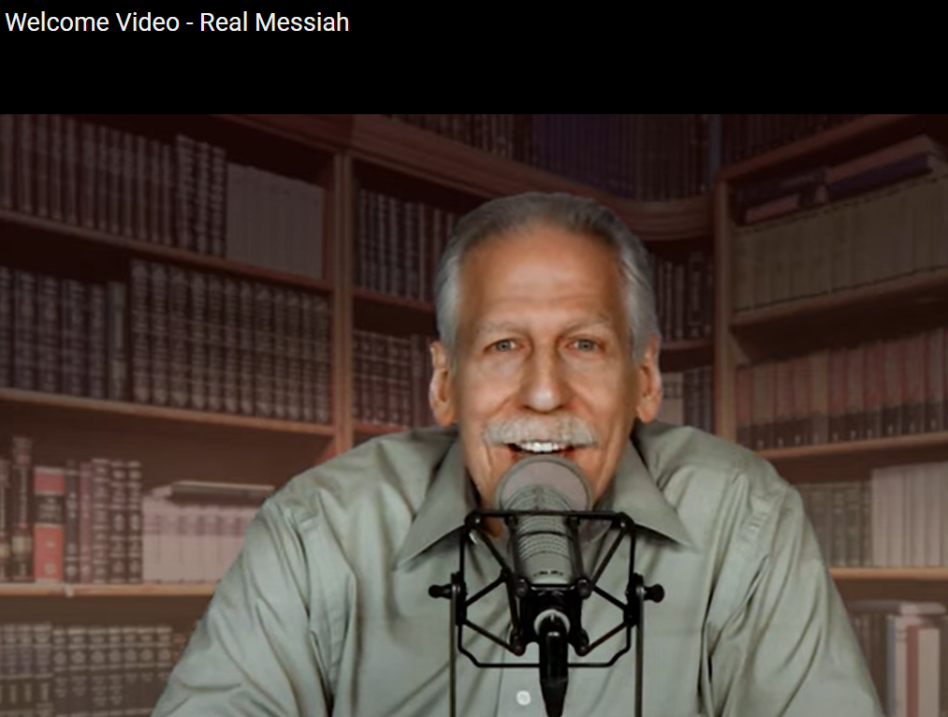
Notes:
https://realmessiah.com/

Slide 30
As proclaimed openly, proudly, and boldly on the Drag Story Hour website, “DSH captures the imagination and play of the gender fluidity of childhood and gives kids glamorous, positive, and unabashedly queer role model.
Notes:
https://askdrbrown.org/article/the-clearest-sign-yet-that-god-has-given-america-over-to-depravity

Slide 31
“Kids are able to see people who defy rigid gender restrictions and imagine a world where people can present as they wish, where dress up is real.”
This is called grooming!
Notes:
https://askdrbrown.org/article/the-clearest-sign-yet-that-god-has-given-america-over-to-depravity

Slide 32
“New York City shelled out more than $200,000 in taxpayer funding in the past five years to have drag queens come into classrooms and interact with schoolchildren as young as age 3 since 2018.”
Notes:
https://askdrbrown.org/article/the-clearest-sign-yet-that-god-has-given-america-over-to-depravity

Slide 33
“The bottom line is that after the Dobbs decision was leaked, there was over 22 times more violence directed against pro-life groups than pro-choice organizations,” said the study, performed by the Crime Prevention Research Center (CPRC).
Notes:
https://washingtonstand.com/news/prolife-centers-22-times-more-likely-to-be-attacked-than-abortion-facilities-studyhttps://washingtonstand.com/news/prolife-centers-22-times-more-likely-to-be-attacked-than-abortion-facilities-study

Slide 34
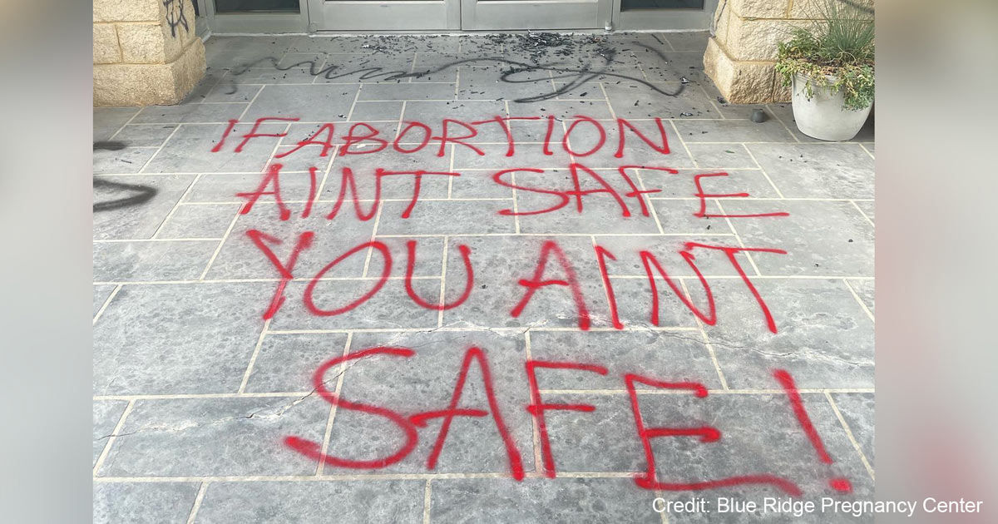
Notes:
https://washingtonstand.com/news/prolife-centers-22-times-more-likely-to-be-attacked-than-abortion-facilities-studyhttps://washingtonstand.com/news/prolife-centers-22-times-more-likely-to-be-attacked-than-abortion-facilities-study

Slide 35
“The overwhelming narrative in the media” holds that “those on the Right are responsible for most of the politically motivated violence in the U.S.
Notes:
https://washingtonstand.com/news/prolife-centers-22-times-more-likely-to-be-attacked-than-abortion-facilities-studyhttps://washingtonstand.com/news/prolife-centers-22-times-more-likely-to-be-attacked-than-abortion-facilities-study

Slide 37
If you can keep it…
Charlie Kirk is the Founder and President of Turning Point USA, a national student movement dedicated to identifying, organizing, and empowering young people to promote the principles of free markets and limited government.
Notes:
https://www.tpusa.com/bio/charliekirk

Slide 38
With representation on over 2,000 high school and college campuses nationwide and over 160 full-time staff, Turning Point USA is the largest and fastest-growing conservative youth activist organization in the country
Notes:
https://www.tpusa.com/bio/charliekirk
But the BEST defense for America is what is practiced NOT in war torn Ukraine…

Slide 39
For the last few months Ukraine, in general, and Kyiv, in particular, have been living with constant power outages. It has been also happening during our Shabbat services. However, lack of electrical power can't stop the joy of Shabbat. We would like to share such Shabbat atmosphere with you in the following video:

Slide 40
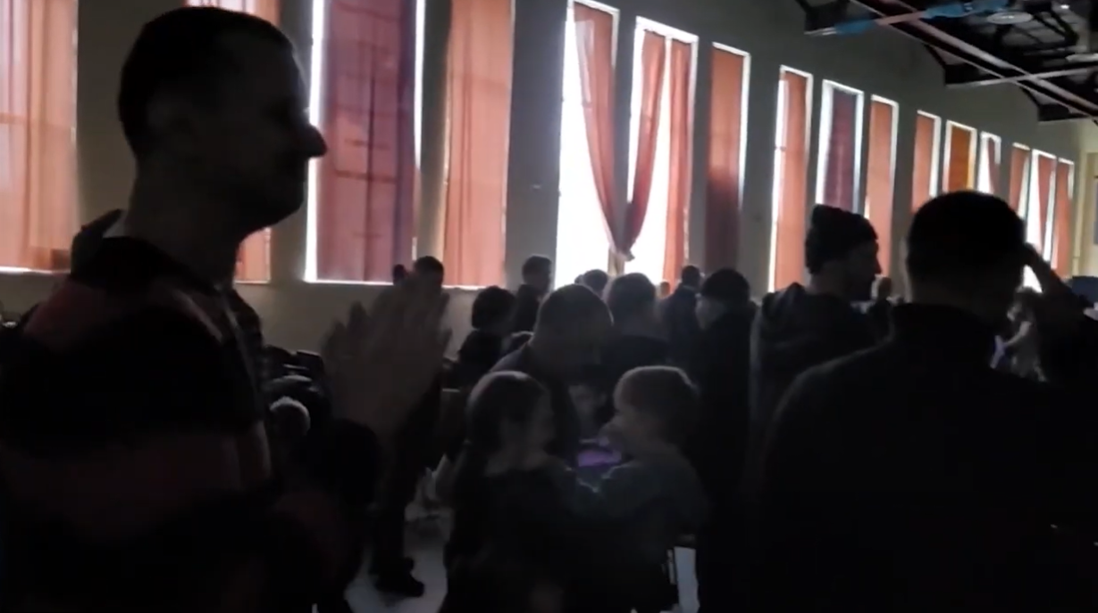
Notes:
https://www.youtube.com/watch?v=sddvf6dSvmk

Slide 42
Shakeable / changeable | UnShakeable / Unchangeable
American righteous republic | “If you can keep it.”
American Jewish security | Hatred of Jews
Security of the Jewish people | G-d’s promises to Israel

Slide 43
Jews in America have had the best refuge and opportunity for advancement since the Diaspora.
[Moorish Spain was a close second.]

Slide 44
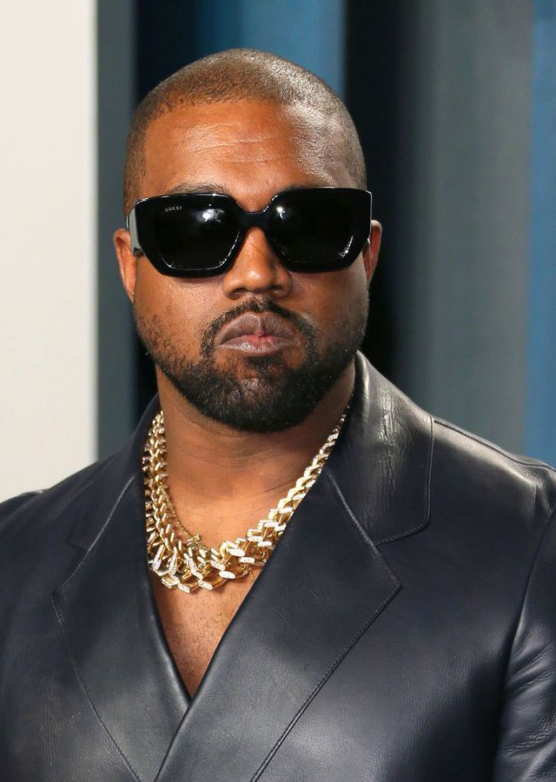
Kanye West Celebrates Hitler, Mocks ‘Brutal Killer’ Netanyahu. [Ye is an American rapper, songwriter, record producer and fashion designer. He is widely regarded as one of the most influential hip hop artists and producers.]
Notes:
https://unitedwithisrael.org/kanye-west-celebrates-hitler-mocks-brutal-killer-netanyahu/
https://external-content.duckduckgo.com/iu/?u=https%3A%2F%2Fwww.nydailynews.com%2Fresizer%2FnAxSS1wjUMX5fPA9sDYKQtew0r0%3D%2F1200x900%2Ftop%2Fcloudfront-us-east-1.images.arcpublishing.com%2Ftronc%2FPSY4DCWGQJC4XJGSGIRUVRU4SM.jpg&f=1&nofb=1&ipt=0116fb06b622d3094bcefc3a2bd0d4d1211c0c9a9ae3bafb7ad8534fd3f16ddc&ipo=images

Slide 45
Hitler “invented highways, invented the very microphone that I use as a musician, you can’t say out loud that this person never did anything good, and I am done with that,” West said.
Notes:
https://unitedwithisrael.org/kanye-west-celebrates-hitler-mocks-brutal-killer-netanyahu/

Slide 46
Saying this is the “perfect answer to the ADL,” West took a net on a stick and a bottle of Yoohoo chocolate milk (net-on-yoohoo). Pretending it was Netanyahu speaking, he said in a high-pitched voice, “I’m the head of the Mossad. I’m going to kill you and take your children away from you. We control the history books, and we control the banks, and we always kill people.”
Notes:
https://unitedwithisrael.org/kanye-west-celebrates-hitler-mocks-brutal-killer-netanyahu/

Slide 47
West wrote that he was ready to “go Death Con 3 on Jewish people,” in an apparent reference to the U.S.’s DEFCON missile alert preparedness system.
Notes:
https://unitedwithisrael.org/kanye-west-celebrates-hitler-mocks-brutal-killer-netanyahu/

Slide 48
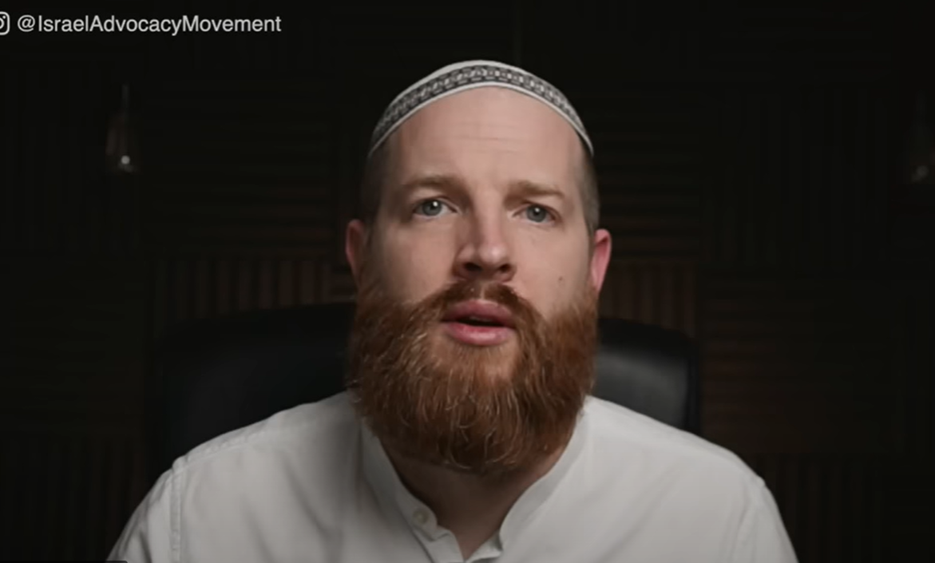
Notes:
https://unitedwithisrael.org/kanye-west-celebrates-hitler-mocks-brutal-killer-netanyahu/

Slide 49
Notes:
https://unitedwithisrael.org/watch-how-kanye-unites-neo-nazis-and-black-hate-groups/

Slide 50
Notes:
https://unitedwithisrael.org/watch-how-kanye-unites-neo-nazis-and-black-hate-groups/

Slide 51
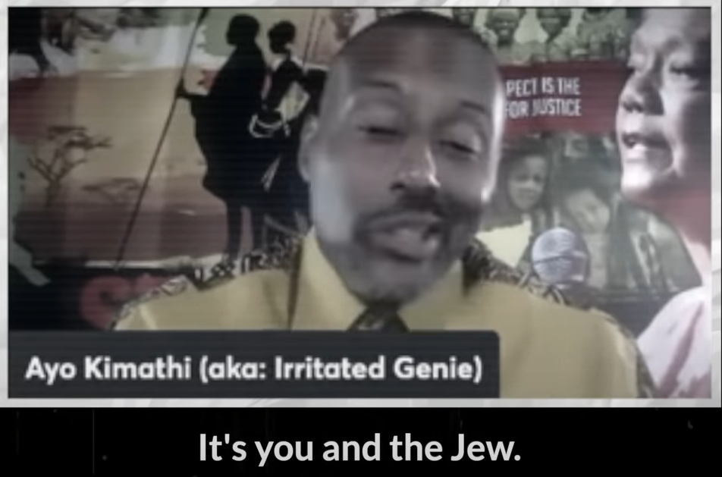
Notes:
https://unitedwithisrael.org/watch-how-kanye-unites-neo-nazis-and-black-hate-groups/

Slide 52
Notes:
https://unitedwithisrael.org/watch-how-kanye-unites-neo-nazis-and-black-hate-groups/
Every single aspect of the media is Jewish.

Slide 53
Notes:
https://unitedwithisrael.org/watch-how-kanye-unites-neo-nazis-and-black-hate-groups/

Slide 54
Notes:
https://unitedwithisrael.org/watch-how-kanye-unites-neo-nazis-and-black-hate-groups/
Besides Ye, likely deranged according to his ex-wife, Kim Kardashian

Slide 55
There's also been a steady rise in the number of hateful incidents directed at Jewish people in the United States over the past several years. According to the Anti-Defamation League, 2021 was the highest year on record for documented reports of harassment, vandalism and violence directed against Jews.
Notes:
https://www.adl.org/news/press-releases/adl-audit-finds-antisemitic-incidents-in-united-states-reached-all-time-high-in

Slide 56
The watchdog group has tracked these incidents since 1979, and it says 2022 will look a lot like last year.
Notes:
https://www.adl.org/news/press-releases/adl-audit-finds-antisemitic-incidents-in-united-states-reached-all-time-high-in
Scripture about G-d’s using anti-Semitism in the last days…

Slide 57
^{Yermiyahu 16.14-16} “Therefore, the days are quickly coming,” declares Adoni, “when it will no longer be said. ‘As Adoni lives, who brought up the children of Israel out of the land of Egypt.’ Rather, ‘As Adoni lives, who brought up the children of Israel from the land of the north and from all the lands where He had banished them.’

Slide 58
^{Yermiyahu 16.14-16} So I will bring them back into their land that I gave to their fathers. “Behold, I will send for many fishers,” says Adoni, “and they will fish for them. After that, I will send for many hunters, and they will hunt them down from every mountain and from every hill, and out of the clefts of the rocks.
Notes:
One notable defender of the Jews…

Slide 59
Sean Ono Lennon, son of Beatles founder John Lennon

Slide 60
Sean Ono Lennon, son of Beatles founder John Lennon, unequivocally stood with Jews this week, condemning the massive spike in hate crimes directed at the community.
Notes:
https://unitedwithisrael.org/strong-stand-world-famous-musician-blasts-kanyes-antisemitism/
I don’t know how it’s going to play out. We have bollards [I was in a mall in Winnipeg where a madman drove into the lobby], armed security, surveillance cameras, an alarm system. But, if you ally with Jews…

Slide 62
Shakeable / changeable | UnShakeable / Unchangeable
American righteous republic | “If you can keep it.”
American Jewish security | Hatred of Jews
World Security of the Jewish people | G-d’s promises to Israel

Slide 63
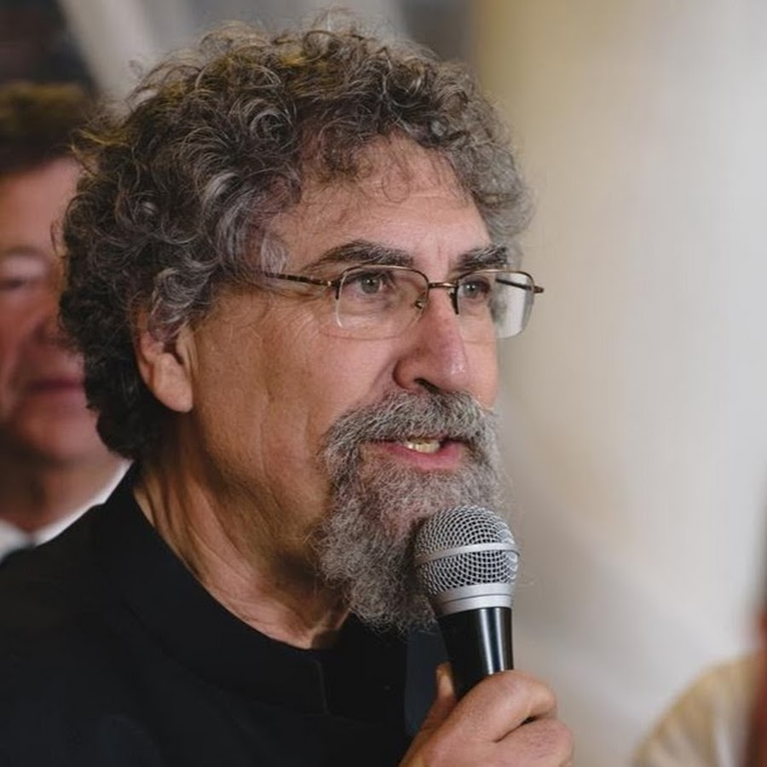
Avner Boskey reports…
Notes:
https://davidstent.org/strong-horses-and-lion-cubs/

Slide 64
The world’s largest sports event – FIFA World Cup 2022 (also known as ‘the Mondial’) – is taking place this month in Doha, Qatar.
Notes:
https://davidstent.org/strong-horses-and-lion-cubs/

Slide 65
Israelis attending the Qatari World Cup have been running into hostility and hatred from Islamic and Arab football fans. Some Israelis have been thrown out of restaurants when their national identity became known. Israel (a member in good standing of FIFA) has been removed from the FIFA site travel links, and visitors are directed instead to a site entitled ‘Occupied Palestinian Territories.’
Notes:
https://davidstent.org/strong-horses-and-lion-cubs/

Slide 66
The Washington Institute for Near East Policy published a July 2022 poll which revealed by national percentages that the majority of the Arab world’s public does not have a positive view about the Abraham Accords.
Notes:
https://davidstent.org/strong-horses-and-lion-cubs/

Slide 67
Positive views of the Abraham Accords were listed as follows:
United Arab Emirates – 25%
Bahrain – 20%
Saudi Arabia – 19%
Kuwait – 14%
Egypt – 13%
Jordan – 12%
Notes:
https://davidstent.org/strong-horses-and-lion-cubs/
The peace treaties with the governments are GREAT, but underlying popular sentiment?

Slide 68
Surprisingly, Palestinians lined up as follows:
Palestinian Authority – 25%
Gaza – 34%
East Jerusalem – 48%
Notes:
https://davidstent.org/strong-horses-and-lion-cubs/

Slide 69
One of the Songs of Ascent,
Too long has my soul had its dwelling with those who hate peace. I am for peace, but when I speak, they are for war” (Psalm 120).
Notes:
https://davidstent.org/strong-horses-and-lion-cubs/

Slide 70
Present military threats against Israel
Iran
Lebanon (Hezbollah)
Syria
Yemenite Houthis
Yemenite Houthis
Notes:
https://davidstent.org/strong-horses-and-lion-cubs/

Slide 71
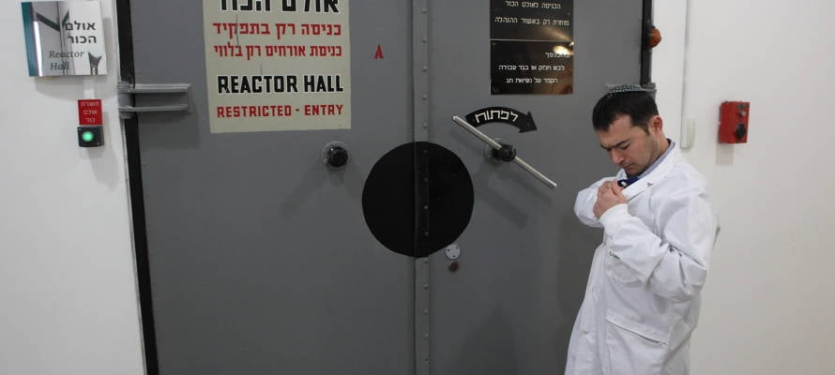
UN Votes 149-6 to Denuclearize Israel
View of the Israeli nuclear reactor located in
the Sorek valley in the Judean hills. (Yaakov Naumi/Flash90
Notes:
– Who are Israel’s 5 Friends?
https://unitedwithisrael.org/un-votes-149-6-to-denuclearize-israel-who-are-israels-5-friends/

Slide 72
Only five countries – the U.S., Canada, Liberia, Micronesia and Palau – voted with Israel against the resolution. There were 26 abstentions, including several from the European Union as well as India. Ukraine was notably absent.
Notes:
Palau?

Slide 73
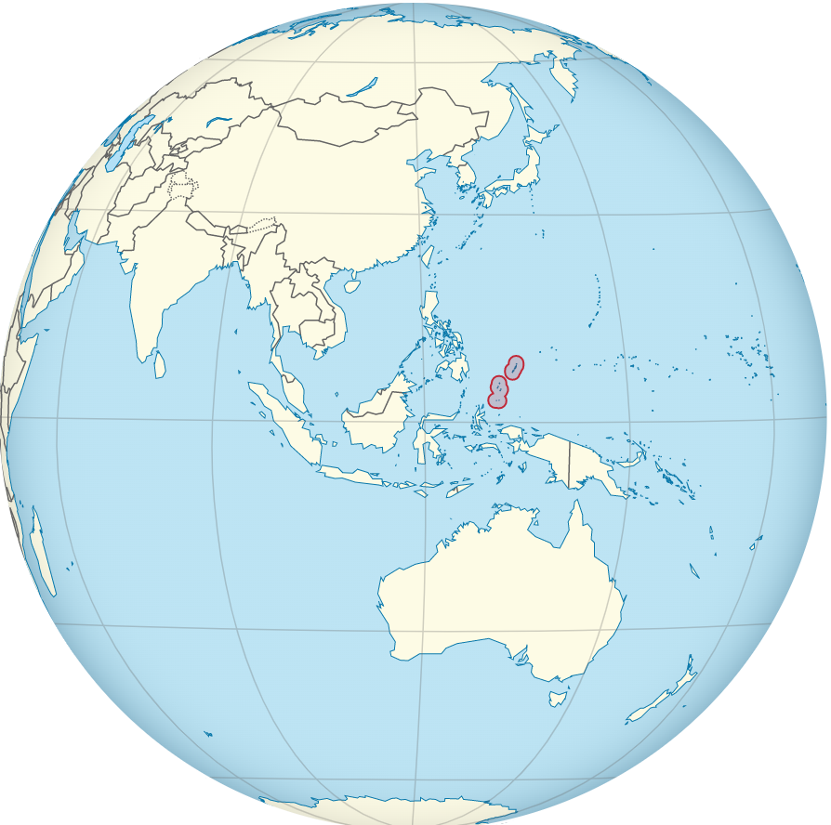
Palau is an island country/
microstate in the western Pacific. The nation has approximately 340 islands.

Slide 74
While Israel has never threatened a nation with a nuclear attack, nor have they ever even acknowledged that they have nuclear warheads, it is simply assumed that they do. Iran was not mentioned once within the resolution, even though it threatens Israel and the United States with destruction regularly.
Notes:
https://www.charismanews.com/world/90898-biblical-prophecy-is-unfolding-as-the-world-turns-against-israel

Slide 75
Just days after two people were killed in twin bombings of Jerusalem bus stops, a key UN human rights investigator, Francesca Albanese, addressing a Hamas-organized event told her audience, “you have a right to resist Israel.”
Notes:
https://unitedwithisrael.org/days-after-deadly-bombings-un-official-justifies-palestinian-resistance/

Slide 76
In May, Albanese said on Italian national television, “Palestinian violence is inevitable because the right to exist of the Palestinian people has been denied for 55 years — almost three generations.”
Notes:
https://unitedwithisrael.org/days-after-deadly-bombings-un-official-justifies-palestinian-resistance/

Slide 78
Shakeable / changeable | UnShakeable / Unchangeable
American righteous republic | “If you can keep it.”
American Jewish security | Hatred of Jews
Security of the Jewish people | G-d’s promises to Israel

Slide 79
Nuclear physicist, Gerald Schroeder, a known researcher for The Weizmann Institute and Hebrew University
Notes:
https://youtu.be/Oml3SJ0vSlk

Slide 80
Israel has been identified as the fifth
safest country in the world for tourists.
Notes:
https://www.israeltoday.co.il/read/study-identifies-israel-as-5th-safest-country-for-tourists/

Slide 81
According to “The Swiftest,” an American insurance comparison website. The website based its travel safety index by comparing the number of deaths resulting from situations such as homicide, road accidents, natural disasters, poor hygiene and other factors in the 50 most-visited countries.
Notes:
https://www.israeltoday.co.il/read/study-identifies-israel-as-5th-safest-country-for-tourists/

Slide 82
Singapore was ranked the world’s safest country for tourists, followed by Denmark, the Netherlands, Switzerland and Israel.
That was higher than the United Kingdom, Italy, Spain and Australia, which also made the top 20.
Notes:
https://www.israeltoday.co.il/read/study-identifies-israel-as-5th-safest-country-for-tourists/

Slide 83
The Swiftest’s list of deadliest countries for tourists was topped by South Africa. Other countries making this list included Mexico, Brazil, China, Iran, and the United States which came in 20th place.
Notes:
https://www.israeltoday.co.il/read/study-identifies-israel-as-5th-safest-country-for-tourists/

Slide 84
Notes:
https://youtu.be/pZzTOQa-T4s?t=50

Slide 85
Interestingly, there were only three conditions:
A reaffirmation of the American-Saudi Arabia Alliance
A restart of American weapons sales to Saudi Arabia comparable to other NATO members
Permission to have a civilian nuclear program
Notes:
https://www.israelunwired.com/saudi-arabia-sets-these-three-conditions-to-make-peace-with-israel/?vgo_ee=WFFU45b9djekULowU6VUeL35hO7C%2FF3J%2FgQB9Uu3XAY%3D

Slide 86
Notice what issue is not one of the conditions. That’s right the “Palestinians.”
Israel has certainly moved into a new league when the Sunni Arab states have realized that the “Palestinian” issue is no issue at all.
Notes:
https://www.israelunwired.com/saudi-arabia-sets-these-three-conditions-to-make-peace-with-israel/?vgo_ee=WFFU45b9djekULowU6VUeL35hO7C%2FF3J%2FgQB9Uu3XAY%3D

Slide 87
The Abraham Accords signing ceremony on the South Lawn of the White House, Sept. 15, 2020, in Washington. (AP/Alex Brandon)
Notes:
‘GOOD NEWS FROM JERUSALEM’: Powerful Arab Country Will Make Peace with Israel
https://unitedwithisrael.org/good-news-from-jerusalem-another-arab-country-will-make-peace-with-israel/

Slide 88
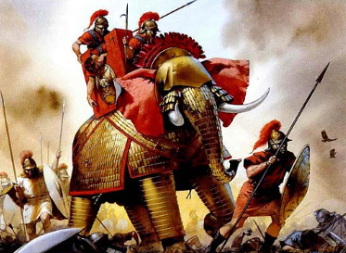
Maccabees fighting the Syrians

Slide 89
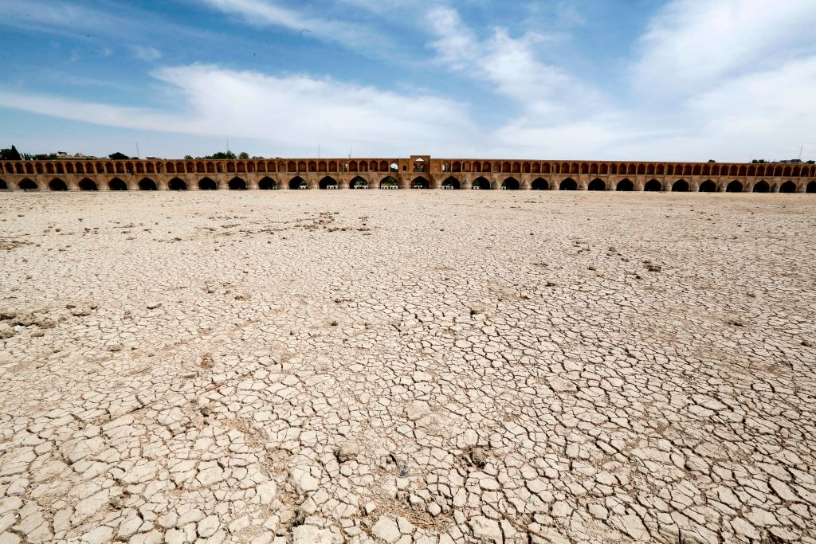
The Si-o-Se Pol bridge ("33 Arches bridge") over the Zayandeh Rud river in Isfahan, Iran, shown on April 11, 2018. Thanks to water
extraction, the river runs dry by the time it
reaches the city. ATTA KENARE/AFP— Getty Images
Notes:
https://time.com/6239669/iran-protests-water-crisis/?et_rid=207180372&lctg=207180372

Slide 90
Attacks are once again on the rise in Israel. At the same time, unity among Jewish and Arab believers is also on the rise—a beautiful picture of the light of Yeshua shining in the darkness.
Notes:
From Asher Intrater
https://www.ritg.org/videos?wix-vod-video-id=eBlm2JWDPec&wix-vod-comp-id=comp-kkysqps6

Slide 91
Akedah nation עֲקִידָהBinding
First use of the word “love”
Sons brought on a donkey
Father placed the wood on the Son
Sons carried the wood.
Son bound to the wood.
Knife
Notes:
Jonathan Cahn Book of Mysteries Day 79

Slide 93
Shakeable / changeable | UnShakeable / Unchangeable
American righteous republic | “If you can keep it.”
American Jewish security | Hatred of Jews
Security of the Jewish people | G-d’s promises to Israel

Slide 94
^{MJ 12.26-29} Even then, his voice shook the earth; but now, he has made this promise: “One more time I will shake not only the earth, but heaven too!” And this phrase, “one more time,” makes clear that the things shaken are removed, since they are created things,

Slide 95
^{MJ 12.26-29} so that the things that cannot be shaken may remain. Therefore, since we have received an unshakeable Kingdom, let us have grace, through which we may offer service that will please God, with reverence and fear. For indeed, “Our God is a consuming fire!”

Slide 96
Do you KNOW Yeshua and His unshakeable redeeming love?
Are you hearing daily from His Word?
How are you applying what you heard?
Are you offering that love to anyone?

